Slide 1
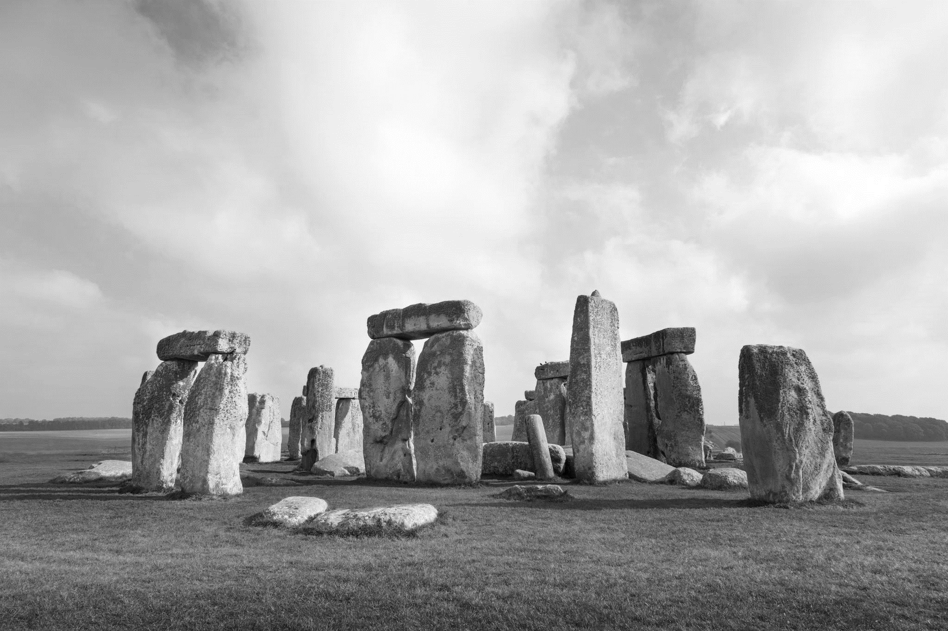
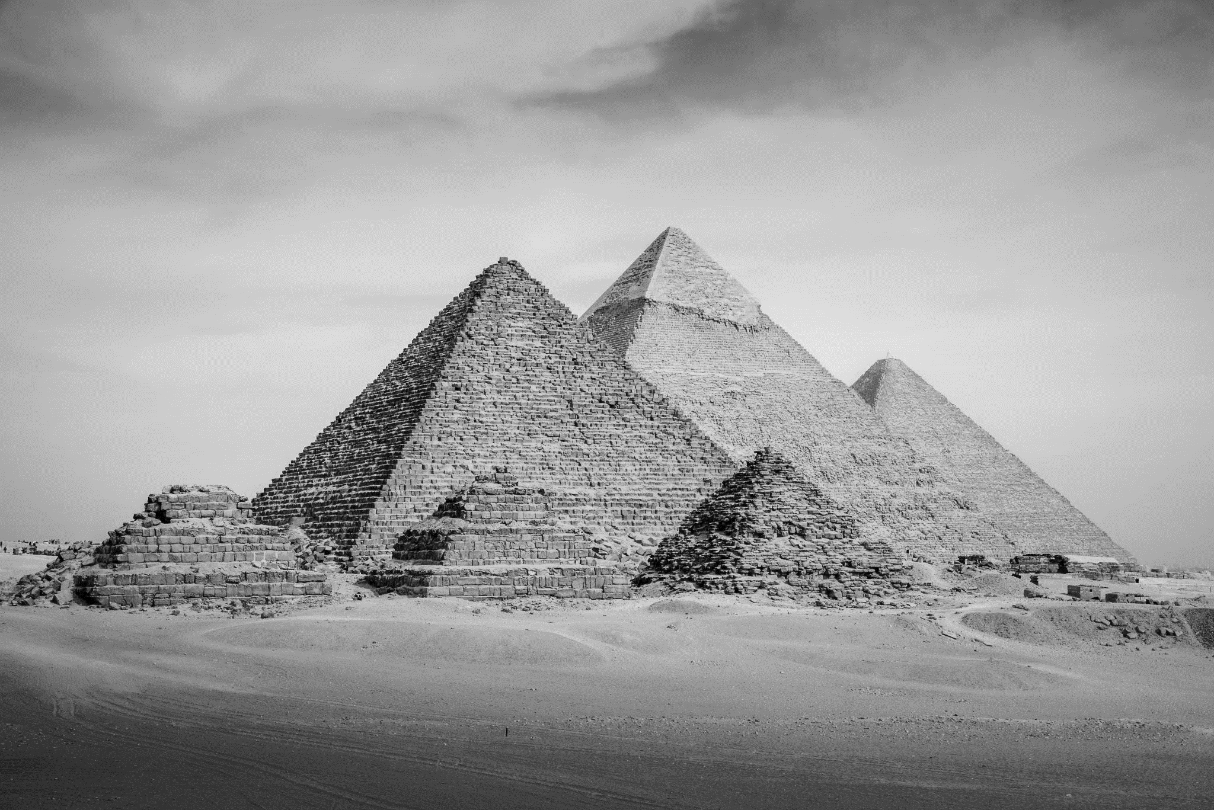
Architecture
Timeline
1200 BC
3500 BC
prehistoric
egyptian
The early era of human civilizations such as The Stone Age, Bronze Age and Neolithic era.
One of the early ancient human civilization. Prominent features such as the Great Pyramid of Giza, the Hieroglyphs, and its mythology makes the Egyptian era an astonishing period in human history.

Slide 2
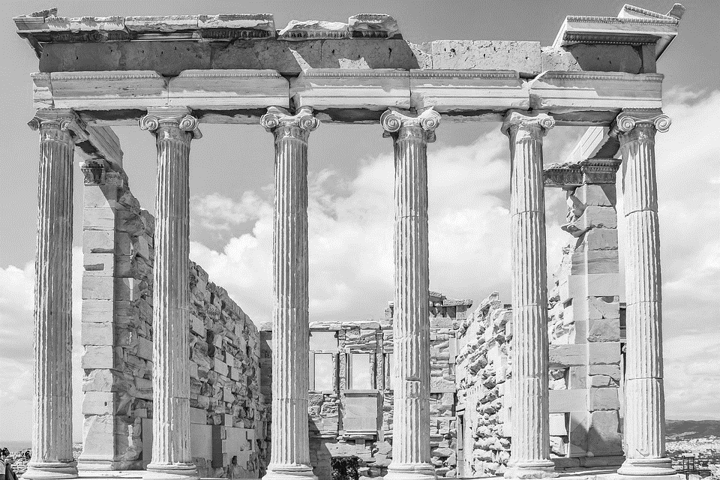
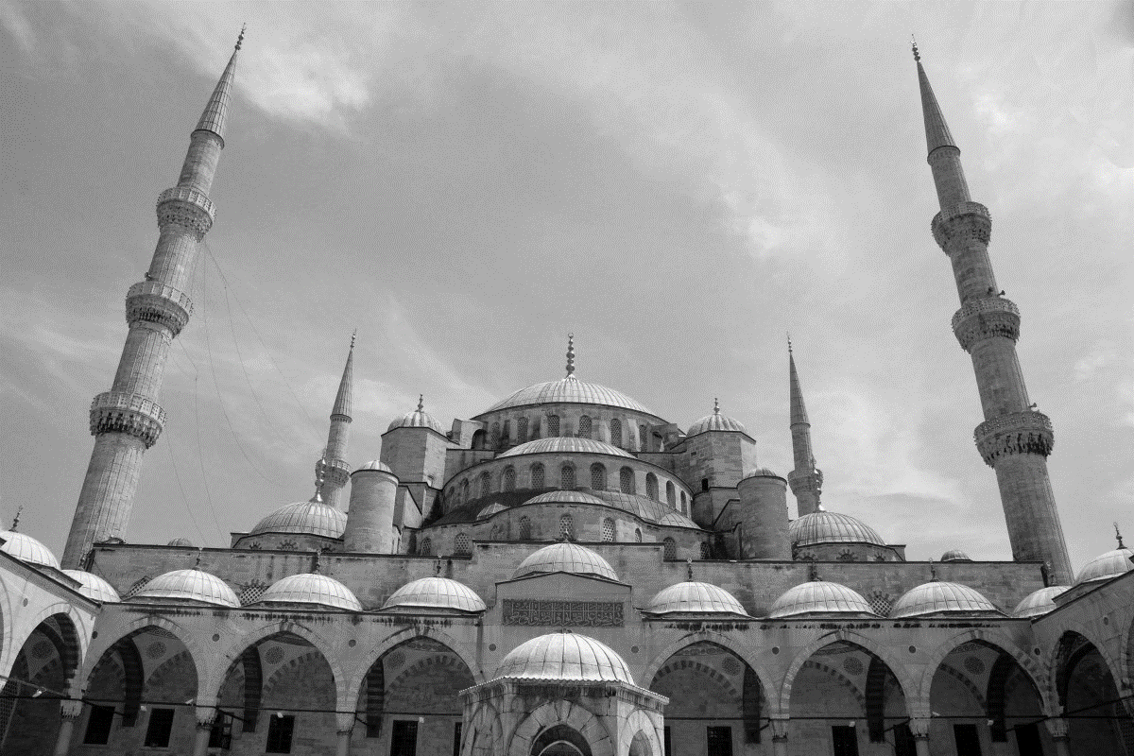
850 BC
373 ad
classical
Early christian
Notable civilizations such as the Greek and the Roman Empires thrived in this era.
This era of human civilization paved the birth of the Byzantine Empire, the Crusades and the foundation of Christianity in the West, as well as the rise of Islam.

