Slide 1
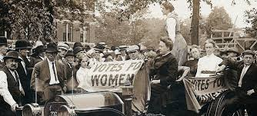
1
2
3
4
5
6
7
8
9
0
1
2
3
4
5
6
7
8
9
0
1
2
3
4
5
6
7
8
9
0
1
2
3
4
5
6
7
8
9
0
First Women’s Rights Convention

Slide 2
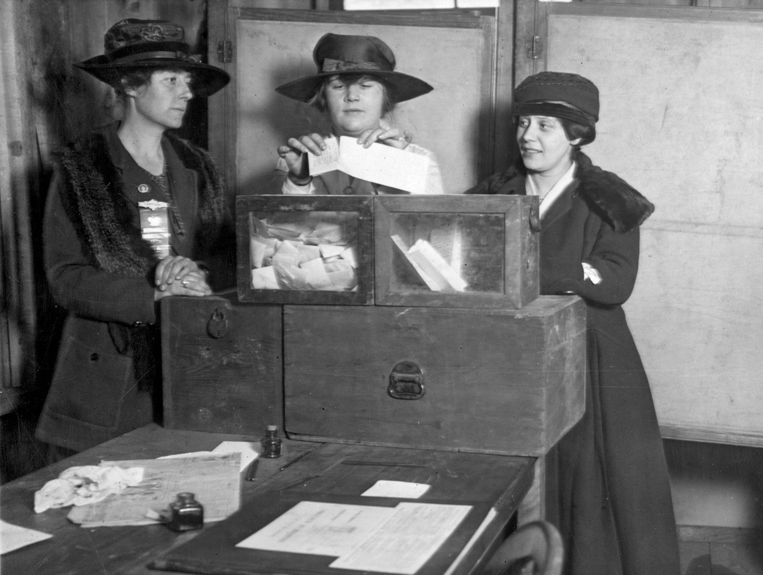
1
2
3
4
5
6
7
8
9
0
1
2
3
4
5
6
7
8
9
0
1
2
3
4
5
6
7
8
9
0
1
2
3
4
5
6
7
8
9
0
Women citizen in the U.S can vote

Slide 3
1
2
3
4
5
6
7
8
9
0
1
2
3
4
5
6
7
8
9
0
1
2
3
4
5
6
7
8
9
0
1
2
3
4
5
6
7
8
9
0
You’re dead
No big surprise

