Slide 1
THE GREYSCALE EPIDEMIC
Yosuf Barzinji

Slide 2
01
WHAT HAPPENED?
Blaming Minimalism

Slide 3
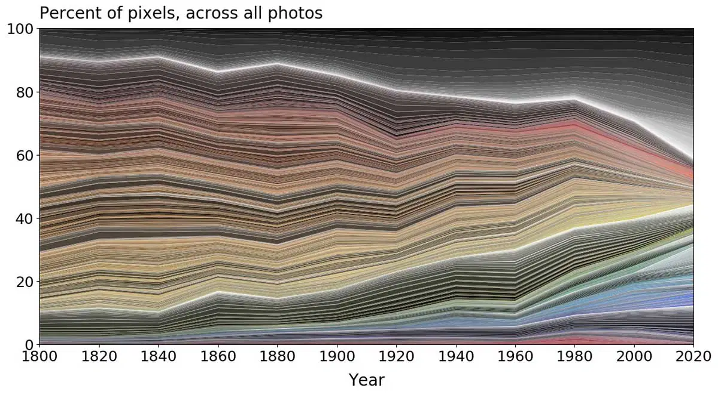
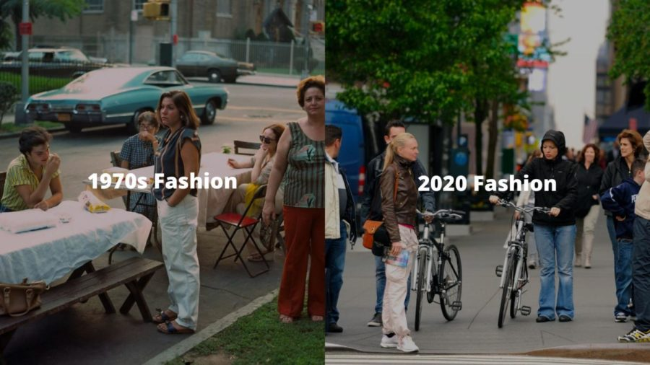
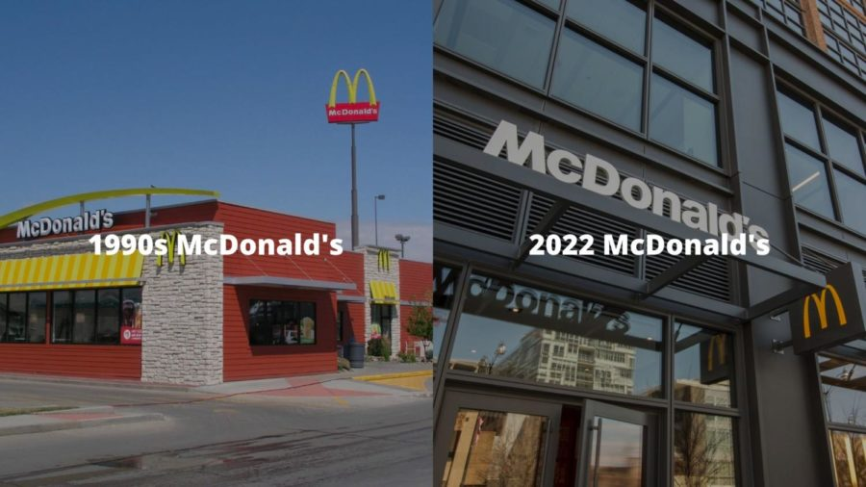
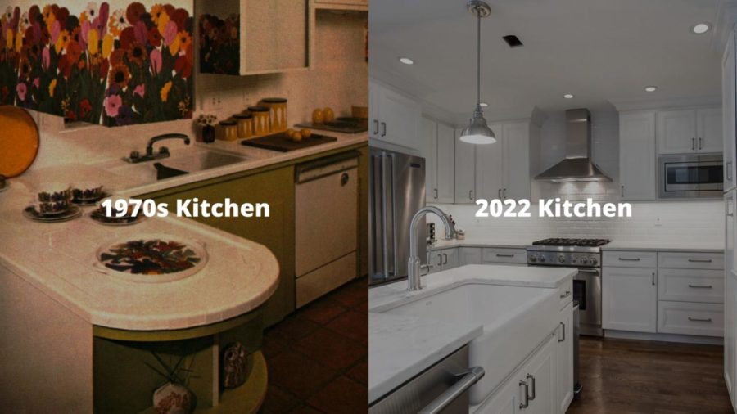

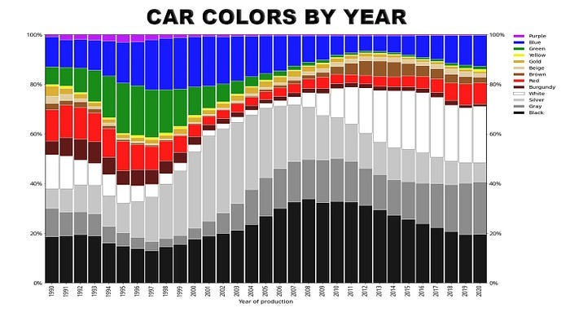
SOURCES
ITS EVERYWHERE
WHOSE FAULT?
2.
3.
Blaming Minimalism: What Happens When Color Disappears?
Why is the world losing color?
COLORLOSS HISTORICALLY
1.
Colour & Shape: Using Computer Vision to Explore the Science Museum Group Collection
ITS EVERYWHERE
2.
Is color disappearing from the world?
WHOSE FAULT?
3.
Blaming Minimalism: What Happens When Color Disappears?
MINIMALISM
CLEAN || MODERN || “LESS IS MORE”

Slide 4
HAS DAILY LIFE CLOTHES LOST COLOR OVER THE LAST DECADE?
HAS THERE BEEN A SIGNIFICANT DECLINE SHIFT IN THE “COLORFULNESS” OF EVERYDAY CLOTHES?

Slide 5
02
METHOD
Picture > Color > Number

Slide 6
THE DATAFRAME
01
02
STYLES.CSV
02
IMAGES.CSV
02
id
gender
masterCategory
subCategory
articleType
baseColour
season
year
usage product
DisplayName
Filename
Link
id
gender
masterCategory
subCategory
articleType
baseColour
season
year
usage product
DisplayName

Slide 7
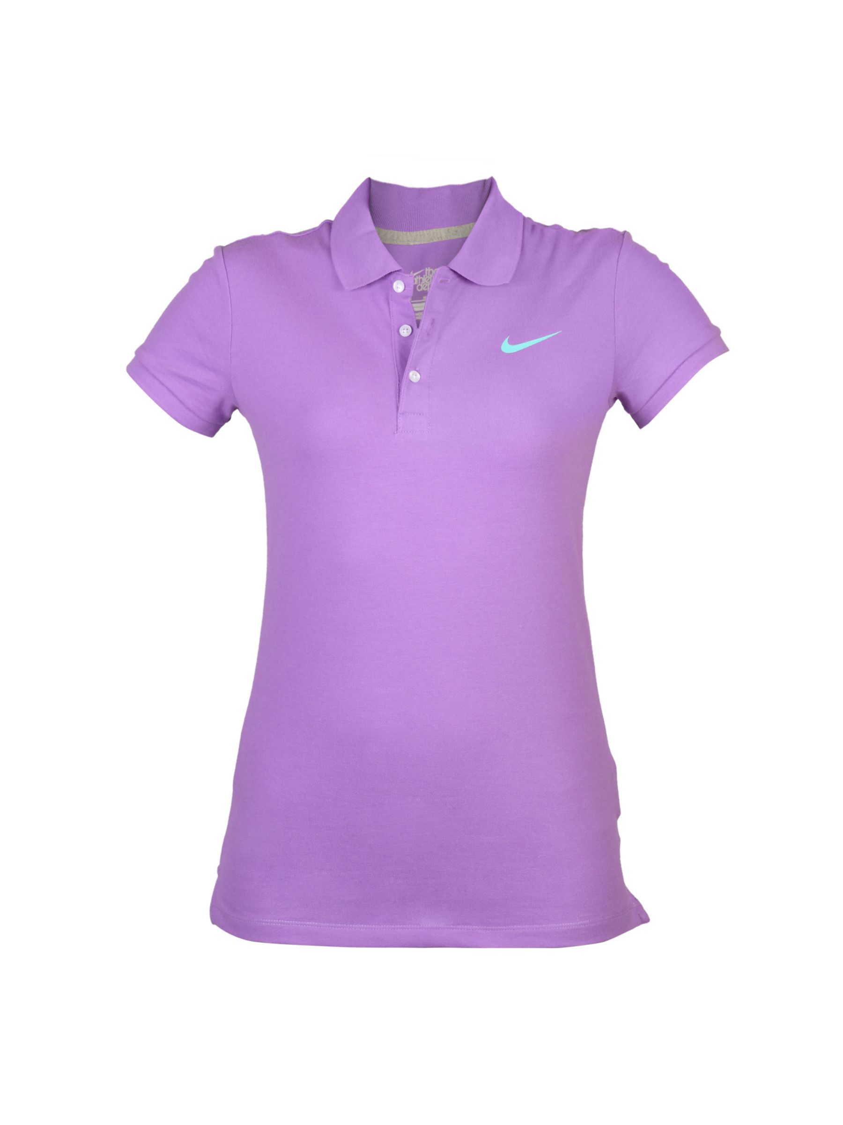
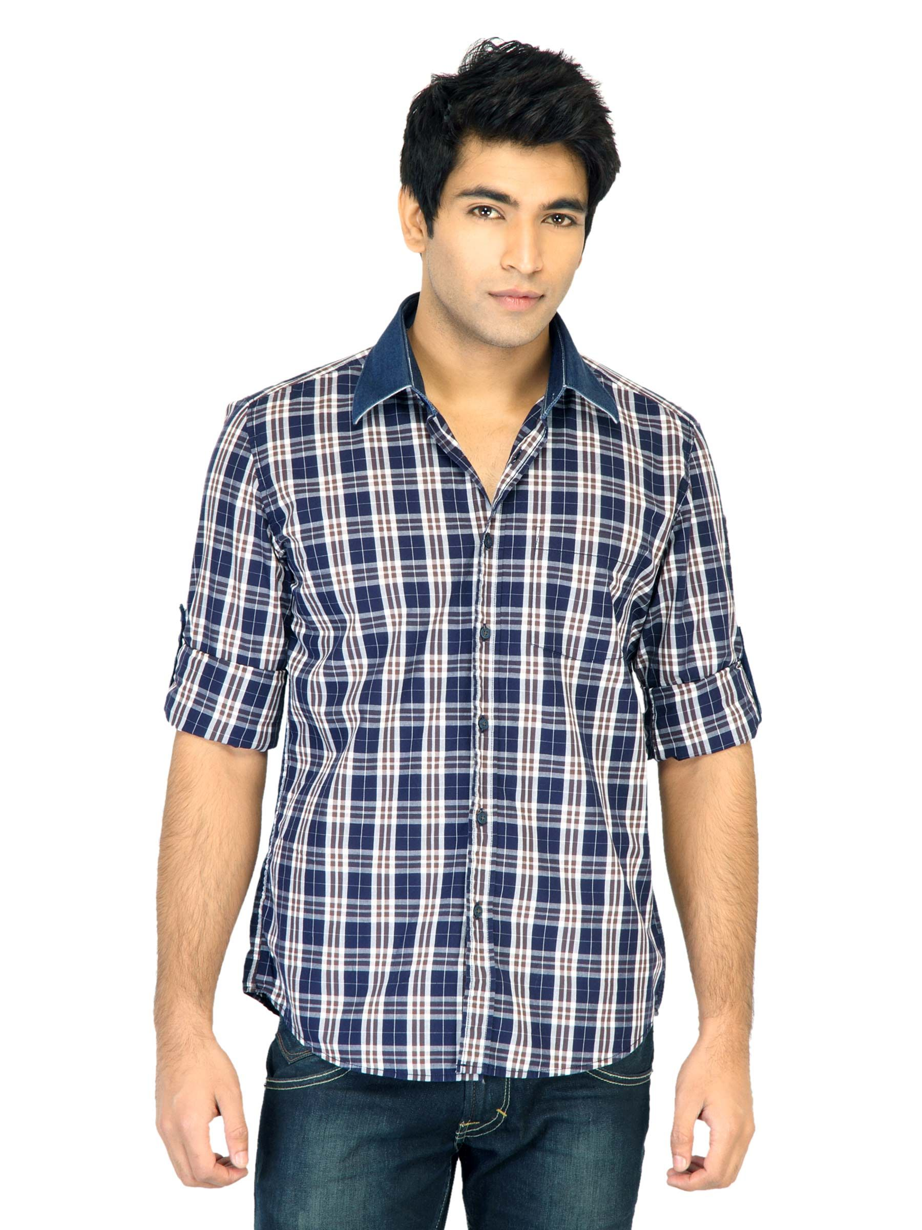
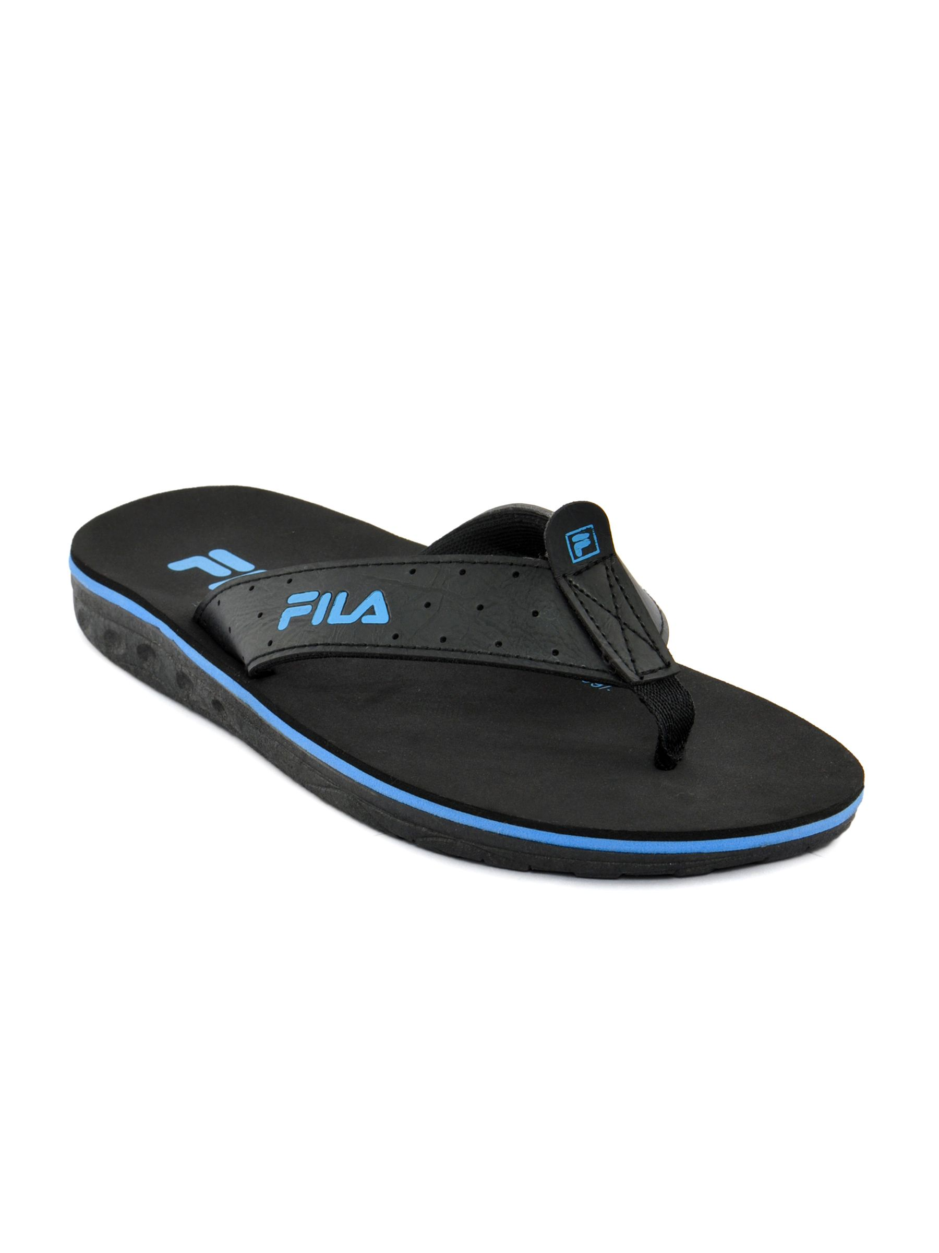
THE DATAFRAME
SubCategory == “Topwear”
02
IMAGES.CSV
02
id
gender
masterCategory
subCategory
articleType
baseColour
season
year
usage product
DisplayName

Slide 8
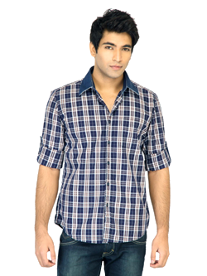
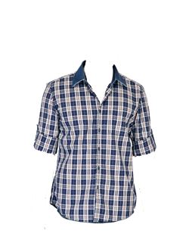
How to extract color code?

Slide 9
How to extract color code?
RGB(134, 135 151)
25% of true size!

Slide 10
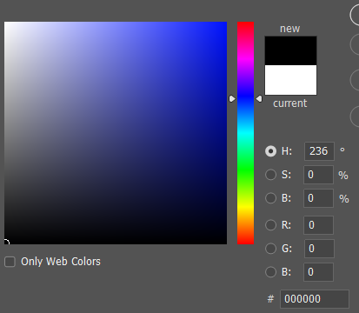
From color code to Colorfulness?
Color Quadrant
Brightness
Saturation

Slide 11

From color code to Colorfulness?
01
Hasler:
= 4.851995
02
Normal:
RGB(134, 135, 151)
= 0.064784

Slide 12
From color code to Colorfulness?
Base Colour | Count
Blue | 1584
White | 1463
Black | 1294
Green | 829
Grey | 723
Red | 761
Purple | 536
Navy Blue | 533
Pink | 521
Yellow | 304
Orange | 171
Maroon | 156
Brown | 249
Beige | 123
Cream | 115
Olive | 82
Off White | 81
Multi | 97
Peach | 70

Slide 13
03
RESULTS
Has day to day clothes lost color or not?

Slide 14
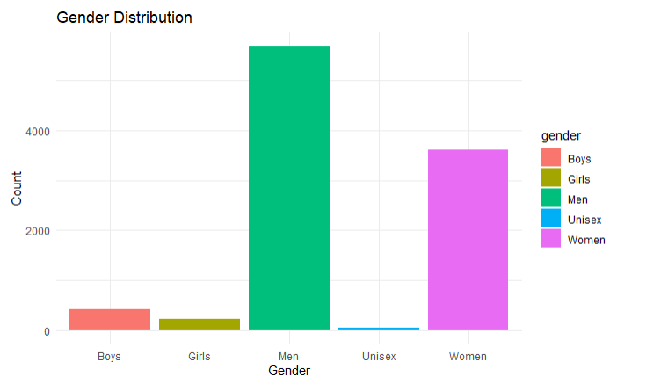
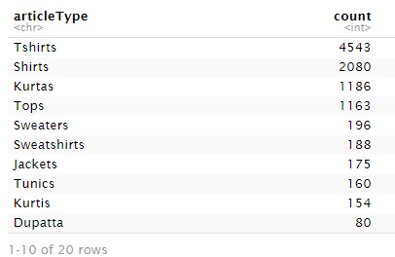
Variables and distributions

Slide 15
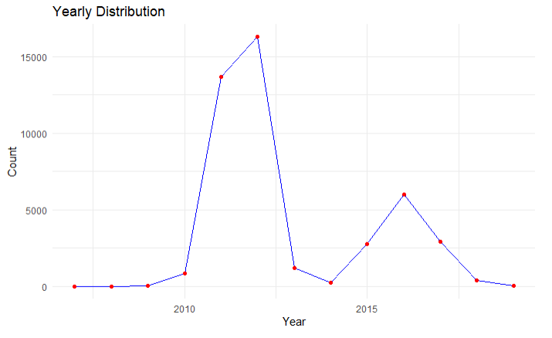
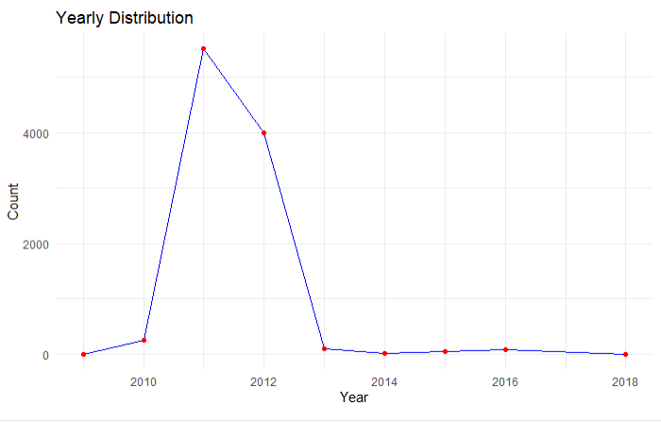
Variables and distributions
Without filtering “Topwear”
With filtering “Topwear”

Slide 16
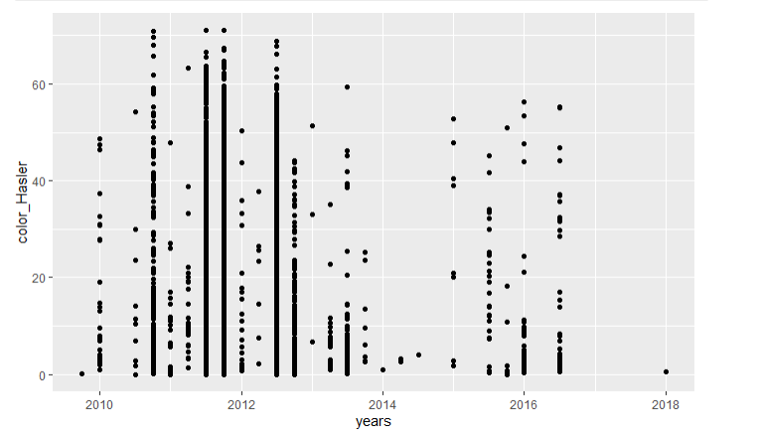
Variables and distributions
Using “seasons”
With filtering “Topwear”

Slide 17
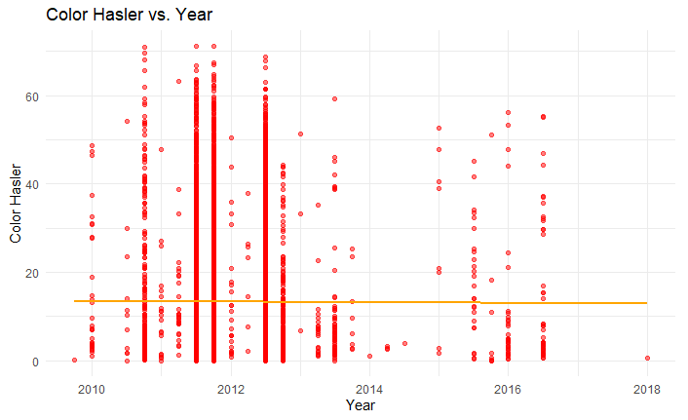
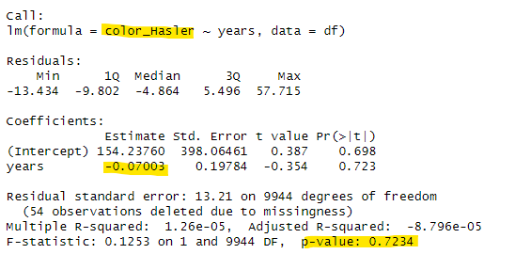
P-values

Slide 18
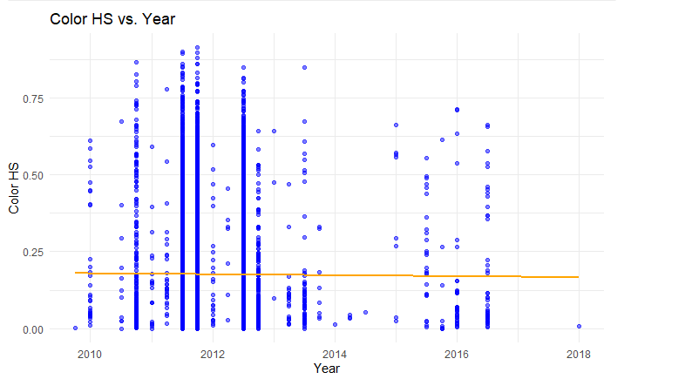
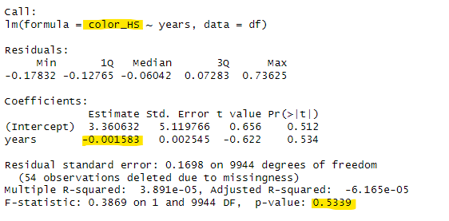
P-values

Slide 19
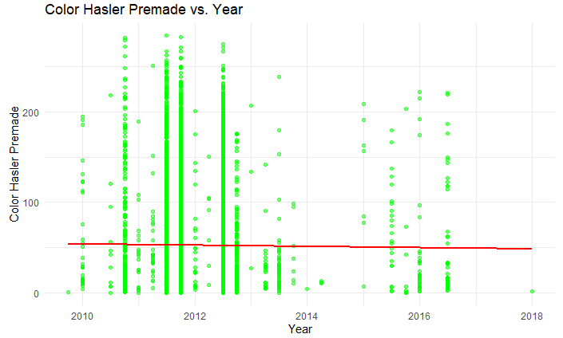
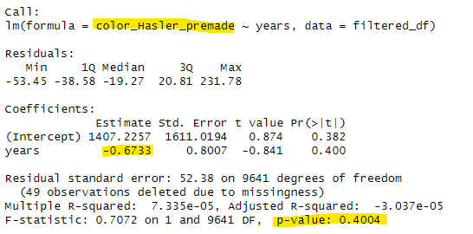
P-values

Slide 20
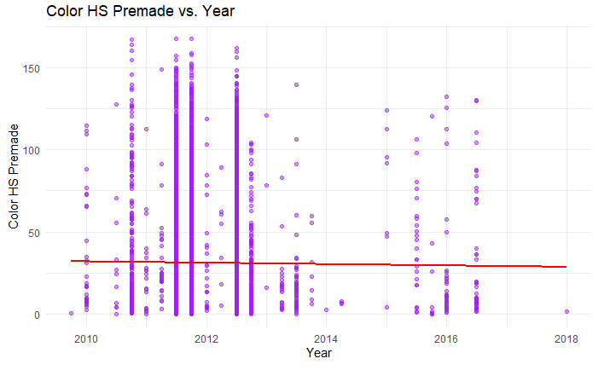
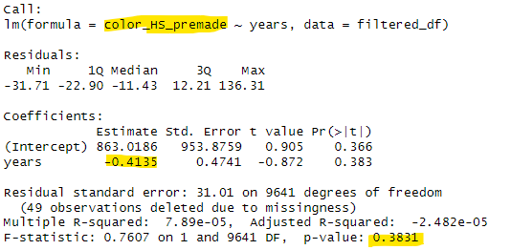
P-values

Slide 21
04
Discussion
Sooo, what happened

Slide 22
Things to consider
What could had influenced bad results?
Color image processing
“Colorfulness” calculations
Uneven distribution of “years”
Other possible hypotheses?
World is not becoming colorless, but shifting into an earthy palette (Vibrancy test?)
World is becoming colorless, but more patterned? (Western Culture?)

Slide 23
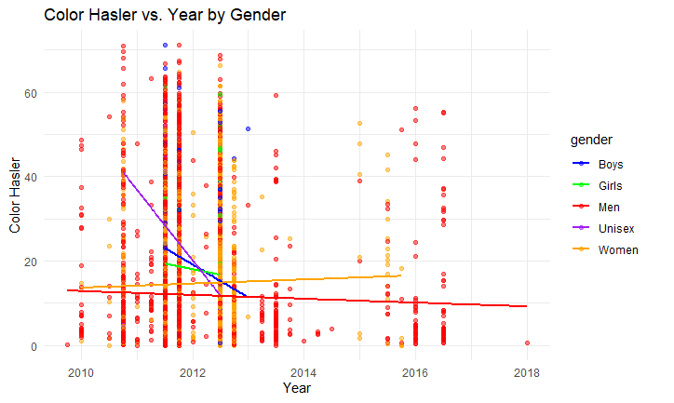
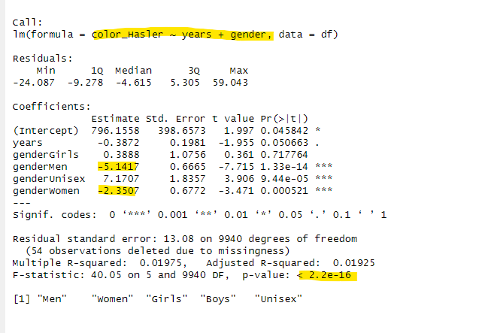
Next step?
Interesting findings within other variables?
Gender
articleType(t-Shirt, sweaters, etc)
Other accessories (not topwear)

Slide 24
