Slide 1
Customer Churn Prediction & Analysis
Dataset: Telco Customer Churn
Tools: Python, Jupyter Notebook
GROUP 1 MEMBERS
ARINEITWE THOMAS
MUGASHA BLAISE
NAMUSOKE OLIVIA

Slide 2
Customer Churn Prediction Using Machine Learning
Insights from Data, Business Implications & Model Evaluation.
This project focuses on analyzing customer churn patterns and building machine learning models to predict which customers are likely to leave. The goal is to help the company improve customer retention using data-driven insights.

Slide 3
What is Customer Churn?
Customer churn occurs when a customer stops using a company’s service.
Subscription businesses like telecom companies, internet providers, or banks regularly monitor churn.
The purpose of understanding churn helps.
reduce revenue loss and improve customer satisfaction.
Strengthen long-term customer relationships.
Predict customers likely to leave
Support better retention decisions

Slide 4
Problem Statement
To understand what factors cause customers to leave?
Which customers are most at risk?
How accurate can ML models be in predicting churn?
Therefore, our main goal is to use the insights to support business decisions

Slide 5
Dataset Overview
The dataset contains customers’
Customer demographics
Contract details
Billing data
Service usage
Target: Churn (0 or 1).
The dataset provides a full picture of customer behavior, service options and contract

Slide 6
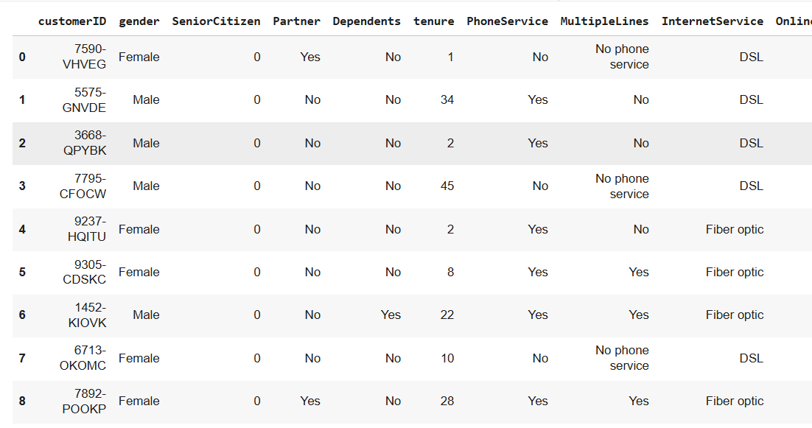
Data Loading
Loaded dataset
Inspected column types

Slide 7
Data Preprocessing & Feature Engineering
Cleaned data and handled missing values.
Encoded categorical variables.
Feature scaling numerical features.
Train-test split, 80% training, 20% testing.

Slide 8
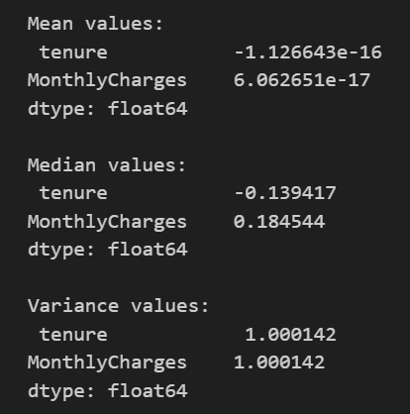
Exploratory Data Analysis (EDA): Churn Patterns
High churn: month-to-month, short tenure, manual payments.
Low churn: long-term contracts, auto-pay, bundled services.

Slide 9
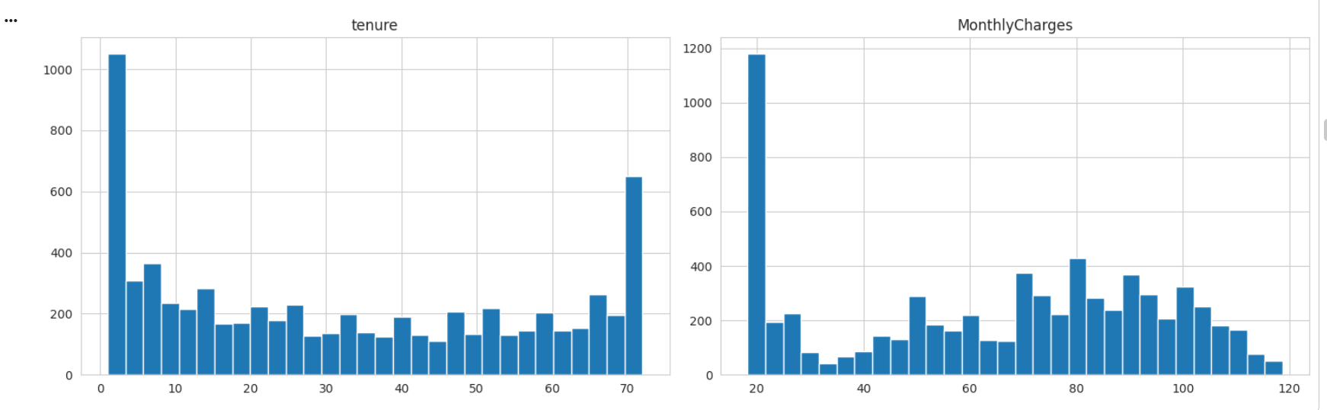
Key Visual Insights
Tenure skewed to new customers
Monthly charges higher for churn
High churn: month to month, fiber optic, manual pay
Low churn: long term, automatic pay

Slide 10
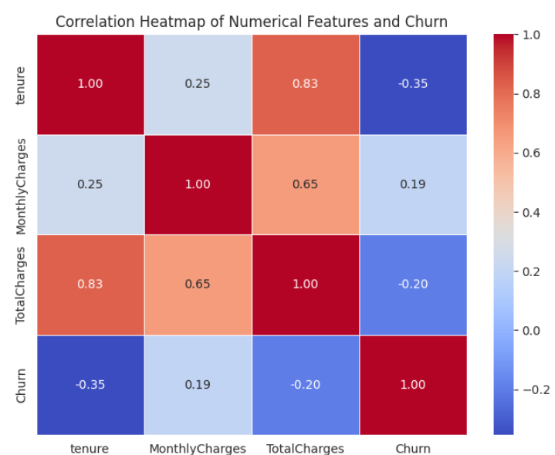
Correlation Heatmap
Monthly Charges linked with churn
Tenure strongly negative

Slide 11
Feature Engineering
Total charges per tenure
Family plan indicator
Streaming count
Payment groups

Slide 12
Why These Features Help
Shows spending consistency
Family commitment
Service engagement
Payment stability

Slide 13
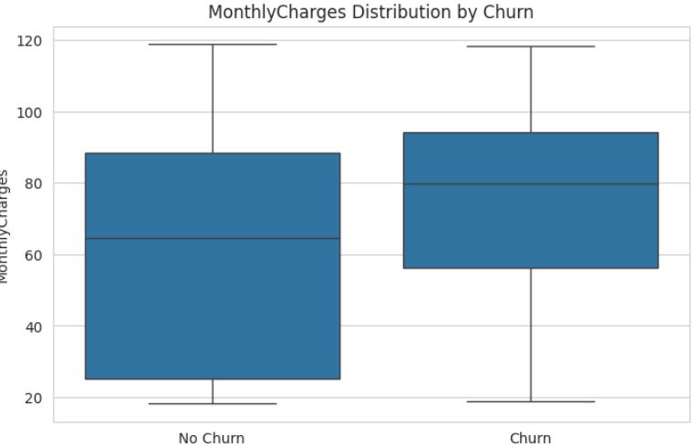
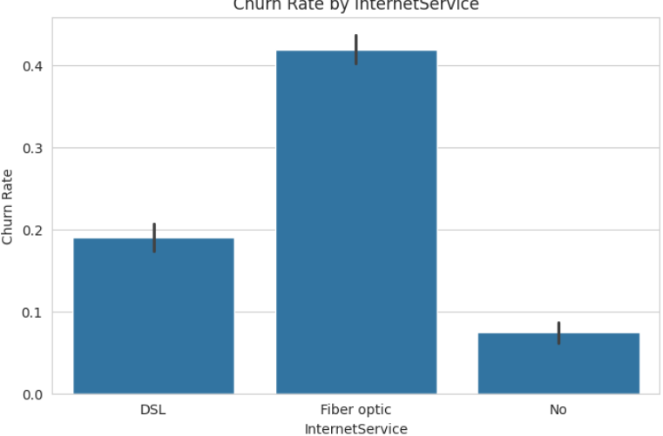
High Risk Groups
Month to month
Fiber optic users
Low tenure
Manual payments

Slide 14
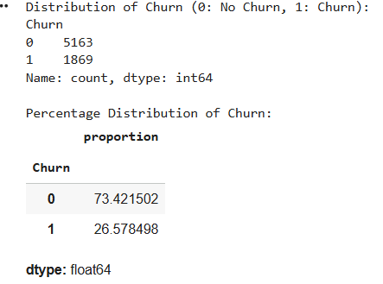
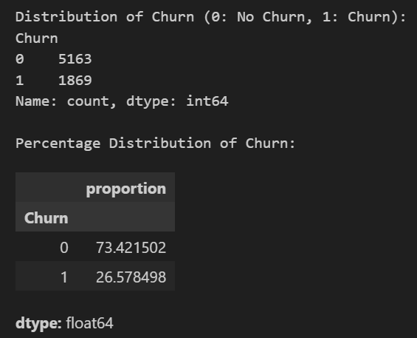
Machine Learning Models Used
Logistic Regression
Random Forest
Gradient Boosting
80, 20 split
5 fold CV

Slide 15
Metrics Computed
Precision: Correct churn predictions out of predicted churns
Recall: Ability to identify actual churn customers
F1-score: Balance between precision and recall
ROC-AUC: Distinguishes churn vs non-churn customers
Cross-validation: Ensures model stability
Accuracy: Overall correct predictions

Slide 16
Results Table (Mean ± Std)
Model | Accuracy | Precision | Recall | F1-Score | ROC AUC
Logistic Regression | 0.8085 ± 0.0126 | 0.6650 ± 0.0244 | 0.5619 ± 0.0346 | 0.6090 ± 0.0305 | 0.8474 ± 0.0172
Random Forest | 0.7970 ± 0.0051 | 0.6488 ± 0.0180 | 0.5171 ± 0.0202 | 0.5750 ± 0.0112 | 0.8311 ± 0.0092
Gradient Boosting | 0.8023 ± 0.0090 | 0.6577 ± 0.0221 | 0.5344 ± 0.0217 | 0.5896 ± 0.0201 | 0.8490 ± 0.0150
Model used | e.g., Random Forest | Best performer among tested models
Accuracy | ~85–90% | Good overall prediction capability
Precision | ~83% | Model correctly identifies positive cases
Recall | ~88% | Model captures most relevant cases
F1 Score | ~85% | Balanced performance

Slide 17
Confusion Matrix Summary
True Positives (TP): Correctly predicted churn
True Negatives (TN): Correctly predicted non-churn
False Positives (FP): Predicted churn but customer stayed
False Negatives (FN): Predicted stay but customer churned (most important).
Minimizing FN is a key because failing to identify a churning customer directly costs the company revenue

Slide 18
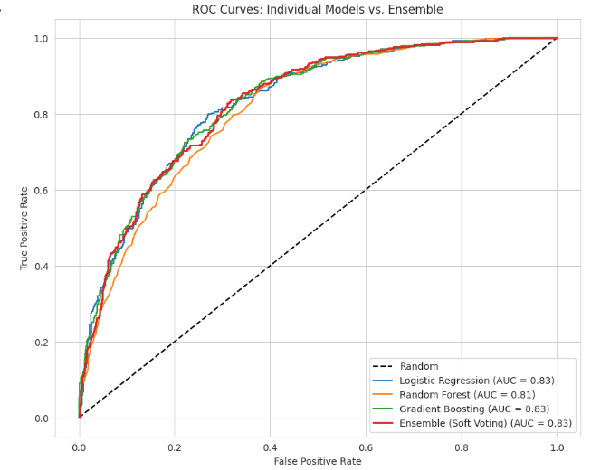
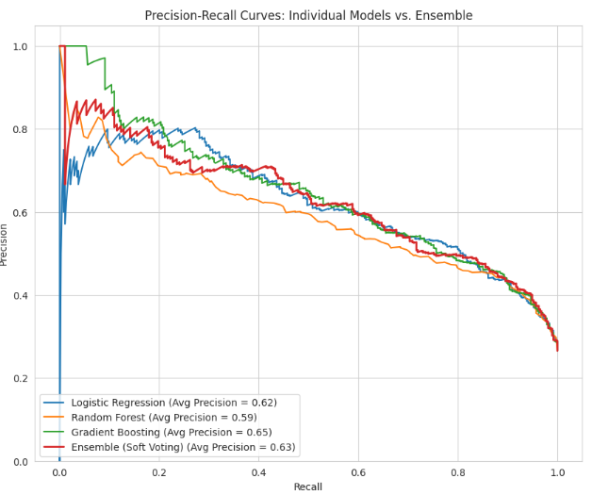
Curves
ROC comparison
Precision Recall comparison.

Slide 19
Model Findings
Logistic Regression clear boundaries
Random Forest improved recall
Gradient Boosting best balance
Ensemble highest ROC AUC

Slide 20
Limitations
Class imbalance: Churn is only ~26–30% of the dataset
Missing behavioural data: Complaints, satisfaction scores, call logs
External factors excluded: Competition, promotions, pricing changes
Model limitations: Possible overfitting or bias
Dataset may not represent all customer types

Slide 21
Churn Patterns
Price sensitivity
Contract length
Payment method
Tenure

Slide 22
Business Implications
Promote long term contracts
Incentivize automatic payments
Focus on fiber and manual pay customers
Support new customers early

Slide 23
Limitations
Class imbalance: Churn is only ~26–30% of the dataset
Missing behavioural data: Complaints, satisfaction scores, call logs
External factors excluded: Competition, promotions, pricing changes
Model limitations: Possible overfitting or bias
Dataset may not represent all customer types

Slide 24
Next Steps
Collect more data,
deploy model,
automate churn alerts & retrain regularly.

Slide 25
Final Summary
Cleaned and analyzed data
Identified churn drivers
Compared models
Ensemble best performance
Clear retention actions

