Slide 1

Customer Segmentation — Mall Customers Dataset Using K-Means & Hierarchical Clustering
NAME | REG NO
ARINEITWE THOMAS | 2024-MI32-24196
MUGASHA BLAISE | 2024-M132-23976
NAMUSOKE OLIVIA
INSTRUCTOR | DR. HARRIET SIBITENDA

Slide 2
INTRODUCTION
This notebook implements a complete clustering analysis comparing K-means and Hierarchical clustering methods on the Mall Customers dataset.
Goal: Understand customer behaviors through clustering.
Why? Improve marketing accuracy & customer targeting.

Slide 3
Problem Statement
Retailers lack deep insights into customer diversity.
One-size-fits-all strategies fail.
Need segmentation for personalized marketing.

Slide 4
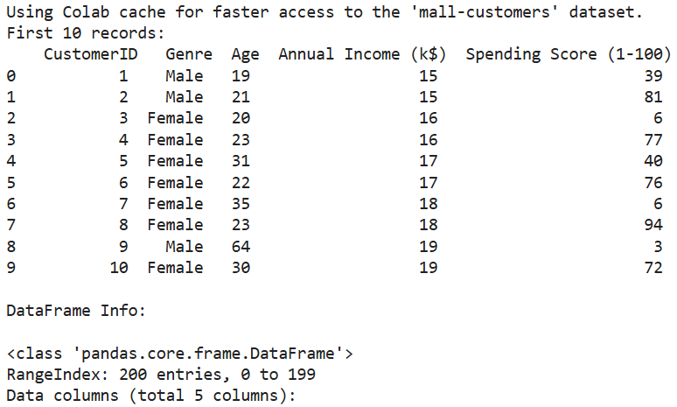
Dataset Overview
Dataset: Mall_Customers.csv
200 customers, 5 variables.
Features: CustomerID, Genre, Age, Annual Income, Spending Score

Slide 5
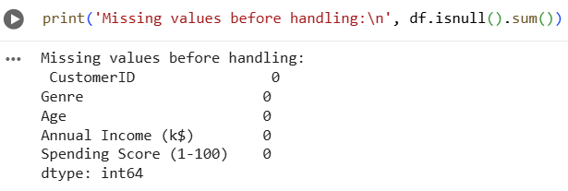
preprocessing (method + quick results)
No duplicates, no missing values.
Created reproducible cleaned copy (random_state=42).
StandardScaler applied; encoded Gender.

Slide 6
Feature Details
CustomerID: identifier (removed).
Genre: Male/Female.
Age: 18–70 range.
Income: in k$.
Spending Score: 1–100 scale.

Slide 7
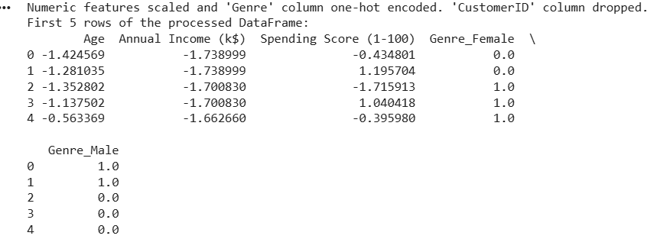
Initial Observations
No missing data.
No duplicates.
Balanced gender distribution.
Wide variation in spending behavior.

Slide 8
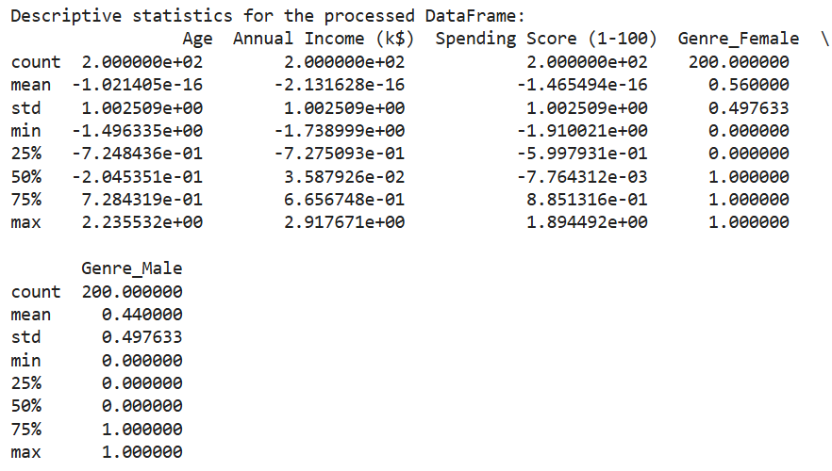
EDA: Summary Stats
Age: mid-30s median.
Income: median ~60k.
Spending Score: wide variance.
Genre distribution: ~56% Female.

Slide 9
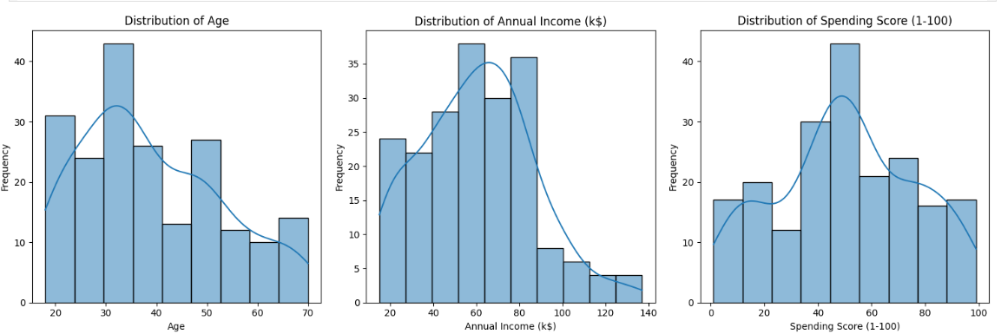
Histograms Findings
Age moderately uniform.
Income right-skewed.
Spending Score bimodal → indicates natural clusters.

Slide 10
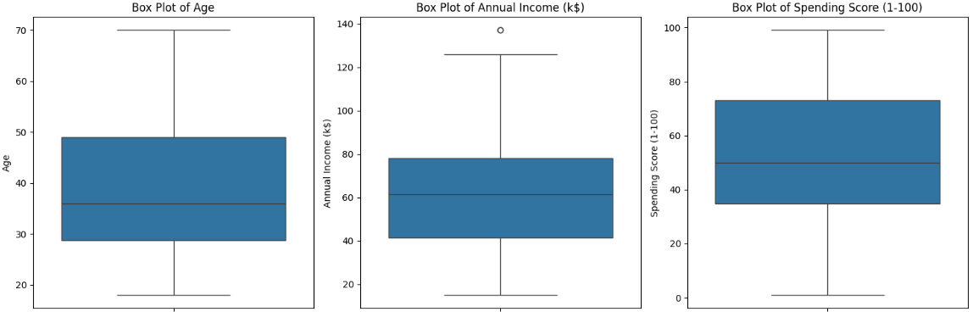
Boxplot Insights
Income has outliers on high end.
Age compact distribution.
Spending Score shows strong variance (good for clustering).

Slide 11
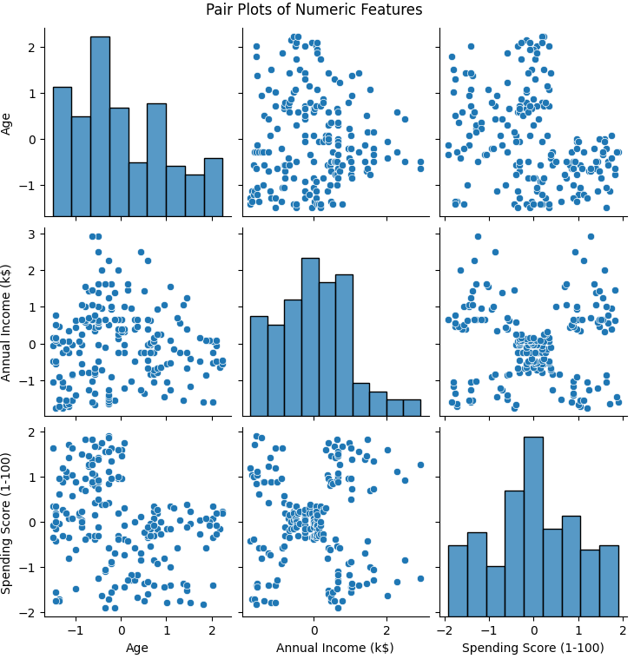
Pair Plot Insights
Age ↓ Spending ↑ (moderate negative correlation).
Distinct clusters in Income vs Spending.
Age vs Income weak relationship.

Slide 12
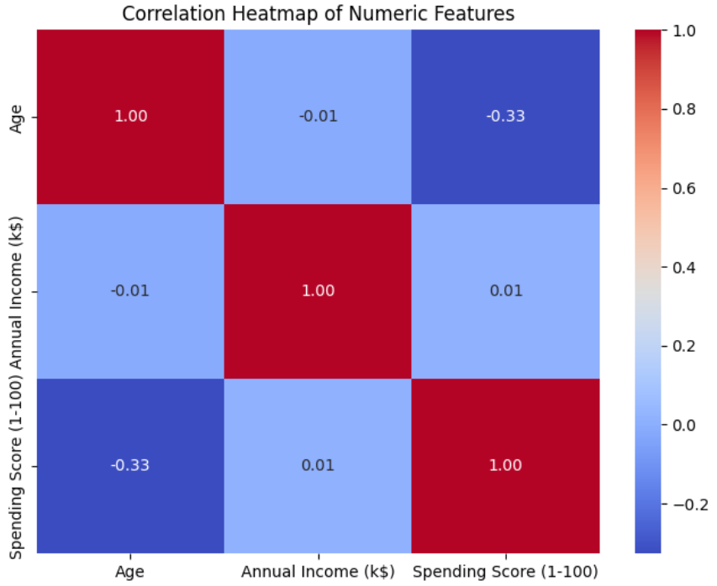
Correlation Analysis
Age & Spending Score: -0.33.
Income & Spending Score: ~0 (unexpected).
Result: Clusters exist but not linear correlations.

Slide 13
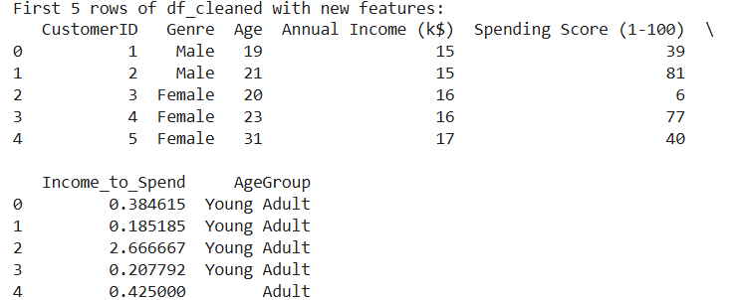
Feature Engineering
Created Income_to_Spend ratio.
Created AgeGroup categories.
Purpose: Enhance interpretability & cluster separability.

Slide 14
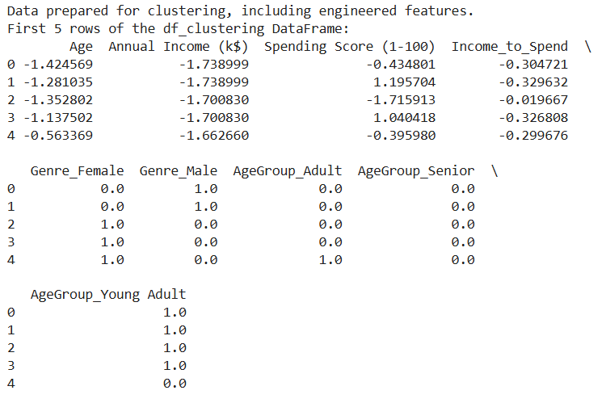
Preprocessing Pipeline
Used ColumnTransformer.
Scaled numerics (StandardScaler).
One-hot encoded Genre & AgeGroup.
Created final df_clustering.

Slide 15
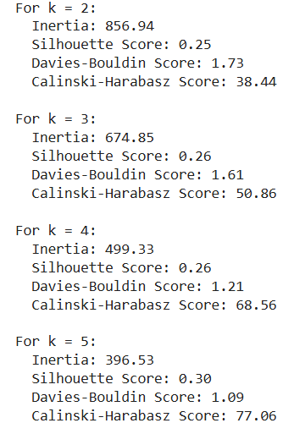
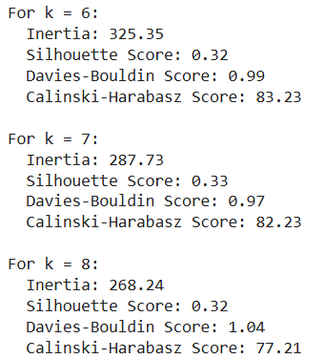
K-Means Evaluation
k tested from 2–8.
Best Silhouette: k=7 (0.33).
Lowest DB Index: k=7 (0.97).
Strong CH Score at k=6–7.

Slide 16
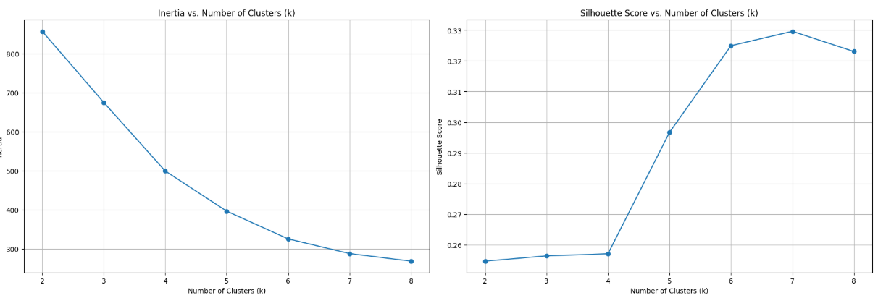
Hierarchical Evaluation
Ward linkage used.
Dendrogram indicates 6–8 clusters.
K-means vs Hierarchical. Both methods show similar ranges for silhouette (best around k=6–7); K-means at k=7 gave slightly better DB and CH scores in notebook outputs.

Slide 17
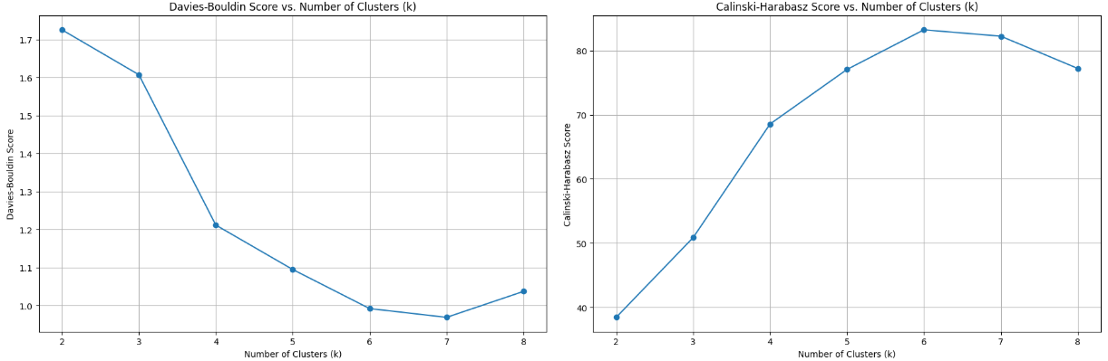
Metrics similar to K-Means: optimal around k=7.
Metrics similar to K-Means: optimal around k=7.

Slide 18
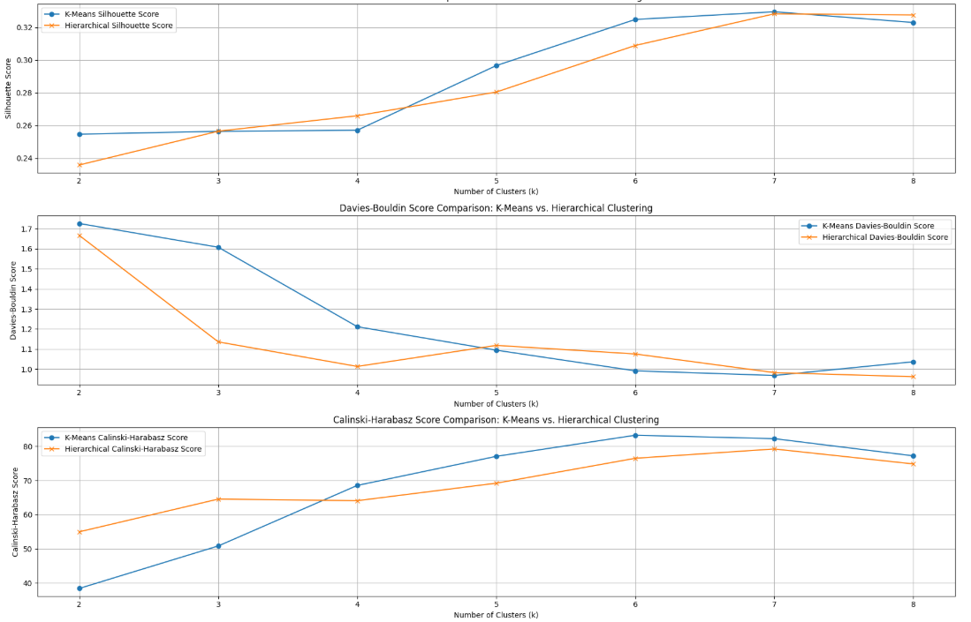
Model Comparison
Both methods peak at k=7.
Silhouette, DB, CH all support k=7.
K-Means slightly more stable.

Slide 19
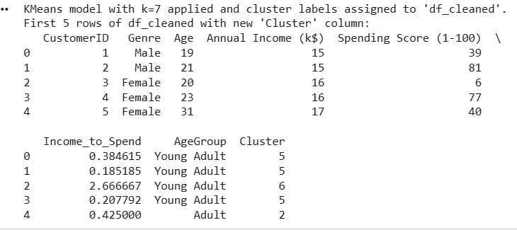
Chosen Solution: k=7
7 clusters selected.
Strong separation & cohesion.
Balanced interpretability & performance.

Slide 20
Cluster Insights Summary
Includes: high-income low-spend segment.
Low-income high-spend group.
Young adults with high scores.
Older adults with moderate spendings.

Slide 21
Cluster Centroids (Means)
Cluster | Age (Mean) | Annual Income (k$) | Spending Score | Income_to_Spend
0 | 59.95 | 49.15 | 41.82 | 1.7596
1 | 44.07 | 91.74 | 19.44 | 5.9422
2 | 41.10 | 45.32 | 41.44 | 1.2785
3 | 35.50 | 78.00 | 1.00 | 78.0000
4 | 32.69 | 86.54 | 82.13 | 1.0683
5 | 24.55 | 25.14 | 78.36 | 0.3277
6 | 22.37 | 59.20 | 41.87 | 2.6156
Cluster Standard Deviations
Cluster | Age (Std) | Annual Income (Std) | Spending Score (Std) | Income_to_Spend (Std)
0 | 3.87 | 1.61 | 7.43 | 0.55
1 | 6.67 | 3.17 | 1.42 | 2.87
2 | 8.29 | 2.35 | 9.25 | 0.19
3 | 3.18 | 1.23 | 0.00 | 0.00
4 | 7.87 | 3.18 | 8.30 | 0.23
5 | 6.75 | 3.03 | 5.52 | 0.09
6 | 4.36 | 2.00 | 8.81 | 0.44

Slide 22
Business Implications
Target high spenders with loyalty programs.
Upsell to high-income low-spend customers.
Personalize offers by AgeGroup.
Improve retention strategies.

Slide 23
Conclusion & Next Steps
Effective segmentation achieved.
k=7 best-performing cluster count.
Future work: GMM, PCA visualization, stability analysis.
Use results for targeted marketing.

