Slide 1
MNIST Image Classification
Convolutional Neural Network (CNN) Analysis
Dataset: MNIST Handwritten Digits (Keras Dataset)
Group members
NAME | REG NO
ARINEITWE THOMAS | 2024-MI32-24196
MUGASHA BLAISE | 2024-M132-23976
NAMUSOKE OLIVIA
INSTRUCTOR | DR. HARRIET SIBITENDA

Slide 2
MNIST Dataset Overview
What is MNIST?
  Modified National Institute of Standards and Technology dataset, is a classic benchmark dataset in machine learning and computer vision.
Dataset Size
  • 60,000 training images
  • 10,000 test images
Image Characteristics
  • 28×28 pixel grayscale images
  • Handwritten digits (0-9)
  • Pixel values: 0-255
Classes
  10 classes (digits 0 through 9)
Why MNIST?
  • Simple yet effective for learning
  • Standard benchmark dataset
  • Well-balanced and preprocessed

Slide 3
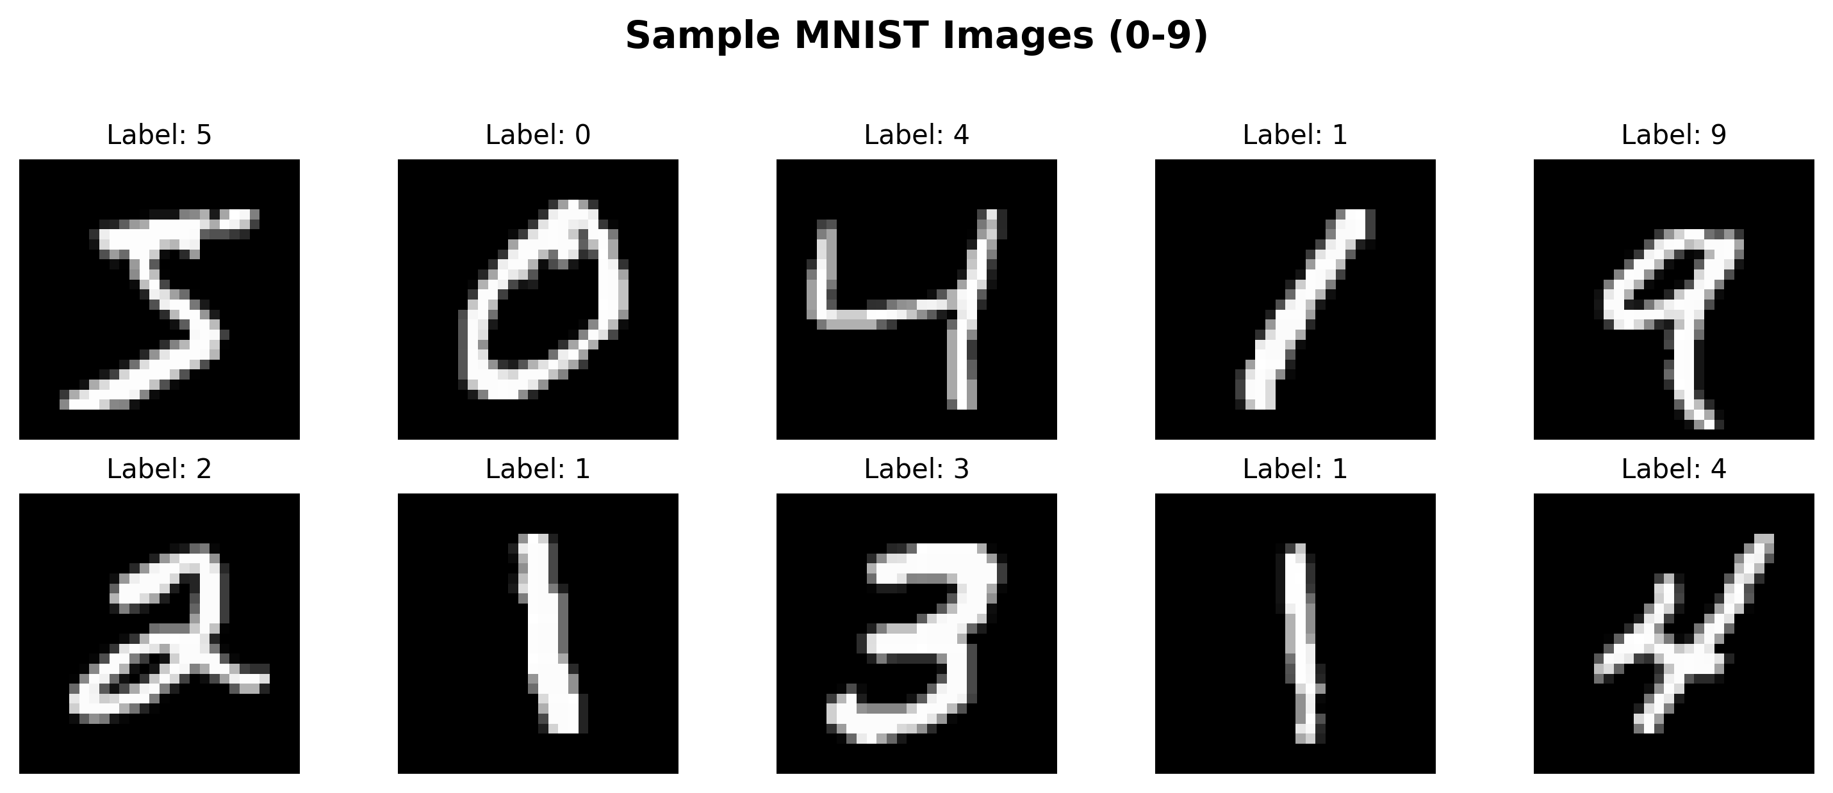
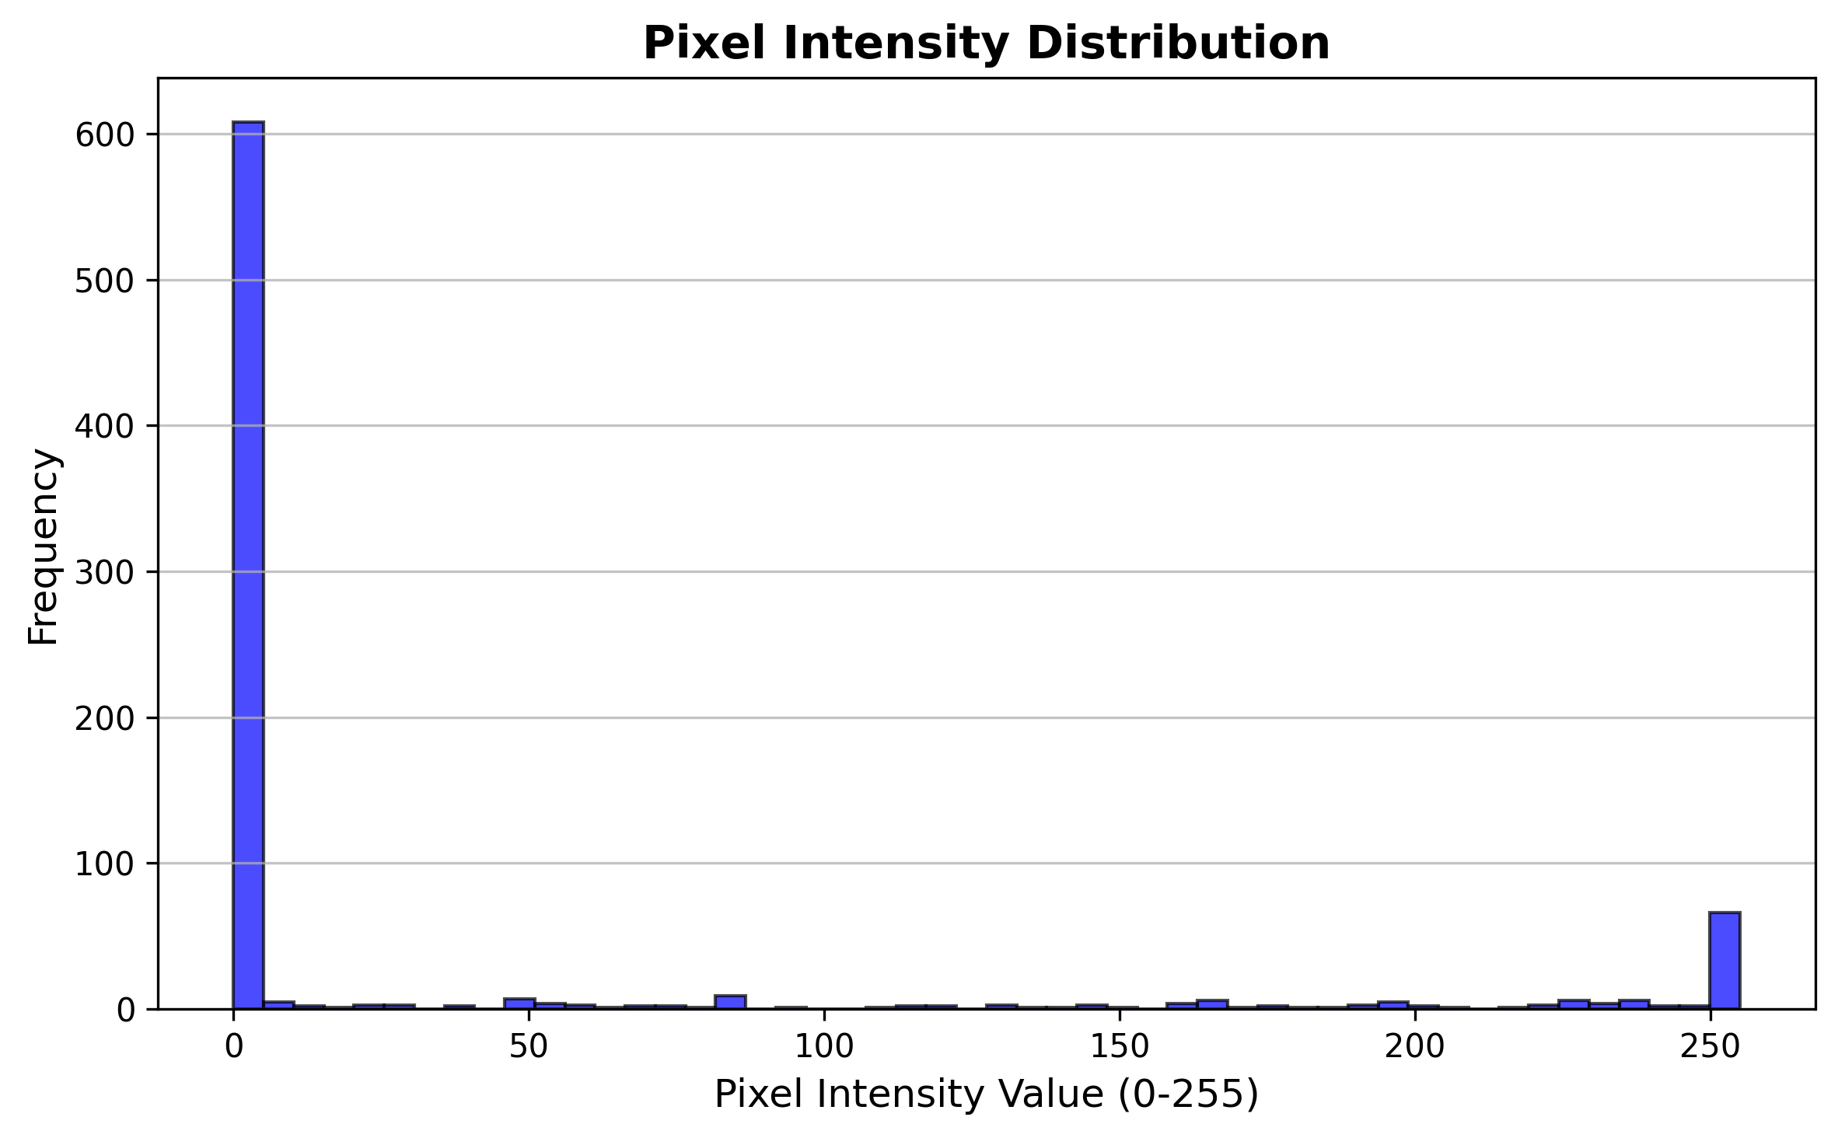
Task 1: Load and Explore MNIST Dataset
Dataset Loading
  • Loaded using tf.keras.datasets.mnist.load_data()
  • Returns: (x_train, y_train), (x_test, y_test)
Data Exploration
  • Training: 60,000 images (28×28 pixels)
  • Testing: 10,000 images (28×28 pixels)

Slide 4
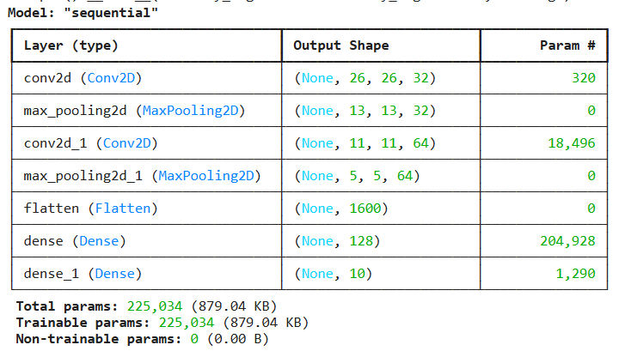
Task 2: Build CNN Architecture
CNN Architecture Components:
  1. Conv2D Layer 1: 32 filters, 3×3 kernel, ReLU activation
  2. MaxPooling2D: 2×2 pooling
  3. Conv2D Layer 2: 64 filters, 3×3 kernel, ReLU activation
  4. MaxPooling2D: 2×2 pooling
  5. Flatten: Convert 2D to 1D
  6. Dense Layer: 128 neurons, ReLU activation
  7. Output Layer: 10 neurons, Softmax activation

Slide 5
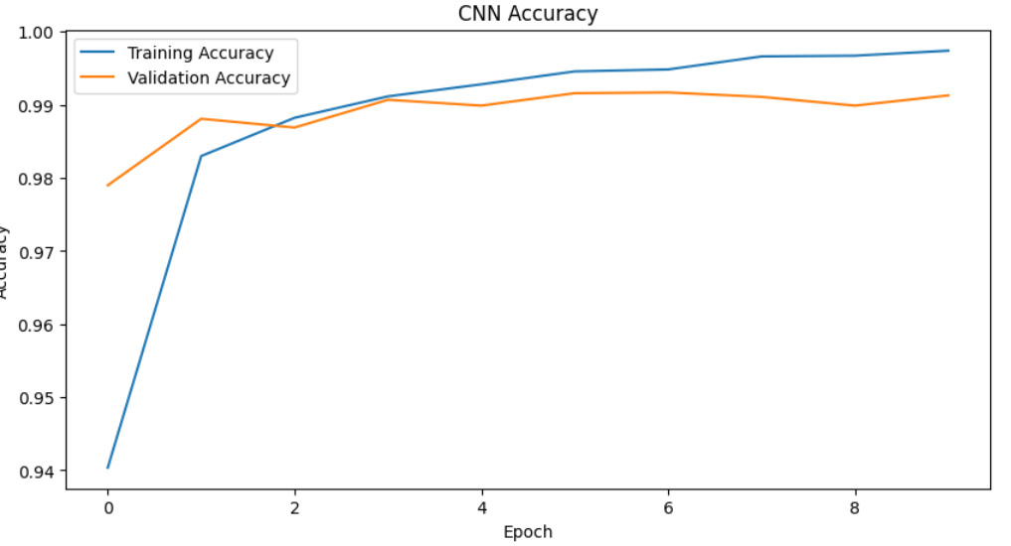
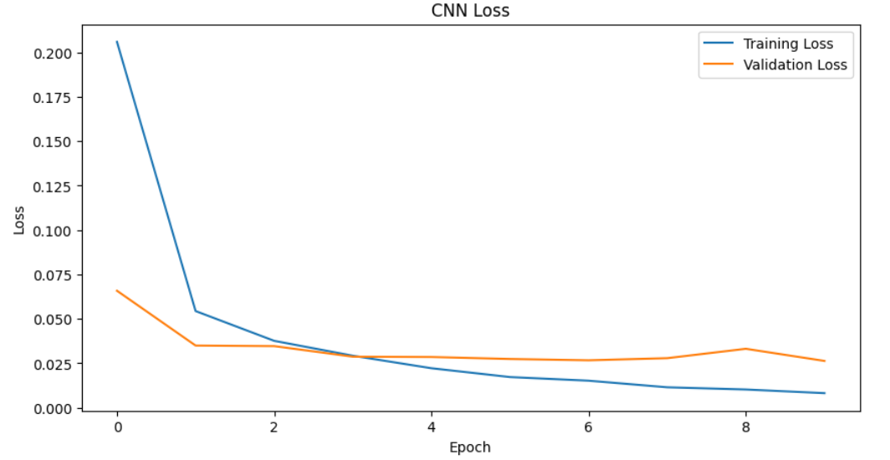
Task 3: Train Model (10 Epochs)
Training Configuration:
  • Epochs: 10
  • Batch Size: 128
  • Optimizer: Adam
  • Loss: Categorical Crossentropy
Training Results:
  • Final Training Accuracy: 99.69%
  • Final Validation Accuracy: 99.16%
  • Final Validation Loss: 0.0271
Interpretation: Accuracy increases; mild overfitting expected

Slide 6
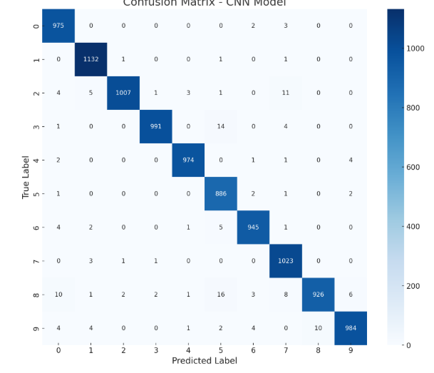
Task 4: Evaluate on Test Data
Test Set Performance:
  Test Accuracy: 99.16%
  Test Loss: 0.0271
  Accuracy, Precision, Recall, F1
  Common errors: 4 vs 9, 3 vs 5

Slide 7
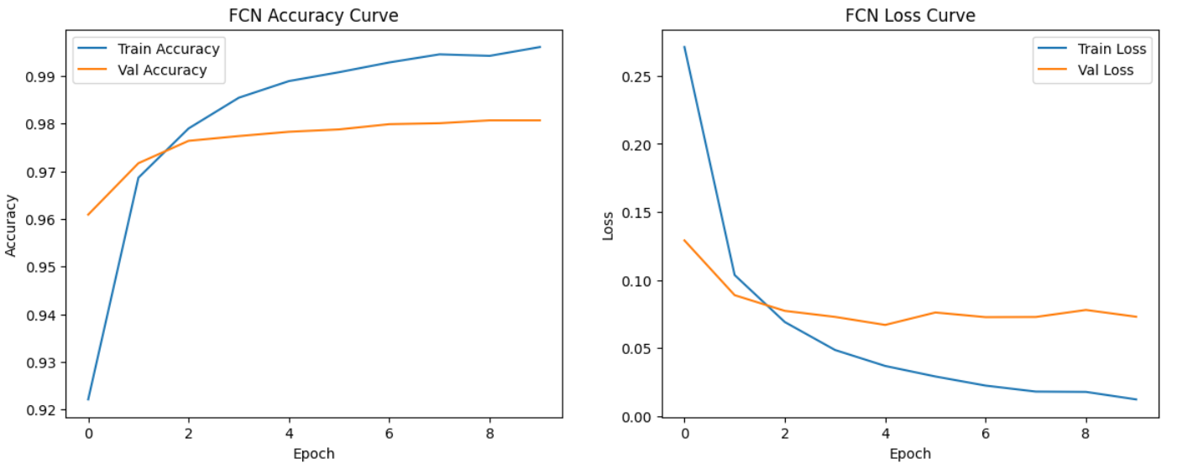
Task 5: Fully Connected Network
FCN Model
  • Test Accuracy: 98.10%
  • Test Loss: 0.0716
  • Flattens image
  • No spatial awareness
The FCN shows high accuracy and low loss, proving it can classify MNIST digits well.
Compared to the CNN, the FCN has:
Slightly higher validation loss
Slightly lower accuracy
More fluctuations, because FCNs don’t extract spatial features as effectively
CNN remains the better architecture for image data — but the FCN still achieves >98% accuracy, which is excellent

Slide 8
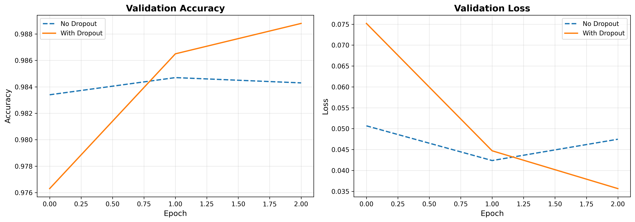
Task 6: Dropout Regularization
Dropout Implementation:
  • Dropout(0.25) after first pooling layer
  • Dropout(0.25) after second pooling layer
  • Dropout(0.5) after dense layer
Results:
  • Test Accuracy: 99.23% (improved from 99.16%)
  • Test Loss: 0.0229 (reduced from 0.0271)
• Dropout reduces overfitting by randomly disabling neurons

Slide 9
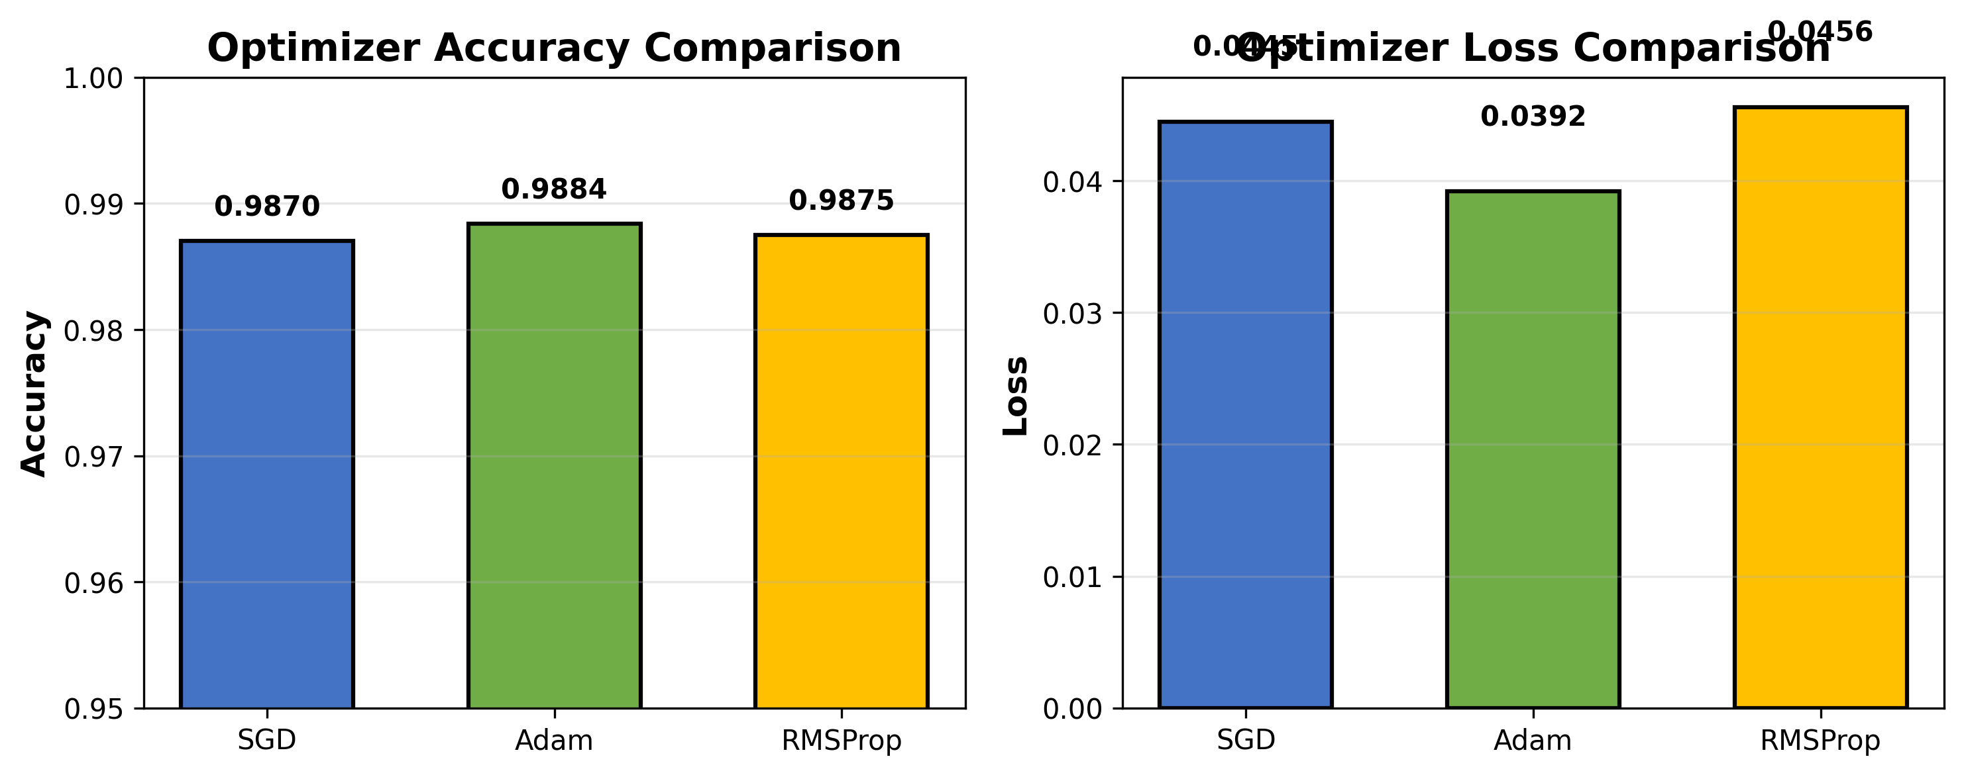
Task 7: Batch Normalization & Optimizers
Batch Normalization:
  • Added after each Conv2D layer
  • Normalizes activations → Stabilizes training
Optimizer Comparison:
  SGD (lr=0.01, momentum=0.9):
    Accuracy: 99.11% | Loss: 0.0288
  Adam (default):
    Accuracy: 99.04% | Loss: 0.0325
  RMSProp (lr=0.001):
    Accuracy: 98.89% | Loss: 0.0404

Slide 10
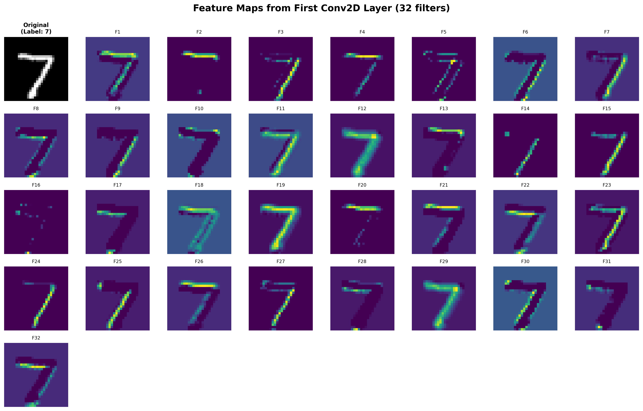
Task 8: Visualize Feature Maps
Feature Map Extraction:
  • Created intermediate model to extract first Conv2D layer outputs
  • Visualized 32 feature maps from first convolutional layer
  • Each filter detects different patterns in the input image

Slide 11
Task 9: How CNN Filters Learn Patterns
What CNN Filters Learn:
Edge Detection
  Filters detect edges in various orientations (horizontal, vertical, diagonal)
Texture Recognition
  Some filters identify simple textures and gradients within digits
Corner & Blob Detection
  Filters sensitive to specific corners or pixel blobs
Feature Diversity
  Each filter specializes in detecting different visual patterns
Hierarchical Learning
  Early layers: basic features → Deeper layers: complex patterns

Slide 12
Key Findings & Results
• CNN outperforms FCN: 99.16% vs 98.10% accuracy
• Dropout improves generalization: 99.23% accuracy
• SGD optimizer performs best: 99.11% accuracy
• Batch normalization stabilizes training
• First layer filters learn edge detection and basic patterns
• Spatial feature extraction is crucial for image classification

Slide 13
Conclusion
Summary:
CNNs are highly effective for image classification tasks like MNIST. Through convolutional layers, they learn spatial hierarchies of features, from simple edges to complex digit patterns. Regularization techniques like dropout and batch normalization further improve model performance and generalization.
The visualization of feature maps demonstrates how CNNs break down images into fundamental building blocks, which are then combined by deeper layers to achieve accurate digit recognition.

Slide 14
Thank You
Questions?

