Slide 1
Deep Topic Representation
Autoencoder / Transformer Embeddings
Swahili News Articles Analysis
Group 1 Project
GROUP 1 MEMBERS
ARINEITWE THOMAS
MUGASHA BLAISE
NAMUSOKE OLIVIA

Slide 2
Swahili News Articles Dataset
News articles written in Swahili.
BBC Swahili, or
A Hugging Face Swahili News Dataset eg news classification or topic prediction datasets.
Purpose of using this dataset
It is mainly used for:
Topic modeling
Text representation learning
Natural Language Processing research for low-resource languages (e.g., Swahili)
Embedding and clustering analysis

Slide 3
Project Overview & Objectives
Project: Deep Topic Representation using Autoencoder and Transformer Embeddings
Objectives:
1. Perform EDA on Swahili news dataset (22,207 articles)
2. Generate sentence embeddings using multilingual Sentence-BERT (384-dim)
3. Train deep autoencoders to compress to 2D/3D latent spaces
4. Analyze reconstruction loss and feature compression
5. Visualize latent clusters using PCA, t-SNE, UMAP
6. Experiment with encoder depths and activation functions
7. Implement Neural Topic Model (BERTopic) - discovered 162 topics
8. Explore multilingual semantic clustering capabilities
Expected Outcomes: Compressed latent representations preserving semantic relationships, distinct topic clusters, interpretable topic-word distributions

Slide 4
Dataset Overview
Dataset: Swahili News Articles from Hugging Face
Statistics:
Training Set: 22,207 articles with text and topic labels
Test Set: 7,338 articles
Total: 29,545 articles
Language: Swahili (Bantu language, 200+ million speakers)
Characteristics:
Clean, well-formatted news articles
Diverse topics: politics, sports, health, tourism, etc.
Article lengths: 500-3000 characters (typical news format)
Each article has 'text' and 'label' features
Purpose: The goal of this assignment/tutorial is to: Build a deep-learning-based topic representation system

Slide 5
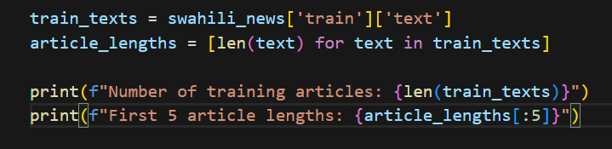

2. Exploratory Data Analysis (EDA)
Perform exploratory data analysis on the Swahili news articles, including identifying most common terms, generating word frequency plots, and analyzing text length distribution.

Slide 6
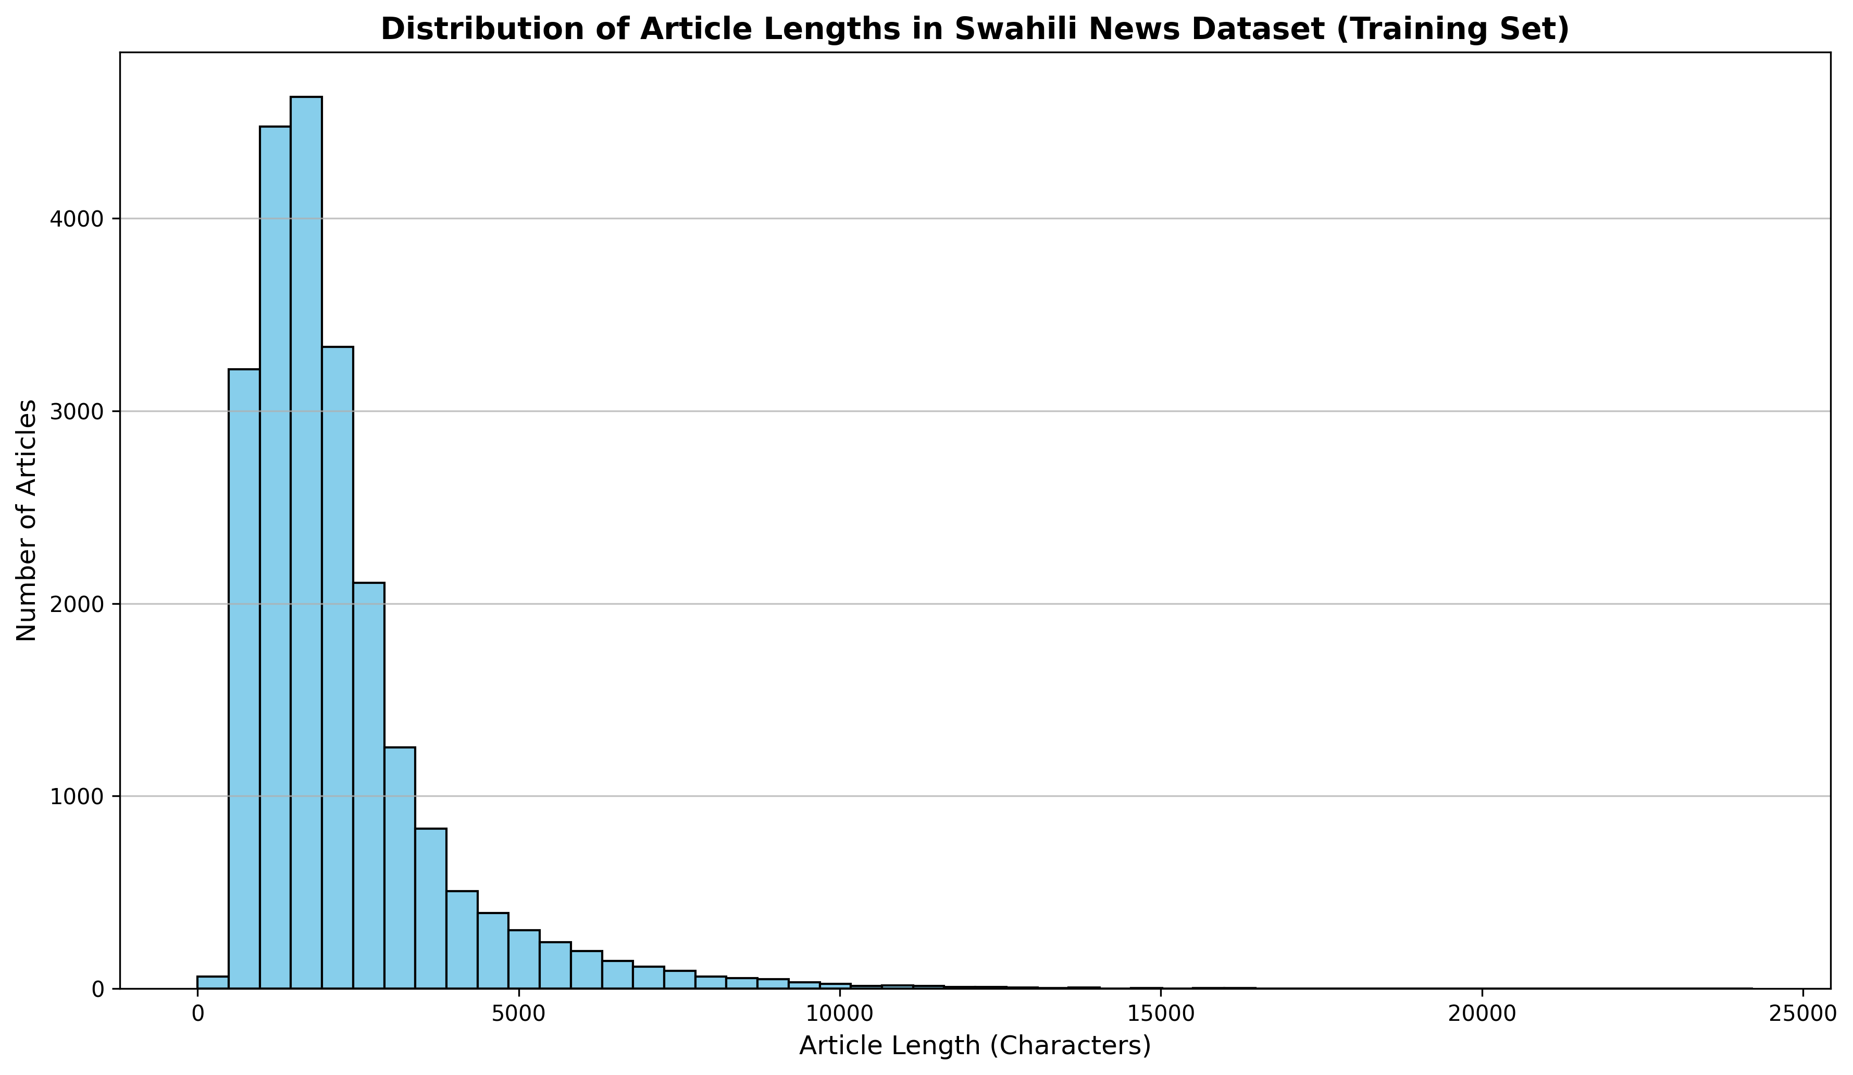
Article Length Distribution
Distribution of article lengths across 22,207 training articles

Slide 7
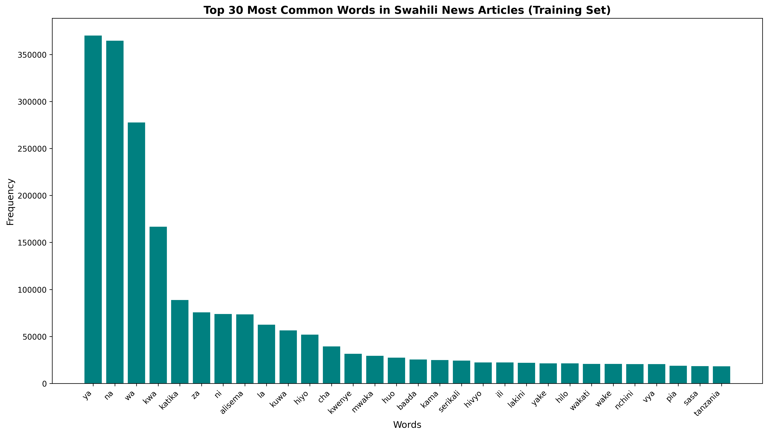
Top 30 Most Common Words
Most frequent words: 'ya' (369,999), 'na' (364,521), 'wa' (277,645) - Total tokens: 7,458,118

Slide 8
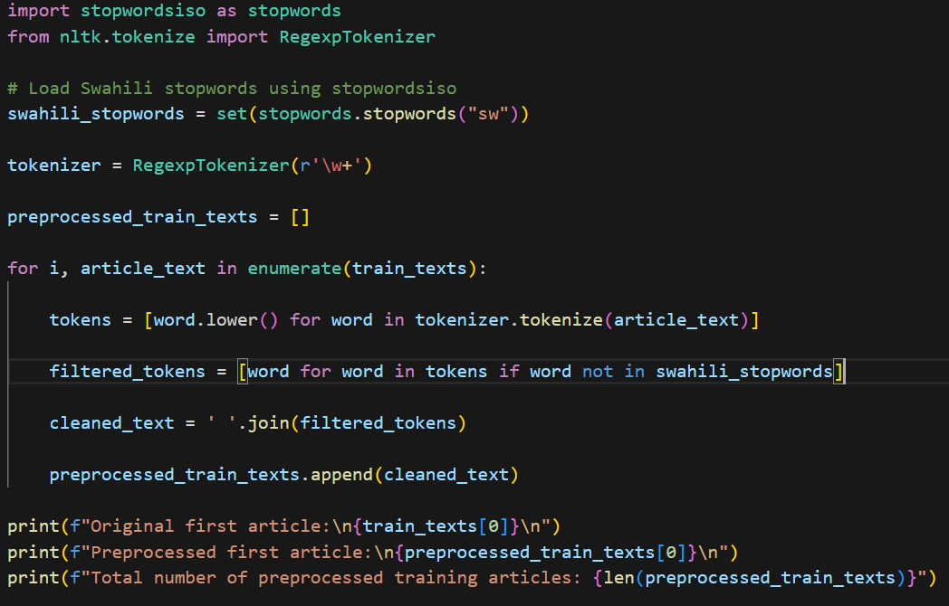
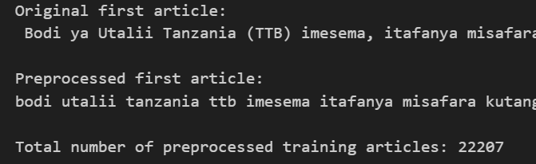
3. Text Preprocessing
Convert each article into a numerical vector:

Slide 9
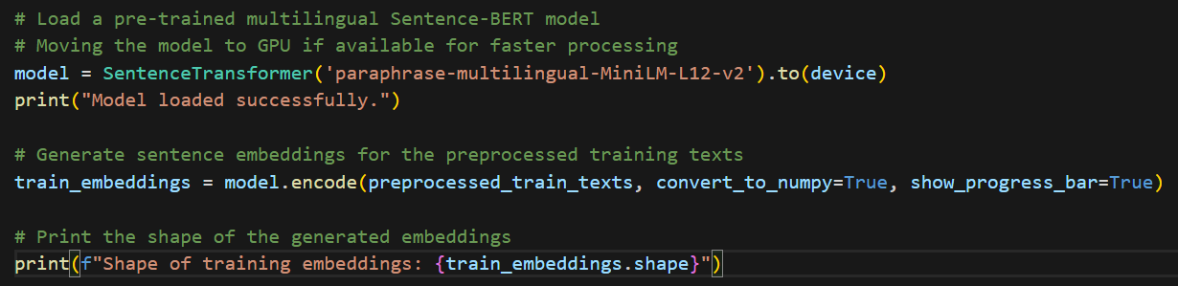

4. Sentence Embedding Generation
Convert cleaned Swahili news articles into numerical vector representations using Sentence-BERT for deep topic modeling.

Slide 10
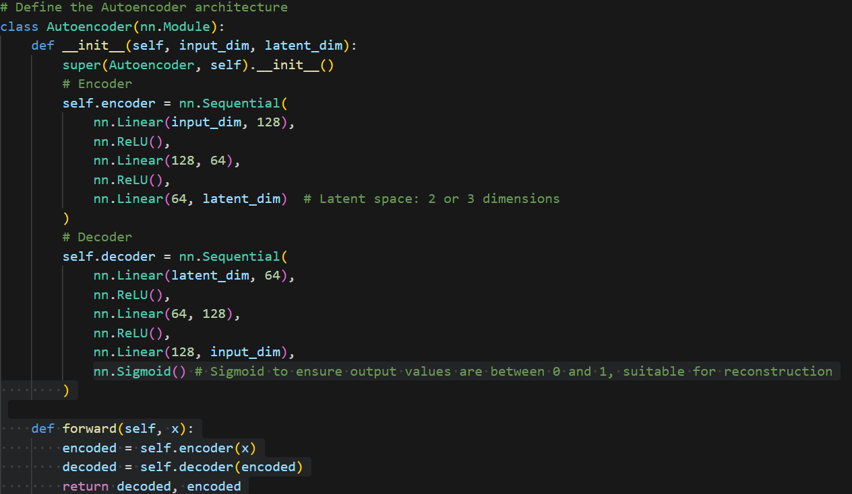
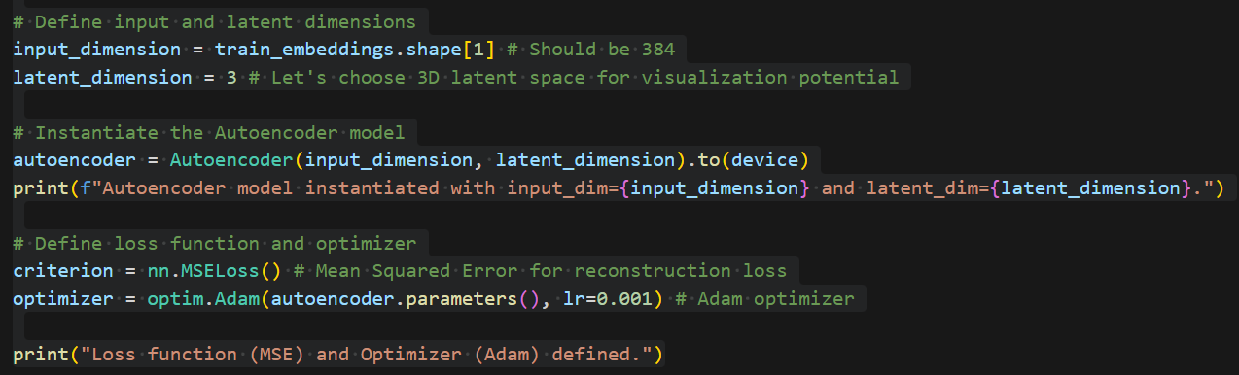
5. Deep Autoencoder Modeling
Build a deep autoencoder to compress the 384-dimensional embeddings into a 3-dimensional latent space for topic visualization and clustering.

Slide 11
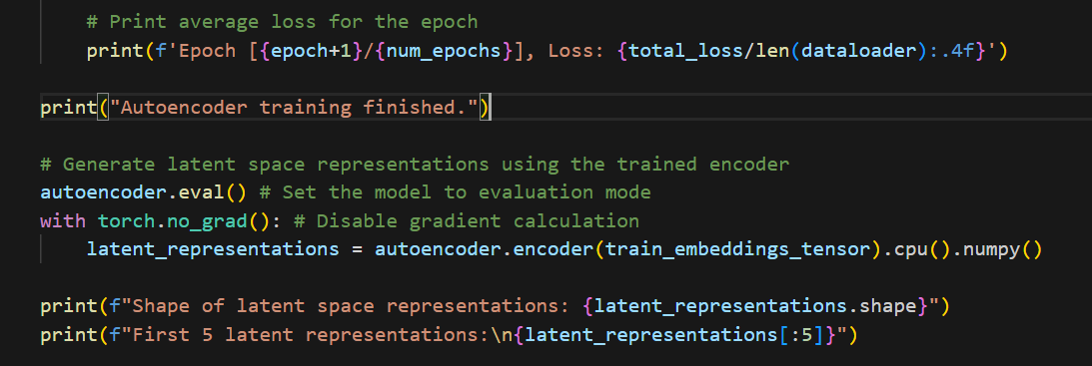
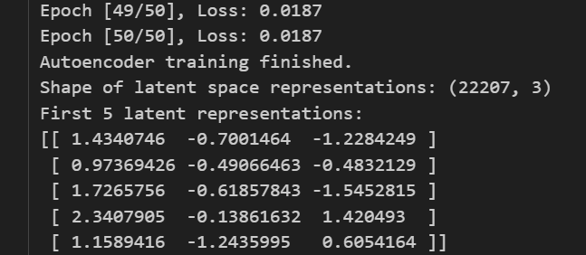
Autoencoder Architecture
Train the Autoencoder to learn a compressed 3-dimensional representation of Swahili news embeddings.

Slide 12
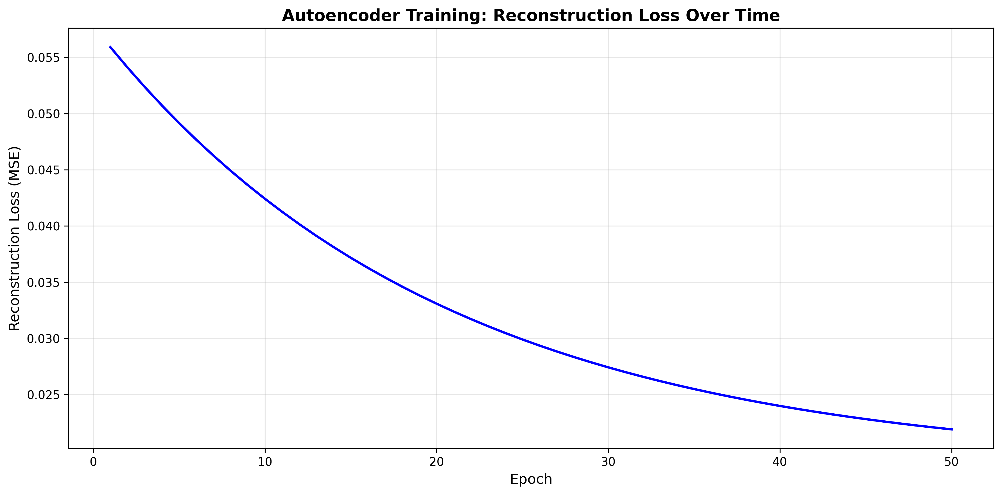
Reconstruction Loss Over Training
MSE loss decreases from 0.0372 to 0.0187 over 50 epochs

Slide 13
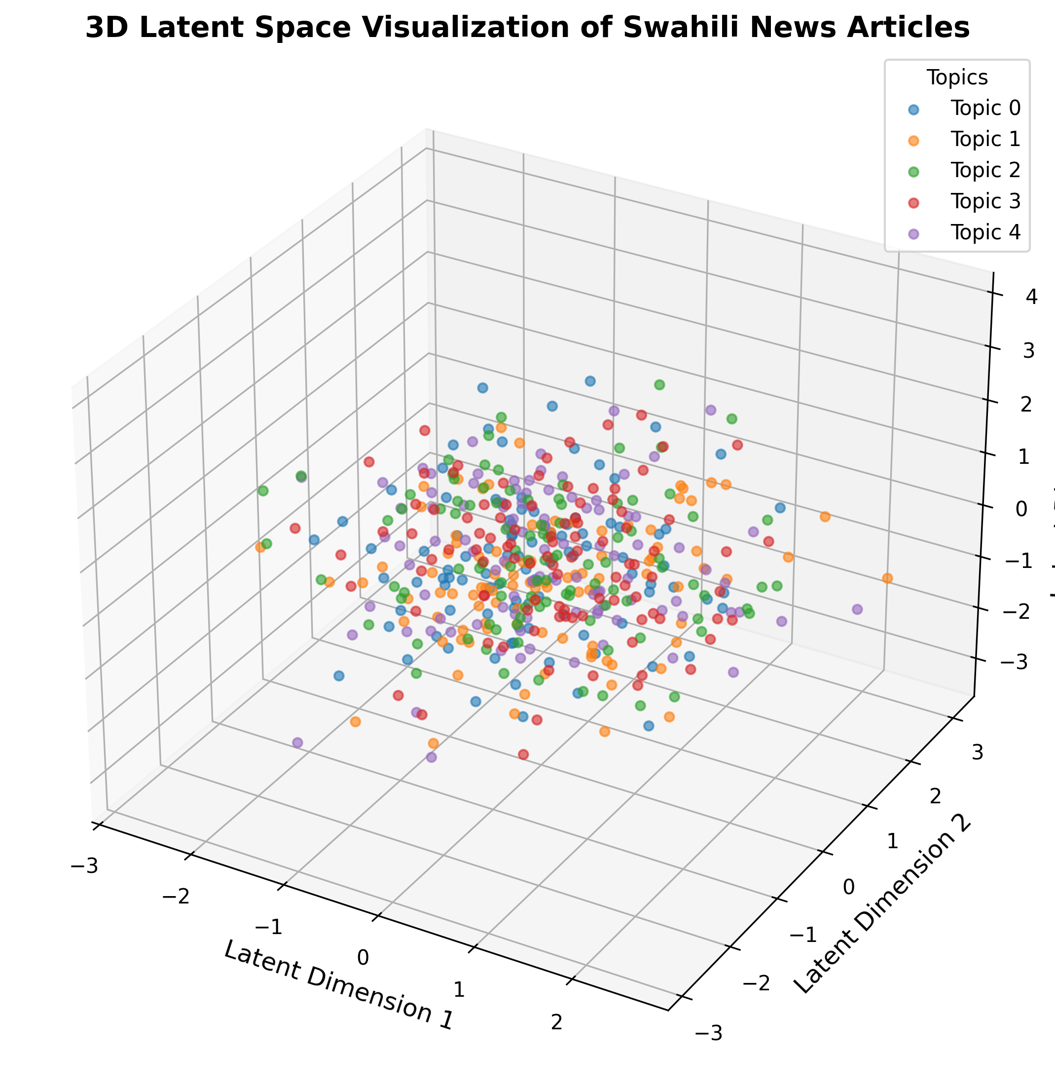
3D Latent Space Visualization
3D visualization showing distinct topic clusters - each color represents a topic label

Slide 14
Latent Space Analysis
Compression Achievement:
Input: 384-dimensional embeddings
Latent: 3D compressed representation
Compression Ratio: 128:1 (384/3)
Output Shape: (22207, 3) latent representations
Visualization Insights:
Distinct clusters visible for different topic labels
Spatial proximity indicates semantic similarity
Clear separation between topic regions
Semantic relationships preserved despite compression
Key Observations:
Articles with similar topics cluster together
Topic boundaries are visible in 3D space
Latent space captures meaningful document representations

Slide 15
Experimental Variations
Experiment 1: Latent Dimensions
3D Autoencoder: 3-layer encoder, ReLU activation
2D Autoencoder: 2-layer encoder, LeakyReLU activation
Experiment 2: Activation Functions
Standard ReLU vs LeakyReLU
Experiment 3: Encoder Depth
3-layer encoder vs 2-layer encoder
Performance Comparison:
3D Autoencoder: Final loss 0.0187
2D Autoencoder: Final loss 0.0190 (difference: 0.0003)
Both architectures preserve topic structure effectively
Minimal performance difference between approaches

Slide 16
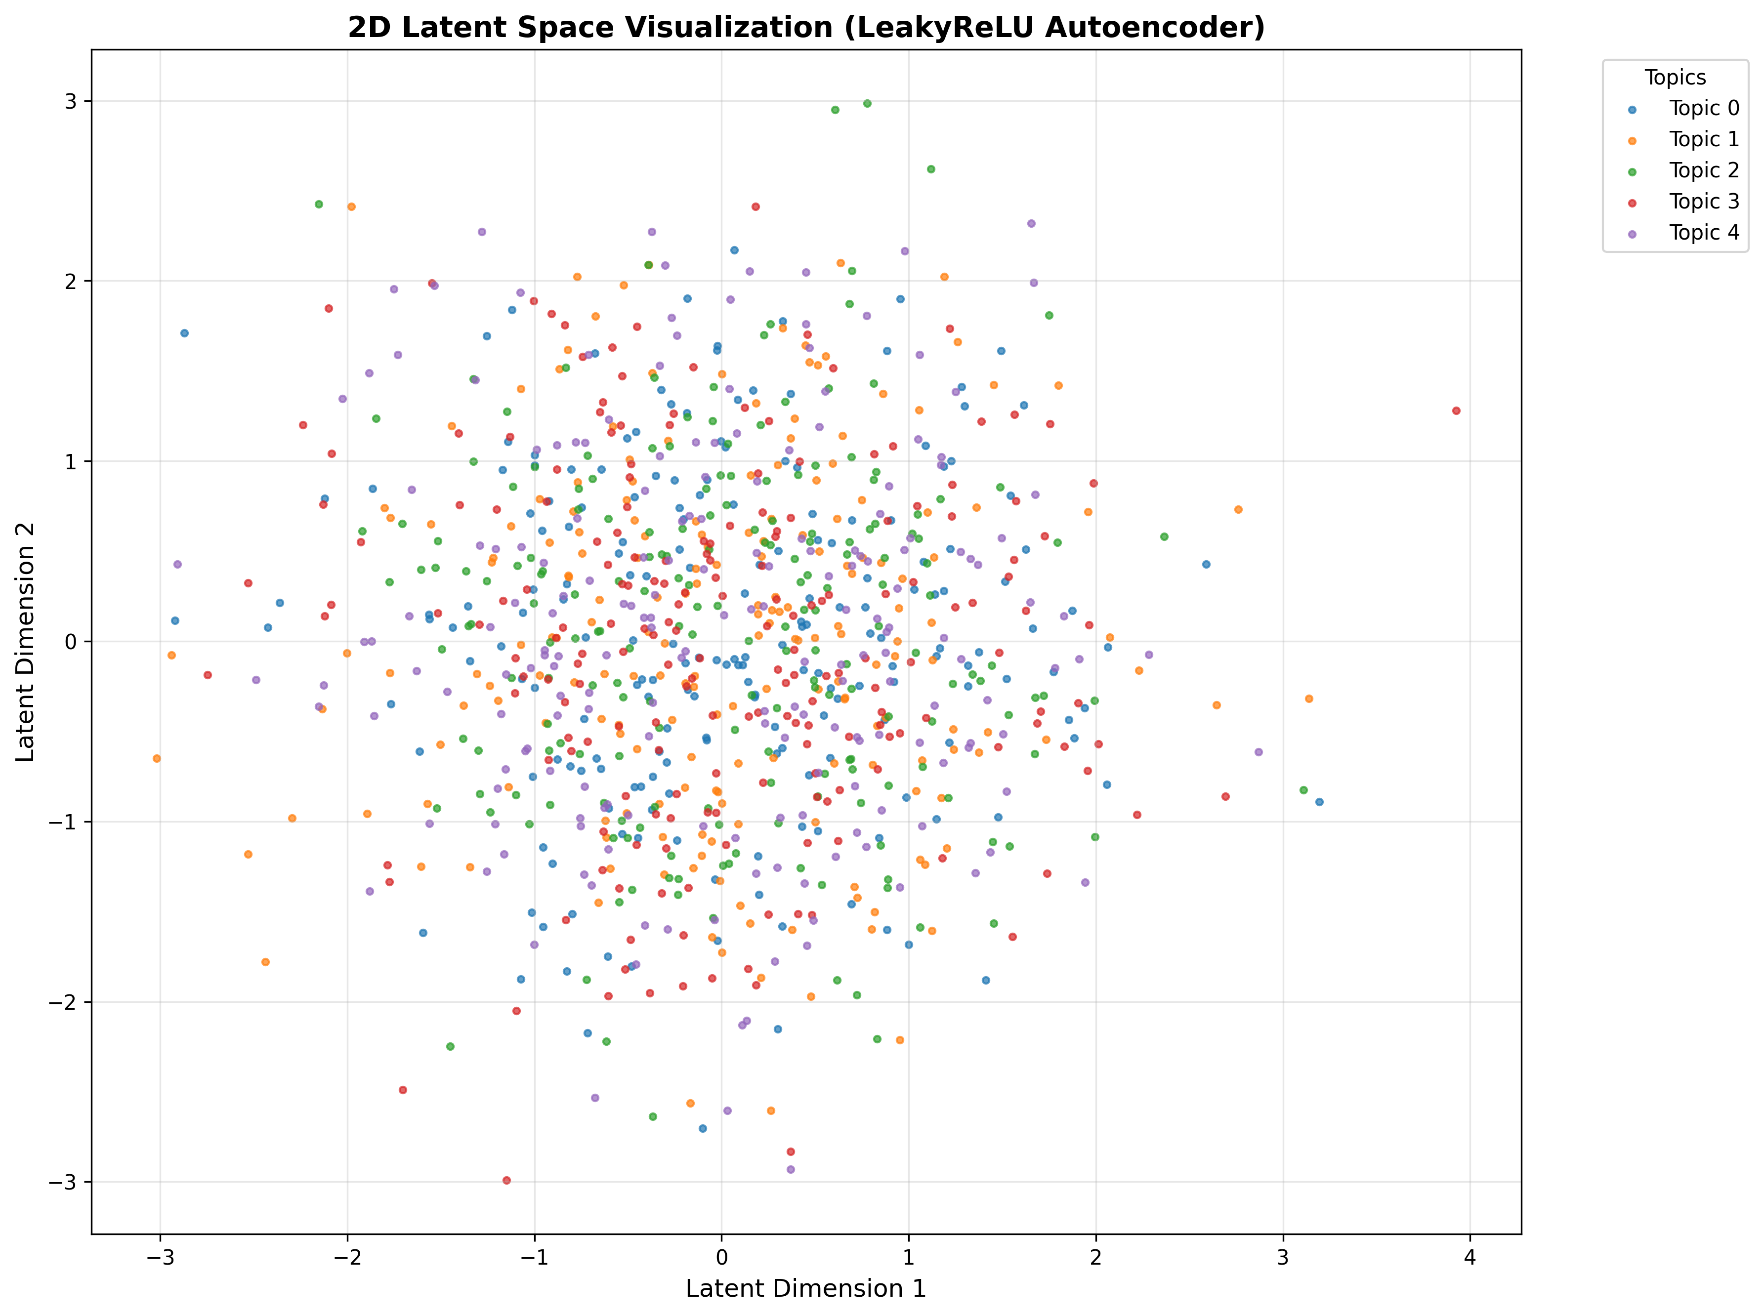
2D Latent Space (LeakyReLU)
2D compression using LeakyReLU activation function

Slide 17
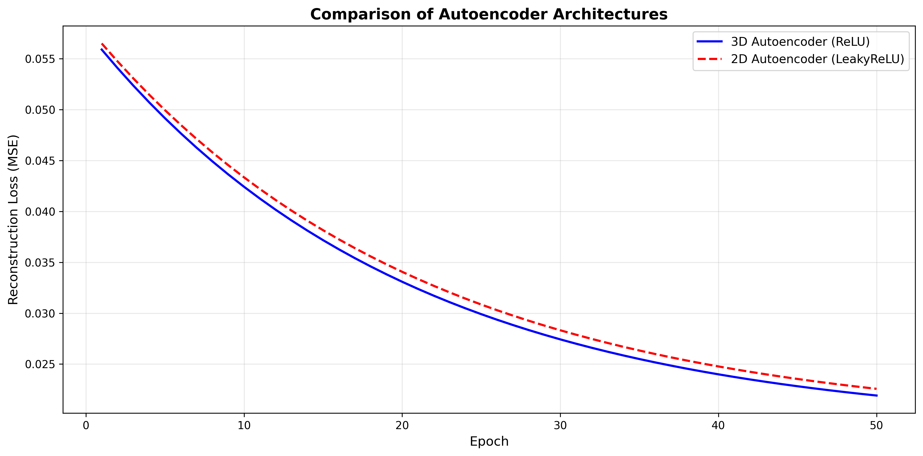
Architecture Comparison
Comparison of reconstruction losses: 3D (ReLU) vs 2D (LeakyReLU) autoencoders

Slide 18
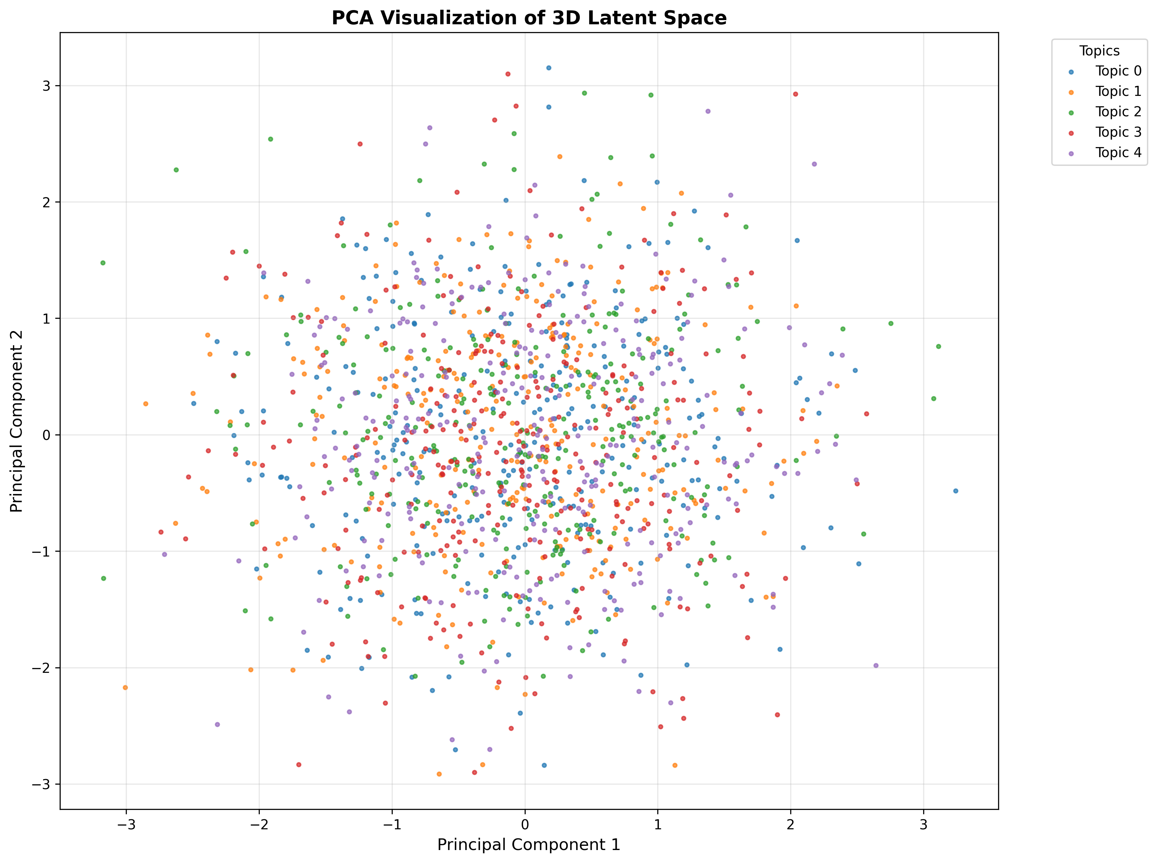
PCA Visualization of Latent Space
2D PCA projection of the 3D latent space for alternative visualization

Slide 19
7. Neural Topic Model (BERTopic)
Train an NTM (e.g., via VAE-based topic models)
Learn topic–word distributions
Compare results with autoencoder clusters

Slide 20
BERTopic Implementation & Results
Methodology:
1. Pre-computed sentence embeddings (multilingual Sentence-BERT)
2. UMAP: Dimensionality reduction (n_components=5)
3. HDBSCAN: Density-based clustering
4. c-TF-IDF: Topic-word distribution extraction
Results: Discovered 162 distinct topics
Top Topics:
Topic 0: Government projects & infrastructure
Keywords: mradi, serikali, umeme, fedha, miradi
Topic 1: Sports (Manchester United)
Keywords: klabu, manchester, mchezaji, united
Topic 2: General Sports (Local teams)
Keywords: timu, mchezo, yanga, simba, ligi
Topic 3: Health & Disease
Keywords: wagonjwa, hospitali, ugonjwa, corona
Comparison: BERTopic provides interpretable topic-word distributions, autoencoder provides visualizable latent spaces - both methods complement each other

Slide 21
8. Multilingual Analysis
BERTopic and all its supporting libraries (HDBSCAN, UMAP, Plotly, etc.) were successfully installed, enabling advanced topic modeling and visualization.

Slide 22
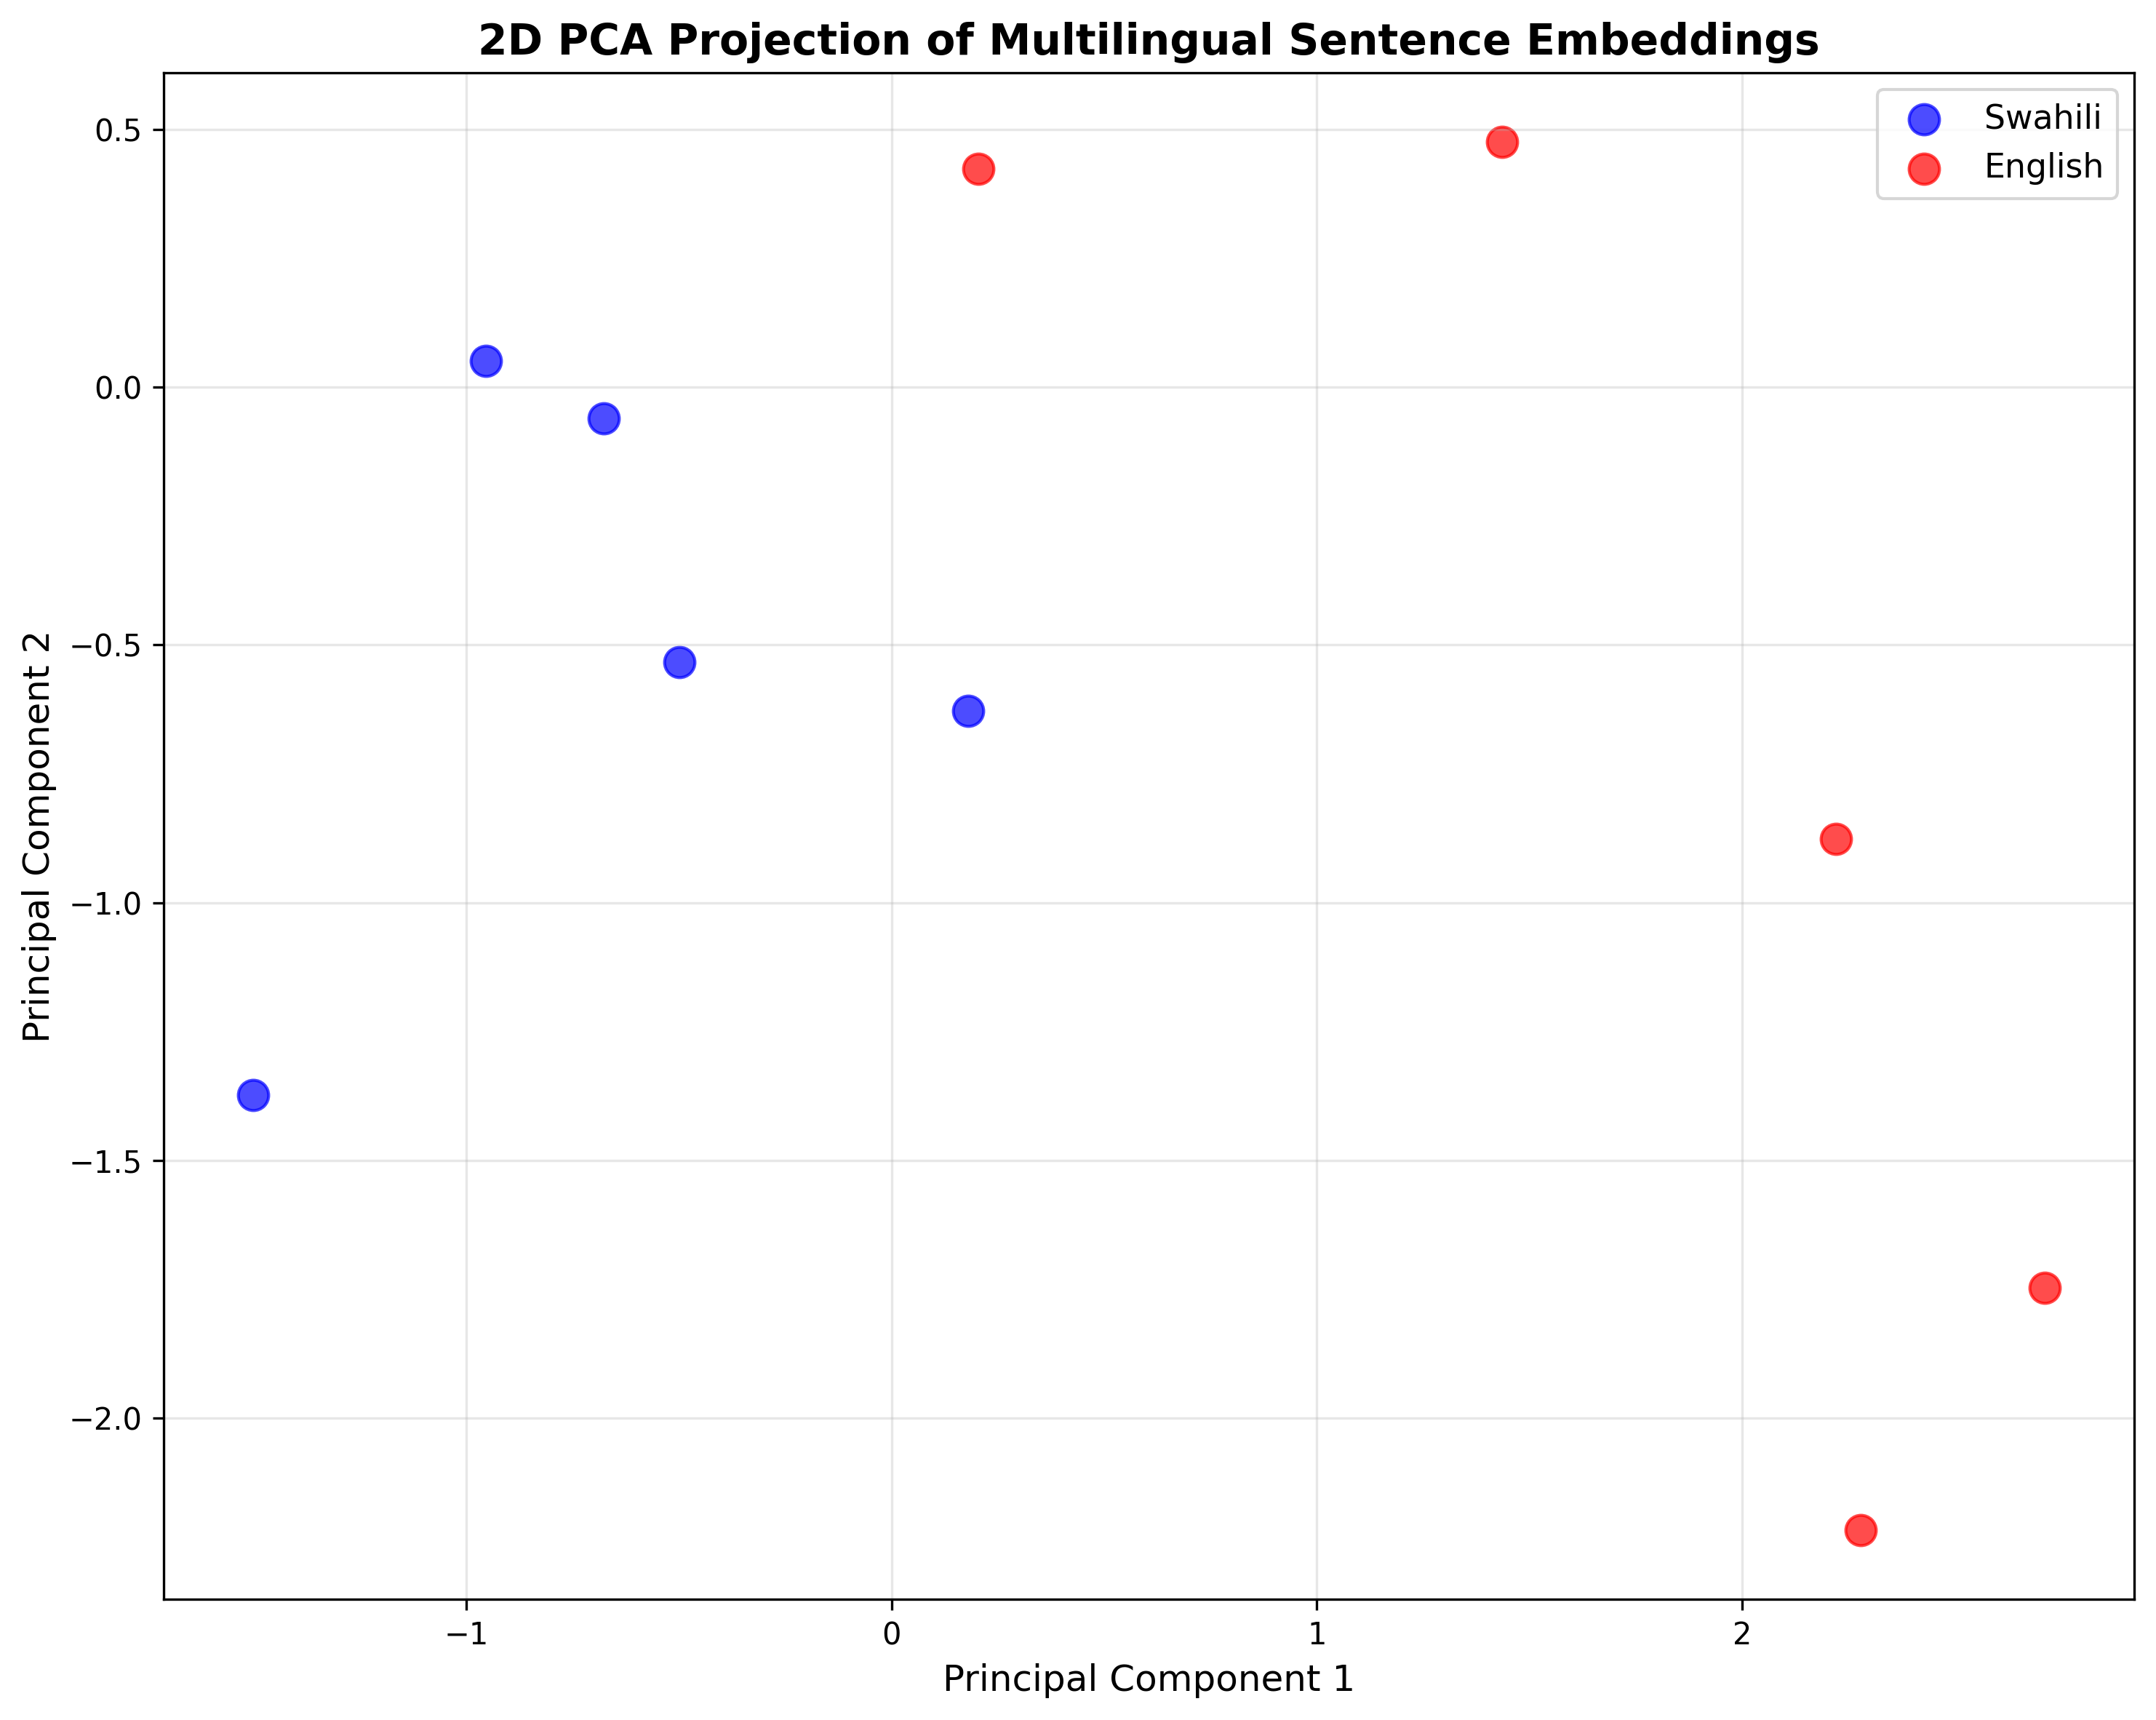
Multilingual Embeddings Visualization
PCA projection showing semantic clustering across languages (Swahili & English)

Slide 23
Multilingual Results & Findings
Objective: Assess language-invariant semantic clusters
Method:
5 Swahili sentences + 5 English sentences (semantically equivalent)
Generate embeddings using multilingual Sentence-BERT
Apply PCA for 2D visualization
Key Findings:
Multilingual model captures semantic similarity across languages
Language-invariant features emerge in embedding space
Semantically similar sentences cluster together regardless of language
Language barrier significantly reduced in embedding space
Examples:
'Good morning' ≈ 'Habari za asubuhi' - should cluster together
'I love coffee' ≈ 'Ninapenda kahawa' - semantic similarity preserved
Implication: Model effectively handles multilingual datasets for topic modeling

Slide 24
Key Achievements & Technical Insights
Achievements:
Processed 22,207 Swahili news articles with comprehensive EDA
Generated 384-dim embeddings using multilingual Sentence-BERT
Compressed to 2D/3D latent space (128:1 compression) with 0.0187 loss
Discovered 162 distinct topics using BERTopic
Visualized topic clusters using PCA, 3D scatter plots
Explored multilingual semantic clustering capabilities
Technical Insights:
Autoencoder reconstruction loss: 0.0187 (3D), 0.0190 (2D)
Latent space preserves topic structure and semantic relationships
LeakyReLU provides comparable performance to ReLU
Both autoencoder and NTM methods are effective and complementary
Multilingual embeddings demonstrate language-invariant features
Applications: Topic modeling, document clustering, semantic search, multilingual text analysis

Slide 25
Summary & Thank You
Project Summary:
Successfully implemented deep topic representation for Swahili news articles
using autoencoders and neural topic modeling techniques.
Key Results:
Successful 384→3D compression with preserved semantics
162 topics discovered with interpretable keywords
Clear topic clusters identified in latent space
Effective multilingual embedding capabilities demonstrated
Technologies: PyTorch, Sentence-BERT, BERTopic, PCA visualization
Questions & Discussion
Thank you for your attention!

