Slide 1
Thermal Shock update on small evals
China RW: WenZhao Ma, Tao Li
Servo: Krit
HDIG: MengXian Sun, Kang Yu
TCO R/W: Jason Fest, TCO Servo: RHO: Erik
Nov,19 - 2013

Slide 2
Current status:
3x groups small eval for instability failures have been done:
Applied power range [30mW, 150mW]
Recovery rate:
~78% for T103 failure
~72% for T63 failure
~77% for T229 failure
No obvious MRE change (measured on disc), did see the improvement of instability failures such as Max Servo AGC/delta BER etc from instability test;
All failures have been re-processed from PRE2 for key parameters checking such as AFH, BER, Servo linear, Preamp gain etc;
Head Temp calculated with DETCR resistance change shows huge difference than the formula of RHO modeling;
Next steps:
Data analysis for three SBRs are ongoing; - FW25
RHO Eric is helping to understand the temp calculation gap btw DETCR resistance vs. modeling;
Then to see if we need TCO Servo to design a new servo code, which can measure DETCR Resistance while applying different heat on RAMP, the objective is to monitor head real time temp.

Slide 3
IM Thermal shock flow chart for SAC failures
start
Rerun T103, still fail?
No
Pass
Delta MR criteria : DELTA_PCT >= 6.0%;
Power range for cert. implementation :
CAL2: [30mW, 150mW], step =5
Yes
Perform Thermal Shock test
TS = Start mW, measure MR
Do thermal shock with 10s, measure MR, Drive pass instability test?
Yes
Rerun 4 more times instability test, all pass?
Yes
MR Change >6%?
No
Pass
No
No
TS = Max power?
No
TS = TS+Step
Yes
Yes
Fail

Slide 4
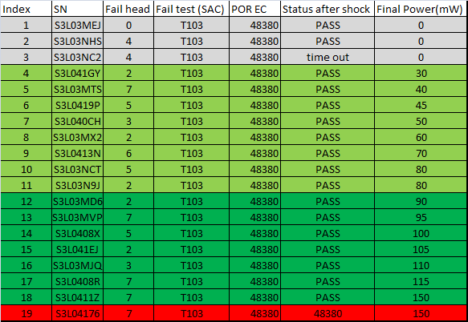
Eval status with 19x CAL2 T103 SAC failures
Power range [30mW, 150mW], just for this small eval study;
2/19x: rerun pass (no shock, final power = 0)
1/19x: time out
1/19x: still failed after shock
15/19x: passed T103 after thermal shock within range[30mW, 150mW]
8/15x: power within range [30mW, 80mW];
7/15x: power within range [85mW, 150mW];

Slide 5
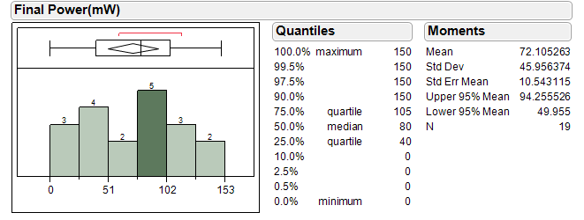
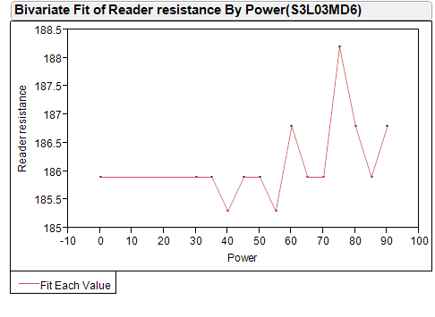
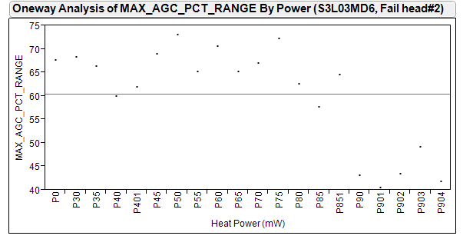
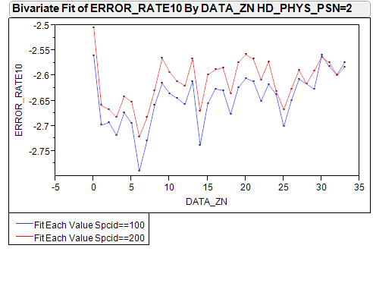
Data analysis
Power distribution
Reader resistance vs. power
Shows variation but no obvious trend
MAX_AGC_PCT_RANGE vs. thermal shock (one example)
BER getting a little worse (only one sample now, more data next slide)
Spec = 60
improvement

Slide 6
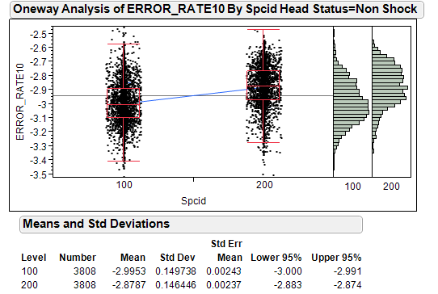
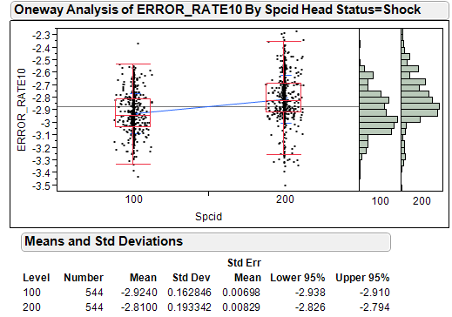
BER comparison:
Spcid 100 is BER before shock, 200 is BER after shock;
BER is getting a little bit worse after thermal shock for both shock and non-shock head; understanding is ongoing;

Slide 7
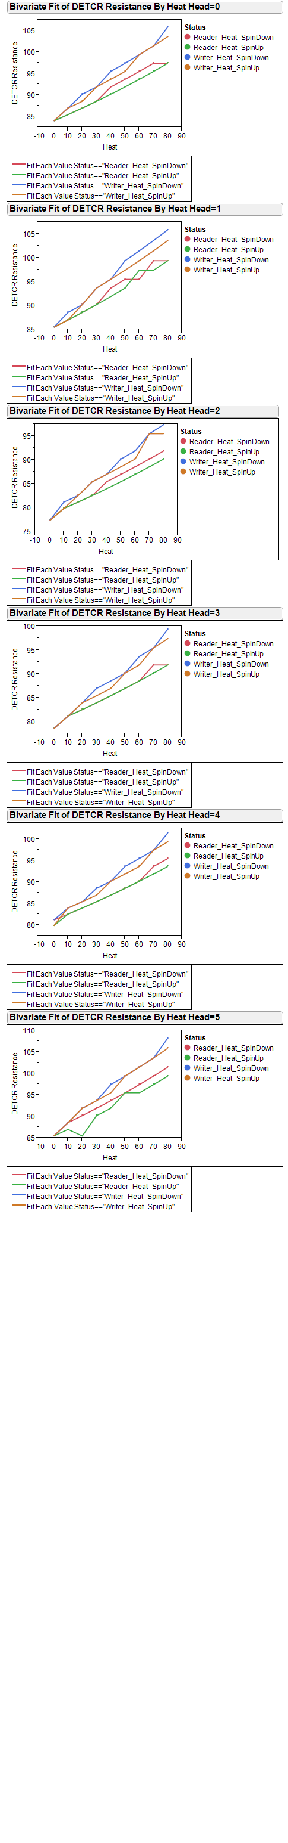
DETCR Resistance vs. heat while head is on RAMP w/o drive spin up
There is almost no difference of DETCR Resistance w/o drive spin up;
Writer heat showed higher impact to DETCR Resistance than that of reader heat;

Slide 8
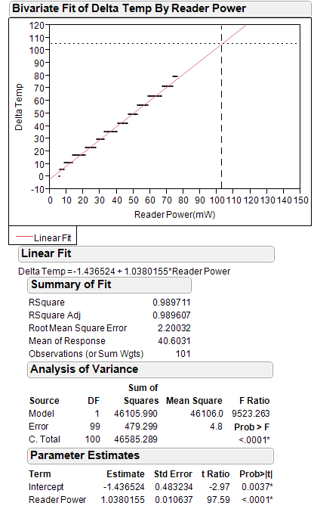
Delta temp vs. DETCR resistance change
105C
Delta temp = current – baseline (Power = 5.6mW , reader heat =0)
Enviorment temp ~25C;
Baseline temp from T172 inside of drive is 30C without heating;
when head DLC temp is 135C, the delta temp is ~105C, then we can apply ~103mW reader heat power to reach 135C DLC temp;
If based on theory modling from RHO, to reach 135C, we can only apply ~60mW;
103mW
Preamp
VTCR= 42.981 + 8.957*N
ITCR=13.14*preampin(17)
RTCR=VTCR/ITCR

Slide 9
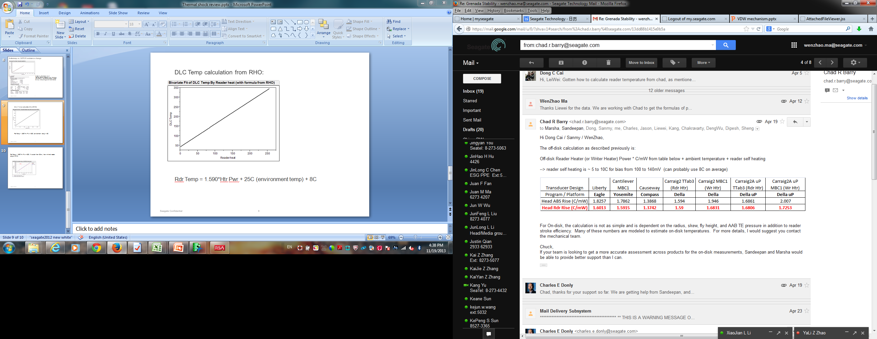
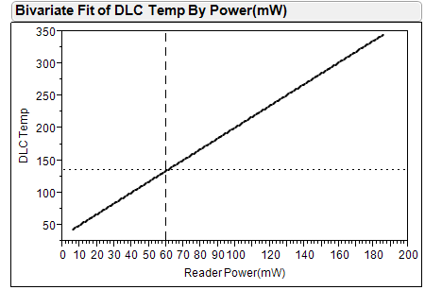
DLC Temp calculation from RHO:
Max DLC temp of 135C
~60 mW reader power
Rdr Temp = 1.590*Htr Pwr + 25C (environment temp) + 8C (reader self heating)
LSI8834
PHeat(mW) = 5.2 + 0.706 × RDHT(DAC)

