Slide 1
Comprehensive Data Analysis and Model Development for Income Prediction
Utilizing Random Forest and XGBoost Algorithms Course: Chemeng_787_Machine Learning: Classification Models Instructor & Faculty : Afzali, Prof. Sayyed Faridoddin Name: Hossain, Al Jubair (hossa27 - 400487352)

Slide 2
Introduction
The dataset used in this model was extracted from the Census bureau database by Ronny Kohavi and Barry Becker (Data Mining and Visualization, Silicon Graphics).
In this code, we perform a comprehensive analysis to predict income levels based on demographic features using machine learning techniques. The dataset is loaded, thoroughly explored, and preprocessed. Initial insights into data distribution and relationships between variables are visualized. We discuss the rationale

Slide 3
Data Loading and Initial Analysis
Libraries such as pandas, seaborn, numpy, and matplotlib are imported.
The dataset is loaded from a CSV file ("adult.csv"). Null values and data types are checked using dataset.isnull().sum() and dataset.dtypes.
The first few rows of the dataset are displayed using dataset.head().

Slide 4
Data Preprocessing
Rows containing '?' are removed, and the 'income' column is labeled as 0 or 1.
The decision to drop 'education' in favor of 'education.num' and 'marital.status' in favor of 'relationship' is discussed.

Slide 5
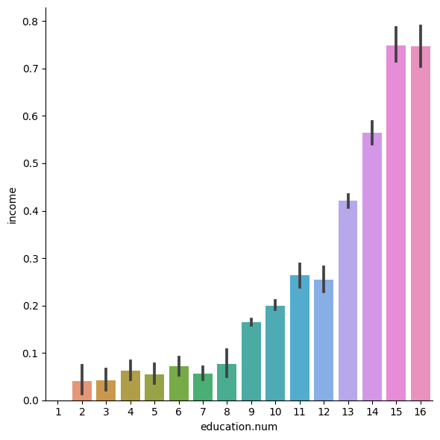

Slide 6
Exploratory Data Analysis (EDA)
Visualizations are created to explore the relationship between 'education.num' and 'income’.
A count plot is used to show the distribution of people across different native countries.
Similar plots are generated for 'marital.status' and 'relationship', highlighting their similarities.

Slide 7
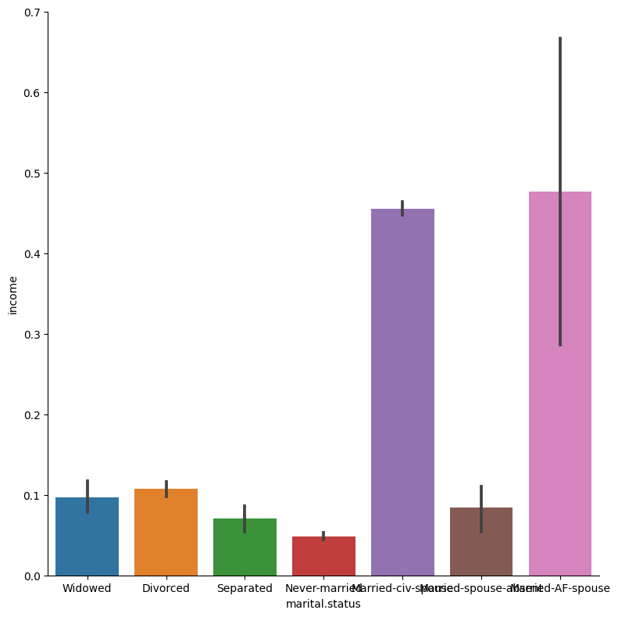

Slide 8
Feature Engineering
The 'marital.status' values are simplified to 'Single' and 'Married’.
Label encoding is applied to categorical columns.
A heatmap of the correlation matrix is visualized to identify highly correlated features.

Slide 9
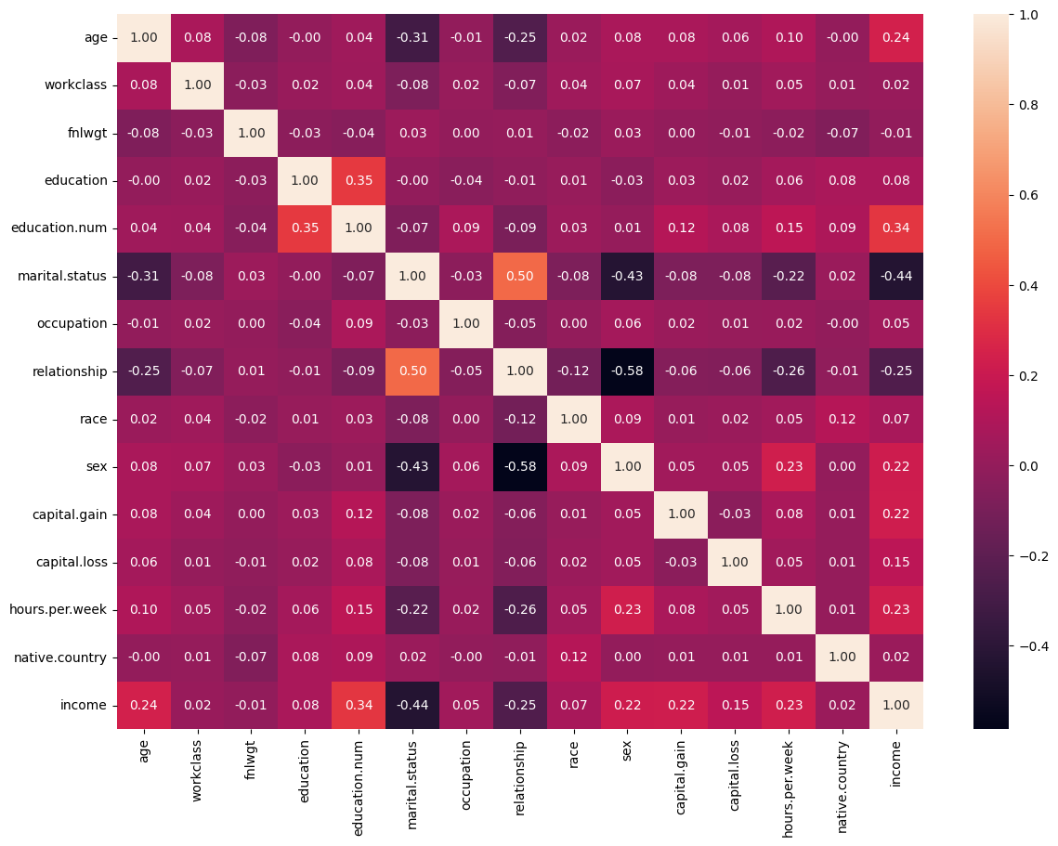

Slide 10
Model Selection and Evaluation
Four classifiers (Gaussian Naive Bayes, Decision Tree, Random Forest, Logistic Regression) are imported.
Cross-validation scores for each model are calculated using the training data.
The Random Forest model is chosen due to its robustness and less sensitivity.

Slide 11
Model Tuning (Grid Search)
The grid search method is employed for hyperparameter tuning in the Random Forest model.
The best parameters obtained are printed, and their impact on accuracy is discussed.
The grid search process is commented out due to its time-consuming nature.

Slide 12
Final Random Forest Model
The Random Forest model is trained with the tuned hyperparameters.
Predictions are made on the test set, and accuracy is evaluated.
The accuracy achieved is printed.

Slide 13
XGBoost Model
XGBoost is introduced as a boosting algorithm, and its installation is covered.
The dataset is converted into DMatrix format, and Bayesian optimization is discussed for hyperparameter tuning.
RandomizedSearchCV is used to find the best hyperparameters for the XGBoost model.

Slide 14
Conclusion and Future Work
The final XGBoost model is trained with tuned hyperparameters and rounds determined through cross-validation.
Predictions are made on the test set, and accuracy is evaluated.
The best hyperparameters and accuracy are printed.
The report concludes by summarizing key findings and suggesting potential avenues for future work.

