Slide 1
CSE110
Introduction to Computers, Programs, and Java
1

Slide 2
Theory and Lab
Theory: 3.0
Laboratory: 1.5
Total: 4.5

Slide 3
Assessment Scheme
Class Participation 5
Class Test/Quizzes 10
Midterm Exam – I 15
Midterm Exam –II 17
Final Exam 20
Laboratory Experiments, Exam, and Lab Project 33

Slide 4
Text Books
Text Book:
Y. Daniel Liang, Introduction to Java Programming, Comprehensive Version, 10th edition, Pearson (2015)
Reference Book:
  Walter Savitch, Absolute Java, Pearson (5th edition)
  Bert Bates and Kathy Sierra, Head First Java, O’Reilly Media (2nd edition)
  Paul Deitel and Harvey Deitel, Java How to Program, Prentice Hall (9th edition)
  Herbert Schildt, Java: The Complete Reference, 10th edition, McGraw-Hill Education (2017)
Software/Tools:
Java Development Kit (JDK 1.8) https://www.oracle.com/technetwork/java/javase/downloads/jdk8-downloads-2133151.html
Any Integrated Development Environment (IDE) supporting Java preferably Eclipse, NetBeans

Slide 5
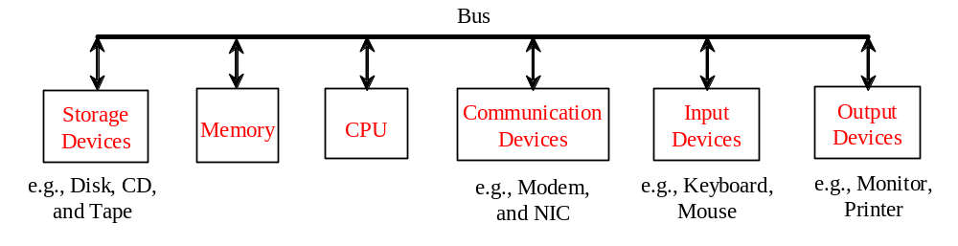
What is a Computer?
A computer consists of a CPU, memory, hard disk, floppy disk, monitor, printer, and communication devices.

Slide 6
CPU
The central processing unit (CPU) is the brain of a computer. It retrieves instructions from memory and executes them. The CPU speed is measured in megahertz (MHz), with 1 megahertz equaling 1 million pulses per second. The speed of the CPU has been improved continuously. If you buy a PC now, you can get an Intel Pentium 4 Processor at 3 gigahertz (1 gigahertz is 1000 megahertz).

Slide 7
Memory
Memory is to store data and program instructions for CPU to execute. A memory unit is an ordered sequence of bytes, each holds eight bits. A program and its data must be brought to memory before they can be executed. A memory byte is never empty, but its initial content may be meaningless to your program. The current content of a memory byte is lost whenever new information is placed in it.

Slide 8

How Data is Stored?
Data of various kinds, such as numbers, characters, and strings, are encoded as a series of bits (zeros and ones). Computers use zeros and ones because digital devices have two stable states, which are referred to as zero and one by convention. The programmers need not to be concerned about the encoding and decoding of data, which is performed automatically by the system based on the encoding scheme. The encoding scheme varies. For example, character ‘J’ is represented by 01001010 in one byte. A small number such as three can be stored in a single byte. If computer needs to store a large number that cannot fit into a single byte, it uses a number of adjacent bytes. No two data can share or split a same byte. A byte is the minimum storage unit.

Slide 9
Storage Devices
Memory is volatile, because information is lost when the power is off. Programs and data are permanently stored on storage devices and are moved to memory when the computer actually uses them. There are three main types of storage devices: Disk drives (hard disks and floppy disks), CD drives (CD-R and CD-RW), and Tape drives.

Slide 10
Output Devices: Monitor
The monitor displays information (text and graphics). The resolution and dot pitch determine the quality of the display.

Slide 11
Programs
Computer programs, known as software, are instructions to the computer.
You tell a computer what to do through programs. Without programs, a computer is an empty machine. Computers do not understand human languages, so you need to use computer languages to communicate with them.
Programs are written using programming languages.

Slide 12
Programming Languages
Machine Language Assembly Language High-Level Language
Machine language is a set of primitive instructions built into every computer. The instructions are in the form of binary code, so you have to enter binary codes for various instructions. Program with native machine language is a tedious process. Moreover the programs are highly difficult to read and modify. For example, to add two numbers, you might write an instruction in binary like this:
  1101101010011010

Slide 13
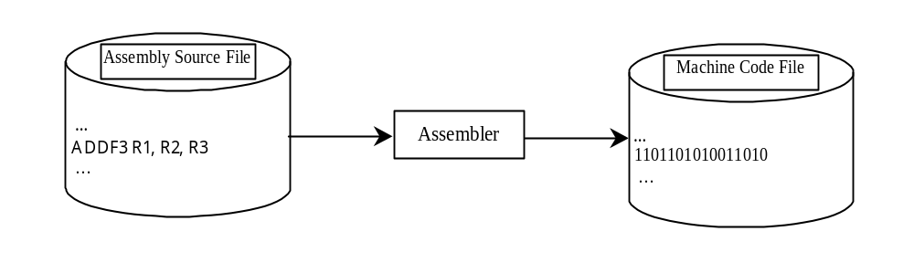
Programming Languages
Machine Language Assembly Language High-Level Language
Assembly languages were developed to make programming easy. Since the computer cannot understand assembly language, however, a program called assembler is used to convert assembly language programs into machine code. For example, to add two numbers, you might write an instruction in assembly code like this:
ADDF3 R1, R2, R3

Slide 14
Programming Languages
Machine Language Assembly Language High-Level Language
The high-level languages are English-like and easy to learn and program. For example, the following is a high-level language statement that computes the area of a circle with radius 5:
area = 5 * 5 * 3.1415;

Slide 15

Popular High-Level Languages

Slide 16
Interpreting/Compiling Source Code
A program written in a high-level language is called a source program or source code. Because a computer cannot understand a source program, a source program must be translated into machine code for execution. The translation can be done using another programming tool called an interpreter or a compiler.

Slide 17
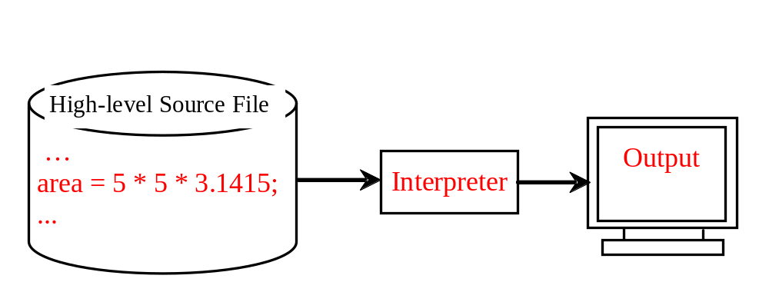
Interpreting Source Code
An interpreter reads one statement from the source code, translates it to the machine code or virtual machine code, and then executes it right away, as shown in the following figure. Note that a statement from the source code may be translated into several machine instructions.

Slide 18
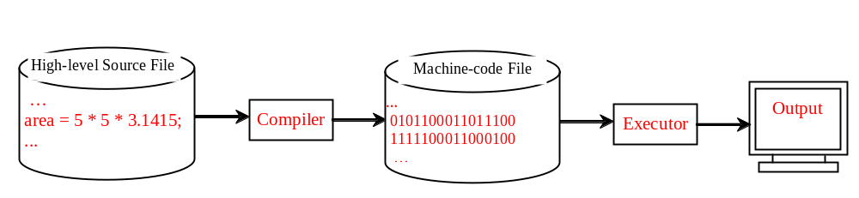
Compiling Source Code
A compiler translates the entire source code into a machine-code file, and the machine-code file is then executed, as shown in the following figure.

Slide 19
Why Java?
The answer is that Java enables users to develop and deploy applications on the Internet for servers, desktop computers, and small hand-held devices. The future of computing is being profoundly influenced by the Internet, and Java promises to remain a big part of that future. Java is the Internet programming language.
Java is a general purpose programming language.
Java is the Internet programming language.

Slide 20
Java, Web, and Beyond
Java can be used to develop Web applications.
Java Applets
Java Web Applications
Java can also be used to develop applications for hand-held devices such as cell phones

Slide 21
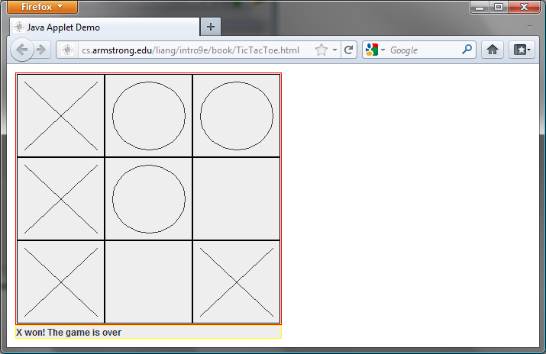
Examples of Java’s Versatility (Applets)

Slide 22
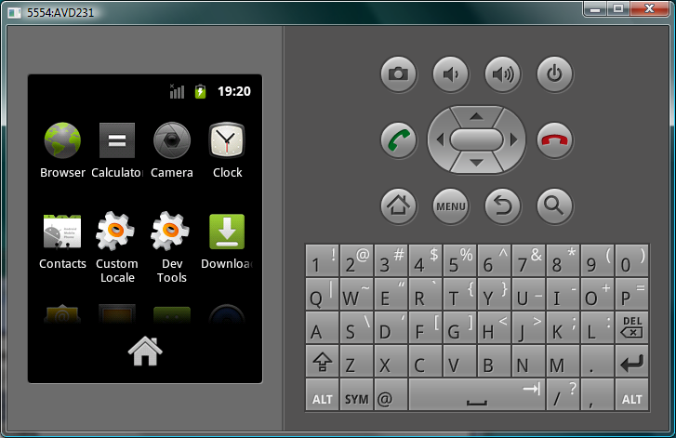
PDA and Cell Phone

Slide 23
Java’s History
JAVA was developed by Sun Microsystems Inc in 1991
later acquired by Oracle Corporation 2010.
It was developed by James Gosling and Patrick Naughton.
It is a simple programming language.
Writing, compiling and debugging a program is easy in java.
It helps to create modular programs and reusable code.

Slide 24
Phases of program execution
1) Writing of the program is of course done by java programmer like you and me.
2) Compilation of program is done by javac compiler, javac is the primary java compiler included in java development kit (JDK). It takes java program as input and generates java bytecode as output.
3) In third phase, JVM executes the bytecode generated by compiler. This is called program run phase.
So, now that we understood that the primary function of JVM is to execute the bytecode produced by compiler. Each operating system has different JVM, however the output they produce after execution of bytecode is same across all operating systems. That is why we call java as platform independent language

Slide 25
Java Virtual Machine (JVM)
Java Virtual Machine (JVM) is a virtual machine that resides in the real machine (your computer) and the machine language for JVM is byte code.
This makes it easier for compiler as it has to generate byte code for JVM rather than different machine code for each type of machine.
JVM executes the byte code generated by compiler and produce output. JVM is the one that makes java platform independent.

Slide 26
Java Terminology
bytecode
javac compiler of JDK compiles the java source code into bytecode so that it can be executed by JVM. The bytecode is saved in a .class file by compiler.
Java Development Kit(JDK)
While explaining JVM and bytecode, I have used the term JDK. Let’s discuss about it. As the name suggests this is complete java development kit that includes JRE (Java Runtime Environment), compilers and various tools like JavaDoc, Java debugger etc.
In order to create, compile and run Java program you would need JDK installed on your computer.
Java Runtime Environment(JRE)
JRE is a part of JDK which means that JDK includes JRE. When you have JRE installed on your system, you can run a java program however you won’t be able to compile it. JRE includes JVM, browser plugins and applets support. When you only need to run a java program on your computer, you would only need JRE.

Slide 27
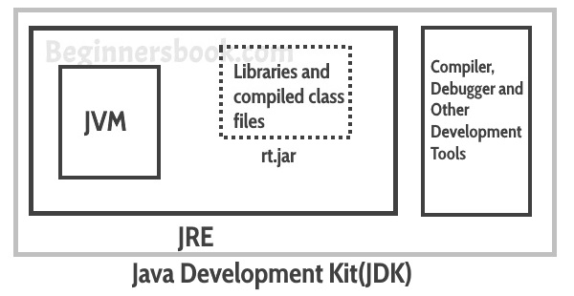

Slide 28
JDK Versions
JDK 1.02 (1995)
JDK 1.1 (1996)
JDK 1.2 (1998)
JDK 1.3 (2000)
JDK 1.4 (2002)
JDK 1.5 (2004) a. k. a. JDK 5 or Java 5
JDK 1.6 (2006) a. k. a. JDK 6 or Java 6
JDK 1.7 (2011) a. k. a. JDK 7 or Java 7

Slide 29
JDK Editions
Java Standard Edition (J2SE)
  J2SE can be used to develop client-side standalone applications or applets.
Java Enterprise Edition (J2EE)
  J2EE can be used to develop server-side applications such as Java servlets, Java ServerPages, and Java ServerFaces.
Java Micro Edition (J2ME).
  J2ME can be used to develop applications for mobile devices such as cell phones.

Slide 30
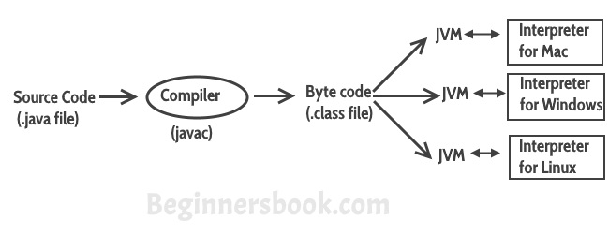
Program Execution
Java Virtual Machine (JVM) is a virtual machine that resides in the real machine (your computer) and the machine language for JVM is byte code.
JVM is the one that makes java platform independent.
Each operating system has different JVM, however the output they produce after execution of byte code is same across all operating systems.

Slide 31
Main Features of JAVA
Java is a platform independent language
Compiler(javac) converts source code (.java file) to the byte code(.class file). As mentioned above, JVM executes the bytecode produced by compiler. This byte code can run on any platform such as Windows, Linux, Mac OS etc. Which means a program that is compiled on windows can run on Linux and vice-versa. Each operating system has different JVM, however the output they produce after execution of bytecode is same across all operating systems. That is why we call java as platform independent language.

Slide 32
Main Features of JAVA
Java is an Object Oriented language
Object oriented programming is a way of organizing programs as collection of objects, each of which represents an instance of a class.
4 main concepts of Object Oriented programming are:
Abstraction
Encapsulation
Inheritance
Polymorphism

Slide 33
Main Features of JAVA
Simple
Java is considered as one of simple language because it does not have complex features like Operator overloading, Multiple inheritance, pointers and Explicit memory allocation.
Robust Language
Robust means reliable. Java programming language is developed in a way that puts a lot of emphasis on early checking for possible errors, that’s why java compiler is able to detect errors that are not easy to detect in other programming languages. The main features of java that makes it robust are garbage collection, Exception Handling and memory allocation.

Slide 34
Main Features of JAVA
Secure
We don’t have pointers and we cannot access out of bound arrays (you get ArrayIndexOutOfBoundsException if you try to do so) in java. That’s why several security flaws like stack corruption or buffer overflow is impossible to exploit in Java.
Java is distributed
Using java programming language we can create distributed applications. RMI(Remote Method Invocation) and EJB(Enterprise Java Beans) are used for creating distributed applications in java. In simple words: The java programs can be distributed on more than one systems that are connected to each other using internet connection. Objects on one JVM (java virtual machine) can execute procedures on a remote JVM.
Multithreading
Java supports multithreading. Multithreading is a Java feature that allows concurrent execution of two or more parts of a program for maximum utilisation of CPU.
Portable
As discussed above, java code that is written on one machine can run on another machine. The platform independent byte code can be carried to any platform for execution that makes java code portable.

Slide 35
Popular Java IDEs
NetBeans
Eclipse

Slide 36
A Simple Java Program
Listing 1.1
//This program prints Welcome to Java!
public class Welcome {
public static void main(String[] args) {
System.out.println("Welcome to Java!");
}
}

Slide 37

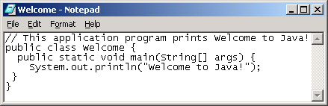
Creating and Editing Using NotePad
To use NotePad, type
  notepad Welcome.java
from the DOS prompt.

Slide 38

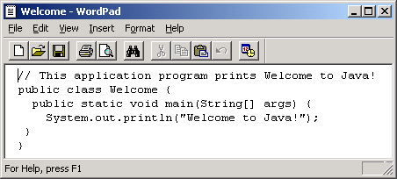
Creating and Editing Using WordPad
To use WordPad, type
  write Welcome.java
from the DOS prompt.

Slide 39
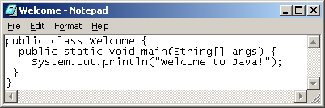
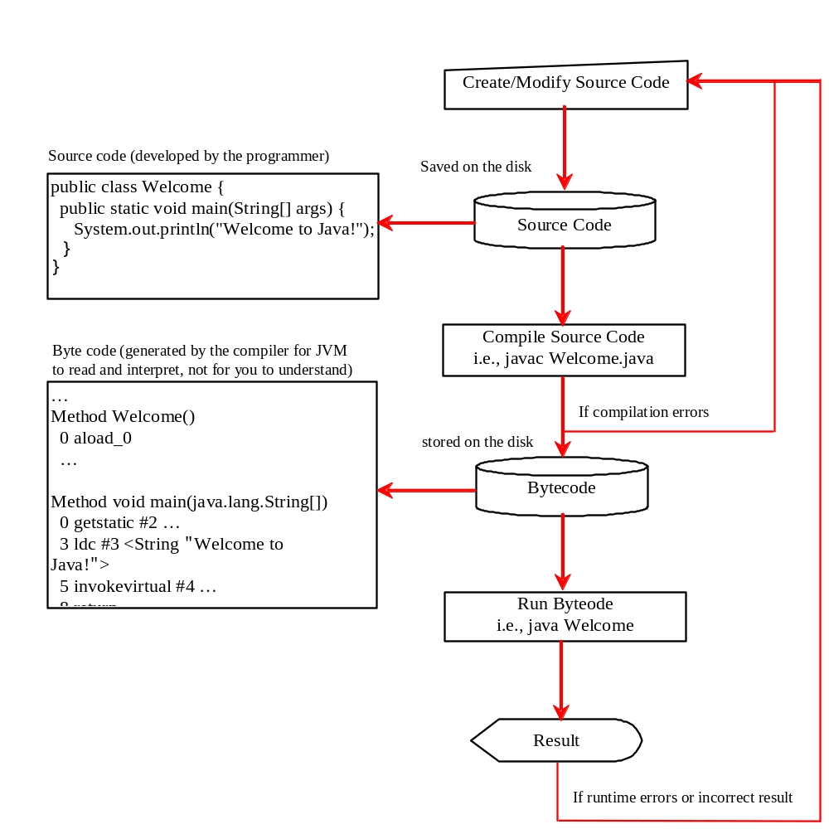
Creating, Compiling, and Running Programs

Slide 40
Trace a Program Execution
Enter main method
//This program prints Welcome to Java!
public class Welcome {
public static void main(String[] args) {
System.out.println("Welcome to Java!");
}
}

Slide 41
animation
Trace a Program Execution
Execute statement
//This program prints Welcome to Java!
public class Welcome {
public static void main(String[] args) {
System.out.println("Welcome to Java!");
}
}

Slide 42

animation
Trace a Program Execution
//This program prints Welcome to Java!
public class Welcome {
public static void main(String[] args) {
System.out.println("Welcome to Java!");
}
}
print a message to the console

Slide 43

Companion Website
Compiling and Running Java from the Command Window
Set path to JDK bin directory
  set path=c:\Program Files\java\jdk1.6.0\bin
Set classpath to include the current directory
  set classpath=.
Compile
  javac Welcome.java
Run
  java Welcome

Slide 44

Compiling and Running Java from TextPad
Companion Website

Slide 45
Anatomy of a Java Program
Class name
Main method
Statements
Statement terminator
Reserved words
Comments
Blocks

Slide 46
Class Name
Every Java program must have at least one class. Each class has a name. By convention, class names start with an uppercase letter. In this example, the class name is Welcome.
//This program prints Welcome to Java!
public class Welcome {
public static void main(String[] args) {
System.out.println("Welcome to Java!");
}
}

Slide 47
Main Method
Line 2 defines the main method. In order to run a class, the class must contain a method named main. The program is executed from the main method.
//This program prints Welcome to Java!
public class Welcome {
public static void main(String[] args) {
System.out.println("Welcome to Java!");
}
}

Slide 48
Statement
A statement represents an action or a sequence of actions. The statement System.out.println("Welcome to Java!") in the program in Listing 1.1 is a statement to display the greeting "Welcome to Java!“.
//This program prints Welcome to Java!
public class Welcome {
public static void main(String[] args) {
System.out.println("Welcome to Java!");
}
}

Slide 49
Statement Terminator
Every statement in Java ends with a semicolon (;).
//This program prints Welcome to Java!
public class Welcome {
public static void main(String[] args) {
System.out.println("Welcome to Java!");
}
}

Slide 50
Reserved words
Reserved words or keywords are words that have a specific meaning to the compiler and cannot be used for other purposes in the program. For example, when the compiler sees the word class, it understands that the word after class is the name for the class.
//This program prints Welcome to Java!
public class Welcome {
public static void main(String[] args) {
System.out.println("Welcome to Java!");
}
}

Slide 51

Blocks
A pair of braces in a program forms a block that groups components of a program.

Slide 52

Special Symbols

Slide 53
{ … }
// This program prints Welcome to Java!
public class Welcome {
public static void main(String[] args) {
System.out.println("Welcome to Java!");
}
}

Slide 54
( … )
// This program prints Welcome to Java!
public class Welcome {
public static void main(String[] args) {
System.out.println("Welcome to Java!");
}
}

Slide 55
;
// This program prints Welcome to Java!
public class Welcome {
public static void main(String[] args) {
System.out.println("Welcome to Java!");
}
}

Slide 56
// …
// This program prints Welcome to Java!
public class Welcome {
public static void main(String[] args) {
System.out.println("Welcome to Java!");
}
}

Slide 57
" … "
// This program prints Welcome to Java!
public class Welcome {
public static void main(String[] args) {
System.out.println("Welcome to Java!");
}
}

Slide 58
Programming Style and Documentation
Appropriate Comments
Naming Conventions
Proper Indentation and Spacing Lines
Block Styles

Slide 59
Appropriate Comments
Include a summary at the beginning of the program to explain what the program does, its key features, its supporting data structures, and any unique techniques it uses.
Include your name, class section, instructor, date, and a brief description at the beginning of the program.

Slide 60
Naming Conventions
Choose meaningful and descriptive names.
Class names:
  Capitalize the first letter of each word in the name. For example, the class name ComputeExpression.

Slide 61
Proper Indentation and Spacing
Indentation
  Indent two spaces.
Spacing
  Use blank line to separate segments of the code.

Slide 62

Block Styles
Use end-of-line style for braces.

Slide 63
Programming Errors
Syntax Errors
  Detected by the compiler
Runtime Errors
  Causes the program to abort
Logic Errors
  Produces incorrect result

Slide 64
Syntax Errors
public class ShowSyntaxErrors {
public static main(String[] args) {
System.out.println("Welcome to Java);
}
}

Slide 65
Runtime Errors
public class ShowRuntimeErrors {
public static void main(String[] args) {
System.out.println(1 / 0);
}
}

Slide 66
Logic Errors
public class ShowLogicErrors {
public static void main(String[] args) {
System.out.println("Celsius 35 is Fahrenheit degree ");
System.out.println((9 / 5) * 35 + 32);
}
}

