Slide 1


Team Details
  Team name: [Your team name]
  Team leader name: [Team leader name]
  Problem Statement: Growing food & nutrition brands lose lakhs a month to stockouts and expired stock because supplier delays and demand spikes arrive as unstructured messages, and limited cash forces hard buy / expedite / discount trade-offs.
Inventory Rescue

Slide 2
Brief about the idea
“With ₹10 lakh available this month, what should we buy, expedite, discount or defer, and when?”
The problem
Mid-size and large D2C / FMCG brands (₹50 crore+ a year) still plan rescues on spreadsheets, email and WhatsApp.
Supplier delays, influencer-driven spikes and expiring lots arrive as unstructured messages.
Cash is tight, so hero SKUs stock out while slow movers expire and get written off.
Our solution
Generative AI reads the messages (English, Hindi, Hinglish), turns text-only news into forecast adjustments and answers “why / what if” questions with planner tools.
A deterministic simulator and optimiser decide quantities and money; every LLM output is validated.
The operator confirms signals, picks when to spend and exports POs.
The outcome
One ranked action list within budget, plus four ways to time the spend (commit now, staggered, reserve, lean).
Demo brand (₹4.3 crore revenue a month): ₹3.8 lakh / month lower simulated loss than a static reorder rule and ₹1.8 lakh than a tuned one, better in 120 of 120 simulated futures.
Keeping 30% in reserve for weekly reviews: a further ₹0.9–1.1 lakh in 9–10 of 10 futures.
Target users: supply-chain and operations teams of mid-size to large FMCG / D2C brands across JAPAC. All values are simulated on seeded data and will be validated in pilots.

Slide 3
Opportunities
How is it different from existing ideas?
Inventory apps / ERPs track stock but use static reorder points and stated lead times, and ignore supplier or campaign messages.
Enterprise demand planners forecast well but take months to roll out and still ignore the inbox; the rescue decisions happen in spreadsheets.
Generic AI chatbots give advice without arithmetic and can invent numbers.
Ours pairs LLM understanding with budget-aware optimisation and a built-in proof of value.
How will it solve the problem?
Turns messages into typed events with verbatim evidence; a human confirms.
Hybrid forecasts: a statistical base, with the LLM tuning event effects that only exist as text.
Supplier delay history gives early / typical / late arrival cases.
Picks the best action mix under one cash budget, tests it on 120 simulated futures and shows when to spend.
USP of the proposed solution
One cash budget across buy, expedite, markdown and defer, and over time (staggered buys).
Trust by design: the LLM proposes, code validates; every number in an answer is checked.
Measured, not claimed: extraction gold set, forecast backtest, Monte Carlo, 11-model comparison.
Built for Google Cloud: Gemini API, Cloud Run, Cloud SQL, Cloud Storage.
Why now: LLMs can finally read messy supplier and campaign messages well enough, when wrapped in validation, to feed real planning maths, and run it on pay-per-use cloud for a fraction of what it saves.

Slide 4
List of features offered by the solution
1
Signal Inbox
2
Hybrid forecasts
3
Planning assistant
4
Grounded explanations
5
Supply & service level
Emails, WhatsApp notes, Hindi/Hinglish → typed delay, spike, drop and expiry events with verbatim quotes. A human confirms each one.
Statistical base (Holt-Winters / Croston). The LLM tunes event effects within bounds, including news that exists only as text.
Ask “why” or “what if” in plain language. The model calls 10 read-only planner tools; every number is checked.
Plan narrative and what-if parsing that may only use numbers and IDs from the plan; else a labelled template.
Supplier delay cases (early / typical / late); hero SKUs carry a goodwill penalty per unit short.
6
Budgeted planner
7
Plan options
8
Robustness & proof
9
Overrides & plan diff
10
Approve & export
Buy, expedite, markdown (with cannibalisation) or defer; an exact knapsack picks the best set under the cash budget.
Commit now, staggered buys, keep a reserve or lean, compared with weekly re-planning in calm and shocked futures.
120 Monte Carlo futures vs static and tuned reorder rules; budget frontier; forecast backtest.
Edit quantities or skip lines; the plan is re-scored within budget and each re-plan lists what changed.
Alerts for stockout, expiry, overstock and suppliers; approve to export PO and markdown CSVs.
Blue = generative AI · Green = deterministic engine · Orange = operator workflow

Slide 5
Process flow diagram
1
Ingest
Messages, sales CSV, POs, lots, receipts
2
Extract signals
LLM: delay · spike · drop · expiry
3
Human review
Confirm or reject each event
4
Forecast
Statistical base; LLM tunes event effects
5
Simulate & optimise
Knapsack under budget; 4 timing options
6
Explain & stress-test
Cited narrative; 120 simulated futures
7
Approve & export
PO and markdown CSVs
✓ Size limits; a CSV is rejected if any row is invalid
✓ Schema, known SKUs and verbatim-quote checks
✓ Only confirmed events change forecasts
✓ Bounded multipliers with stated drivers; else statistical
✓ Deterministic; the LLM never sets quantities
✓ Numbers and IDs must exist in the plan JSON
✓ Every LLM call is logged with an input hash
Generative AI (validated)
Deterministic engine
Human in the loop
Data ingestion
↻ Weekly reviews (days 0 / 7 / 14 / 21): realised sales re-forecast → remaining and scheduled cash re-planned → staggered tranches re-confirmed, resized or redirected
Ask the assistant: “What if SUP-04 slips another week?” → the model calls read-only planner and simulator tools → answer with a tool trace; every number checked against tool results

Slide 6
Wireframes / mock diagrams of the proposed solution
Recovery Plan
Signal Inbox
SKU Detail
Scenario & Value
Budget ₹ [10,00,000]
Re-plan
delay
spike
expiry
SKU-019 · Peanut Butter 1kg
What if SUP-04 delays 7 days?
Run
Cash
Loss
Savings
Risk
Paste supplier / campaign message…
forecast band
Current plan
Adapted plan
Why this plan ✓ LLM (validated)
Scorecard vs baseline
Extract signals
EV-2 Demand spike ×3
“…expect roughly 3x demand…”
Forecast drivers
Ranked actions
Confirm
Reject
buy
buy
EV-1 Supplier delay +9 d
“…will be delayed by 9 days.”
Sensitivity · Backtest
Lots & expiry
Supplier metrics
markdown
defer
Confirm
Reject
Approve & export CSVs
Run backtest
1. Decide & approve
2. Capture signals
3. Inspect a SKU
4. Stress-test value

Slide 7
Architecture diagram of the proposed solution
Ops manager / founder
browser
FastAPI backend (Python 3.12) · GCP: Cloud Run + Secret Manager
Adapters (local ➜ Google Cloud)
API routes · background jobs (job table) · alerts · audit log
LLM
Gemini API (AI Studio key) ➜ Secret Manager key / Vertex AI
Deterministic decision engine
React + TypeScript SPA
Vite · Recharts
Recovery Plan
Signal Inbox
SKU Detail
Scenario & Value
Assistant
GCP: served by the same Cloud Run service
Hybrid forecasts (Holt-Winters / Croston)
Simulator (FEFO lots, delay cases)
Planner (multi-choice knapsack)
Operational DB
SQLite file (no server) ➜ Cloud SQL for PostgreSQL
Plan options & weekly re-plan
Monte Carlo robustness & baselines
Scenarios, frontier & backtest
Files, uploads & exports
local var/ folder ➜ Cloud Storage
Generative AI layer: Gemini API (AI Studio key) or Gemini on Vertex AI
JSON tasks with schema validation and one repair retry · tool-calling agent · cache · call log
REST JSON
Hosting & secrets
uvicorn + Vite, .env ➜ Cloud Run + Secret Manager
Signal extraction
verbatim evidence
Forecast event tuning
bounded multipliers
Planning assistant
10 tools, numbers checked
Explanation & what-if
no new numbers
Build & deploy
deploy.sh (no local Docker) ➜ Cloud Build + Artifact Registry

Slide 8
Technologies to be used in the solution
Layer | Prototype (built and running) | Google Cloud (production)
Frontend | React 19, TypeScript, Vite, Recharts | Built into the API image, served by Cloud Run
Backend API | Python 3.12, FastAPI, Pydantic v2, SQLAlchemy 2, Uvicorn | Cloud Run, Secret Manager
Generative AI | google-genai, gemini-3.5-flash-lite via the Gemini API; validated JSON tasks; tool-calling assistant | Gemini API (key in Secret Manager) or Gemini on Vertex AI
Decision engine | Holt-Winters and Croston/SBA in NumPy; stochastic simulator; exact knapsack | Same code in Cloud Run (CPU always allocated)
Data & files | SQLite (no database server); local folder for uploads, exports, forecast cache | Cloud SQL for PostgreSQL, Cloud Storage
Evaluation | Extraction gold set, rolling backtest, Monte Carlo, 11-model comparison | Same jobs; CSV exports ready for BigQuery
Quality & delivery | pytest (160 tests), oxlint, strict TypeScript, LLM call log | Cloud Build → Artifact Registry → Cloud Run

Slide 9
Estimated implementation cost
Component (one brand, as deploy.sh sets it up) | US$ / month
Cloud Run: API + UI, 2 vCPU / 2 GiB, one always-on instance | 90 – 105
Cloud SQL for PostgreSQL 16: db-g1-small, 10 GB | 25 – 40
Gemini 3.5 Flash-Lite (Gemini API): ~10M input + 1M output tokens | 5 – 10
Cloud Storage, Secret Manager, Artifact Registry, Cloud Build | < 3
Total running cost, single tenant | ≈ 120 – 160
Lean pilot: 1 vCPU / 1 GiB, background jobs on Cloud Tasks, scale to zero | ≈ 35 – 55
Usage assumptions
Daily re-forecast of 30 SKUs (≈900 forecast calls a month).
≈300 plans, 600 messages and 1,000 assistant questions a month.
Measured LLM outputs are small: 0.2–2.3k characters per call.
Cost vs value
Dedicated deployment ≈ ₹10.5k–14k a month (at ₹88 / US$).
Simulated loss avoided for the demo brand (₹4.3 crore revenue a month): ₹1.6–4.0 lakh a month.
≈ 11–38× the running cost. At a twentieth of this size (≈ ₹2.6 crore a year) a dedicated instance only breaks even, so small brands should share one.
Indicative list prices (asia-south1); confirm with the Google Cloud Pricing Calculator. Excludes team effort. Cost does not grow with revenue: a 300-SKU catalogue adds roughly US$ 50–90 of Gemini calls a month on the same servers. Smaller brands can share one multi-tenant deployment.

Slide 10
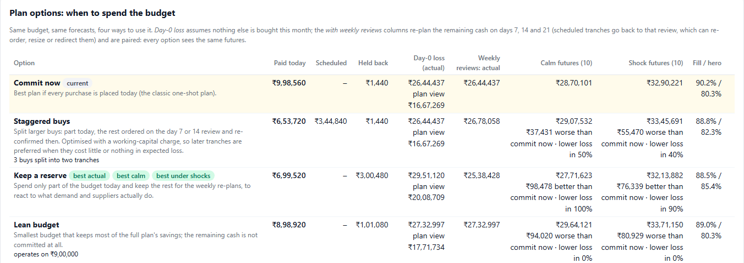
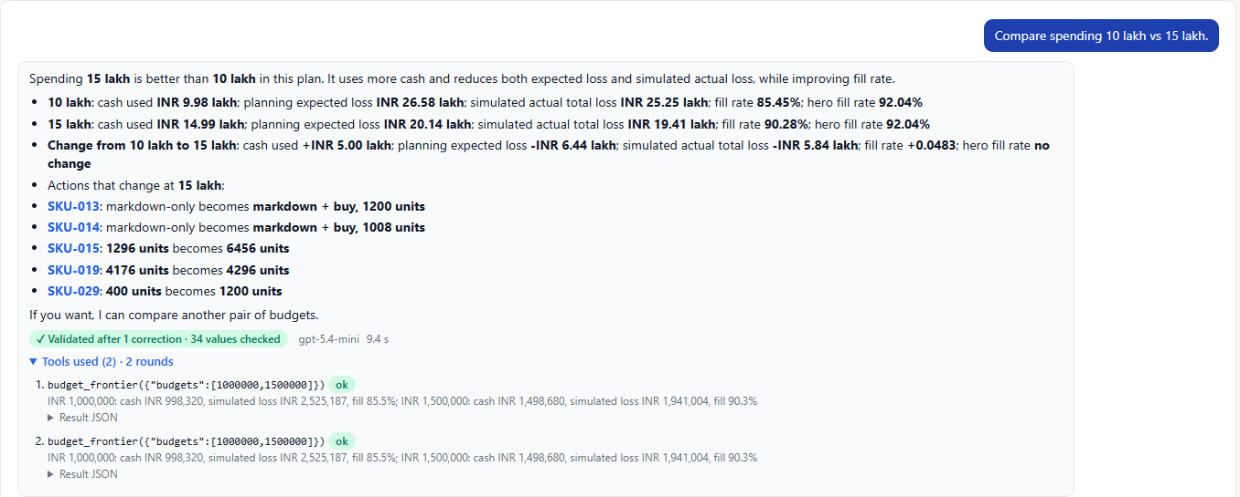
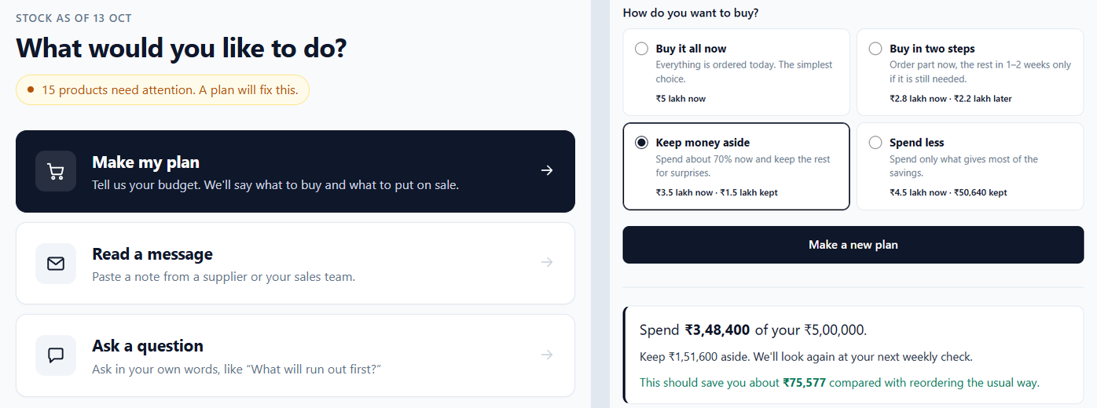
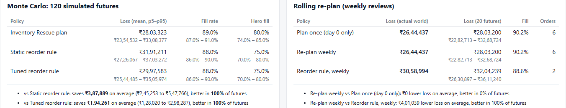
Snapshots of the prototype
Plan options: the same ₹10 lakh four ways, tested in calm and shocked futures
Planning assistant: “10 lakh vs 15 lakh?” answered from a planner tool; 34 values checked
Simple view (default): three big buttons; budget, then how to buy
Robustness: 120 simulated futures vs reorder rules; weekly re-planning

Slide 11
Prototype performance report / benchmarking
₹3.8 lakh / ₹1.8 lakh a month lower loss
Mean vs static / tuned reorder rule; better in 120 of 120 futures
30% reserve: ₹0.9–1.1 lakh further gain
Re-planned at weekly reviews; better in 10 / 10 calm and 9 / 10 shocked futures
Extraction F1 0.97 vs 0.65
LLM + validators vs keyword rules, 40 labelled messages; plans from LLM signals keep 100% of the gold-signal gain
Forecast WAPE 21.5% vs 23.0%
Hybrid vs statistical, 1,050 points (22.2% vs 23.9% on 16 text-only series)
Every policy starts from the same stock and budget and faces the same simulated demand and supplier delays. Fill rate 89.7% vs 88.6–88.8% for the rules; hero-SKU fill 80.3% vs 75.2%.
Engineering: 160 automated tests pass · 30 / 30 seed forecasts passed LLM validation · every LLM call logged with its status.
Assistant: 6 / 6 answers number-checked
5 on the first try, 1 after one repair; 3–10 s each (gemini-3.5-flash-lite)

Slide 12
Which LLM? The same evaluations on 11 models
Model | Extraction F1 | Messages correct | Signal value kept | Forecast WAPE (statistical) | Text-only WAPE (statistical) | Assistant checked (first try) | Assistant median
gemini-3.5-flash-lite (default) | 0.966 | 95.0% | 100% | 21.5% (23.0%) | 22.2% (23.9%) | 6/6 (5) | 4.0 s
claudesonnet4.5 | 1.000 | 100.0% | 100% | 20.9% (23.0%) | 19.0% (23.9%) | 5/6 (5) | 10.3 s
gpt-5 | 0.983 | 97.5% | 100% | 21.0% (23.2%) | 19.2% (23.9%) | 6/6 (6) | 30.4 s
gpt-5.1 | 0.983 | 97.5% | 100% | 20.9% (23.0%) | 19.6% (23.9%) | 6/6 (6) | 11.9 s
claudesonnet4.6 | 0.983 | 97.5% | 100% | 21.6% (23.0%) | 20.1% (23.9%) | 6/6 (5) | 10.3 s
qwen3.6-27b | 0.966 | 95.0% | 100% | 21.0% (23.0%) | 20.2% (23.9%) | 6/6 (5) | 8.8 s
claudeopus5 | 0.983 | 97.5% | 100% | 21.3% (23.0%) | 20.2% (23.9%) | 6/6 (4) | 12.3 s
gpt-5.6-luna | 0.983 | 97.5% | 100% | 21.2% (23.0%) | 20.3% (23.9%) | 6/6 (6) | 14.8 s
gpt-5.2 | 0.983 | 97.5% | 100% | 21.3% (23.0%) | 21.2% (23.9%) | 6/6 (6) | 8.4 s
gpt-5.3-chat | 0.983 | 97.5% | 100% | 21.5% (23.0%) | 21.6% (23.9%) | 0/6 (0) | –
gpt-5.4-mini | 0.968 | 95.0% | 100% | 21.5% (23.1%) | 21.9% (24.2%) | 6/6 (5) | 3.9 s
Every model beats the statistical forecast (by 1.7–4.9 pp on text-only series); extraction is near saturated (38–40 of 40 messages). gemini-3.5-flash-lite (Gemini API) is the default: as fast as the quickest model and 6 / 6 assistant answers checked; a stronger model could run the overnight forecasts.
Signal value kept: share of the gold-signal plan gain kept by plans built from the model's signals (found and fixed an end-date bug: −17% → 100%). gpt-5.3-chat's gateway rejects tool calls. Larger Gemini models need a paid key (free tier: 20 requests a day).

Slide 13
Additional details / future development
Product
Multi-warehouse and channel allocation (marketplace vs D2C).
Email / WhatsApp connectors and auto-drafted supplier follow-ups.
SAP, Unicommerce and Shopify connectors for stock and POs.
Plan for signal uncertainty: one misread day can move ₹1 lakh.
Learn event multipliers from realised outcomes.
Platform on Google Cloud
Go live on Cloud Run + Cloud SQL (scripted in deploy.sh).
Benchmark larger Gemini models on a paid key; route each task to its best model.
Background jobs on Cloud Tasks; multi-tenant auth via Identity Platform.
BigQuery ML forecasts as a second benchmark; Looker dashboards.
Validation & go-to-market
Pilot with 2–3 mid-size FMCG / D2C brands on their real data.
Measure realised savings against the simulated scorecard.
Grow the gold set with real, operator-labelled messages.
Pricing: subscription per SKU band, well below the savings.
Responsible AI: the LLM never sets quantities or money; every output is validated, labelled and logged, and signals need human confirmation.

Slide 14
Links
GitHub public repository
https://github.com/Xhahat/inventory-rescue
Demo video (3 minutes)
[Add demo video URL]
Final product link
[Add deployed URL] · runs locally at http://localhost:5173 (see README)

Slide 15


