Slide 1

Investigate and Implement KNN Classifier Team_Mariglen_Kejdjon
Kejdjon Cela Mariglen Xhelo
1439829 1439887
Evaluated by: Prof. Dr.Damir Dobric

Slide 2
Agenda
Introduction
K-Nearest Neighbors (KNN) Classifier
The Factor k
Hierarchical Temporal Memory (HTM)
Conclusion

Slide 3
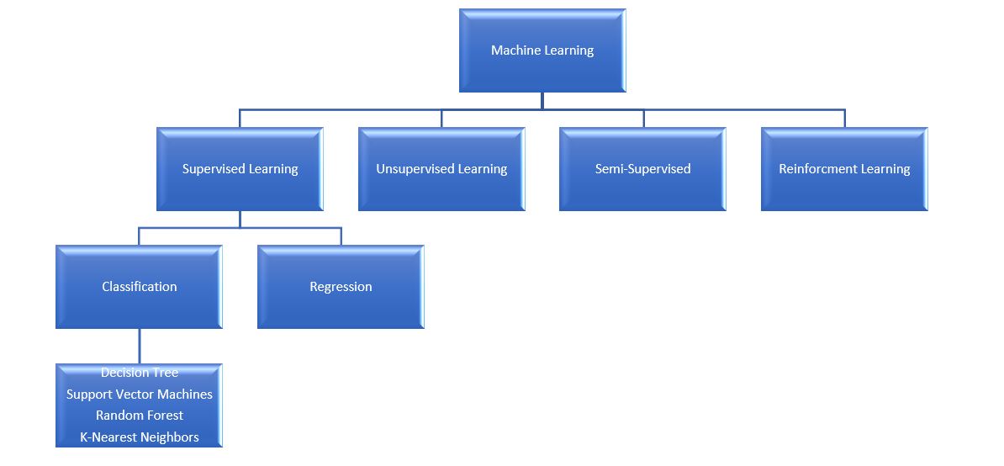
Introduction

Slide 4
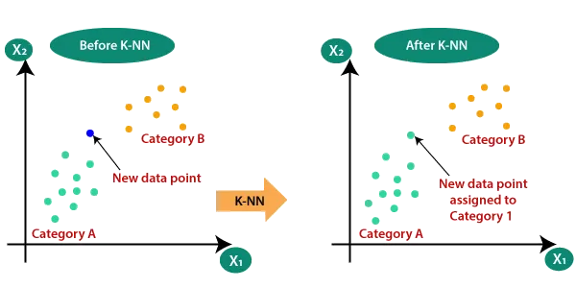
K-Nearest Neighbors (KNN) Classifier

Slide 5
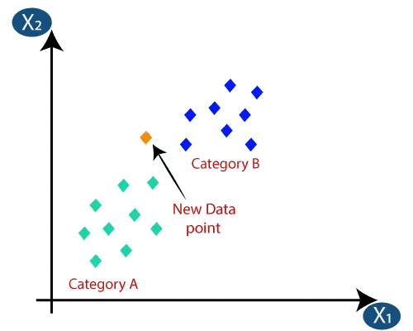
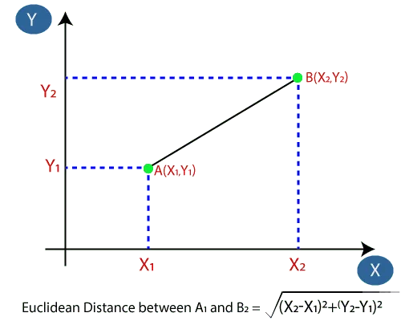
K-Nearest Neighbors (KNN) Classifier

Slide 6
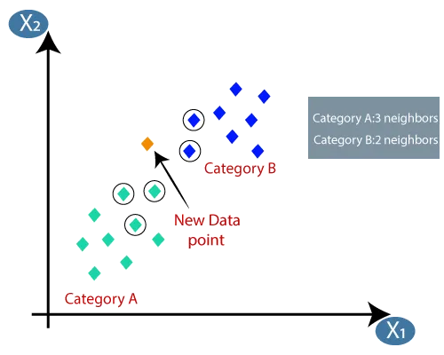
K-Nearest Neighbors (KNN) Classifier

Slide 7
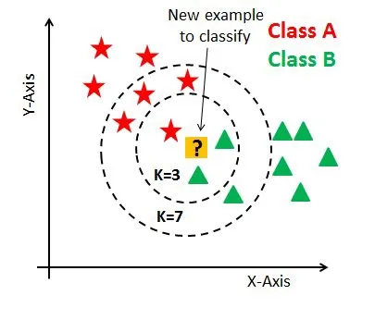
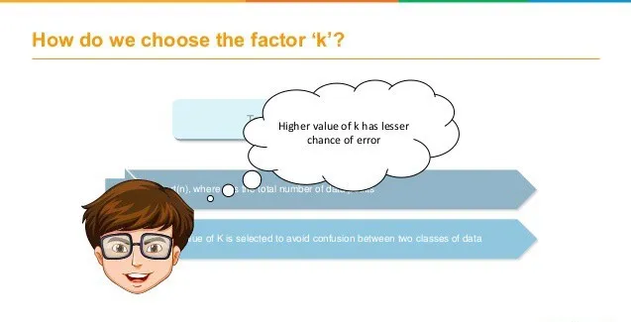
The Factor k

Slide 8
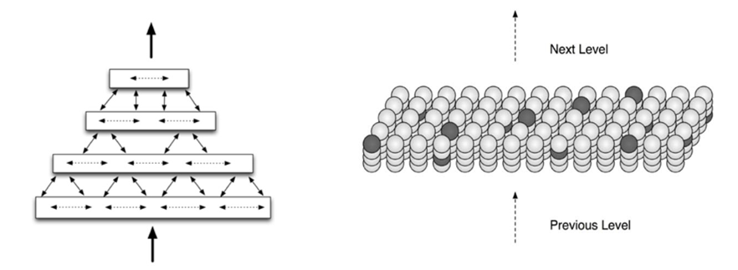
Hierarchical Temporal Memory (HTM)

Slide 9
Hierarchical Temporal Memory (HTM)
Data
Encoder
Spatial Pooler
Temporal Pooler
Classifier

Slide 10
Conclusion
The KNN model is successfully integrated and gets the stream of data sequences to predict the outcome.
The model gives high accuracy in most of the input data sequences.
Unit test is implemented to handle special cases.

Slide 11
Thank You

