Slide 1
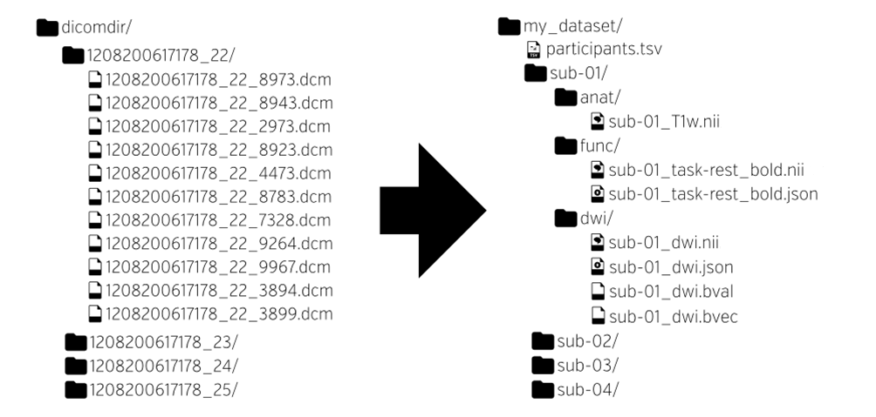
Data Organisation: Import from raw data
Brain Imaging Data Structure (BIDS)
Raw data
DICOM Imported “Raw” Data
http://bids.neuroimaging.io/

Slide 2
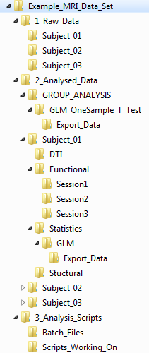
Data Organisation: Good Analysis Folder Structure
Raw_Data
Has data direct from scanner (.IMA; .dcm)
Analysed Data
Where you import data to (into .nii or .img files)
Where you do preprocessing of data (realign, coregister, normalise, smooth etc)
Statistics: where you put the model and analysis for each individual subject
Group Analysis: where you put the group level analyses
Export_Data: where you export masks, thresholded data, VOI (voxel of interest) time series etc
Analysis_Scripts
Where you put scripts and batch files to help run analysis
Can put other helpful files (e.g. masks for regions of interest) here.

Slide 3
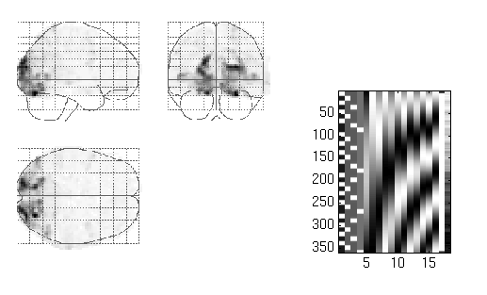
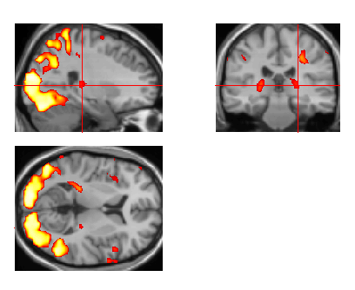
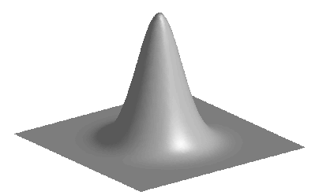
SPM 12 Analysis
Image time-series
Spatial filter
Design matrix
Statistical Parametric Map
Realignment
Smoothing
General Linear Model
Statistical Inference
RFT
Normalisation
Anatomical reference
p <0.05
Parameter estimates

Slide 4
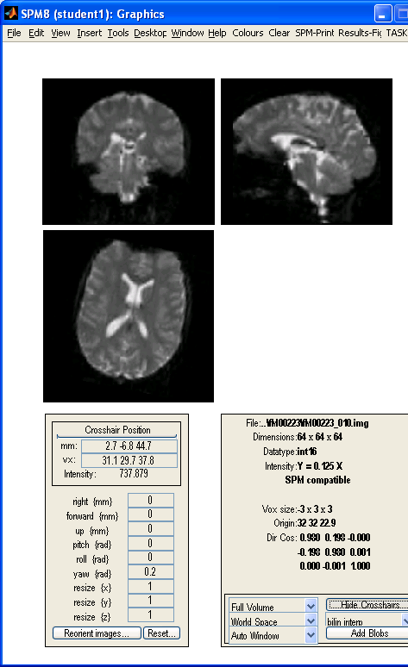
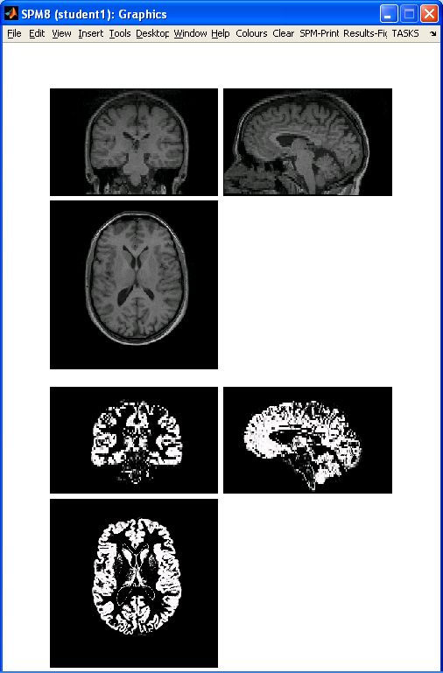
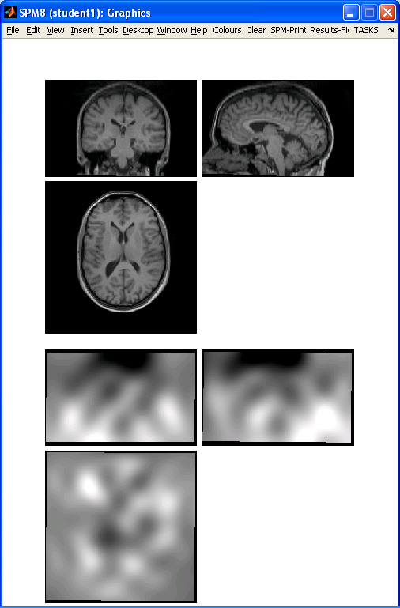
1. Pre-processing
ANALYSIS
Images to Write
Headers Changed
(functional: uf*.img)
swuf*.img
Structural
7
fMRI Time Series
Volumes
5
NORMALISE
SMOOTH
Images
2
SEGMENT
Write
Voxel size: change to original image size
1
REALIGN
4
COREG
“Save Bias Corrected”
“Deformation Fields: Forward”
Estimate & Unwarp
Estimate
Other
Res
Res
Reference
wuf*.img
Source
Segment
(c1s*.nii)
Bias-corrected structural
(ms*.nii)
Deformation Field
(y_s*.nii)
Skull Stripped Bias-corrected
“Brain”
6
uf*.img
& rp_f*.txt file
Mean Functional
(meanuf*.img)
NORMALISE
wBrain*.img
3
ImCalc
Write
Voxel size: change to original image size

Slide 5
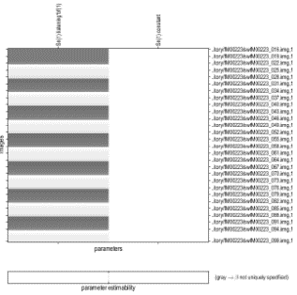
2. First-Level Analysis
SPM12 batch file:
stats1_within_subject_fmri.m
PRE-PROC
4
swuf*.img
Results Report
Scans
Directory
One contrast at a time
Conjunction analysis
Inf: all contrasts
Threshold (type and p)
Conjunction Number
Data Type
Export Results choice
1
SPM.mat
Interscan Interval
fMRI Model Specification
TR
2
Model Estimation
Units for design: scans/seconds
Condition
General Linear Model
3
Contrast Manager
Multiple Regressors
Onset & Duration of Stimuli
T-contrast
F-Contrast
T-Contrast (cond/sess based)
Delete existing contrasts (Y/N)
Behavioural Data:
Logfiles
Parameter estimates
Movement:
rp_f*.txt file
SPM.mat
SPM.mat

Slide 6
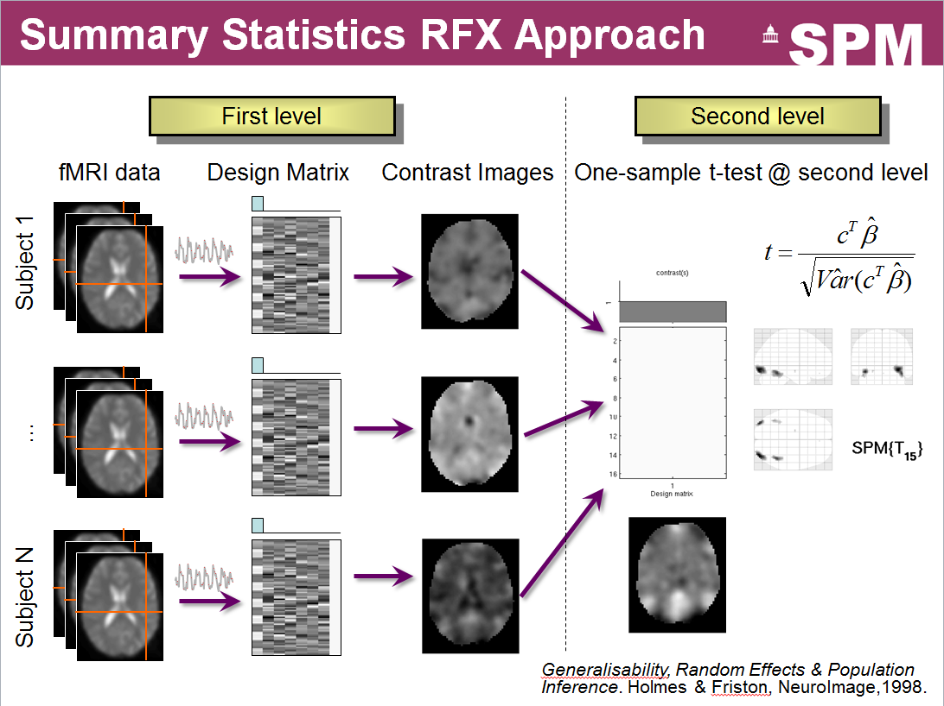
Background: Second-level Analysis

Slide 7
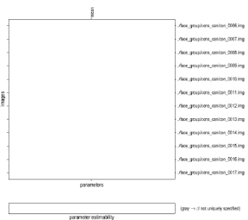
3. Second-Level Analysis
SPM12 batch file:
stats2_between_subject_fmri.m
Design matrix
1st LEVEL ANALYSIS
4
Results Report
One contrast at a time
Conjunction analysis
Inf: all contrasts
Threshold (type and p)
Conjunction Number
Data Type
Export Results choice
con_0001.img
…..
Directory
SPM.mat
2
Scans
Model Estimation
1
Factorial Design Specification
General Linear Model
3
Average of con images
Contrast Manager
Design: One-sample t-test
Covariates
T-contrast
F-Contrast
T-Contrast (cond/sess based)
Delete existing contrasts (Y/N)
Parameter estimates
SPM.mat
SPM.mat

