Slide 1

Name
Affiliation
Contact

Slide 2
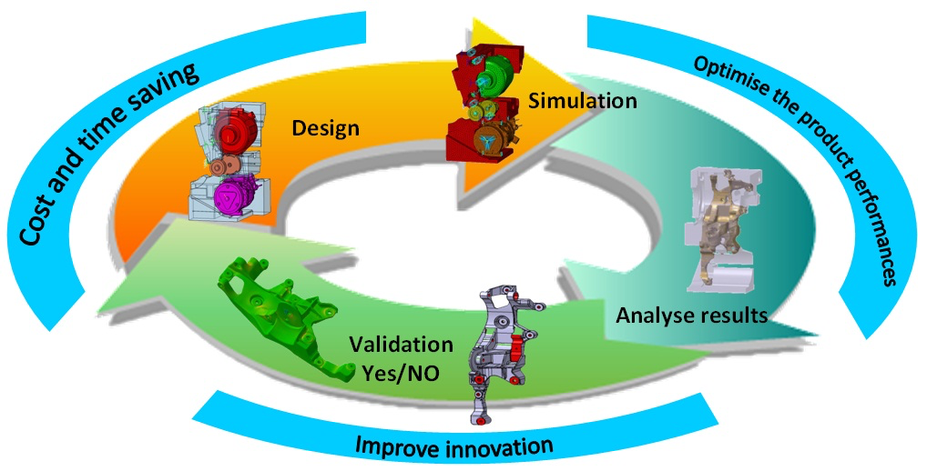
Title
……..

Slide 3
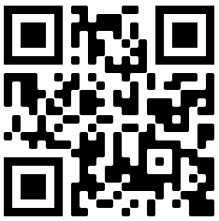

VISIT OUR SITE: https://www.xilab.unimore.it/

