Slide 1
ABOUT DID
XIA JIANG

Slide 2
Potential Outcome Framework to Causal Inference – DID Estimator
Recall the RCT approach.
outcome
Treatment group
Treatment
🧛‍♀️
Sample
Randomization
Control group
Placebo
outcome
RCT is to find whether there is a difference in treatment effects between the treatment and control groups via manipulation (doing experiments).
DID estimator attempts to estimate the difference in treatment effects using existing data.
Outcomes will then be compared to see whether there is a difference.

Slide 3
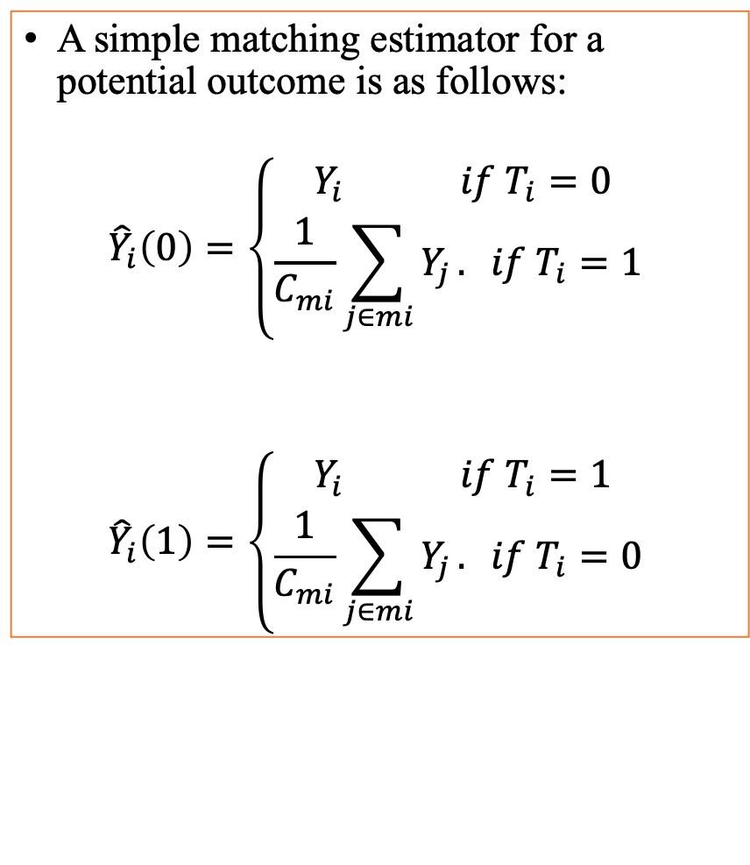
A Simple DID Estimator
When estimating the treatment effect from existing data, only one potential outcome of the two possible outcomes is observed for each participant. The unobserved outcome can be estimated using a simple “matching” estimator.
We denote the treatment as T_{i} for the ith participant, Y_{i}(0) as the potential outcome when T_{i} =0 for the ith participant, Y_{i}(1) as the potential outcome when T_{i} =1 for the ith participant, C_{mi} as the count of the set (mi) of participants who approximate matching the ith participant in terms the covariates but took the opposite treatment.
A simple matching estimator for a potential outcome is as follows:
$${\hat{Y}}_{i}\left(0\right)=\left\{\begin{matrix}Y_{i} if{ T}_{i}=0 \\ \frac{1}{C_{mi}}\sum_{j∈mi}{Y_{j}}. if T_{i}=1 \end{matrix}\right.$$
$${\hat{Y}}_{i}\left(1\right)=\left\{\begin{matrix}Y_{i} if{ T}_{i}=1 \\ \frac{1}{C_{mi}}\sum_{j∈mi}{Y_{j}}. if T_{i}=0 \end{matrix}\right.$$
Implementation introduced by Alberto Abadie et al. in 2004

Slide 4
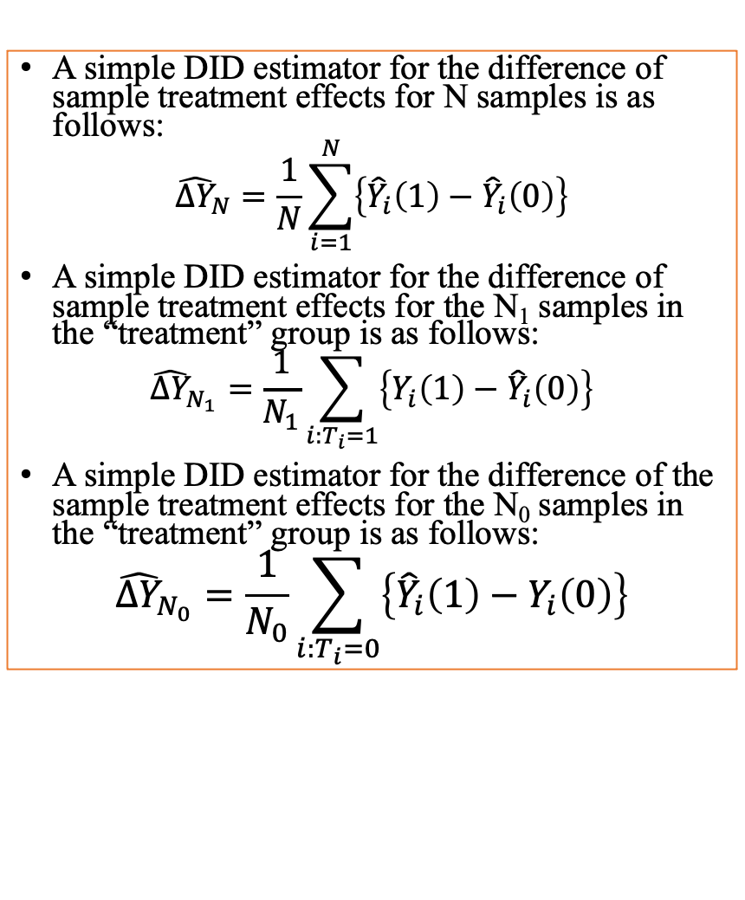
A Simple DID Estimator
When estimating the treatment effect from existing data, only one potential outcome of the two possible outcomes is observed for each participants. The unobserved outcome can be estimated using a simple “matching” estimator.
We denote the treatment as T_{i} for the ith participant, Y_{i}(0) as the potential outcome when T_{i} =0 for the ith participant, Y_{i}(1) as the potential outcome when T_{i} =1 for the ith participant, C_{mi} as the count of the set (mi) of participants who approximate matching the ith participant in terms the covariates but took the opposite treatment.
A simple DID estimator for the difference of sample treatment effects for N samples is as follows:
$${\hat{∆Y}}_{N}=\frac{1}{N}\sum_{i=1}^{N}{\left\{{\hat{Y}}_{i}\left(1\right)−{\hat{Y}}_{i}\left(0\right)\right\}}$$
A simple DID estimator for the difference of sample treatment effects for the N₁ samples in the “treatment” group is as follows:
$${\hat{∆Y}}_{N_{1}}=\frac{1}{N_{1}}\sum_{i:T_{i}=1}{\left\{Y_{i}\left(1\right)−{\hat{Y}}_{i}\left(0\right)\right\}}$$
A simple DID estimator for the difference of the sample treatment effects for the N₀ samples in the “treatment” group is as follows:
$${\hat{∆Y}}_{N_{0}}=\frac{1}{N_{0}}\sum_{i:T_{i}=0}{\left\{{\hat{Y}}_{i}\left(1\right)−Y_{i}\left(0\right)\right\}}$$

Slide 5
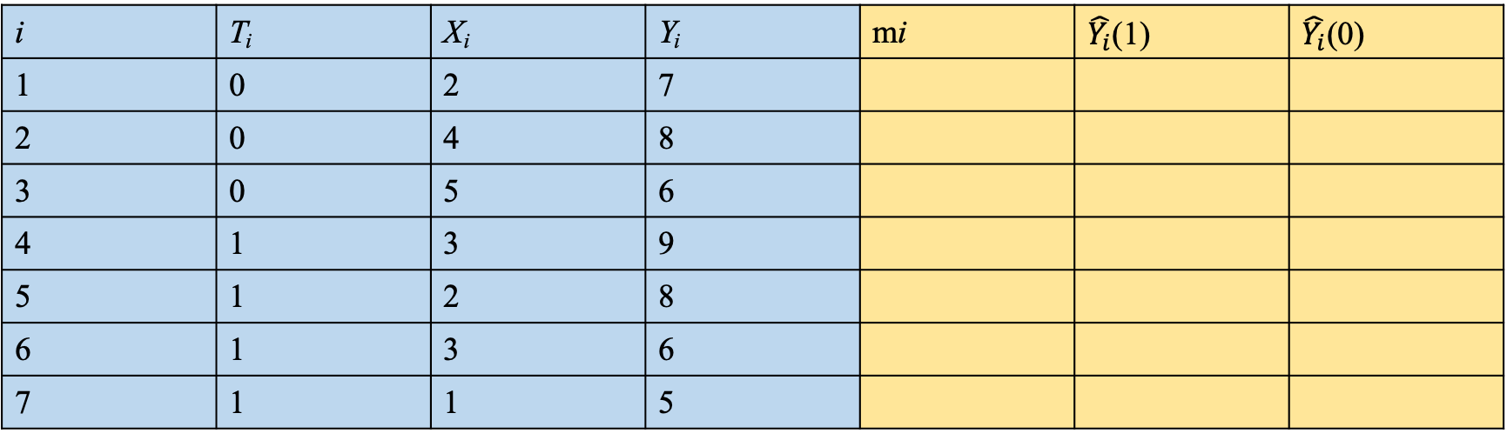
Example
i | T_{i} | X_{i} | Y_{i} | mi | $\hat{Y_{i}}$(1) | $\hat{Y_{i}}$(0)
1 | 0 | 2 | 7
2 | 0 | 4 | 8
3 | 0 | 5 | 6
4 | 1 | 3 | 9
5 | 1 | 2 | 8
6 | 1 | 3 | 6
7 | 1 | 1 | 5
Example by Alberto Abadie et al. in their 2004 paper

Slide 6
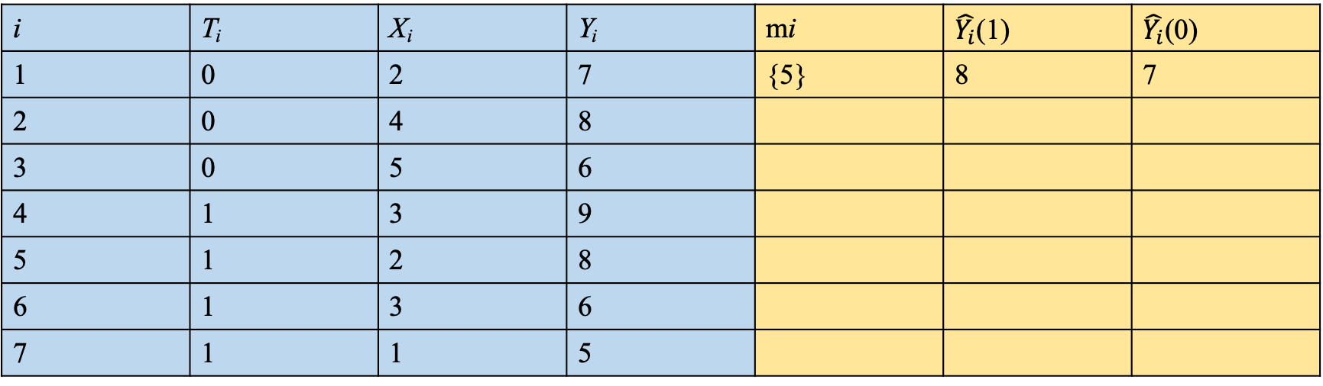
Example
i | T_{i} | X_{i} | Y_{i} | mi | $\hat{Y_{i}}$(1) | $\hat{Y_{i}}$(0)
1 | 0 | 2 | 7 | {5} | 8 | 7
2 | 0 | 4 | 8
3 | 0 | 5 | 6
4 | 1 | 3 | 9
5 | 1 | 2 | 8
6 | 1 | 3 | 6
7 | 1 | 1 | 5

Slide 7
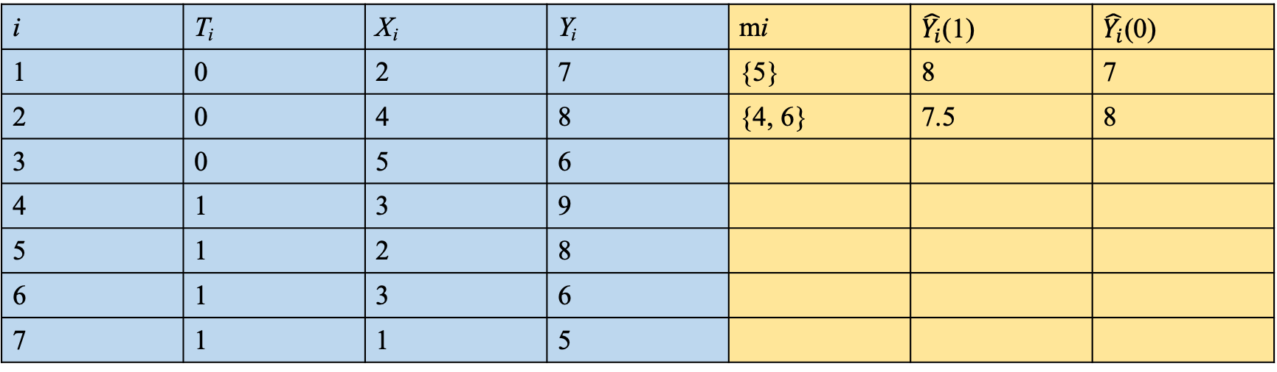
Example
i | T_{i} | X_{i} | Y_{i} | mi | $\hat{Y_{i}}$(1) | $\hat{Y_{i}}$(0)
1 | 0 | 2 | 7 | {5} | 8 | 7
2 | 0 | 4 | 8 | {4, 6} | 7.5 | 8
3 | 0 | 5 | 6
4 | 1 | 3 | 9
5 | 1 | 2 | 8
6 | 1 | 3 | 6
7 | 1 | 1 | 5

Slide 8
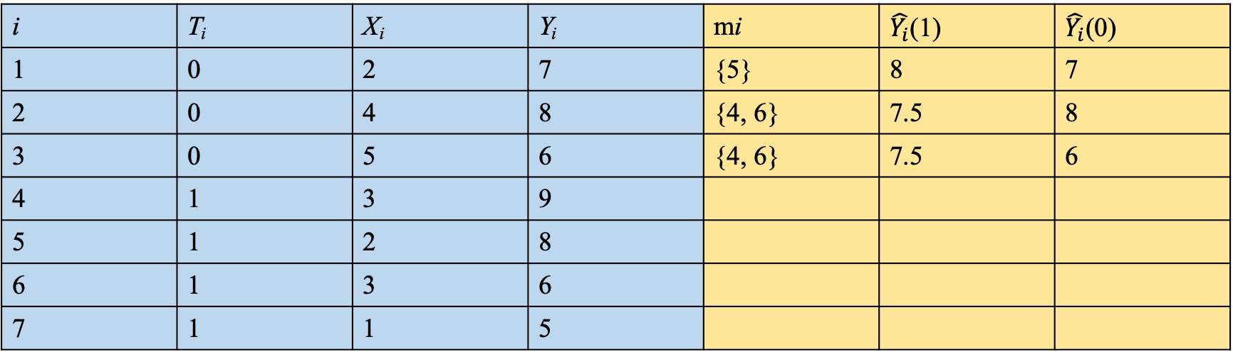
Example
i | T_{i} | X_{i} | Y_{i} | mi | $\hat{Y_{i}}$(1) | $\hat{Y_{i}}$(0)
1 | 0 | 2 | 7 | {5} | 8 | 7
2 | 0 | 4 | 8 | {4, 6} | 7.5 | 8
3 | 0 | 5 | 6 | {4, 6} | 7.5 | 6
4 | 1 | 3 | 9
5 | 1 | 2 | 8
6 | 1 | 3 | 6
7 | 1 | 1 | 5

Slide 9
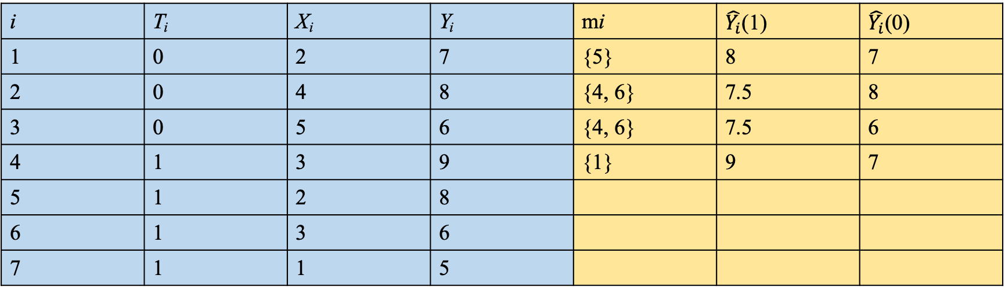
Example
i | T_{i} | X_{i} | Y_{i} | mi | $\hat{Y_{i}}$(1) | $\hat{Y_{i}}$(0)
1 | 0 | 2 | 7 | {5} | 8 | 7
2 | 0 | 4 | 8 | {4, 6} | 7.5 | 8
3 | 0 | 5 | 6 | {4, 6} | 7.5 | 6
4 | 1 | 3 | 9 | {1} | 9 | 7
5 | 1 | 2 | 8
6 | 1 | 3 | 6
7 | 1 | 1 | 5

Slide 10
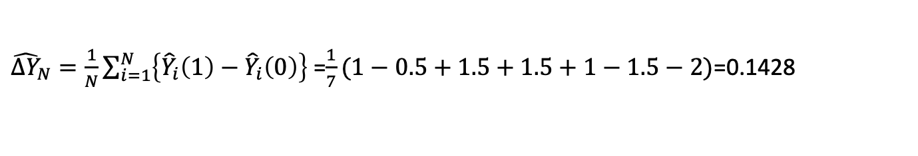
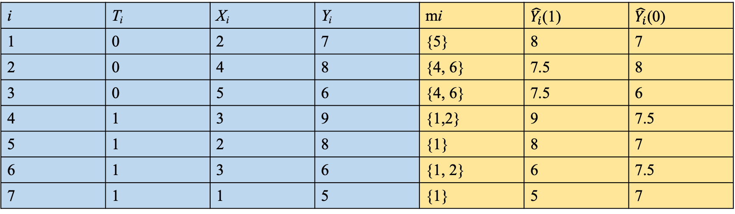
Example
i | T_{i} | X_{i} | Y_{i} | mi | $\hat{Y_{i}}$(1) | $\hat{Y_{i}}$(0)
1 | 0 | 2 | 7 | {5} | 8 | 7
2 | 0 | 4 | 8 | {4, 6} | 7.5 | 8
3 | 0 | 5 | 6 | {4, 6} | 7.5 | 6
4 | 1 | 3 | 9 | {1,2} | 9 | 7.5
5 | 1 | 2 | 8 | {1} | 8 | 7
6 | 1 | 3 | 6 | {1, 2} | 6 | 7.5
7 | 1 | 1 | 5 | {1} | 5 | 7
${\hat{∆Y}}_{N}=\frac{1}{N}\sum_{i=1}^{N}{\left\{{\hat{Y}}_{i}\left(1\right)−{\hat{Y}}_{i}\left(0\right)\right\}}$ =$\frac{1}{7}(1−0.5+1.5+1.5+1−1.5−2)$=0.1428
The purpose of ”matching” is the same as the one of the ”randomization” process in RCT.
The key issue is how to find matching samples for the ith patient. Later development is largely about the optimization of the matching procedure, such as the introduction of the probability-based propensity score.

Slide 11
Randomization and Matching
The effect of the confounder on the the two groups is being considered the same due to randomization
Confounder
Edge can be removed by randomization when grouping!
Confounder
Treatment
Effect
Treatment
Effect
If the edge is still there, then there is a causal effect from Treatment
If the edge is gone, then there is no causal effect from Treatment
Confounder
Treatment
Effect

