Slide 1

About MBIL
Department of Biomedical Informatics
University of Pittsburgh School of Medicine
http://www.dbmi.pitt.edu
Xia Jiang, PhD

Slide 2
Definition of Bayesian Network
Suppose we have the following:
a directed acyclic graph (DAG) 𝔾 whose nodes are random variables.
A joint probability distribution P of the variables in 𝔾.
Each node is conditionally independent of its nondescendents given its parents.
Then we say that 𝔾 and P satisfy the Markov condition and we call (𝔾,P) a Bayesian network.
BN is a probability based graphic model that represents conditional independent (dependent) relationships among variables.

Slide 3
Markov Condition
Suppose we have a joint probability distribution P of the random variables in some set V and a DAG G = (V, E). We say that (𝔾, P) satisfies the Markov condition if for each variable X ∈ V, {X} is independent of the set of all its other nondescendents given the set of all its parents
I_{𝔾}({X}, ND_{X} | PA_{X})
We spent quite some time to discuss I_{P}({X}, {Y}|Z) in the first lecture !
I_{𝔾}({X},{Y}|Z) ➱ I_{P}({X}, {Y}|Z)
🧛‍♀️

Slide 4
B(Burglary)
P(b) =0.01
E(Earthquake)
P(e) = 0.0001
E
B
A(Alarm)
P(a|b,e)=0.9
P(a|b,-e)=0.8
P(a|-b,e)=0.3
P(a|-b,-e)=0.0009
J(Joe Called)
P(j|a)=0.6
P(j|-a)=0.1
A
J
M
M(Marry Called)
P(m|a)=0.8
P(j|-a)=0.01

Slide 5
Learning BN Structure from Data : The Score-based Approach
Model selection is to select a ”good” causal model from among all possible models, and use it as if it were the correct model.
When we apply model selection to causal Bayesian network structure learning, how do we decide whether or not a model is ”good”?
The answer is that we can use a Bayesian scoring criterion to measure the relative strength of a model.

Slide 6
A Bayesian Score Criterion
A Bayesian score criterion for a DAG is a function that assigns a value to the DAG under consideration based on data.
Assuming G is a variable that represents a possible DAG, P(data|G) is a Bayesian score criterion that we can use in our model selection approach of learning BN structures.
In this class, we will introduce two formulas for obtaining P(data|G), that is, the K2 Score and the BDeu Score.

Slide 7
The Probability of a DAG given Data
Assuming Data is a variable that represents our observed data, assuming G₁ is a variable that represents a possible DAG of the “true” model, G₂ is a variable that represents another possible DAG of the “true” model, then
if P(G₁|Data) > P(G₂|Data)
We can say that between G₁ and G₂, G₁ is more likely to be the DAG of the “true” model that is responsible for the data we observed.
Why a Bayesian score criterion can be a measure of the strength of a Model?
🧛‍♀️

Slide 8
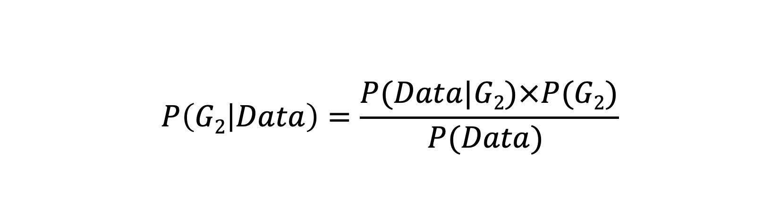
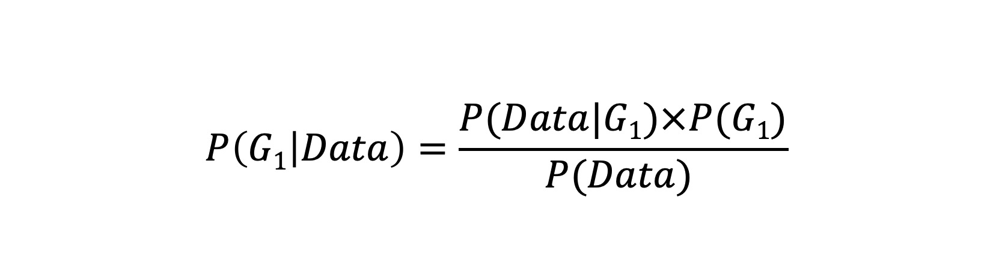
The Probability of a DAG given Data
$$P\left(G1 | Data\right)=\frac{P(Data|G1)×P(G1)}{P(Data) }$$
Bayes’ Rule
$$P\left(G2 | Data\right)=\frac{P(Data|G2)×P(G2)}{P(Data) }$$

Slide 9
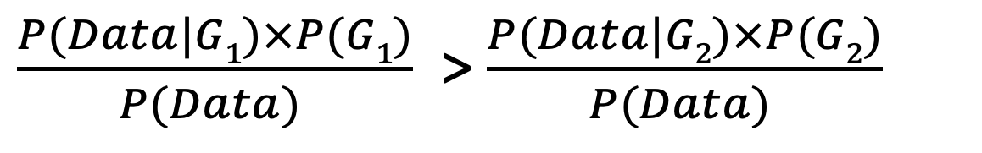
The Probability of a DAG given Data
P(G₁|Data) > P(G₂|Data)
Likelihood Function
$\frac{P(Data|G1)×P(G1)}{P(Data) }$ > $\frac{P(Data|G2)×P(G2)}{P(Data) }$

Slide 10
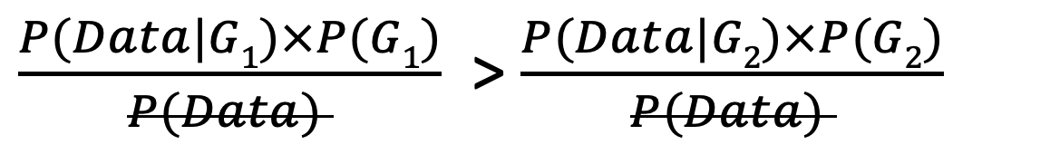
The Probability of a DAG given Data
P(G₁|Data) > P(G₂|Data)
$\frac{P(Data|G1)×P(G1)}{P(Data) }$ > $\frac{P(Data|G2)×P(G2)}{P(Data) }$
P(Data) can be treated as a constant in our comparison.
Normalization Constant
🧛‍♀️

Slide 11
The Probability of a DAG given Data
P(G₁|Data) > P(G₂|Data)
Prior Probability of the DAG structure
When we have no prior knowledge about the DAG structures, we can assume that P(G₁) and P(G₂) are equal. In that case, can you think of a principle that we previously covered that allows us to make this assumption?
$\frac{P(Data|G1)×P(G1)}{P(Data) }$ > $\frac{P(Data|G2)×P(G2)}{P(Data) }$
So P(Data|G) is used as the score criterion
🧛‍♀️

Slide 12
How do We Compute P(Data|G)?
G₁
Example
HEAD
HEAD
TAIL
TAIL
TAIL
HEAD
TAIL
P(HEAD) = 𝜃=0.5
P(TAIL)= 1-𝜃=0.5
IID stands for Independently obtained and following Identical Distribution.
P(Data| 𝜃,G₁) =𝜃³ (1-𝜃)⁴
= (0.5)³(0.5)⁴
G₂
Data should be IID!
P(HEAD)=𝜃=0.4
P(TAIL)=1-𝜃= 0.6
🧛‍♀️
P(Data| 𝜃,G₁) =(0.4)³(0.6)⁴

Slide 13

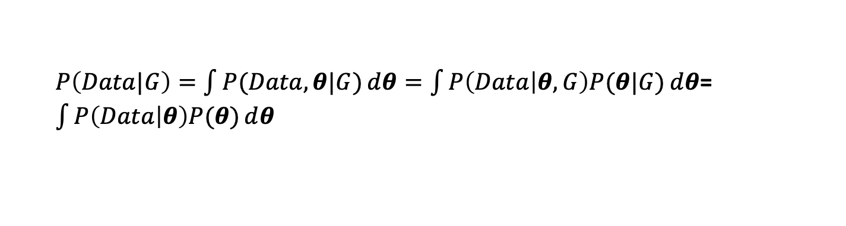
How do We Compute P(Data|G)? A More general case
Assuming Data is a variable that represents our data concerning one single multinomial variable X that has r different values, assuming G is a variable that represents a possible DAG of the “true” model, assuming IID, how do we compute P(Data|G)?
$θ$={$θ_{1},…,θ_{r}\}$
What is this based on?
$P\left(Data|G\right)=\int{P(Data,θ|G)}ⅆθ=\int{P\left(Data | θ, G\right)P(θ|G)ⅆθ}$= $\int{P\left(Data | θ\right)P(θ)ⅆθ}$
🧛‍♀️

Slide 14
How do We Compute P(Data|G)? A More general case
Assuming Data is a variable that represents our data concerning one single multinomial variable X that has r different values, assuming G is a variable that represents a possible DAG of the “true” model, assuming IID, how do we compute P(Data|G)?
$θ$={$θ_{1},…,θ_{r}\}$
What is this based on?
$P\left(Data|G\right)=\int{P(Data,θ|G)}ⅆθ=\int{P\left(Data | θ, G\right)P(θ|G)ⅆθ}$= $\int{P\left(Data | θ\right)P(θ)ⅆθ}$
🧛‍♀️

Slide 15
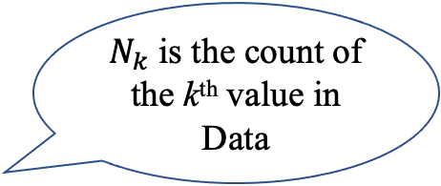
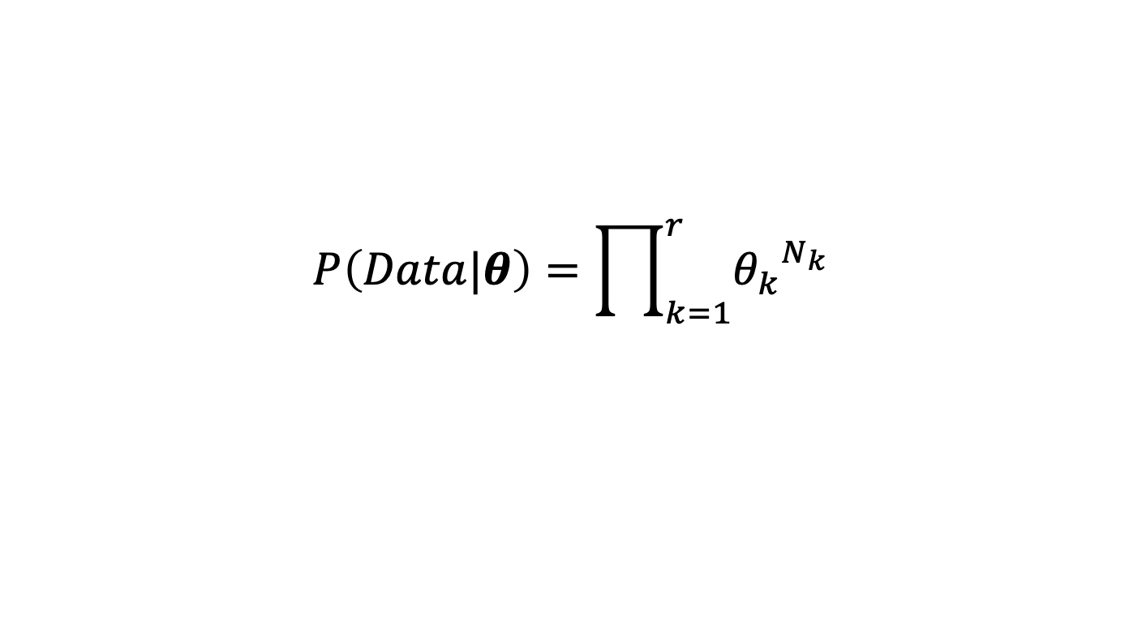
How do we compute P(Data|G)? A More general case
Assuming Data is a variable that represents our data concerning one single multinomial variable X that has r different values, assuming G is a variable that represents a possible DAG of the “true” model, assuming IID, how do we compute P(Data|G)?
$N_{k}$ is the count of the k^{th} value in Data
$$P\left(Data|θ\right)=\prod_{k=1}^{r}{{θ_{k}}^{N_{k}}}$$
True for IID Data and single multinomial variable !
🧛‍♀️

Slide 16
How do we compute P(Data|G)?
G₁
Example
HEAD
HEAD
TAIL
TAIL
TAIL
HEAD
TAIL
P(HEAD) = 𝜃=0.5
P(TAIL)= 1-𝜃=0.5
IID stands for Independently obtained and following Identical Distribution.
P(Data|𝜃, G₁) =𝜃³ (1-𝜃)⁴
= (0.5)³(0.5)⁴
G₂
Data should be IID!
P(HEAD)=𝜃=0.4
P(TAIL)=1-𝜃= 0.6
🧛‍♀️
P(Data|𝜃,G₂) =(0.4)³(0.6)⁴

Slide 17
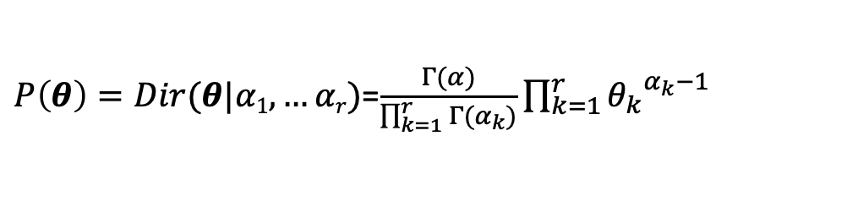
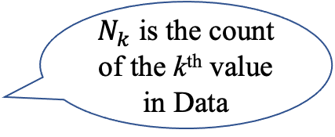
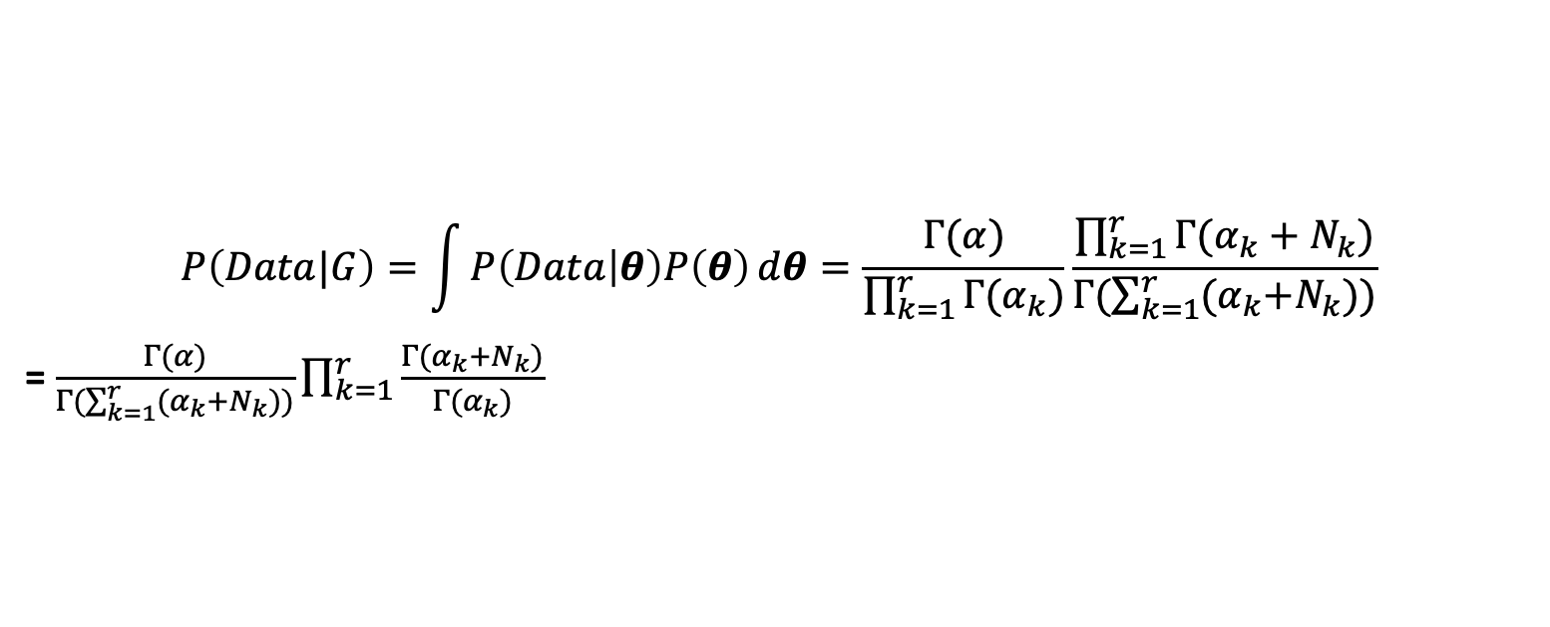
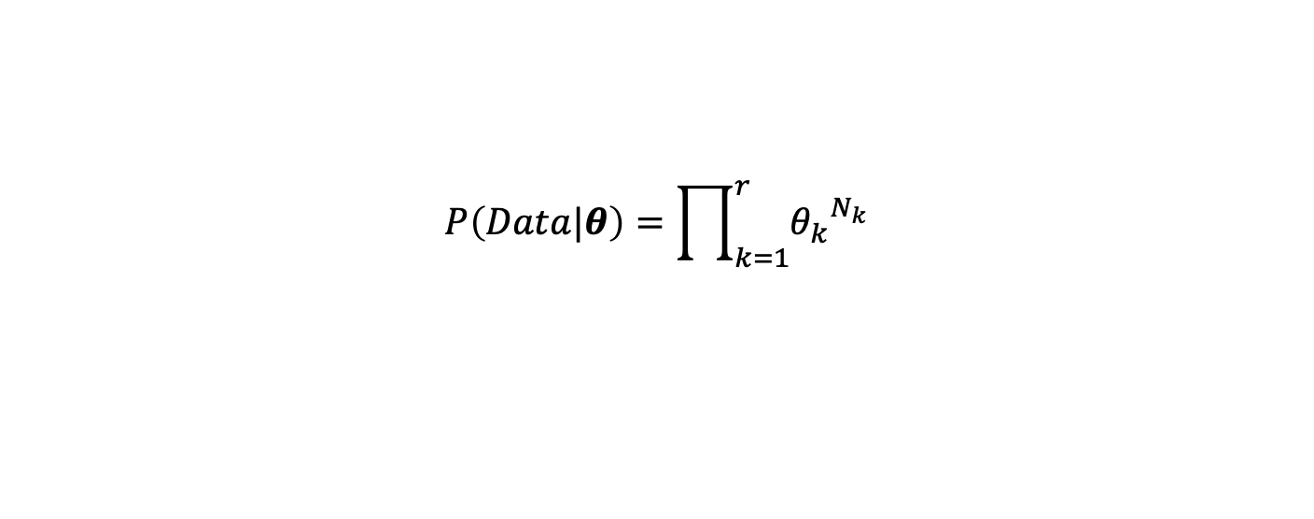

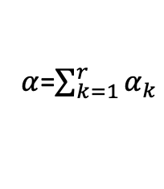
How do we compute P(Data|G)? A More general case
Assuming Data is a variable that represents our data concerning one single multinomial variable X that has r different values, assuming G is a variable that represents a possible DAG of the “true” model, assuming IID, how do we compute P(Data|G)?
$α$=$\sum_{k=1}^{r}{α_{k}}$
$θ$={$θ_{1},…,θ_{r}\}$
$P\left(θ\right)=Dir(θ|α1, …αr)$=$\frac{Γ(α)}{\prod_{k=1}^{r}{Γ(α_{k})}}\prod_{k=1}^{r}{{θ_{k}}^{α_{k}−1}}$
$N_{k}$ is the count of the k^{th} value in Data
True when G contains a single multinomial variable and IID data!
$$P\left(Data|θ\right)=\prod_{k=1}^{r}{{θ_{k}}^{N_{k}}}$$
$$P\left(Data|G\right)=\int{P\left(Data | θ\right)P\left(θ\right)ⅆθ=\frac{Γ(α)}{\prod_{k=1}^{r}{Γ(α_{k})}}\frac{\prod_{k=1}^{r}{Γ(α_{k}+N_{k})}}{Γ(\sum_{k=1}^{r}{{(α}_{k}+N_{k}}))}}$$
= $\frac{Γ(α)}{Γ(\sum_{k=1}^{r}{{(α}_{k}+N_{k}}))}\prod_{k=1}^{r}{\frac{Γ(α_{k}+N_{k})}{Γ(α_{k})}}$

Slide 18
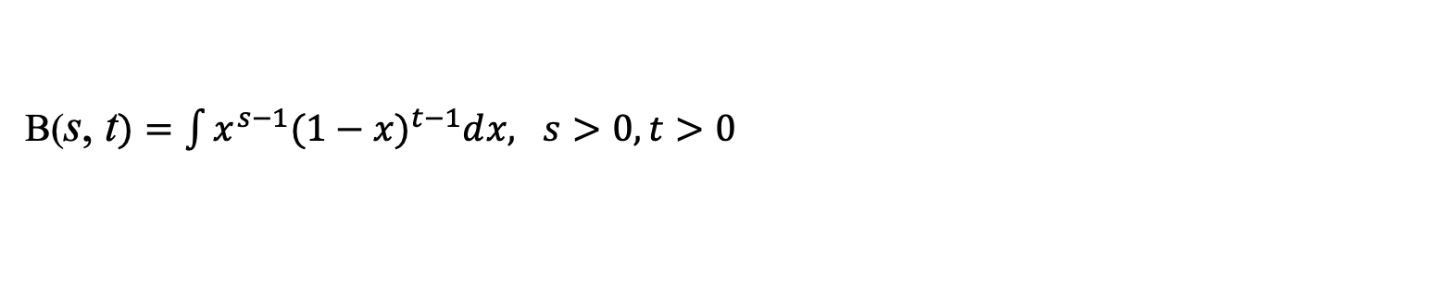
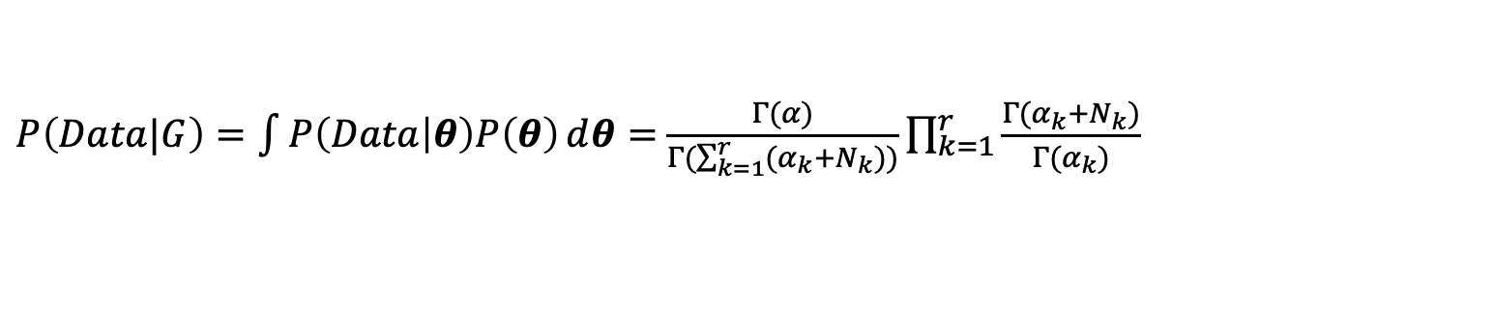
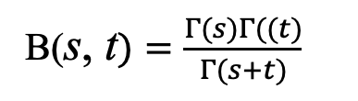
How do we compute P(Data|G)? A More general case
Assuming Data is a variable that represents our data concerning one single multinomial variable X that has r different values, assuming G is a variable that represents a possible DAG of the “true” model, assuming IID, how do we compute P(Data|G)?
$α$=$\sum_{k=1}^{r}{α_{k}}$
$θ$={$θ_{1},…,θ_{r}\}$
$P\left(θ\right)=Dir(θ|α1, …αr)$=$\frac{Γ(α)}{\prod_{k=1}^{r}{Γ(α_{k})}}\prod_{k=1}^{r}{{θ_{k}}^{α_{k}−1}}$
True when G contains a single multinomial variable and IID data!
$N_{k}$ is the count of the k^{th} value in Data
$$P\left(Data|θ\right)=\prod_{k=1}^{r}{{θ_{k}}^{N_{k}}}$$
$P\left(Data|G\right)=\int{P\left(Data | θ\right)P\left(θ\right)ⅆθ=}$ $\frac{Γ(α)}{Γ(\sum_{k=1}^{r}{{(α}_{k}+N_{k}}))}\prod_{k=1}^{r}{\frac{Γ(α_{k}+N_{k})}{Γ(α_{k})}}$
B(s, t$)=\int{x^{s−1}{(1−x)}^{t−1}ⅆx, s>0, t>0}$
B(s, t$)=\frac{Γ(s)Γ((t)}{Γ(s+t)}$
$Γ\left(n\right)=\left(n−1\right)!, when n$≥$1 and n is an integer$

Slide 19
The Bayesian score
Recall we have previously derived this for the single variable case.
🧛‍♀️

Slide 20
K2 Score
n
q
i
Γ
(
r
)
r
i
score
(
G
:
Data
)
=
P
(
Data
|
G
)
=
∏
∏
i
∏
Γ
(
1
+
s
)
K2
Γ
(
r
+
∑
r
i
s
)
ijk
i
=
1
j
=
1
i
k
=
1
ijk
k
=
1

Slide 21
BDeu Score

Slide 22
Example
Consider a binary disease variable D and a binary symptom E. Both variables have the values T (present) and F (absent). Suppose a physician, Dr. Roberts, believes that the following two causal Bayesian network structures G₁ and G₂ are possible, with the prior probabilities shown. Use the BDeu score with 𝜶 =4 to learn from the given data the most probable DAG structure, that is to obtain and compare the P(G₁ | data) and P(G₂ | data).
D | E
T | F
T | T
F | T
T | T
F | F
E
E
P(G₂)=0.7
P(G₁)=0.3
D
D

Slide 23

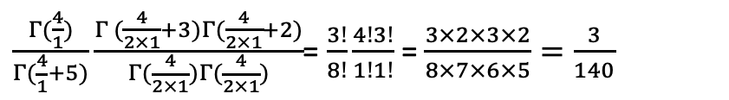

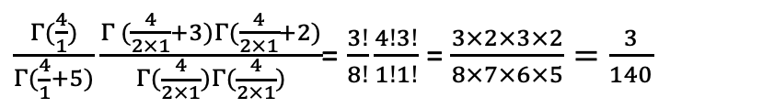
Example
D | E
T | F
T | T
F | T
T | T
F | F
What is the value of P(data | G₁)?
$$α=4$$
$\frac{Γ(\frac{4}{1})}{Γ(\frac{4}{1}+5)}\frac{Γ (\frac{4}{2×1}+3)Γ(\frac{4}{2×1}+2)}{Γ(\frac{4}{2×1})Γ(\frac{4}{2×1})}$= $\frac{3!}{8!}\frac{4!3!}{1!1!}$ = $\frac{3×2×3×2}{8×7×6×5}=\frac{3}{140}$
_{Term for Node D}
$\frac{Γ(\frac{4}{1})}{Γ(\frac{4}{1}+5)}\frac{Γ (\frac{4}{2×1}+3)Γ(\frac{4}{2×1}+2)}{Γ(\frac{4}{2×1})Γ(\frac{4}{2×1})}$= $\frac{3!}{8!}\frac{4!3!}{1!1!}$ = $\frac{3×2×3×2}{8×7×6×5}=\frac{3}{140}$
_{Term for Node E}
E
E
P(G₂)=0.7
P(G₁)=0.3
$P\left(Data | G1\right)=\frac{9}{19600}$=4.5918$×{10}^{−4}$
D
D

Slide 24
D | E
T | F
T | T
F | T
T | T
F | F
What is the value of P(data | G₂)?
$$α=4$$
E
E
P(G₂)=0.7
P(G₁)=0.3
D
D

Slide 25

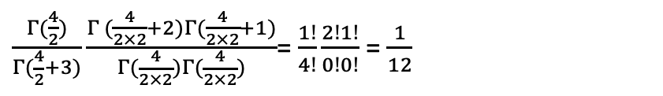
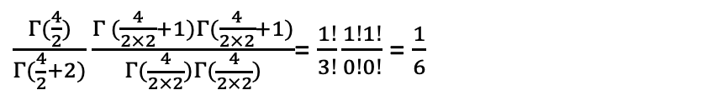
D | E
T | F
T | T
F | T
T | T
F | F
What is the value of P(data | G₂)?
$$α=4$$
$\frac{Γ(\frac{4}{1})}{Γ(\frac{4}{1}+5)}\frac{Γ (\frac{4}{2×1}+3)Γ(\frac{4}{2×1}+2)}{Γ(\frac{4}{2×1})Γ(\frac{4}{2×1})}$= $\frac{3!}{8!}\frac{4!3!}{1!1!}$ = $\frac{3×2×3×2}{8×7×6×5}=\frac{3}{140}$
_{Term for Node D}
Term for Node E when j=1, ie, D=T
$\frac{Γ(\frac{4}{2})}{Γ(\frac{4}{2}+3)}\frac{Γ (\frac{4}{2×2}+2)Γ(\frac{4}{2×2}+1)}{Γ(\frac{4}{2×2})Γ(\frac{4}{2×2})}$= $\frac{1!}{4!}\frac{2!1!}{0!0!}$ = $\frac{1}{12}$
E
E
$\frac{Γ(\frac{4}{2})}{Γ(\frac{4}{2}+2)}\frac{Γ (\frac{4}{2×2}+1)Γ(\frac{4}{2×2}+1)}{Γ(\frac{4}{2×2})Γ(\frac{4}{2×2})}$= $\frac{1!}{3!}\frac{1!1!}{0!0!}$ = $\frac{1}{6}$
Term for Node E when j=2, ie, D=F
D
D
P(G₂)=0.7
P(G₁)=0.3
$P\left(Data | G2\right)=\frac{3}{12×6x140}$=2.976$×{10}^{−4}$

Slide 26


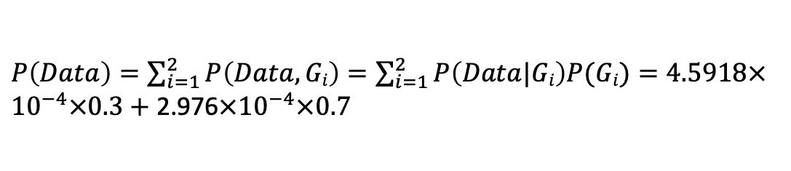
Example
D | E
T | F
T | T
F | T
T | T
F | F
What is the P(G₁ | data) and what is P(G₂ | data), using the likelihoods that we just derived?
$P\left(Data\right)=\sum_{i=1}^{2}{P\left(Data, Gi\right)=\sum_{i=1}^{2}{P\left(Data|Gi\right)P(Gi)}}=4.5918×{10}^{−4}×0.3+$ 2.976$×{10}^{−4}×0.7$
$P\left(G1|Data\right)=\frac{P\left(Data|G1\right)P(G1)}{P(Data)}$=$\frac{4.5918×{10}^{−4}×0.3}{4.5918×{10}^{−4}×0.3+\text{ 2.976}×{10}^{−4}×0.7}$=0.398
E
E
Thought about Bayesian priors?
P$\left(G2|Data\right)$=1-0.398=0.602
🧛‍♀️
$P\left(Data | G1\right)=\frac{9}{19600}$=4.5918$×{10}^{−4}$
D
D
P(G₂)=0.7
P(G₁)=0.3
$P\left(Data | G2\right)=\frac{3}{12×6x140}$=2.976$×{10}^{−4}$

Slide 27
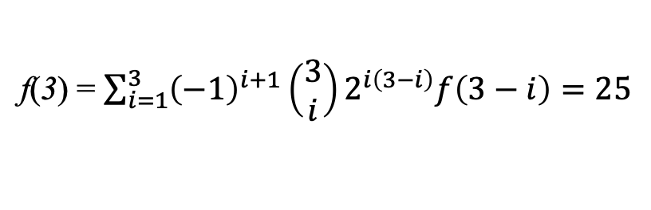
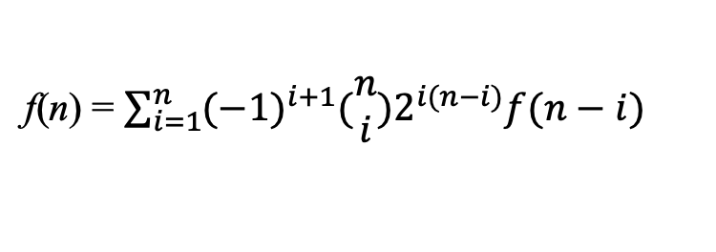
How Big is the DAG Search Space?
The number of DAGs containing n nodes can be computed using the following recurrence:
n > 2
f(0)=1
f(n) = $\sum_{i=1}^{n}{{(−1)}^{i+1}(\begin{matrix}n \\ i\end{matrix})2^{i(n−i)}f(n−i)}$
f(1)=1
n | f(n)
1 | 1
2 | 3
3
f(3) = $\sum_{i=1}^{3}{{\left(−1\right)}^{i+1}\left(\begin{matrix}3 \\ i\end{matrix}\right)2^{i\left(3−i\right)}f\left(3−i\right)=25}$
RW, Robinson “Continuing Unlabeled Acyclic Digraphs,” in Little, C.H.C. (Ed): Lecture Notes in Mathematics Springer-Verlag, 1977

Slide 28
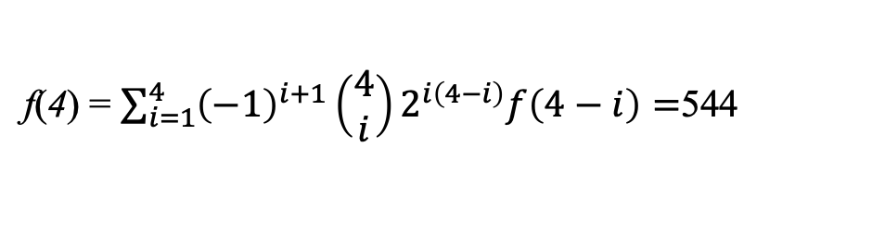
How Big is the DAG Search Space?
The number of DAGs containing n nodes can be computed using the following recurrence:
n > 2
f(0)=1
f(n) = $\sum_{i=1}^{n}{{(−1)}^{i+1}(\begin{matrix}n \\ i\end{matrix})2^{i(n−i)}f(n−i)}$
f(1)=1
n | f(n)
1 | 1
2 | 3
3 | 25
4
f(3) = $\sum_{i=1}^{3}{{\left(−1\right)}^{i+1}\left(\begin{matrix}3 \\ i\end{matrix}\right)2^{i\left(3−i\right)}f\left(3−i\right)=25}$
f(4) = $\sum_{i=1}^{4}{{\left(−1\right)}^{i+1}\left(\begin{matrix}4 \\ i\end{matrix}\right)2^{i\left(4−i\right)}f\left(4−i\right)=}$544
RW, Robinson “Continuing Unlabeled Acyclic Digraphs,” in Little, C.H.C. (Ed): Lecture Notes in Mathematics Springer-Verlag, 1977

Slide 29
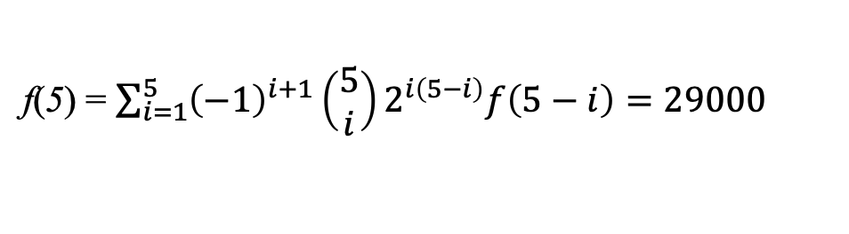
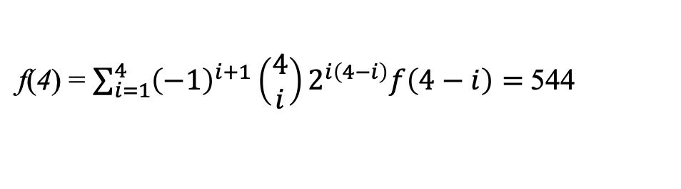
How Big is the DAG Search Space?
The number of DAGs containing n nodes can be computed using the following recurrence:
n > 2
f(0)=1
f(n) = $\sum_{i=1}^{n}{{(−1)}^{i+1}(\begin{matrix}n \\ i\end{matrix})2^{i(n−i)}f(n−i)}$
f(1)=1
n | f(n)
1 | 1
2 | 3
3 | 25
4 | 544
5
f(3) = $\sum_{i=1}^{3}{{\left(−1\right)}^{i+1}\left(\begin{matrix}3 \\ i\end{matrix}\right)2^{i\left(3−i\right)}f\left(3−i\right)=25}$
f(4) = $\sum_{i=1}^{4}{{\left(−1\right)}^{i+1}\left(\begin{matrix}4 \\ i\end{matrix}\right)2^{i\left(4−i\right)}f\left(4−i\right)= }$544
f(5) = $\sum_{i=1}^{5}{{\left(−1\right)}^{i+1}\left(\begin{matrix}5 \\ i\end{matrix}\right)2^{i\left(5−i\right)}f\left(5−i\right)=29000}$
RW, Robinson “Continuing Unlabeled Acyclic Digraphs,” in Little, C.H.C. (Ed): Lecture Notes in Mathematics Springer-Verlag, 1977

Slide 30

How Big is the DAG Search Space?
The number of DAGs containing n nodes can be computed using the following recurrence:
n > 2
f(0)=1
f(n) = $\sum_{i=1}^{n}{{(−1)}^{i+1}(\begin{matrix}n \\ i\end{matrix})2^{i(n−i)}f(n−i)}$
f(1)=1
n | f(n)
1 | 1
2 | 3
3 | 25
4 | 544
5 | 29000
f(3) = $\sum_{i=1}^{3}{{\left(−1\right)}^{i+1}\left(\begin{matrix}3 \\ i\end{matrix}\right)2^{i\left(3−i\right)}f\left(3−i\right)=25}$
f(4) = $\sum_{i=1}^{4}{{\left(−1\right)}^{i+1}\left(\begin{matrix}4 \\ i\end{matrix}\right)2^{i\left(4−i\right)}f\left(4−i\right)= }$544
f(5) = $\sum_{i=1}^{5}{{\left(−1\right)}^{i+1}\left(\begin{matrix}5 \\ i\end{matrix}\right)2^{i\left(5−i\right)}f\left(5−i\right)=29000}$
…
$$f\left(10\right)>{10}^{18}$$

Slide 31
MBIL : A Score-based Approach to Learn A Causal DAG that Contains One Outcome/Effect Node and its Parents
BMIL stands for the Markov Blanket and Interactive risk factor Learner.
BMIL learns single and interactive risk factors having a direct influence on a patient’s outcome.
The algorithm does not merely find correlation, but rather identifies direct interactive risk factors.

Slide 32
Examples of Models Learned by MBIL
Examples are as follows.
X
X
Y
X
Y
Z
T
T
T

Slide 33
Markov Boundary
Let V be a set of random variables, P be their joint probability distribution, and X is in V, then a Markov boundary of X is any Markov blanket of X such that none of its proper subsets is a Markov blanket of X.
In a Bayesian Network, for each variable X in the set of all variables V, the set of all parents of X, children of X, and parents of children of X is a Markov blanket and a Markov boundary of X

Slide 34
Markov Blanket
Let (𝔾, P) represent a Bayesian network, then a Markov blanket Mx of a node X is any set of variables such that X is conditionally independent of all the other nodes given Mx.
I_{𝔾}({X}, V-({X}∪ M_{X}) | M_{X})

Slide 35
MBIL Procedures
1. determine_single_predictors learns the set PA1 of single-variable risk factors of a target T. The procedure does this by determining whether the BDeu score of the model in which the variable has an edge to T is greater than the BDeu score of the model in which T has no parents.
P₁
P₂
P₃
…
Versus
M
Versus
M
Versus
M
M
M
M

Slide 36
MBIL Procedures
1. determine_single_predictors learns the set PA1 of single-variable risk factors of a target T. The procedure does this by determining whether the BDeu score of the model in which the variable has an edge to T is greater than the BDeu score of the model in which T has no parents. For example, we learned that,
P₁
P₁₀
P₁₅
PA1={P₁, P₁₀, P₁₅}
M
M
M

Slide 37
MBIL Procedures
2. determine_interactions uses Exhaustive_IGain to learn interactive risk factors of target T. Examples are as follows. These modes are included in one of my output files named as “…learned_interactions…”.
P₂
P₇
P₈
P₁₄
P₂₂
M
M

Slide 38
MBIL Procedures
3. transform_from_interactions collapses each interaction to a single variable. The set of these new single variables is PA2, and the set PA = PA1∪PA2 is the set of all candidate direct risk factors of T.
Assuming we have n candidate predictors, we will create new predictors (n+1, n+2, , …) by transformation. For example,
P₂
P₇
P₃₂
⇒
M
M

Slide 39
MBIL Procedures
3. transform_from_interactions collapses each interaction to a single variable. The set of these new single variables is PA2, and the set PA = PA1∪PA2 is the set of all candidate direct risk factors of T.
Assuming we have n candidate predictors, we will create new predictors (n+1, n+2, , …) by transformation. For example,
P₈
P₁₄
P₂₂
P₃₃
PA2={P₃₂, P₃₃}
⇒
PA={P₁, P₁₀, P₁₅ P₃₂, P₃₃}
M
M

Slide 40
MBIL Procedures
4. find_parents then removes indirect risk factors of T from PA. It does this as follows. When i=1, the procedure checks whether each one parent model has a lower score than the model with no parents. If it does, the variable in the model is not a direct risk factor and is removed from PA. When i=2 it checks, for each two parent models, whether removing one of the variables in the model increases the score of the model. If so, T is independent of the removed variable given the other variable, and so the removed variable is not a direct risk factor and is removed from PA. Next when i=3 the algorithm checks, for each three parent model, whether removing one of the variables in the model increases the score of the model. If so, T is independent of the removed variable given the other two variables, and so the removed variable is not a direct risk factor and is removed from PA. The procedure continues in this fashion until i equals the size of PA or some maximum number R of Markov blanket variables is reached.

Slide 41
MBIL Procedures
5. transform_to_interactions transforms the variables representing interactions back to interactions. For example, assume P₁ and P₃₂ get removed during procedure 4, then
The mt odels we will learn are as follows, these are included in one of my output files called “… causal_sets …”
PA={ P₁₀, P₁₅ , P₃₃}
P₁
P₁₅
P₈
P₁₄
P₂₂
M
M
M

Slide 42
Some questions
Input
input
dataset
limitations parameters of Bnetwork
1.we will list all possible Bnetwork if the features of dataset are less than a certain number, what is the smallest number of features to support all possible Bnetwork?
2.What kind of data structure we can use to present the Bnetwork? Matrix and adjacent table
3.Design algorithm to generate possible Bnetwork
1. Number of single features, default n_feature / 2, determined by Bdeu score
2.The total numbers of Bnetwork you want to generate based on feature chose by Bdeu
3.How many layers you want to use for Bnetwork

