Slide 1
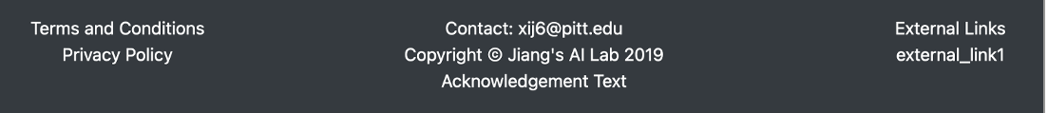
The front page
About Learning Causal Risk Factors to a Chosen Target
Text placeholder, we will compose and enter the proper text here later
a button that leads to the iRCT Page
Go to iRCT Package
About Learning Causal Networks from Data
Text placeholder, we will compose and enter the proper text here later
a button that leads to the CausalLearning Page
Go to Causal Learning Package

Slide 2
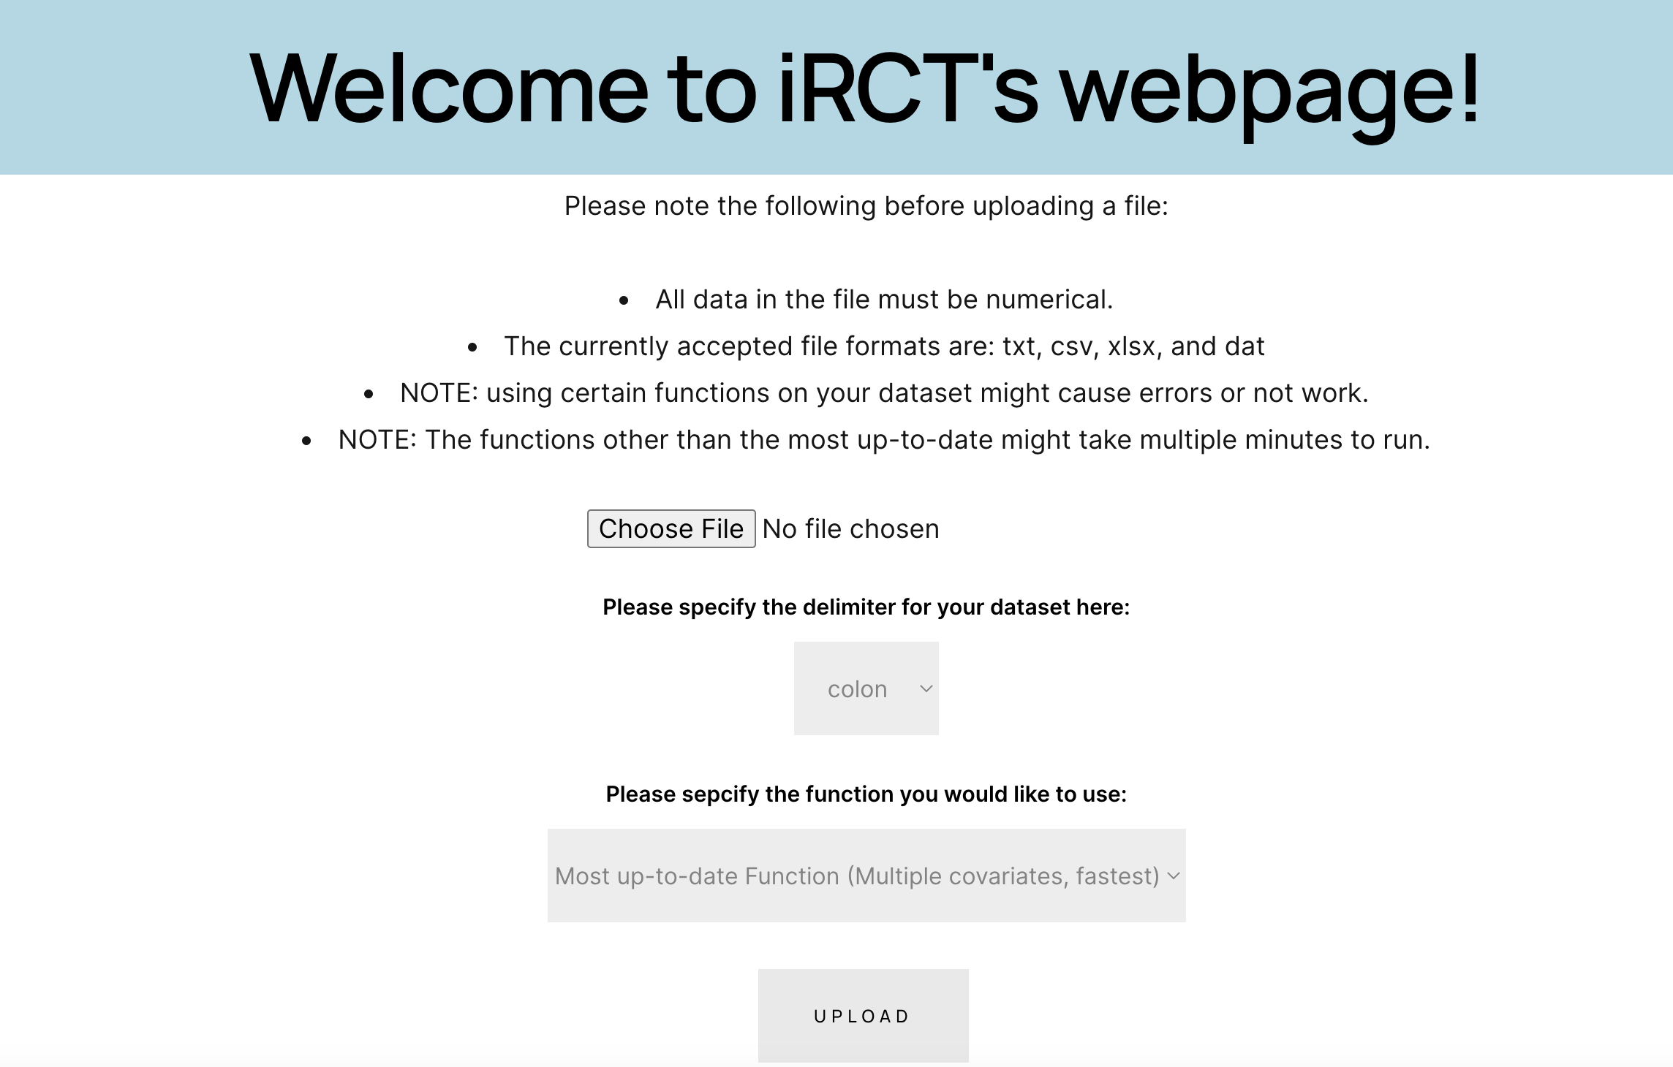
The iRCT Page
Note that we should add MBIL-java as the first method here. The DID methods follows.

Slide 3
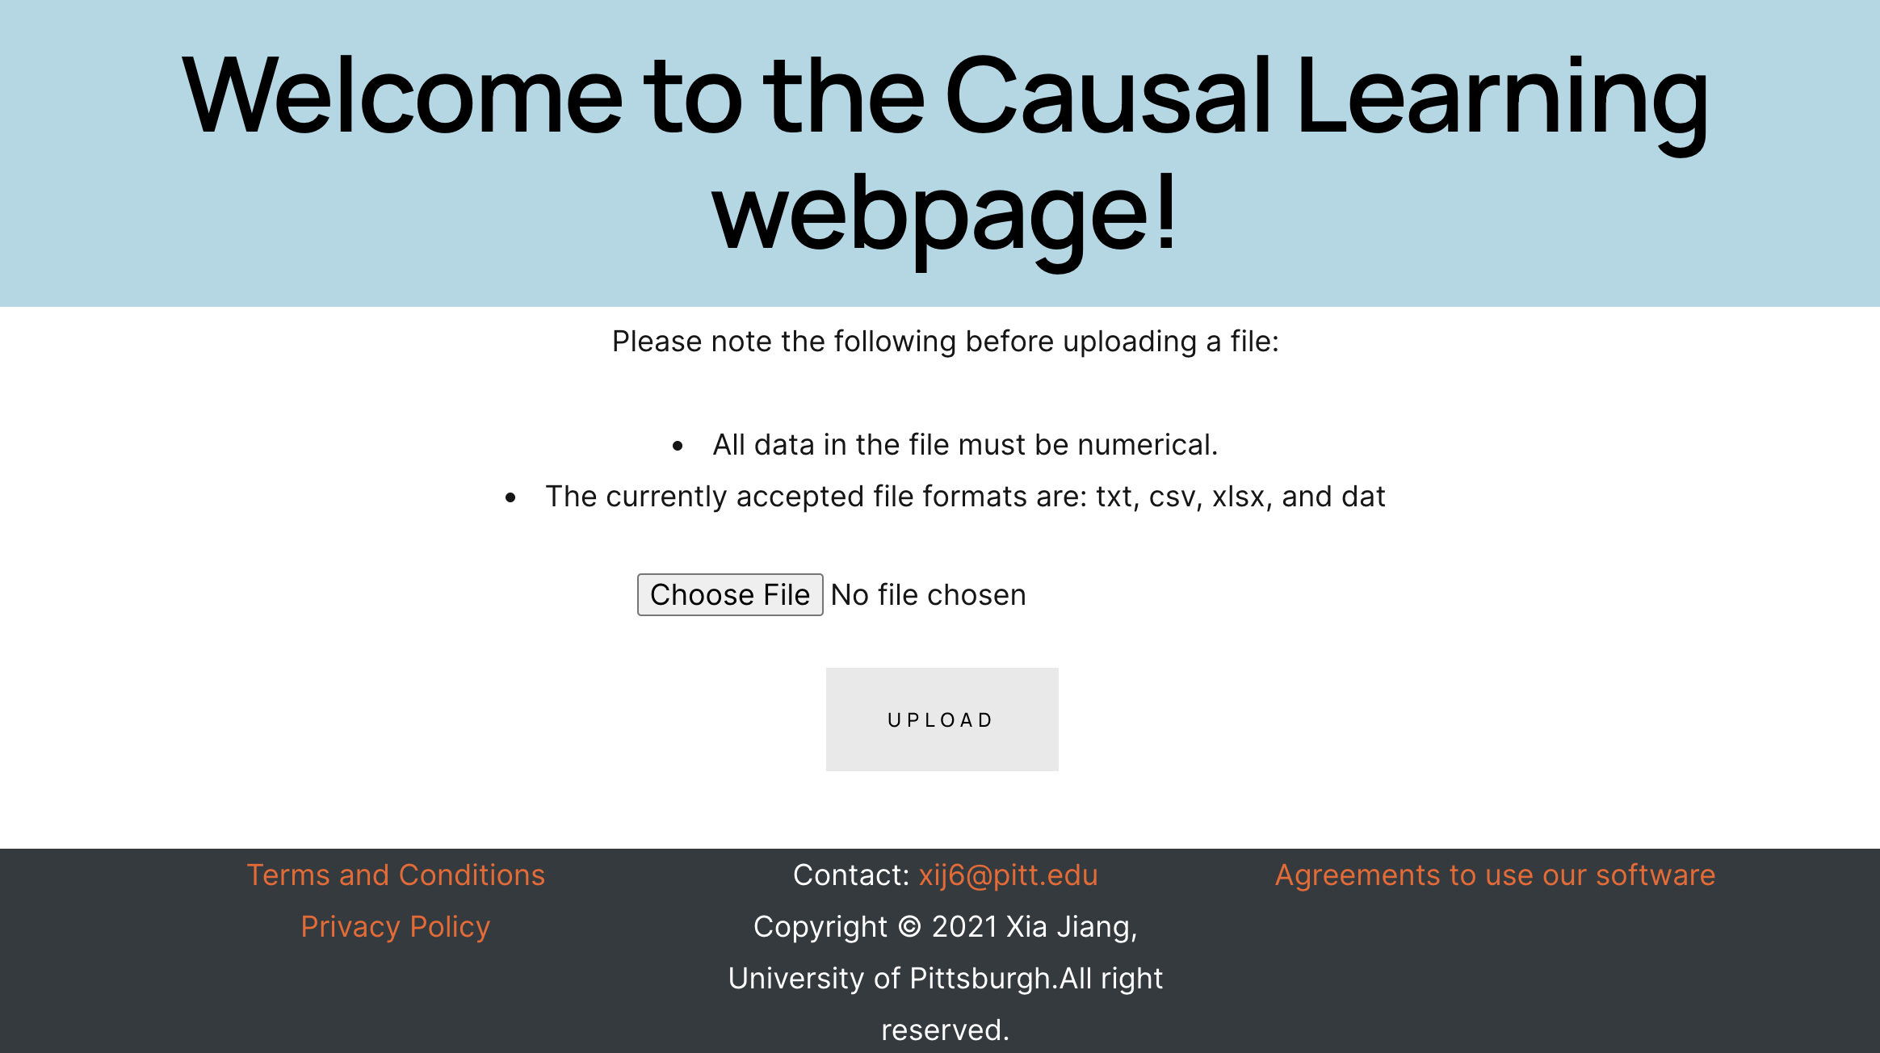
The Causal Learning Page
Note that we can allow non-numerical data

