Slide 1
Kaggle Task: Digit Recognizer Presentation
Xia Rui

Slide 2
Resources
Stanford University cs231n Convolutional Neural Networks for Visual Recognition
Python / Jupyter Notebook / Keras
Research Articles on Batch Normalization / softmax + crossentropy
Other’s kernel

Slide 3
Basic Models
Idea:
Leaky ReLU
Add more Conv2D layers
Batch Normalization
Increase epochs
Data argumentation
Conv2D
ReLU
MaxPool
DropOut
1x5x5x32
Conv2D
ReLU
MaxPool
DropOut
Flatten
FC
+
Relu
DropOut
FC
+
Softmax
1x3x3x64
128
10

Slide 4

Data Preparation
label | pixel0 | pixel1 | pixel2 | pixel3 | pixel4 | pixel5 | pixel6 | pixel7 | pixel8 | ... | pixel773 | pixel774 | pixel775 | pixel776 | pixel777 | pixel778 | pixel779 | pixel780 | pixel781 | pixel782 | pixel783
1 | 0 | 0 | 0 | 0 | 0 | 0 | 0 | 0 | 0 | 0 | ... | 0 | 0 | 0 | 0 | 0 | 0 | 0 | 0 | 0 | 0
0 | 0 | 0 | 0 | 0 | 0 | 0 | 0 | 0 | 0 | 0 | ... | 0 | 0 | 0 | 0 | 0 | 0 | 0 | 0 | 0 | 0
1 | 0 | 0 | 0 | 0 | 0 | 0 | 0 | 0 | 0 | 0 | ... | 0 | 0 | 0 | 0 | 0 | 0 | 0 | 0 | 0 | 0
4 | 0 | 0 | 0 | 0 | 0 | 0 | 0 | 0 | 0 | 0 | ... | 0 | 0 | 0 | 0 | 0 | 0 | 0 | 0 | 0 | 0
0 | 0 | 0 | 0 | 0 | 0 | 0 | 0 | 0 | 0 | 0 | ... | 0 | 0 | 0 | 0 | 0 | 0 | 0 | 0 | 0 | 0
784 Pixels = 28x28 Pixels integer 0-255 10 digits: from 0-9

Slide 5
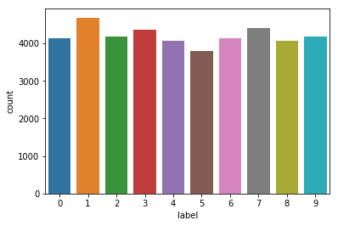
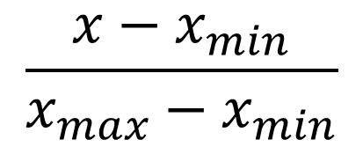
Data Preparation
Data Distribution
Checking for Missing Values
Normalization /255
To reduce the illumination’s influence
Gradient Descent will converge faster on input range (0,1) than (0,255)
$$\frac{x−x_{min}}{x_{max}−x_{min}}$$
Data reshape 1x784 to 28x28
Encode labels to one hot vectors 9 -> (0,0,0,0,0,0,0,0,0,1)
Convert a class vector (integers) to binary class matrix
Split the training set to training set and validation set for fitting

Slide 6
Convolutional Layers
FC: 28x28x1 too large
Conv: connected to a small region of the layer
5x5x1
5x5x1
28x28 each neurons calculate gradients
28
28
5
32
1
1
………..
42000
5
Padding = ‘same’
Equal input and output shape
28
∑
Update a single 5x5x1 weights
28
Parameters sharing:
Features useful to compute at (x1,y1) will be also useful at (x2,y2)
28x28x32 neurons
5x5x1 parameters
32x5x5x1 parameters

Slide 7
Convolutional Layers
32x5x5 overall features, more large-scale features
64x3x3 local features, more detailed features, more filters
Conv2D
ReLU
Max
Pool
DropOut
Conv2D
ReLU
Max
Pool
DropOut
Final loss: 0.0277
Final accuracy: 0.9923
32x5x5
64x3x3
Conv2D
ReLU
Conv2D
ReLU
Max
Pool
DropOut
Conv2D
ReLU
Conv2D
ReLU
Max
Pool
DropOut
32x5x5
32x5x5
64x3x3
64x3x3
Final loss: 0.0226
Final accuracy: 0.9926

Slide 8
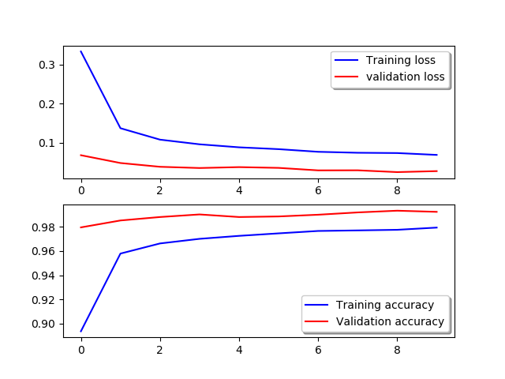
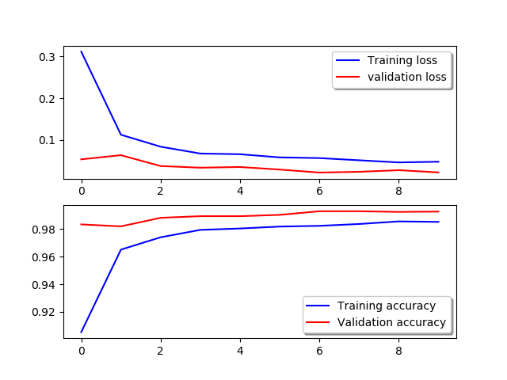
Convolutional Layers
Training curves are closer to the validation curves --- more Convolutional layers tend to overfit more

Slide 9
Data Argumentation
Reason for why validation loss curve is lower
Training harder to identify
Not to overfit, artificially expand the dataset
Someone will write bigger/smaller numbers, scale
Rotate
Shift horizontally/vertically
datagen = ImageDataGenerator(
rotation_range=10,
zoom_range = 0.1,
width_shift_range=0.1,
height_shift_range=0.1)

Slide 10
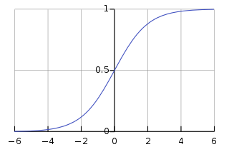
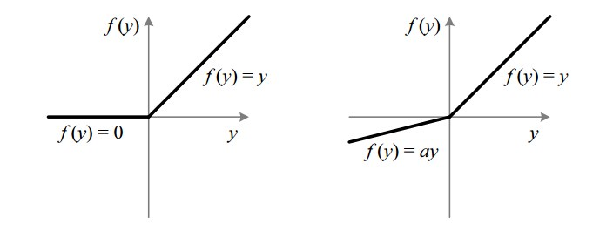


Activation Layers
Add non-linearity to the models
Sigmoid & Tanh
Gradient vanishing (derivative = g(x)(1-g(x)) )
Not zero-centred (always greater than 0, zig-zagging dynamics)
Time-consuming to calculate
ReLU max(0,x)
Not zero-centred
Simply thresholding
Can ‘die’: Every input x put ReLU zero → die
At least one x activate ReLU (fixed by small lr)
Leaky ReLU max(0.01x, x)
Should be better since solved not zero-centred problem
Accuracy decrease from 0.9926 to 0.9864
Error raise from 0.0226 to 0.0431

Slide 11
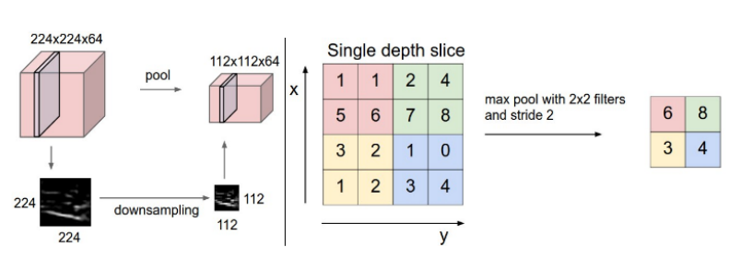
MaxPooling Layers
Down-sampling, pick maximum value in a 2x2 square
Reduce computation cost, reduce overfitting (reduce dimension)
28x28 → 14x14
Dropout Layers
Randomly ignore some nodes in layer (Making new nns)
Forces network to learn in a distributed way
≈ training different neural network and then take average

Slide 12
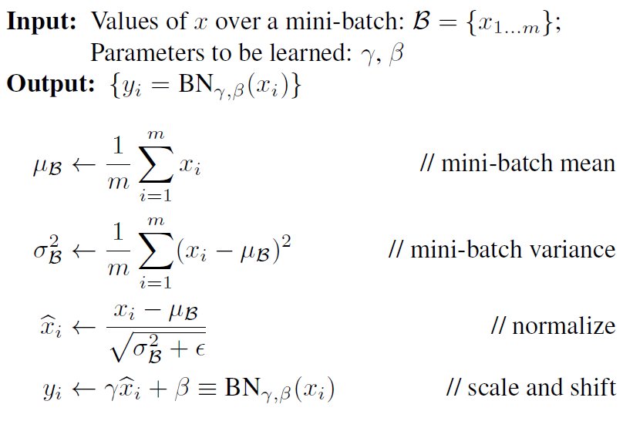
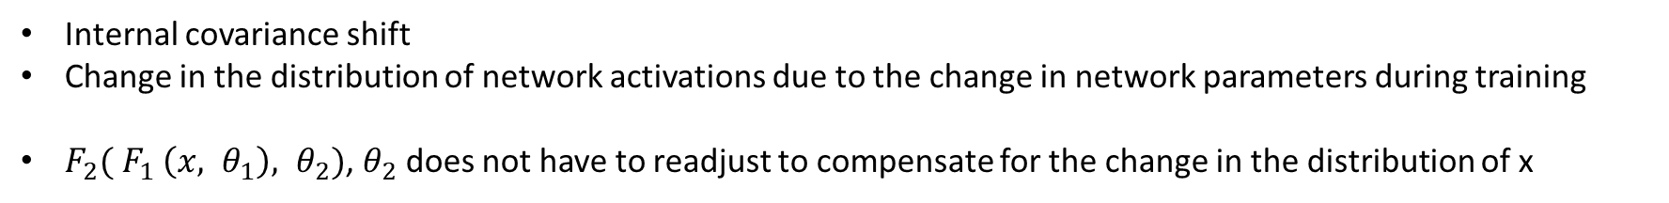
Batch Normalization Layers
Internal covariance shift
Change in the distribution of network activations due to the change in network parameters during training
$F_{2}({ F}_{1} \left(x, θ_{1}\right), θ_{2})$, $θ_{2}$ does not have to readjust to compensate for the change in the distribution of x
Normalize each scalar feature independently
Mini-batch estimate mean & variance
New parameters are learned, in order to restore the representation power of the network

Slide 13
Batch Normalization Layers
Conv2D
ReLU
Conv2D
ReLU
Max
Pool
DropOut
Conv2D
ReLU
Conv2D
ReLU
Max
Pool
DropOut
32x5x5
32x5x5
64x3x3
64x3x3
After FC
BN
BN
BN
BN
BN
4Conv2D + BN + ReLU
Accuracy: 0.9926 Error: 0.0226
4Con2D + ReLU
Accuracy: 0.9905 Error: 0.0323

Slide 14
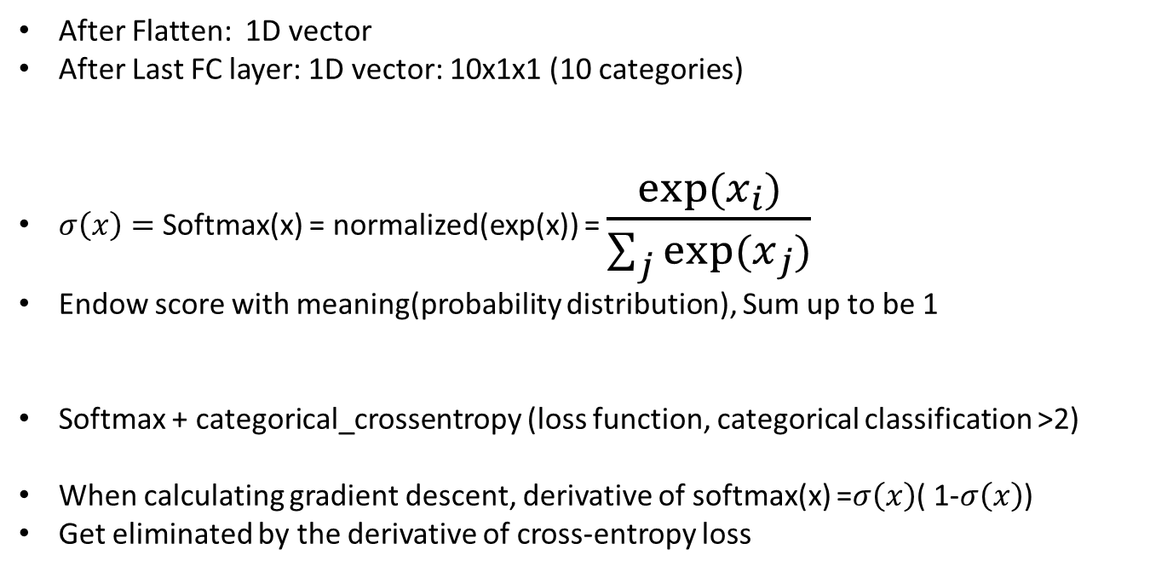
Flatten + FC + Softmax Layers
After Flatten: 1D vector
After Last FC layer: 1D vector: 10x1x1 (10 categories)
$σ\left(x\right)=$Softmax(x) = normalized(exp(x)) = $\frac{exp⁡(x_{i})}{\sum_{j}{exp⁡(x_{j})}}$
Endow score with meaning(probability distribution), Sum up to be 1
Softmax + categorical_crossentropy (loss function, categorical classification >2)
When calculating gradient descent, derivative of softmax(x) =$σ\left(x\right)$( 1-$σ\left(x\right)$)
Get eliminated by the derivative of cross-entropy loss

Slide 15
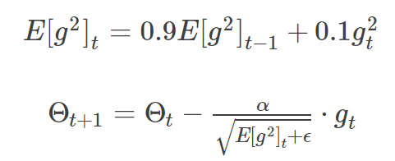
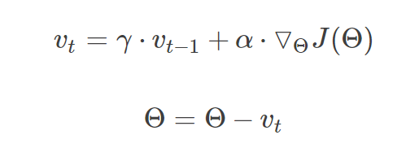
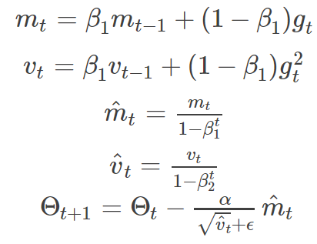
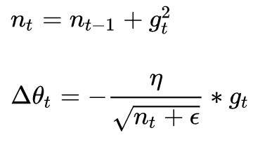
4Conv2D + ReLU + RMSprop
Accuracy: 0.9905 Error: 0.0323
Optimizer
RMSprop
Adam
Functions to iteratively improve parameters
SGD (slow), mini-batch Gradient Descent (partial)
Every time different batch of inputs (not stable)
Momentum
Consider previous gradients
Adagrad
4Conv2D + ReLU + Adam
Accuracy: 0.9933 Error: 0.0232

Slide 16
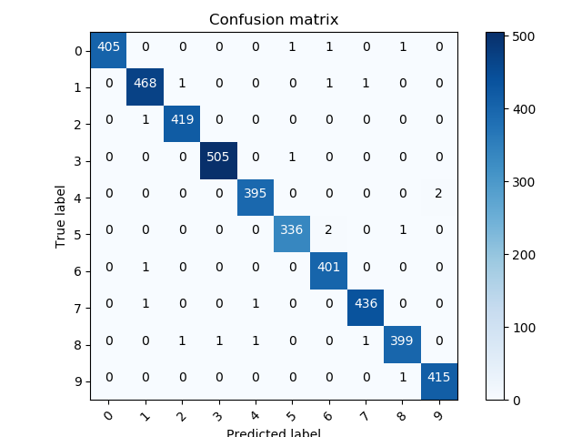
Result Evaluation : Confusion Matrix & Classification Report
[Conv2D + ReLU + BN] x2 + MaxPooling + DropOut + [Conv2D + ReLU + BN] x2 + MaxPooling + DropOut + Flatten + FC + DropOut + FC + Softmax
Epochs → 30
Final loss: 0.013653, final accuracy: 0.995000
precision recall f1-score support
0 1.00 0.99 1.00 408
1 0.99 0.99 0.99 471
2 1.00 1.00 1.00 420
3 1.00 1.00 1.00 506
4 0.99 0.99 0.99 397
5 0.99 0.99 0.99 339
6 0.99 1.00 0.99 402
7 1.00 1.00 1.00 438
8 0.99 0.99 0.99 403
9 1.00 1.00 1.00 416
avg / total 1.00 0.99 0.99 4200

Slide 17
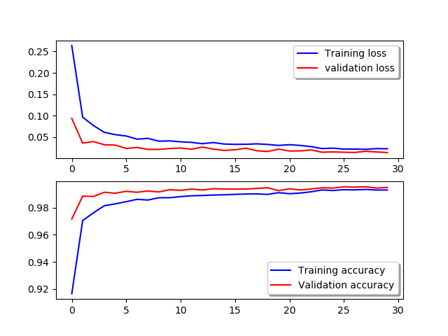
Result Evaluation : Training & Validation Curves
[Conv2D + ReLU + BN] x2 + MaxPooling + DropOut + [Conv2D + ReLU + BN] x2 + MaxPooling + DropOut + Flatten + FC + DropOut + FC + Softmax
Epochs → 30

Slide 18
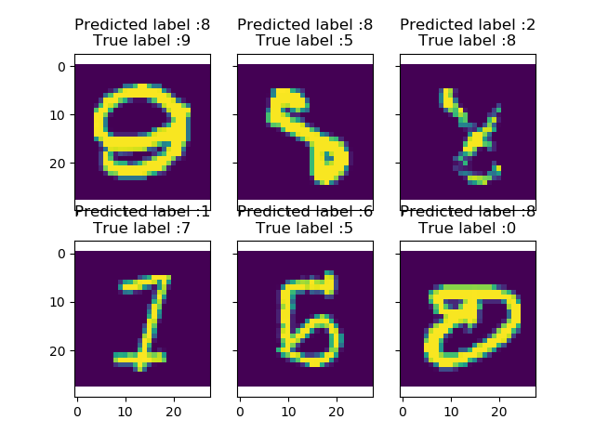
Result Evaluation : Top 6 Errors
[Conv2D + ReLU + BN] x2 + MaxPooling + DropOut + [Conv2D + ReLU + BN] x2 + MaxPooling + DropOut + Flatten + FC + DropOut + FC + Softmax
Epochs → 30

