Slide 1
Definite Integrals
Frame 334~343.
2019/12/24
數學讀書會
6. 334-343

Slide 2
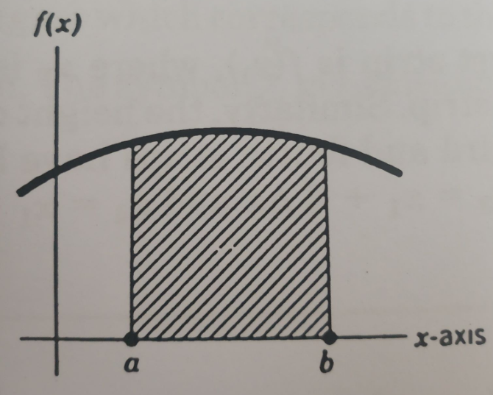
ANOTHER WAY ...
If F'(x) = f(x)
then,
and A is the area under the curve of f(x),
then,
A = F(b) - F(a)

Slide 3
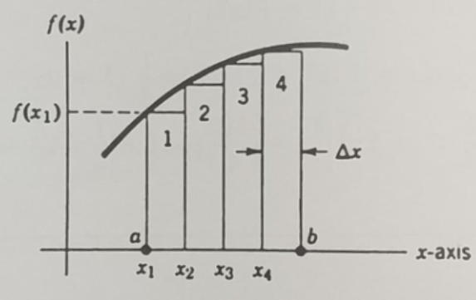
TO COMPUTE...

Slide 4
THE AREA.
ΔA3 ≈ f(x3)Δx
Write the an approximate expression for A, the total area of all four trips?
A ≈ ____________
The approximate expression for the area of strip number 3, ΔA3?
ΔA3 ≈ __________

Slide 5
Definite Integrals
A = ΔA1 + ΔA2 + ΔA3 + ΔA4
A ≈ f(x1)Δx + f(x2)Δx + f(x3)Δx + f(x4)Δx
N
Σ
A = f(xi)Δx
i=1

Slide 6
THANKS
END

