Slide 1
Sentiment Analysis of Chinese Short Texts
Xiaming Gu
A report submitted in fulfillment of the requirements for Course 3253, Final Term Project, University of Toronto

Slide 2
Naive Bayes
Abstract
Conclusion
CNN
Data Preparation
Semtiment Analysis

Slide 3

1
Abstract
Data
Douban Movie is a Chinese website that allows Internet users to share their comments and viewpoints about movies. Users are able to post short or long comments on movies and give them marks.
The dataset has 2,125,056 reivews.
Purpose
Classifies movie reviews as positive or negative using the text of the review.
Modules& Evaluation
Scikit-learn： Naive Bayes classifier for multinomial models
TensorFlow: Convolutional Neural Networks
延时

Slide 4

1
Abstract
Background
Natural language processing (NLP) is concerned with the interactions between computers and human (natural) languages, in particular how to program computers to process and analyze large amounts of natural language data.
Sentiment analysis (also known as opinion mining or emotion AI) is widely applied to the voice of the customer materials such as reviews and survey responses, online and social media...
延时

Slide 5
2
Data Preparation -- Chinese
Chinese basic knowledge：
Different from the English, in Chinese, the concept of words and the boundaries between them is not always transparent,and the Chinese script does not use spaces between words. So first we need cut the sentence to words with using space between words.
Chinese text segmantation ：jieba
"Jieba" (Chinese for "to stutter") built to be the best Python Chinese word segmentation module.
[https://github.com/fxsjy/jieba]
For example
Before 我很高兴。 （translation：I'm happy。）
After 我 很 高兴 。
延时符

Slide 6
2
Data Preparation - Stop words
Stop words：
Stop words are generally the most common words in a language.
In computing, stop words are words which are filtered out before or after processing of natural language data (text).[https://en.wikipedia.org/wiki/Stop_words]
There is no single universal list of stop words used by all natural language processing tools.
Some tools avoid removing stop words to support phrase search.
Chinese stopwords library:
Here, the library for stop words is from https://github.com/goto456/stopwords
Use the "哈工大停用词表.txt" which is from HIT university.
延时符

Slide 7
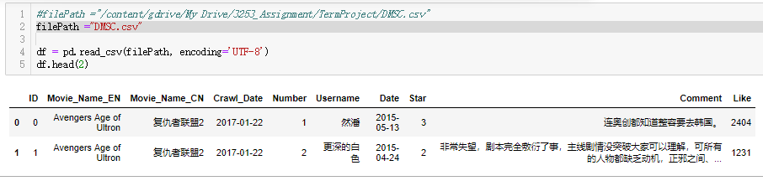
2
Data Preparation--DataSet
Dataset
Douban Movie is a Chinese website that allows Internet users to share their comments and viewpoints about movies. Users are able to post short or long comments on movies and give them marks.
Data clean & transform
Avoid ambiguity , we think the Star >3 , it is positive ; Star < 3 , it is the negative review. Drop the data which's star ==3.
Drop the length of comments == 0
Cut the comments into words(split with space)
Filter the stopwords
延时

Slide 8

3
Scikit-learn Naive Bayes
Use the sheet to select module
Labeled data, text Data , <100k
At last , to find Naive Bayes
添加标题
添加标题
添加标题

Slide 9
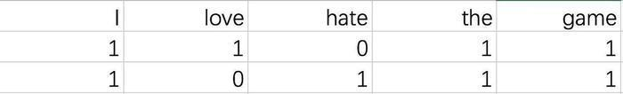
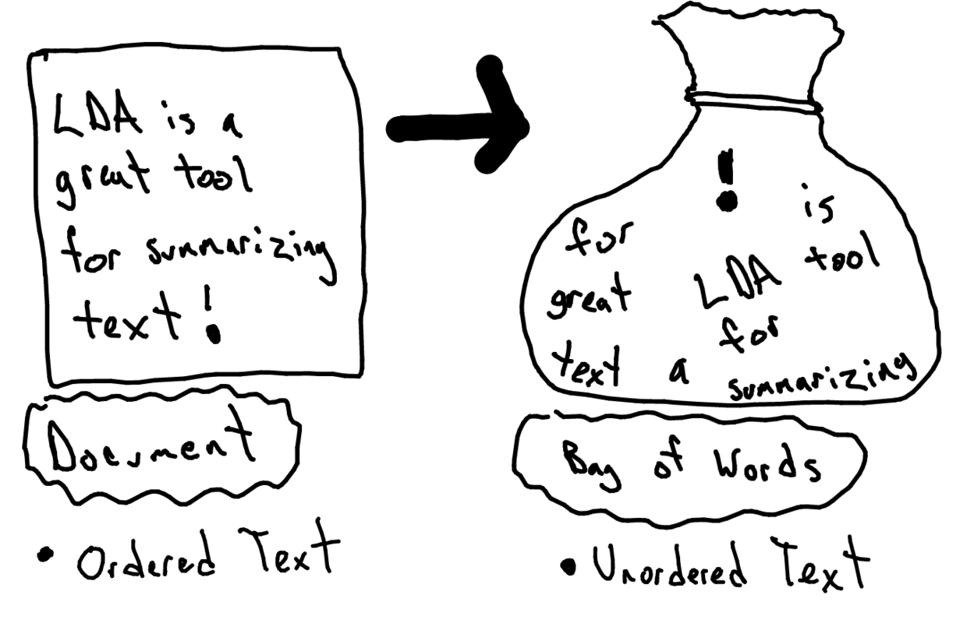
3
Explore the data format - vectorization
For example：
I love the game.
I hate the game.
Then we can simply extract the following features (in other words, list all the words)：
I , love, hate, the, game
For each sentence, count the number of features。Two sentences above are translated into the following table：
Here, we use （bag of words）
Each word is treated as a separate feature
添加标题
添加标题
添加标题

Slide 10
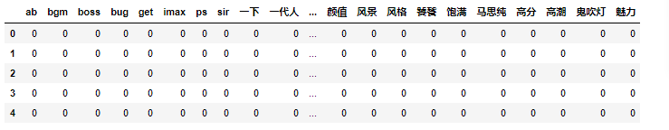
3
Explore the data format - vectorization
Smaple term_matrix
添加标题
添加标题
添加标题

Slide 11
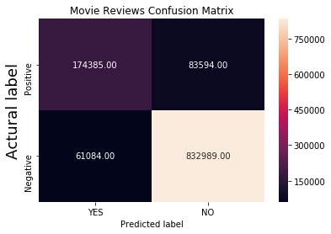
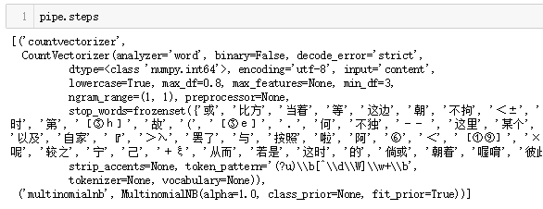

3
model implementation
Vectorization
Pipline
Trainning
Evaluation
Reduces features
Pipline Steps
Use 70% data to trainning.
Plot the maxtrix
* Numbers make no sense without units and context.
* The words used commonly should not be the features
* Those too special words, in fact, should not be retained
vectorization
MultionimalNB
Divided all the data into : 70% for training, 30% for test model.
Solution: This shows the module achieves an accuracy of about 87%.

Slide 12
4
CNN(Convolutional Neural Network)
Convolutional Neural Network (CNN)
The aim of a sentence model is to analyse and represent the semantic content of a sentence for purposes of classification or generation
Module
Remove all punctuations，alphabetic characters，all known stop words.
Calculate all vocabularies.
Convert words to the integers
Pad the arrays to the same length, then create an integer tensor of shape max_length * num_reviews
Data Preparation
Layers
Two Channel
Five Lyers (Input, Embedding, Convolution, Pooling, Faltten)
Evaluation
Plot loss and accuracy

Slide 13
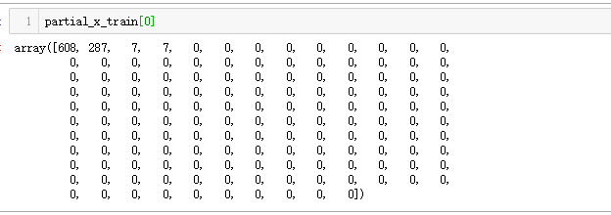
4
CNN-- data format
Since the movie reviews must be the same length, we will use the pad_sequences function to standardize the lengths:
添加标题
添加标题
添加标题

Slide 14
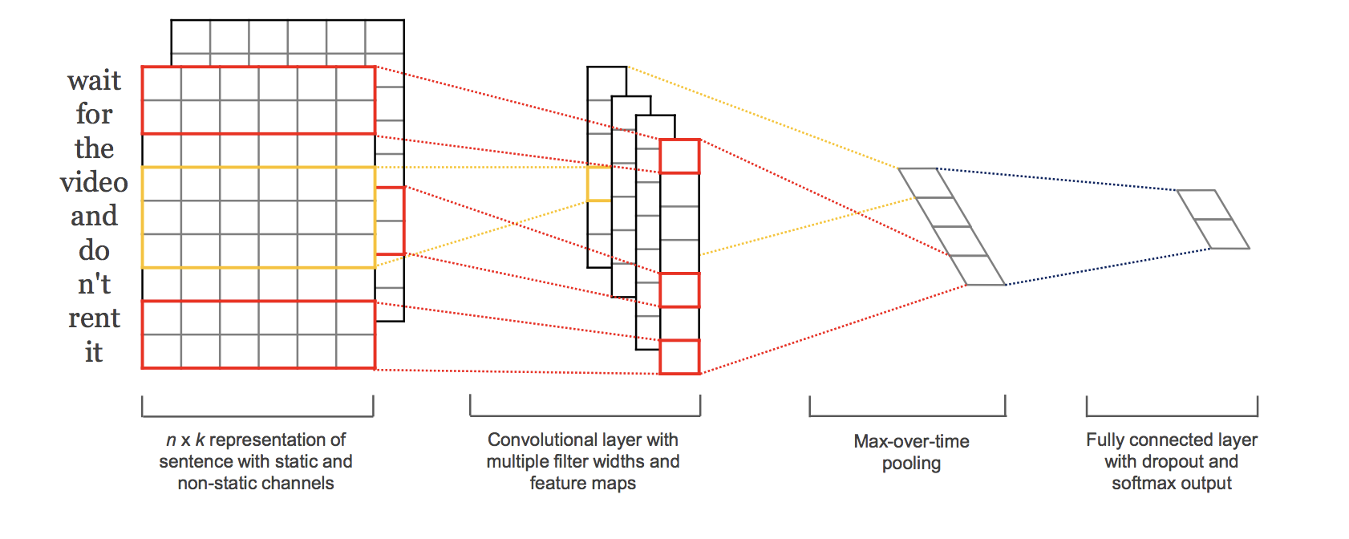
4
CNN(Convolutional Neural Network)
Input layer, which defines the length of the input sequence.
Embedding layer. This layer takes the integer-encoded vocabulary and looks up the embedding vector for each word-index. These vectors are learned as the model trains. The vectors add a dimension to the output array. The resulting dimensions are: (batch, sequence, embedding).
Convolution layer, with 32 filters, the kernel size defines the number of words to be considered when the convolution is passed in the input text document, thus providing grouping parameters.
MaxPooling1D layer merge the output of the convolution layer.
Flatten layer reduce the 3d output to 2d for linking.
添加标题
添加标题
添加标题

Slide 15
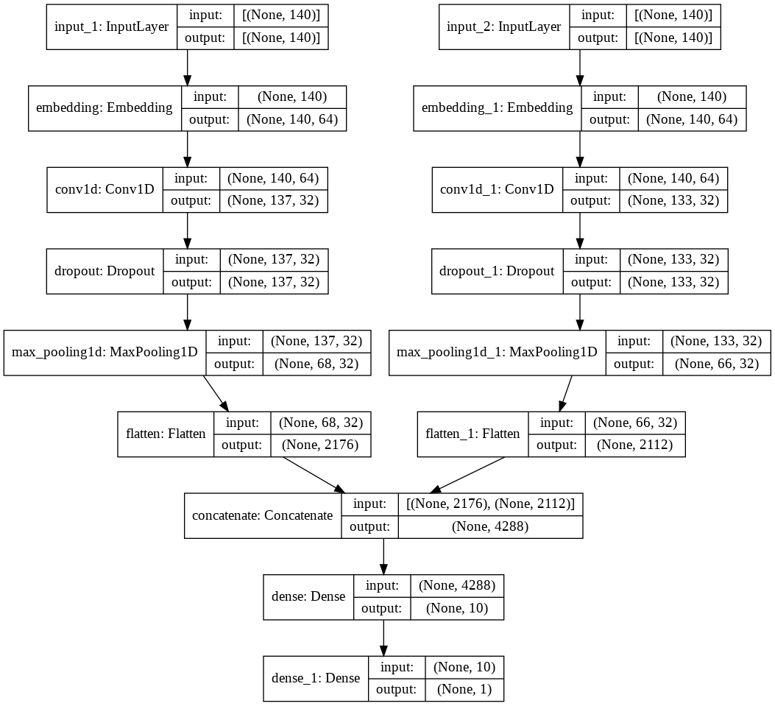
4
CNN(Convolutional Neural Network)
添加标题
添加标题
添加标题

Slide 16
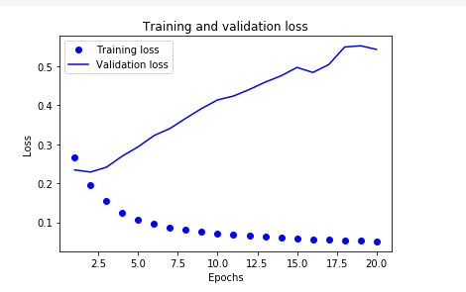
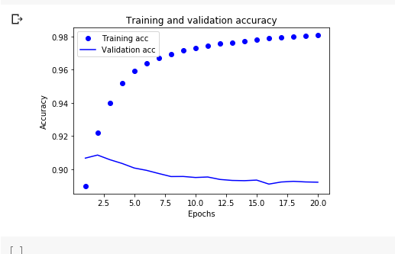
4
CNN- Evaluation
In this plot, the dots represent the training loss and accuracy, and the solid lines are the validation loss and accuracy.
Notice the training loss decreases with each epoch and the training accuracy increases with each epoch. This is expected when using a gradient descent optimization—it should minimize the desired quantity on every iteration.
This isn't the case for the validation loss and accuracy—they seem to peak after about 2 epochs. After this point, the model over-optimizes and learns representations specific to the training data that do not generalize to test data.
For this particular case, we could prevent overfitting by simply stopping the training after 2 epochs.
添加标题
添加标题
添加标题

Slide 17
THANKS!

