Slide 1
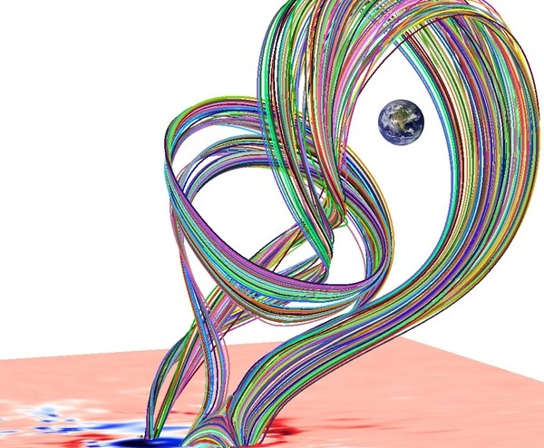
PHYS 8750 Numerical Fluid Dynamics
Simulation of a coronal mass ejection. Amari et al./Nature; link
Fall 2020

Slide 2
PHYS 8750
Outline
1) Introduction
2) Terminology and basics
ODE vs. PDE
Order of PDE
Linear vs. nonlinear
Types of equations
3) Numerical Scheme
Forward/backward/leapfrog
Upstream/downstream/center space
4) Criteria to evaluate Stability; accuracy; convergence; consistency
9:30 – 10:45 AM
Tuesday,Thursday 2020
Class #1

Slide 3
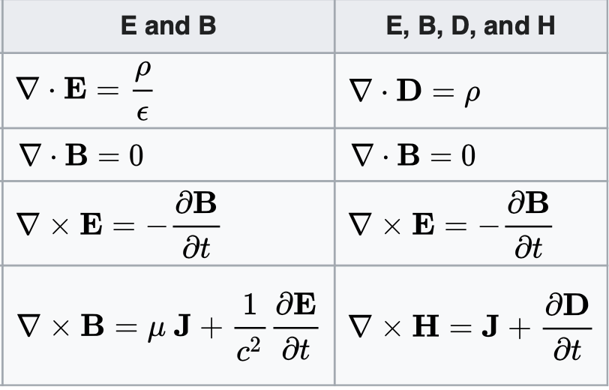
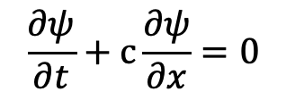

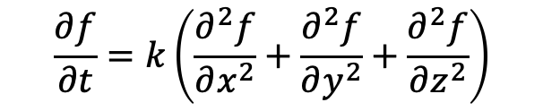

Our world consists of ordinary and partial differential equations
Wave equations:
$$\frac{∂ψ}{∂t}+c\frac{∂ψ}{∂x}=0$$
Solution:$ψ=f(x−ct)$
Heat conduction/diffusion equations:
$$\frac{∂f}{∂t}=k\left(\frac{∂^{2}f}{∂x^{2}}+\frac{∂^{2}f}{∂y^{2}}+\frac{∂^{2}f}{∂z^{2}}\right)$$
Laplace Equation:
$\left(\frac{∂^{2}ψ}{∂x^{2}}+\frac{∂^{2}ψ}{∂y^{2}}+\frac{∂^{2}ψ}{∂z^{2}}\right)$=0
Maxwell’s Equation:

Slide 4
Left side of “=“ … time rate of change of each variable.
Right side: advective terms for each variable.
Variables:
u: X-wind component
v: Y-wind component
w: Z-wind component
θ: potential temperature
p: pressure

Slide 5
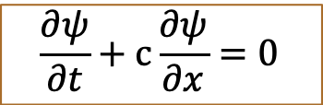
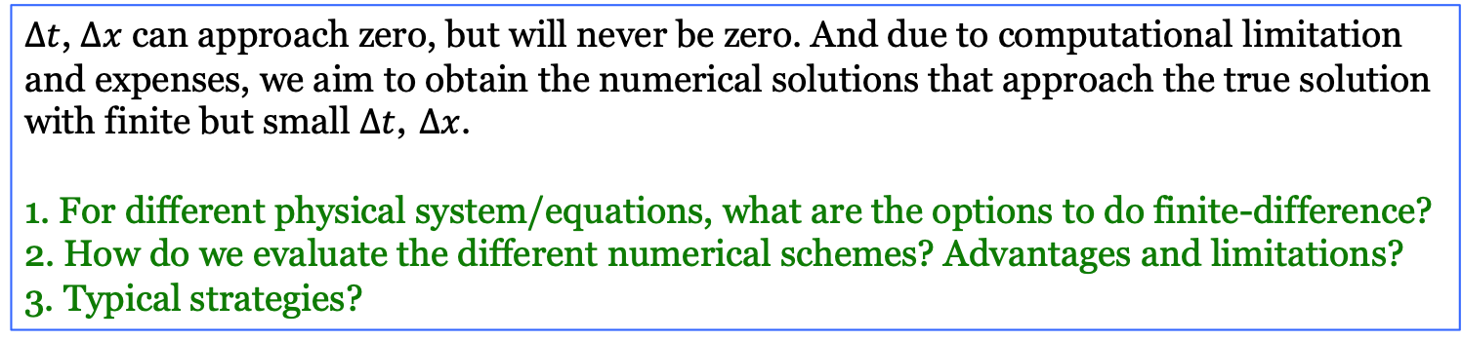
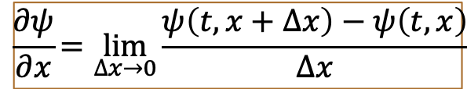
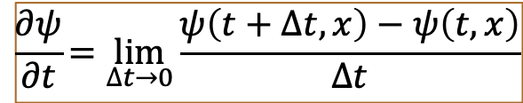
Sometimes, the solutions to these PDEs are analytical; but more than often, they are not! So we need to solve the equations numerically.
Finite-Difference
$$\frac{∂ψ}{∂t}+c\frac{∂ψ}{∂x}=0$$
Forward
time
Upstream
space
$$\frac{∂ψ}{∂t}=\lim_{∆t→0}{\frac{ψ\left(t+∆t,x\right)−ψ\left(t,x\right)}{∆t}}$$
$$\frac{∂ψ}{∂x}=\lim_{∆x→0}{\frac{ψ\left(t,x+∆x\right)−ψ\left(t,x\right)}{∆x}}$$
$ψ\left(t+∆t,x\right)=ψ\left(t,x\right)−c\frac{∆t}{∆x}$ $\left(ψ\left(t,x+∆x\right)−ψ\left(t,x\right)\right)$
$∆t$, $∆x$ can approach zero, but will never be zero. And due to computational limitation and expenses, we aim to obtain the numerical solutions that approach the true solution with finite but small $∆t$, $∆x$.
1. For different physical system/equations, what are the options to do finite-difference?
2. How do we evaluate the different numerical schemes? Advantages and limitations?
3. Typical strategies?

Slide 6
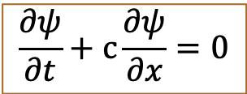


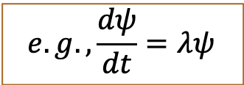

Terminology and Basics
ODE vs. PDE
ODE: contains only one independent variable, functions of this variable, and the derivatives of those functions.
PDE: more than one independent variables are involved.
$$e.g., \frac{dψ}{dt}=λψ$$
$ψ$= $ψ(t)$
$F(t,ψ^{′},ψ^{′′},{…,ψ}^{(n−1)}$ ${,ψ}^{(n)})=0$
$$\frac{∂ψ}{∂t}+c\frac{∂ψ}{∂x}=0$$
$ψ$= $ψ(t,x)$
$$F(t,ψ_{t}^{′},ψ_{t}^{′′},…,ψ_{t}^{\left(n\right)},x,ψ_{x}^{′},ψ_{x}^{′′},…,ψ_{x}^{\left(n\right)},ψ_{tx}^{′′},ψ_{ttx}^{′′′},ψ_{txx}^{′′′},…)=0$$

Slide 7

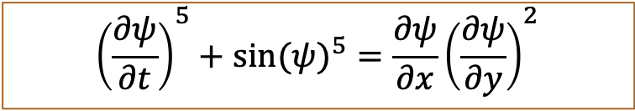
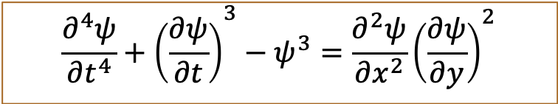
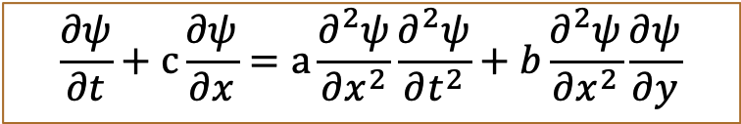
Order of ODE and PDE
Determined by highest order of derivatives
$F(t,ψ^{′},ψ^{′′},{…,ψ}^{(n−1)}$ ${,ψ}^{(n)})=0$
Order of n
$$F(t,ψ_{t}^{′},ψ_{t}^{′′},…,ψ_{t}^{\left(n\right)},x,ψ_{x}^{′},ψ_{x}^{′′},…,ψ_{x}^{\left(n\right)},ψ_{tx}^{′′},ψ_{ttx}^{′′′},ψ_{txx}^{′′′},…)=0$$
$$\frac{∂ψ}{∂t}+c\frac{∂ψ}{∂x}=a\frac{∂^{2}ψ}{∂x^{2}}\frac{∂^{2}ψ}{∂t^{2}}+b\frac{∂^{2}ψ}{∂x^{2}}\frac{∂ψ}{∂y}$$
Second Order
$${\frac{∂^{4}ψ}{∂t^{4}}+\left(\frac{∂ψ}{∂t}\right)}^{3}−ψ^{3}=\frac{∂^{2}ψ}{∂x^{2}}{\left(\frac{∂ψ}{∂y}\right)}^{2}$$
Fourth
$${\left(\frac{∂ψ}{∂t}\right)}^{5}+sin({ψ)}^{5}=\frac{∂ψ}{∂x}{\left(\frac{∂ψ}{∂y}\right)}^{2}$$
First

Slide 8
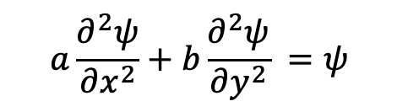
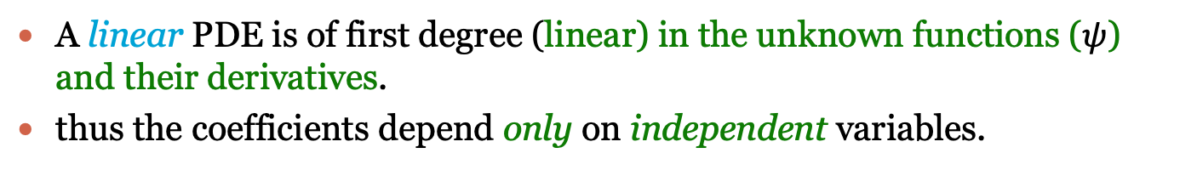
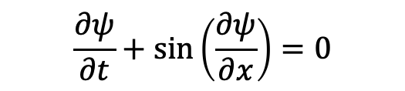

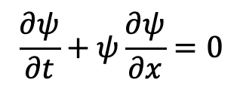
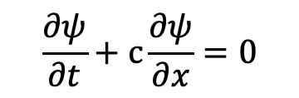
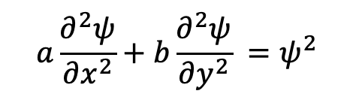
Linearity
A linear PDE is of first degree (linear) in the unknown functions ($ψ$) and their derivatives.
thus the coefficients depend only on independent variables.
$$\frac{∂ψ}{∂t}+c\frac{∂ψ}{∂x}=0$$
$${\left(\frac{∂ψ}{∂t}\right)}^{2}+c\frac{∂ψ}{∂x}=0$$
linear
nonlinear
$$a\frac{∂^{2}ψ}{∂x^{2}}+b\frac{∂^{2}ψ}{∂y^{2}} =ψ$$
$$\frac{∂ψ}{∂t}+sin\left(\frac{∂ψ}{∂x}\right)=0$$
$$\frac{∂ψ}{∂t}+ψ\frac{∂ψ}{∂x}=0$$
$$a\frac{∂^{2}ψ}{∂x^{2}}+b\frac{∂^{2}ψ}{∂y^{2}} =ψ^{2}$$
quasi-linear

Slide 9
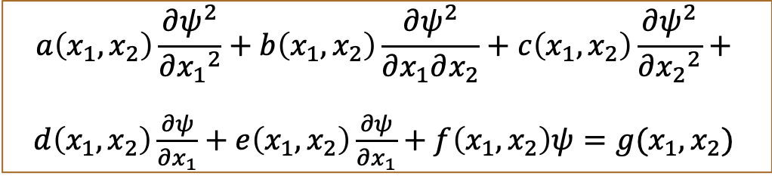

Type of PDE
Suppose we have a second-order PDE of the form:
$$a\left(x_{1},x_{2}\right)\frac{∂ψ^{2}}{∂{x_{1}}^{2}}+b\left(x_{1},x_{2}\right)\frac{∂ψ^{2}}{∂x_{1}∂x_{2}}+c\left(x_{1},x_{2}\right)\frac{∂ψ^{2}}{∂{x_{2}}^{2}}+$$
$d\left(x_{1},x_{2}\right)\frac{∂ψ}{∂x_{1}}+e\left(x_{1},x_{2}\right)\frac{∂ψ}{∂x_{1}}+f\left(x_{1},x_{2}\right)ψ=g(x_{1},x_{2}$)
Elliptical:
$$b^{2}−4ac<0, e.g.,2D Laplace equation$$
$\left(\frac{∂^{2}ψ}{∂x^{2}}+\frac{∂^{2}ψ}{∂y^{2}}\right)=0, a=1,b=0,c=1,b^{2}−4ac$=-4
Hyperbolic
$$b^{2}−4ac>0, e.g.,wave (advection, transport) equation,$$
$\frac{∂ψ}{∂t}+\frac{∂ψ}{∂x}=0→\frac{∂^{2}ψ}{∂t^{2}}+\frac{∂^{2}ψ}{∂x∂t}, a=1,b=1,c=0,b^{2}−4ac$=1
Parabolic:
$$b^{2}−4ac=0, e.g.,heat diffusion$$
$\frac{∂f}{∂t}=k\left(\frac{∂^{2}f}{∂x^{2}}\right), a=0,b=0,c=k,b^{2}−4ac$=0

Slide 10
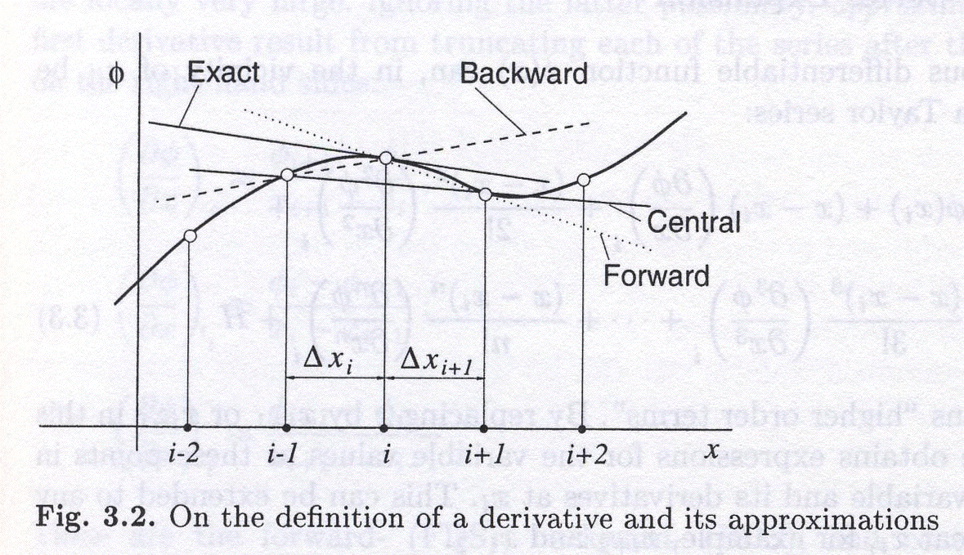
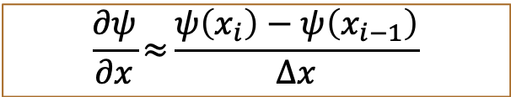
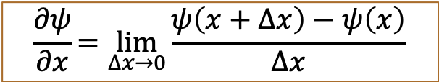
Finite difference approximations to derivatives
$$\frac{∂ψ}{∂x}=\lim_{∆x→0}{\frac{ψ\left(x+∆x\right)−ψ\left(x\right)}{∆x}}$$
$$\frac{∂ψ}{∂x}≈{\frac{ψ\left(x_{i}\right)−ψ\left(x_{i−1}\right)}{∆x}}$$
We want the slope (derivative) at this point
Ferziger and Peric (2002), p. 41

Slide 11

Approximations Forward
$$\frac{∂ψ}{∂x}=\lim_{∆x→0}{\frac{ψ\left(x+∆x\right)−ψ\left(x\right)}{∆x}}$$
$$\frac{∂ψ}{∂x}≈{\frac{ψ\left(x_{i+1}\right)−ψ\left(x_{i}\right)}{∆x}}$$

Slide 12
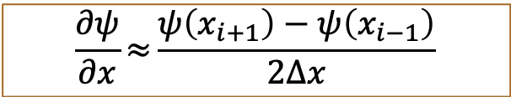
Approximations Central
$$\frac{∂ψ}{∂x}=\lim_{∆x→0}{\frac{ψ\left(x+∆x\right)−ψ\left(x\right)}{∆x}}$$
$$\frac{∂ψ}{∂x}≈{\frac{ψ\left(x_{i+1}\right)−ψ\left(x_{i−1}\right)}{2∆x}}$$

