Slide 1
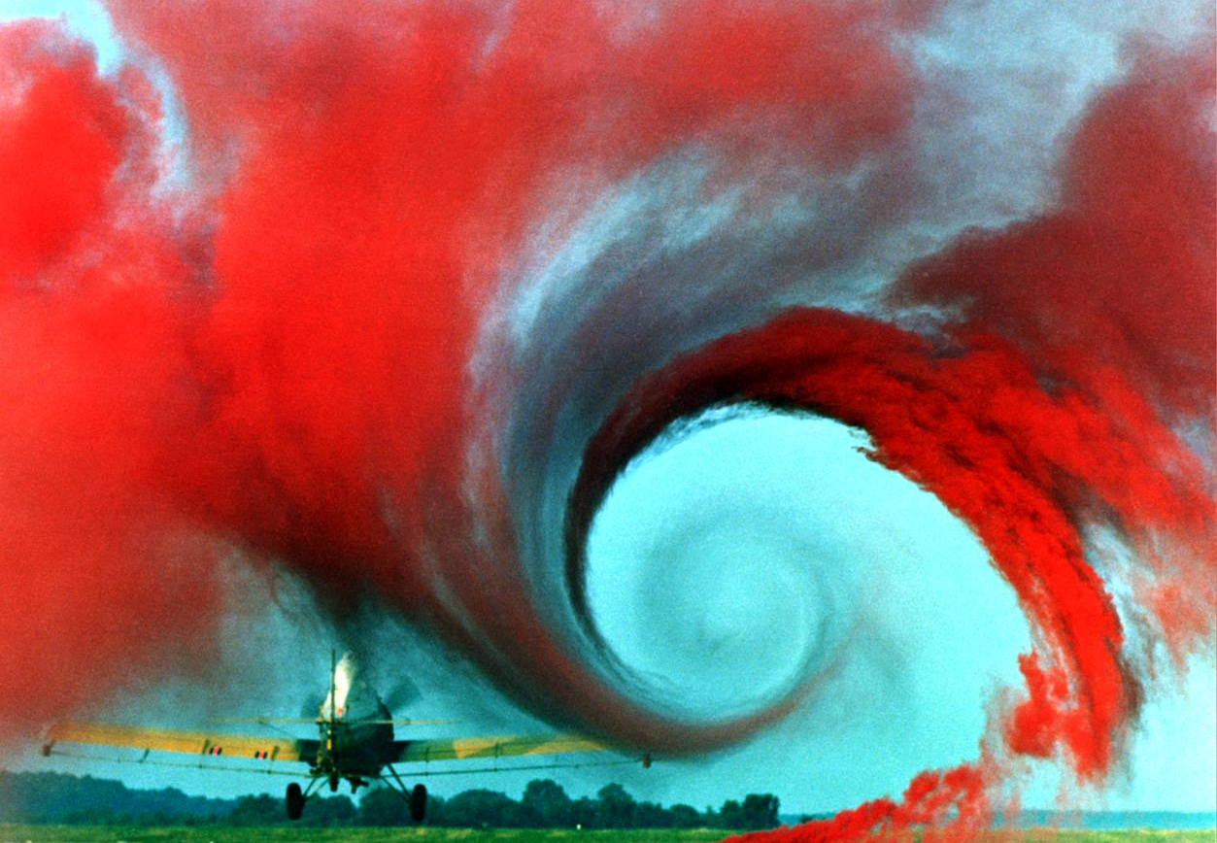
PHYS 8750 Numerical Fluid Dynamics
http://lisar.larc.nasa.gov/UTILS/info.cgi?id=EL-1996-00130
Fall 2020

Slide 2
PHYS 8750
Outline
Multi-stage methods
1) Runge-Kutta method
2) Matsuno method
Multi-step methods
1) Leap-frog method
Amplitude and phase behavior of multi-stage(step) methods
Class #2 (Chapter 2.1, 2.2) 1) Truncation errors & order of accuracy
2) A-stability and stability diagram
3) Amplitude and phase error
Class #3 (Chapter 2.3, 2.4)

Slide 3
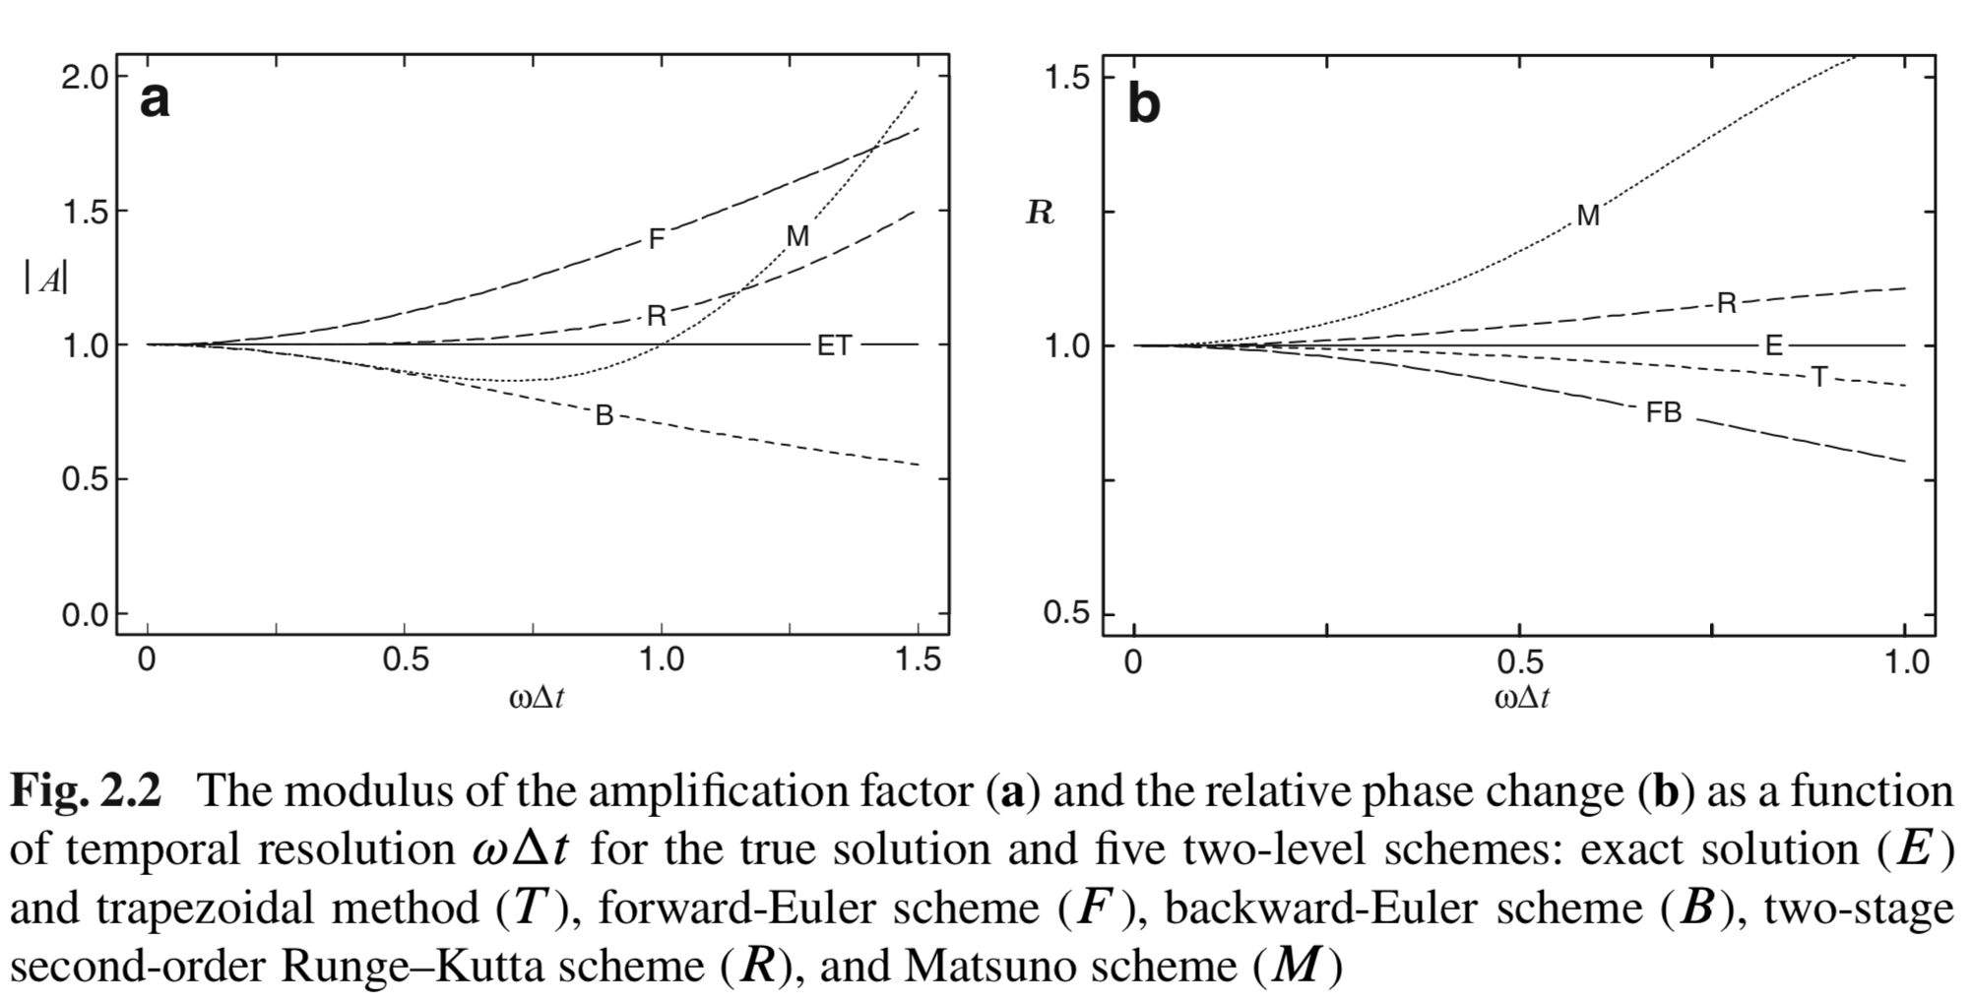
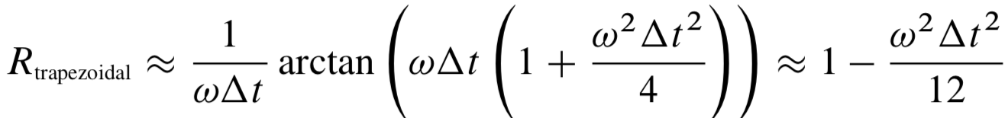
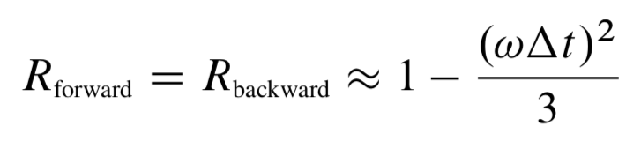
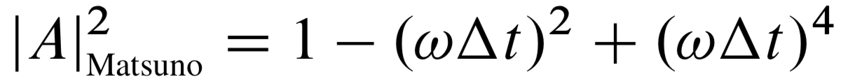
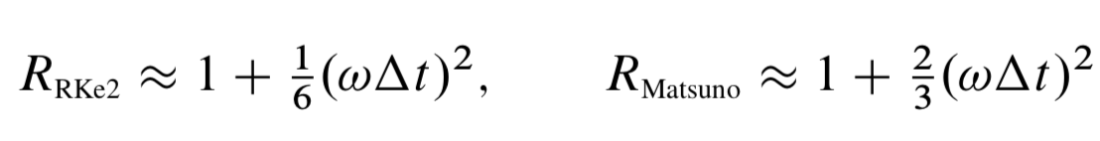
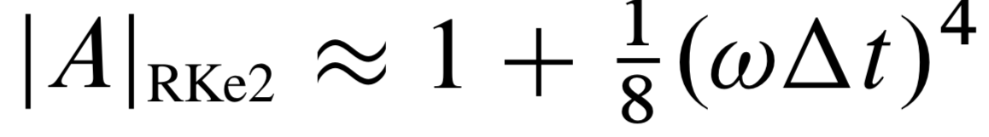
Amplitude and Phase Behavior

Slide 4
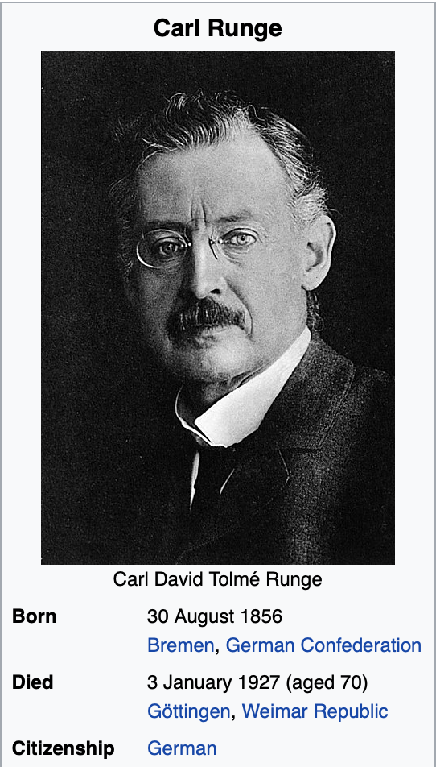
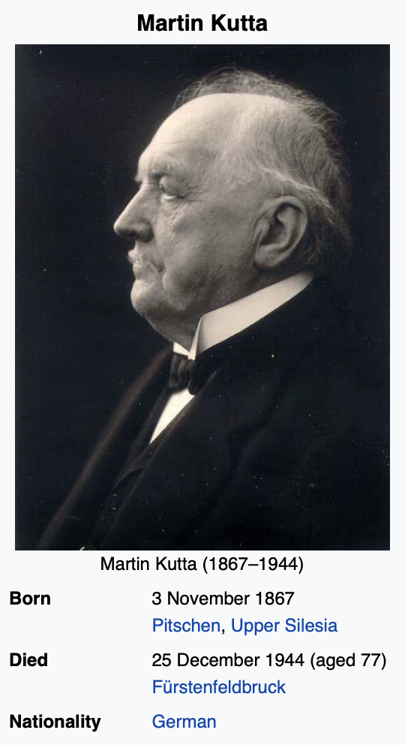
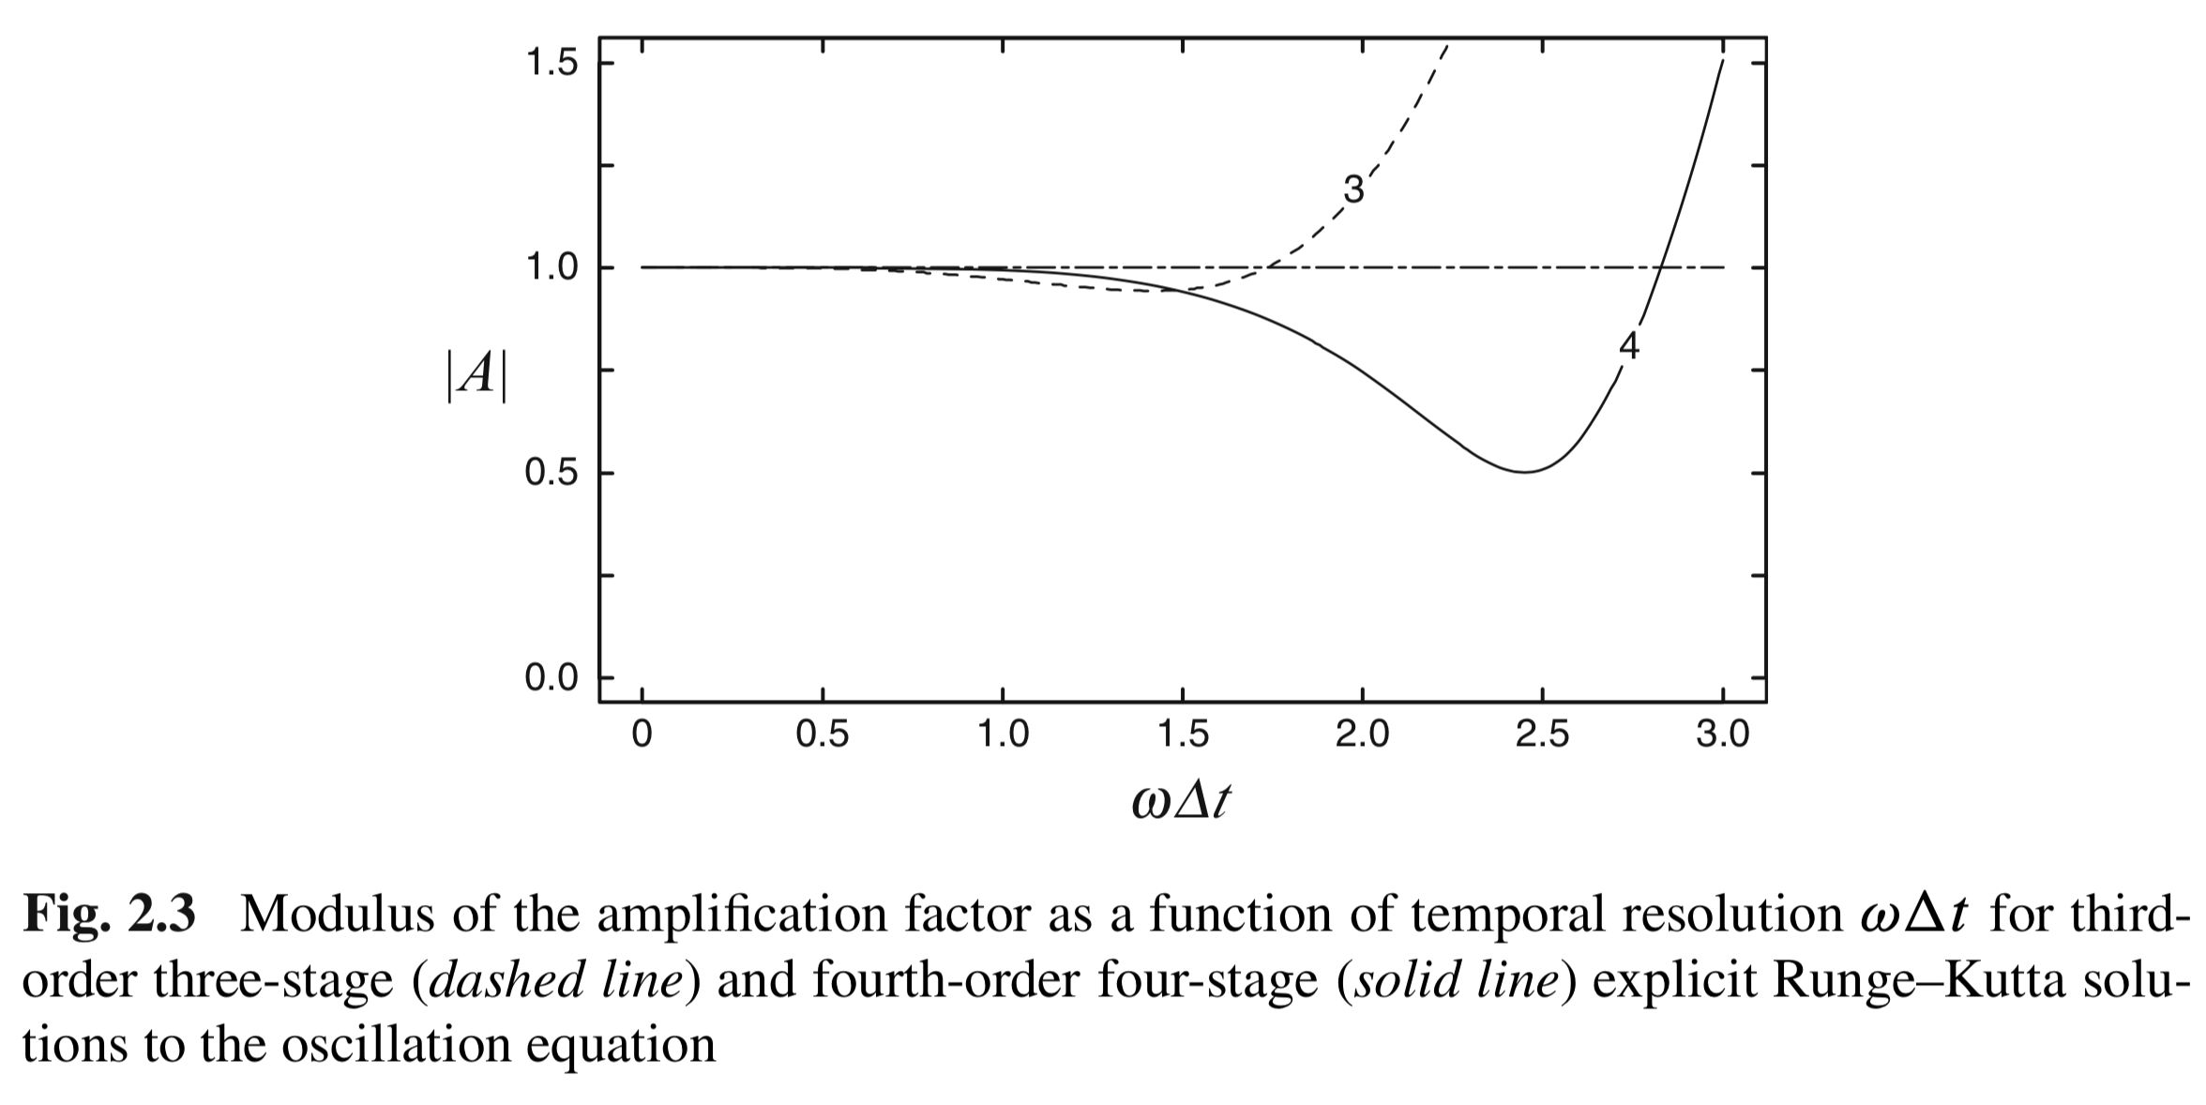
Multi-Stage Runge-Kutta Method

