Slide 1
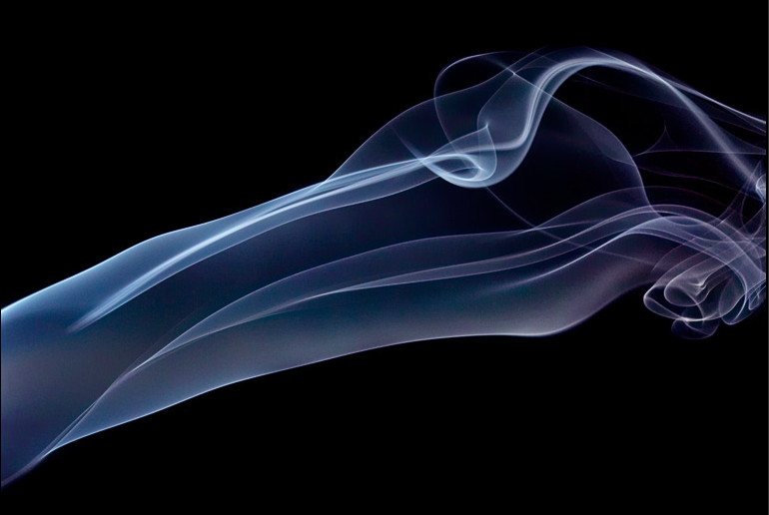
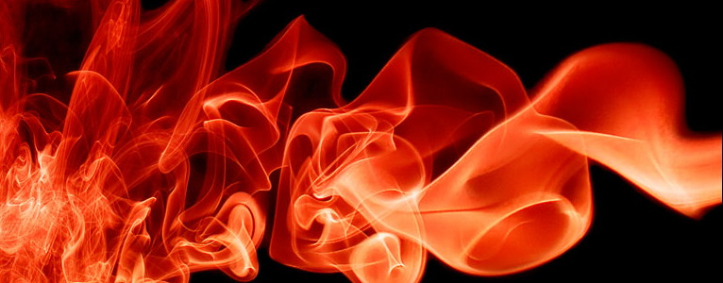
PHYS 8750 Numerical Fluid Dynamics
Graham Jeffery, sensitivelight.com -- colored smoke
Fall, 2020

Slide 2
PHYS 8750
Outline
Multi-stage methods
1) Runge-Kutta scheme
2) Matsuno scheme
Multi-step methods
1) Leap-frog scheme
2) Adams-Bashforth scheme
Amplitude and phase behavior of multi-stage(step) methods
Class #3 (Chapter 2.3) 1) Multi-stage methods
Runge-Kutta 2-stage and 4-stage
2) Stability, amplitude and phase diagram
3) Amplitude and phase error
Class #4 (Chapter 2.4)

Slide 3
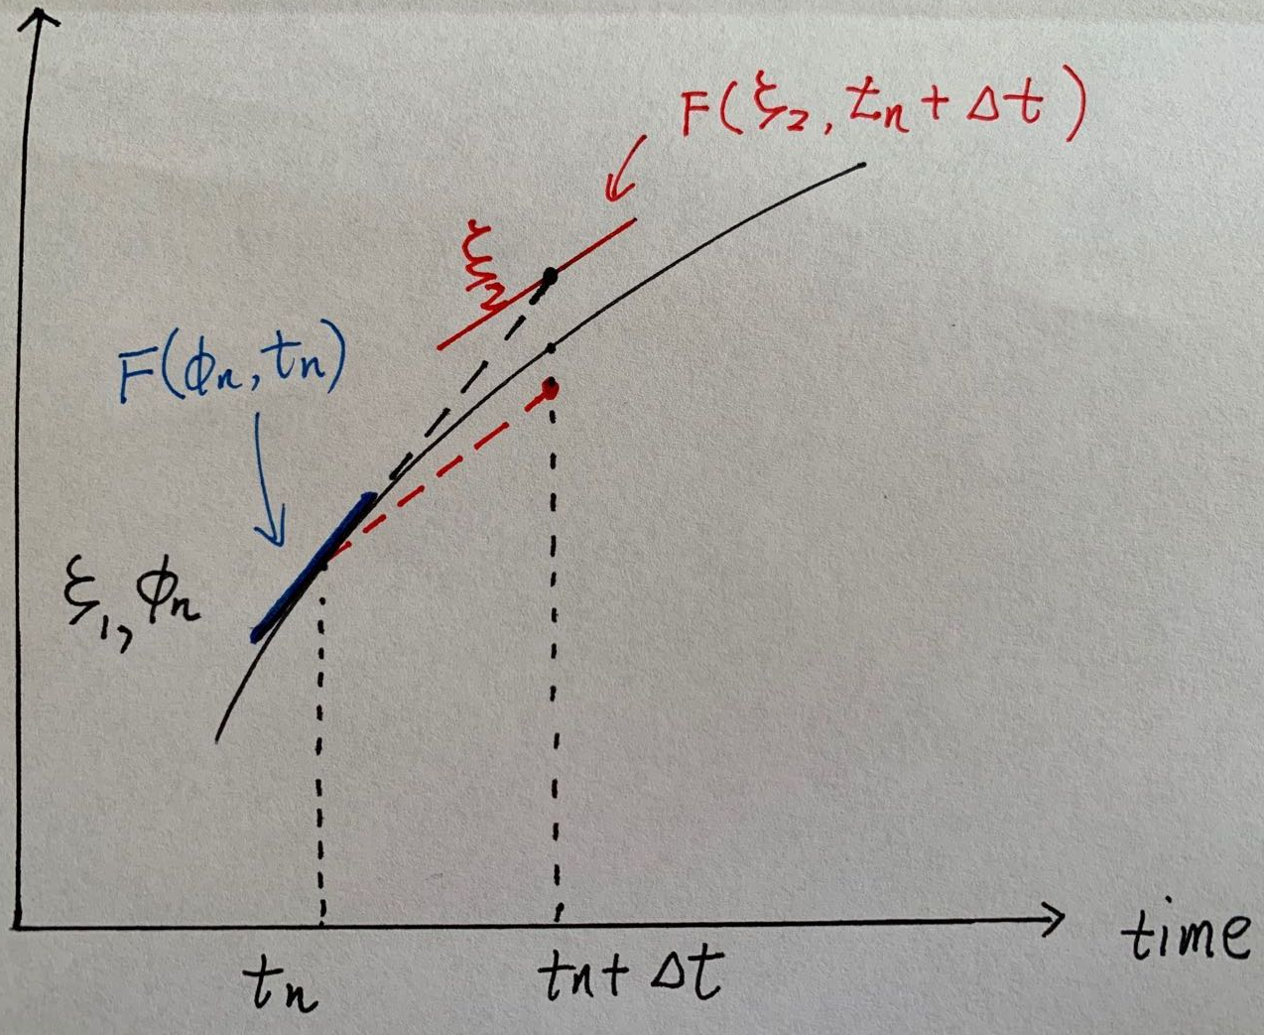
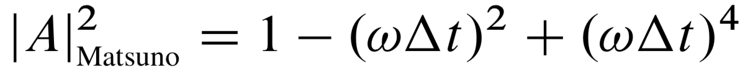

Two-Stage Matsuno Scheme
$ξ_{1}=φ_{n}$, $ξ_{2}=φ_{n}+ΔtF\left(φ_{n},t_{n}\right), φ_{n+1}=φ_{n}+ΔtF\left(ξ_{2},t_{n}+Δt\right)$
Damp high-frequency gravity waves in meteorological models

Slide 4
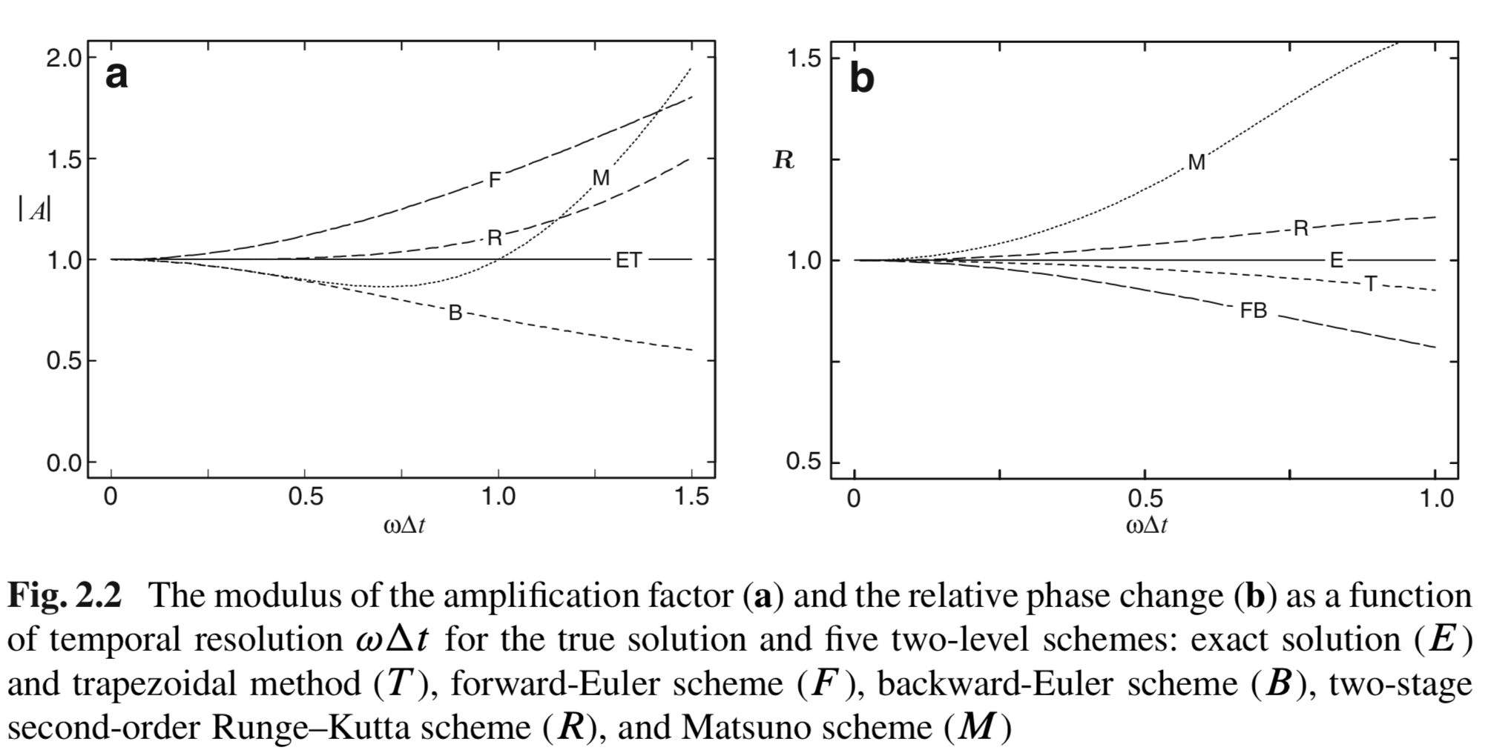
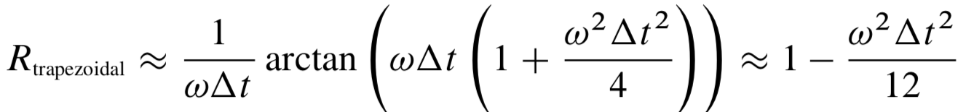
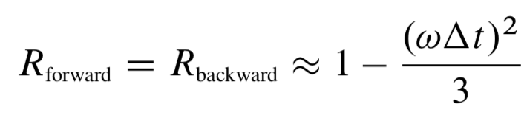
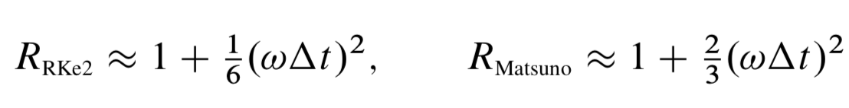
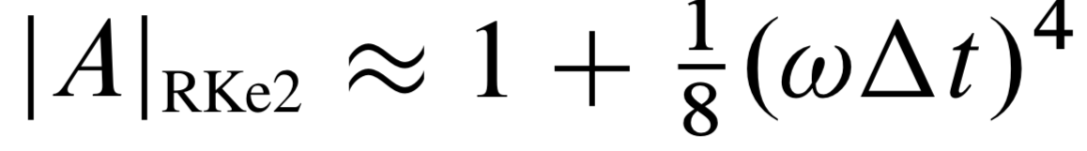
Amplitude and Phase Behavior

Slide 5
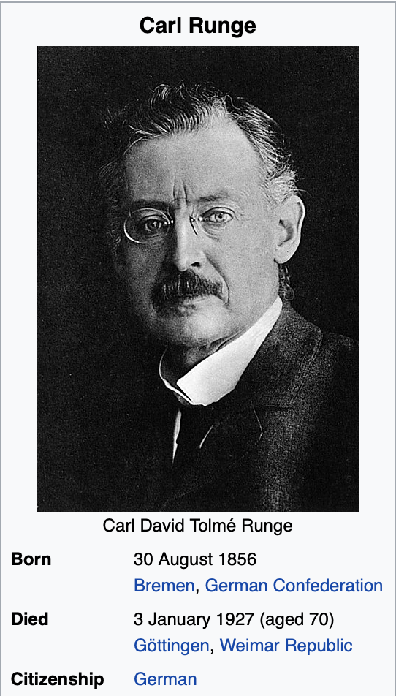
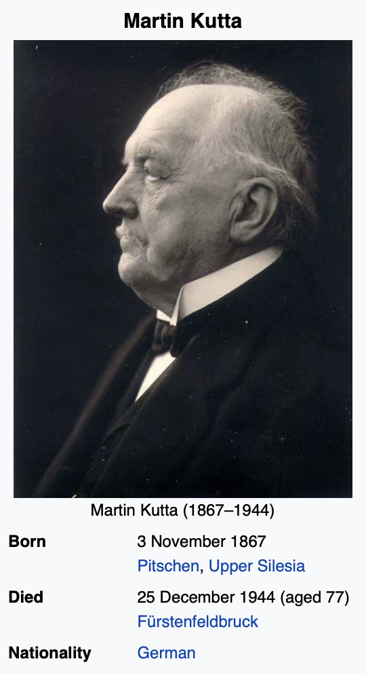
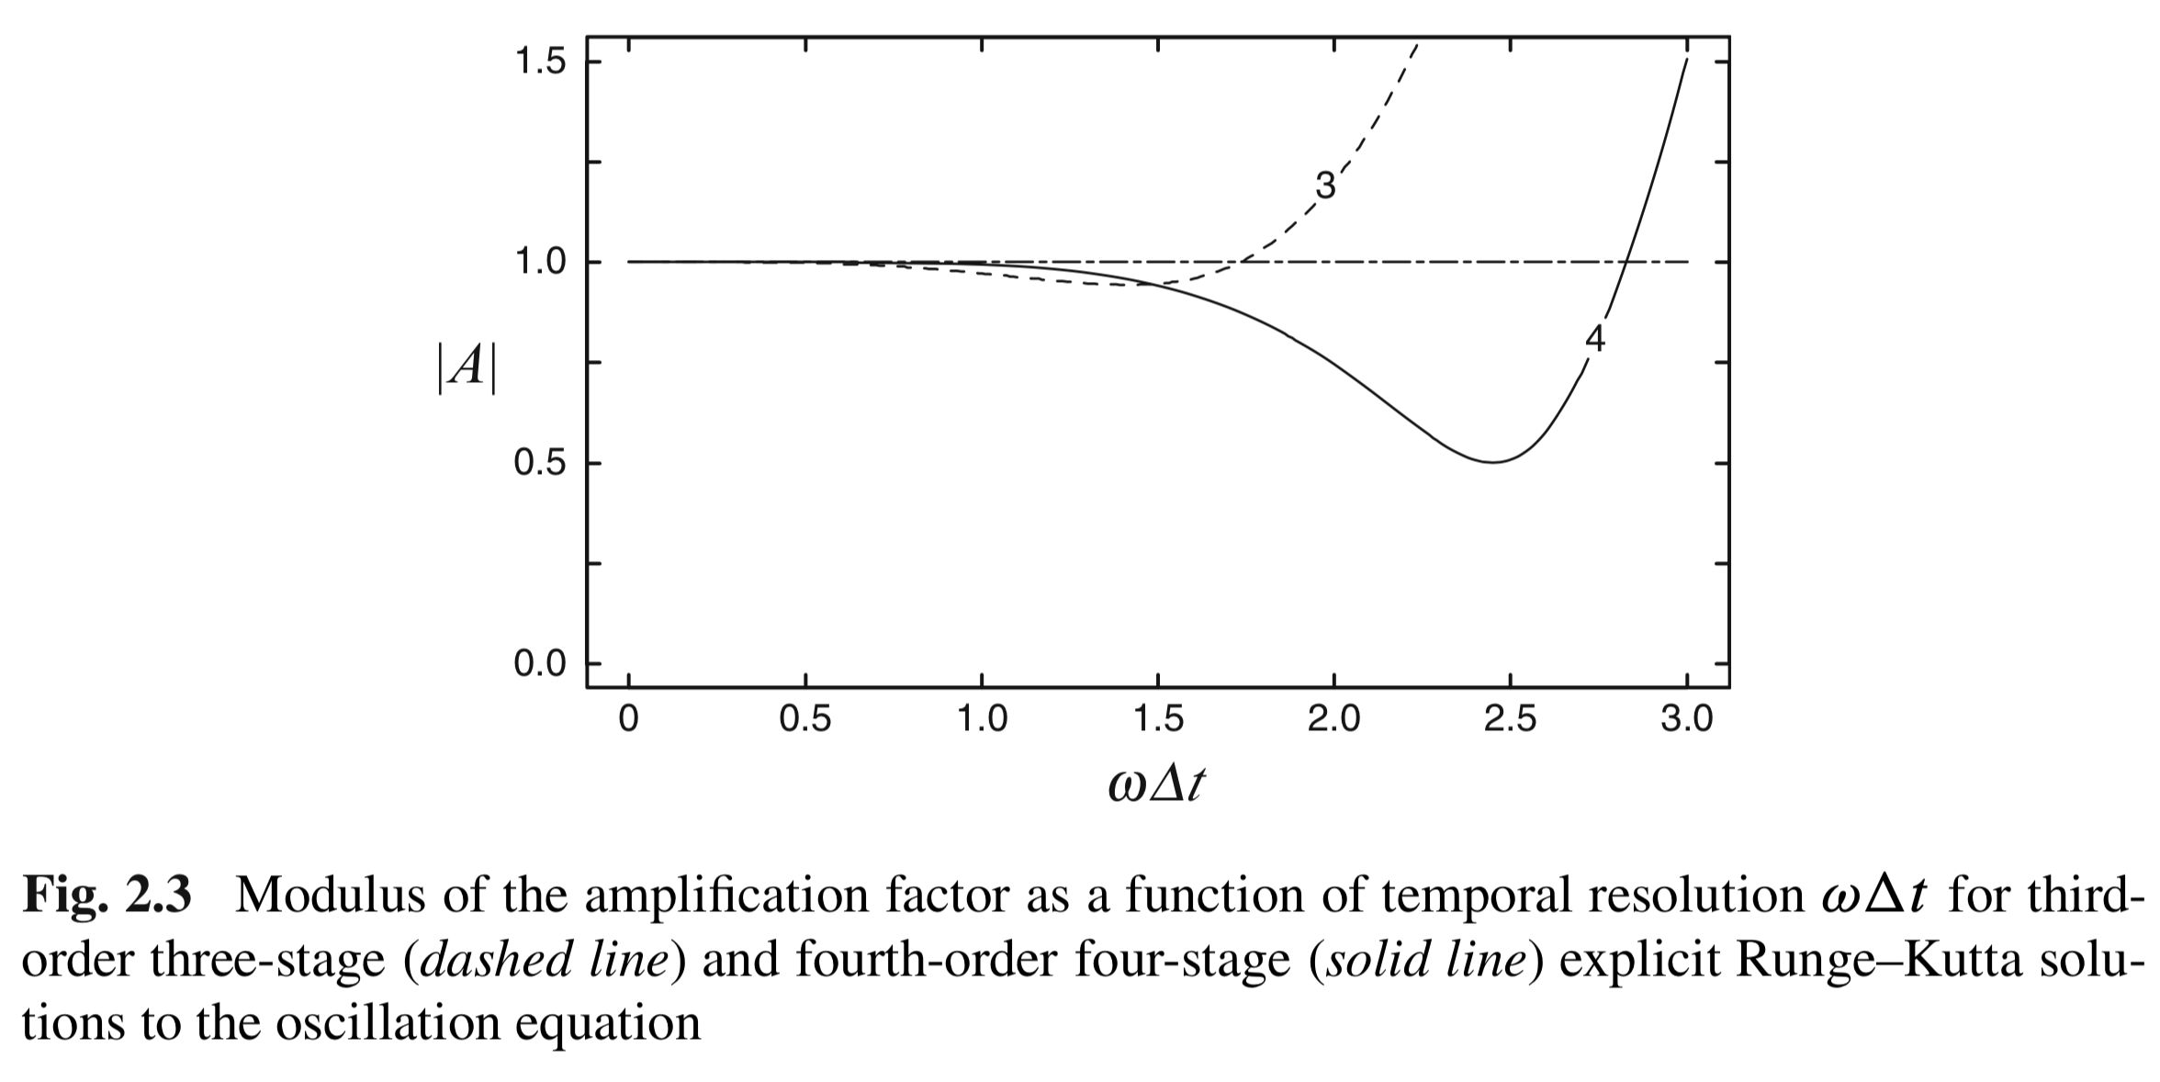
Multi-Stage Runge-Kutta Method

Slide 6

Disadvantage & Advantage
Advantages
Disadvantages
High order of accuracy
Small amp errors
Small phase errors
Efficient damping at high-frequency
Stability
Large $Δt$ allowed
Evaluating derivatives multiple times
Extensive storage
More expensive computation

Slide 7
Multi-Step Scheme
Multiple time steps are used to computer the next time step.
Achieve high order of accuracy, without using too much storage.
Physical and computational modes both exist. Need to suppress the errors arising from computation modes.
Leapfrog & Adams-Bashforth

Slide 8

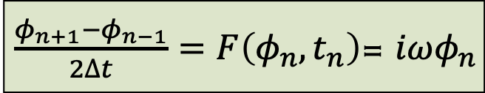



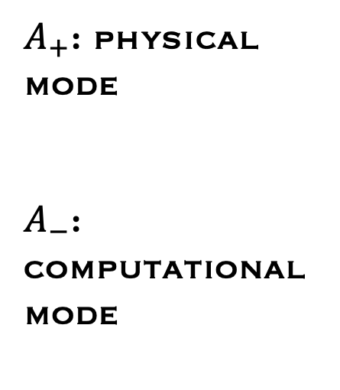


Leapfrog
$A_{+}$: physical mode
$A_{−}$: computational mode
$\frac{φ_{n+1}−φ_{n−1}}{2∆t}=F\left(φ_{n},t_{n}\right)$= $iωφ_{n}$
$$A^{2}−2iω∆t−1=0$$
$$A_{±}=iω∆t±{\left(1−ω^{2}{∆t}^{2}\right)}^{1/2}$$
$$\left|ω∆t\right|≤1$$
$$\left|ω∆t\right|≥1$$
$$\left|A_{±}\right|=1$$
$$\left|A_{+}\right|>\left|ω∆t\right|>1$$

Slide 9
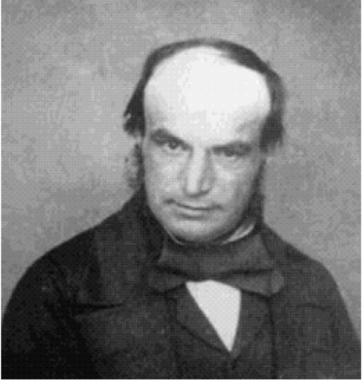
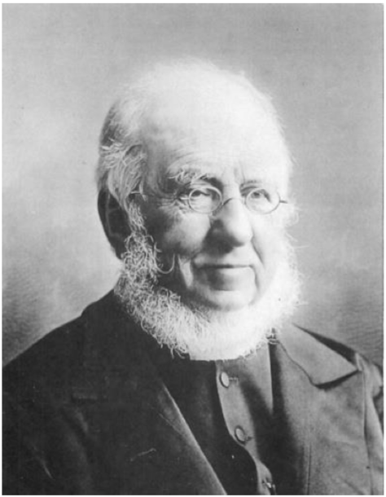
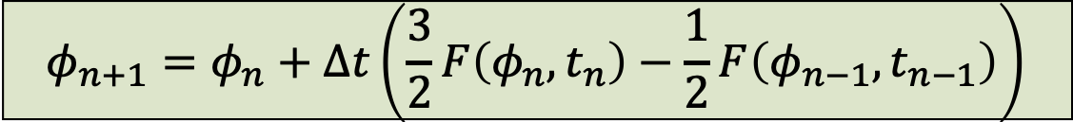
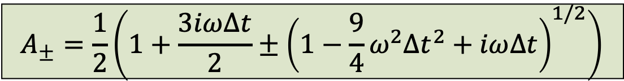
Adams-Bashforth
John Couch Adams
1819-1892
British astronomer and mathematician; predicted existence of Neptune
Francis Bashforth
1819-1912
British mathematician; influential ballistics expert.
$$φ_{n+1}=φ_{n}+∆t\left(\frac{3}{2}F\left(φ_{n},t_{n}\right)−\frac{1}{2}F\left(φ_{n−1},t_{n−1}\right)\right)$$
$$A_{±}=\frac{1}{2}\left(1+\frac{3iω∆t}{2}±{\left(1−\frac{9}{4}ω^{2}{∆t}^{2}+iω∆t\right)}^{1/2}\right)$$

Slide 10
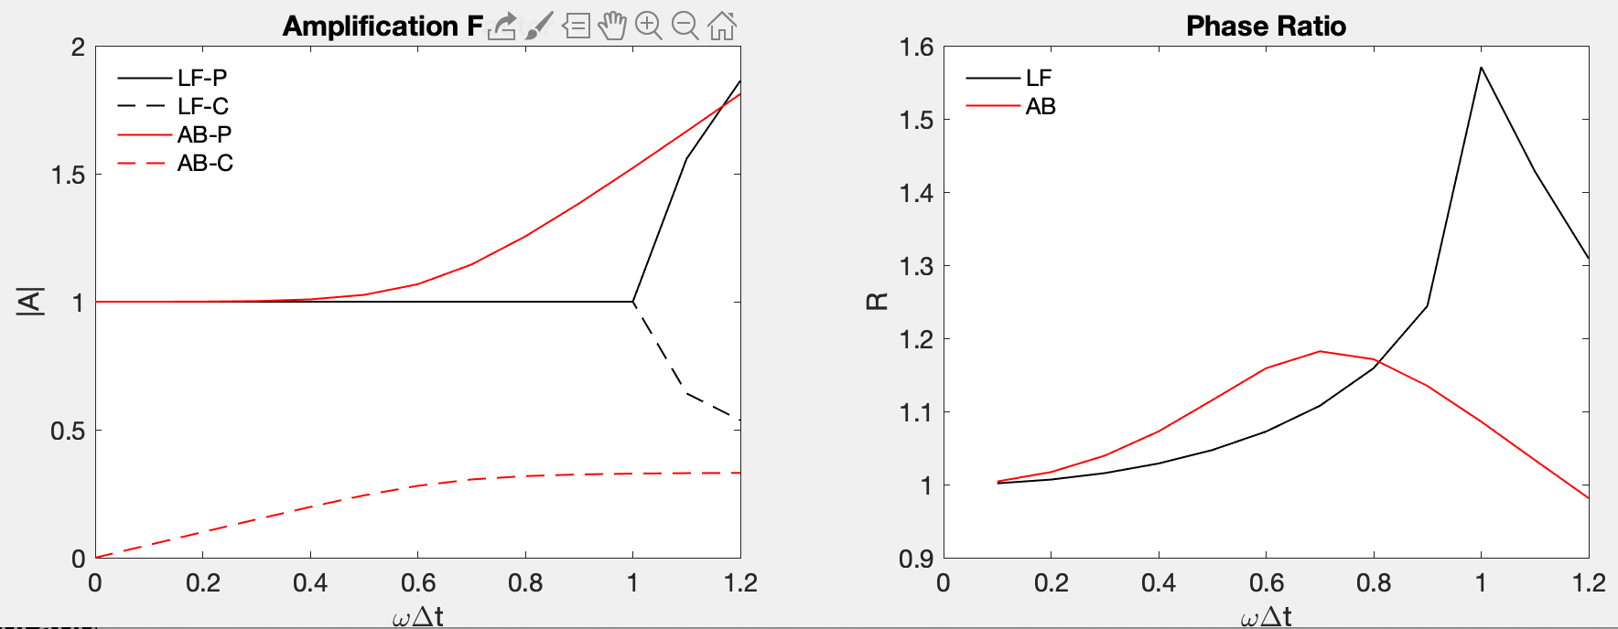

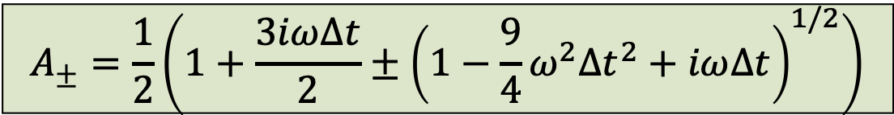
Amplification & Phase Ratio
Leapfrog
$$A_{±}=iω∆t±{\left(1−ω^{2}{∆t}^{2}\right)}^{1/2}$$
Adams-
Bashforth
$$A_{±}=\frac{1}{2}\left(1+\frac{3iω∆t}{2}±{\left(1−\frac{9}{4}ω^{2}{∆t}^{2}+iω∆t\right)}^{1/2}\right)$$

Slide 11
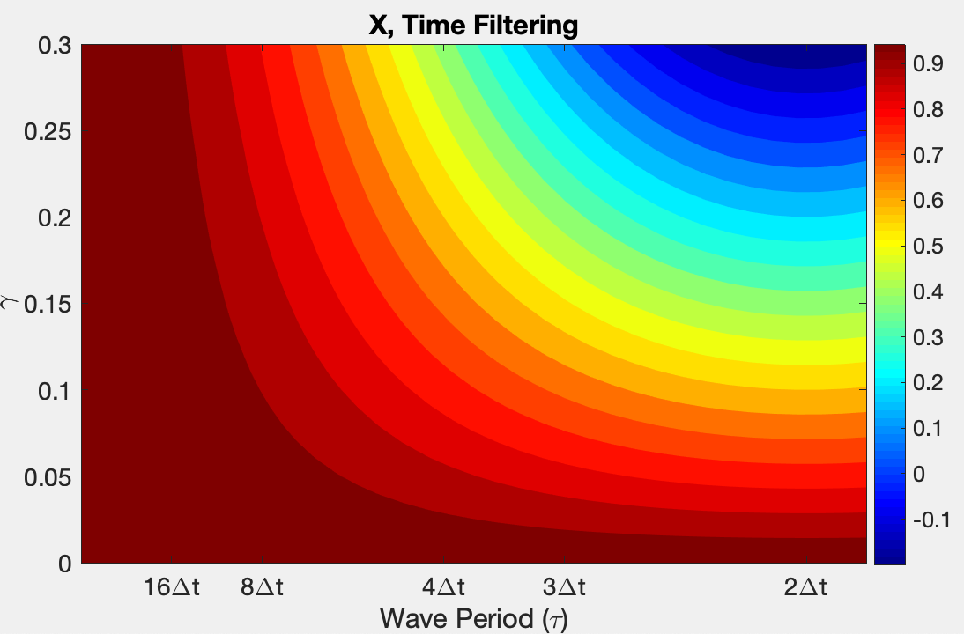


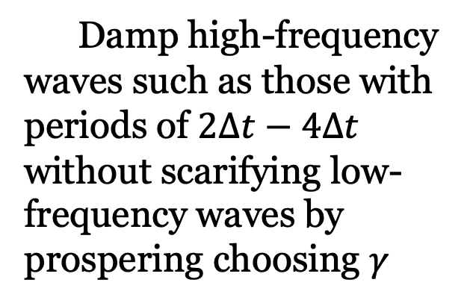
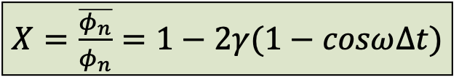
Leapfrog + Time Filtering
Time filtering: Damp the poorly resolved oscillation ($2∆t$) and/or suppress computational mode
Post-processing way
$$\overline{φ_{n}}=φ_{n}+γ\left(φ_{n+1}−2φ_{n}+φ_{n−1}\right)$$
$X=$ $\frac{\overline{φ_{n}}}{φ_{n}}=1−2γ(1−cosω∆t)$
Damp high-frequency waves such as those with periods of $2∆t−$ $4∆t$ without scarifying low-frequency waves by prospering choosing $γ$

Slide 12
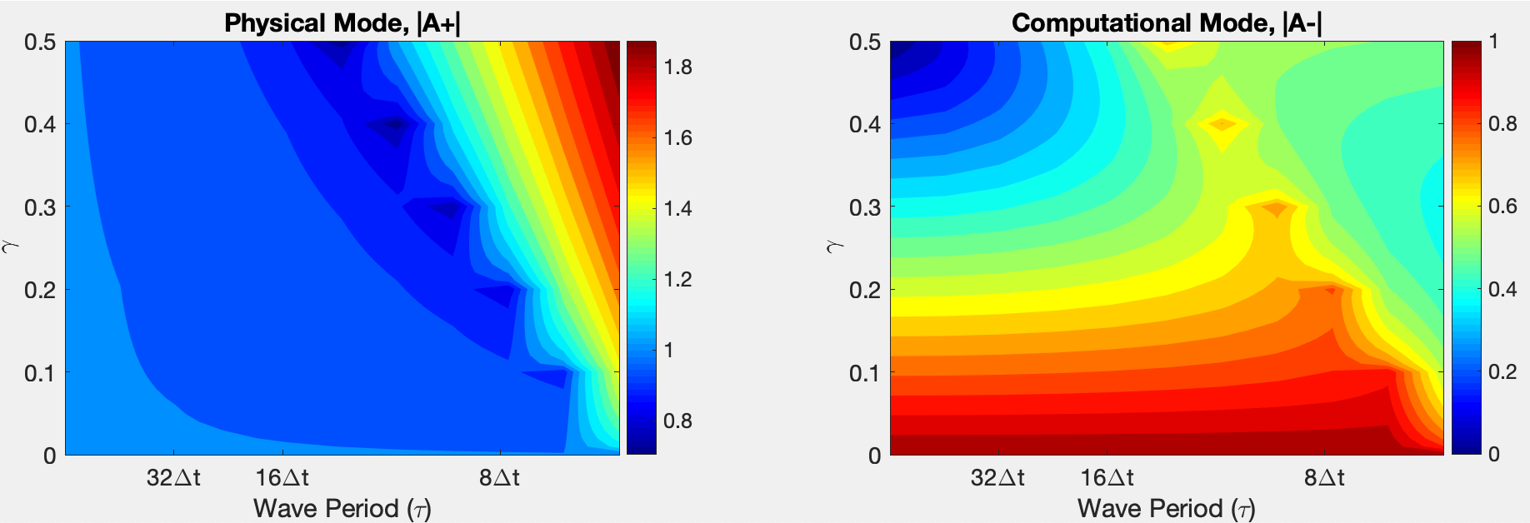
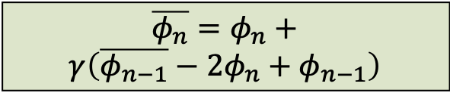

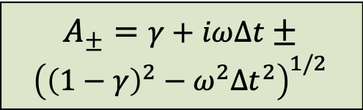
Leapfrog + Time Filtering
2) Interactive Way: e.g., incorporate second-derivative time filter into the time integration cycle
$$φ_{n+1}=\overline{φ_{n−1}}+2∆tF\left(φ_{n}\right)$$
Asselin-filtered
$$A_{±}=γ+iω∆t±$$
$${\left({\left(1−γ\right)}^{2}−ω^{2}{∆t}^{2}\right)}^{1/2}$$
$$\overline{φ_{n}}=φ_{n}+$$
$$γ\left(\overline{φ_{n−1}}−2φ_{n}+φ_{n−1}\right)$$
Choose $γ:A_{+}≈1, \& A_{−}<1 andA_{−}→0$ for low-freq waves.
Limitation: unstable for high-frequency components.

Slide 13
Oscillation Problem
Leapfrog w/wo filter, and Adams-Bashforth
Code: LF_AB_StabilityAmplification_ODE_OscillationProb_7.m
LF: would suffer computational mode
Asselin-LF: damp computational mode, accurate amplitude.
AB: damp computational mode, errors contaminate

