Slide 1
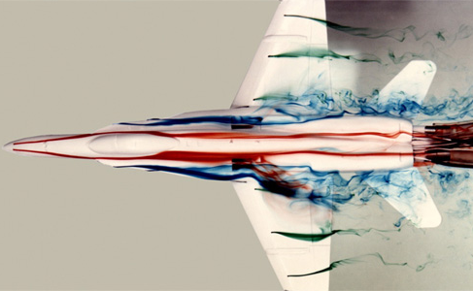
PHYS 8750 Numerical Fluid Dynamics
NASA/DRYDEN flow visualization facility
Fall, 2020

Slide 2
PHYS 8750
Outline
Partial Differential Equations
1) Truncation errors
2) Stability, Convergence, Consistency
Von Neumann’s methods (Stability)
Dispersion and Dissipation errors
1-st, 2-nd, 3-rh, and 4-th order space schemes (Runge-Kutta scheme).
Lax-Wendroff Scheme (two time step)
Takacs Scheme (two time step)
Class #4 (Chapter 2.4) 1) Multi-step schemes
Leapfrog
Adams-Bashforth
2) Physical and computational modes
3) Time filtering for multi-step schemes
Class #5 (Chapter 3.1， 3.2)

Slide 3
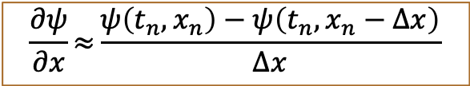
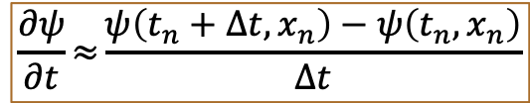
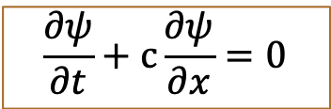
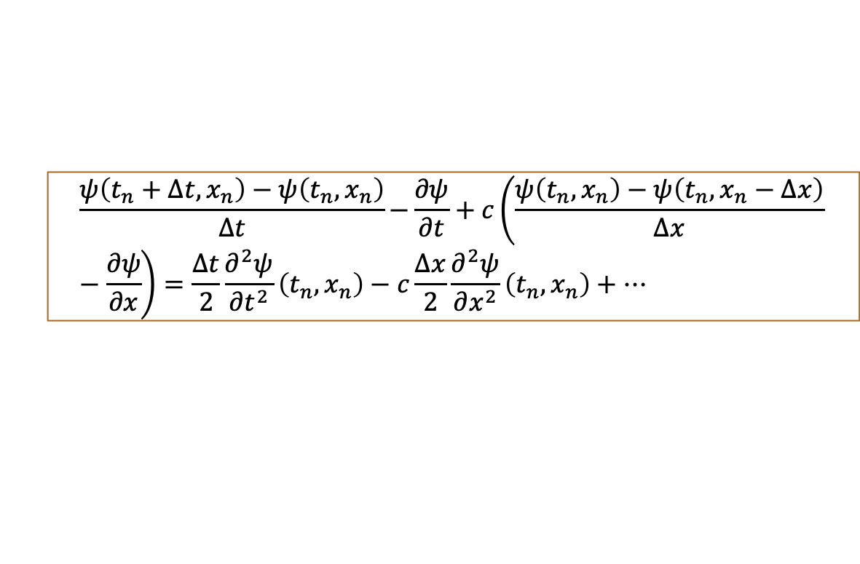
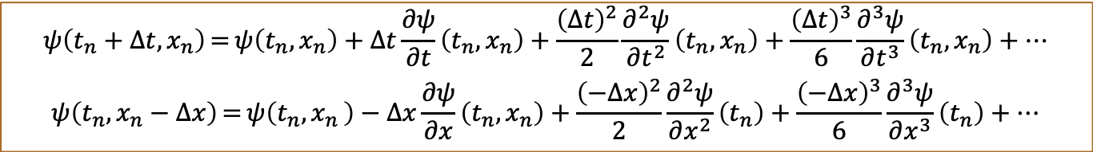

Truncation Error & Order of Accuracy
Analytical Solution
TRANSPORT PDE
$$\frac{∂ψ}{∂t}+c\frac{∂ψ}{∂x}=0$$
$$ψ=f\left(x−ct\right), c is speed$$
Forward
time
Upstream
space
$$\frac{∂ψ}{∂t}≈{\frac{ψ\left(t_{n}+∆t,x_{n}\right)−ψ\left(t_{n},x_{n}\right)}{∆t}}$$
$$\frac{∂ψ}{∂x}≈{\frac{ψ\left(t_{n},x_{n}\right)−ψ\left(t_{n},x_{n}−∆x\right)}{∆x}}$$
Taylor Expansion:
$$ψ\left(t_{n}+∆t,x_{n}\right)={ψ\left(t_{n},x_{n}\right)+∆t\frac{∂ψ}{∂t}\left(t_{n},x_{n}\right)+\frac{{\left(∆t\right)}^{2}}{2}\frac{∂^{2}ψ}{∂t^{2}}\left(t_{n},x_{n}\right)+\frac{{\left(∆t\right)}^{3}}{6}\frac{∂^{3}ψ}{∂t^{3}}\left(t_{n},x_{n}\right)+…}$$
$$ψ\left(t_{n},x_{n}−∆x\right)={ψ\left(t_{n}{,x}_{n}\right)−∆x\frac{∂ψ}{∂x}\left(t_{n},x_{n}\right)+\frac{{\left(−∆x\right)}^{2}}{2}\frac{∂^{2}ψ}{∂x^{2}}\left(t_{n}\right)+\frac{{\left(−∆x\right)}^{3}}{6}\frac{∂^{3}ψ}{∂x^{3}}\left(t_{n}\right)+…}$$
Truncation Error
$$\frac{ψ\left(t_{n}+∆t,x_{n}\right)−ψ\left(t_{n},x_{n}\right)}{∆t}−{\frac{∂ψ}{∂t}+c\left(\frac{ψ\left(t_{n},x_{n}\right)−ψ\left(t_{n},x_{n}−∆x\right)}{∆x}−\frac{∂ψ}{∂x}\right)=\frac{∆t}{2}\frac{∂^{2}ψ}{∂t^{2}}\left(t_{n},x_{n}\right)−c\frac{∆x}{2}\frac{∂^{2}ψ}{∂x^{2}}\left(t_{n},x_{n}\right)+…}$$
The lowest orders of $∆t$ and $∆x$ determines the order of accuracy of the finite difference scheme: first order of accuracy in both time and space

Slide 4
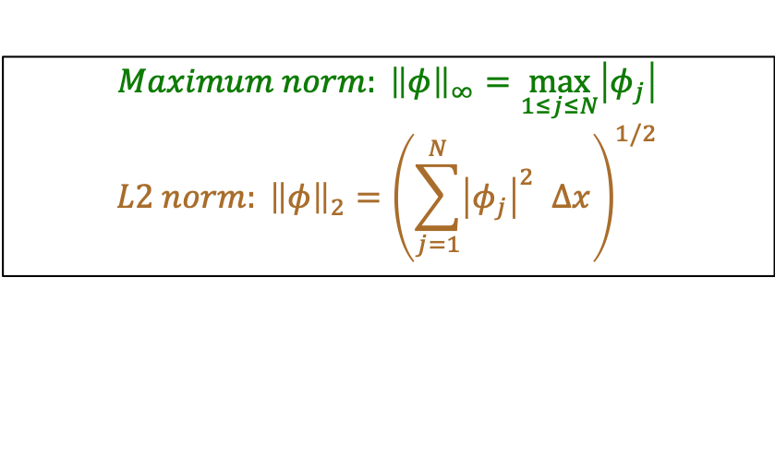
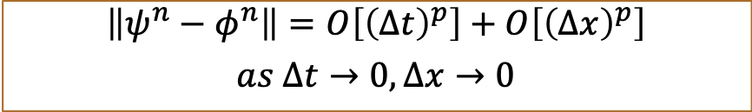
Consistency and Convergence
A scheme is consistent if truncation error of the finite-difference scheme approaches zero as $∆t→0,∆x→0$
e.g., Forward-time and Upstream-space scheme is consistent.
A finite scheme is convergent of order of $\left(p,q\right)$if at any time:
$$\left\|ψ^{n}−φ^{n}\right\|=Ο\left[{\left(∆t\right)}^{p}\right]+O\left[{\left(∆x\right)}^{p}\right]$$
$$as ∆t→0,∆x→0$$
$${Maximum norm: \left\|φ\right\|}_{∞}=\max_{1≤j≤N}\left|φ_{j}\right|$$
$${L2 norm: \left\|φ\right\|}_{2}={\left(\sum_{j=1}^{N}{{\left|φ_{j}\right|}^{2}} ∆x\right)}^{1/2}$$
Lax equivalent theorem: if a finite-difference scheme is linear, stable, and accurate of order of $\left(p,q\right)$, then it is convergent of order of $\left(p,q\right)$ [Lax and Richtmyer, 1956].

Slide 5
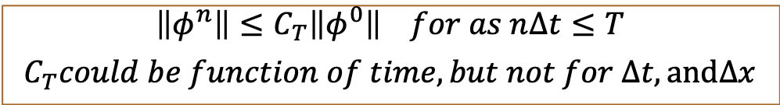

Stability
A consistent linear finite-difference scheme is convergent, satisfy Lax equivalent theorem, provided that for any time T, there exists such as
$$\left\|φ^{n}\right\|≤C_{T}\left\|φ^{0}\right\| for as n∆t≤T$$
$$C_{T}could be function of time, but not for ∆t, and∆x$$
Solutions can grow, but will grow with a bound: won’t blow up.
A-Stability for Non-increasing problems (wave, advection, transport, diffusion)
Two popular methods to judge: Energy method & Von Neumann’s method.
$$\left\|φ^{n}\right\|≤\left\|φ^{0}\right\| for n$$

Slide 6
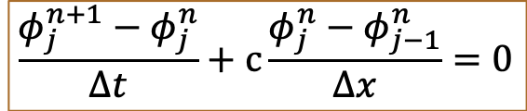



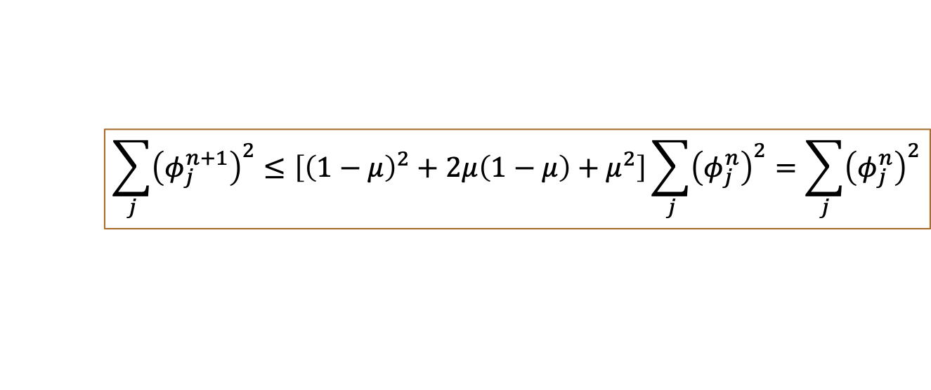
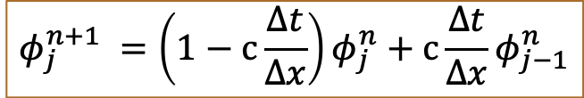
Energy method
Compared with Von Neumann’s method, used to nonlinear questions and problems without periodic boundaries.
$$\sum_{j=1}^{N}{{\left(φ_{j}^{n}\right)}^{2} is bounded for any n}$$
Forward
time
Upstream
space
$$\frac{φ_{j}^{n+1}−φ_{j}^{n}}{∆t}+c{\frac{φ_{j}^{n}−φ_{j−1}^{n}}{∆x}}=0$$
$$φ_{j}^{n+1} =\left(1−c{\frac{∆t}{∆x}}\right)φ_{j}^{n}+c{\frac{∆t}{∆x}}φ_{j−1}^{n}$$
$if μ$ $\left(1−μ\right)≥0$
$μ$= $c{\frac{∆t}{∆x}}$
$$\sum_{j}{{\left(φ_{j}^{n+1}\right)}^{2}}≤\left[{\left(1−μ\right)}^{2}+2μ\left(1−μ\right)+μ^{2}\right]\sum_{j}{{\left(φ_{j}^{n}\right)}^{2}}=\sum_{j}{{\left(φ_{j}^{n}\right)}^{2}}$$
$$Sufficient condition for stability:0<μ≤1, i.e.,\left(0<c{\frac{∆t}{∆x}}≤1\right)$$

Slide 7
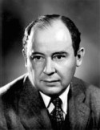
Stability condition
The von Neumann stability condition:
The (numerical) amplification factor A_{k} of every resolvable Fourier component must be bounded such that:
We’ll go with the more restrictive criteria:
This “≤1” is satisfactory for constant-speed advection …for which there should be no distortion and no amplitude change w/time.
|A_{k}| ≤ 1 means the numerical solution results, over time, remain bounded by their initial values. Appropriate if the norm of the true solution is constant with time.
John von Neumann
Wikipedia
Notes:
Finished here.

Slide 8
von Neumann’s method: limitations
Small print:
This is appropriate when the true solution is bounded by the norm of the initial data
If the stability criteria is met, every Fourier component is stable, and the full solution is, too.
The Von Neumann condition is a necessary and sufficient condition for stability.
The Von Neumann method is strictly speaking only applicable to linear, constant-coefficient problems
Sufficiency only for single equations in one unknown
Periodic boundary conditions are implied here.

Slide 9
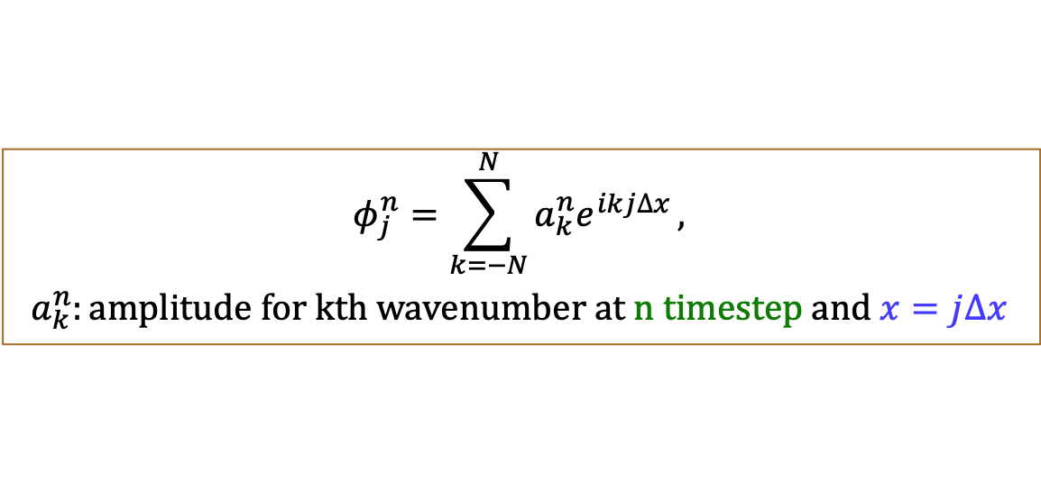


Von Neumann’s method
Only applicable for linear F-D equations with constant coefficients.
Decompose the solution (in analogue to Fourier transformation)
$$φ_{j}^{n}=\sum_{k=−N}^{N}{a_{k}^{n}e^{ikj∆x}},$$
$$a_{k}^{n}:amplitude for kth wavenumber at n timestep and x=j∆x$$
Von Neumann’s method: for every wavenumber, amplification factor is smaller than 1.
For k^{th} wavenumber
$$φ_{j}^{n+1} =A_{k}^{n}φ_{j}^{n}=\left(1−μ\right)φ_{j}^{n}+μφ_{j}^{n}e^{−ik∆x}$$
$${\left|A_{k}^{n}\right|}^{2}=1−2μ\left(1−μ\right)\left(1−cosk∆x\right)≤1$$
$$A_{k}^{n}=\left(1−μ\right)+μe^{−ik∆x}$$
$$0<μ≤1$$

Slide 10
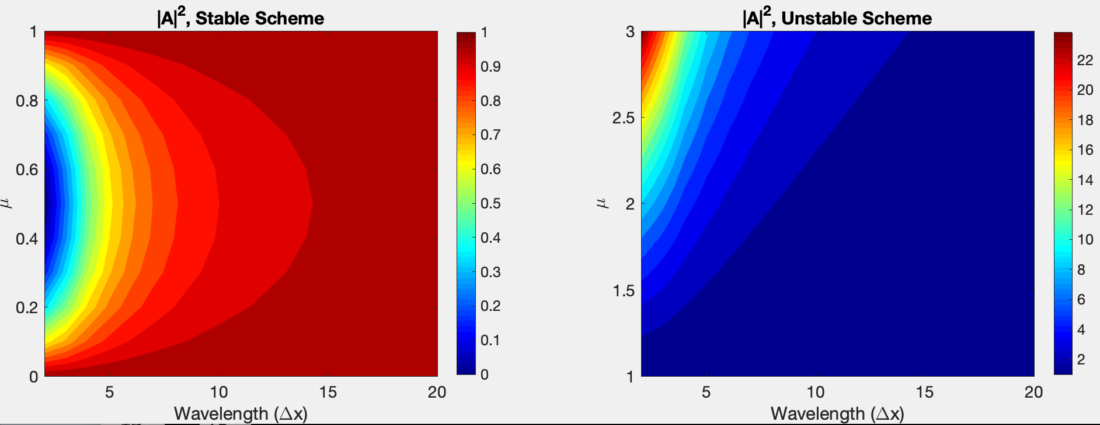
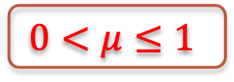
Stability & Amplification
$${\left|A_{k}^{n}\right|}^{2}=1−2μ\left(1−μ\right)\left(1−cosk∆x\right)≤1$$
$$0<μ≤1$$
For stable scheme, high-wavenumber (small-scale) waves are damped more efficiently.
For unstable scheme, high-wavenumber (small-scale) waves grow most rapidly.

Slide 11
Resolution: extremes
An infinitely long wave
… is a straight line.
A well-resolved wave
… has 7-10 (or more) grid points over a wavelength
A poorly-resolved wave
… has 3-5 grid points spanning a wavelength
A 2∆x (“two delta-x”) wave
… is basically unresolved at all (see Durran figure), though we say 2∆x is the “minimum” wavelength we could describe.
… similarly, a 2∆t wave appears over the span of two time steps. We say 2∆t is the minimum period we could describe.

Slide 12
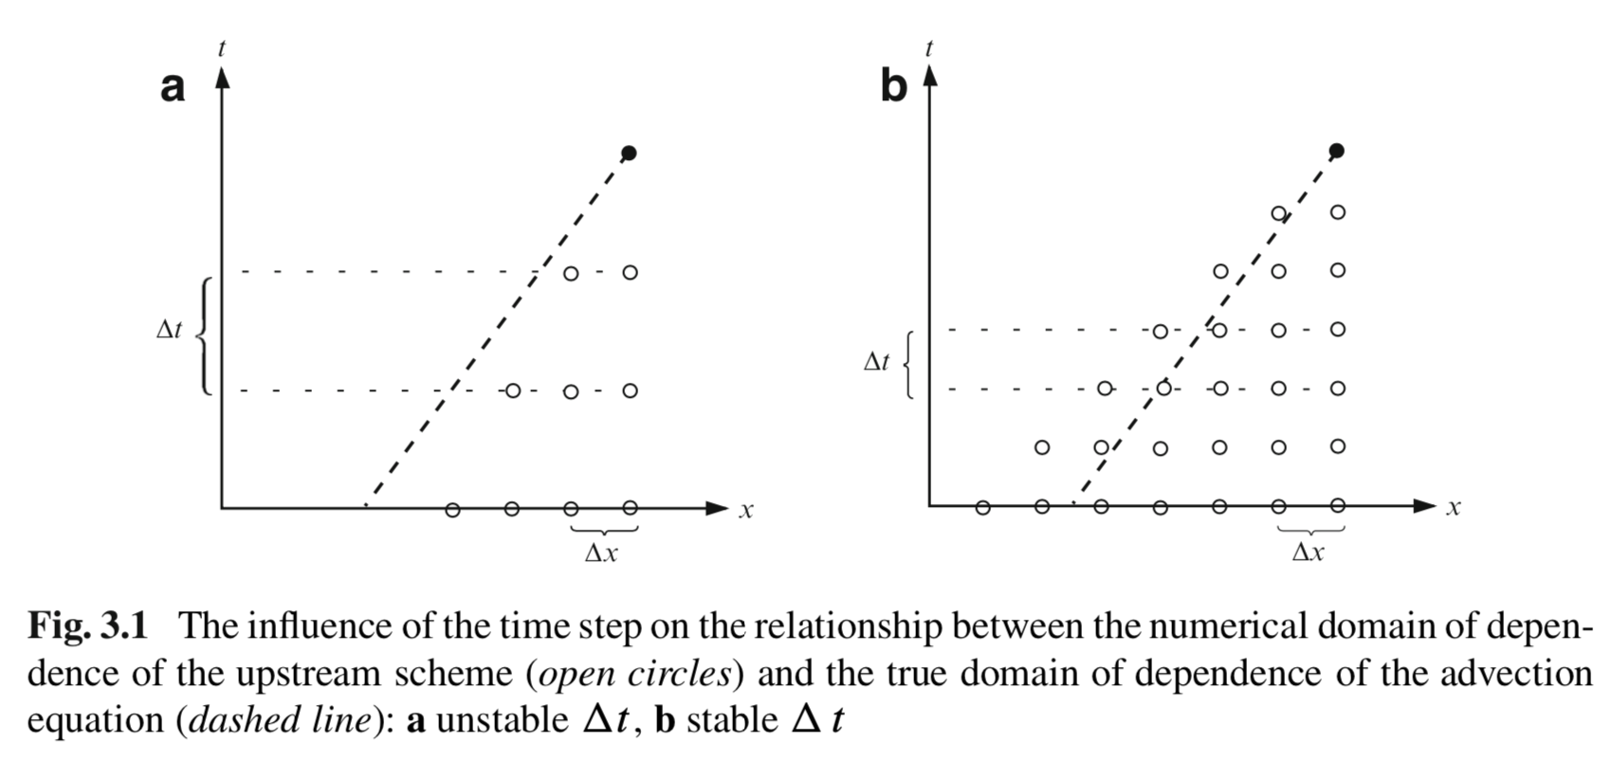


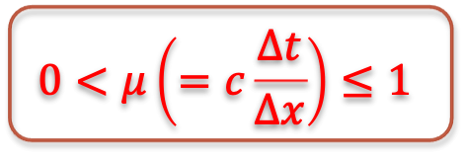
Courant-Friedrichs-Lewy Condition
$$0<μ\left(=c\frac{∆t}{∆x}\right)≤1$$
$$φ_{j}^{n+1} =\left(1−μ\right)φ_{j}^{n}+μφ_{j−1}^{n}$$
$ψ=f\left(x−ct\right),∆x$/ $∆t=c$
To reach solid circle:
FD scheme: open circles are domain of dependence of (Domain 1).
Associated PDE: domain of dependence is dashed line (Domain 2).
CFL condition: Domain 1 includes Domain 2.

Slide 13
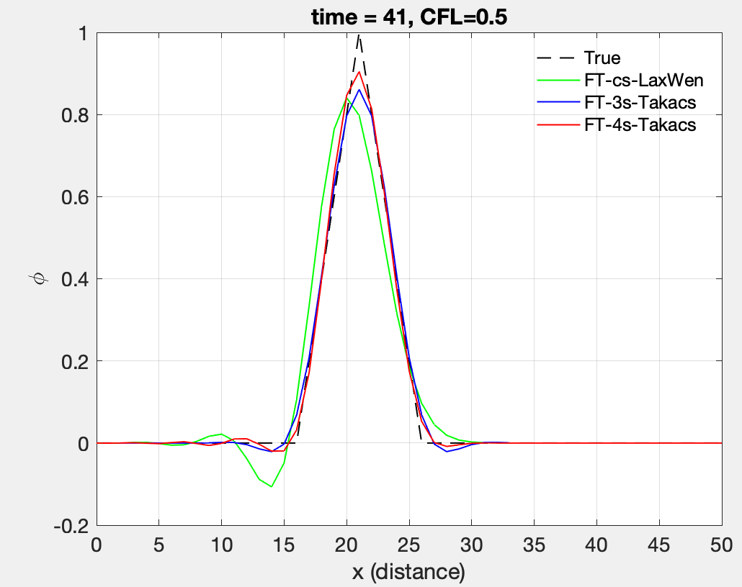
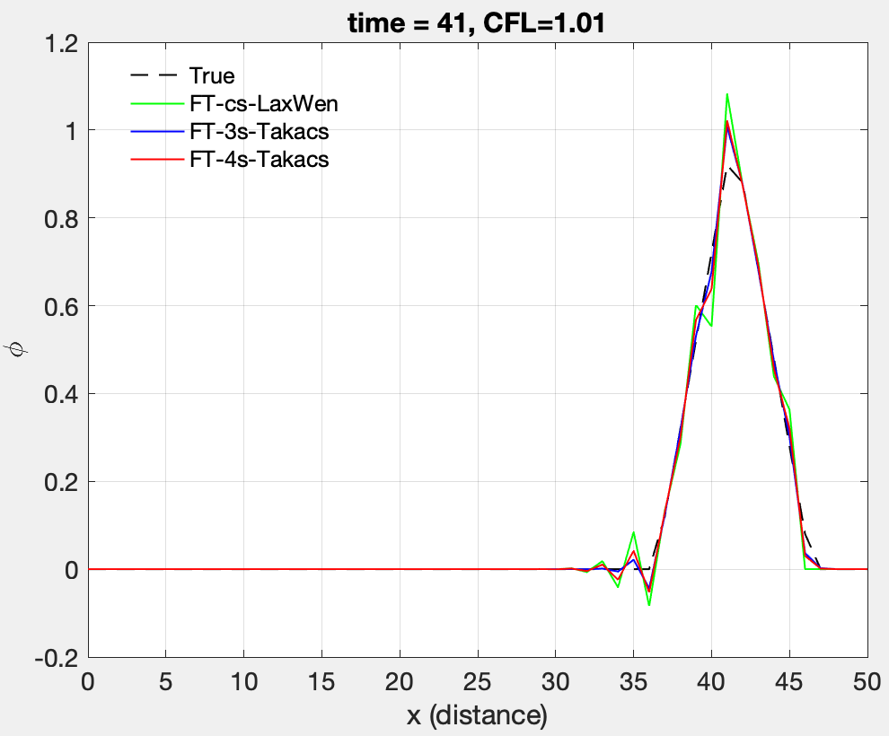
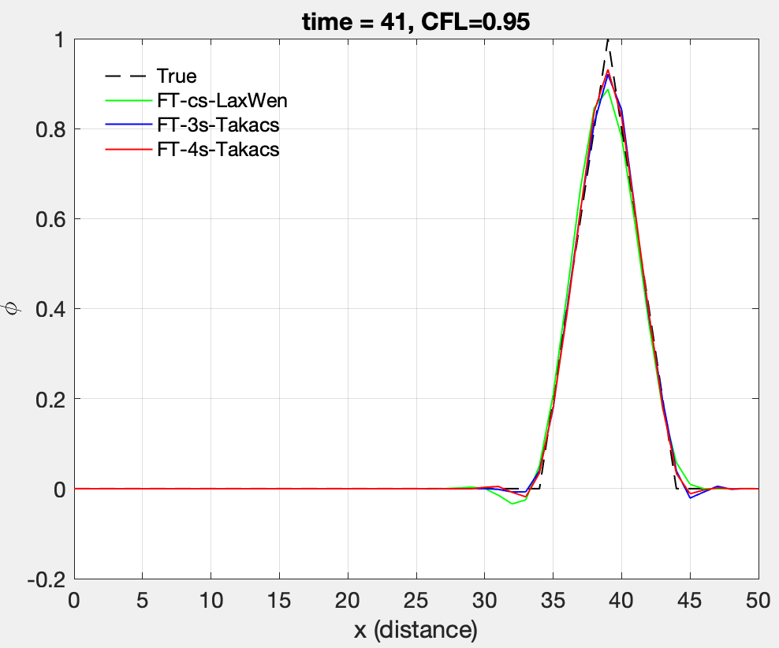
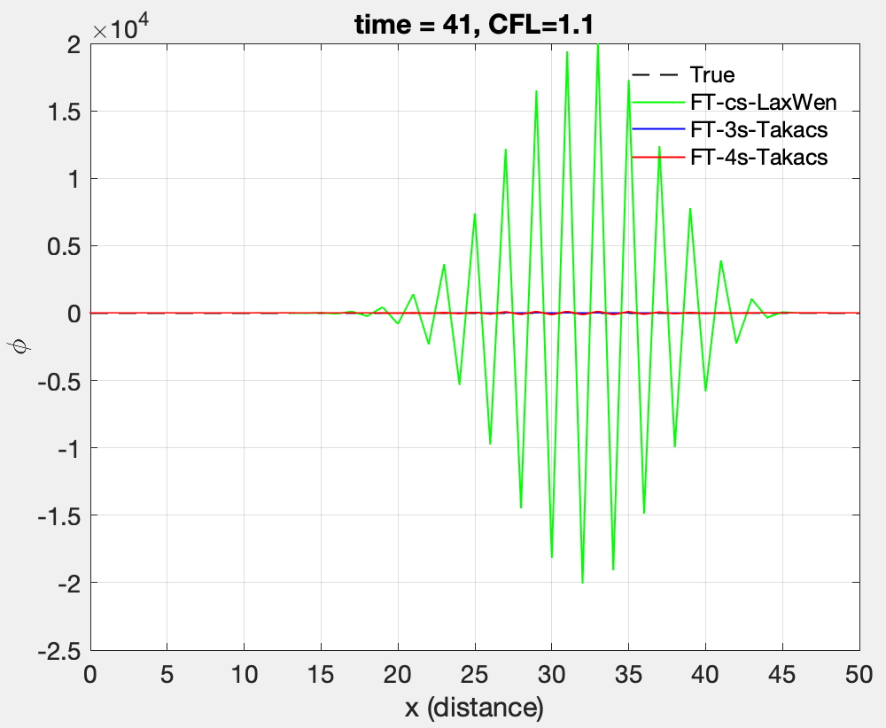
Stability & CFL Condition
Code: Advection_PDE_RK_2rdSpace_LaxWen_Spike_stability_2.m

