Slide 1
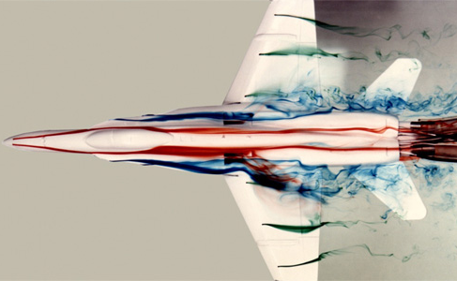
PHYS 8750 Numerical Fluid Dynamics
NASA/DRYDEN flow visualization facility
Fall, 2020

Slide 2
PHYS 8750
Class #6 (HW1, HW2 discussions)
Class #5 (Chapter 3.1) 1) Partial Differential Equations
Truncation errors
Stability, convergence, consistency
2) Von Neumann’s method (Stability)
Class #6 (HW1, HW2 discussions)

