Slide 1
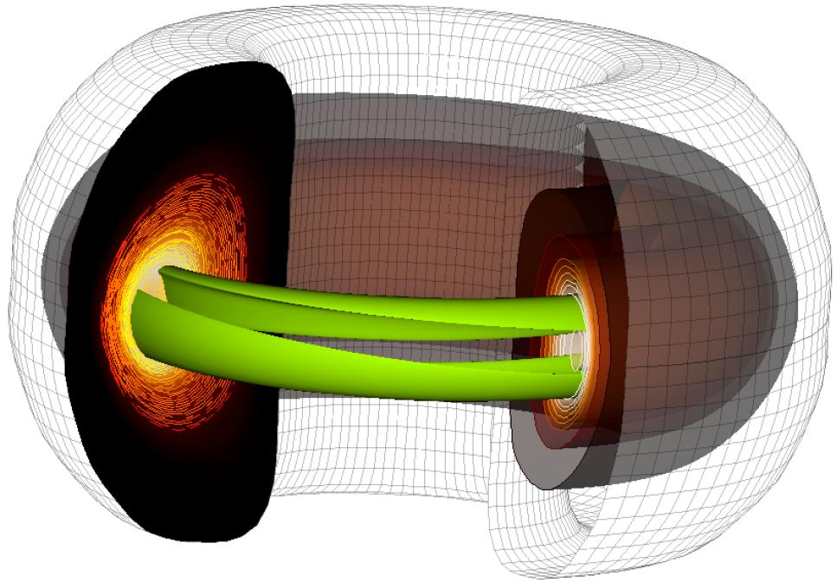
PHYS 8750 Numerical Fluid Dynamics
Fall, 2020
Recurrent patterns in toroidal magnetic fields - Sanderson et al.

Slide 2
PHYS 8750
Outline
Partial Differential Equations
1) Truncation errors
2) Stability, Convergence, Consistency
Von Neumann’s methods (Stability)
Dispersion and Dissipation errors
1-st, 2-nd, 3-rh, and 4-th order space schemes (Runge-Kutta scheme).
Lax-Wendroff Scheme (two time step)
Takacs Scheme (two time step)
Class #5 (Chapter 3.1) 1) Partial Differential Equations
Truncation errors
Stability, convergence, consistency
2) Von Neumann’s method (Stability)
Class #7 (Takac’s Schemes)

Slide 3
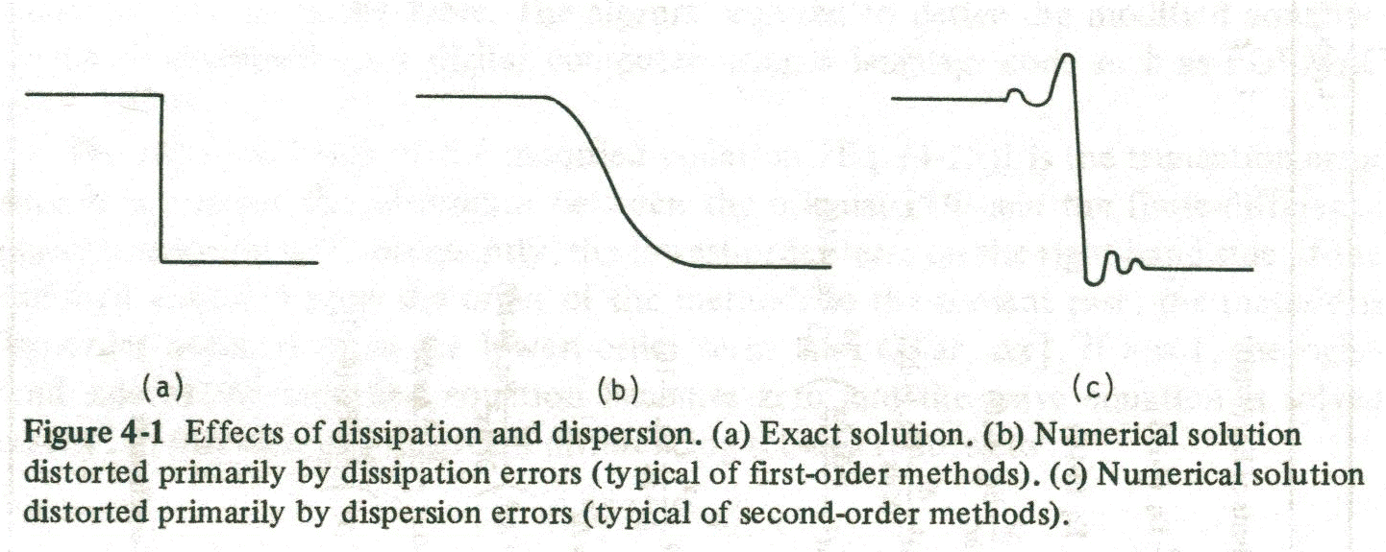
Forms of diffusion
Behavior seen especially w/sharp gradients:
Dissipation
Dispersion
odd-order scheme
even-order scheme
Anderson (1984)
Notes:
3

Slide 4
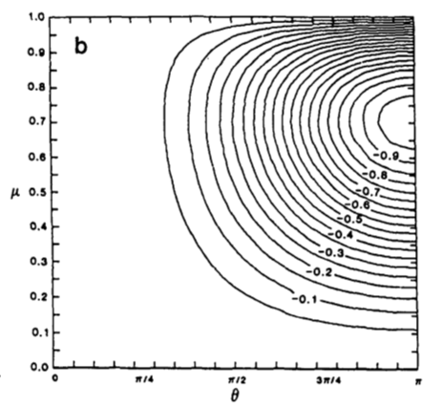
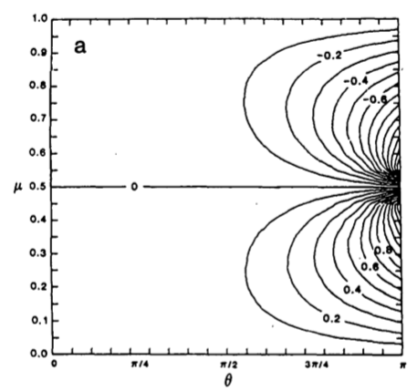
Takacs’ plots
Takacs pp. 1053-1054
Plots – Amplitude and Phase Error
θ = k∆x = nondimensional wavenumber
μ = Courant number c*dt/dx
Waves too slow
Amplitude error
Phase error
max Courant #
max Courant #
< 0 values: damping: worst @ 2∆x
Small error in this region
Small error in this region
No error in this region
no flow or ∆t=>0
no flow or ∆t=>0
infinite
wavelength
2∆x
wavelength
2∆x
wavelength
Waves too fast

Slide 5
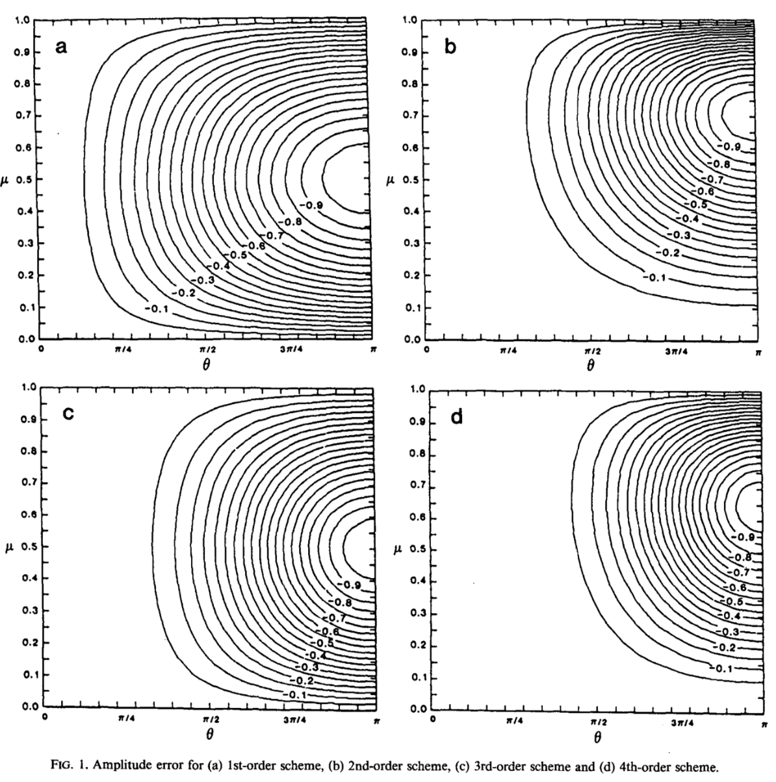
Takacs’ plots – Amplitude Errors
1st error
2nd error
3rd error
4th error
Infinite wavelength
2∆x

Slide 6
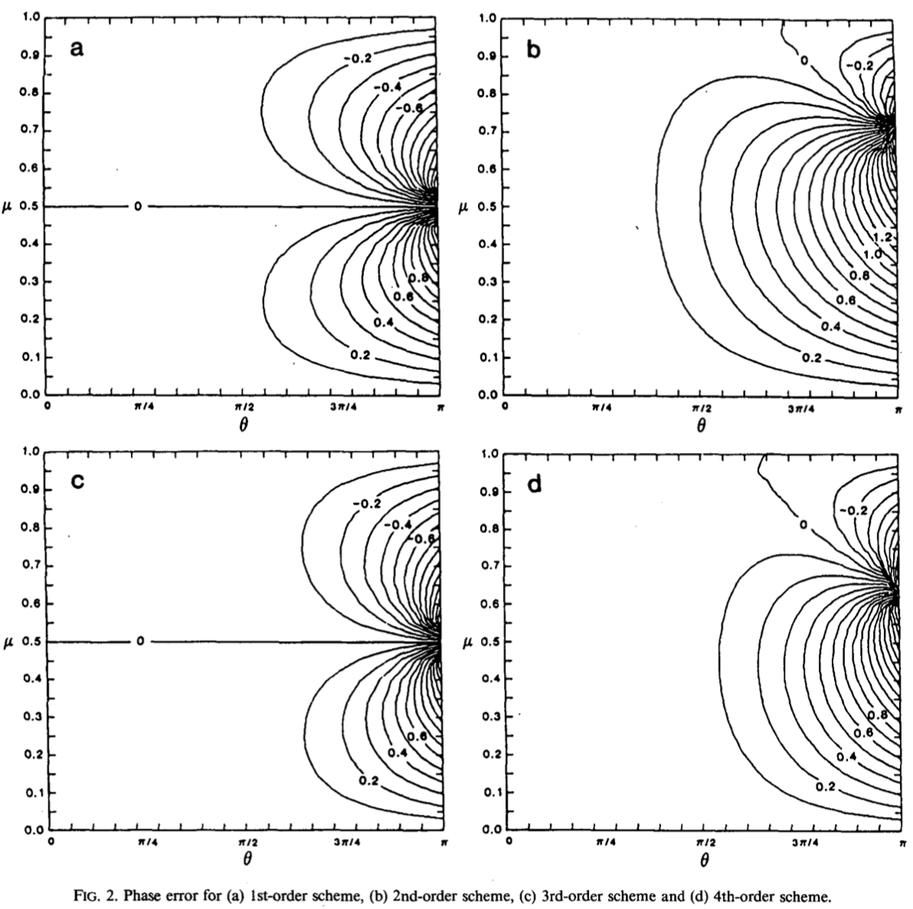
Takacs’ plots – Phase Errors
Small error in this region
1st error
2nd error
Small error in this region
3rd error
4th error

Slide 7
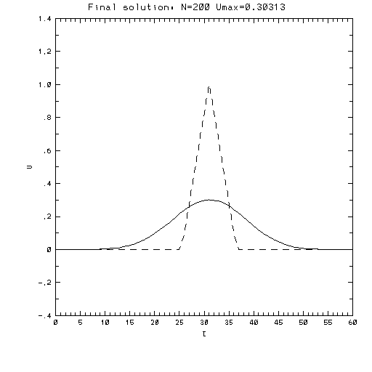
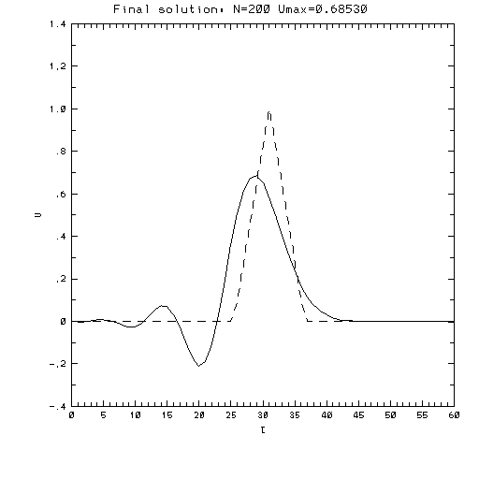
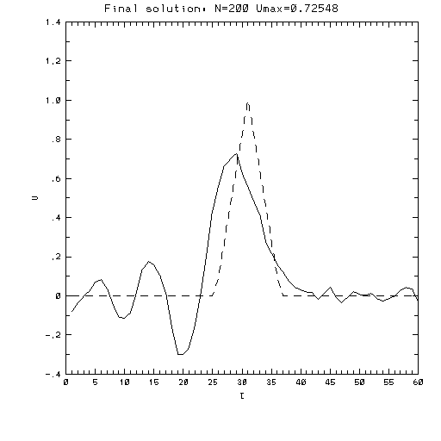
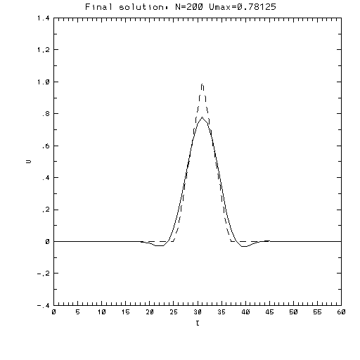
Takacs (1985)
Considerations:
Odd-order schemes generally dissipative
amplitude errors
Even-order schemes generally dispersive
phase errors
1st order
2nd order
2nd order
3rd order
Upstream
Lax-Wendroff
Leapfrog
Takacs

