Slide 1
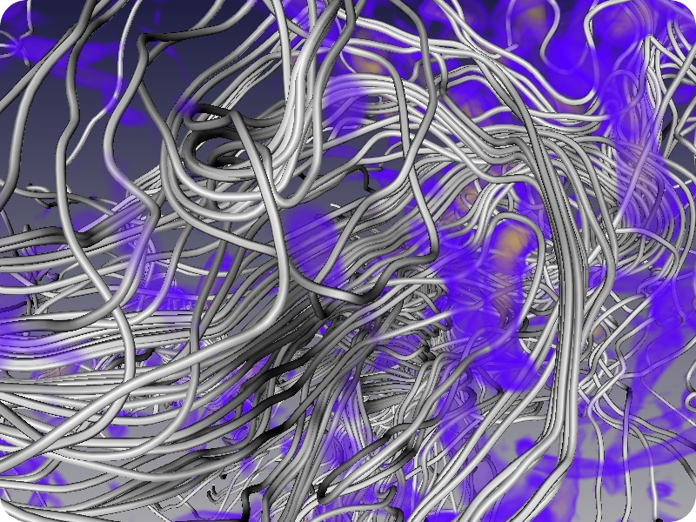
PHYS 8750 Numerical Fluid Dynamics
Isotropic Turbulence
Visualization by NCSA’s advanced applications support group
Fall, 2020
vis.ncsa.illinois.edu/gallery.html

Slide 2
PHYS 8750
Outline
Fundamental concept of finite volume method
Flux form of FV method (3D and 1D)
Flux form (high-order vs low-order) for different schemes.
Flux limited/corrected methods
Monotonic and total variances diminishing (TVD) schemes
Class #14
Summary of Chapters 1-4
Class #15 (Chapter 5.1)
Finite Volume Method

Slide 3
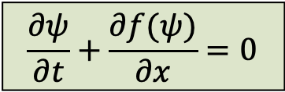
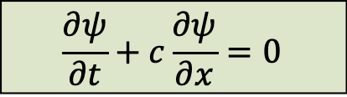
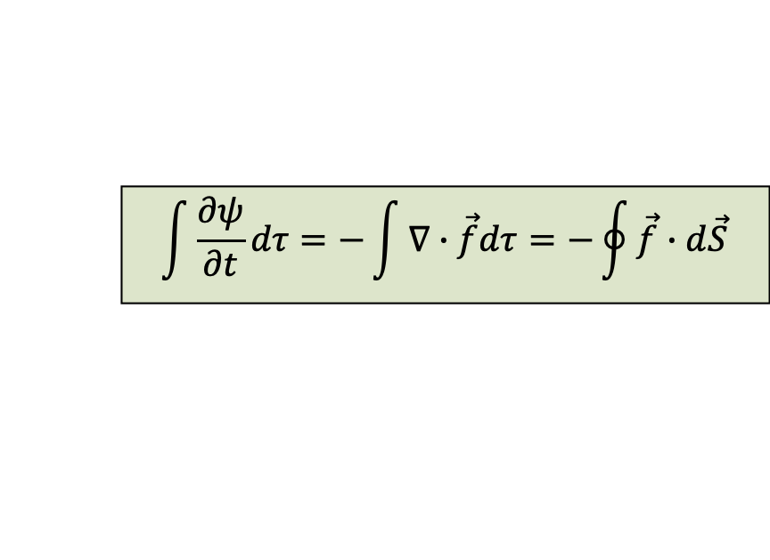
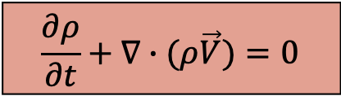
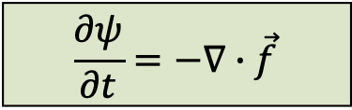
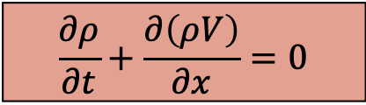
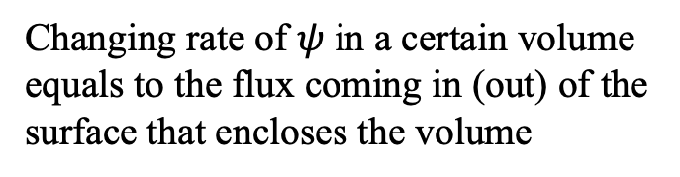
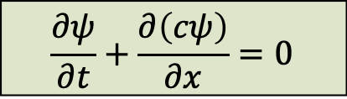
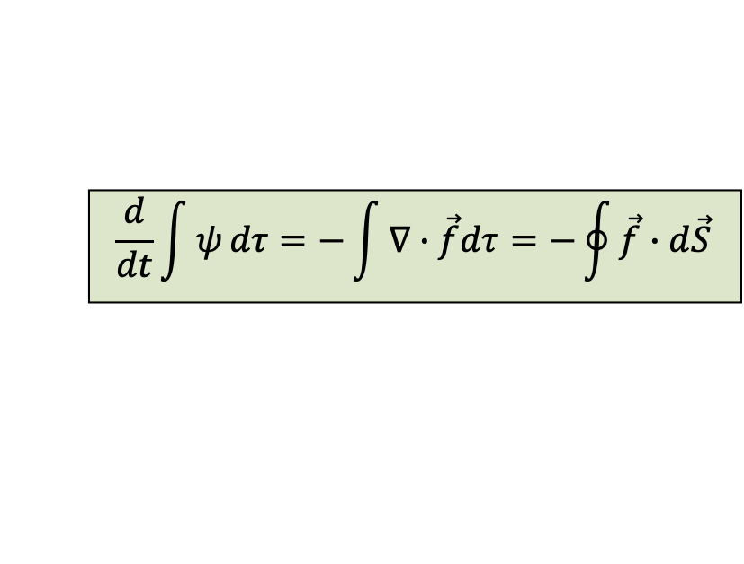
Finite Volume Method
Flux concept:
Example (continuity):
$$\frac{∂ψ}{∂t}+c\frac{∂ψ}{∂x}=0$$
$$\frac{∂ψ}{∂t}+\frac{∂\left(cψ\right)}{∂x}=0$$
$$\frac{∂ρ}{∂t}+\frac{∂\left(ρV\right)}{∂x}=0$$
If we define $f\left(ψ\right)=cψ$ as flux term, then
$$\frac{∂ψ}{∂t}+\frac{∂f(ψ)}{∂x}=0$$
3D
$$\frac{∂ψ}{∂t}=−∇∙\vec{f}$$
$$\frac{∂ρ}{∂t}+∇∙(ρ\vec{V})=0$$
Flux form
$$\int{\frac{∂ψ}{∂t}}dτ=−\int{∇∙\vec{f}dτ}=−\oint{\vec{f}}∙d\vec{S}$$
$$\frac{d}{dt}\int{ψ}dτ=−\int{∇∙\vec{f}dτ}=−\oint{\vec{f}}∙d\vec{S}$$
Changing rate of $ψ$ in a certain volume equals to the flux coming in (out) of the surface that encloses the volume
Only evaluating $f(ψ)$ instead of its derivative, useful when the solution contains discontinuity, and the derivatives are not defined at the discontinuity.

Slide 4
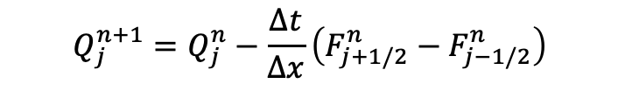
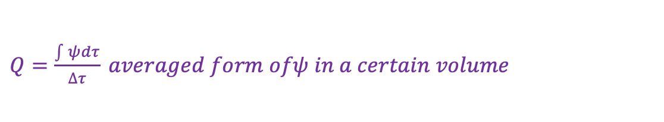
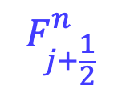

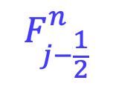


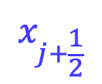

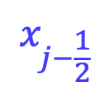
Flux Form 3D
$$\frac{d}{dt}\int{ψ}dτ=−\int{∇∙\vec{f}dτ}=−\oint{\vec{f}}∙d\vec{S}$$
$Q=\frac{\int{ψ}dτ}{∆τ} averaged form ofψ in a certain volume$
$$F_{j−\frac{1}{2}}^{n}$$
$$F_{j+\frac{1}{2}}^{n}$$
$$Q_{j}^{n}$$
$$x_{j−\frac{1}{2}}$$
$$x_{j}$$
$$x_{j+\frac{1}{2}}$$
$\frac{Q_{j}^{n+1}−Q_{j}^{n}}{∆t}×A×∆x=−\left(F_{j+1/2}^{n}−F_{j−1/2}^{n}\right)$ $×A$
$$Q_{j}^{n+1}=Q_{j}^{n}−\frac{∆t}{∆x}\left(F_{j+1/2}^{n}−F_{j−1/2}^{n}\right)$$

Slide 5


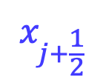
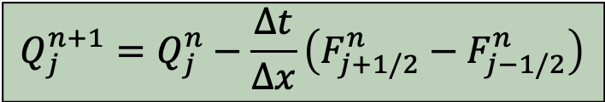
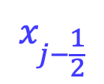
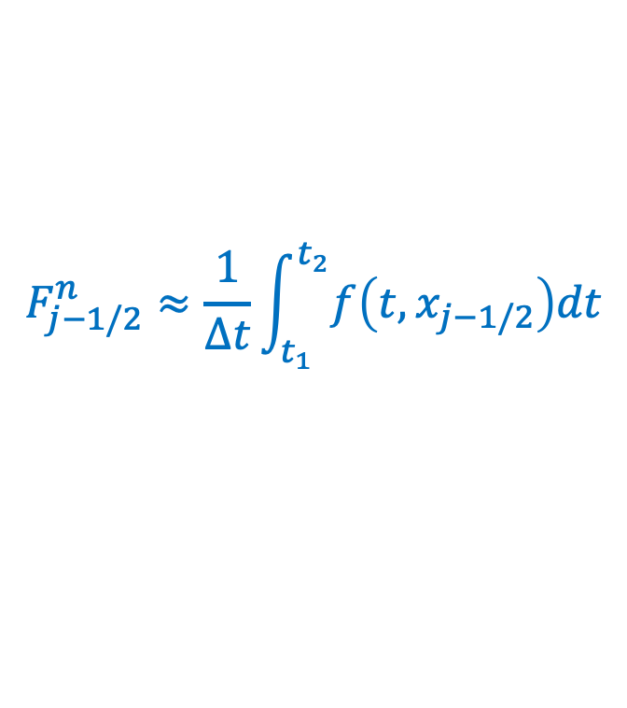

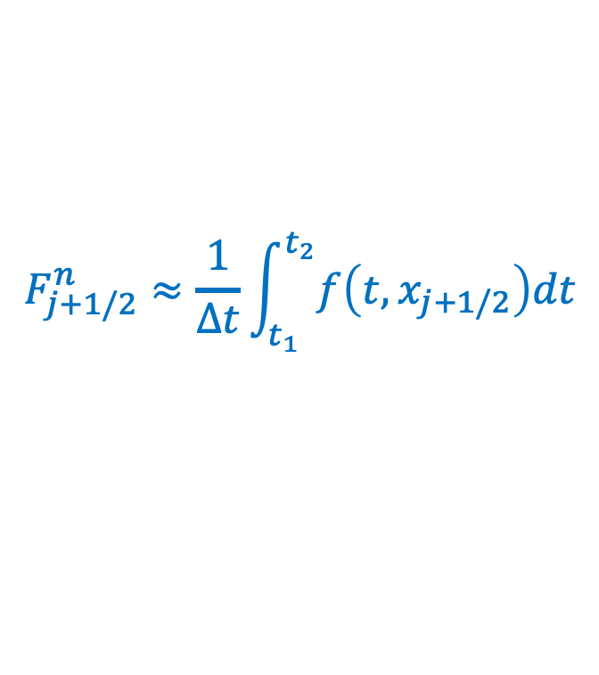
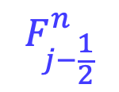
Finite Volume Principle
$$F_{j−\frac{1}{2}}^{n}$$
$$Q_{j}^{n}$$
$$F_{j+\frac{1}{2}}^{n}$$
$$x_{j−\frac{1}{2}}$$
$$x_{j}$$
$$x_{j+\frac{1}{2}}$$
Flux Form
$$Q_{j}^{n+1}=Q_{j}^{n}−\frac{∆t}{∆x}\left(F_{j+1/2}^{n}−F_{j−1/2}^{n}\right)$$
FV methods seek to obtain an appropriate flux term “$F$”, to approximate an averaged flux at the cell interfaces occurring between certain time steps.
$$F_{j+1/2}^{n}≈\frac{1}{∆t}\int_{t_{1}}^{t_{2}}{f\left(t,x_{j+1/2}\right)dt}$$
$$F_{j−1/2}^{n}≈\frac{1}{∆t}\int_{t_{1}}^{t_{2}}{f\left(t,x_{j−1/2}\right)dt}$$
&

Slide 6
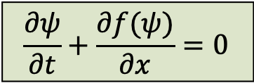
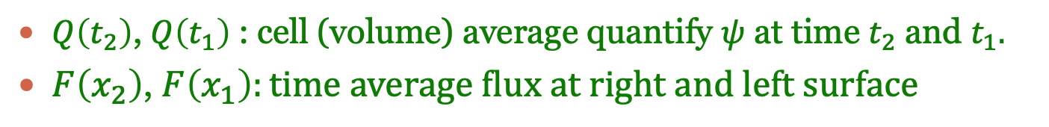


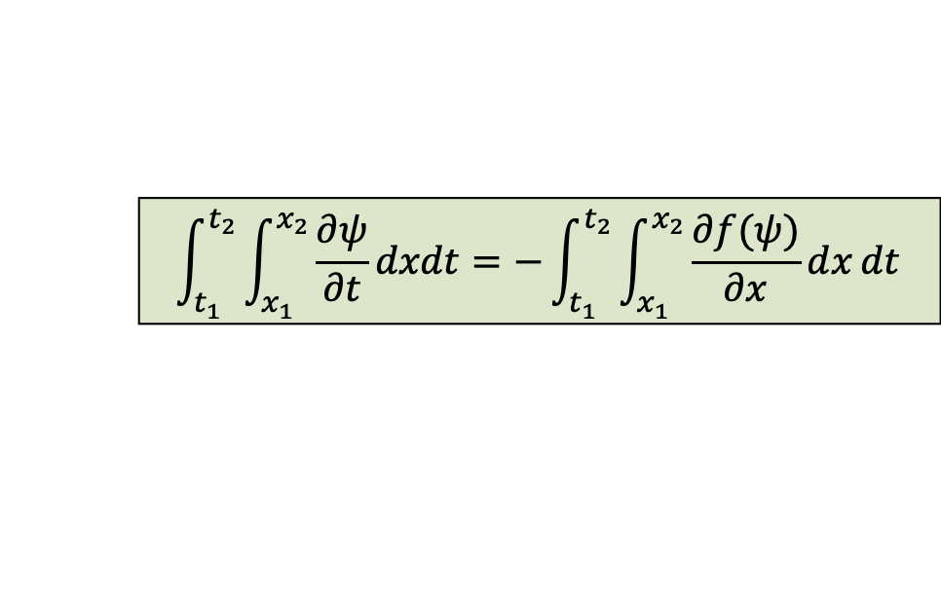
1D Flux Form
Integrate over time and space which can avoid discontinuity problem:
$$\frac{∂ψ}{∂t}+\frac{∂f(ψ)}{∂x}=0$$
$$\int_{t_{1}}^{t_{2}}{\int_{x_{1}}^{x_{2}}{\frac{∂ψ}{∂t}}dxdt}=−\int_{t_{1}}^{t_{2}}{\int_{x_{1}}^{x_{2}}{\frac{∂f(ψ)}{∂x}}dx}dt$$
$$\int_{x_{1}}^{x_{2}}{ψ\left(x,t_{2}\right)dx−}\int_{x_{1}}^{x_{2}}{ψ\left(x,t_{1}\right)dx}=−\left(\int_{t_{1}}^{t_{2}}{f\left(ψ\left(x_{2},t\right)\right)}dt−\int_{t_{1}}^{t_{2}}{f\left(ψ\left(x_{1},t\right)\right)}dt\right)$$
$$\left[Q\left(t_{2}\right)−Q\left(t_{1}\right)\right]∆x=−\left[F\left(x_{2}\right)−F\left(x_{1}\right)\right]∆t$$
$Q\left(t_{2}\right)$, $Q\left(t_{1}\right)$: cell (volume) average quantify $ψ$ at time $t_{2}$ and $t_{1}.$
$F\left(x_{2}\right)$, $F\left(x_{1}\right):time average flux at right and left surface$

Slide 7

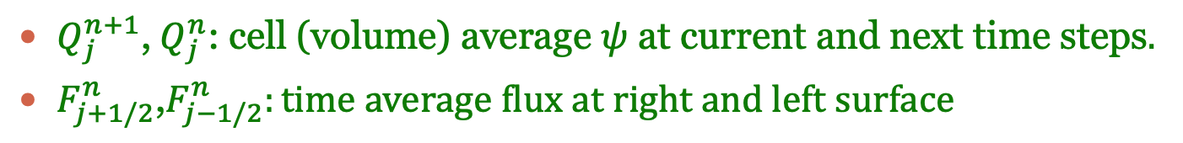
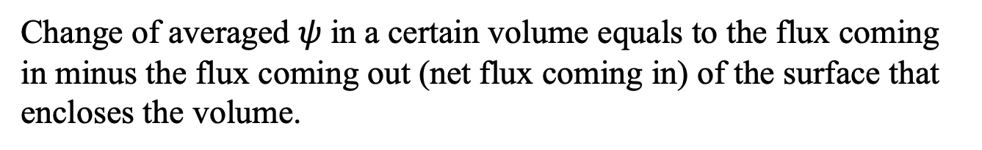
Physical Meaning
Flux Form
$$Q_{j}^{n+1}=Q_{j}^{n}−\frac{∆t}{∆x}\left(F_{j+1/2}^{n}−F_{j−1/2}^{n}\right)$$
$Q_{j}^{n+1}$,${ Q}_{j}^{n}$: cell (volume) average $ψ$ at current and next time steps$.$
$F_{j+1/2}^{n}$,$F_{j−1/2}^{n}:time average flux at right and left surface$
Change of averaged $ψ$ in a certain volume equals to the flux coming in minus the flux coming out (net flux coming in) of the surface that encloses the volume.
Different schemes use different flux forms for the finite volume methods.
Key issue: identify the most efficient/appropriate flux terms.

Slide 8
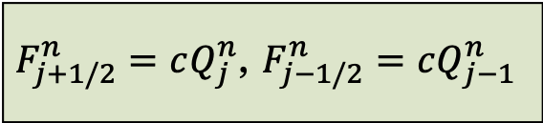
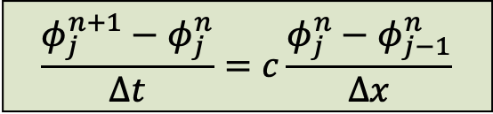
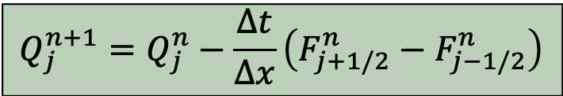
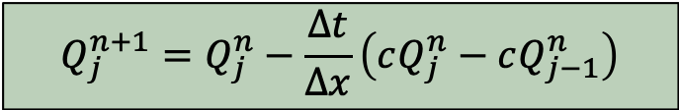
Forward Time/Upstream Method
Upstream solution for constant coefficient advection equation:
$$\frac{φ_{j}^{n+1}−φ_{j}^{n}}{∆t}=c\frac{φ_{j}^{n}−φ_{j−1}^{n}}{∆x}$$
$$Q_{j}^{n+1}=Q_{j}^{n}−\frac{∆t}{∆x}\left(F_{j+1/2}^{n}−F_{j−1/2}^{n}\right)$$
$$Q_{j}^{n+1}=Q_{j}^{n}−\frac{∆t}{∆x}\left(cQ_{j}^{n}−cQ_{j−1}^{n}\right)$$
$F_{j+1/2}^{n}=cQ_{j}^{n}$, $F_{j−1/2}^{n}=cQ_{j−1}^{n}$
Flux form

Slide 9
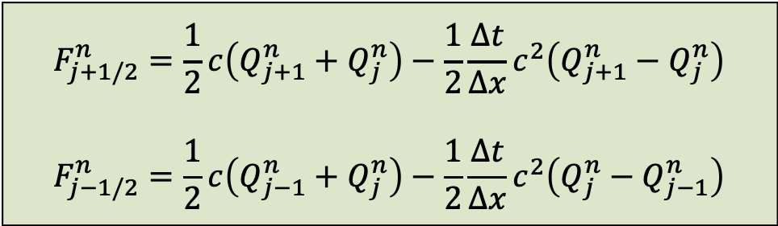
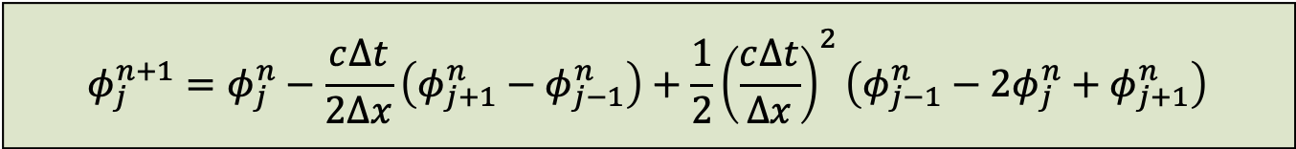
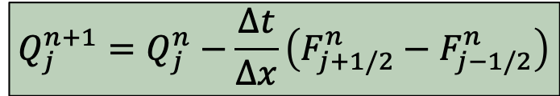
Lax-Wendroff
Upstream solution for constant coefficient advection equation:
$$φ_{j}^{n+1}=φ_{j}^{n}−\frac{c∆t}{2∆x}\left(φ_{j+1}^{n}−φ_{j−1}^{n}\right)+\frac{1}{2}{\left(\frac{c∆t}{∆x}\right)}^{2}\left(φ_{j−1}^{n}−2φ_{j}^{n}+φ_{j+1}^{n}\right)$$
$$Q_{j}^{n+1}=Q_{j}^{n}−\frac{∆t}{∆x}\left(F_{j+1/2}^{n}−F_{j−1/2}^{n}\right)$$
$$F_{j+1/2}^{n}=\frac{1}{2}c\left(Q_{j+1}^{n}+Q_{j}^{n}\right)−\frac{1}{2}\frac{∆t}{∆x}c^{2}\left(Q_{j+1}^{n}−Q_{j}^{n}\right)$$
$$F_{j−1/2}^{n}=\frac{1}{2}c\left(Q_{j−1}^{n}+Q_{j}^{n}\right)−\frac{1}{2}\frac{∆t}{∆x}c^{2}\left(Q_{j}^{n}−Q_{j−1}^{n}\right)$$
Flux form

Slide 10
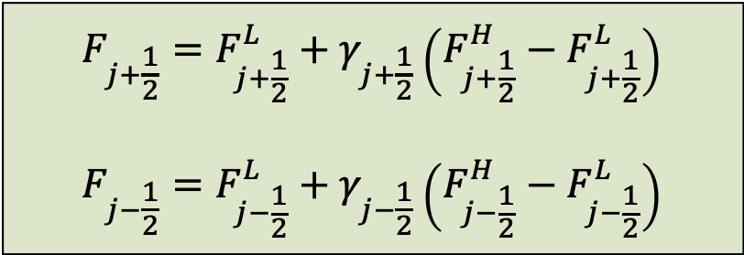
Flux-Limited Methods
Different schemes can define different flux forms (from low to high orders), flux limited & flux corrected methods combine the best features of low order and high order methods:
$$F_{j+\frac{1}{2}}=F_{j+\frac{1}{2}}^{L}+γ_{j+\frac{1}{2}}\left(F_{j+\frac{1}{2}}^{H}−F_{j+\frac{1}{2}}^{L}\right)$$
$$F_{j−\frac{1}{2}}=F_{j−\frac{1}{2}}^{L}+γ_{j−\frac{1}{2}}\left(F_{j−\frac{1}{2}}^{H}−F_{j−\frac{1}{2}}^{L}\right)$$
Flux Limited
$$if γ=0, totally low−order flux, highly diffusive$$
$$if γ=1, totally high−order flux, doesnot necessarily satisfy TVD$$
$$if 0<γ<1, mix of low and high−order fluxes$$

Slide 11

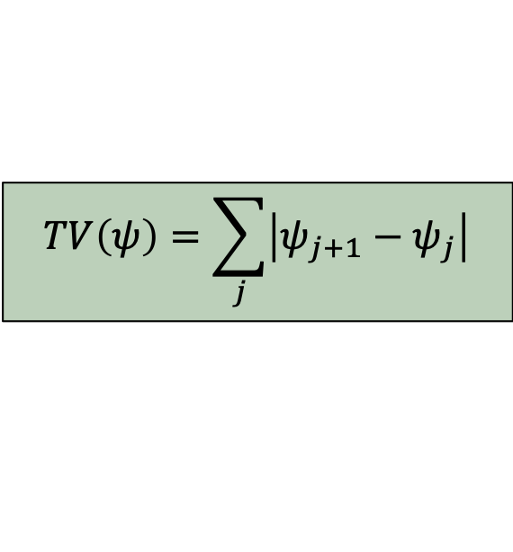
Total Variation Diminishing (TVD)
TVD is a criteria to judge whether a FVM is practical. Independent of scheme stability, not a sufficient condition for a “satisfactory” solution.
If the system is not to develop nonphysical maxima or minima (e.g., oscillation problem), the “total variation” of the solution must remain constant or decreasing over each time step:
$$TV\left(ψ\right)=\sum_{j}{\left|ψ_{j+1}−ψ_{j}\right|}$$
$$TV\left(ψ^{n+1}\right)≤TV\left(ψ^{n}\right)$$
Useful higher 0rder methods do not satisfy TVD alone, and many TVD low-order methods are too diffusive for practical application. Flux limiters: anti-diffusion.
“High resolution” TVD methods are of great utility for systems with initially discontinuous or steep solutions, or those apt to produce shocks or steep solutions.

Slide 12
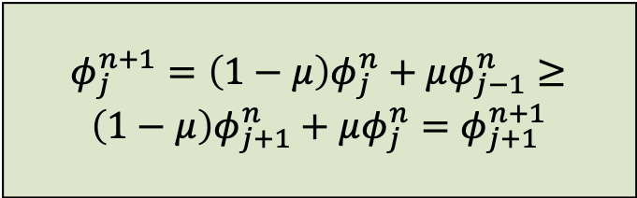




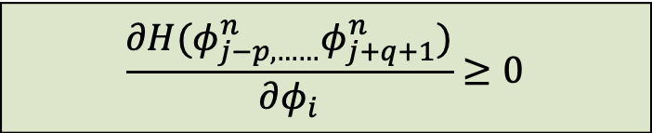

Monotonicity of a Method
Methods which satisfy TVD also preserve monotonicity of solutions. A scheme is monotone if:
Given: Then:
$$φ_{j}^{n}≥φ_{j+1}^{n}$$
$$φ_{j}^{n+1}≥φ_{j+1}^{n+1}$$
Won’t develop new local maxima or minima.
$$\frac{∂H(φ_{j−p,……}^{n}φ_{j+q+1}^{n})}{∂φ_{i}}≥0$$
$$φ_{j}^{n+1}=H(φ_{j−p,……}^{n}φ_{j+q+1}^{n})$$
First-Order Upstrem/Forward-Time
$$φ_{j}^{n+1}=\left(1−μ\right)φ_{j}^{n}+μφ_{j−1}^{n}$$
$$φ_{j}^{n+1}=\left(1−μ\right)φ_{j}^{n}+μφ_{j−1}^{n}≥$$
$$\left(1−μ\right)φ_{j+1}^{n}+μφ_{j}^{n}=φ_{j+1}^{n+1}$$
$φ_{j}^{n}≥φ_{j+1}^{n}$, $φ_{j−1}^{n}≥φ_{j}^{n}$

Slide 13
Goals of FVM
Pure second order methods cannot be monotone; any linear monotone scheme is at best first-order accurate.
We week to use flux limiters to control the inclusion of high-order terms, creating nonlinear schemes with greater than first order accuracy, while preserving TVD criteria.

