Slide 1
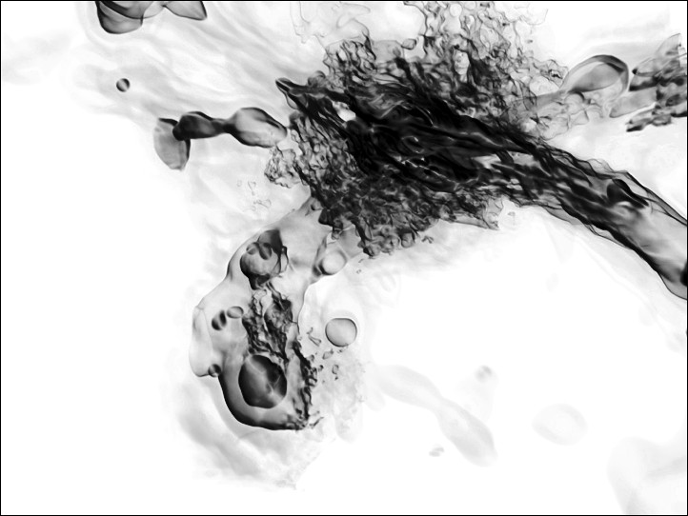
PHYS 8750 Numerical Fluid Dynamics
Galaxy formation – Burns, Greif, Bromm, and Klessen –- Texas Advanced Computing Center-- www.tacc.utexas.edu/research/gallery
Fall, 2020

Slide 2
PHYS 8750
Outline
1. Review of FV method
1.1 fundamental concept of finite volume method
1.2 Flux form (high-order vs low-order) for different schemes.
2. Flux corrected transport methods
3. Examples (coding)
Class #16
Flux corrected transport
Class #15 (Chapter 5.1)
Finite Volume Method

Slide 3
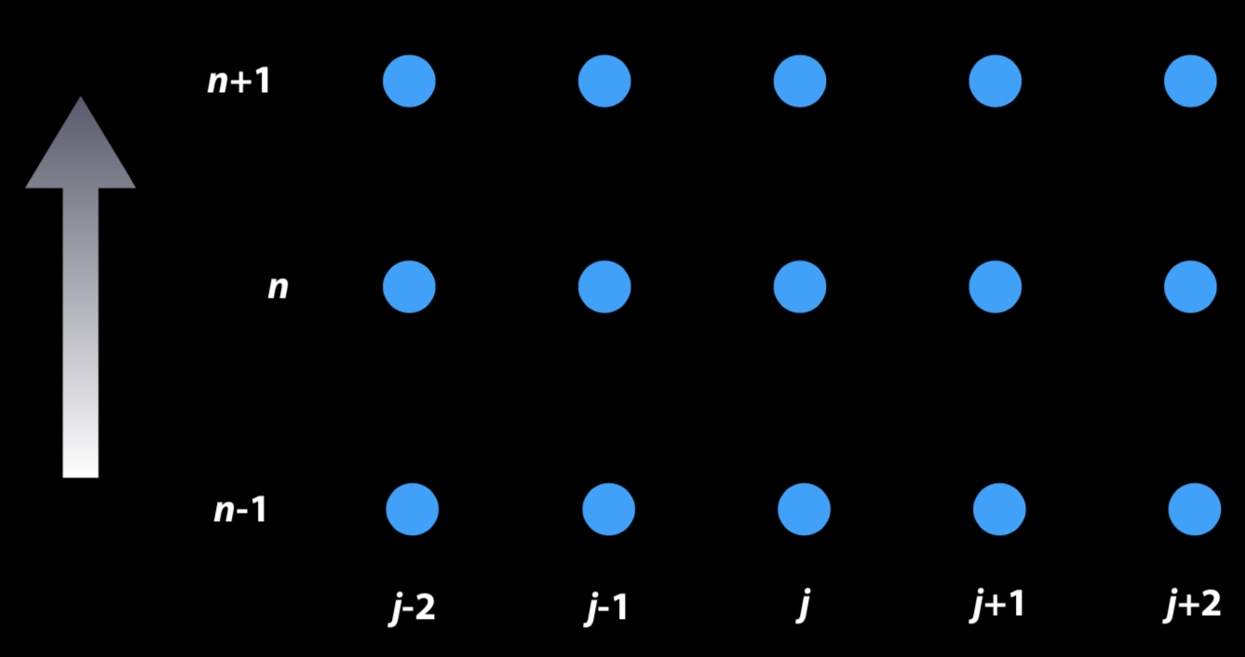


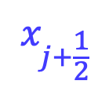
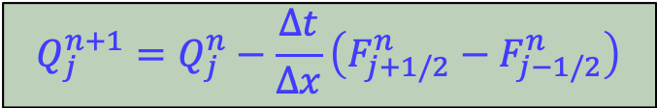
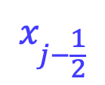
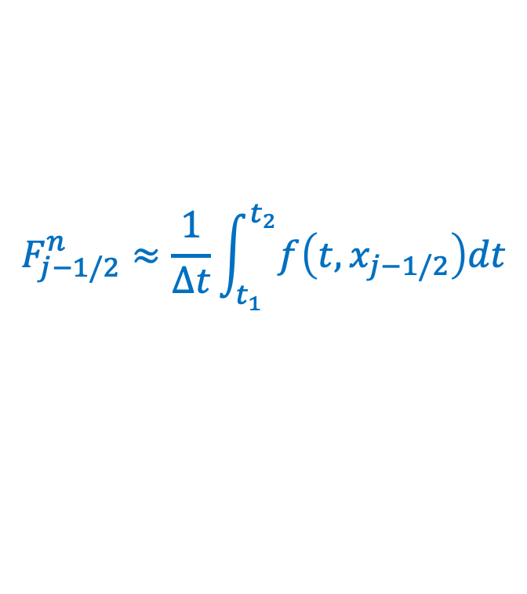
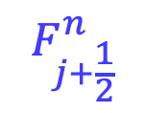
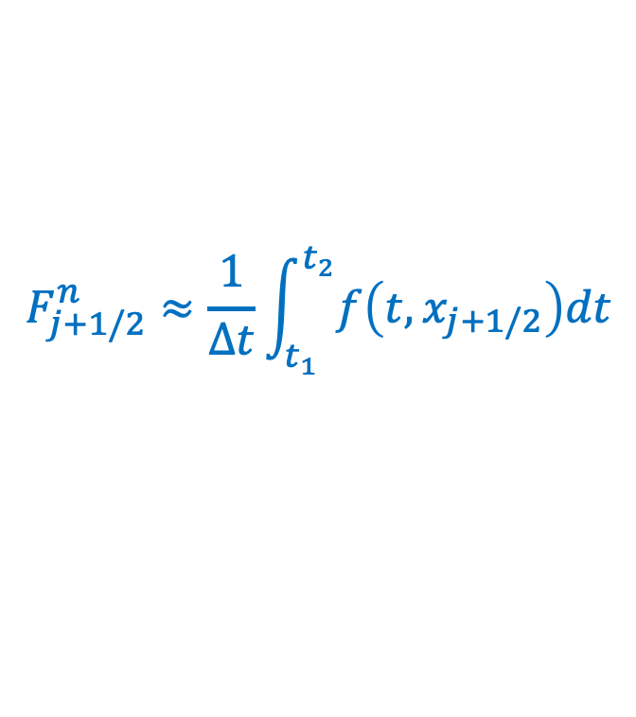
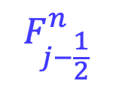
Finite Volume Principle
Finite Difference
Finite Volume
$$F_{j−\frac{1}{2}}^{n}$$
$$Q_{j}^{n}$$
$$F_{j+\frac{1}{2}}^{n}$$
$$x_{j−\frac{1}{2}}$$
$$x_{j}$$
$$x_{j+\frac{1}{2}}$$
Values and derivatives are evaluated at discrete grid points.
$$Q_{j}^{n+1}=Q_{j}^{n}−\frac{∆t}{∆x}\left(F_{j+1/2}^{n}−F_{j−1/2}^{n}\right)$$
Flux Form
FV methods seek to obtain an appropriate flux term “$F$”, to approximate an averaged flux at the cell interfaces occurring between certain time steps.
$$F_{j+1/2}^{n}≈\frac{1}{∆t}\int_{t_{1}}^{t_{2}}{f\left(t,x_{j+1/2}\right)dt}$$
$$F_{j−1/2}^{n}≈\frac{1}{∆t}\int_{t_{1}}^{t_{2}}{f\left(t,x_{j−1/2}\right)dt}$$
&

Slide 4
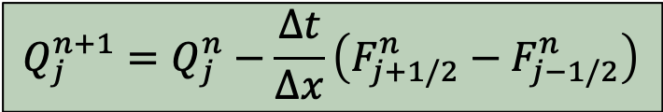
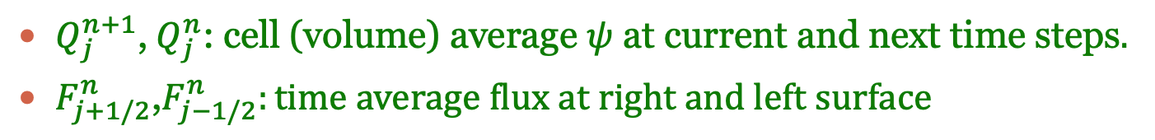
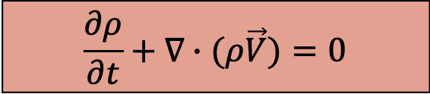
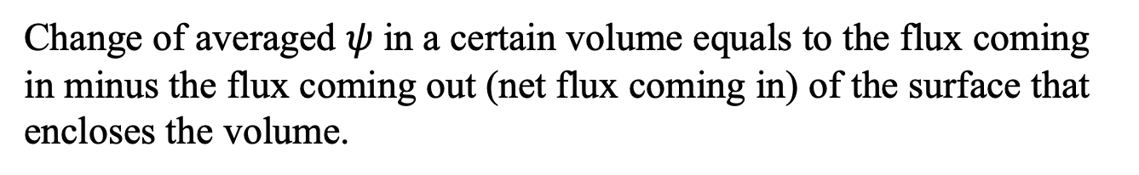
Physical Meaning
Flux Form
$$Q_{j}^{n+1}=Q_{j}^{n}−\frac{∆t}{∆x}\left(F_{j+1/2}^{n}−F_{j−1/2}^{n}\right)$$
$Q_{j}^{n+1}$,${ Q}_{j}^{n}$: cell (volume) average $ψ$ at current and next time steps$.$
$F_{j+1/2}^{n}$,$F_{j−1/2}^{n}:time average flux at right and left surface$
Change of averaged $ψ$ in a certain volume equals to the flux coming in minus the flux coming out (net flux coming in) of the surface that encloses the volume.
Example (continuity or mass conservation):
$$\frac{∂ρ}{∂t}+∇∙(ρ\vec{V})=0$$

Slide 5
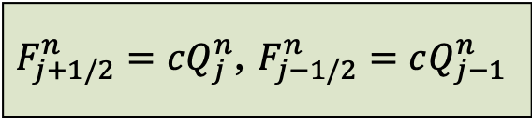
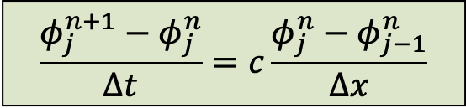
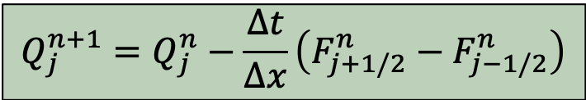
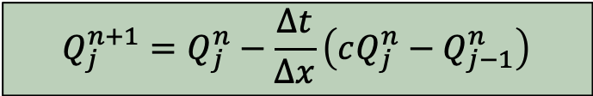
Forward Time/Upstream Method
Different schemes use different flux forms for the finite volume methods.
Key issue: identify the most efficient/appropriate flux terms.
Upstream solution for constant coefficient advection equation:
$$\frac{φ_{j}^{n+1}−φ_{j}^{n}}{∆t}=c\frac{φ_{j}^{n}−φ_{j−1}^{n}}{∆x}$$
$$Q_{j}^{n+1}=Q_{j}^{n}−\frac{∆t}{∆x}\left(F_{j+1/2}^{n}−F_{j−1/2}^{n}\right)$$
$$Q_{j}^{n+1}=Q_{j}^{n}−\frac{∆t}{∆x}\left(cQ_{j}^{n}−Q_{j−1}^{n}\right)$$
Flux form
$F_{j+1/2}^{n}=cQ_{j}^{n}$, $F_{j−1/2}^{n}=cQ_{j−1}^{n}$

Slide 6
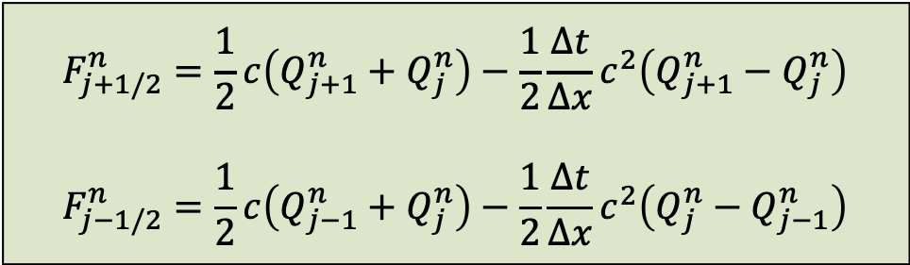
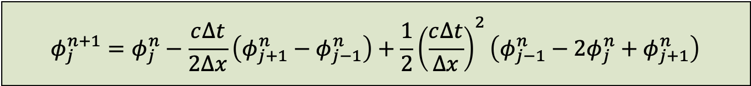
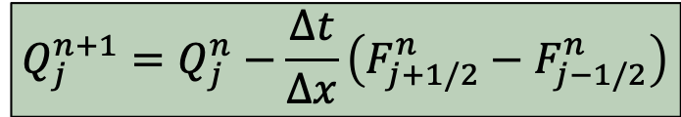
Lax-Wendroff
Upstream solution for constant coefficient advection equation:
$$φ_{j}^{n+1}=φ_{j}^{n}−\frac{c∆t}{2∆x}\left(φ_{j+1}^{n}−φ_{j−1}^{n}\right)+\frac{1}{2}{\left(\frac{c∆t}{∆x}\right)}^{2}\left(φ_{j−1}^{n}−2φ_{j}^{n}+φ_{j+1}^{n}\right)$$
$$Q_{j}^{n+1}=Q_{j}^{n}−\frac{∆t}{∆x}\left(F_{j+1/2}^{n}−F_{j−1/2}^{n}\right)$$
$$F_{j+1/2}^{n}=\frac{1}{2}c\left(Q_{j+1}^{n}+Q_{j}^{n}\right)−\frac{1}{2}\frac{∆t}{∆x}c^{2}\left(Q_{j+1}^{n}−Q_{j}^{n}\right)$$
$$F_{j−1/2}^{n}=\frac{1}{2}c\left(Q_{j−1}^{n}+Q_{j}^{n}\right)−\frac{1}{2}\frac{∆t}{∆x}c^{2}\left(Q_{j}^{n}−Q_{j−1}^{n}\right)$$
Flux form

Slide 7
Goals of FVM
First-order scheme (forward time/upstream) keeps good performance on TVD and monotonicity. But it is highly diffusive and first-order accurate.
Pure second (higher) order methods cannot be monotone; any linear monotone scheme is at best first-order accurate. Less errors.
We week to use flux limiters to control the inclusion of high-order terms, creating nonlinear schemes with greater than first order accuracy, while preserving TVD criteria.

Slide 8
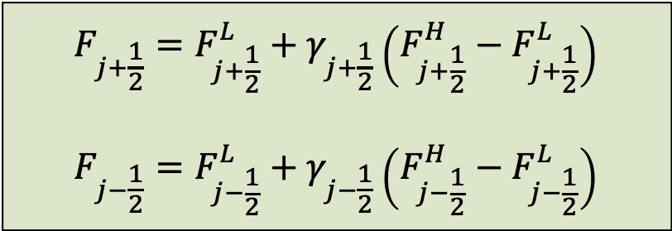
Flux-Limited Methods
Different schemes can define different flux forms (from low to high orders), flux limited & flux corrected methods combine the best features of low order and high order methods:
$$F_{j+\frac{1}{2}}=F_{j+\frac{1}{2}}^{L}+γ_{j+\frac{1}{2}}\left(F_{j+\frac{1}{2}}^{H}−F_{j+\frac{1}{2}}^{L}\right)$$
$$F_{j−\frac{1}{2}}=F_{j−\frac{1}{2}}^{L}+γ_{j−\frac{1}{2}}\left(F_{j−\frac{1}{2}}^{H}−F_{j−\frac{1}{2}}^{L}\right)$$
Flux Limited
$$if γ=0, totally low−order flux, highly diffusive$$
$$if γ=1, totally high−order flux, doesnot necessarily satisfy TVD$$
$$if 0<γ<1, mix of low and high−order fluxes$$

Slide 9
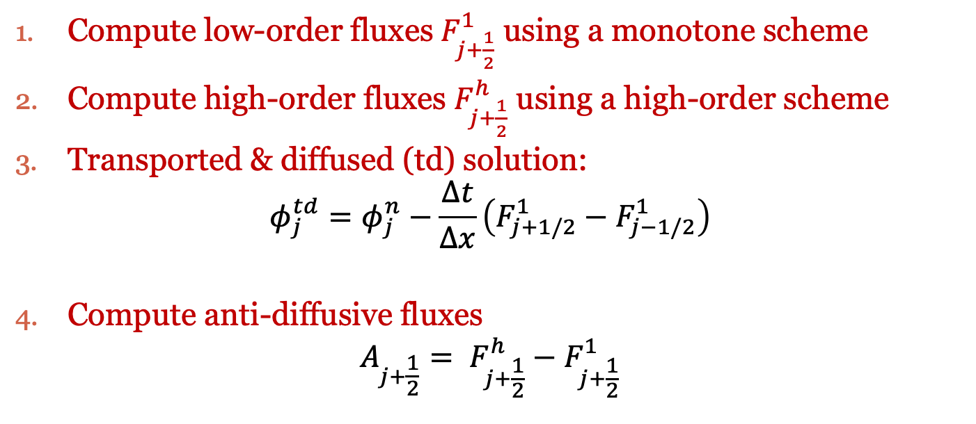
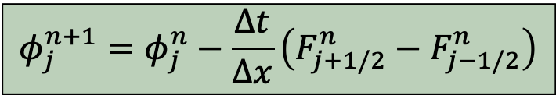
Flux-Corrected Transport
General Idea:
Flux Form
$$φ_{j}^{n+1}=φ_{j}^{n}−\frac{∆t}{∆x}\left(F_{j+1/2}^{n}−F_{j−1/2}^{n}\right)$$
Compute low-order fluxes $F_{j+\frac{1}{2}}^{1}$ using a monotone scheme
Compute high-order fluxes $F_{j+\frac{1}{2}}^{h}$ using a high-order scheme
Transported & diffused (td) solution:
$$φ_{j}^{td}=φ_{j}^{n}−\frac{∆t}{∆x}\left(F_{j+1/2}^{1}−F_{j−1/2}^{1}\right)$$
Compute anti-diffusive fluxes
$$A_{j+\frac{1}{2}}= F_{j+\frac{1}{2}}^{h}−F_{j+\frac{1}{2}}^{1}$$

Slide 10

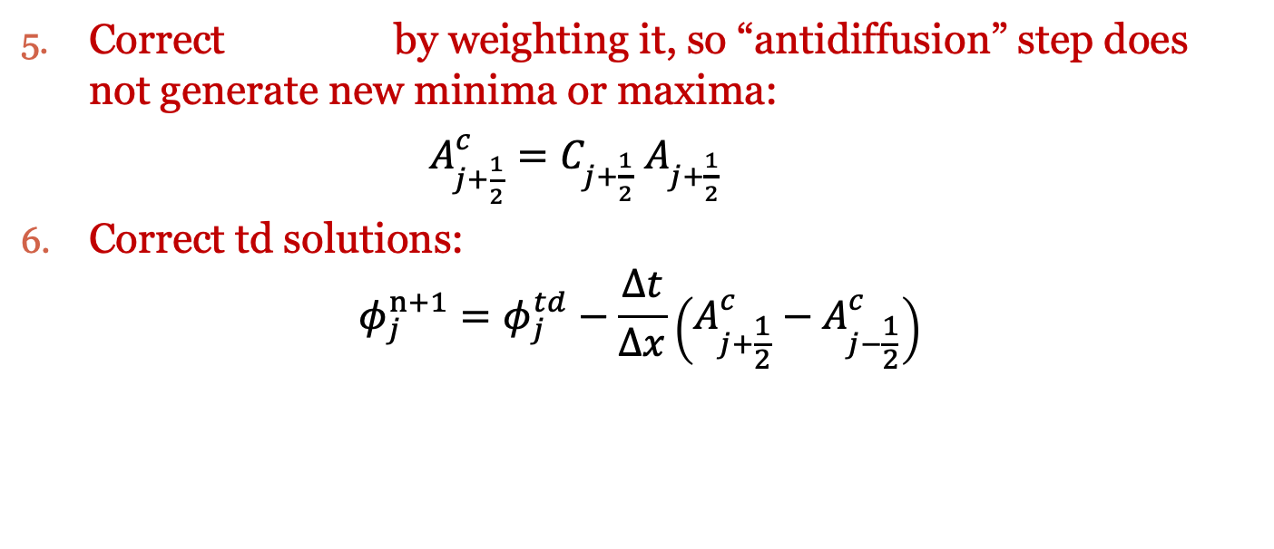
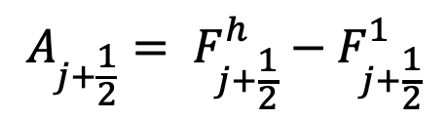
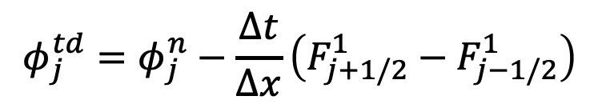
Flux-Corrected Transport
$$A_{j+1/2}$$
Correct by weighting it, so “antidiffusion” step does not generate new minima or maxima:
$A_{j+\frac{1}{2}}^{c}=C_{j+\frac{1}{2}}$ $A_{j+\frac{1}{2}}$
Correct td solutions:
$$φ_{j}^{n+1}=φ_{j}^{td}−\frac{∆t}{∆x}\left(A_{j+\frac{1}{2}}^{c}−A_{j−\frac{1}{2}}^{c}\right)$$
$$φ_{j}^{td}=φ_{j}^{n}−\frac{∆t}{∆x}\left(F_{j+1/2}^{1}−F_{j−1/2}^{1}\right)$$
$$A_{j+\frac{1}{2}}= F_{j+\frac{1}{2}}^{h}−F_{j+\frac{1}{2}}^{1}$$

Slide 11
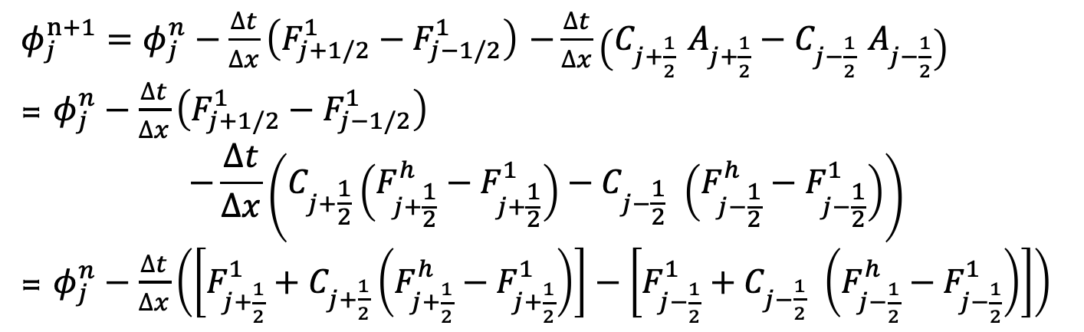
Flux-Corrected Transport
$φ_{j}^{n+1}=φ_{j}^{n}−\frac{∆t}{∆x}\left(F_{j+1/2}^{1}−F_{j−1/2}^{1}\right)$ $−\frac{∆t}{∆x}\left(C_{j+\frac{1}{2}} A_{j+\frac{1}{2}}−C_{j−\frac{1}{2}} A_{j−\frac{1}{2}}\right)$
= $φ_{j}^{n}−\frac{∆t}{∆x}\left(F_{j+1/2}^{1}−F_{j−1/2}^{1}\right)$
$$−\frac{∆t}{∆x}\left(C_{j+\frac{1}{2}}\left(F_{j+\frac{1}{2}}^{h}−F_{j+\frac{1}{2}}^{1}\right)−C_{j−\frac{1}{2}} \left(F_{j−\frac{1}{2}}^{h}−F_{j−\frac{1}{2}}^{1}\right)\right)$$
= $φ_{j}^{n}−\frac{∆t}{∆x}\left(\left[F_{j+\frac{1}{2}}^{1}+C_{j+\frac{1}{2}}\left(F_{j+\frac{1}{2}}^{h}−F_{j+\frac{1}{2}}^{1}\right)\right]−\left[F_{j−\frac{1}{2}}^{1}+C_{j−\frac{1}{2}} \left(F_{j−\frac{1}{2}}^{h}−F_{j−\frac{1}{2}}^{1}\right)\right]\right)$
Corrected Flux at j+1/2
Corrected Flux
At j-1/2

Slide 12
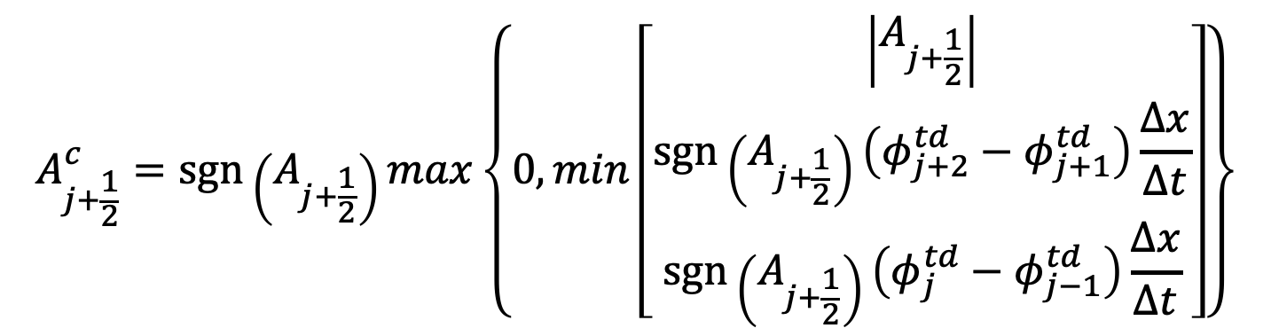
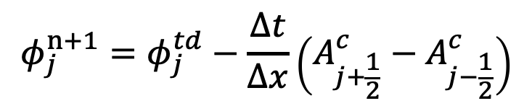
Flux Correction
Boris and Book (1973)
$$φ_{j}^{n+1}=φ_{j}^{td}−\frac{∆t}{∆x}\left(A_{j+\frac{1}{2}}^{c}−A_{j−\frac{1}{2}}^{c}\right)$$
$$A_{j+\frac{1}{2}}^{c}=sgn⁡\left(A_{j+\frac{1}{2}}\right)max\left\{0,min\left[\begin{aligned}\left|A_{j+\frac{1}{2}}\right| \\ \operatorname{sgn}\left(A_{j+\frac{1}{2}}\right)\left(φ_{j+2}^{td}−φ_{j+1}^{td}\right)\frac{∆x}{∆t} \\ sgn⁡\left(A_{j+\frac{1}{2}}\right)\left(φ_{j}^{td}−φ_{j−1}^{td}\right)\frac{∆x}{∆t}\end{aligned}\right]\right\}$$

Slide 13
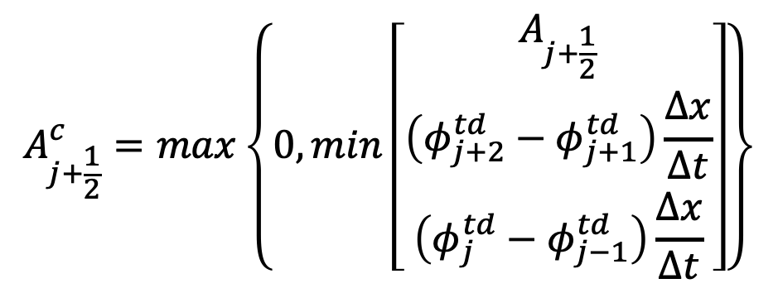
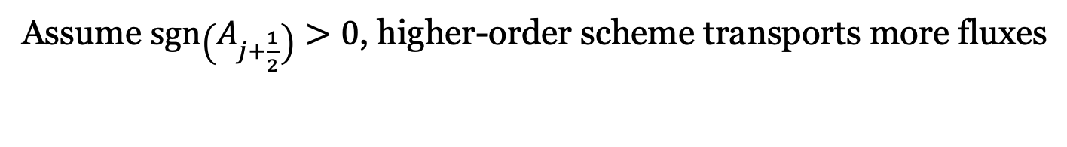
Flux Correction
Assume $\operatorname{sgn}\left(A_{j+\frac{1}{2}}\right)>0$, higher-order scheme transports more fluxes
$$A_{j+\frac{1}{2}}^{c}=max\left\{0,min\left[\begin{aligned}A_{j+\frac{1}{2}} \\ \left(φ_{j+2}^{td}−φ_{j+1}^{td}\right)\frac{∆x}{∆t} \\ \left(φ_{j}^{td}−φ_{j−1}^{td}\right)\frac{∆x}{∆t}\end{aligned}\right]\right\}$$
Won’t be negative and do anti-correction
Won’t create new minima or maxima: retain the monotonity of low-order scheme

Slide 14
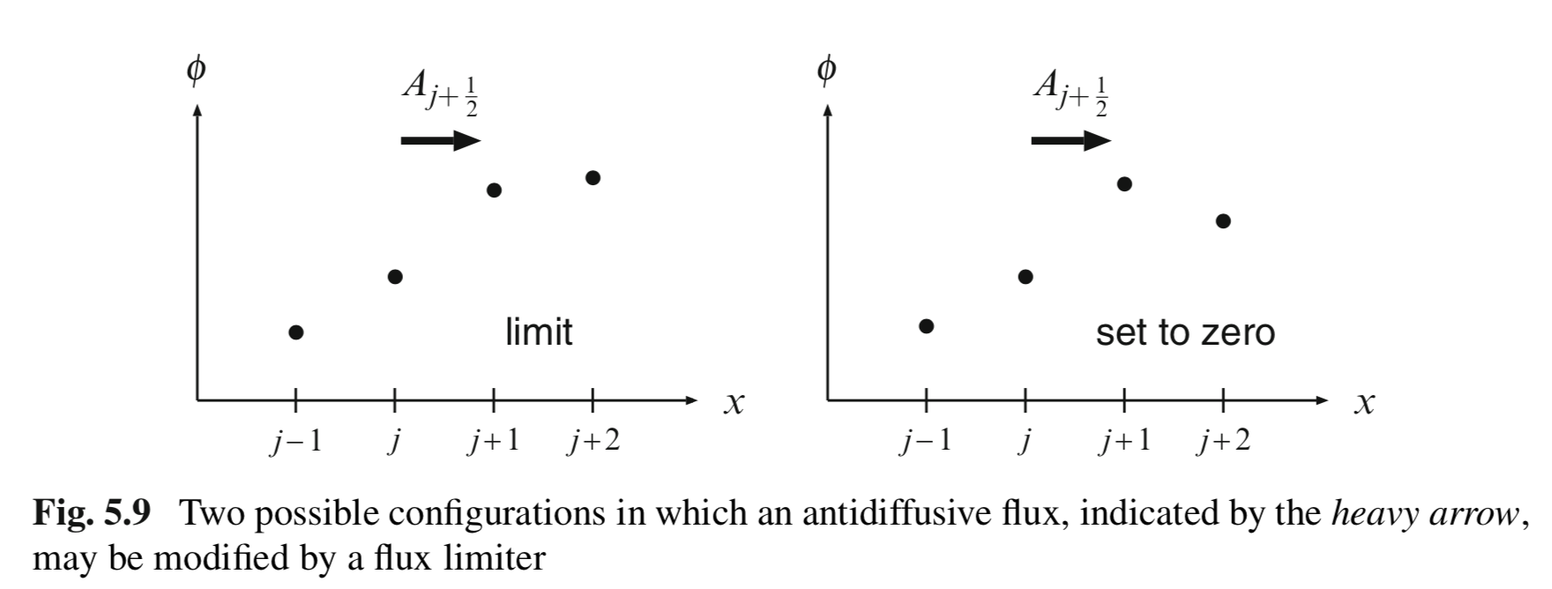
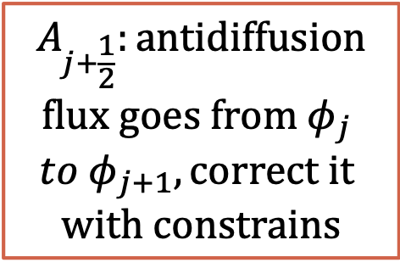
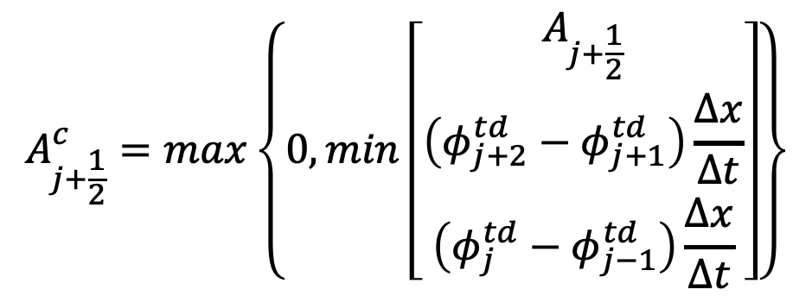
Flux Correction Principle
Durran’s book
$$A_{j+\frac{1}{2}}^{c}=max\left\{0,min\left[\begin{aligned}A_{j+\frac{1}{2}} \\ \left(φ_{j+2}^{td}−φ_{j+1}^{td}\right)\frac{∆x}{∆t} \\ \left(φ_{j}^{td}−φ_{j−1}^{td}\right)\frac{∆x}{∆t}\end{aligned}\right]\right\}$$
$$A_{j+\frac{1}{2}}:antidiffusion$$
$$flux goes from{ φ}_{j}$$
$$to{ φ}_{j+1}, correct it$$
$$with constrains$$

Slide 15
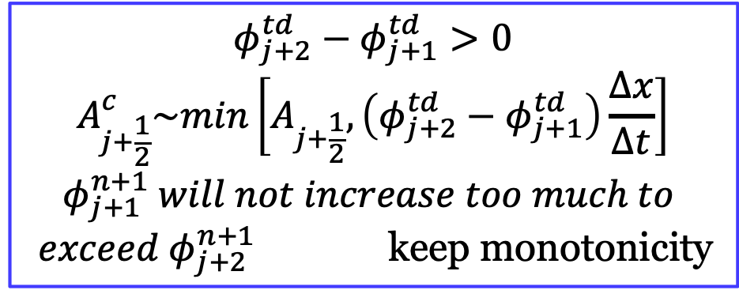
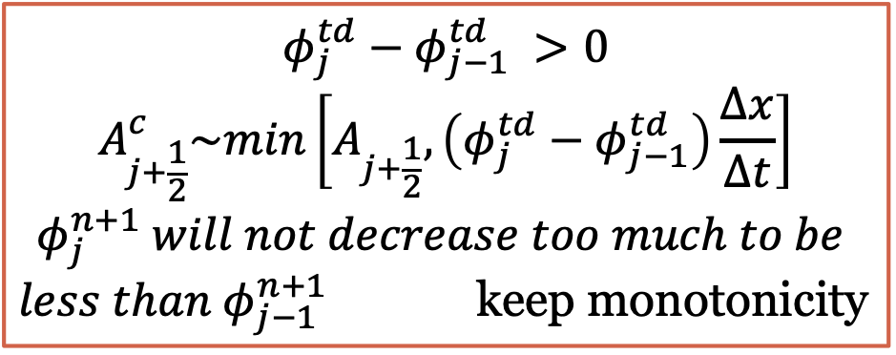
$$φ_{j+2}^{td}−φ_{j+1}^{td}>0$$
$$A_{j+\frac{1}{2}}^{c}\sim min\left[A_{j+\frac{1}{2}},\left(φ_{j+2}^{td}−φ_{j+1}^{td}\right)\frac{∆x}{∆t}\right]$$
$$φ_{j+1}^{n+1} will not increase too much to$$
$exceed{ φ}_{j+2}^{n+1}$ keep monotonicity
Scenario 1
$$φ_{j}^{td}−φ_{j−1}^{td} >0$$
$$A_{j+\frac{1}{2}}^{c}\sim min\left[A_{j+\frac{1}{2}},\left(φ_{j}^{td}−φ_{j−1}^{td}\right)\frac{∆x}{∆t}\right]$$
$$φ_{j}^{n+1} will not decrease too much to be$$
$less than φ_{j−1}^{n+1}$ keep monotonicity

Slide 16
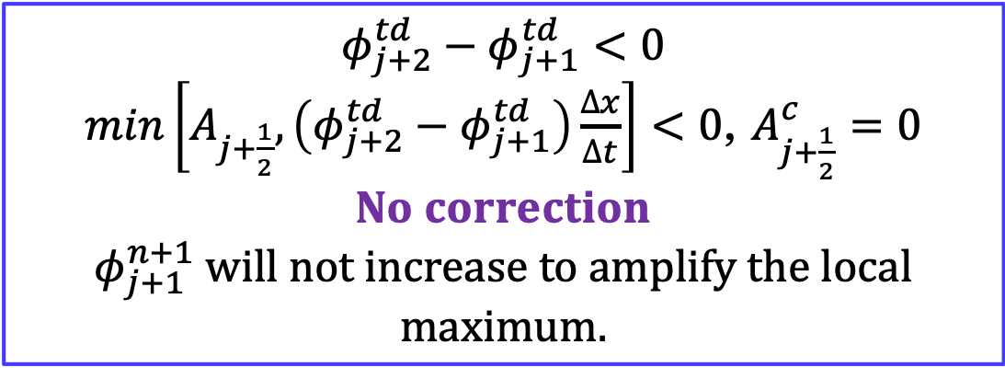
Scenario 2
$$φ_{j+2}^{td}−φ_{j+1}^{td}<0$$
$min\left[A_{j+\frac{1}{2}},\left(φ_{j+2}^{td}−φ_{j+1}^{td}\right)\frac{∆x}{∆t}\right]<0$, $A_{j+\frac{1}{2}}^{c}=0$
$$No correction$$
$φ_{j+1}^{n+1}$ will not increase to amplify the local maximum.
Won’t create new or amplify the existing local maxima and minima correct with constraint and keep monotonicity

Slide 17
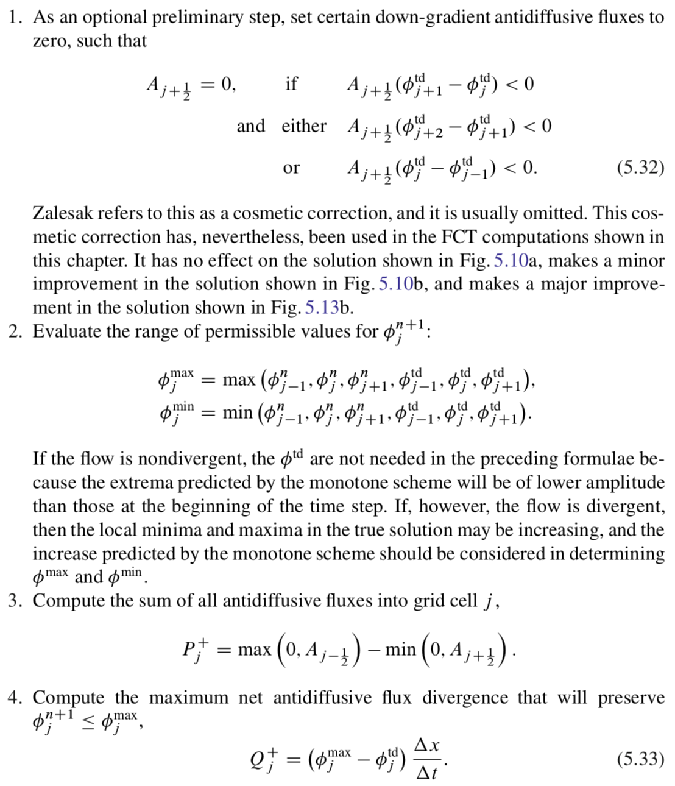
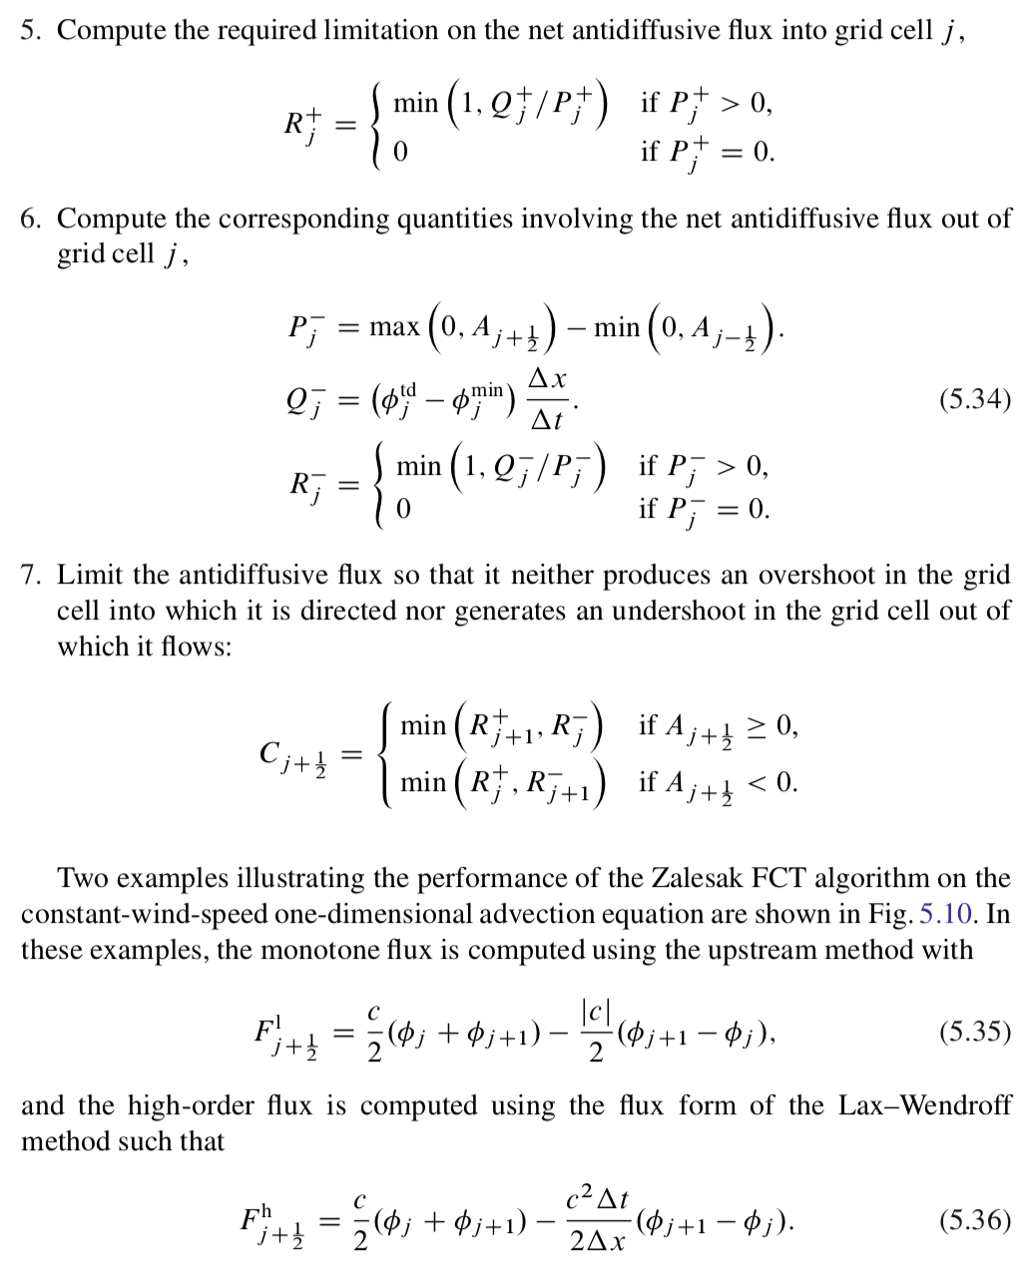
The Zalesak Corrector (1979)

Slide 18
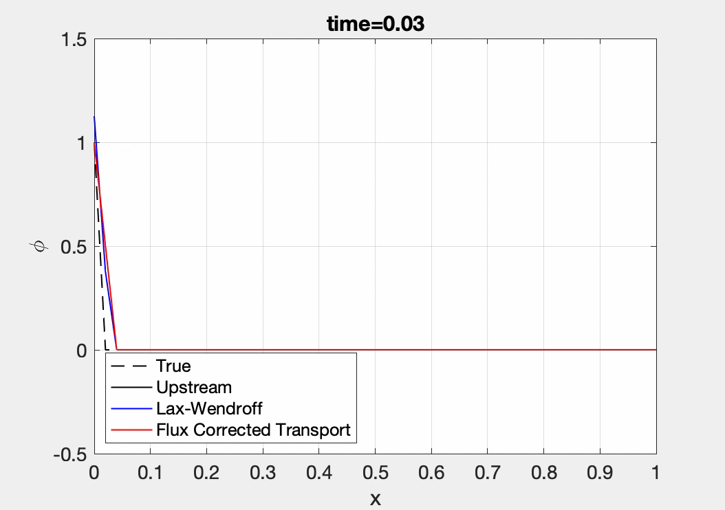
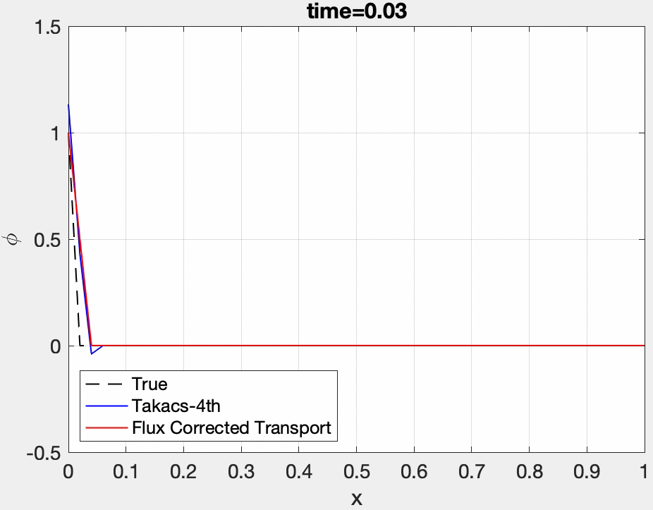
Comparison w/wo FCT
FCT can efficiently remove ripples (avoid generating local new maxima/minima or make them extreme) and correct the high-order scheme.

Slide 19
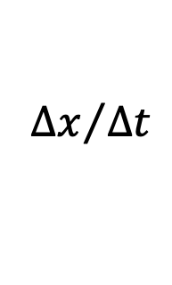
$${∆x}/{∆t}$$
Weighted high-order flux by a factor of even gives
better results? Homework?

