Slide 1
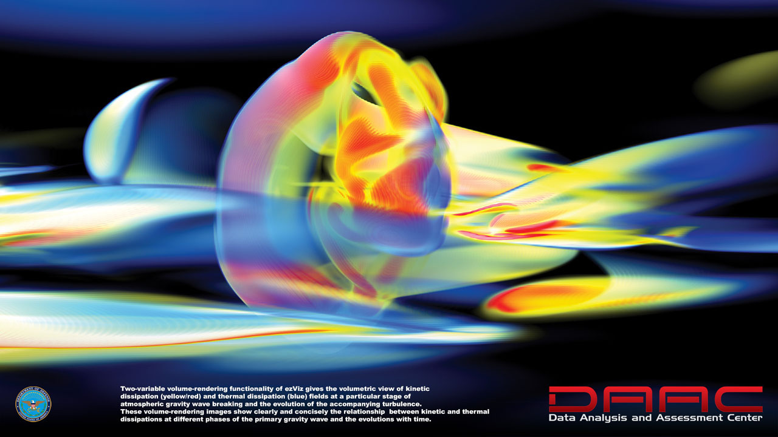
PHYS 8750 Numerical Fluid Dynamics
Fall, 2020
daac.hpc.mil/gallery/

Slide 2
PHYS 8750
Outline
1. Review of FCT method
2. Flux limiter methods
2.1. Main ideas
2.2. Schemes: Superbee, Van Leer, minmod
3. Examples (coding)
Class #17 (Chapter 5.5)
Finite Volume Method
Flux limiters
Class #16
(Chapter 5.4)
Flux corrected transport

Slide 3
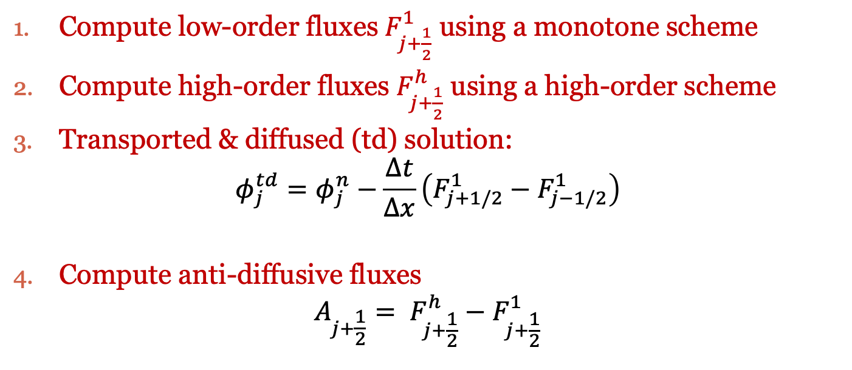
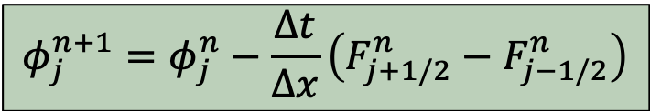
Flux-Corrected Transport
General Idea:
Flux Form
$$φ_{j}^{n+1}=φ_{j}^{n}−\frac{∆t}{∆x}\left(F_{j+1/2}^{n}−F_{j−1/2}^{n}\right)$$
Compute low-order fluxes $F_{j+\frac{1}{2}}^{1}$ using a monotone scheme
Compute high-order fluxes $F_{j+\frac{1}{2}}^{h}$ using a high-order scheme
Transported & diffused (td) solution:
$$φ_{j}^{td}=φ_{j}^{n}−\frac{∆t}{∆x}\left(F_{j+1/2}^{1}−F_{j−1/2}^{1}\right)$$
Compute anti-diffusive fluxes
$$A_{j+\frac{1}{2}}= F_{j+\frac{1}{2}}^{h}−F_{j+\frac{1}{2}}^{1}$$

Slide 4

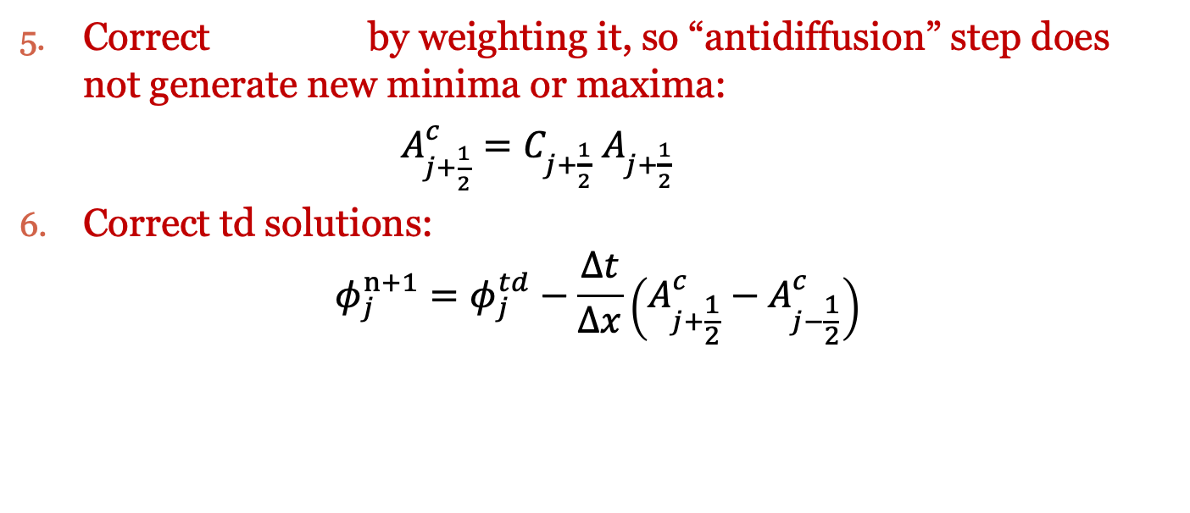
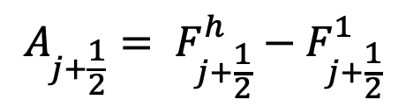
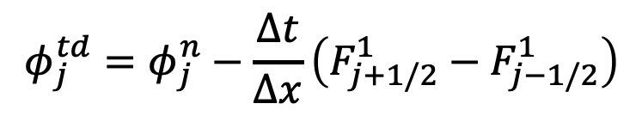
Flux-Corrected Transport
$$A_{j+1/2}$$
Correct by weighting it, so “antidiffusion” step does not generate new minima or maxima:
$A_{j+\frac{1}{2}}^{c}=C_{j+\frac{1}{2}}$ $A_{j+\frac{1}{2}}$
Correct td solutions:
$$φ_{j}^{n+1}=φ_{j}^{td}−\frac{∆t}{∆x}\left(A_{j+\frac{1}{2}}^{c}−A_{j−\frac{1}{2}}^{c}\right)$$
$$φ_{j}^{td}=φ_{j}^{n}−\frac{∆t}{∆x}\left(F_{j+1/2}^{1}−F_{j−1/2}^{1}\right)$$
$$A_{j+\frac{1}{2}}= F_{j+\frac{1}{2}}^{h}−F_{j+\frac{1}{2}}^{1}$$

Slide 5
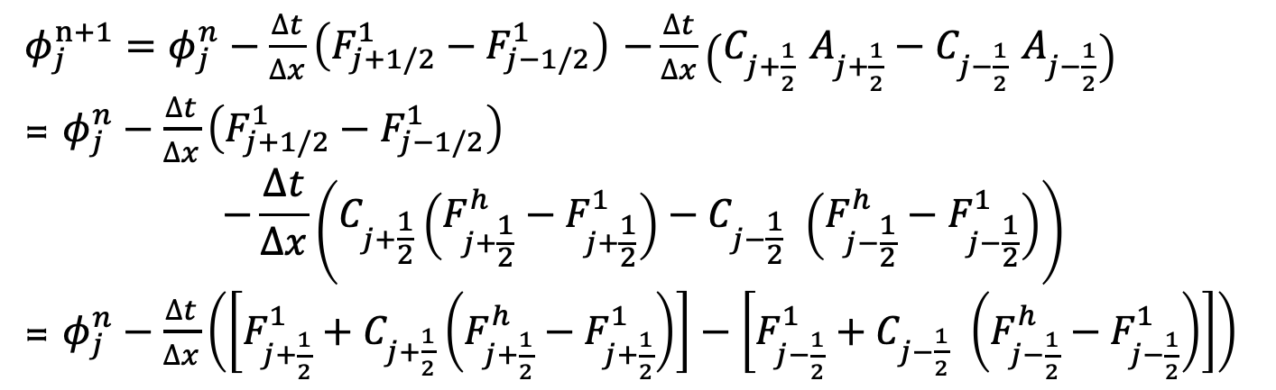
Flux-Corrected Transport
$φ_{j}^{n+1}=φ_{j}^{n}−\frac{∆t}{∆x}\left(F_{j+1/2}^{1}−F_{j−1/2}^{1}\right)$ $−\frac{∆t}{∆x}\left(C_{j+\frac{1}{2}} A_{j+\frac{1}{2}}−C_{j−\frac{1}{2}} A_{j−\frac{1}{2}}\right)$
= $φ_{j}^{n}−\frac{∆t}{∆x}\left(F_{j+1/2}^{1}−F_{j−1/2}^{1}\right)$
$$−\frac{∆t}{∆x}\left(C_{j+\frac{1}{2}}\left(F_{j+\frac{1}{2}}^{h}−F_{j+\frac{1}{2}}^{1}\right)−C_{j−\frac{1}{2}} \left(F_{j−\frac{1}{2}}^{h}−F_{j−\frac{1}{2}}^{1}\right)\right)$$
= $φ_{j}^{n}−\frac{∆t}{∆x}\left(\left[F_{j+\frac{1}{2}}^{1}+C_{j+\frac{1}{2}}\left(F_{j+\frac{1}{2}}^{h}−F_{j+\frac{1}{2}}^{1}\right)\right]−\left[F_{j−\frac{1}{2}}^{1}+C_{j−\frac{1}{2}} \left(F_{j−\frac{1}{2}}^{h}−F_{j−\frac{1}{2}}^{1}\right)\right]\right)$
Corrected Flux at j+1/2
Corrected Flux
At j-1/2
Flux-Limited Methods: do not calculate $φ_{j}^{td}$, but deal with $C_{j+\frac{1}{2}}$

Slide 6
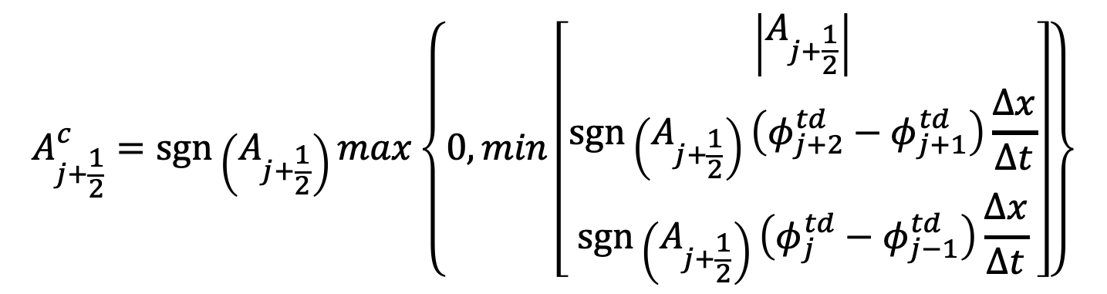
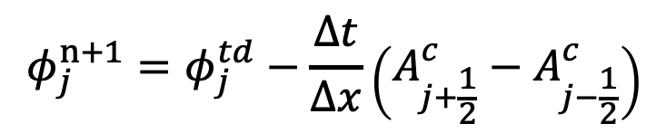
FCT Flux Correction
Boris and Book (1973)
$$φ_{j}^{n+1}=φ_{j}^{td}−\frac{∆t}{∆x}\left(A_{j+\frac{1}{2}}^{c}−A_{j−\frac{1}{2}}^{c}\right)$$
$$A_{j+\frac{1}{2}}^{c}=sgn⁡\left(A_{j+\frac{1}{2}}\right)max\left\{0,min\left[\begin{aligned}\left|A_{j+\frac{1}{2}}\right| \\ \operatorname{sgn}\left(A_{j+\frac{1}{2}}\right)\left(φ_{j+2}^{td}−φ_{j+1}^{td}\right)\frac{∆x}{∆t} \\ sgn⁡\left(A_{j+\frac{1}{2}}\right)\left(φ_{j}^{td}−φ_{j−1}^{td}\right)\frac{∆x}{∆t}\end{aligned}\right]\right\}$$
Won’t do anti-correction
Won’t create new minima or maxima: retain the monotonicity of low-order scheme

Slide 7
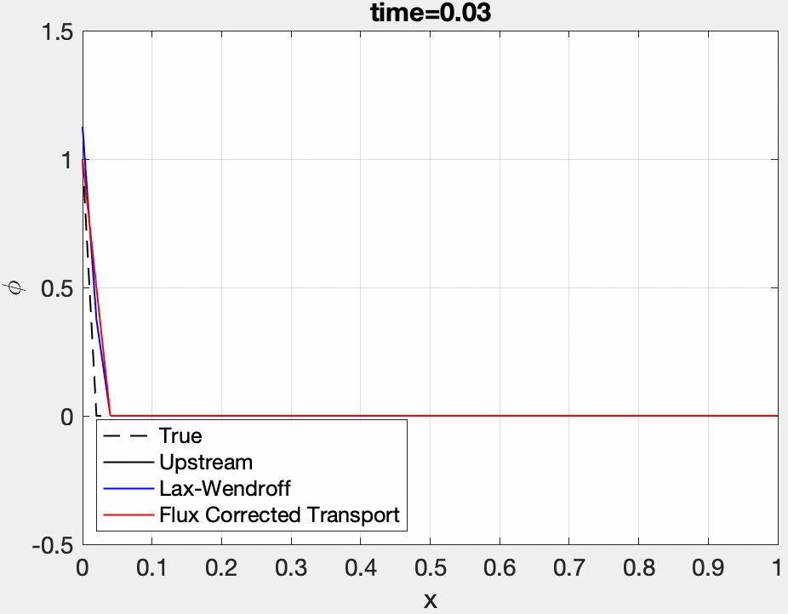
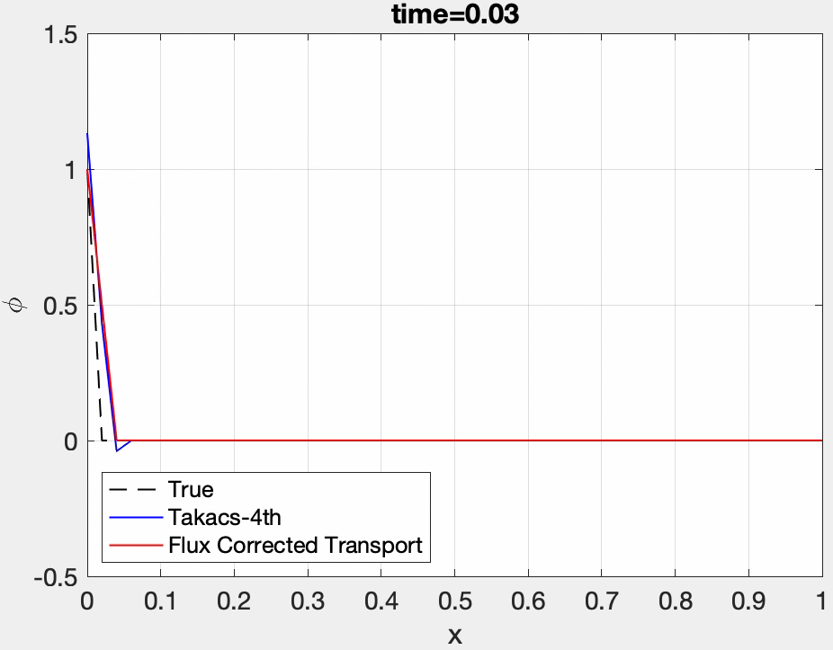
Comparison w/wo FCT
FCT can efficiently remove ripples (avoid generating local new maxima/minima or make them extreme) and correct the high-order scheme.

Slide 8
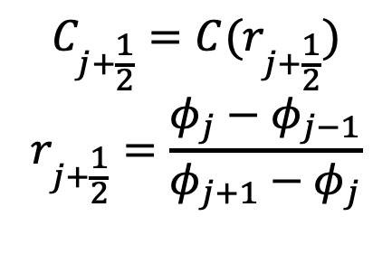
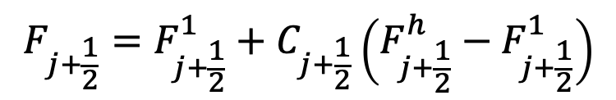
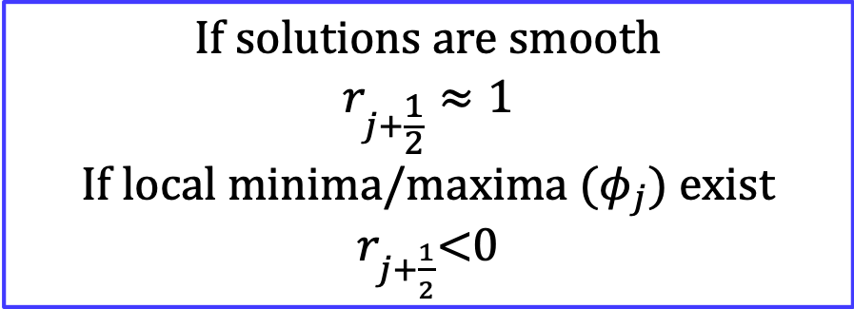
Flux-Limited Methods
Flux-Limited Methods: do not calculate $φ_{j}^{td}$, but deal with $C_{j+\frac{1}{2}}$
$$C_{j+\frac{1}{2}}={C(r}_{j+\frac{1}{2}})$$
$$r_{j+\frac{1}{2}}=\frac{φ_{j}−φ_{j−1}}{φ_{j+1}−φ_{j}}$$
$${F_{j+\frac{1}{2}}=F}_{j+\frac{1}{2}}^{1}+C_{j+\frac{1}{2}}\left(F_{j+\frac{1}{2}}^{h}−F_{j+\frac{1}{2}}^{1}\right)$$
$$\text{If} \text{solutions} \text{are} \text{smooth}$$
$$r_{j+\frac{1}{2}}≈1$$
If local minima/maxima ($φ_{j}$) exist
$r_{j+\frac{1}{2}}$<0

Slide 9
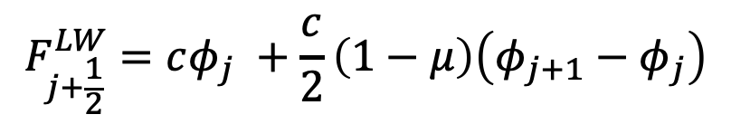
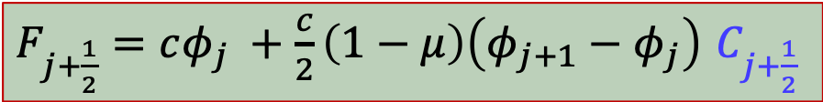
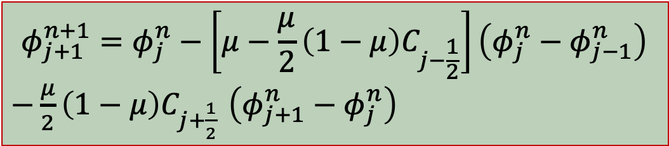
Lax-Wendroff Method
Flux form for Lax-Wendroff method (Sweby, 1984):
$$F_{j+\frac{1}{2}}^{LW}=cφ_{j} +\frac{c}{2}\left(1−μ\right)\left(φ_{j+1}−φ_{j}\right)$$
Upstream Flux
$F_{j+\frac{1}{2}}=cφ_{j} +\frac{c}{2}\left(1−μ\right)\left(φ_{j+1}−φ_{j}\right)$ $C_{j+\frac{1}{2}}$
$$φ_{j+1}^{n+1}=φ_{j}^{n}−\left[μ−\frac{μ}{2}\left(1−μ\right)C_{j−\frac{1}{2}}\right]\left(φ_{j}^{n}−φ_{j−1}^{n}\right)$$
$−\frac{μ}{2}\left(1−μ\right)C_{j+\frac{1}{2}}$ $\left(φ_{j+1}^{n}−φ_{j}^{n}\right)$

Slide 10
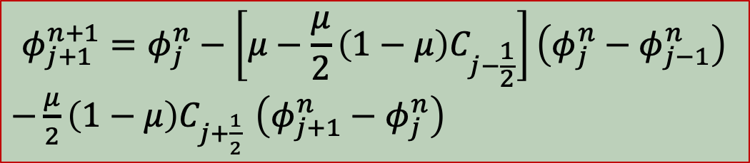
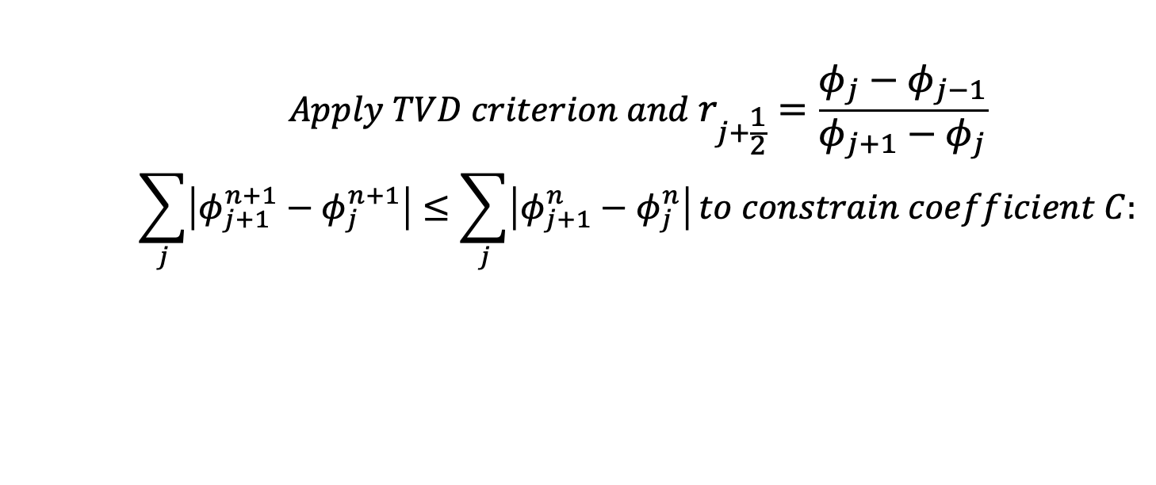
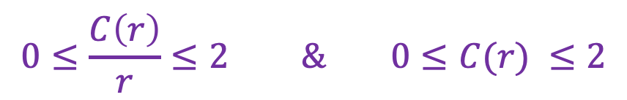
Use TVD to Constrain C Section 5.5.1
$$φ_{j+1}^{n+1}=φ_{j}^{n}−\left[μ−\frac{μ}{2}\left(1−μ\right)C_{j−\frac{1}{2}}\right]\left(φ_{j}^{n}−φ_{j−1}^{n}\right)$$
$−\frac{μ}{2}\left(1−μ\right)C_{j+\frac{1}{2}}$ $\left(φ_{j+1}^{n}−φ_{j}^{n}\right)$
$$Apply TVD criterion and{ r}_{j+\frac{1}{2}}=\frac{φ_{j}−φ_{j−1}}{φ_{j+1}−φ_{j}}$$
$$\sum_{j}{\left|φ_{j+1}^{n+1}−φ_{j}^{n+1}\right|}≤\sum_{j}{\left|φ_{j+1}^{n}−φ_{j}^{n}\right|}to constrain coefficient C:$$
$$0≤\frac{C\left(r\right)}{r}≤2 \& 0≤C(r) ≤2$$

Slide 11
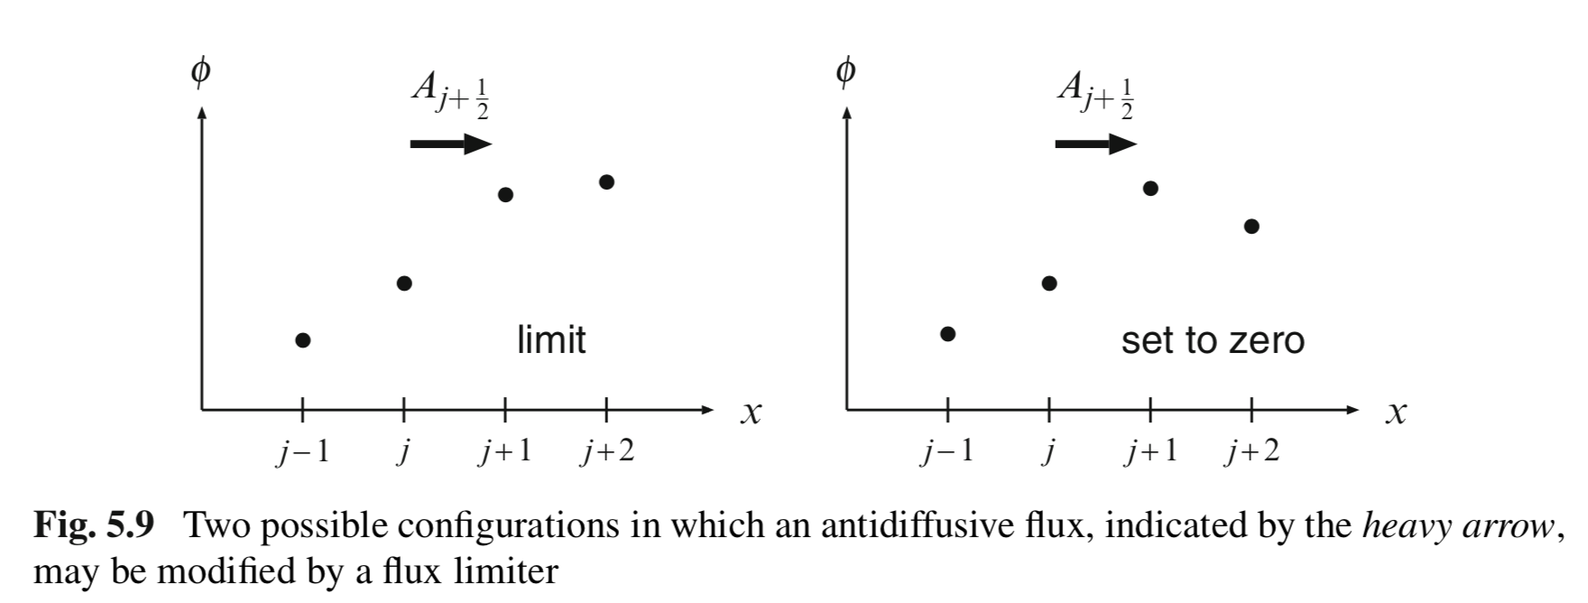
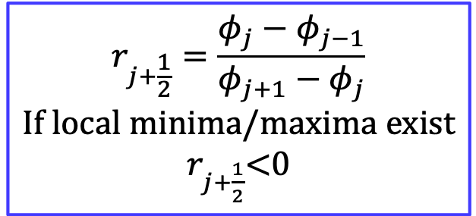
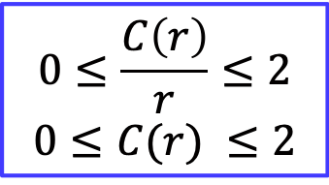
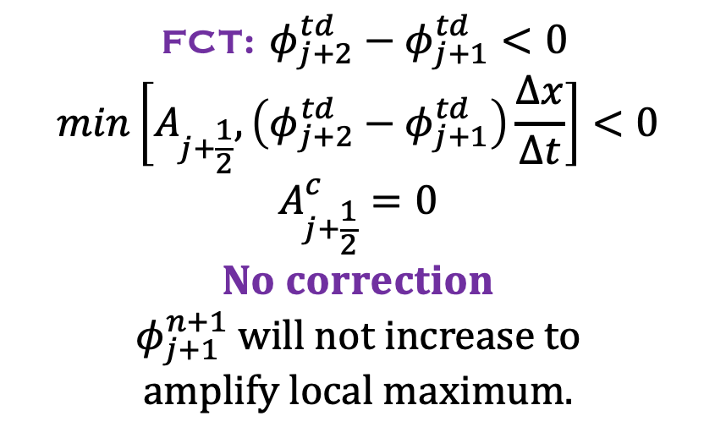
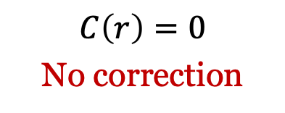
Compare with FCT Method
$$r_{j+\frac{1}{2}}=\frac{φ_{j}−φ_{j−1}}{φ_{j+1}−φ_{j}}$$
If local minima/maxima exist
$r_{j+\frac{1}{2}}$<0
$$0≤\frac{C\left(r\right)}{r}≤2$$
$$0≤C(r) ≤2$$
$$C\left(r\right)=0$$
No correction
Scenario 2
FCT: $φ_{j+2}^{td}−φ_{j+1}^{td}<0$
$$min\left[A_{j+\frac{1}{2}},\left(φ_{j+2}^{td}−φ_{j+1}^{td}\right)\frac{∆x}{∆t}\right]<0$$
$$A_{j+\frac{1}{2}}^{c}=0$$
$$No correction$$
$φ_{j+1}^{n+1}$ will not increase to
amplify local maximum.

Slide 12
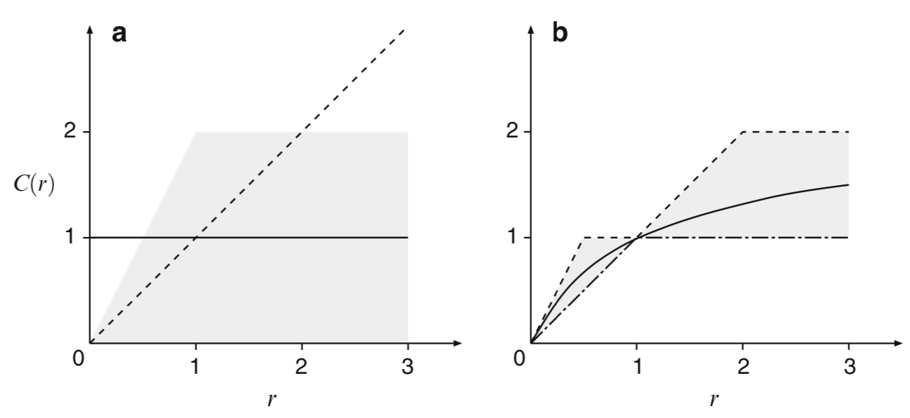

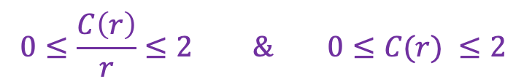
Selection of Coefficient C
If no local minima/maxima exist: $r_{j+\frac{1}{2}}>$0
$$0≤\frac{C\left(r\right)}{r}≤2 \& 0≤C(r) ≤2$$
To maintain second-order accuracy, weighted averages of Lax-Wendroff ($C(r)$=1) and Warming and Beam ($C(r)$=r).
Durran’s book

Slide 13
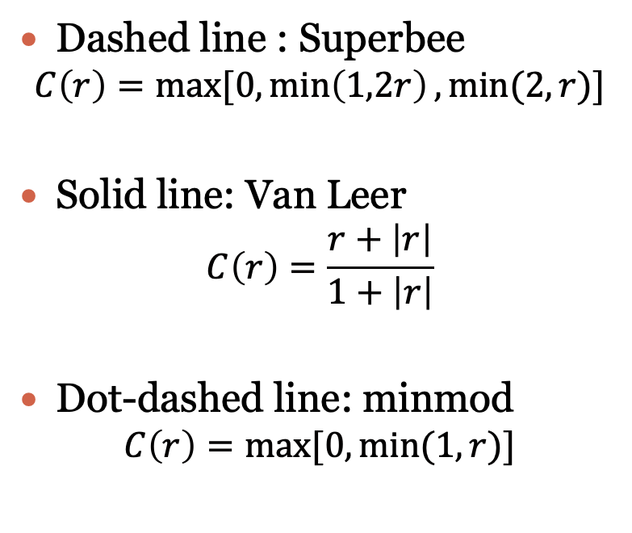
Flux-Limiters
C(r)
Dashed line : Superbee
$$C\left(r\right)=max⁡[0,\min\left(1,2r\right),min⁡(2,r)]$$
Solid line: Van Leer
$$C\left(r\right)=\frac{r+\left|r\right|}{1+\left|r\right|}$$
Dot-dashed line: minmod
$$C\left(r\right)=max⁡[0,min⁡(1,r)]$$

Slide 14
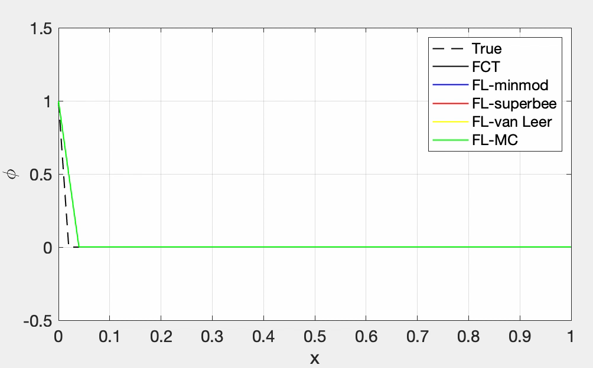
Method Comparison

Slide 15
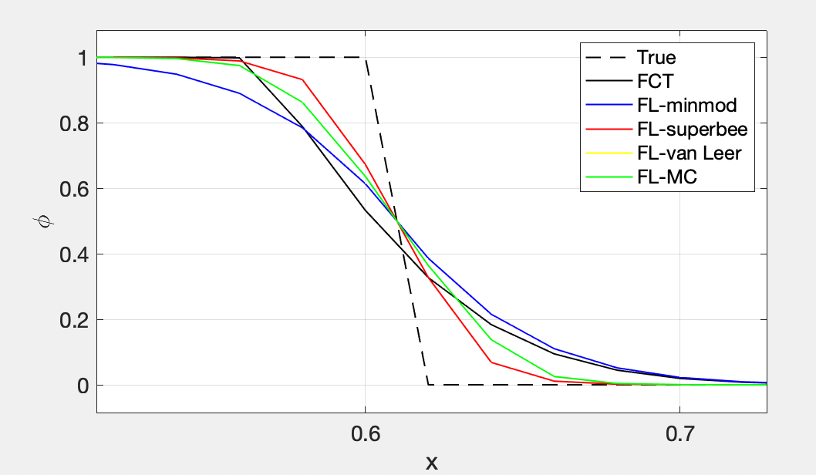
Method Comparison

Slide 16
Schedule
Oct 27, 29
Nov 3 (fall break), 5, 10, 12, 17, 19, 24,
26 (Thanksgiving)
Dec 1, 3
Proposal presentations: Nov 10, 12
Final project presentations: Nov 24, Dec 1, 3

Slide 17
Final Projects
Proposal & Final Projects:
1) Modify parameters in an existing model to study the science/engineering questions you are interested.
2) Modify an existing model (add new equations, new grids, and etc.)
3) Develop your own model.
Points to include in the report (subset of all of these):
Introduction of the model.
What is the numerical problem you want to solve?
What is the numerical scheme used?
What improvements/modifications you want to make and why?

