Slide 1
RefSeq Target Validity and Unlearning Diagnostics
A control-variable check for whether our probe is measuring a real Evo representation or a dataset shortcut.
Step 1
Is the target a real Evo-readable ability?
Step 2
Can the probe measure that ability reliably?
Then
Use unlearning results as causal evidence.
Meeting deck | Evo-1 RefSeq target analysis

Slide 2
Why I re-checked the original host-tropism target
What raised the concern
- The previous target asked the model to infer human tropism from viral sequence.
- Controlled splits on Virus-Host-Genomes showed weak cross-taxonomy generalization.
- That pattern suggests the probe may learn taxonomy identity or close sequence similarity.
Why target fit matters
- Evo is a nucleotide prediction model.
- It may be stronger on sequence-level patterns than on a high-level phenotype.
- Host tropism can depend on receptor biology, immune context, and annotation bias.
Main point: before judging unlearning, I wanted to check whether the target itself is well matched to Evo.

Slide 3
Why I changed the target
I changed the target to test whether the weak causal story came from the method, or from the target itself.
Previous target
Human host tropism
A higher-level phenotype with strong shortcut risk
Current implemented target
Coronaviridae vs non-Coronaviridae
A RefSeq taxonomy-defined sequence proxy
Important clarification: this is not strict human-tropic vs non-human-tropic classification. I use it as a proxy to ask whether Evo gives a cleaner sequence-level signal.
The target change is a control-variable check, not a final claim that host tropism has been solved.

Slide 4
How I built the RefSeq proxy target
Data source
- Read NCBI taxonomy and RefSeq viral assembly metadata.
- Use Coronaviridae family taxid as the positive lineage.
- Use other viral assemblies as matched negative candidates.
Processing
- Clean sequences to A, C, G, T, and N.
- Sample fixed-length windows.
- Match negatives by rough sequence length.
- Keep labels balanced across splits.
Controls
- Split Coronaviridae records by species/group.
- Assign matched negatives by split and length bin.
- This helps, but does not remove all taxonomy shortcuts.
The manifest is label-balanced, but the positive and negative sides can still differ in taxonomy composition.

Slide 5
Phase 1 workflow: readout first, then localization
Extract Evo features
Mean-pooled hidden states from each layer
Train probes
One balanced logistic probe per layer
Patch activations
Find layers that shift target probability
Implementation details that matter
- Representation: next_norm hidden states with mask mean pooling.
- Metric: validation and test AUROC.
- Localization rule: select layers with strong activation-patching effect.
Phase 1 asks: where is the target most readable, and which layers look causally relevant under patching?

Slide 6
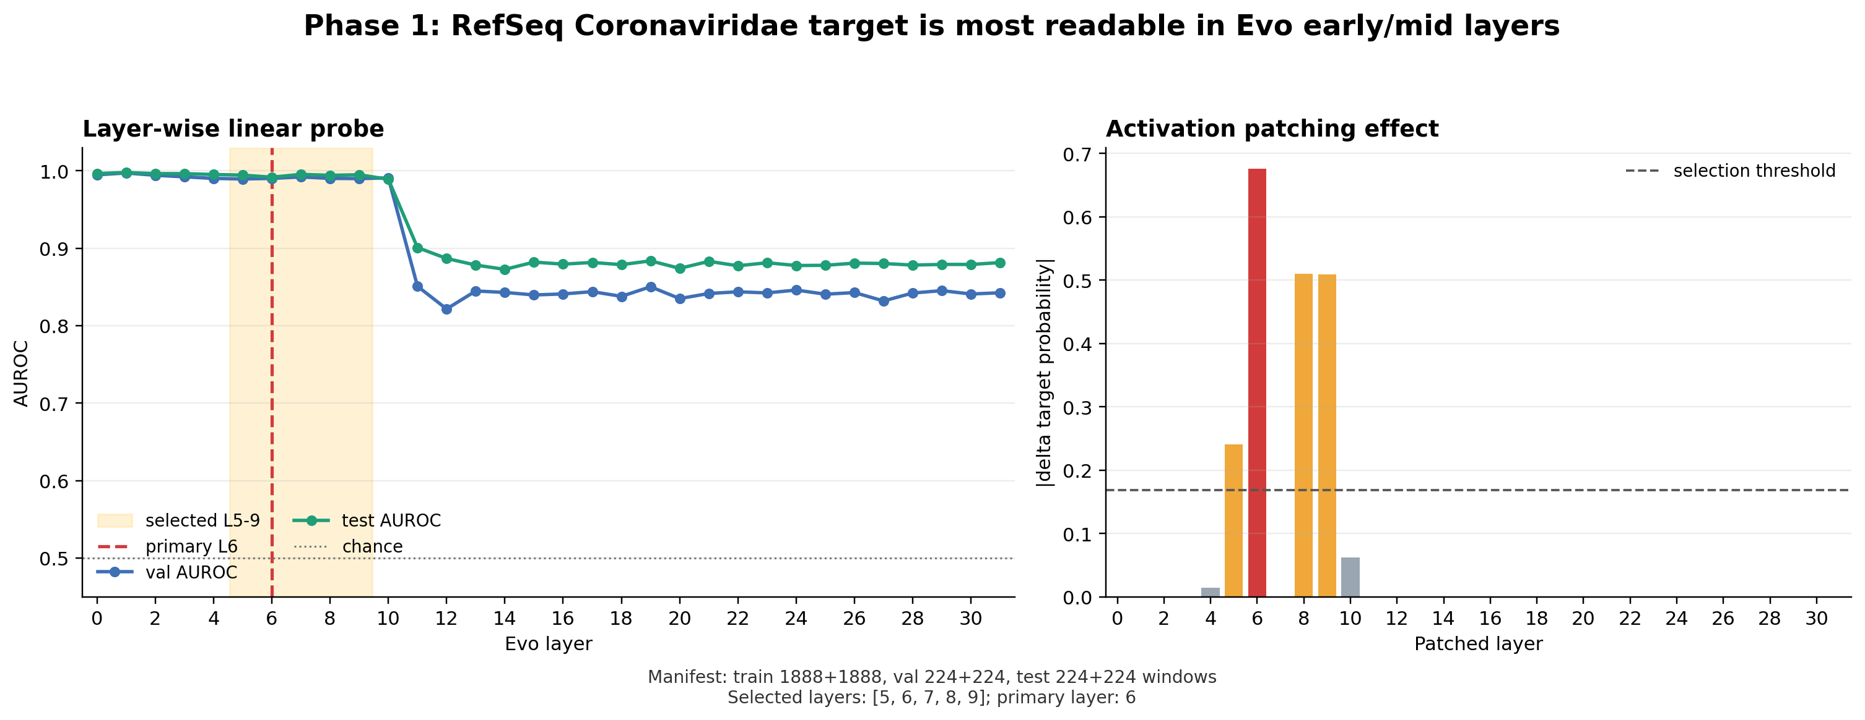
Phase 1 result: the signal is concentrated around L5-L9
Left: layer-wise probe AUROC. Right: activation-patching effect. Selected layers are L5-L9, with L6 as the primary target layer.

Slide 7
How I interpret Phase 1
Positive signal
- The RefSeq proxy target is easy to read from Evo early and middle layers.
- Activation patching gives a narrower candidate range than the earlier host-tropism setup.
- Layer 6 is the strongest single patching signal.
Caution
- Very high probe performance can also indicate shortcut risk.
- The probe may rely on taxonomy, k-mer, GC, or RefSeq source patterns.
- So Phase 1 is useful, but not enough to prove target validity.
Phase 1 looks cleaner than before, but it does not close the shortcut question.

Slide 8
Phase 2 setup: test whether the localized layers are editable
Forget/retain split
- label 1 becomes the forget side.
- label 0 becomes the retain/control side.
- Unlearning uses only the training split.
- Evaluation uses held-out validation and test windows.
Methods
- GD increases forget loss while preserving retain loss.
- RMU pushes forget activations away while matching retain activations to a frozen reference.
Conditions
- Full: train all layers.
- Localized: train L5-L9 only.
- Random: train random non-causal layers as a control.
Phase 2 asks: are L5-L9 only readout layers, or can they serve as clean causal edit points?

Slide 9
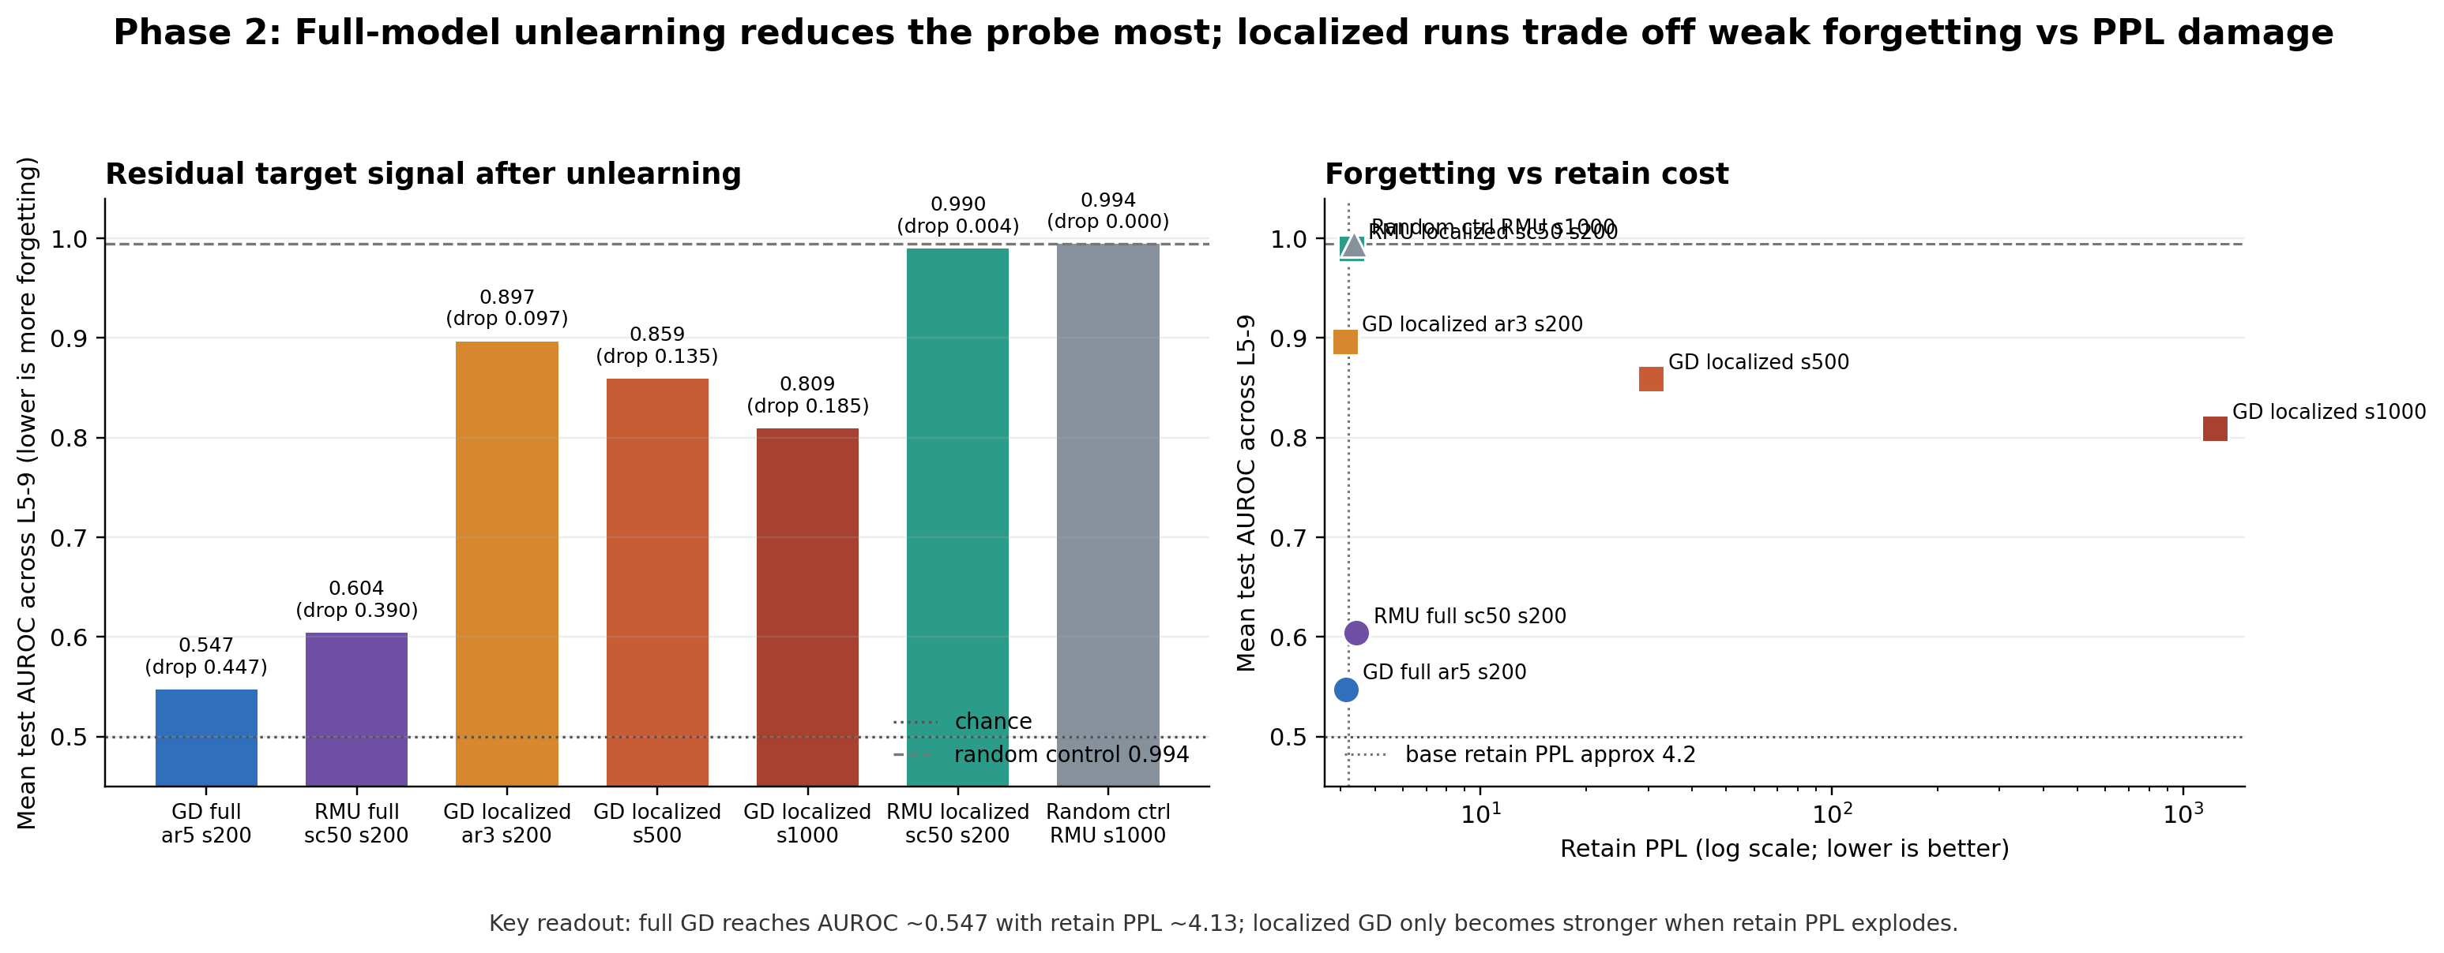
Phase 2 result: full-model edits reduce the probe most
Left: residual L5-L9 target AUROC after unlearning. Right: forgetting versus retain PPL cost.

Slide 10
What Phase 2 means
GD full
0.547
Main readout
- Full GD and full RMU remove much more probe signal than localized runs.
- Localized GD only becomes stronger when retain quality breaks down.
- Localized RMU preserves retain quality, but barely forgets.
- Random controls stay close to the original probe signal.
RMU full
0.604
GD localized stable
0.897
RMU localized
0.992
Random control
0.995
Lower AUROC is more forgetting. The full methods move the target signal most; localized methods do not yet look like clean selective edits.

Slide 11
The main concern: shortcut can still explain the chain
If the Phase 1 probe reads a shortcut, Phase 2 may only prove that full-model training can damage that shortcut.
Possible shortcut sources
- Coronaviridae versus non-Coronaviridae taxonomy identity.
- Family or genus composition differences.
- GC, k-mer, or sequence-source artifacts.
- Manual split choices in the current manifest.
Current interpretation
- The target is useful as a proxy.
- It is not yet a final human-tropism target.
- I should validate the target before treating unlearning as causal evidence.
This is the key decision point: target validity should come before a larger sweep.

Slide 12
Discussion questions for tonight
Core decision
- Should we pause larger unlearning sweeps until target validity is stronger?
- Do we first need a target that is better matched to Evo and less shortcut-prone?
- Can we trust Phase 2 if the Phase 1 probe may be reading a split artifact?
Concrete validation checks
- Could family/genus composition explain the current RefSeq result?
- Should we use a public dataset or a standard split if one exists?
- If not, should we run family/genus-held-out, homology-held-out, GC/k-mer baselines, and negative-sampling ablations?
The goal is to prove that the probe reads a reliable sequence-level signal, not just the way I split this dataset.

Slide 13
Take-home message
Step 1 and Step 2 are not fully closed yet: first prove the target is real and suitable for Evo, then prove the probe measures it.
Phase 1 gives a sharper candidate region around L5-L9, but Phase 2 shows that localized edits do not yet have a strong causal interpretation.
My request: prioritize target and split validation, then return to localized unlearning and benchmark evaluation.
More sweep numbers may not answer the real question unless the probe target is trustworthy.

