Slide 1

Guarding Healthcare Integrity:
Utilizing Machine Learning for
Medical Provider Fraud Detection
Zhiguo Chen, Xiang Gao, Snow Lin,
Daquan Sun, Yanyan Yang, Cuixia Xu
Notes:
Give a fancier name

Slide 2
What is the problem you would like to solve? Why is it important?
Healthcare Fraud is one of the major problems in the US Healthcare System, and it leads to tens of billions of dollars lost each year.
The Insurance Agencies like Medicare, Medicaid, and other agencies have to spend more money, and to incur the financial losses, they have to decide to increase the insurance premium amount. Eventually, the healthcare system is becoming more and more expensive for everyone.
Not only is the financial loss a major concern, fraud can also lead to unnecessary procedures, inappropriate medications, and even over-treatment, putting patients at risk.

Slide 3
How to measure the business value of your solution? What is the benchmark?
Goal: Detect as many fraud claims as possible
Average cost of $1000 per claim reimbursement
Every 1% increase in detection rate can save hundreds of millions nationwide
Notes:
Zhiguo

Slide 4
How to measure the business value of your solution? What is the benchmark?
Benchmark 1: Rely on domain experts to manually review claims, ~0.00%
Benchmark 2: Claim Audits Team , random or target, vary 20%-40%

Slide 5
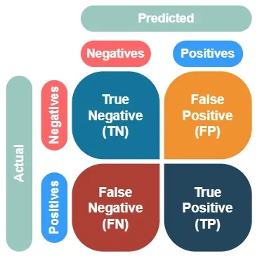
What are the metrics you will use? Why?
False Positive: Denial of Insurance Benefits for Legitimate Claims.
Business Impact: Degrade the insurance companies’ reputation and undermine customer trust.
False Negative: Authorization of Insurance Benefits for Fraudulent Claims.
Business Impact: Lead to significant monetary losses for insurance companies.
Notes:
Xiang

Slide 6
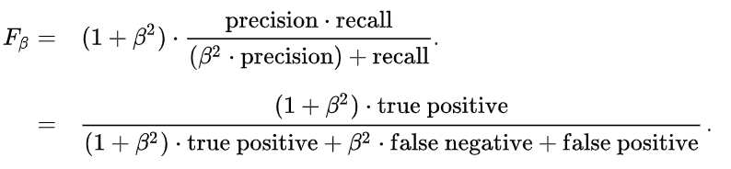
What are the metrics you will use? Why?
Fβ Score: Keep a balance between business interests and the company's reputation, with the exact beta value being determined by the company's economic situation and strategic objectives.

Slide 7
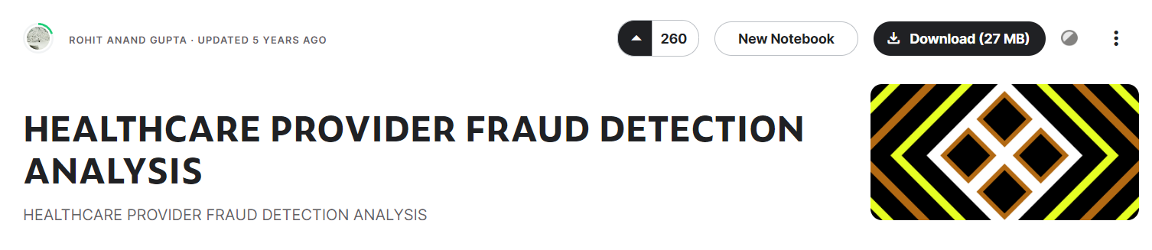
Proof of Concept - Data Source
Data source: https://www.kaggle.com/datasets/rohitrox/healthcare-provider-fraud-detection-analysis/
Data from Medicare, a federal health insurance program in the United States
Historical claim data from 2009
Multiple datasets
Notes:
What data do you need? How will you get the data?

Slide 8
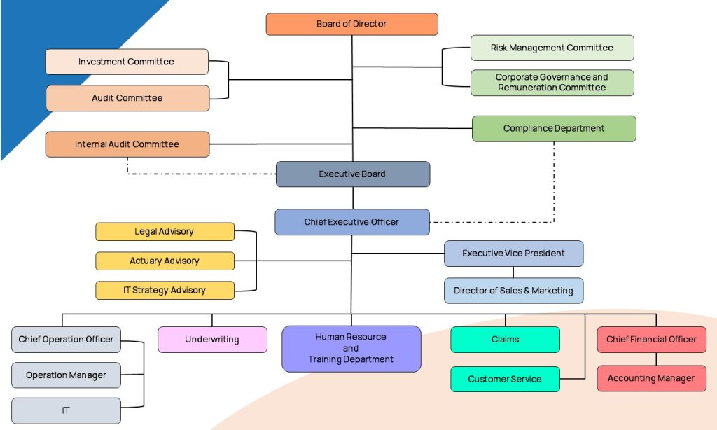
What Will Be The Input And Output Data?
Input data
Internal data of payer
EHR of beneficiaries
Claim transferred from medical provider to payer
Inpatient
Outpatient
Output data
Medical Provider is fraudulent or not

Slide 9
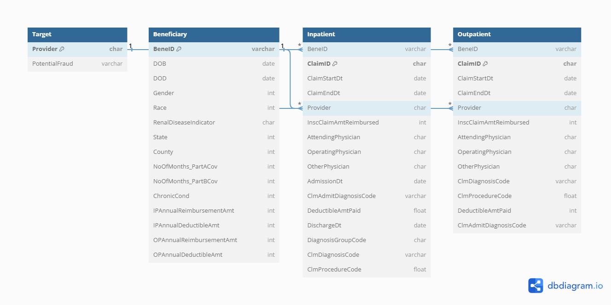
Data Structure

Slide 10
What Will Be The Input Features?
Create data dictionary
Merge EHR & Claim
Create new feature
Data element name
Data element definition
Data type
Allowable values
Constraints and rules
Df_train_inpatient
Df_train_outpatient
Df_test_inpatient
Df_test_inpatient
Create new feature based on domain knowledge review

Slide 11
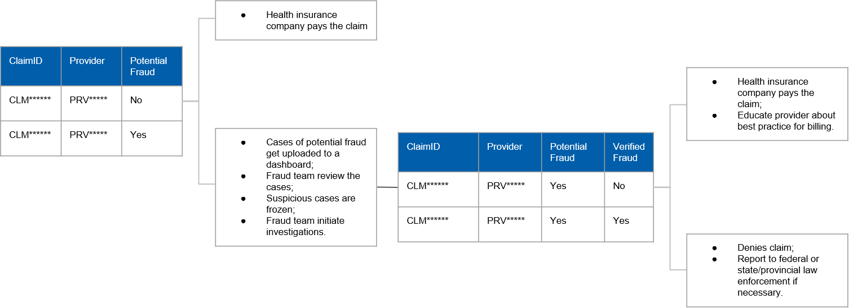
What Will Be The Output Feature?

Slide 12
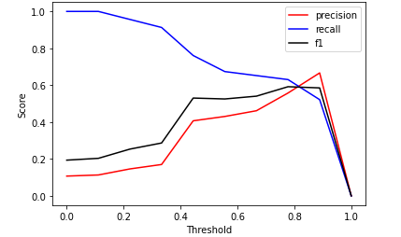
What algorithms will you choose for this project? Why?
Logistic Regression
Our target - PotentialFraud is a binary boolean (yes and no). We thus use logistic regression to build the model.
Set class_weight in Logistic Regression and retrain the model.

Slide 13


Slide 14
kaggle
Data: https://www.kaggle.com/datasets/rohitrox/healthcare-provider-fraud-detection-analysis/
Customer: healthcare insurance company, ????department
10%gdp 10% fraud claim
Bluecross, 意外保险
Metalife??
gaco??
信用局 credit bureau
Problem to solve:
Deploy:
Meeting schedule: Dec. 03, 2023: 确定数据 kaggle -> real world data
Dec. 08, 2023: 讨论数据
Deadline: Dec. 15 开题报告

Slide 15
Customer

Slide 16
As-Is
10%gdp 10% fraud claim
几百个billion

Slide 17
To-Be

Slide 18
Gap

Slide 19
Data Source

Slide 20
Missing Data

Slide 21
EDA

Slide 22
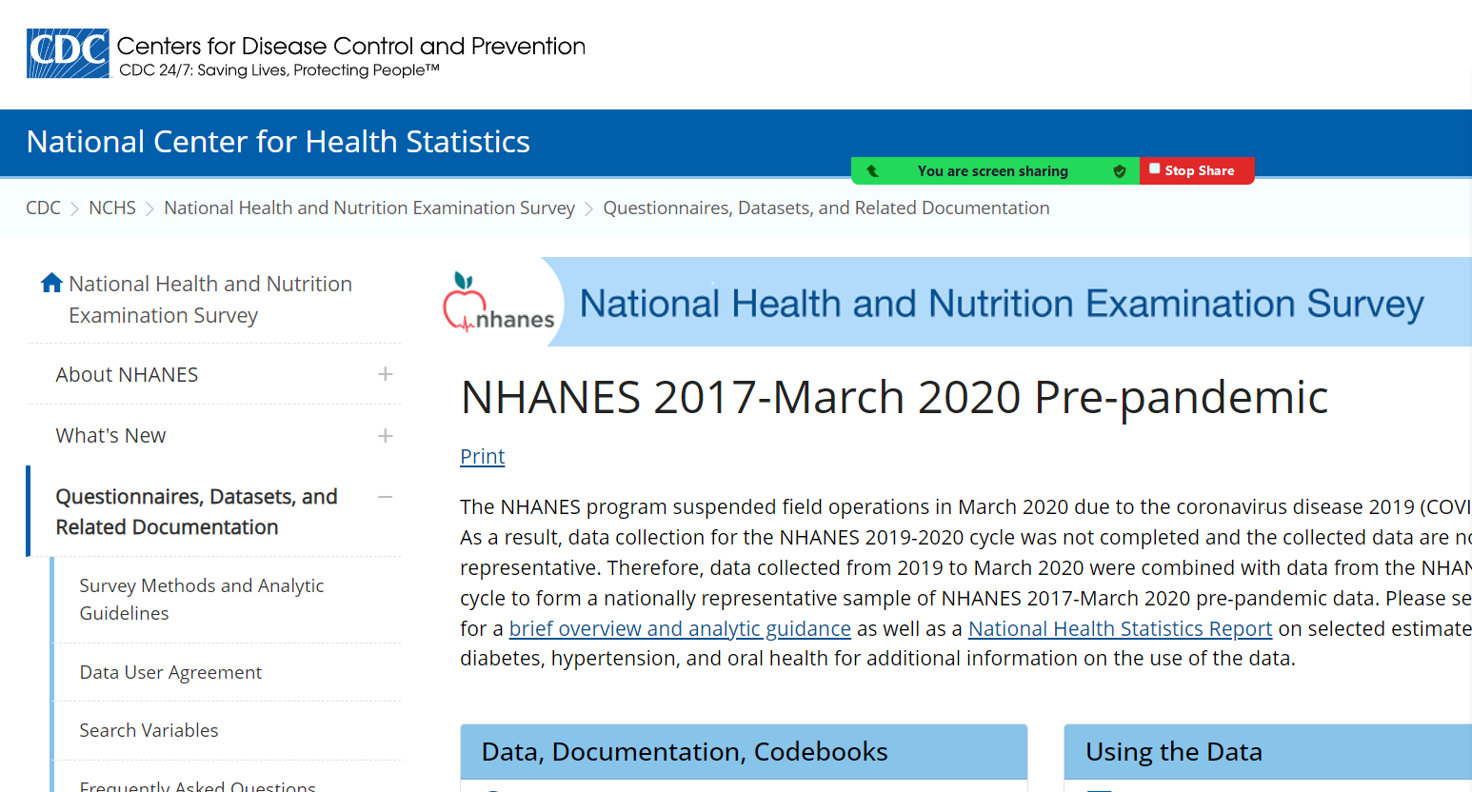
Real world data
https://wwwn.cdc.gov/nchs/nhanes/continuousnhanes/default.aspx?Cycle=2017-2020 与保险间接相关

