Slide 1

StudyMatch
a data-driven tool for Chinese students applying to the overseas universities

Slide 2

StudyMatch
  Problem: International students know little about choosing overseas schools.
  Dataset: Historical data of university applications scraped from the webpages.
  Goals: Providing international students with assistance and guidance in applying overseas schools.
  Methods: Applying Bayesian Linear Regression, Bootstrap Sampling, Wald Test and Permutation Test.

Slide 3
StudyMatch
  Data Collection
  Data Cleaning
  Data Exploration
  Data Modeling
  Outcomes

Slide 4
Data Collection
Download webpages:
  Prevent data transfer issues resulting from network disruptions.
  Use the pyautogui package
Scrape data from local webpages:
  Locate the object data table through the label tbody
  Use the BeautifulSoup package

Slide 5
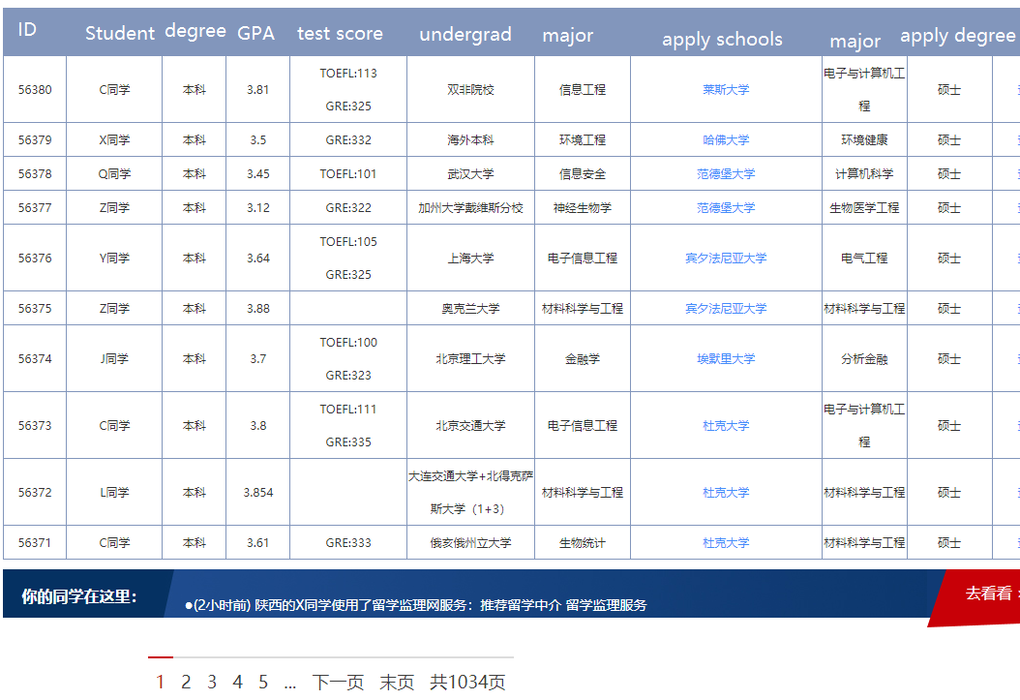
Web page:

Slide 6
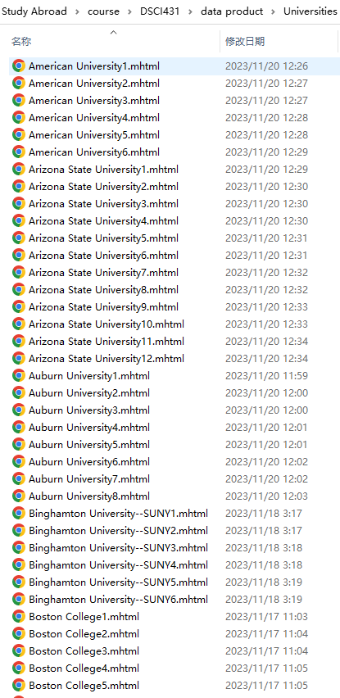
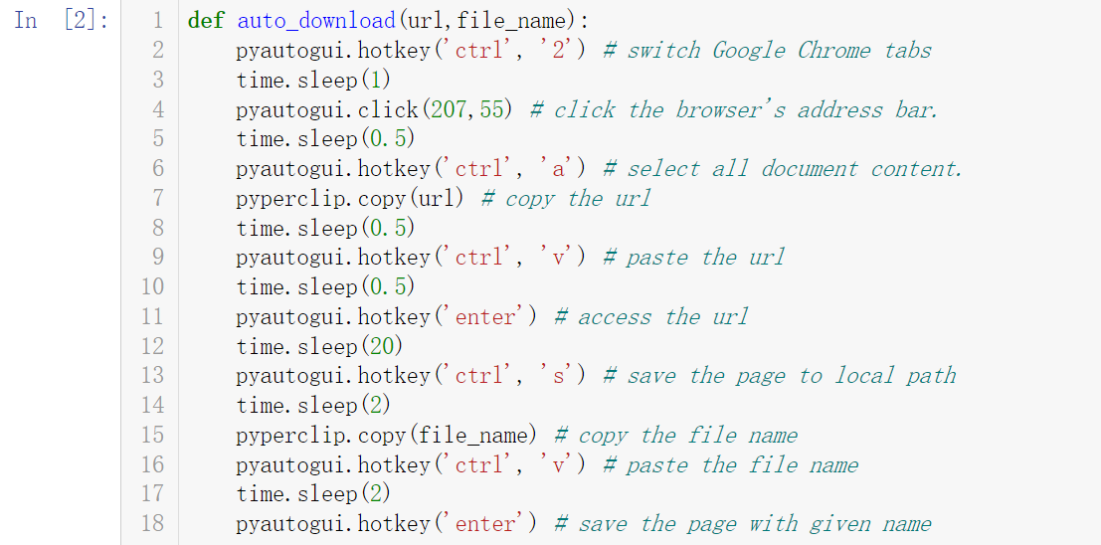
Code and local copies:

Slide 7
Data Cleaning
Reformat datasets:
  Convert URL-encoded string to Chinese characters.
  Detele HTML tag like </a>
  Use urllib and quopri
Create and discard features:
  Drop unnecessary features like Name or Degree
  Unpack overloaded features, like create TOEFL, ILTES, GMAT, GRE to store values of Tests
  Normalize Old Version Test Scores to Current Standards
Comprehensive Database:
  Postgresql
  Multiple tables – raw data, translation, universities ranking

Slide 8
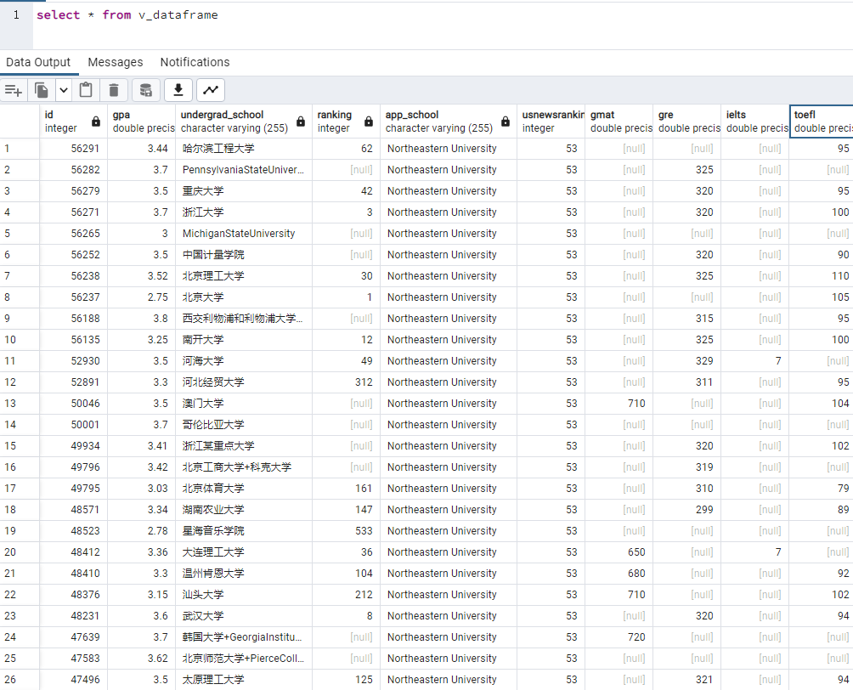
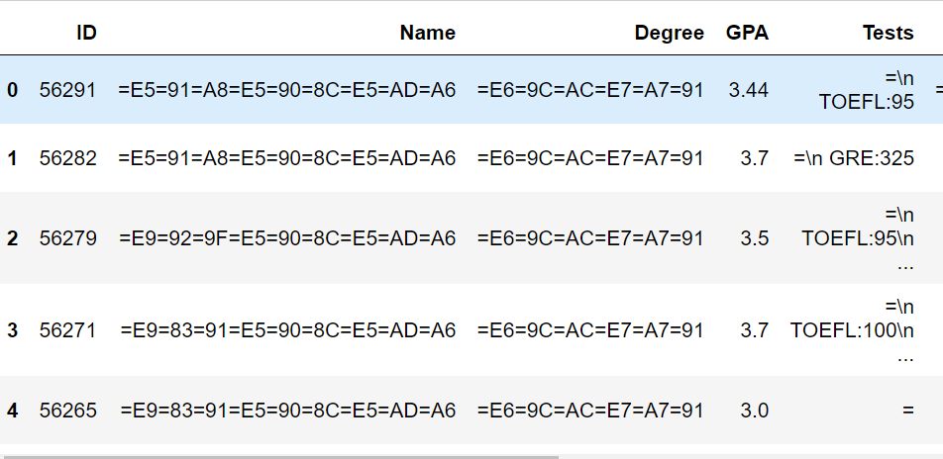
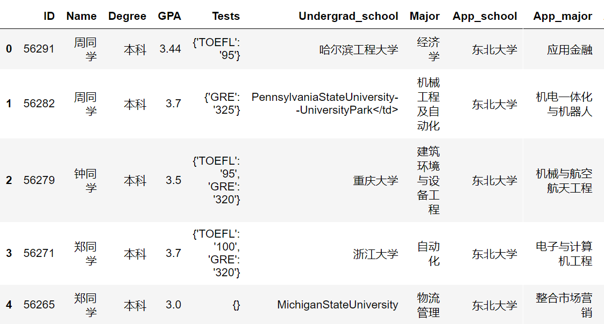
Raw data and database table:

Slide 9
Data Exploration
Correlation analysis:
  Bootstrap Sampling - Explore the relationship between applicants GRE and GMAT.
Hypothesis test
  Permutation Test - Compare the backgrounds of students applying to two different schools.
  Wald Test - Examine the consequences of discontinuing the GRE requirement for applicants.

Slide 10
Data Exploration
Correlation analysis:
  Bootstrap Sampling - Explore the relationship between applicants GRE and GMAT.
Hypothesis test
  Permutation Test - Compare the backgrounds of students applying to two different schools.
  Wald Test - Examine the consequences of discontinuing the GRE requirement for applicants.

Slide 11
Question:
  Some students took the GRE test, while others took the GMAT test. What is the intercorrelation between these two test scores? Can a student who took the GMAT infer what GRE score they might achieve based on their current level, especially if their target school requires a GRE score?
Dataset:
  We only have 35 students in the database who simultaneously took both the GRE and GMAT tests.
Solution:
  Use bootstrap sampling to estimate the correlation using data from students who simultaneously took both the GRE and GMAT tests.
Inspiration:
  8.6 Example in the textbook

Slide 12
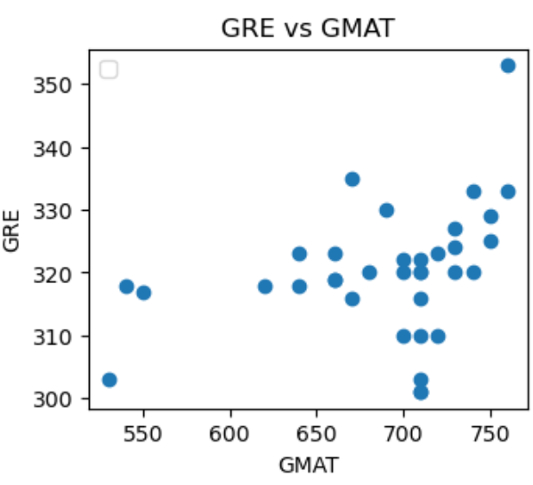
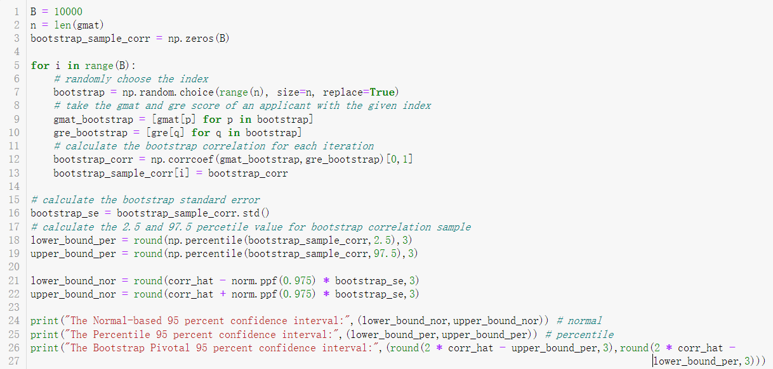
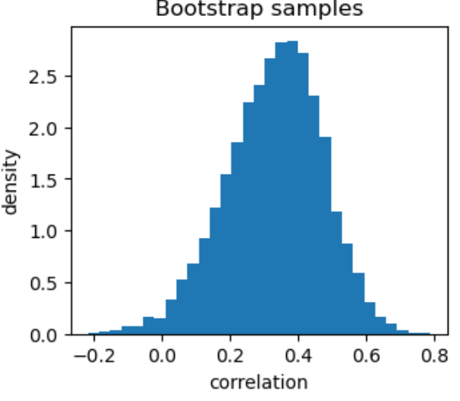
Code and Visualization:

Slide 13
Method:
  Take bootstrap samples and calculate the 95% confidence intervals for the correlation between GRE and GMAT scores.
Results:
  The Normal-based 95 percent confidence interval: (0.059, 0.613)
  The Percentile 95 percent confidence interval: (0.026, 0.578)
  The Bootstrap Pivotal 95 percent confidence interval: (0.094, 0.646)
Analysis:
  The confidence interval does not include 0, indicating GMAT and GRE scores have at least some correlation.
  Nonetheless, the broad range of this interval points to considerable uncertainty regarding the precise magnitude of the correlation between these two standardized tests.
  Consequently, inferring a students GRE score from their GMAT score is not reliably feasible due to this uncertainty.

Slide 14
Data Exploration
Correlation analysis:
  Bootstrap Sampling - Explore the relationship between applicants GRE and GMAT.
Hypothesis test
  Permutation Test - Compare the backgrounds of students applying to two different schools.
  Wald Test - Examine the consequences of discontinuing the GRE requirement for applicants.

Slide 15
Question:
  If I am offered admissions to two schools, beyond the US News Rankings, what other factors could be considered for comparison?
Dataset:
  We have historical data on students who have applied to both schools, including grades and educational background.
Solution:
  Generate permutation samples for the GPAs of applicants to both schools and plot their ECDFs for comparison.
  Conduct hypothesis testing to compare the mean GPAs of students who applied to both schools using a permutation test.
Inspiration:
  Statistical Thinking in Python (Part 2) in Datacamp

Slide 16
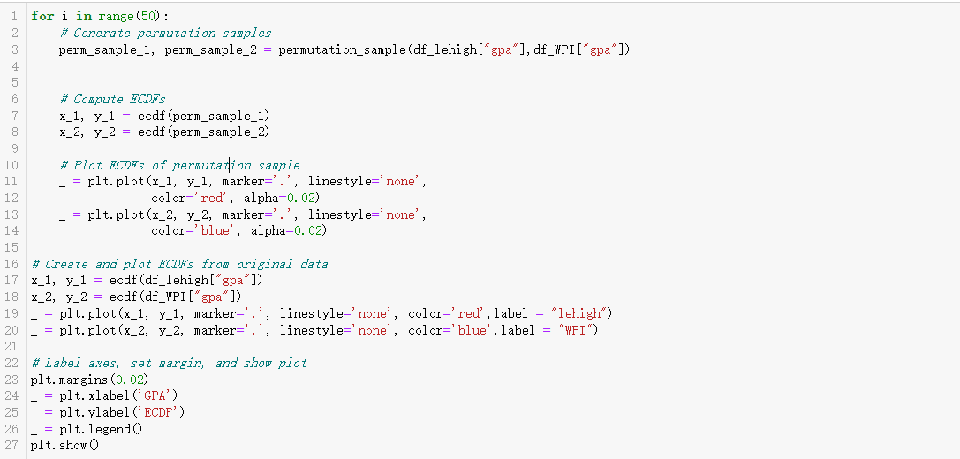
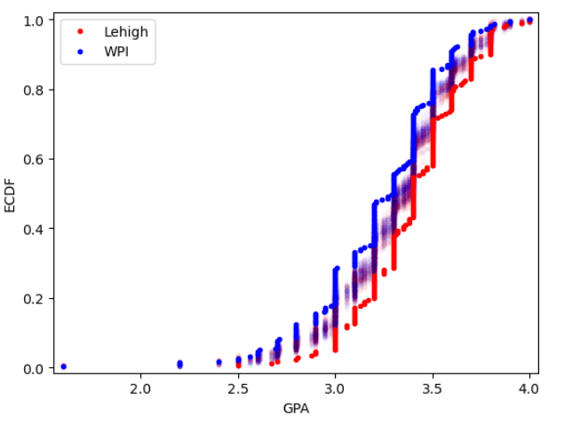
Code and Visualization:

Slide 17
Method 1:
  Take permutation samples to compare GPAs of Lehigh and WPI applicants, plot their ECDFs in different colors, and overlay the original data for a comparative analysis.
Result and Analysis:
  The ECDF plot distinctly illustrates a divergence in the GPA distributions for the two schools applicants. It is evident that Lehigh applicants display a generally higher GPA compared to those of WPI.

Slide 18
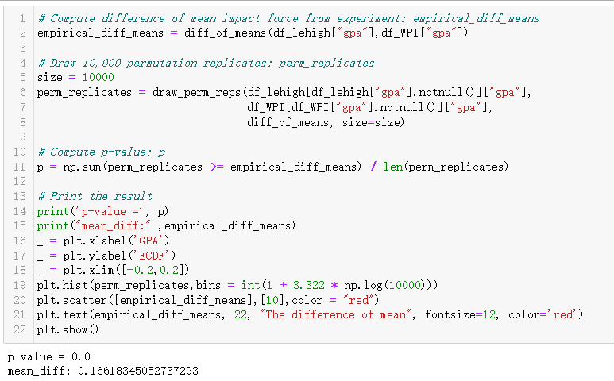
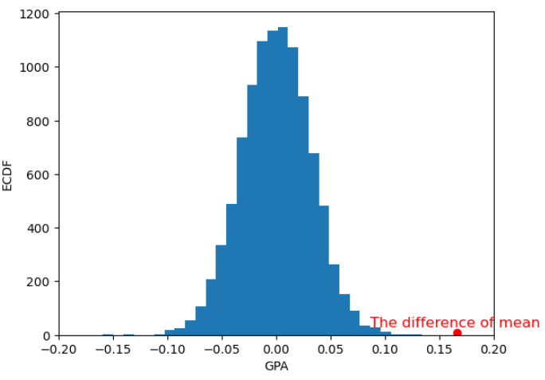
Code and Visualization:

Slide 19
Method 2:
  Compare the mean GPA of applicants of two schools by conducting hypothesis tests with permutation replicates and calculating the p-value to evaluate the significance of the observed difference.
Results:
  p – value: 0.0
  mean difference: 0.166
Analysis:
  Although the p-value can not be exactly 0, it indicates none of the permutation replicates yielded a test statistic as extreme as the observed test statistic (mean_diff = 0.166). It offers robust evidence against the null hypothesis. Thus, we can confidently assert that applicants of Lehigh tend to have higher GPAs than those of WPI.

Slide 20
Data Exploration
Correlation analysis:
  Bootstrap Sampling - Explore the relationship between applicants GRE and GMAT.
Hypothesis test
  Permutation Test - Compare the backgrounds of students applying to two different schools.
  Wald Test - Examine the consequences of discontinuing the GRE requirement for applicants.

Slide 21
Question:
  In 2019, one department at Boston University eliminated the GRE as a requirement for admission to its graduate programs. What impact has this had on the quality of applicants?
Dataset:
  We have historical data on applicants who have applied to Boston University, including profiles with and without GRE scores.
Solution:
  Conduct hypothesis testing to compare the mean GPAs of Boston University applicants with and without GRE using a Wald test.
  Conduct hypothesis testing to compare the proportion of Boston University applicants with TOEFL scores over 100 between those with and without GRE scores, using a Wald test.
Inspiration:
  10.7 and 10.8 Example in the textbook

Slide 22
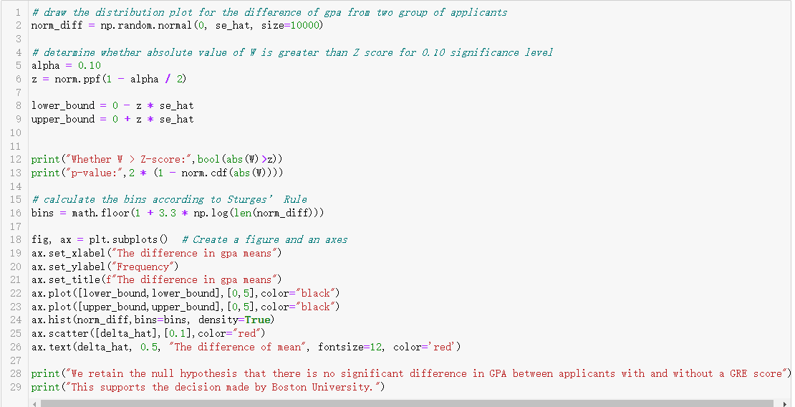
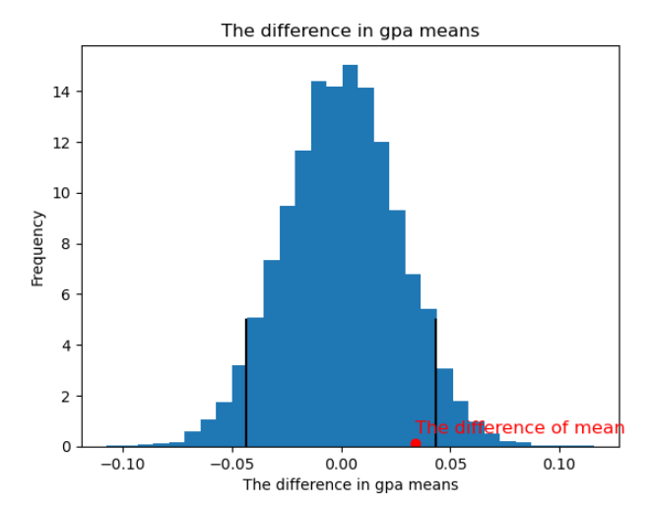
Code and Visualization:

Slide 23
Method 1:
  Compare the mean GPA of Boston University applicants with and without GRE by conducting Wald test at a significance level of 0.10 and calculating the p-value to evaluate the significance of the observed difference.
Results:
  p – value: 0.197
  mean difference: 0.034
Analysis:
  A higher p-value of 0.197 indicates the necessity to retain the null hypothesis, implying no significant difference in GPA between applicants with and without GRE scores. This finding aligns with and supports Boston University decision.

Slide 24
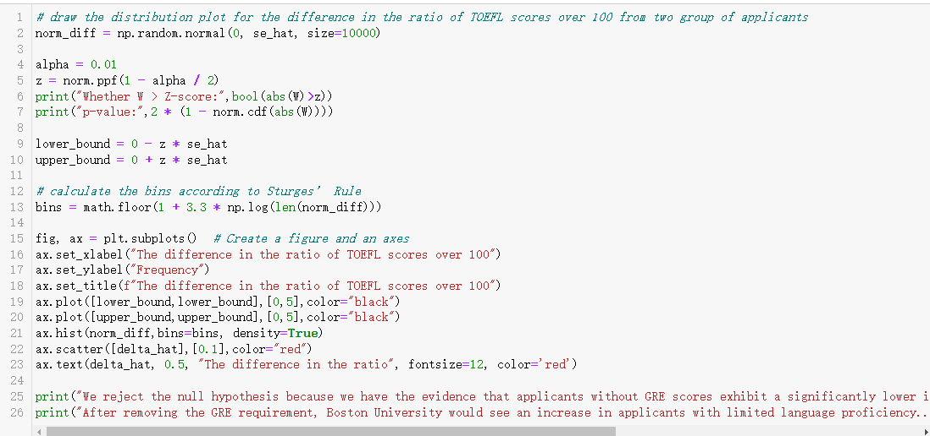
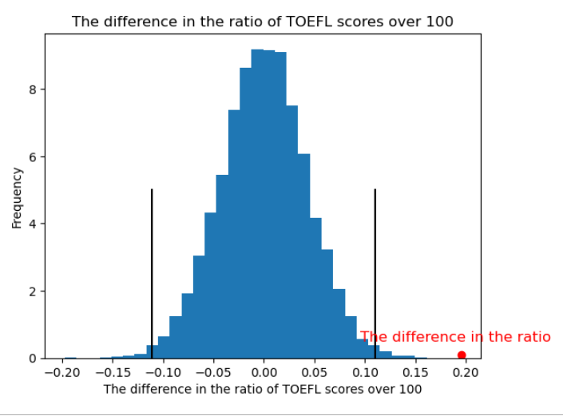
Code and Visualization:

Slide 25
Method 2:
  Compare the proportion of Boston University applicants with TOEFL scores over 100 between those with and without GRE scores by conducting Wald test at a significance level of 0.01 and calculating the p-value to evaluate the significance of the observed difference.
Results:
  p – value: 5e-06
  mean difference: 0.195
Analysis:
  A very low p-value of 5e-06 provides strong evidence against the null hypothesis, leading us to confidently conclude that applicants without GRE scores have a significantly lower frequency of TOEFL scores above 100 compared to those with GRE scores. This suggests that Boston University elimination of the GRE requirement might result in a rise in applicants with limited language proficiency.

Slide 26
Data Modeling
Question:
  Considering my educational background and academic achievements, which universities would be appropriate for me to apply to?
Solution:
  Develop a statistical model to predict the ranking(s) of appropriate university tailored to an applicants academic level.
Model Selection:
  Bayesian Linear Regression Model
Inspiration:
  Bayesian Data Analysis in Python in Datacamp

Slide 27
Bayesian Linear Regression Model:
  The model gives us an output of a Normal Distribution characterized by a mean and variance.
  E.g. A student graduated from Zhejiang University(3) with GPA of 3.7, TOEFL of 100 and GRE of 320 will satisfy the following distribution:
  It will return a range from 18 to 48 (95% confidence level), corresponding to a series of Universities.
  Justification:
  To enhance our chances of success and deal with uncertainties arising from other elements like statements of purpose, resume, and recommendation letters, we plan to apply to a range of universities instead of just one.

Slide 28
Model: Bayesian Linear Regression
Features Included:
  Academic Performance: GPA
  English Proficiency: TOEFL score
  Standardized Tests: GRE and GMAT score
  Prestige Factor: Ranking of undergraduate institutions in China
Features excluded:
  English Proficiency: ILETS score (Few applicants use this as their language proficiency test)
Predictive Target: The US News Ranking of U.S. universities that are appropriate for applicants.

Slide 29
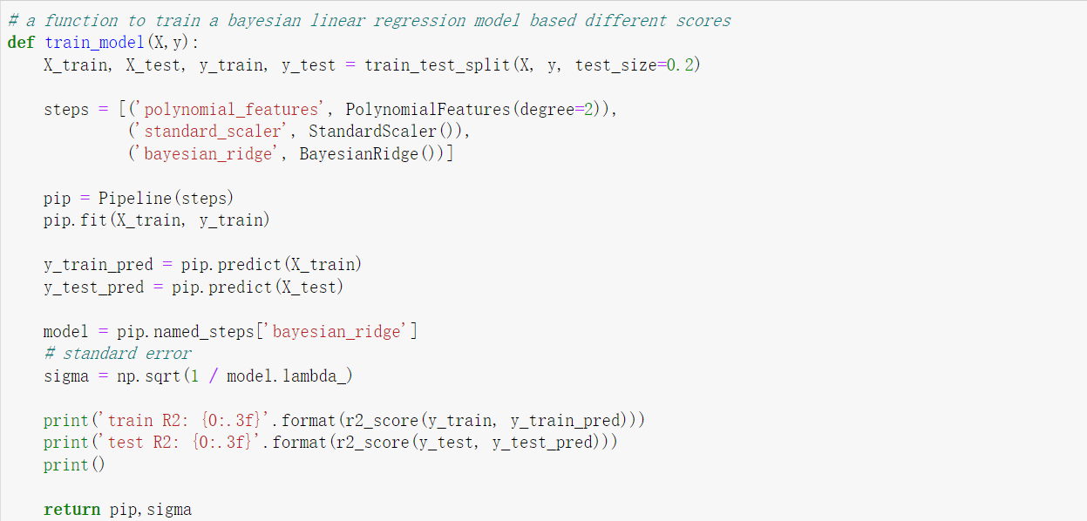
Code:

Slide 30

Methods:
  Construct polynomial features to capture the effect of interaction terms on the target and scale all features to neutralize varying magnitudes, then employ these scaled polynomial features to train a Bayesian model with a Ridge regularization term.
Results:
  Train R2: 0.344, 0.189, 0.293, 0.227
  Test R2: 0.322, 0.193, 0.275, 0.199
Analysis:
  The model has the best performance when selecting features as GPA, undergrad_ranking, GRE and TOFEL.

Slide 31
Outcomes
Ranking Ranges for Selecting Schools:
  A distribution for the rankings of U.S. universities tailored to the applicants profile.
  A confidence interval with significance level for the rankings.
School suggestions:
  A schools list that applicant can prioritize.
Case Study – My application for Data Science Program:
  Comparison of my result and model prediction.
  Further analysis

Slide 32
Example:
  A student graduated from Zhejiang University(3) with GPA of 3.7, TOEFL of 100 and GRE of 320.
Ranking Ranges:
  (18,48)
School suggestions:
  Dartmouth College, Vanderbilt University, University of Notre Dame, University of Michigan--Ann Arbor, Georgetown University, University of North Carolina at Chapel Hill, Carnegie Mellon University, Emory University, University of Virginia, Washington University in St. Louis, University of California Davis, University of California San Diego, University of Florida, University of Southern California, University of Texas at Austin, Georgia Institute of Technology, University of California Irvine, New York University, University of California Santa Barbara, University of Illinois Urbana-Champaign, University of Wisconsin--Madison, Boston College, Rutgers University--New Brunswick, Tufts University, University of Washington, Boston University, The Ohio State University, Purdue University--Main Campus, University of Maryland College Park, Lehigh University, University of Georgia, University of Rochester, Virginia Tech
School Applications:
  University of Michigan--Ann Arbor, University of Southern California, University of California San Diego, The Ohio State University, Northeastern University(53).

Slide 33
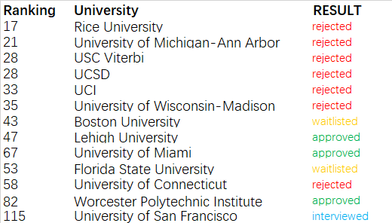
Case study:
  I graduated from University of Science and Technology Beijing (40) with GPA of 3.0, TOEFL of 97 and no GRE.
Ranking Ranges:
  (43,73)
Application results:

Slide 34
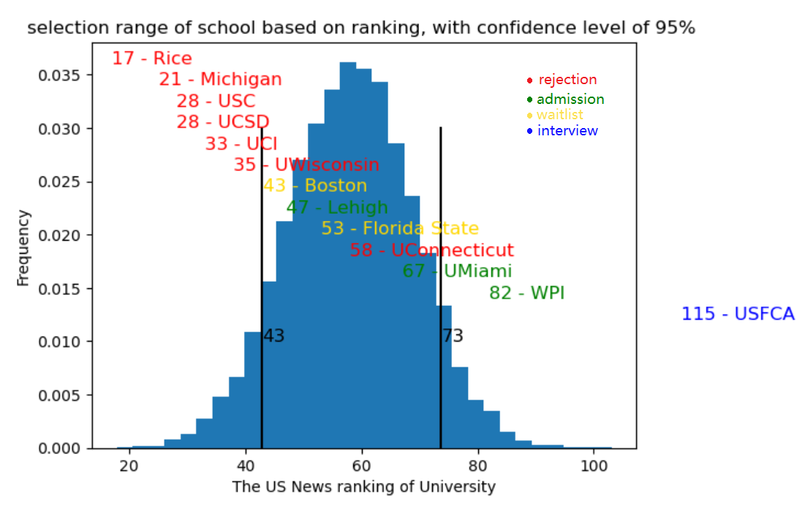
Visualization:

Slide 35
Results:
  All universities ranked above the interval rejected my applications.
  Most universities ranked within the interval offered me admission or placed me on the waitlist.
  All Universities below the interval offered admission or interview opportunities, but they were not appropriate for me.
Further analysis:
  The output from Bayesian Linear Regression model is not a typical probabilistic distribution.
  Universities ranked above the interval are less likely to offer admission.
  Universities within the interval are more likely to offer admission and are appropriate for the applicant.
  Universities ranked below the interval, while likely to offer admission, may be less appropriate due to lower prestige and educational standards.

Slide 36
Thank you

