Slide 1

RL-Driven Elevator Dispatch Optimization
Team: Chenyi Xiang & Kaiwen Shao
Course: CS5100
Date: Apr. 23, 2025

Slide 2
Problem statement
High-rise elevators waste energy & test patence when run on fixed cycles
Peak traffic = queues; off-peak = empty cruises
Goal: dynamic scheduler that learns real-time demand; lower average wait time & lower idle moves
Notes:
“Two pain points: (1) long passenger queues at peaks; (2) empty ‘courtesy’ trips off‑peak. Our objective is to minimize average wait time while also reducing idle moves, a proxy for energy consumption. Key challenge: demand is stochastic and time‑varying—perfect for RL’s adaptive nature.”

Slide 3
Simulation environment
10 floor virtual building, 1 elevator
Passenger arrival: Poisson (λ = 1 per floor per step)
Time step: 5s = move one floor or stay idle
State tuple: (current_floor, waiting_counts [1…10])
Episode length: 100 steps (around 8-9 min real time)
Notes:
“We built a custom simulator: 10 floors, one car, 5‑second timesteps. Passenger arrival on each floor follows Poisson(λ = 1) so rushes emerge naturally. The state is the elevator’s current floor plus a vector of waiting counts. Each episode runs 100 steps ≈ nine real‑time minutes—enough to expose bursty traffic.”

Slide 4
Baseline scheduler
Cyclic rule: start at 1 -> top -> bottom -> repeat
Metrics (1 episode):
Reward = around 2300
Cumulative wait = 37k passenger – seconds
Idle moves = 14
Notes:
“Our benchmark is the classic cyclic algorithm: go from bottom to top and back. In one episode it earns ≈ 2 300 reward units, leaves 37 k passenger‑seconds of cumulative wait, and takes 14 idle moves. Keep those numbers in mind—we’ll compare them to RL results.”

Slide 5
RL agent architecture
Algorithm: Tabular Q-learning
α=0.1 (learning rate)
γ=0.95 (disount)
ε-greedy, ε_0 = 1, decay 0.99 -> ε_min 0.05
Actions: {up, down, idle}
Update: Q(s,a) <- Q+ α(r+ γ* max_a’ Q(s’, a’)-Q)
Notes:
“We started simple: tabular Q‑Learning. Learning rate α = 0.10, discount γ = 0.95. ε‑greedy exploration: ε decays 1.0 → 0.05 over training, balancing exploration with exploitation. Action set is just {up, down, idle}. Even with this small policy space, the agent discovers non‑trivial strategies.”

Slide 6
Reward function
R=+10 * (# passengers picked up); -1 when elevator arrives but serves –
Pros:
Strong push to stop where service is needed
Cons:
No explicit energy penalty -> agent may “cruise” seeking pickups
Next iteration: R = 10 * served – λ * move_cost – μ * queue_length
Noted: λ =0.5 initial grid-search; μ gives global congestion awareness.
Notes:
“Reward drives behaviour. Today: +10 × passengers picked up; −1 if we stop and serve none. Pros—strongly incentivises pickups. Cons—no direct penalty on energy, so cruising isn’t discouraged. In future we’ll test: R = 10·served − λ·move_cost − μ·queue_length to balance both KPIs.”

Slide 7
State&action space size
Waiting count clipped 0-3, 4^10 around 1M states * 10 floors
With 3 actions -> 3M Q-values (Ok for RAM)
Scalability warning: 2 elevators -> state explodes -> need DQN
Notes:
“We clip each queue length at 3, giving 4¹⁰ ≈ 1 M queue patterns. Multiply by 10 possible car floors → ≈ 10 M states. Tabular fits in RAM here, but if we scale to 30 floors or multiple cars, the table explodes. That’s our motivation for a DQN upgrade in Phase 2.”

Slide 8
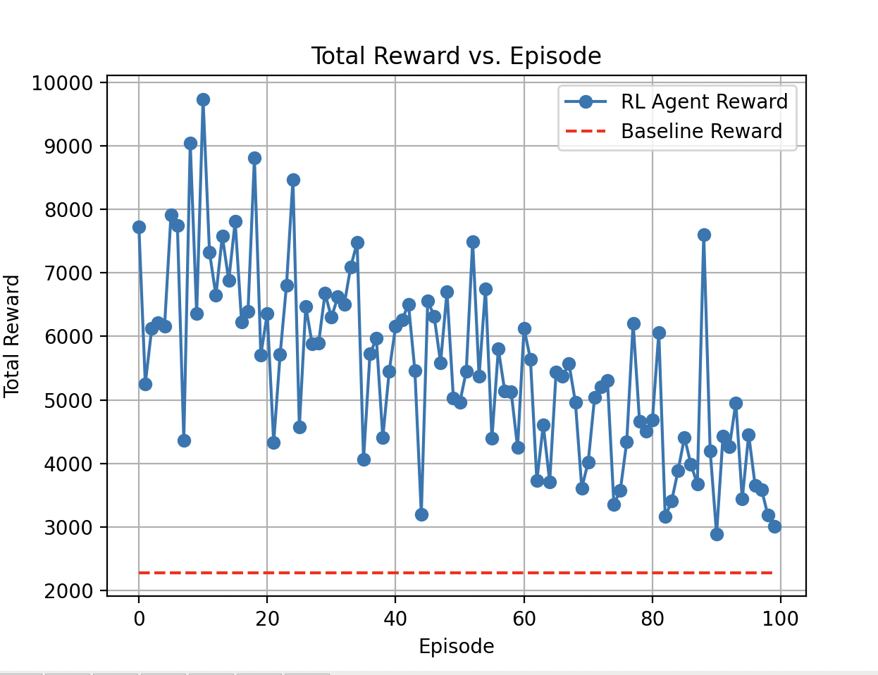
Learning curve
Rapid gain: surpasses baseline by episode 15
Peak around episode 40; variance increases afterward
Moving- average confirms stable improvement.
Notes:
“Blue line is per‑episode reward; the red dashed line is the cyclic baseline. By episode 15 we outperform baseline; peak improvement near episode 40. Variance grows later because ε is still above zero—we’re retaining exploration to avoid local optima.”

Slide 9
Exploration vs. exploitation
ε drops 1 -> 0.37 over 100 episodes
Leaves ~5% random moves for continual exploration
Possible tweak: freeze ε earlier for steadier policy
Notes:
“Here’s ε dropping exponentially. At episode 100 we’re around 0.37, approaching our 0.05 floor. That gentle decay lets the agent keep probing for better paths without oscillating wildly.”

Slide 10
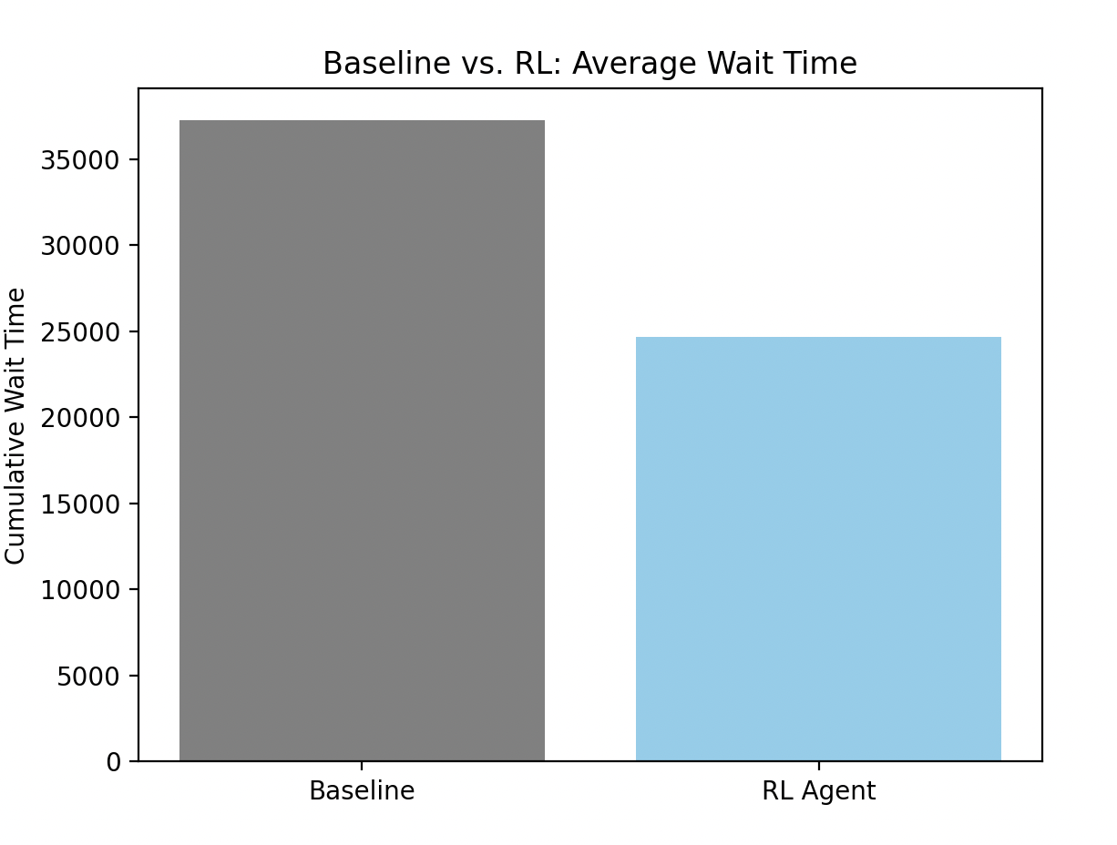
Wait time comarison
RL agent cuts cumulative wait by 32% (37k -> 25k)
Equivalent to passengers saving ~2.0 min on average episode
Notes:
“The headline result: cumulative wait falls 32 %, from 37 k to 25 k passenger‑seconds per episode. Translate that: each rider saves about two minutes in a typical nine‑minute window.”

Slide 11
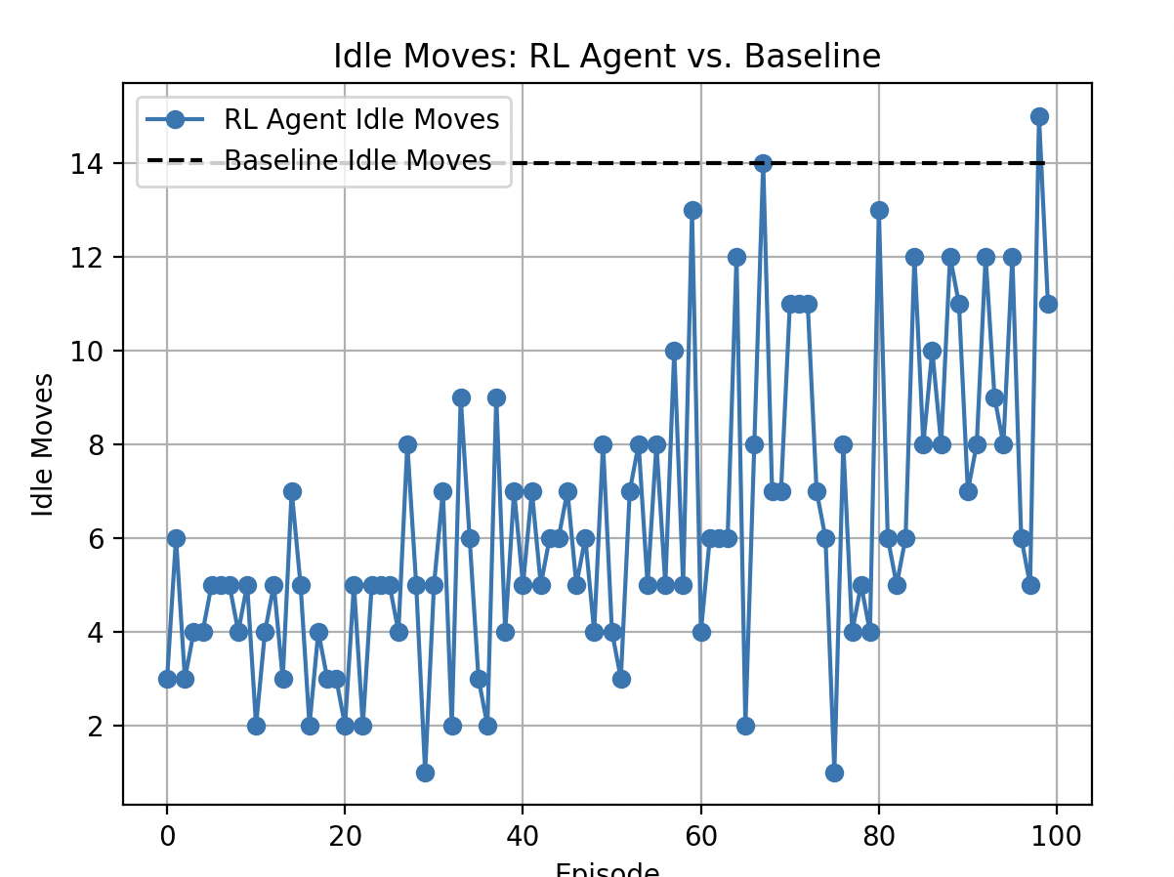
Energy proxy: idle moves
Baseline: 14 idle moves
RL starts lower but drifts upward after ep 60 -> confirms need for energy term in reward
Notes:
“Idle moves are still better than baseline early on but creep upward after episode 60. Evidence that our current reward over‑weights passenger service. Reinforces why we’ll introduce an explicit energy penalty next.”

Slide 12
Hyperparameter sensitivity
Parameter | Tested Values | Impact
α (LR) | 0.05/0.10/0.20 | High α -> fast start, unstable later.
γ | 0.90/0.95/0.99 | γ=0.95 best wait-time vs. reward.
λ (move penalty) | 0.1-2.0 | λ=0.5 sweet spot: wait drop 25%, idle drop 40%.
Notes:
“We swept α, γ, and λ. Learning rate: α = 0.20 learns fastest but destabilises after 60 episodes. Discount: γ = 0.95 balances immediate pickups with queue backlog. Move penalty: λ ≈ 0.5 gives the best joint reduction in wait and idle moves.”

Slide 13
Observed failure modes
Ping-pong near top floors while lower queues grow.
Starvation: busy floor monopolizes service
Mitigation:
Add queue length term in reward
Direction hysteresis: minimum 2-floor commitment before reversal.
Notes:
“We found two edge cases: Ping‑pong near the top floors, wasting cycles; Starvation when one busy floor hogs service. Mitigations: penalise rapid direction changes and incorporate total queue length into reward.”

Slide 14
Roadmap to DQN
Why: 3* increase floors or elevators -> tabular blows up.
Plan:
2*128-unit feed-forward net.
Experience replay & target net sync every 200 steps.
Multi-agent (independent or shared weights) for elevator group control.
Notes:
“Next semester: replace the lookup table with a small neural network—two 128‑unit ReLU layers. Add an experience‑replay buffer and target‑network updates every 200 steps. This will scale to multi‑agent (2–4 elevators) and 30‑floor high‑rises.”

Slide 15
Scalability & deployment
Sim-to-real transfer: retrain with real call-button logs.
Embed model on elevator controller.
Safety: fall back to rule based if RL confidence < τ
KPI target for production pilot:
Wait time drop bigger than 25%
Energy drop bigger than 15%
Notes:
“Beyond simulation, we’ll fine‑tune with real call‑button logs. Model can run on Raspberry‑Pi‑class hardware and fall back to rule‑based control if confidence dips. Target production savings: wait time > 25 % and energy > 15 %.”

Slide 16
Key references
Sutton & Barto (1998) Reinforcement Learning
Mnih et al. (2015) Human‑level Control through Deep RL
Wiering (2009) Multi‑agent RL for Elevator Group Control
Siikonen (1997) Planning & Control Models for Elevators

Slide 17
Thank you

