Slide 1


SQL inner join
Lesson 24
Trainer: Bach Ngoc Toan– TEDU
Website: http://tedu.com.vn

Slide 2
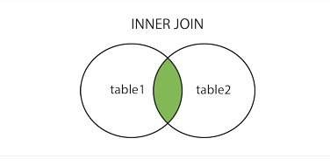
SQL INNER JOIN Example
The INNER JOIN keyword selects all rows from both tables as long as there is a match between the columns.
If there are records in the "Orders" table that do not have matches in "Customers", these orders will not be shown!

Slide 3
JOIN Three Tables
SELECT Orders.OrderID, Customers.CustomerName, Shippers.ShipperName FROM ((Orders INNER JOIN Customers ON Orders.CustomerID = Customers.CustomerID) INNER JOIN Shippers ON Orders.ShipperID = Shippers.ShipperID);

