Slide 1

SpaceX Falcon-9 Success Landing Prediction

Slide 2
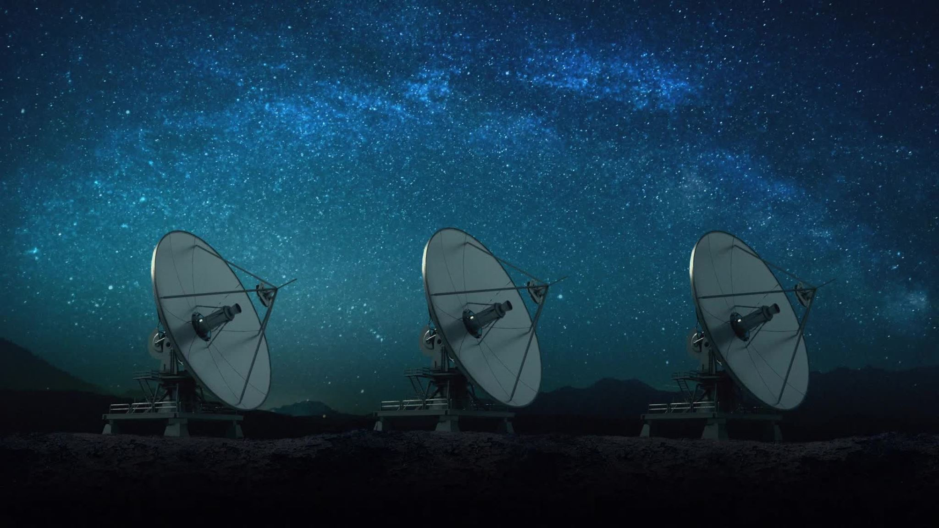
Executive Summary
This presentation encapsulates the analysis and prediction of SpaceX Falcon 9 first stage landing success

Slide 3
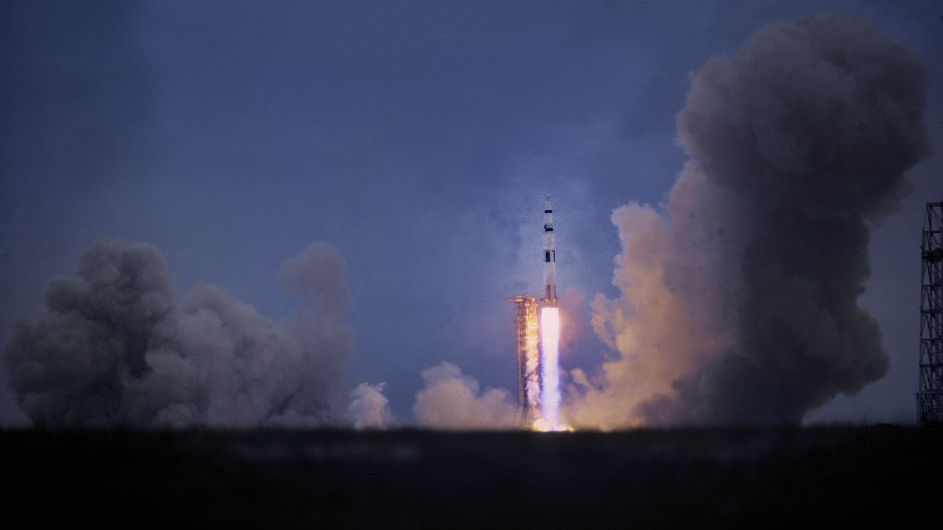
Introduction
SpaceX, founded by Elon Musk, aims to make spaceflight a common reality

Slide 4
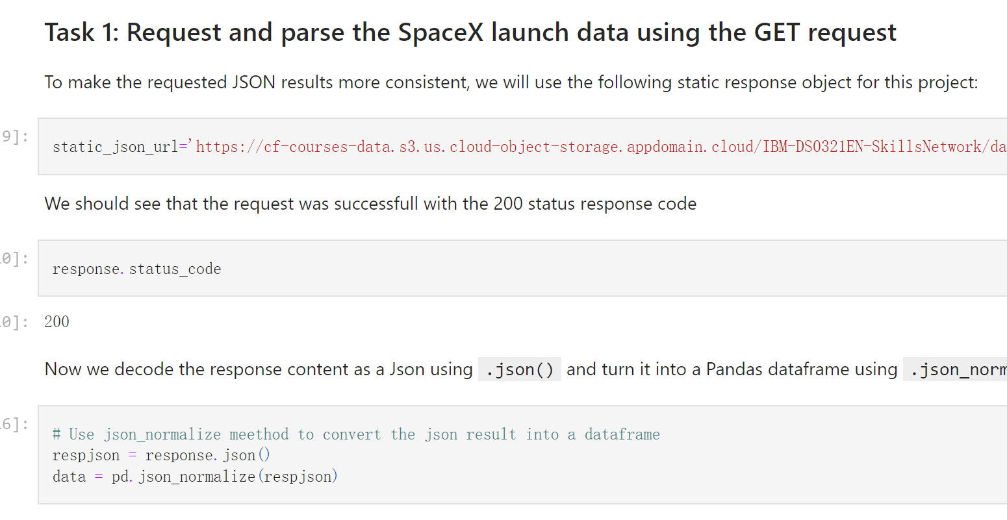
Data Collection and Wrangling
Data was collected from the SpaceX API and Falcon 9 launch records on Wikipedia

Slide 5
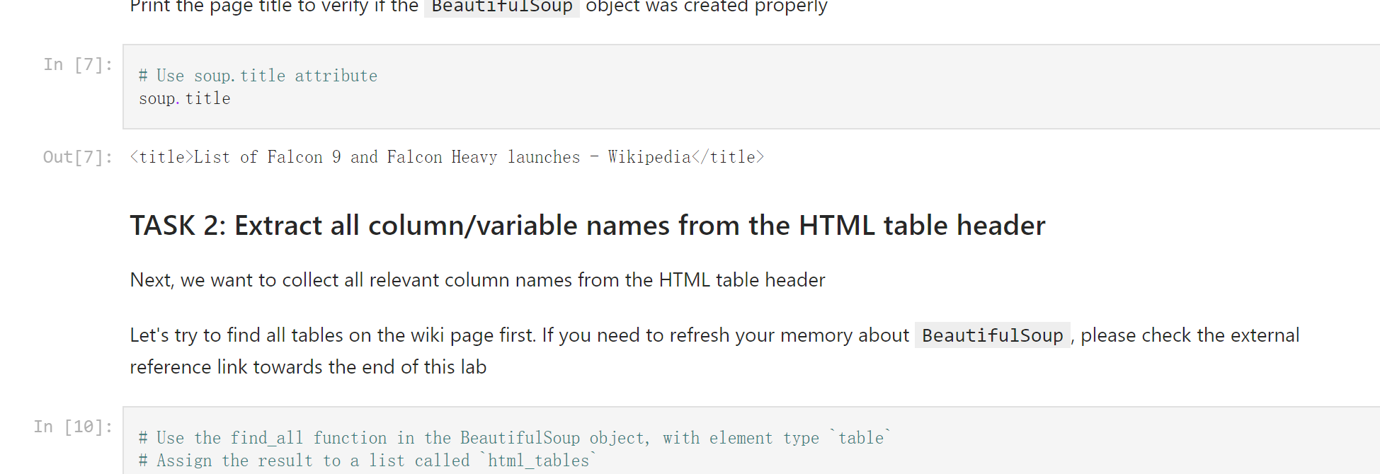
Data Collection and Wrangling
Data was collected from the SpaceX API and Falcon 9 launch records on Wikipedia

Slide 6
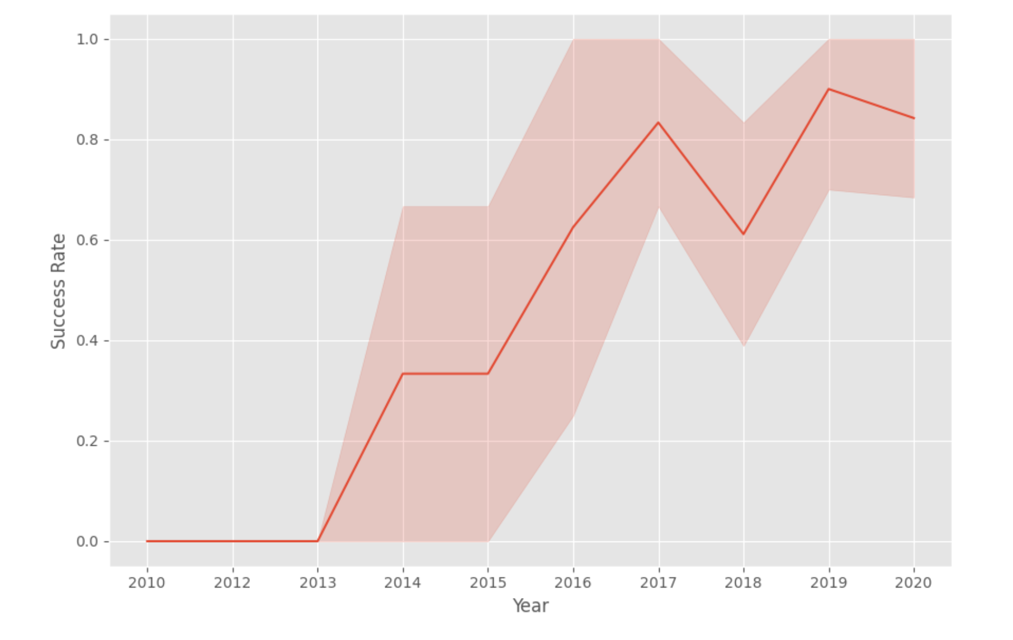
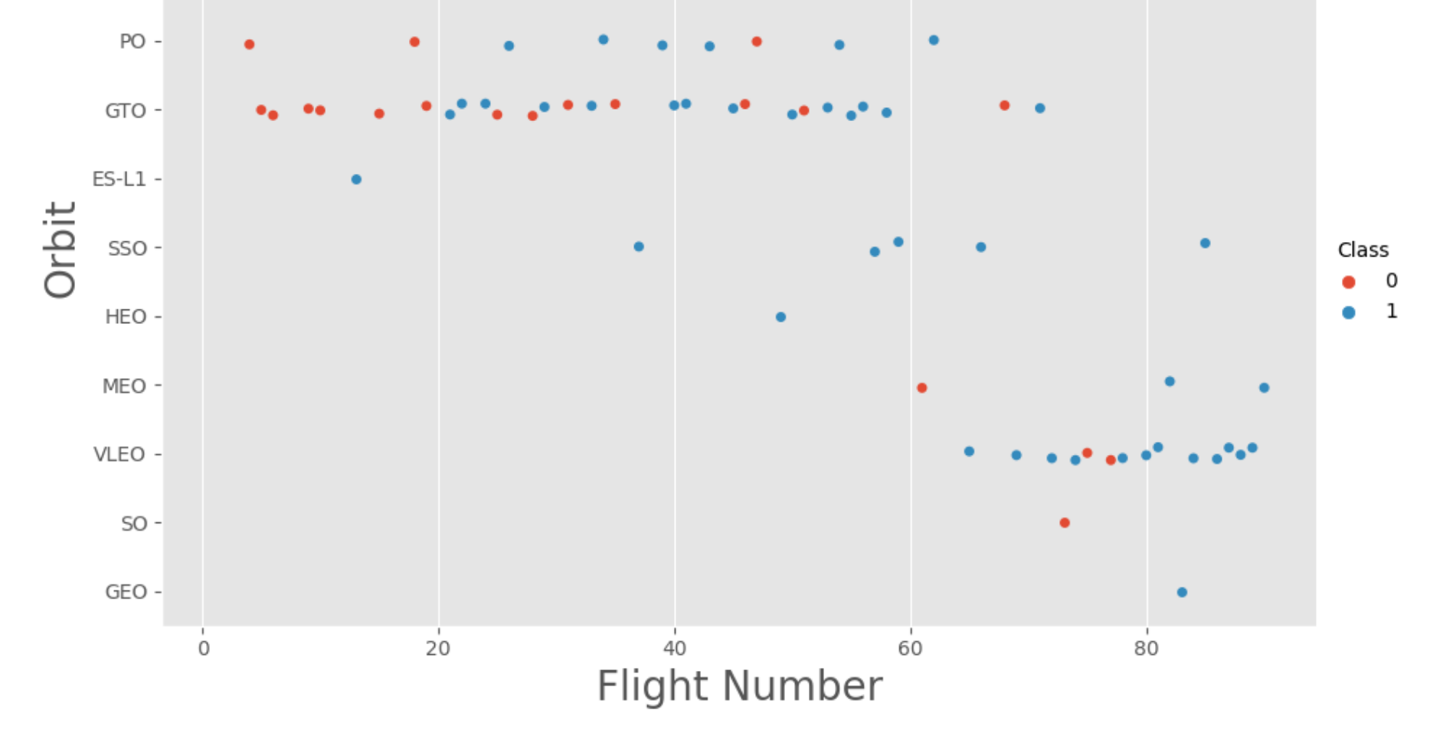
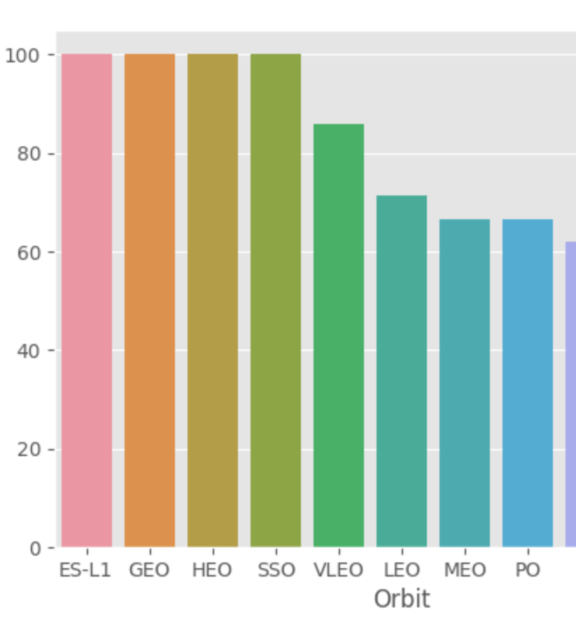
Exploratory Data Analysis
EDA was performed using SQL to uncover patterns and insights in the data

Slide 7
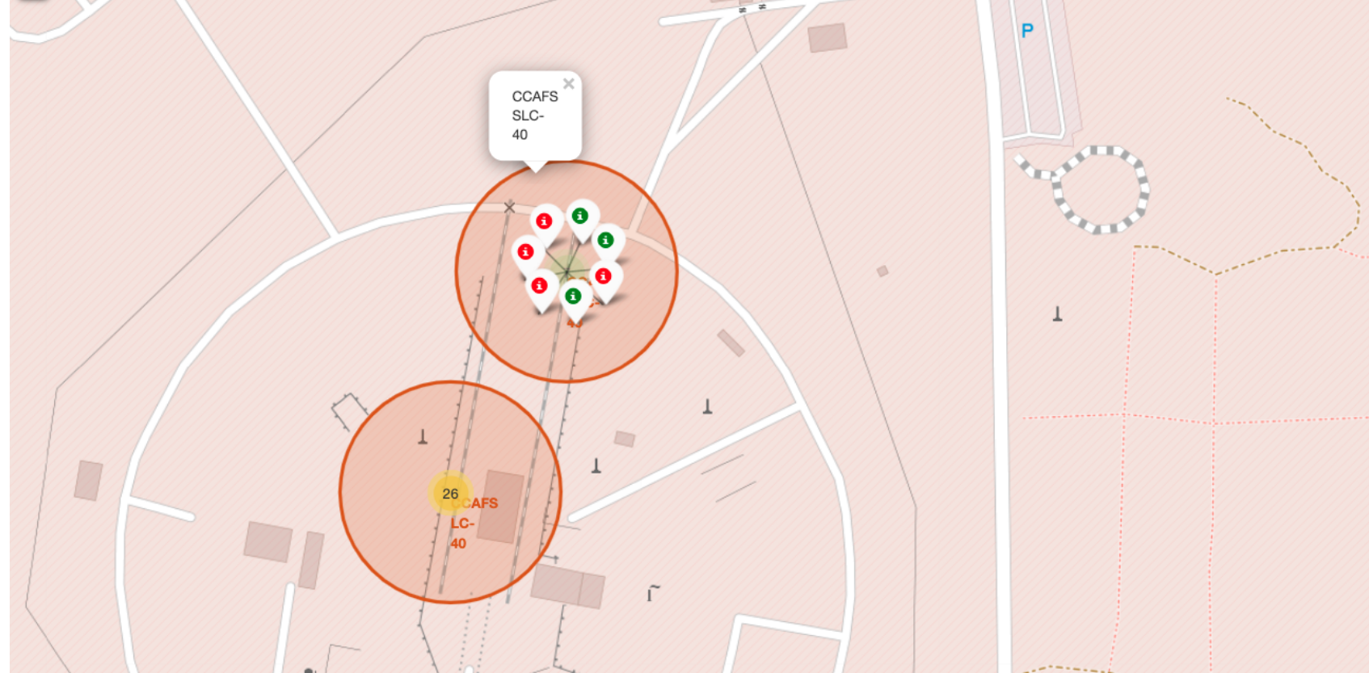
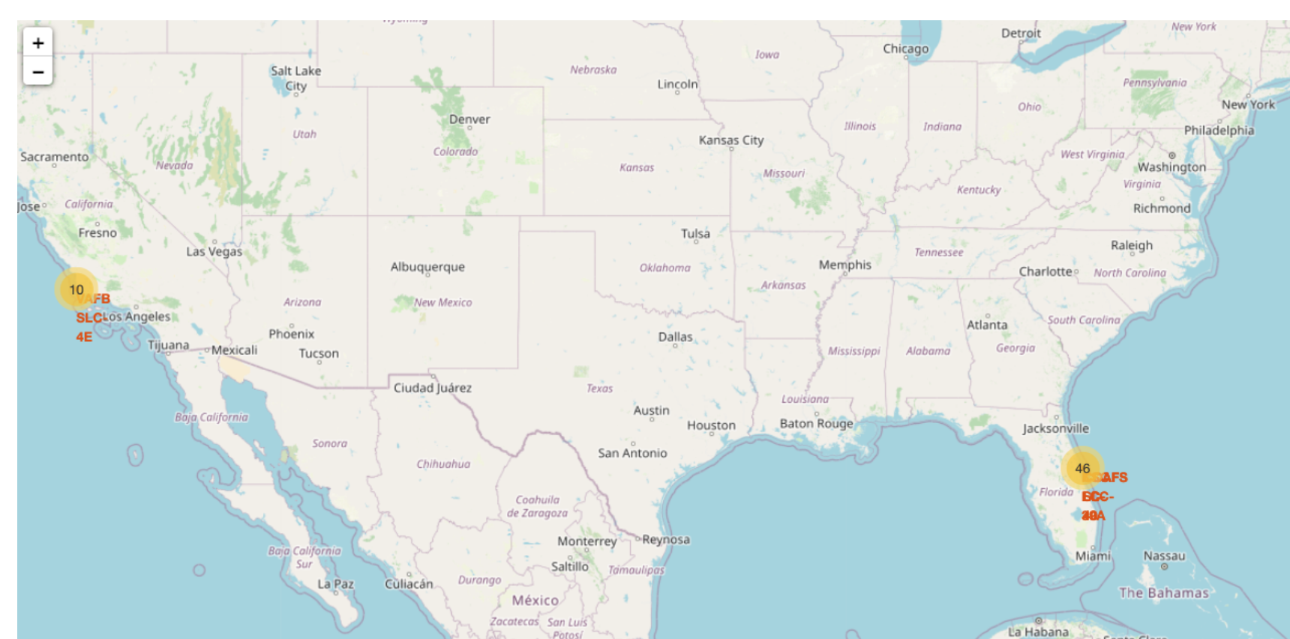
Interactive Visual Analytics and Dashboards
An interactive dashboard was created using Plotly Dash to allow users to explore the data in a user-friendly manner

Slide 8
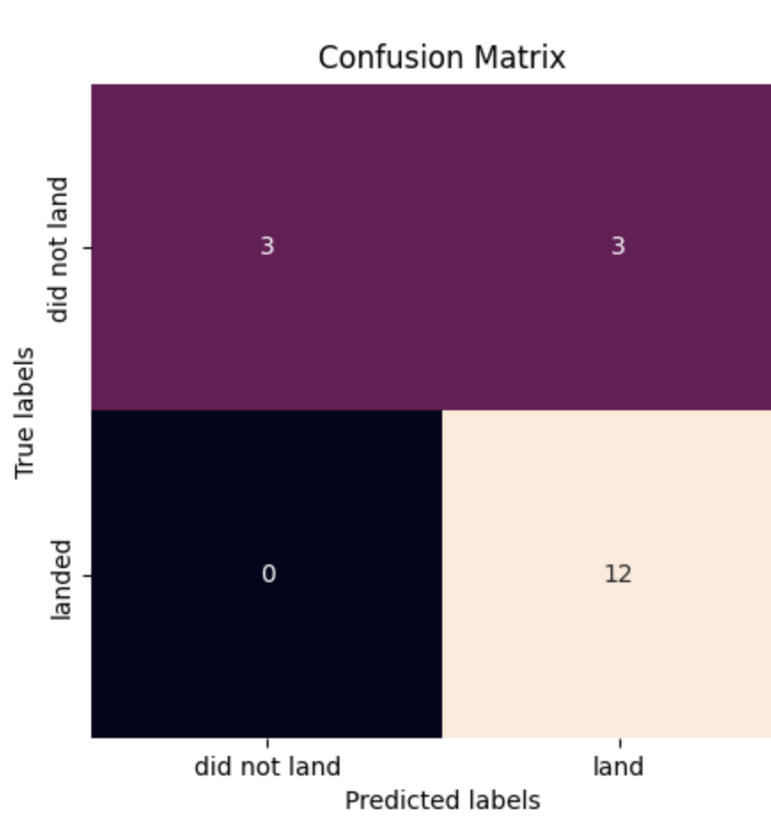
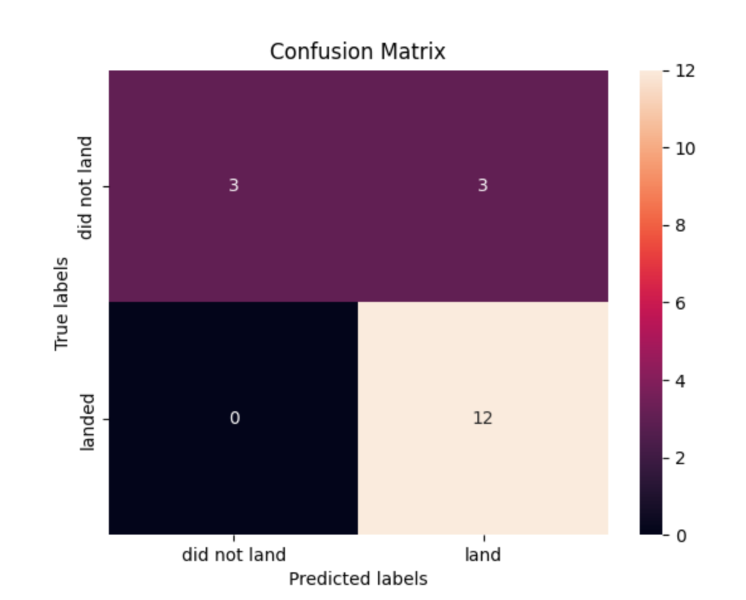
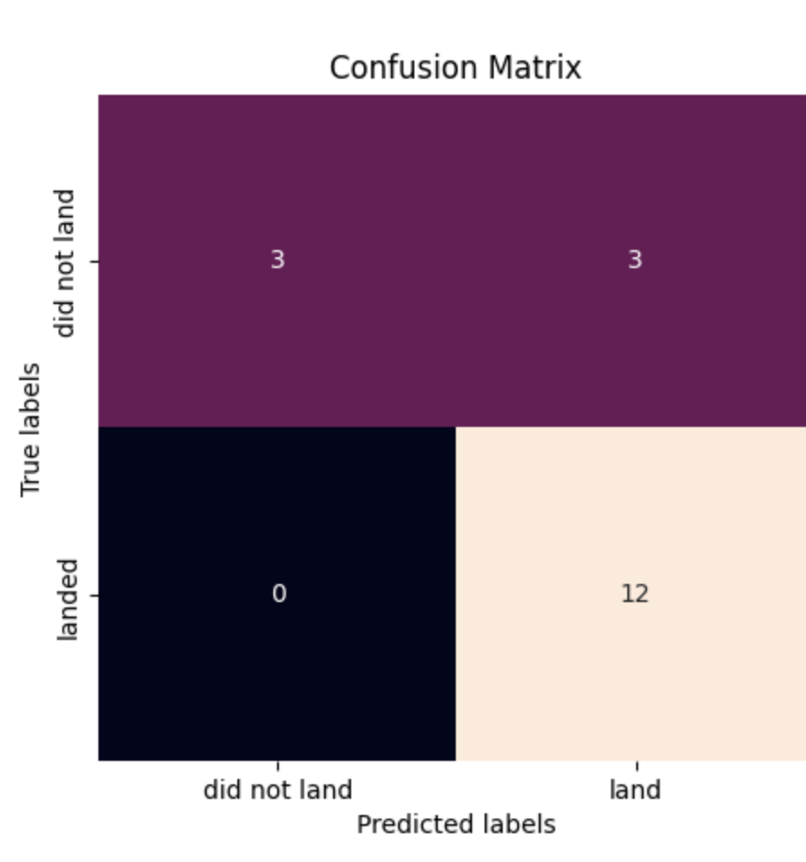
Predictive Analysis
A machine learning model was trained to predict SpaceX Falcon 9 first stage landing success
Tree_cv
logreg_cv
svm_cv

Slide 9
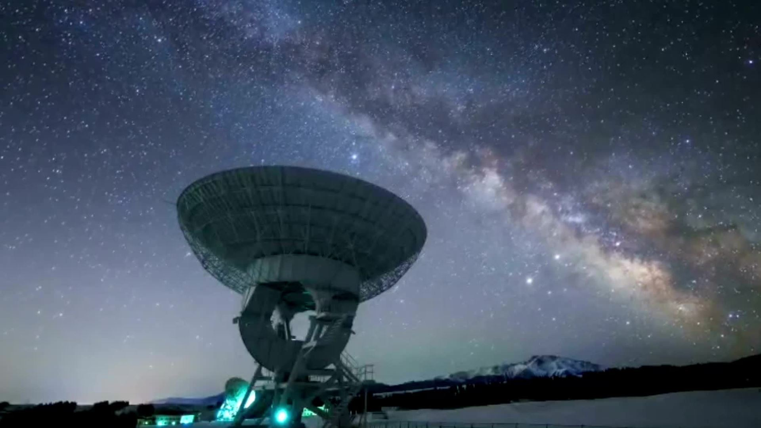
Conclusion
The project successfully analyzed and predicted SpaceX Falcon 9 first stage landing success

Slide 10

Creativity and Innovation
The project went beyond the basic requirements by creating an interactive dashboard and using machine learning for prediction

