Slide 1

MIND: MIcrosoft News Dataset
A Large-Scale English News Recommendation Research
Team #6

Slide 2
01
MIND Dataset
Introduction
SOURCE
Official website:
https://msnews.github.io
Primary paper:
Wu et al., ACL 2020
WHY IT MATTERS
MIND is a public benchmark for personalized news recommendation. It supports content-based, collaborative, recall-stage, and ranking-stage modeling under a shared evaluation setup.
MIND is Microsoft's large-scale English news recommendation benchmark. This deck introduces what the dataset is, how it is organized, and why it is widely used in recommender-system research.
MAIN IDEA
160k+
15M+
1M
Each impression contains a candidate set of news articles, plus the user's earlier click history. Models use this context to predict which candidate items are most likely to be clicked.
English news articles
impression logs
users
Source: MIND official website, About section, accessed April 21, 2026.

Slide 3

02
What Is MIND?
MIND stands for Microsoft News Dataset and is designed for news recommendation research.
OFFICIAL DESCRIPTION
RESEARCH VALUE
The MIND website describes it as a large-scale English dataset for news recommendation research, collected from anonymized Microsoft News behavior logs and released to support benchmark-driven work in recommendation.
Because MIND includes both rich article text and interaction behavior, it supports a wide range of methods: content-based models, collaborative filtering, neural news recommenders, and two-stage recall-and-ranking systems.
CORE DATA MODALITIES
News content:
• title
• abstract
• body
• category
• entities
Behavior logs:
• clicks
• non-clicked impressions
• user click history before each impression
Source: MIND official website, About section.

Slide 4
03
Dataset Scale And Versions
The website highlights both the full dataset and a smaller quick-start variant.
160k+
15M+
1M
50k
news articles
impression logs
users
users in MIND-small
MIND-LARGE
MIND-SMALL
The full dataset is intended for benchmark-scale training, validation, and leaderboard submission. It is the version typically used when comparing against published state-of-the-art systems.
The website also provides MIND-small, created by randomly sampling 50,000 users and their behavior logs. This version is especially useful for quick experiments, tutorials, and reproducible classroom projects.
PRACTICAL TAKEAWAY
For learning and baseline building, MIND-small is usually the easiest place to start. For serious model comparison and leaderboard-style benchmarking, the full MIND release is the more representative choice.
We use the MIND-small dataset due to limited computational resources.
Source: MIND official website, Download section.

Slide 5
04
Main Files And Data Structure
MIND combines article metadata with user behavior logs.
news.tsv
behaviors.tsv
One row per news article.
Common fields:
• title
• abstract
• body
• category
• entities
One row per impression event.
Contains:
• user ID
• timestamp
• clicked history before the impression
• candidate impressions with click / non-click labels
This file supports interaction modeling and ranking evaluation.
The orders of news in an impression have been shuffled.
The position of a candidate should not be used as a training feature.
Example for one impression
Impression ID | User ID | Timestamp | User’s clicked history | Candidate impressions with label
1 | U13740 | 11/11/2019 9:05 | N55189 N42782 … | N55689-1 (Click) N35729-0(Non-click)…
Source: MIND official website, About section and linked dataset description reference.

Slide 6
05
Repository Map And Evaluation Workflow
Every notebook and saved artifact is represented in the reporting pipeline.
NOTEBOOKS
OUTPUTS
COMMON PROTOCOL
round1_descriptive_stats.ipynb
popularity_baseline.ipynb
tfidf.ipynb
itemcf.ipynb
lr_ctr.ipynb
lightgbm_ctr.ipynb
round1_descriptive_stats_output/
popularity_baseline_output/
tfidf_output/
itemcf_output/
lr_ctr_output/
lightgbm_ctr_output/
1. Expand impressions to candidate-level rows.
2. Score each candidate within an impression.
3. Export prediction.txt or metrics files.
4. Evaluate AUC, MRR, nDCG@5, nDCG@10 on validation.
WHY THIS MATTERS
PROJECT HEADLINE
We moves from simple heuristics to stronger CTR models while keeping the same evaluation target. That makes the final comparison fair and easy to explain in one deck.
We mixes two baseline families: recall-style methods that generate or pre-score candidates from popularity/content/collaborative signals and ranking-style methods that learn click-oriented ordering over candidate-level rows.

Slide 7
06
Recall vs Ranking
For a full recommender system, these two stages play different roles and usually need separate baselines.
RECALL / RETRIEVAL
RANKING
Goal: quickly surface a smaller candidate pool from the large corpus.
Typical signals:
• global popularity
• content similarity
• collaborative filtering
In this repo:
Popularity, TF-IDF, and ItemCF fit this family best.
Goal: reorder an existing candidate set so clicked items move above non-clicked items.
Typical signals:
• candidate position
• user-history match features
• metadata features
• supervised CTR labels
In this repo:
Logistic Regression CTR and LightGBM CTR are ranking baselines.

Slide 8
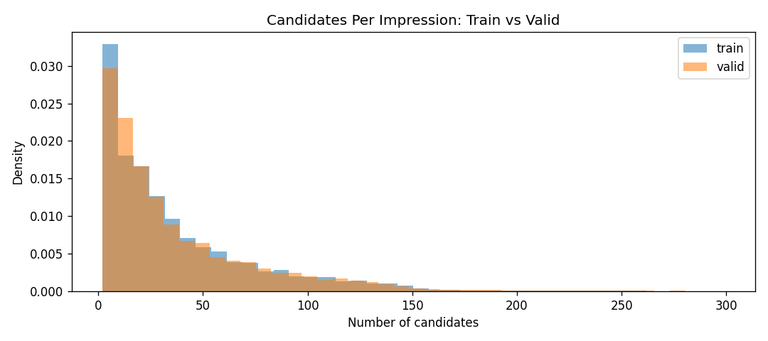
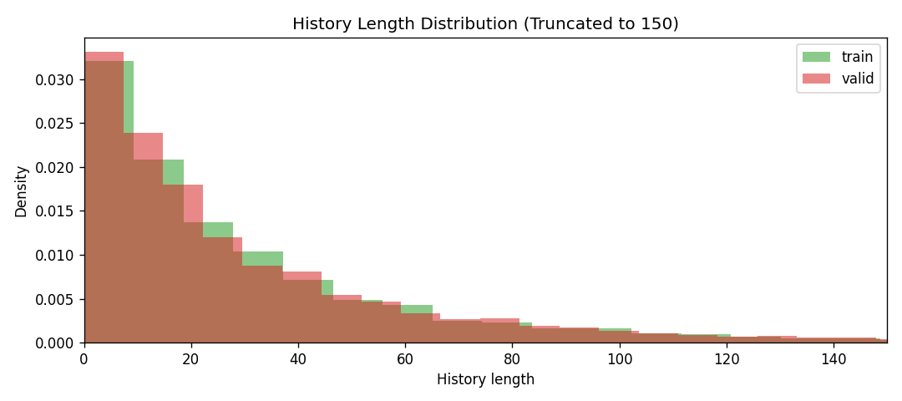
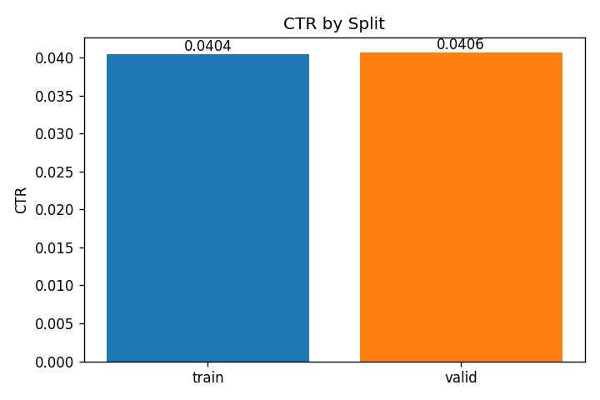
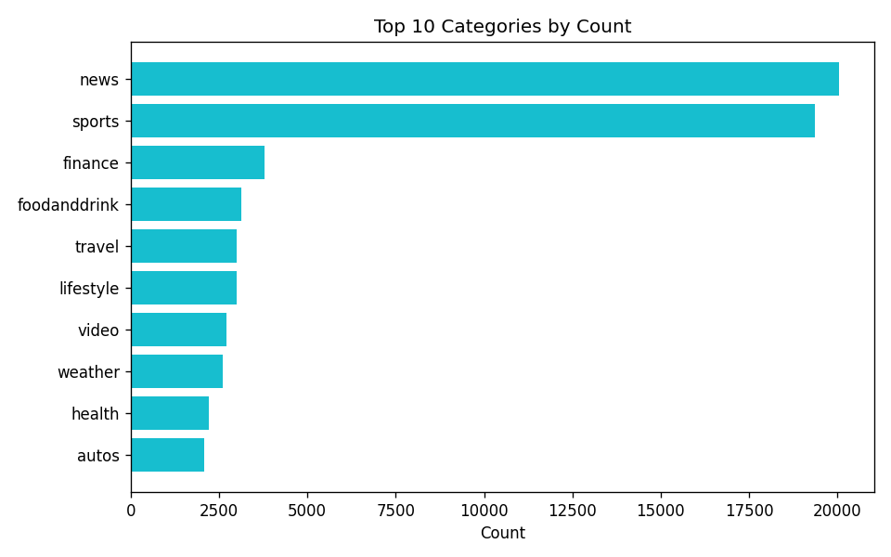
07
Dataset Overview
The train/validation split is stable, sparse, and large enough for meaningful baseline comparison.
Key descriptive takeaways
5.84M
2.74M
37.23
4.06%
• Train and validation candidate density are almost identical.
• CTR stays near 4%, confirming a sparse ranking task.
• History length is long-tailed across users.
• News and sports dominate the category mix.
train candidates
valid candidates
avg candidates/train impression
validation CTR
Candidates per impression: train vs valid
History length: train vs valid
CTR by split
Top-10 category count
Values from round1_descriptive_stats_output/summary.json, candidate_summary.csv, history_summary.csv, and category_top20.csv.

Slide 9
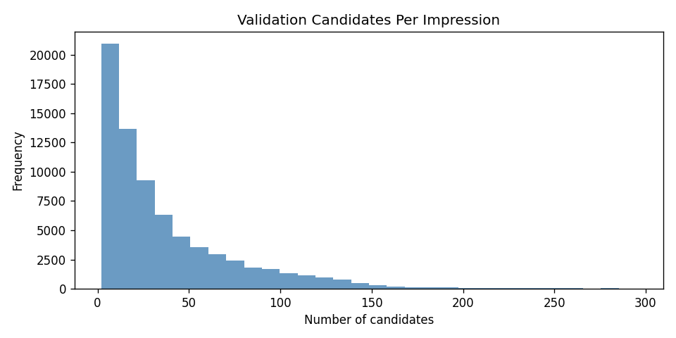
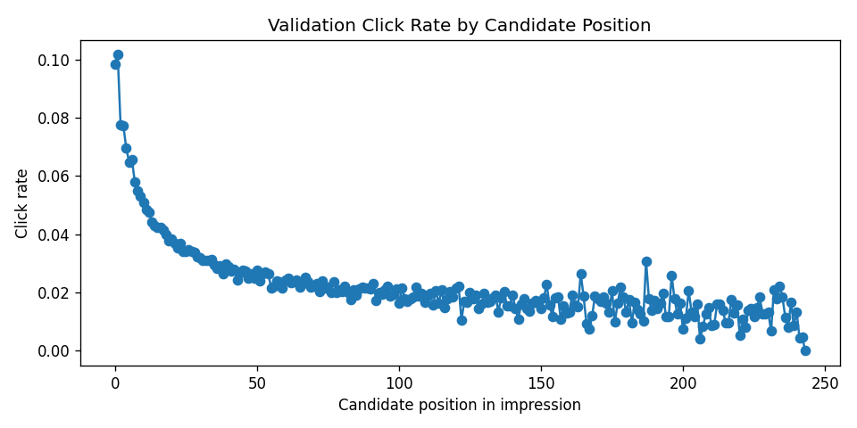
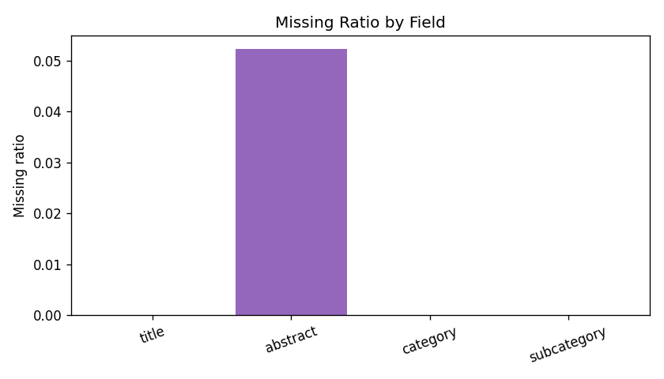
08
Descriptive Findings And Modeling Implications
The saved screenshots highlight where simple baselines help and where richer features are needed.
Validation candidates per impression
Validation click rate by candidate position
Missing ratio by field
INTERPRETATION
MODELING CONSEQUENCE
Candidate count and history-length distributions overlap strongly across splits, so comparison risk from distribution shift is low.
The click-rate-by-position chart suggests presentation order still carries signal.
Missingness is concentrated in abstract, which motivates fallback handling and lightweight text statistics in later models.
These plots justify the design of later baselines:
• popularity for a quick prior
• TF-IDF for content similarity
• history-match features for CTR models
• candidate position as a useful context feature
All remaining descriptive PNGs from round1_descriptive_stats_output are embedded on this slide.

Slide 10
09
Popularity Baseline
The simplest reference model ranks validation candidates by global training click counts.
popularity_baseline.ipynb
RECALL-STYLE BASELINE
METHOD
1. Parse impressions from behaviors.tsv.
2. Count how often each news article was clicked in training.
3. Score each candidate by that global popularity.
4. Evaluate ranking metrics on validation.
0.5318
0.2671
0.2460
0.3098
AUC
MRR
nDCG@5
nDCG@10
SUMMARY
Popularity beats random ranking and gives a consistent baseline, but it cannot personalize by user history or article content. The next notebooks improve on this with content, collaborative, and CTR-specific signals.
WHY KEEP IT
This notebook is the minimum sanity-check baseline for the end-to-end ranking pipeline. It is cheap, transparent, and useful for verifying that stronger methods are learning beyond a popularity prior.
Metrics from popularity_baseline_output/metrics_popularity_baseline.csv.

Slide 11
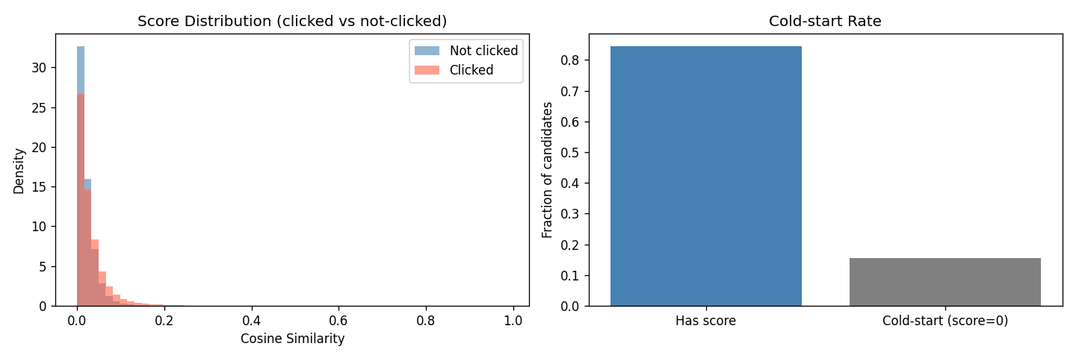
10
TF-IDF Content Baseline
This notebook turns title and abstract text into a user profile and scores each candidate by cosine similarity.
tfidf.ipynb
RECALL-STYLE BASELINE
PIPELINE
0.5656
0.3154
0.2882
0.3513
• Build text with title + abstract.
• Fit a TF-IDF vectorizer over the news corpus.
• Average clicked-history vectors into a user representation.
• Score candidates by cosine similarity to that profile.
AUC
MRR
nDCG@5
nDCG@10
LIMITATIONS
No semantic understanding, no collaborative signal, and cold-start users with empty history get score 0. Even so, this notebook offers a strong content-based reference and a reusable text-processing path.
Score distribution of clicked vs. non-clicked candidates
Metrics from tfidf_output/metrics.json; figure from tfidf_output/score_distribution.png.

Slide 12
11
Item-Based Collaborative Filtering
ItemCF scores each validation candidate by its similarity to the items in a user's click history.
itemcf.ipynb
RECALL-STYLE BASELINE
CORE IDEA
0.5212
0.2634
0.2406
0.3039
Build train-time user-clicked item sets, then compare a candidate item with the user's history through pairwise similarity. In this notebook, the similarity function is Jaccard-based and fully collaborative.
AUC
MRR
nDCG@5
nDCG@10
WORKFLOW
INTERPRETATION
clicked history
↓
find similar items in train clicks
↓
aggregate similarity score per candidate
↓
rank candidates inside each impression
ItemCF provides a pure collaborative baseline, but its AUC and ranking metrics are weaker than the content and CTR models here. That suggests user-history overlap alone is not enough in this Round 1 setup.
Metrics from itemcf_output/metrics.json. Similarity function described in itemcf.ipynb.

Slide 13


12
Logistic Regression CTR
A lightweight tabular CTR model adds explicit history-match, context, and metadata features.
lr_ctr.ipynb
RANKING BASELINE
Task Formulation
Feature Groups
Logistic Regression estimates click probability for each (user, candidate news) pair.
User history, news content, and contextual signals are encoded as a feature vector;
Model learns a linear decision boundary to score each candidate. Final ranking is by predicted click probability.
👤 User History
🔗 History–Match
· history_len
· same_category_count / ratio
· history_unique_len
· same_subcategory_count / ratio
⏰ Context
📰 Candidate News
· hour
· category / subcategory (OHE)
⚡ Efficient Training
🔍 Interpretable
📐 Great Baseline
· weekday
· title & abstract word/char count
· is_weekend
Pipeline
Data Merge
news.tsv + candidates
outputs/shared/
5.84M train / 2.74M valid
Feature
Engineering
sklearn Pipeline
(OHE + Scaler)
Logistic
Regression (L2)
Ranked
Predictions
$$→$$
$$→$$
$$→$$
$$→$$
Metrics from lr_ctr_output/metrics.json; coefficient summary from lr_ctr_output/coefficient_importance.csv.

Slide 14
13
Logistic Regression Results & Findings
These details come from the separate lr_ctr_baseline.pptx and strengthen the LR interpretation section.
lr_ctr.ipynb
RANKING BASELINE
0.6112
0.3130
0.3005
0.3640
AUC
MRR
nDCG@5
nDCG@10
sports_news
1.54
topnews
0.98
musicnews
0.87
KEY FINDINGS
music-celebrity
0.76
finance-companies
0.73
Simple tabular features already capture effective click signals: LR reaches AUC 0.6112 without text embeddings.
Subcategory features dominate the linear model, with sports_news and topnews as strong positives while music-gallery and football_nfl_videos are strong negatives.
newsopinion
0.68
tv-gallery
-0.76
abstract_char_count
-0.76
football_nfl_videos
-1.01
music-gallery
-1.14
TOP POSITIVE COEFFICIENTS
TOP NEGATIVE COEFFICIENTS
sports_news +1.54
topnews +0.98
musicnews +0.87
music-celebrity +0.76
finance-companies +0.73
newsopinion +0.68
tv-gallery -0.76
abstract_char_count -0.76
football_nfl_videos -1.01
music-gallery -1.14
TUNING TAKEAWAY
The separate LR baseline slide deck reports that tuning around C=0.1 only produced marginal gains. The bottleneck is featuring expressiveness rather than regularization strength.
Added from lr_ctr_baseline.pptx: task formulation, pipeline summary, coefficient highlights, and key LR takeaways.

Slide 15
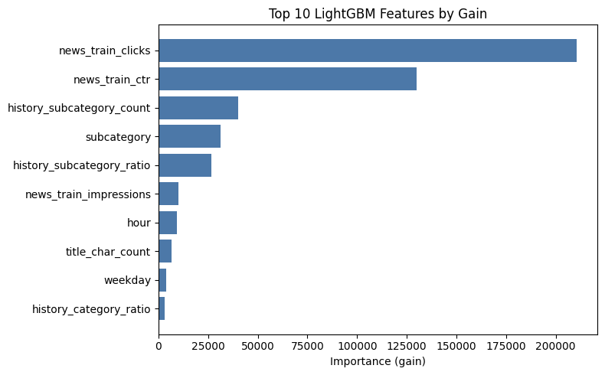
14
LightGBM CTR
The strongest ranking baseline adds nonlinear tree interactions and train-time popularity statistics.
lightgbm_ctr.ipynb
RANKING BASELINE
0.6408
0.3539
0.3366
0.3962
FEATURES
AUC
MRR
nDCG@5
nDCG@10x
User behavior features: history length, unique history length, history category/subcategory count and ratios
Content features: category, subcategory, title length, abstract length
Context features: hour, weekday, weekend
Popularity features: news_train_clicks, news_train_ctr, news_train_impressions
TOP IMPORTANCE
TUNED PARAMS
Feature importance shows that news_train_clicks and news_train_ctr dominate the model, indicating that the model relies heavily on global popularity signals learned from training data.
User-interest features (e.g., history_subcategory_count, history ratios) contribute moderately, suggesting some level of personalization, but their impact is significantly smaller.
Contextual features (hour, weekday) and content-based features (title length, category) have relatively minor contributions.
Overall, the model is primarily driven by popularity signals, with limited reliance on deep user preference modeling.
n_estimators=400
learning_rate=0.1
num_leaves=31
max_depth=6
feature_fraction=0.8
bagging_fraction=0.7
TAKEAWAY
LightGBM is effectively tied with Logistic Regression on AUC and wins all the ranking-oriented metrics. That makes it the best overall Round 1 baseline for recommendation quality.
Popularity over-reliance risk: The model is heavily driven by news_train_ctr, so it may over-prioritize already popular items and under-serve long-tail or emerging content.
Future improvements should focus on:
strengthening user-interest modeling
incorporating semantic representations (e.g., embeddings)

Slide 16
15
Overall Comparison And Recommendation
The deck closes by comparing all five baselines under the same validation protocol.
Model
AUC
MRR
nDCG@5
nDCG@10
Popularity
0.5318
0.2671
0.2460
0.3098
TF-IDF
0.5656
0.3154
0.2882
0.3513
ItemCF
0.5212
0.2634
0.2406
0.3039
Logistic Regression
0.6112
0.3130
0.3005
0.3640
LightGBM
0.6408
0.3539
0.3366
0.3962
RECOMMENDATION
NEXT STEPS
Use one baseline per stage.
Recall: TF-IDF.
Ranking: LightGBM CTR.
1. Use TF-IDF as the recall-stage baseline.
2. Use LightGBM CTR as the ranking-stage baseline.
3. use a neural model (preferably NRMS, or NAML/LSTUR) to rescore and reorder those candidates.

