Slide 1


Bf-Tree: A Modern Read-Write-Optimized Concurrent Larger-Than-Memory Range Index
Xiangpeng Hao*
University of Wisconsin-Madison
Badrish Chandramouli
Microsoft Research
*Research done during internship at MSR.​

Slide 2
Memory
B-Tree basics
Fixed-size pages.
Hot pages are cached in memory.
Multiple records in a page.
Disk

Slide 3
Memory
1. Traverse to leaf
Problem 1:
Write amplification
3. Evict to disk
Disk
2. Bring to memory

Slide 4
Memory
Problem 2:
Inefficient caching
Disk

Slide 5
B-Trees today
Ad-hoc solutions
Page cache
Record cache
Compete for resources
Delta records
Log-structured write
+
Complex tuning
Need a simple, holistic re-design!

Slide 6
Bf-Tree: Decouple cache pages from disk pages
B-Tree
Bf-Tree
Mini pages!
Memory ⬆️
Memory ⬆️
Disk ⬇️
Hot!
Disk ⬇️
Hot!
Hot records
Cold records

Slide 7
Mini pages
Bf-Tree
=
Buffer pool for mini pages

Slide 8
1. Traverse to leaf
2. Search in mini-page
Mini-page:
Cache records
3. Search disk page
4. Cache record in mini-page

Slide 9
1. Traverse to leaf
2. Search mini-page
Mini-page:
buffer writes

Slide 10
1. Traverse to leaf
Mini-page:
Grow larger
2. Insert to mini-page
Full!

Slide 11
1. Traverse to leaf
2. Search mini-page
Mini-page:
Batch write to disk
Full!
3. Merge to leaf

Slide 12
Mini pages
Bf-Tree
=
Buffer pool for mini pages

Slide 13
Buffer pool: allocate mini-pages
Head
Tail
Head
Tail

Slide 14
Buffer pool: track hot mini-pages
Copy-on-access
Head
Tail
Second-chance region
Copy-on-access to tail
Evicted to disk when reached head
Inspired by FASTER’s “hybrid log” design

Slide 15
Buffer pool: grow & shrink mini-pages
Copy-on-access
Head
Tail
Grow/shrink a mini page
Copy then grow
De-allocate to a free list

Slide 16

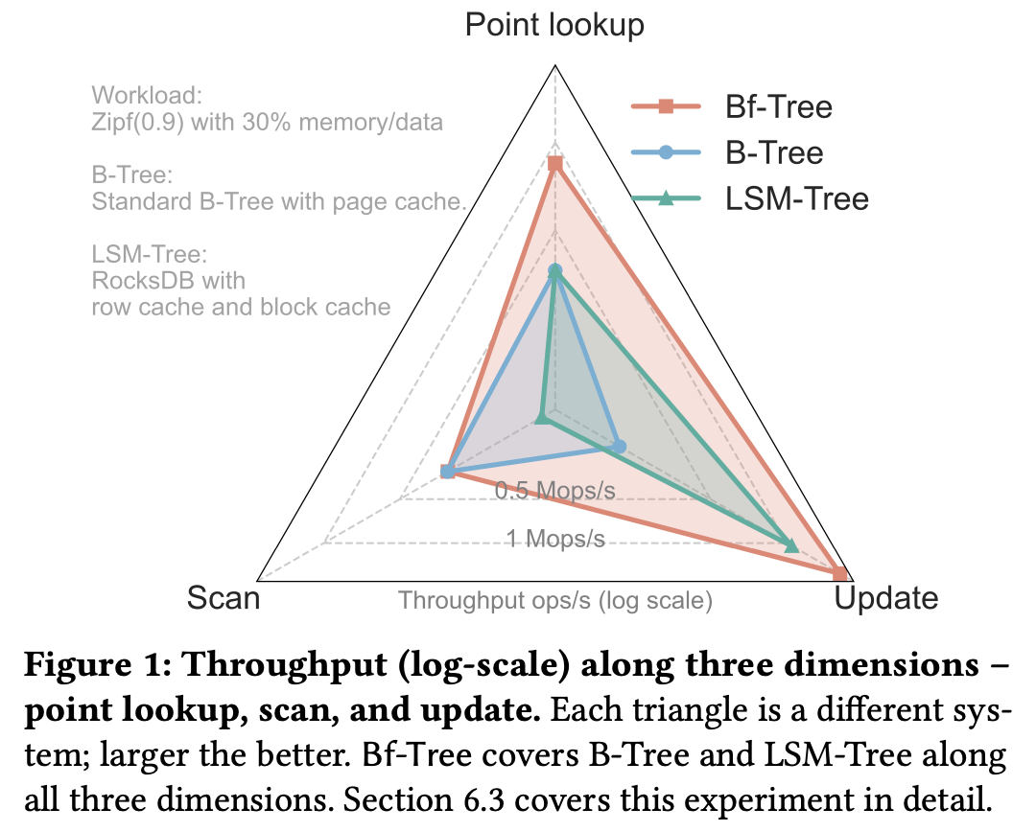
Read our paper!
Bf-Tree is FAST
2x-6x faster than B-Tree and LSM-Tree for small records
Optimized for in-memory and larger-than-memory workloads
More in the paper
Modern (Rust + SSD) re-design
I/O handling
Prefix compression etc.

