Slide 1
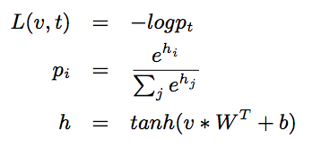
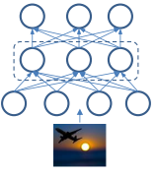
Advanced User Guide
Application
Train a MLP model for digit recognition
Dataset
MNIST， 60K training, 10K test images, 10 labels.
The MLP model
Notes:
In this talk, I will talk about a bit of deep leaning background in terms of models and training frameworks
Then, I will give an overview of SINGA followed by its programming model and architecture
Also, I will show a few experiment results in terms of training efficiency comparing with other systems
Then, if time is allowed, I will talk about a few sample applications done with SINGA

Slide 2
myproto.proto
Configuration fields
Name, type, source layers, parameters
Number of units
Insert the specific config into singa::LayerProto via extension
package singa;
import "job.proto”;
message HiddenProto {
required int32 num_output = 1;
}
extend LayerProto {
optional HiddenProto hidden_conf = 102;
}

Slide 3
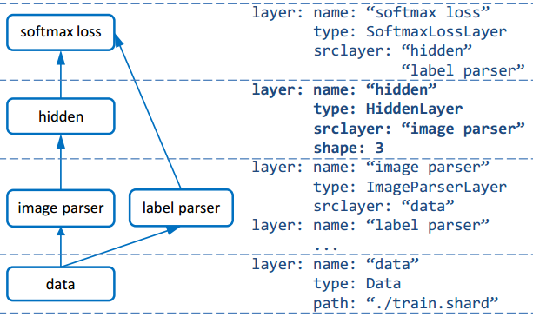
job.conf
layer{
name: "hid1"
user_type: "kHidden"
srclayers:"mnist"
[singa.hidden_conf] {
num_output: 10
}
param{
name: "w1"
init {
type: kUniform
low:-0.05
high:0.05
}
}
param{
name: "b1"
init {
type : kUniform
low: -0.05
high:0.05
}
}
}
Config the neuralnet
The hidden layer is shown

Slide 4
hidden_layer.h
Declare the hidden layer
class HiddenLayer : public NeuronLayer {
public:
~HiddenLayer();
void Setup(const LayerProto& proto, int npartitions) override;
void ComputeFeature(int flag, Metric* perf) override;
void ComputeGradient(int flag, Metric* perf) override;
const std::vector<Param*> GetParams() const override {
std::vector<Param*> params{weight_, bias_};
return params;
}
private:
int batchsize_, vdim_, hdim_;
Param *weight_, *bias_;
};

Slide 5
hidden_layer.cc
HiddenLayer :: Setup
void HiddenLayer::Setup(const LayerProto& proto, int npartitions) {
Layer::Setup(proto, npartitions);
CHECK_EQ(srclayers_.size(), 1);
const auto& src = srclayers_[0]->data(this);
batchsize_ = src.shape()[0];
vdim_ = src.count() / batchsize_;
hdim_ = layer_proto_.GetExtension(hidden_conf).num_output();
data_.Reshape(vector<int>{batchsize_, hdim_});
grad_.ReshapeLike(data_);
weight_ = Param::Create(proto.param(0));
bias_ = Param::Create(proto.param(1));
weight_->Setup(vector<int>{hdim_, vdim_});
bias_->Setup(vector<int>{hdim_});
}

Slide 6

hidden_layer.cc
HiddenLayer :: ComputeFeature
void HiddenLayer::ComputeFeature(int flag, Metric* perf) {
…
data = dot(src, weight.T());
data += expr::repmat(bias, batchsize_);
data = expr::F<op::stanh>(data);
}

Slide 7
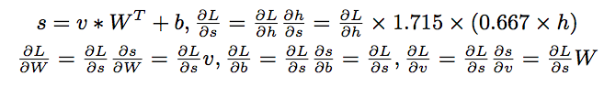
hidden_layer.cc
HiddenLayer :: ComputeGradient
void HiddenLayer::ComputeGradient(int flag, Metric* perf) {
….
grad = expr::F<op::stanh_grad>(data) * grad;
gbias = expr::sum_rows(grad);
gweight = dot(grad.T(), src);
if (srclayers_[0]->mutable_grad(this) != nullptr) {
auto gsrc = NewTensor2(srclayers_[0]->mutable_grad(this));
gsrc = dot(grad, weight);
}
}

Slide 8
main.cc
Register HiddenLayer
…
#include "hidden_layer.h"
#include "myproto.pb.h”
int main(int argc, char **argv) {
…
// users can register new subclasses of layer, updater, etc.
driver.RegisterLayer<singa::HiddenLayer, std::string>("kHidden");
…
}

Slide 9
job.conf
name: "mlp”
train_one_batch {
alg: kBP
}
updater{
type: kSGD
learning_rate{
type : kStep
base_lr: 0.001
step_conf{
change_freq: 60
gamma: 0.997
}
}
}
neuralnet{…..}
cluster {….}

Slide 10
Compile and run
Compile
cp Makefile.example Makefile
make
Run
export LD_LIBRARY_PATH=.libs:$LD_LIBRARY_PATH
./bin/singa-run –exec examples/mlp/mlp.bin –conf examples/mlp/job.conf
./bin/singa-run –exec examples/mlp/mlp.bin –conf examples/mlp/deep.conf

