Slide 1
Basic User Guide
Installation
Data preparation
Examples
Convolutional Neural Network (CNN)
Dataset: CIFAR-10
Single Worker / Synchronous / Downpour
Restricted Boltzmann Machine (RBM)
Dataset: MNIST
Single Worker
Notes:
In this talk, I will talk about a bit of deep leaning background in terms of models and training frameworks
Then, I will give an overview of SINGA followed by its programming model and architecture
Also, I will show a few experiment results in terms of training efficiency comparing with other systems
Then, if time is allowed, I will talk about a few sample applications done with SINGA

Slide 2
Installation
Download
VirtualBox Image
Compile
git clone https://github.com/apache/incubator-singa.git
git clone https://git-wip-us.apache.org/repos/asf/incubator-singa.git
http://www.comp.nus.edu.sg/~dbsystem/singa/docs/quick-start
Username: singa Password: singa
# get latest version
cd singa
git fetch origin master
./autogen.sh
./configure
make

Slide 3
Data Preparation
SINGA recognizable Records
Generate data records
convert program
Support user-defined record format (and parser layer)
Use data records
corresponding data/parser layer as input
Raw Data
Load
Parse
Data Records
Data Layers
Parser Layers
Imdb, leveldb, DataShard

Slide 4
Convert program for DataShard
// a built-in lightweight data layer
class DataShard {
bool Insert(const std::string& key, const google::protobuf::Message& tuple); // write
bool Next(std::string* key, google::protobuf::Message* val); // read
};
Message SingleLabelmageRecord {
repeated int32 shape; // the shape of contained data, e.g. 32*32 for a image
optional int32 label; // label for classification
optional bytes pixel; // pixels of a image
repeated float data; // feature vector
};
singa::DataShard myShard(outputpath, kCreate);
singa:: SingleLabelmageRecord record;
record->add_shape( int_val ); // for repeated field
record->set_label( int_val );
// key (string) is a unique record ID (e.g., converted from a number starting from 0) myShard.Insert( key, record );

Slide 5
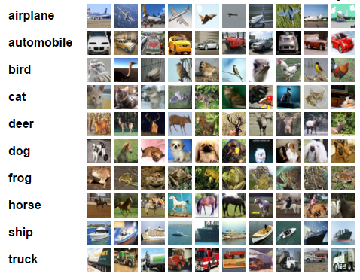
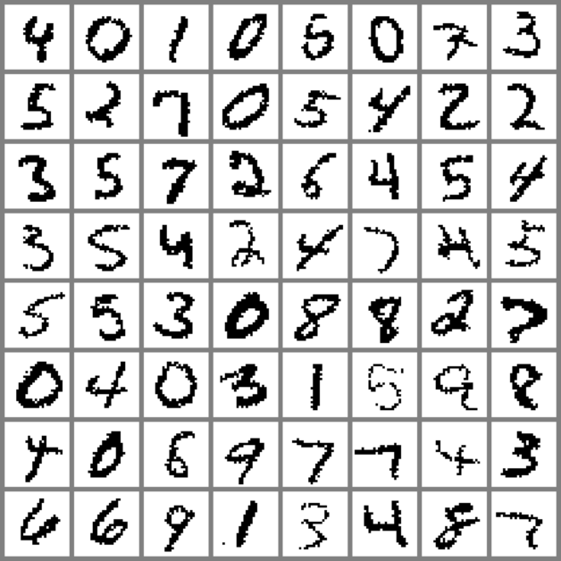
Prepared Datasets
Datasets
CIFAR-10^{[1]}
MNIST^{[2]}
Generate records
Already done for you in virtualbox
examples/cifar10/create_shard.cc
examples/mnist/create_shard.cc
# go to example folder
$ cp Makefile.example Makefile
$ make download # download raw data
$make create # generate data records
[1] http://www.cs.toronto.edu/~kriz/cifar.html
[2] http://yann.lecun.com/exdb/mnist/

Slide 6
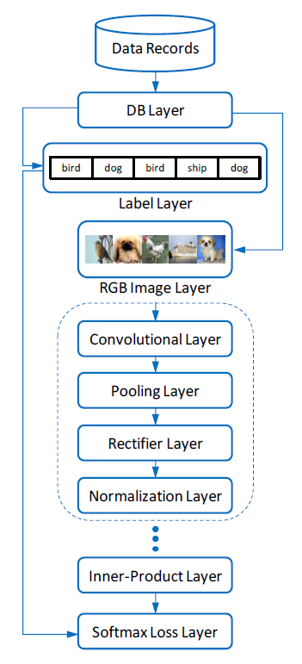
Examples (CNN)

Slide 7
Examples (CNN)
layer {
name: "data"
type: kShardData
sharddata_conf {
path: "examples/cifar10/cifar10_train_shard"
batchsize: 16
random_skip: 5000
}
exclude: kTest # exclude for the testing net
}
layer {
name: "data"
type: kShardData
sharddata_conf {
path: "examples/cifar10/cifar10_test_shard“
batchsize: 100
}
exclude: kTrain # exclude for the training net
}

Slide 8
Examples (CNN)
layer {
name:"rgb"
type: kRGBImage
srclayers: "data"
rgbimage_conf {
meanfile: "examples/cifar10/image_mean.bin"
# normalized image feature
}
}
layer {
name: "label"
type: kLabel
srclayers: "data"
}

Slide 9
Examples (CNN)
layer {
name: "conv1"
type: kConvolution
srclayers: "rgb"
convolution_conf { … }
param {
name: "w1"
init { type: kGaussian }
}
param {
name: "b1"
lr_scale:2.0
init { type: kConstant }
}
}

Slide 10
Examples (CNN)
layer {
name: "pool1"
type: kPooling
srclayers: "conv1"
pooling_conf { … }
}
layer {
name: "relu1"
type: kReLU
srclayers:"pool1"
}
layer {
name: "norm1"
type: kLRN
srclayers:"relu1"
lrn_conf { … }
}

Slide 11
Examples (CNN)
layer {
name: "ip1"
type: kInnerProduct
srclayers:"pool3"
innerproduct_conf { … }
param { … }
}
layer {
name: "loss"
type: kSoftmaxLoss
softmaxloss_conf { … }
srclayers:"ip1“
srclayers: "label“
}

Slide 12
Configure a CNN Job
4 Main Components
NeuralNet (as configured above)
Updater
TrainOneBatch
ClusterTopology
updater {
type: kSGD
learning_rate { type: kFixedStep }
}
alg: kBP

Slide 13
Run a CNN Job
A quick-start job
Default ClusterTopology (single worker)
Provided in
Run it!
examples/cifar10/job.conf
# start zookeeper (do it only once)
$ ./bin/zk-service start
# run the job using default setting
$ ./bin/singa-run.sh -conf examples/cifar10/job.conf
# stop the job
$ ./bin/singa-stop.sh

Slide 14
Run a CNN Job
Record job information to /tmp/singa-log/job-info/job-2-20150817-055601
Executing : ./singa -conf /xxx/incubator-singa/examples/cifar10/job.conf -singa_conf /xxx/incubator-singa/conf/singa.conf -singa_job 2
E0817 06:56:18.868259 33849 cluster.cc:51] proc #0 -> 192.168.5.128:49152 (pid = 33849)
E0817 06:56:18.928452 33871 server.cc:36] Server (group = 0, id = 0) start
E0817 06:56:18.928469 33872 worker.cc:134] Worker (group = 0, id = 0) start
E0817 06:57:13.657302 33849 trainer.cc:373] Test step-0, loss : 2.302588, accuracy : 0.077900
E0817 06:57:17.626708 33849 trainer.cc:373] Train step-0, loss : 2.302578, accuracy : 0.062500
E0817 06:57:24.142645 33849 trainer.cc:373] Train step-30, loss : 2.302404, accuracy : 0.131250
E0817 06:57:30.813354 33849 trainer.cc:373] Train step-60, loss : 2.302248, accuracy : 0.156250
E0817 06:57:37.556655 33849 trainer.cc:373] Train step-90, loss : 2.301849, accuracy : 0.175000
E0817 06:57:44.971276 33849 trainer.cc:373] Train step-120, loss : 2.301077, accuracy : 0.137500
E0817 06:57:51.801949 33849 trainer.cc:373] Train step-150, loss : 2.300410, accuracy : 0.135417
E0817 06:57:58.682281 33849 trainer.cc:373] Train step-180, loss : 2.300067, accuracy : 0.127083
E0817 06:58:05.578366 33849 trainer.cc:373] Train step-210, loss : 2.300143, accuracy : 0.154167
E0817 06:58:12.518497 33849 trainer.cc:373] Train step-240, loss : 2.295912, accuracy : 0.185417

Slide 15
SINGA Scripts
Launch singa jobs
Manage singa jobs
Stop all singa processes
singa-run.sh -conf <job config file> [ other arguments ]
-resume : if want to recover a job
-exec <path to mysinga> : if want to use own singa driver
singa-console.sh <command> <args>
list : list running singa jobs
view <job id> : view procs of a singa job
kill <job id> : kill a singa job"
singa-stop.sh

Slide 16
Run CNN (cont.)
Synchronous Training
2 workers in a single process
Asynchronous Training
downpour
2 worker groups and 1 global server group
# default setting
cluster {
nworker_groups: 1
nserver_groups: 1
nworkers_per_group: 1
nservers_per_group: 1
nworkers_per_procs: 1
nservers_per_procs: 1 server_worker_separate: false
}
cluster {
nworkers_per_group: 2
nworkers_per_procs: 2
}
cluster {
nworker_groups: 2
nservers_per_group: 2
}

Slide 17
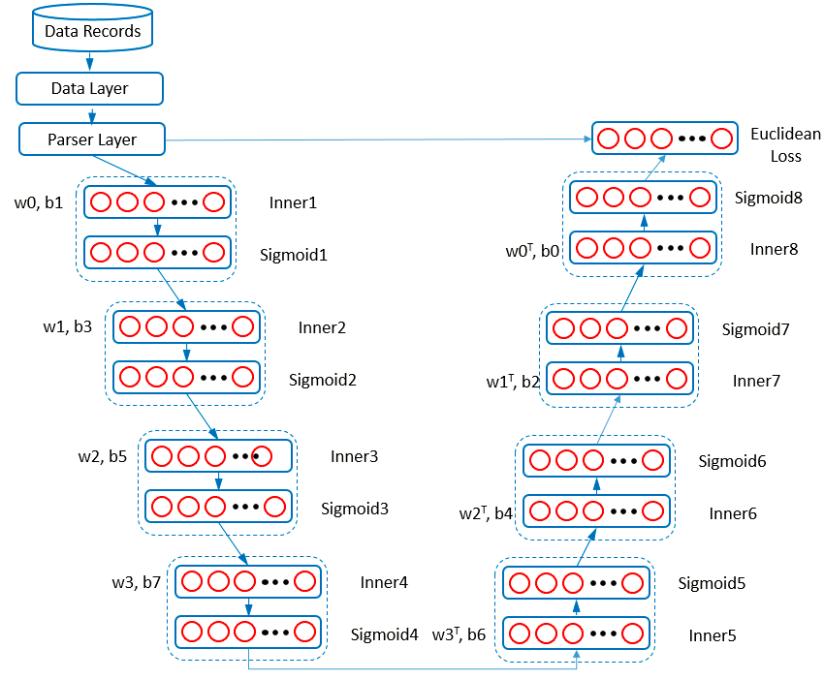
Examples (RBM-Auto Encoder)

Slide 18
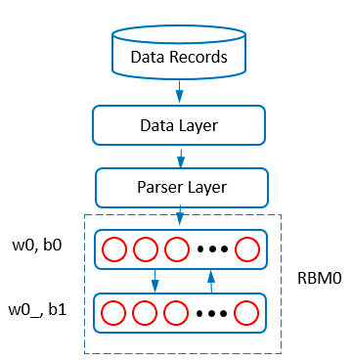
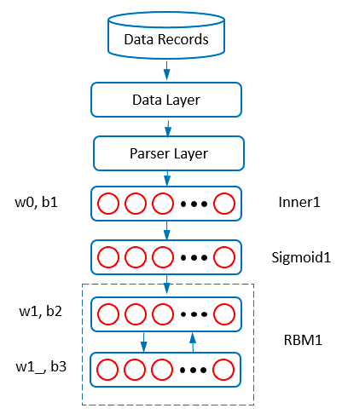
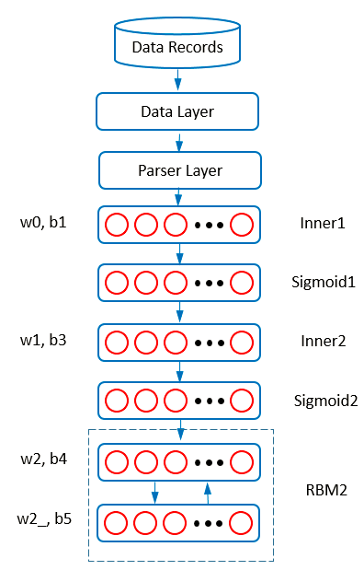
Examples (RBM-Auto Encoder)

Slide 19
Examples (RBM-Auto Encoder)
4 RBM and 1 Auto-encoder
Need to pre-train models one by one
How to use parameters from previous models?
Check points are output files from a model
When load check points for a new model, SINGA puts parameters values into the parameter with the same identity name
checkpoint_path: "examples/rbm/rbm0/checkpoint/step6000-worker0.bin"

Slide 20
Run RBM-Auto Encoder
# at SINGA_HOME/
$ ./bin/singa-run.sh -conf examples/rbm/rbm0.conf
$ ./bin/singa-run.sh -conf examples/rbm/rbm1.conf
$ ./bin/singa-run.sh -conf examples/rbm/rbm2.conf
$ ./bin/singa-run.sh -conf examples/rbm/rbm3.conf
$ ./bin/singa-run.sh -conf examples/rbm/autoencoder.conf

Slide 21
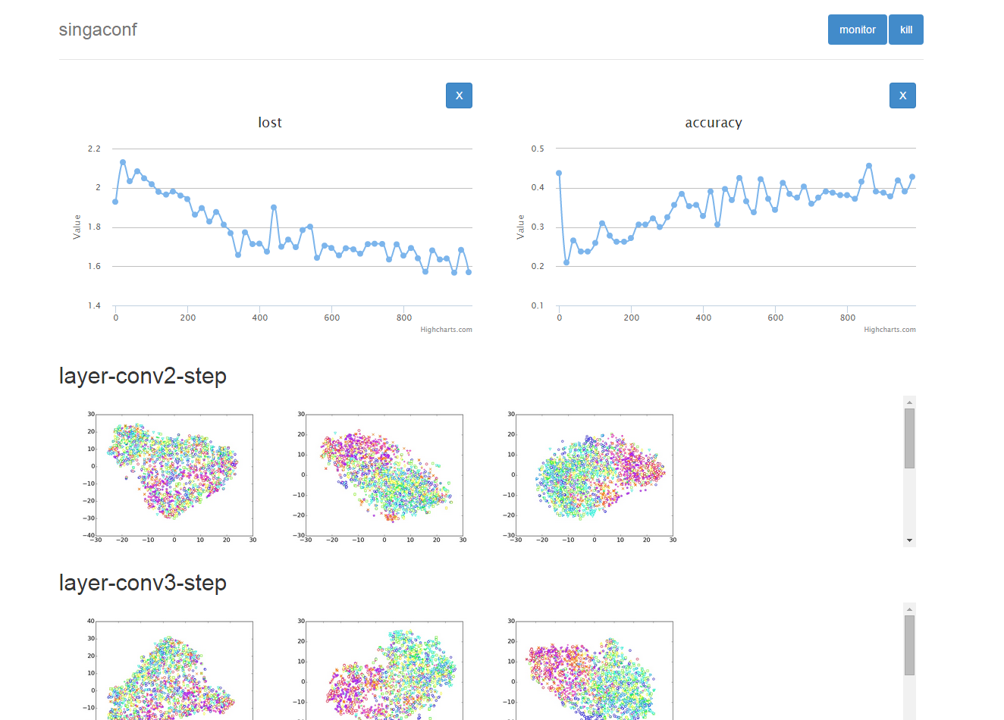
CNN-1
Notes:
Demo 3-1

Slide 22
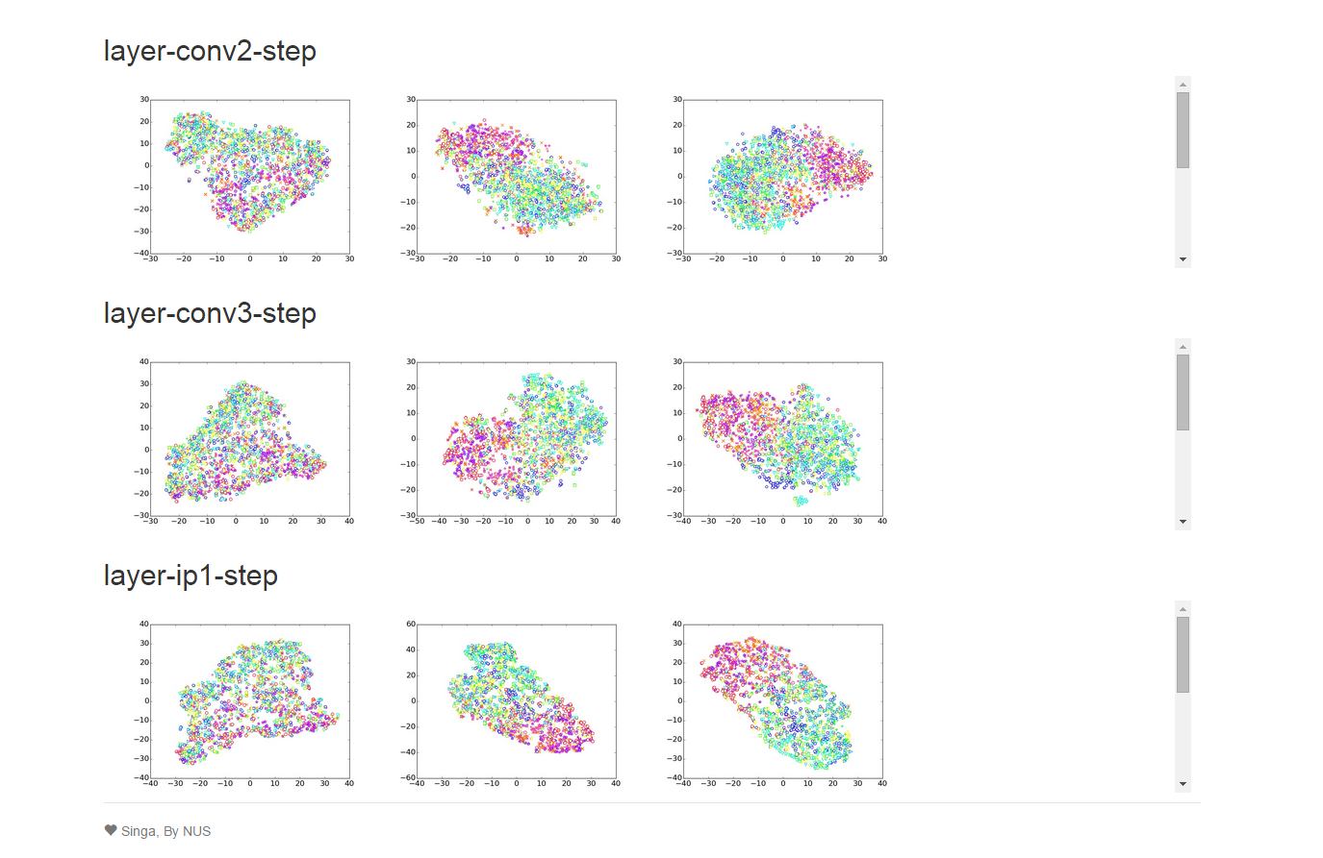
CNN-2
Notes:
Demo 3-2

Slide 23
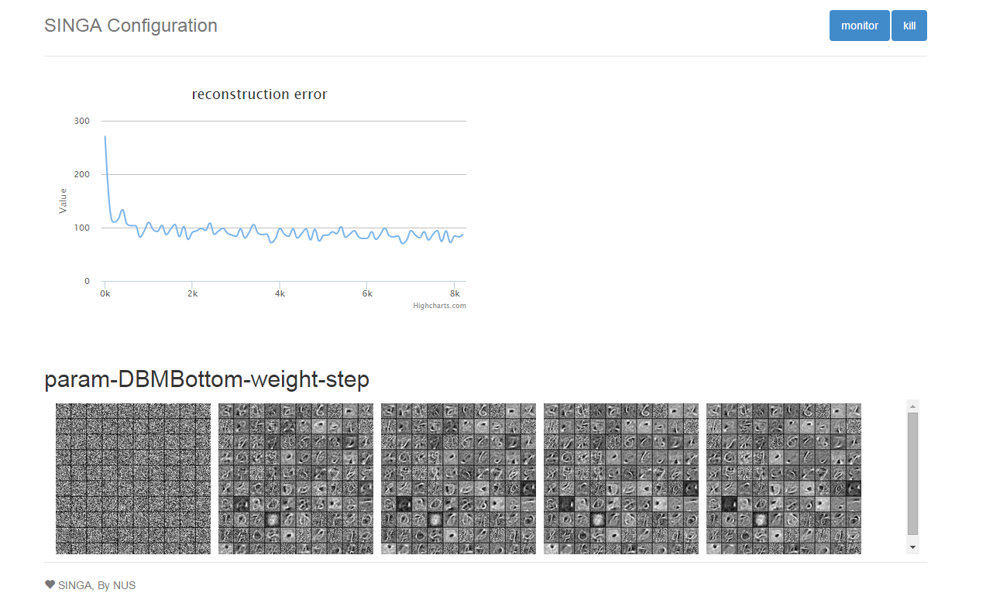
RBM

