Slide 1


A General Distributed Deep Learning Platform
Apache SINGA
SINGA Team
September 4, 2015 @VLDB BOSS

Slide 2
Outline
Part one
Background
SINGA
Overview
Programming Model
System Architecture
Experimental Study
Research Challenges
Conclusion
Part two
Basic user guide
Advanced user guide
Notes:
In this talk, I will talk about a bit of deep leaning background in terms of models and training frameworks
Then, I will give an overview of SINGA followed by its programming model and architecture
Also, I will show a few experiment results in terms of training efficiency comparing with other systems
Then, if time is allowed, I will talk about a few sample applications done with SINGA

Slide 3
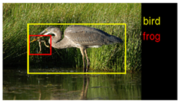
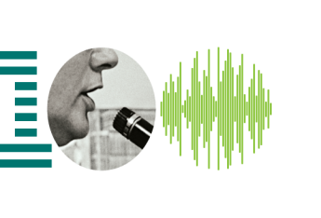
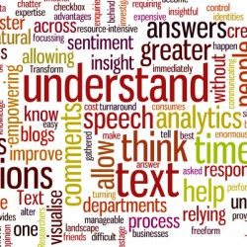
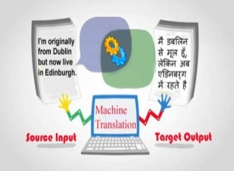
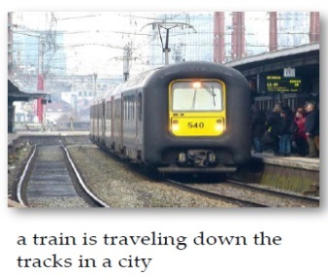


Background: Applications and Models
Image/video classification
Acoustic modeling
Natural language processing
Machine translation
Image caption generation
Drug detection
Source websites of each image can be found by click on it
Notes:
As you may know,
Deep leaning has shown break-through improvement for image classification and speech recognition.
It also produced promising results for various tasks in
natural language processing (e.g., topic classification, sentiment analysis, question anwsering)
machine translation,
image caption generation
drug detection (determine which chemical compounds would be effective drug treatment for a variety of diseases).

Slide 4
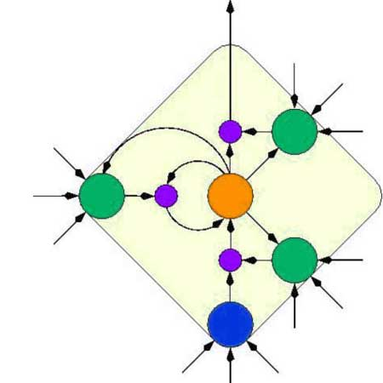
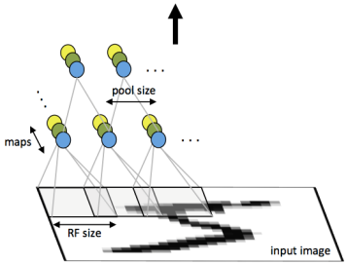
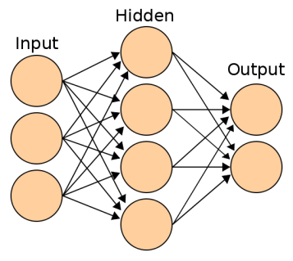
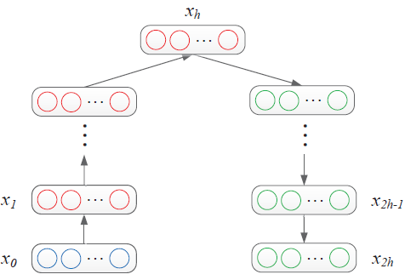
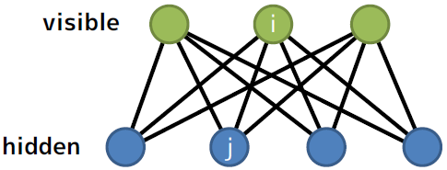
Background: Applications and Models
Image/video classification
Acoustic modeling
Natural language processing
Machine translation
Image caption generation
Drug detection
CNN
MLP
Auto-Encoder
LSTM
RBM
Directed acyclic connection
Recurrent connection
Undirected connection
Convolutional Neural Network (CNN)
Multi-Layer Perceptron (MLP)
Auto-Encoder (AE)
Long Short Term Memory (LSTM)
Recurrent Neural Network (RNN)
Restricted Boltzman machine (RBM)
Deep Botzman Machine (DBM)
Deep Belief Network (DBN)
Source websites of each image can be found by click on it
Source websites of each image can be found by click on it
Notes:
For developing such applicatoins
Many different types of deep learning models are proposed, e.g., convolutional neural network.
For SINGA project, we group the models into 3 categories based on how layers connected.
the layers are connected into directed acyclic structure, like the CNN and MLP.
the 2nd category have directed cyclic structure like RNN and LSTM.
the 3rd category is undirected, like RBM
(Deep learning has turned out to be very good at discovering complicated structures in high-dimensional data
and is therefore applicable to many domains of science)

Slide 5

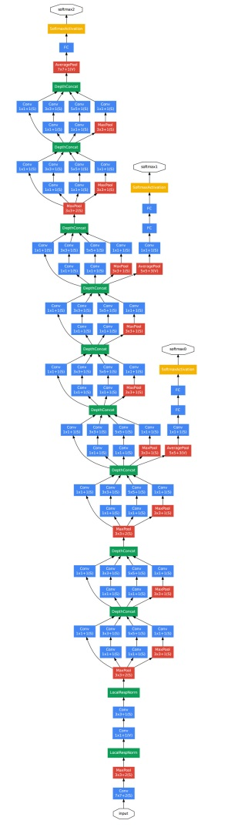
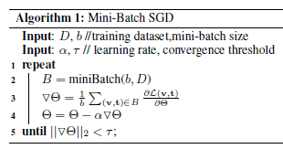
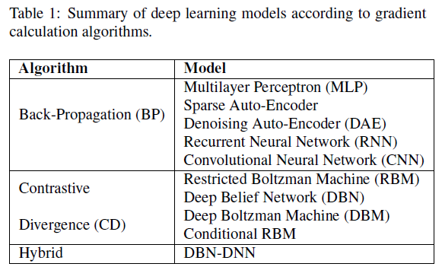
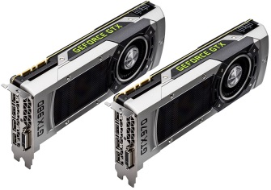
Background: Parameter Training
Objective function
Loss functions of deep learning models are (usually) non-linear non-convex → No closed form solution.
Mini-batch Stochastic Gradient Descent (SGD)
Compute Gradients
Update Parameters
1 week
Notes:
For parameter training, we typically set loss functions, which defines “better prediction” with the model
e.g., Cross-entropy loss to measure difference between predicted prob distribution and truth prob distribution.
However, it does not have closed form solution
So, SINGA uses mini-batch SGD algorithms
that compute gradients and update parameters in a distributed manner
For gradient calculation, SINGA supports BP, BPTT, and CD
Recently, many research have shown that larger models and datasets improve the performance of deep learning models.
However, they also bring challenges in terms of training time.
---
Train the parameters involved in the layer transformations to make the learned features better for predicting the ground truth or modelling the data distribution.

Slide 6
Background: Distributed Training Framework
Synchronous frameworks
Asynchronous frameworks
---one group
server
coordinator
worker
worker
worker
worker
worker
worker
worker
worker
Sandblaster of Google Brain [1]
AllReduce in Baidu’s DeepImage[2]
server
worker
worker
worker
worker
worker
worker
worker
worker
Distributed Hogwild in Caffe[4]
Downpour of Google Brain[1]
Notes:
Then, people propose different types of distributed training frameworks.
For SINGA, We categorize the existing systems into two, namely synchronous frameworks and asynchronous frameworks.
In Syn frameworks, the node groups run synchronously.
For example, Google Brain’s Sandblaster framework and Baidu’s DeepImage system’s AllReduce framework,
For each iteration, they all together compute over a mini-batch of training data
In Asyn frameworks are based on shared memory hogwild algorithm.
The worker groups run the SGD algorithm asynchronously and independently.
I will talk about how users configure such training frameworks in SINGA

Slide 7
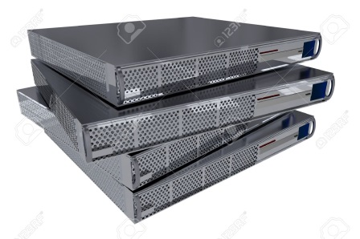
SINGA Design Goals
RNN
General
Different categories of models
Different training frameworks
Scalable
Scale to a large model and training dataset
e.g., 1 Billion parameters and 10M images
Model partition and Data partition
Easy to use
Simple programming model
Built-in models, Python binding, Web interface
without much awareness of the underlying distributed platform
Abstraction for extensibility, scalability and usability
CNN
RBM
…
…
AllReduce
Hogwild
Notes:
As explained before, SINGA has 3 design goals
We design SINGA
to support several different categories of models and training frameworks.
to be scale to both a large model and also a large training dataset. SINGA achieves both model and data partition.
to make it easy for users to use and extend

Slide 8
Outline
Part one
Background
SINGA
Overview
Programming Model
System Architecture
Experimental Study
Research Challenges
Conclusion
Part two
Basic user guide
Advanced user guide
Notes:
In this talk, I will talk about a bit of deep leaning background in terms of models and training frameworks
Then, I will give an overview of SINGA followed by its programming model and architecture
Also, I will show a few experiment results in terms of training efficiency comparing with other systems
Then, if time is allowed, I will talk about a few sample applications done with SINGA

Slide 9
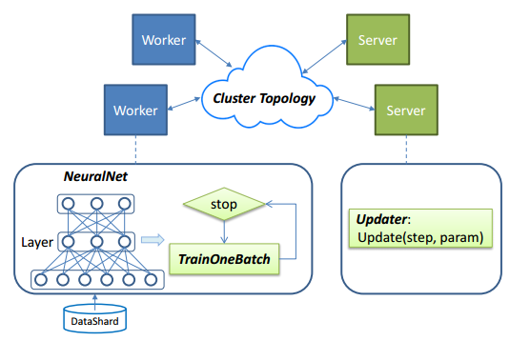

SINGA Overview
Main Components
ClusterToplogy
NeuralNet
TrainOneBatch
Updater
Users (or programmers) submit a job configuration for 4 components.
Notes:
This diagram shows an overview of SINGA
It consists of 4 components: cluster topology, neural net, train one batch, updater
Users are supposed to just submit “configuration” for the 4 components.
SINGA trains model over worker-server architecture
Basically, workers takes care of gradient computation,
server takes care of parameter updates
ClusterTopology component maintains the topology of workers and servers
I will explain how users configure the topology later.

Slide 10
SINGA Overview
Main Components
ClusterToplogy
NeuralNet
TrainOneBatch
Updater
Users (or programmers) submit a job configuration for 4 components.
SINGA trains models over the worker-server architecture.
Workers compute parameter gradients
Servers perform parameter updates
Notes:
This diagram shows an overview of SINGA
It consists of 4 components: cluster topology, neural net, train one batch, updater
Users are supposed to just submit “configuration” for the 4 components.
SINGA trains model over worker-server architecture
Basically, workers takes care of gradient computation,
server takes care of parameter updates
ClusterTopology component maintains the topology of workers and servers
I will explain how users configure the topology later.

Slide 11
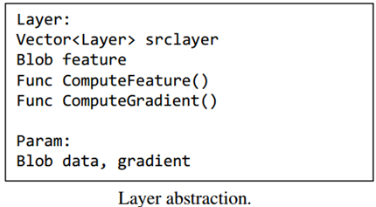
SINGA Programming Model
Notes:
NeuralNet component describes the neural network structure with the layers and their connections.
- Basically, Layer class has 2 fields and 2 functions (srclayer, feature, ComputeFeature(), ComputeGadient())

Slide 12
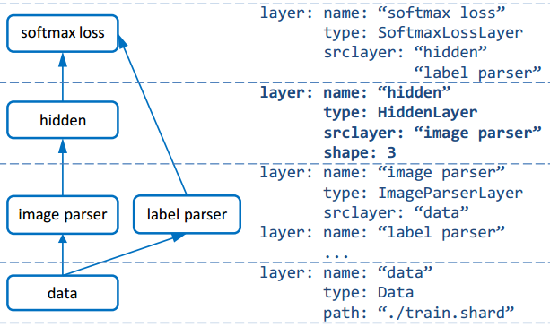
SINGA Programming Model
Notes:
NeuralNet component describes the neural network structure with the layers and their connections.
- Basically, Layer class has 2 fields and 2 functions (srclayer, feature, ComputeFeature(), ComputeGadient())
- Users are required to write configuration file to specify properties and connections in a configuration file
for example of hidden layer, users will specify name, type, srclayer, and # of hidden nodes, etc.
SINGA comes with many built-in layers, and users can also implement their own layers.
e.g., Built-in layers:
Neuron layers apply feature transformations, e.g., convolutional layer, inner-product layer, pooling layer, normalization layer, softmax layer, etc.
Loss layers, e.g., Euclidean loss, Cross-Entropy (CE) loss, Softmax+CE
Parser layer for parse features from records, e.g., label parser layer, RGB image parser layer
Data layer for load records into memory, e.g., lmdb layer, disk layer, hdfs layer
Utility layers for data/model partition, e.g., bridge layers for transferring features

Slide 13
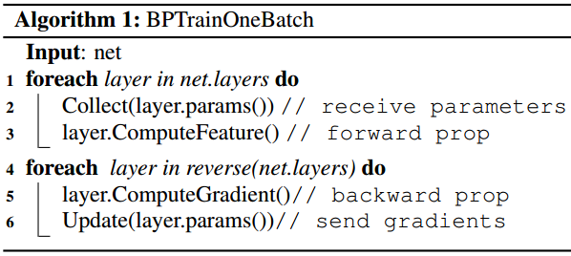
SINGA Programming Model
Note:
BP, BPTT and CD have different flows, so implement different TrainOneBatch
Notes:
TrainOneBatch component specifies a sequence of invoking Feature computation and Gradient computation
SINGA supports different algorithms (e.g., BP, BPTT, CD) for all 3 model categories (FW, Dir, UnDir).
This pseudocode is an example of BP.
1) Given a job configuration about cluster and network, workers call TrainOneBatch at each iteration
2) It computes features and the gradients, which are sent to the corresponding servers invoking Updater for parameter updates.
3) Then, at the next iteration, the workers fetch the updated parameters
This is how SINGA works

Slide 14
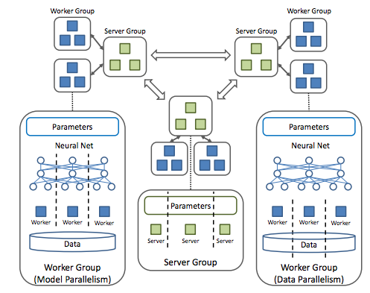
Distributed Training
Worker Group
Loads a subset of training data and
computes gradients for model replica
Workers within a group run synchronously
Different worker groups run asynchronously
Server Group
Maintains one ParamShard
Handles requests of multiple worker groups for parameter updates
Synchronize with neighboring groups
Notes:
Now, I will talk about system architecture more details.
As I explain, SINGA is designed in a worker-server architecture
It consists of two components, worker groups and server groups.
A Worker group loads a subset of training data
Worker groups run asynchronous to compute gradients.
Workers within one group run synchronously.
Each worker group runs for one model replica over a subset of training data.
Each server group takes care of some worker groups to update model parameters.
Server groups are connected according to cluster configuration. They may synchronize with neighbor groups periodically or following some rules.
Users can specify such cluster configuration by setting values
and implement different training frameworks.

Slide 15
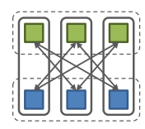
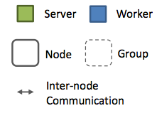
Synchronous Frameworks
Configuration for AllReduce (Baidu’s DeepImage)
1 worker group
1 server group
Co-locate worker and server
Notes:
Just by configuring cluster topology, users can use 4 popular training frameworks (as mentioned before)
For example, to implement the synchronous framework like AllReduce (Baidu DeepImage)
users will set 1 worker group and 1 server group.
So, all worker nodes run synchronously to compute the gradients for one mini-batch.
For this framework, we co-locate servers and workers in the same process.

Slide 16
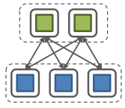
Synchronous Frameworks
Configuration for Sandblaster
Separate worker and server groups
1 server group
1 worker group
Notes:
If we separate workers and servers into different process, then we can implement the sandblaster framework (Google Brain)

Slide 17
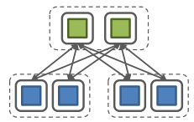
Asynchronous Frameworks
Configuration for Downpour
Separate worker and server groups
>=1 worker groups
1 server group
Notes:
Similar to sandblaster, if users configure multiple worker groups, which run in asynchronous manner.
Then we can implement Downpour framework.

Slide 18
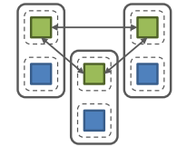
Asynchronous Frameworks
Configuration of distributed Hogwild
1 server group/procs
>=1 worker groups/procs
Co-locate worker and server
Share ParamShard
Notes:
Users can also implement distributed hogwild, implemented in Caffe
For this framework, users can set 1 server group and multiple worker groups per process
Parameter updates are done at local, so communication cost is minimized
However, server groups need to synchronize with each other periodically.
Like 4 popular training frameworks I showed, SINGA users can flexibly configure cluster topology as they want.

Slide 19
Outline
Part one
Background
SINGA
Overview
Programming Model
System Architecture
Experimental Study
Research Challenges
Conclusion
Part two
Basic user guide
Advanced user guide
Notes:
In this talk, I will talk about a bit of deep leaning background in terms of models and training frameworks
Then, I will give an overview of SINGA followed by its programming model and architecture
Also, I will show a few experiment results in terms of training efficiency comparing with other systems
Then, if time is allowed, I will talk about a few sample applications done with SINGA

Slide 20
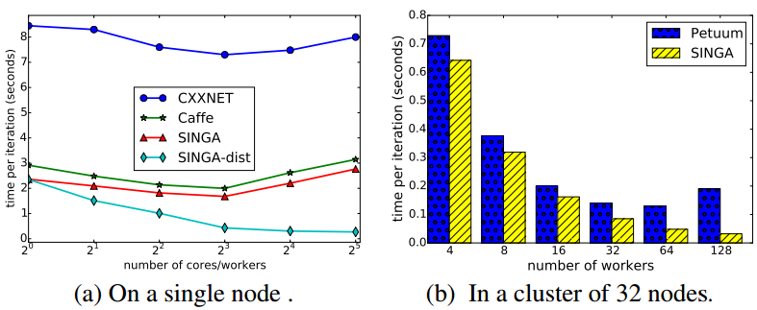
Experiment: Training Performance (Synchronous)
CIFAR10 dataset: 50K training and 10K test images.
For single node setting
a 24-core server with 500GB
“SINGA-dist”:
disable OpenBlas multi-threading
with Sandblaster topology
Notes:
Now, please let us show experimental results, comparing SINGA with CXXNET and CAFFE
In this experiment, We conducted synchronous training and asynchronous training
We utilize CIFAR10 dataset
First, this graph shows training time for 1 iteration on a single node
As you see, when we increase # of cores, all systems speed up their training time
However, when # of cores is larger than 8, it shows a poor scalability.
Actually, all system uses OpenBlas multi-threading feature for linear algebra operations.
This increase is due to the overhead for cross-cpu memory access.
However, SINGA is already multi-threaded (by launching multiple workers and servers), so we disabled OpenBlas multi-threading
SINGA-dist line is the results when we configure topology as Sandblaster
(1 server group with 4 servers, 1 worker group with different number of worker threads (x-axis)
(256 images per one-minibatch)
Reason:
OpenBlas cannot be fully optimized. It may parallelize only particular operations, e.g., matrix multiplications
SINGA-dist executes workers in parallel for whole iteration
Changing to multinodes setting
with AllReduce framework (topology)
1 worker group, 1 server group,
each node has 4 workers and 1 server
as # of nodes increases
- the size of worker group varies 4 – 128
- the size of server group varies 1 – 32
Petuum (it runs Caffe): up to 64 workers
Reason: communication overhead, synchronization delays

Slide 21
Experiment: Training Performance (Synchronous)
CIFAR10 dataset: 50K training and 10K test images.
For single node setting
a 24-core server with 500GB
“SINGA-dist”:
disable OpenBlas multi-threading
with Sandblaster topology
For multi nodes setting
a 32-node cluster
each node with a quad-core Intel Xeon 3.1 GHz CPU and 8G memory
with AllReduce topology
Notes:
For multi node setting
We compare SINGA with Petuum (distributed ML framework, and it runs Caffe)
(mini-batch-sizw 256 and 512)
We use a 32-node cluster, each node with a quad-core CPU and 8G memory
With AllReduce framework (topology)
1 worker group, 1 server group, each node has 4 workers and 1 server
Both system scale when # of workers increase
- the size of worker group varies 4 – 128
- the size of server group varies 1 – 32
However, Petuum scale only up to 64 nodes due to communication overhead and synchronization delay

Slide 22
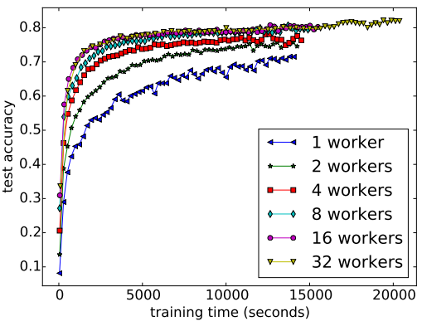
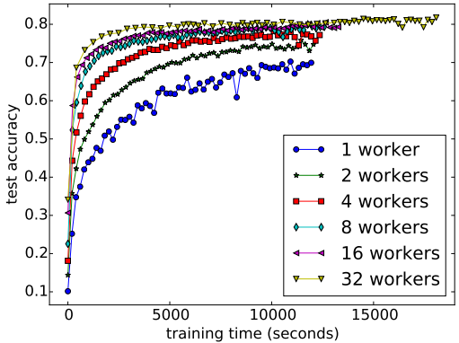
Experiment: Training Performance (Asynchronous)
60,000 iterations
Caffe on a single node
SINGA on a single node
Notes:
This slide shows results for asynchronous training
60K training iterations
X-axis indicates training time for 60K iterations, Y-axis indicates prediction accuracy
(Downpour framework: parameter updates are done by a single server (thread) in SINGA, workers in Caffe)
When increasing # of workers, Both systems scale well in terms of
time to reach the same accuracy (i.e., time reduces to reach a particular accuracy)
time to reach the final accuracy (i.e., accuracy is higher at the end of training)
For all cases, SINGA performs faster training

Slide 23
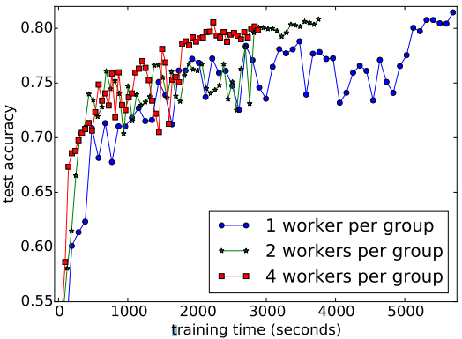
Experiment: Training Performance (Asynchronous)
60,000 iterations
Caffe on a single node
SINGA in cluster of 32 nodes
SINGA on a single node
Notes:
When we utilize a cluster of 32 nodes, we can dramatically reduce training time (e.g., to reach 80%)
Due to the delay of parameter synchronization, it does not stable
But, Training becomes faster because each worker processes fewer images
(Actually, it is a kind of distributed Downpour framework
with 32 worker groups
1 server group with 32 servers (1 server thread per node)

Slide 24
Challenge: Scalability
Problem
How to reduce the wall time to reach a certain accuracy by increasing cluster size?
Key factors
Efficiency of one training iteration, i.e., time per iteration
Convergence rate, i.e., number of training iterations
Solutions
Efficiency
Distributed training over one worker group
Hardware, e.g., GPU
Convergence rate
Numeric optimization
Multiple groups
Overhead of distributed training
communication would easily become the bottleneck
Parameter compression[8,9], elastic SGD[5], etc.
Notes:
[5] S. Zhang, A. Choromanska, and Y. LeCun. Deep learning with elastic averaging SGD. CoRR, abs/1412.6651, 2014
[10] C. Zhang and C. Re. Dimmwitted: A study of main-memory statistical analytics. PVLDB, 7(12):1283–1294, 2014.
[8] Matthieu Courbariaux, Yoshua Bengio, Jean-Pierre David. Low precision storage for deep learning. arXiv:1412.7024
[9] Frank Seide, Hao Fu, Jasha Droppo, Gang Li, and Dong Yu. 1-Bit Stochastic Gradient Descent and Application to Data-Parallel Distributed Training of Speech DNNs. 2014

Slide 25
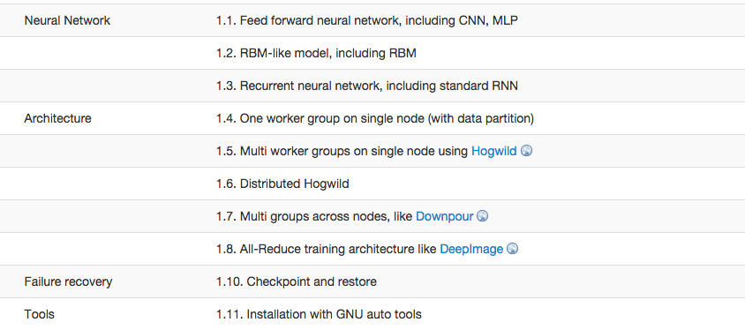
Conclusion: Current status

Slide 26
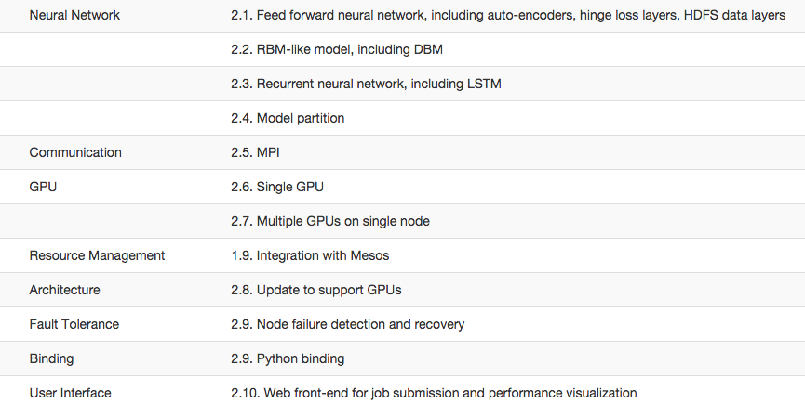
Feature Plan

Slide 27
References
[1] J. Dean, G. Corrado, R. Monga, K. Chen, M. Devin, Q. V. Le, M. Z. Mao, M. Ranzato, A. W. Senior, P. A. Tucker, K. Yang, and A. Y. Ng. Large scale distributed deep networks. In NIPS, pages 1232-1240,2012.
[2] R. Wu, S. Yan, Y. Shan, Q. Dang, and G. Sun. Deepimage: Scaling up image recognition. CoRR,
abs/1501.02876, 2015.
[3] B. Recht, C. Re, S. J. Wright, and F. Niu. Hogwild: A lock-free approach to parallelizing stochastic gradient descent. In NIPS, pages 693{701, 2011.
[4] Y. Jia, E. Shelhamer, J. Donahue, S. Karayev, J. Long, R. Girshick, S. Guadarrama, and T. Darrell. Caffe: Convolutional architecture for fast feature embedding. arXiv preprint arXiv:1408.5093, 2014.
[5] S. Zhang, A. Choromanska, and Y. LeCun. Deep learning with elastic averaging SGD. CoRR, abs/1412.6651, 2014
[6] D. C. Ciresan, U. Meier, L. M. Gambardella, and J. Schmidhuber. Deep big simple neural nets excel on handwritten digit recognition. CoRR, abs/1003.0358, 2010.
[7] D. Jiang, G. Chen, B. C. Ooi, K. Tan, and S. Wu. epic: an extensible and scalable system for processing big data. PVLDB, 7(7):541–552, 2014.
[8] Matthieu Courbariaux, Yoshua Bengio, Jean-Pierre David. Low precision storage for deep learning. arXiv:1412.7024
[9] Frank Seide, Hao Fu, Jasha Droppo, Gang Li, and Dong Yu. 1-Bit Stochastic Gradient Descent and Application to Data-Parallel Distributed Training of Speech DNNs. 2014
[10] C. Zhang and C. Re. Dimmwitted: A study of main-memory statistical analytics. PVLDB, 7(12):1283–1294, 2014.
[11] Nicolas Vasilache, Jeff Johnson, Michael Mathieu, Soumith Chintala, Serkan Piantino, Yann LeCun . Fast Convolutional Nets With fbfft: A GPU Performance Evaluation. 2015

