Slide 1
Mapping the Network Drive

Slide 2
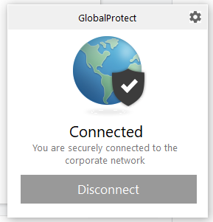
VPN Installation
https://wiki.albany.edu/display/public/askit/VPN+GlobalProtect+Service
Pick your operating system
Follow the instructions
When prompted, only put in your netID (no @ualbany.edu) and password
Should say connected

Slide 3
Windows Users
NOTE: You have to be connected to the VPN for this to work
Navigate to This PC
Click on Computer in the top left hand corner
Select Map Network Drive
In the folder option put in: \\storage.arcc.albany.edu\andamlab\bioinformatics_workshop
Click connect or finish and you will be prompted for your username and password
For username: UAlbany\YourNetID (UAlbany\ed547423 for example)
For password: Your password used for your NetID
You can now view all your folders on the HPCC in a nice file browser!

Slide 4
Mac Users
NOTE: You have to be connected to the VPN for this to work
Use command connect to server
Go -> Connect To Server
Input: cifs://storage.arcc.albany.edu/andamlab/bioinformatics_workshop
Username should be your netID
Password is the password associated with it
You can now view all your folders on the HPCC in a nice file browser!

