Slide 1
Corpora and Text Processing
USC VSoE CSCI 544: Applied Natural Language Processing
Jonathan May -- 梅約納
Nanyun (Violet) Peng -- 彭楠赟
August 24, 2018
Slides from Kristy Hollingshead-Seitz, Nathan Schneider, Dan Jurafsky

Slide 2
Homework 1 is available
Due Friday, 9/7 (Note: Homework 2 will become available Friday, 8/31)
Warmup to get familiar with Python, Vocareum, solving language problems
No special knowledge from lectures should be needed to work on it
Read the instructions carefully
Feel free to ask questions in Piazza!

Slide 3
Lot of Work on the Terminal Today
Get set up in Vocareum, on the 'In-class' assignment
Or download code/data from my webpage to your own machine
Mac: you'll probably need to install gnu stuff with homebrew/ports; preface non-working commands with 'g'
Windows: cygwin is usually pretty good but it's been a while for me...
We're going to code 'competitively': post your answers in Piazza

Slide 4
Pre-Statistical NLP
NLP (really, more like Computational Linguistics) through the 80s was mostly about modeling specific linguistic phenomena with code
Linguists/highly trained coders wrote fine-grained detailed rules to capture various aspects
E.g. "swallow" is a verb of ingestion, taking an animate subject and a physical object that is edible...
Very time-consuming, expensive, limited coverage, but high precision
Academically satisfying, but not good at producing systems beyond the demo phase
h/t K. Hollingshead-Seitz

Slide 5
The Alternative?
Empirical approach: learn by observing language as it's used "in the wild"
Many different names:
Corpus Linguistics
Empirical NLP
Statistical NLP
Central tools:
Corpus
Thing to count with (i.e. statistics)

Slide 6
Advantages
Generalize patterns as they actually exist (i.e. bottom-up, not top-down)
Little need for knowledge (just count)
Systems are robust and adaptable (change domain by changing corpus)
Systems degrade more gracefully (corner cases captured in data)
Evaluations are (more) meaningful

Slide 7
Limitations
Bound by data – can't model what you can't see
Big Data methods fail when the data is small
I just got finished trying to build an Oromo-English translation system in three weeks with 50,000 words of the bible...most MT is built on 10mw+
Tends to be more computationally expensive (but less human-expensive)
Usually a good trade-off, but it's application-dependent
But, a lot of effort was spent in coming up with rules that work well in certain corners
Mostly English
Mostly formal
Do what you need to, leverage the resources you have, consider trade-offs

Slide 8
It's all about the corpus!
Corpus (pl. corpora): a collection of (natural language) text systematically gathered and organized in some manner
Features
Size
Balanced/domain
Written/Spoken
Raw/Annotated
Free/Pay
Famous (Text) Examples
Brown Corpus: 1m words balanced English text, POS tags
Wall Street Journal: 1m words English news text, syntax trees
Canadian Hansards: 10m words French/English parliamentary text, aligned at sentence level
Clueweb 12: 100+b words English web text
Google books ngrams: 500B words

Slide 9
How Big Does It Need To Be?
We'd like to get examples of all linguistic phenomena, ideally several times so we know how likely they are to occur
How big should a corpus be to get every possible sentence in English?
Every possible idea?
Every 5-word phrase?
Every word?
None of these are possible!

Slide 10
Sparsity and Zipf's Law
Let's look at the frequencies of different words in a large text corpus
Assume "word" is a string of letters separated by spaces (oversimplification!)
h/t Nathan Schneider

Slide 11
Vocareum Demo
words and counts
Notes:
tell me the 10 most frequent words in tom sawyer and ho
look at word counts (how many appear once vs token count)
look at ngram counts

Slide 12
Reminder
Count the word types:
sed 's/ /\n/g' corpus | sort | uniq -c | grep –v "^$" | sort -k1nr
how many 1-count types? What % of all types?
how many tokens?
Count the ngram types:
paste 1grams <(tail -n+2 1grams) | sort | uniq –c | sort –k1nr
how many 1-count types? What % of all types?

Slide 22
Zipf's Law and n-grams
Sparsity keeps getting worse
Moby Dick
110927 tokens; 18971 types (17% of tokens); 11874 1-count (62.6% of types)
110927 3-grams; 103531 types (93% of tokens); 99150 1-count (95.7% of types)

Slide 24
Piazza Quiz: What is the review given to each (1-5 stars)

Slide 26
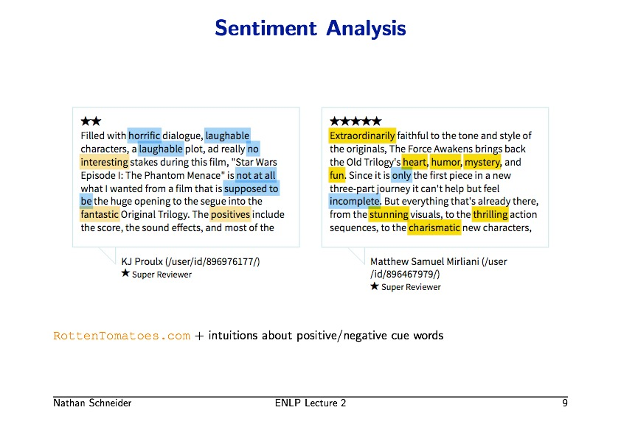
Notes:
Blue: Count of negative words
Yellow: Count of positive words

Slide 28
Notes:
Development set: is the set of data that we evaluate on

Slide 29
sentiment corpus: https://www.cs.jhu.edu/~mdredze/datasets/sentiment/

Slide 31
Notes:
Sometime accuracy won’t work this on some applications as a measure. What’s an example of an application?

Slide 32
Vocareum Demo
Extracting and labeling data
Building an evaluation set
Inspecting for ideas
Notes:
clean up some data with beautifulsoup
make train/dev/test sets with shuf, labeling (use yes!)
process substitution (not on vocareum)
make a scoring script
find frequent ngrams for positive and negative

Slide 33
Reminder
Cleaning up data
boilerplate python: very useful!
beautiful soup:
soup = bs(infile, "lxml")
soup.find_all('review_text')
Adding labels
paste elec.pos.txt <(yes "pos" | head -2198) > elec.pos.tagged

Slide 34
Reminder
Dividing into train, dev, blind test
cat elec.pos.tagged elec.neg.tagged | shuf > elec.mix.tagged
head -800 elec.mix.tagged > elec.devtest
tail -n+801 elec.mix.tagged > elec.train
head -400 elec.devtest > elec.dev
tail -400 elec.devtest > elec.test
for i in train dev test; do cut f1 elec.$i > elecdata/$i.input; cut -f2 elec.$i > elecdata/$i.label; done
World's simplest scorer and test
cat <(yes "pos" | head -200) <(yes "neg" | head -200) | shuf > dev.random
paste dev.random elecdata/dev.label | awk '$1==$2{hit++}END{printf("%f\n",hit/NR)}'
Notes:
These are analogues to the commands run in class but different names of files were used

Slide 37
Vocareum Demo
Human Experiment
Build a classifier
Notes:
take top 10 from training, ask for shout

Slide 43
Corpus Wrangling
We use corpora to extract features, rules, and statistics for our models
Even the cleanest corpora are noisy and most corpora aren't the cleanest
The following techniques are useful for getting 'clean' information from your data

Slide 44
Basic Text Processing
Regular Expressions
demos using regexpal.com
these slides from Jurafsky
Notes:
http://regexpal.com.s3-website-us-east-1.amazonaws.com/?_ga=2.62220396.1344291647.1503425670-931939134.1503425670
or
regexpal.com and click
We looked!
Then we saw him step in on the mat.
We looked!
And we saw him!
The Cat in the Hat!
The other one there, the blithe one
[Ww]
[em]
[A-Z]
[a-z]
[A-Za-z]
[ !]
(slide)
[^A-Z]
[^A-Za-z]
(slide)
looked|step
at|ook
(slide)
o
o+
^[A-Z]
[!.]$
\. vs .

Slide 45
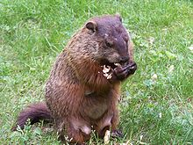
Regular expressions
A formal language for specifying text strings
How can we search for any of these?
woodchuck
woodchucks
Woodchuck
Woodchucks
Motivation: don't just find "happy" in a movie review, find all forms
happiness
happiest
but not unhappy

Slide 46
Regular Expressions: Disjunctions
Letters inside square brackets []
Ranges [A-Z]
Pattern | Matches
[wW]oodchuck | Woodchuck, woodchuck
[1234567890] | Any digit
Pattern | Matches
[A-Z] | An upper case letter | Drenched Blossoms
[a-z] | A lower case letter | my beans were impatient
[0-9] | A single digit | Chapter 1: Down the Rabbit Hole

Slide 47
Regular Expressions: Negation in Disjunction
Negations [^Ss]
Carat means negation only when first in []
Pattern | Matches
[^A-Z] | Not an upper case letter | Oyfn pripetchik
[^Ss] | Neither ‘S’ nor ‘s’ | I have no exquisite reason”
[^e^] | Neither e nor ^ | Look here
a^b | The pattern a carat b | Look up a^b now
Notes:
^e^ BUG

Slide 48
Regular Expressions: More Disjunction
Woodchuck is another name for groundhog!
The pipe | for disjunction
Pattern | Matches
groundhog|woodchuck
yours|mine | yours mine
a|b|c | = [abc]
[gG]roundhog|[Ww]oodchuck

Slide 49
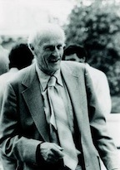
Regular Expressions: ? * + .
Pattern | Matches
colou?r | Optional previous char | color colour
oo*h! | 0 or more of previous char | oh! ooh! oooh! ooooh!
o+h! | 1 or more of previous char | oh! ooh! oooh! ooooh!
baa+ |  | baa baaa baaaa baaaaa
beg.n |  | begin begun begun beg3n
Stephen C Kleene
Kleene *, Kleene +

Slide 50
Regular Expressions: Anchors ^ $
Pattern | Matches
^[A-Z] | Palo Alto
^[^A-Za-z] | 1 “Hello”
\.$ | The end.
.$ | The end? The end!
\$\.\[\^\\ | $.[^\

Slide 51
Example
Find me all instances of the word “the” in a text.
the
Misses capitalized examples
[tT]he
Incorrectly returns other or theology
[^a-zA-Z][tT]he[^a-zA-Z]
Notes:
[Ww]
[em]
[A-Z]
[a-z]
[A-Za-z]
[ !]
(slide)
[^A-Z]
[^A-Za-z]
(slide)
looked|step
at|ook
(slide)
o
o+
^[A-Z]
[!.]$
\. vs .

Slide 52
Errors
The process we just went through was based on fixing two kinds of errors
Matching strings that we should not have matched (there, then, other)
False positives (Type I)
Not matching things that we should have matched (The)
False negatives (Type II)

Slide 53
Errors cont.
In NLP we are always dealing with these kinds of errors.
Reducing the error rate for an application often involves two antagonistic efforts:
Increasing accuracy or precision (minimizing false positives)
Increasing coverage or recall (minimizing false negatives).

Slide 54
Summary
Regular expressions play a surprisingly large role
Sophisticated sequences of regular expressions are often the first model for any text processing text
For many hard tasks, we use machine learning classifiers
But regular expressions are used as features in the classifiers
Can be very useful in capturing generalizations

Slide 55
Basic Text Processing
Word tokenization

Slide 56
Text Normalization
Every NLP task needs to do text normalization:
Segmenting/tokenizing words in running text
Normalizing word formats
Segmenting sentences in running text

Slide 57
How many words?
I do uh main- mainly business data processing
Fragments, filled pauses
Seuss’s cat in the hat is different from other cats!
Lemma: same stem, part of speech, rough word sense
cat and cats = same lemma
Wordform: the full inflected surface form
cat and cats = different wordforms

Slide 58
How many words?
they lay back on the San Francisco grass and looked at the stars and their
Type: an element of the vocabulary.
Token: an instance of that type in running text.
How many?
15 tokens (or 14)
13 types (or 12) (or 11?)

Slide 59
How many words?
N = number of tokens
V = vocabulary = set of types
|V| is the size of the vocabulary
Church and Gale (1990): |V| > O(N^{½})
 | Tokens = N | Types = |V|
Switchboard phone conversations | 2.4 million | 20 thousand
Shakespeare | 884,000 | 31 thousand
Google N-grams | 1 trillion | 13 million

Slide 60
We already did some basic tokenization
gsed 's/ /\n/g' sawyr11.txt | sort | uniq | less
We can see some problems...
"'Bout
"A
"AIN'T
...
America
America,
Douglas
Douglas'
Douglas'.
Douglas'."
Douglas,
Douglass,

Slide 61
Issues in Tokenization
Finland’s capital → Finland Finlands Finland’s ?
what’re, I’m, isn’t → What are, I am, is not
Hewlett-Packard → Hewlett Packard ?
state-of-the-art → state of the art ?
Lowercase → lower-case lowercase lower case ?
San Francisco → one token or two?
m.p.h., PhD. → ??

Slide 62
Tokenization: language issues
French
L'ensemble → one token or two?
L ? L’ ? Le ?
Want l’ensemble to match with un ensemble
German noun compounds are not segmented
Lebensversicherungsgesellschaftsangestellter
‘life insurance company employee’
German information retrieval needs compound splitter

Slide 63
Tokenization: language issues
Chinese and Japanese no spaces between words:
莎拉波娃现在居住在美国东南部的佛罗里达。
莎拉波娃 现在 居住 在 美国 东南部 的 佛罗里达
Sharapova now lives in US southeastern Florida
Further complicated in Japanese, with multiple alphabets intermingled
Dates/amounts in multiple formats
フォーチュン500社は情報不足のため時間あた$500K(約6,000万円)
Katakana
Hiragana
Kanji
Romaji
End-user can express query entirely in hiragana!

Slide 64
Word Tokenization in Chinese
Also called Word Segmentation
Chinese words are composed of characters
Characters are generally 1 syllable and 1 morpheme.
Average word is 2.4 characters long.
Standard baseline segmentation algorithm:
Maximum Matching (also called Greedy)

Slide 65
Maximum Matching Word Segmentation Algorithm
Given a wordlist of Chinese, and a string.
Start a pointer at the beginning of the string
Find the longest word in dictionary that matches the string starting at pointer
Move the pointer over the word in string
Go to 2

Slide 66
Max-match segmentation illustration
Thecatinthehat
Thetabledownthere
Doesn’t generally work in English!
But works astonishingly well in Chinese
莎拉波娃现在居住在美国东南部的佛罗里达。
莎拉波娃 现在 居住 在 美国 东南部 的 佛罗里达
Modern probabilistic segmentation algorithms even better
the cat in the hat
the cat int he hat
the table down there
theta bled own there

Slide 67
What About in English?
Usually a set of rules that are appropriate for the application
Can be implemented with regex!
Cheat (that you should use): nltk!
>>> import nltk >>> nltk.word_tokenize("This isn't much of--or indeed at all--a test.") ['This', 'is', "n't", 'much', 'of', '--', 'or', 'indeed', 'at', 'all', '--', 'a', 'test', '.']
Notes:
a="\"This isn't the first sentence that I wrote (that one was at 8:30), but it's the best, right?!\""
nltk.word_tokenize
write quick tokenizer
outfile.write(' '.join(nltk.word_tokenize(line.strip()))+"\n")

