Slide 1
Lecture 7: Syntax And CKY Parser
USC CSCI 544: Applied Natural Language Processing
Nanyun (Violet) Peng -- 彭楠赟
September 12, 2018
based on slides of Jason Eisner

Slide 2
Credits/Further Reading
Michael Collins’ notes:
http://www.cs.columbia.edu/~mcollins/courses/nlp2011/notes/pcfgs.pdf
http://www.cs.columbia.edu/~mcollins/courses/nlp2011/notes/lexpcfgs.pdf
Luke Zettlemoyer’s/Dan Klein’s notes:
http://homes.cs.washington.edu/~lsz/lectures/parsing.pdf
Yoav Goldberg’s notes:
http://u.cs.biu.ac.il/~89-680/parsing-and-cky.pdf
Jason Eisner’s notes:
http://u.cs.biu.ac.il/~89-680/eisner-parse.pdf
Chris Manning’s lectures:
http://nlp.stanford.edu/courses/lsa354/
Klein and Manning on parsing:
http://www.cs.berkeley.edu/~klein/papers/unlexicalized-parsing.pdf

Slide 3
Levels of Language
Phonetics/phonology/morphology: what words (or subwords) are we dealing with?
Syntax: What phrases are we dealing with? Which words modify one another?
Semantics: What’s the literal meaning?
Pragmatics: What should you conclude from the fact that I said something? How should you react?

Slide 4
Syntax
“Hexy planars garumphed by the snox three zamfirs ago.”
What kind of planars are being discussed?
Why do you know that?

Slide 5
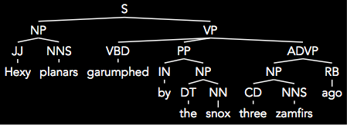
Syntax
The characteristics of the words and their relative location to each other allow us to generate this interpretation even though we don’t really understand the sentence
Goal of parsing is to write a computer program to generate this automatically.

Slide 6
What is Parsing?
S → NP VP
NP → Det N
NP → NP PP
VP → V NP
VP → VP PP
PP → P NP
NP → Papa
N → caviar
N → spoon
V → spoon
V → ate
P → with
Det → the
Det → a
S
NP
VP
VP
PP
V
NP
P
NP
Det
N
Det
N
Papa
ate
the
caviar
with
a
spoon

Slide 7
What is Parsing?
S → NP VP
NP → Det N
NP → NP PP
VP → V NP
VP → VP PP
PP → P NP
NP → Papa
N → caviar
N → spoon
V → spoon
V → ate
P → with
Det → the
Det → a
S
NP
VP
Papa
VP
PP
V
NP
P
NP
ate
Det
N
with
Det
N
the
caviar
a
spoon

Slide 8
Programming languages
printf ("/charset [%s",
(re_opcode_t) *(p - 1) == charset_not ? "^" : "");
assert (p + *p < pend);
for (c = 0; c < 256; c++)
if (c / 8 < *p && (p[1 + (c/8)] & (1 << (c % 8)))) {
/* Are we starting a range? */
if (last + 1 == c && ! inrange) {
putchar ('-');
inrange = 1;
}
/* Have we broken a range? */
else if (last + 1 != c && inrange) {
putchar (last);
inrange = 0;
}
if (! inrange)
putchar (c);
last = c;
}
Easy to parse.
Designed that way!
Notes:
Let me start with a few words on parsing.
This is random code from Emacs, so if you see anything you like, it’s yours.
It’s written in an artificial language, designed to be easy to parse. Not completely trivial - we can’t tell whether (re_opcode_t) * (p-1) is a pointer cast or a mulitiplication, without some more context. But the scope of the ifs and fors is clearly marked. So is order of operations.

Slide 9
Natural languages
printf "/charset %s", re_opcode_t *p - 1 == charset_not ? "^" : ""; assert p + *p < pend; for c = 0; c < 256; c++ if c / 8 < *p && p1 + c/8 & 1 << c % 8 Are we starting a range? if last + 1 == c && ! inrange putchar '-'; inrange = 1; Have we broken a range? else if last + 1 != c && inrange putchar last; inrange = 0; if ! inrange putchar c; last = c;
No {} () [] to indicate scope & precedence
Lots of overloading (arity varies)
Grammar isn’t known in advance!
Context-free grammar not best formalism
Notes:
To get some flavor for why natural language is harder , think about parsing
this. Same code, but now we have no parentheses or indentation. Without that information, this is wildly ambiguous.
There are many other reasons why natural languages are subtle and difficult, but maybe the biggest - and most important for today - is function overloading. The English verb “bet”, B-E-T, can be either a noun or a verb, and as a verb it can take from 1 to 4 arguments: “I, would bet, you, five dollars, that it’s got four arguments.” But you can also say “you bet!”
Finally, you didn’t design the language, so you don’t know the grammar in advance. In fact, there’s a long-standing question as to what class of grammars is even appropriate for natural languages.

Slide 10
Ambiguity
S → NP VP
NP → Det N
NP → NP PP
VP → V NP
VP → VP PP
PP → P NP
S
NP → Papa
N → caviar
N → spoon
V → spoon
V → ate
P → with
Det → the
Det → a
NP
VP
Papa
VP
PP
V
NP
P
NP
ate
Det
N
with
Det
N
the
caviar
a
spoon

Slide 11
Ambiguity
S → NP VP
NP → Det N
NP → NP PP
VP → V NP
VP → VP PP
PP → P NP
S
NP → Papa
N → caviar
N → spoon
V → spoon
V → ate
P → with
Det → the
Det → a
NP
VP
Papa
V
NP
ate
NP
PP
Det
N
P
NP
the
caviar
with
Det
N
a
spoon

Slide 12
The parsing problem
correct test trees
P
A
R
S
E
R
s
c
o
r
e
r
accuracy
test
sentences
Recent parsers quite accurate
… good enough to help a range of NLP tasks!
Grammar
Notes:
That’s why parsing is hard; here’s what a parser does. We feed it some sentences. For each sentence, it consults its grammar, and produces a tree whose leaves are the sentence’s words, and whose structure is intended to be helpful.
If you want to see how good the parser is, feed it some test sentences, and using your favorite scoring method, compare the output trees to an answer key of trees produced by a human. Suffice it to say that the recent crop of parsers is quite accurate. Most sentences are parsed correctly, or with one error

Slide 13
Applications of parsing (1/2)
Warning: these slides are out of date
Machine translation (Alshawi 1996, Wu 1997, ...)
tree
operations
English
Chinese
Speech synthesis from parses (Prevost 1996)
The government plans to raise income tax.
The government plans to raise income tax the imagination.
Speech recognition using parsing (Chelba et al 1998)
Put the file in the folder.
Put the file and the folder.
Notes:
So why is accurate parsing a good thing? Many hard natural language problems become somewhat easier once you can parse the input.
(MT) If you want to translate sentences, it helps to parse them first, because the manipulations that turn English into Chinese are more easily defined or learned over trees than over sentences.
(SS) If you want your machine to read your email to you over the phone with perfect elocution, then it had better be careful with the following apparently similar strings: (read). These similar strings have very different intonation because they have very different parses. So again, computing intonation from the parse is much easier.
(SR) It’s recently been demonstrated that parsing helps in speech recognition. Commercial speech recognizers will mix up these sentences, because they sound the same and each is locally well-formed within a three-word window. But the first transcription is much more likely for syntactic reasons. A recognizer that parses as it goes will prefer the first transcription.

Slide 14
Applications of parsing (2/2)
Warning: these slides are out of date
Grammar checking (Microsoft)
Indexing for information retrieval (Woods 1997)
... washing a car with a hose ... vehicle maintenance
Information extraction (Hobbs 1996)
NY Times
archive
Database
query
Notes:
(GC) Microsoft is doing a lot of work on parsing, in part to improve the grammar checker in MS Word.
(IR) There are Information Retrieval systems that use light parsing to get really great results in user tests. If your document says “washing a car with a hose,” the system will pick out this phrase and construct up a bunch of ways to index it, including “vehicle maintenance.”
(IE) Finally, there’s so much information out there on the web. If we parse it, we should be able to read all kinds of useful information off the parse trees, both in general and for specific queries. Informative queries are easier to write over parse trees than over strings.

Slide 15
Parsing → Compositional Semantics
+
3
*
5
6
E
E
F
E
N
+
E
F
E
3
N
*
N
5
6
600.465 - Intro to NLP - J. Eisner
15
What is meaning of 3+5*6?
First parse it into 3+(5*6)

Slide 16
Parsing → Compositional Semantics
+
33
3
3
*
30
5
5
6
6
E
33
E
F
E
30
3
N
+
E
F
E
add
3
5
N
*
N
6
mult
5
6
600.465 - Intro to NLP - J. Eisner
16
What is meaning of 3+5*6?
First parse it into 3+(5*6)
Now give a meaning to each node in the tree (bottom-up)

Slide 17
Parsing
Now let’s develop some parsing algorithms!
What substrings of this sentence are NPs?
Which substrings could be NPs in the right context?
Which substrings could be other types of phrases?
How would you defend a substring on your list?
0
1
2
3
4
5
6
7
8
9
The government plans to raise income
tax
are unpopular
Notes:
Plans, raise, tax

Slide 18
“Papa ate the caviar with a spoon”
0
1
2
3
4
5
6
7
S → NP VP
NP → Det N
NP → NP PP
VP → V NP
VP → VP PP
PP → P NP
NP → Papa
N → caviar
N → spoon
V → spoon
V → ate
P → with
Det → the
Det → a

Slide 19
First try … does it work?
“Papa ate the caviar with a spoon”
0
1
2
3
4
5
6
7
for each constituent on the LIST (Y i mid)
scan the LIST for an adjacent constituent (Z mid j)
if grammar has a rule to combine them (X → Y Z)
then add the result to the LIST (X i j)
Notes:
2 questions: how to define (initialize) the constituents? How to produce the whole tree?

Slide 20
Second try …
“Papa ate the caviar with a spoon”
0
1
2
3
4
5
6
7
initialize the list with parts-of-speech (T j-1 j) where T is a preterminal tag (like Noun) for the J^{th} word
for each constituent on the LIST (Y i mid)
scan the LIST for an adjacent constituent (Z mid j)
if grammar has a rule to combine them (X → Y Z)
then add the result to the LIST (X i j)
if the above loop added anything, do it again! (so that X i j gets a chance to combine or be combined with)

Slide 21
Third Try…
“Papa ate the caviar with a spoon”
0
1
2
3
4
5
6
7
initialize the list with parts-of-speech (T j-1 j)
for each constituent on the LIST (Y i mid)
for each adjacent constituent on the list (Z mid j)
for each rule to combine them (X → Y Z)
add the result to the LIST (X i j)
if it’s not already there
if the above loop added anything, do it again! (so that X i j gets a chance to combine or be combined with)

Slide 22
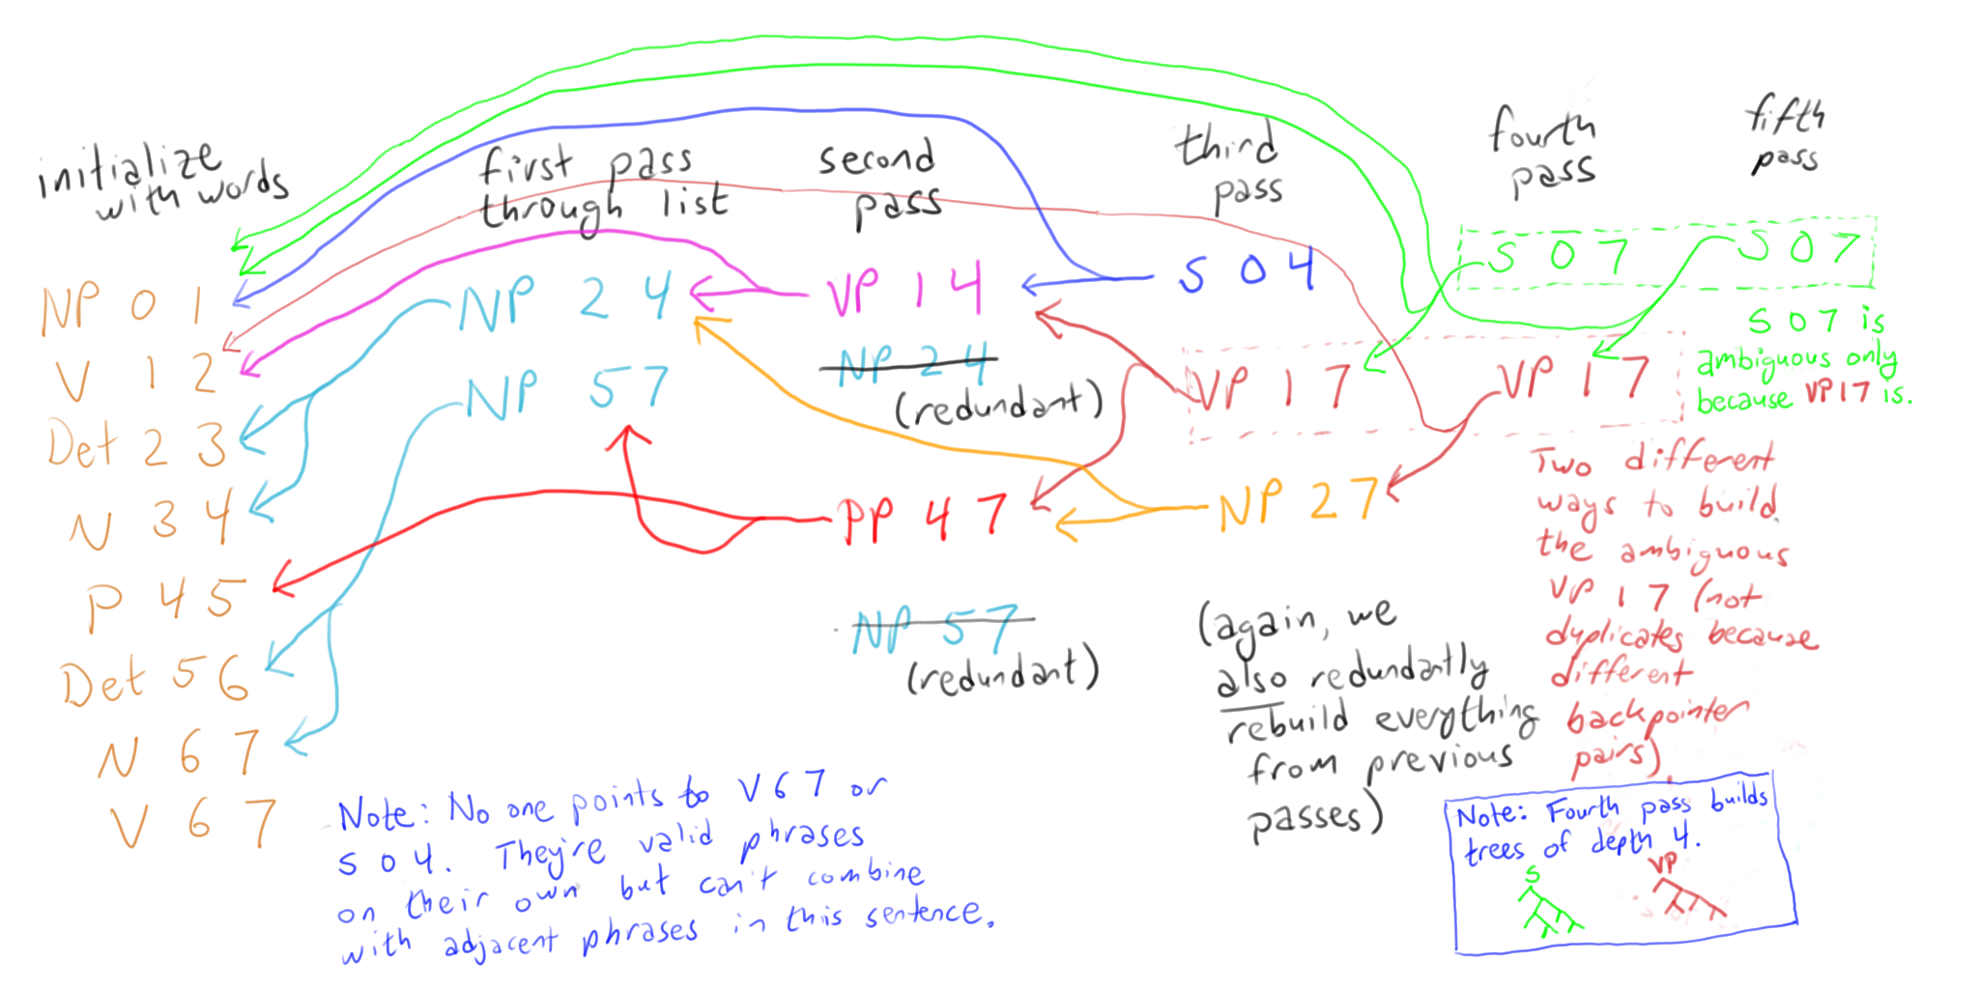
Follow backpointers to get the parse
0
1
2
3
4
5
6
7
“Papa ate the caviar with a spoon”

Slide 23
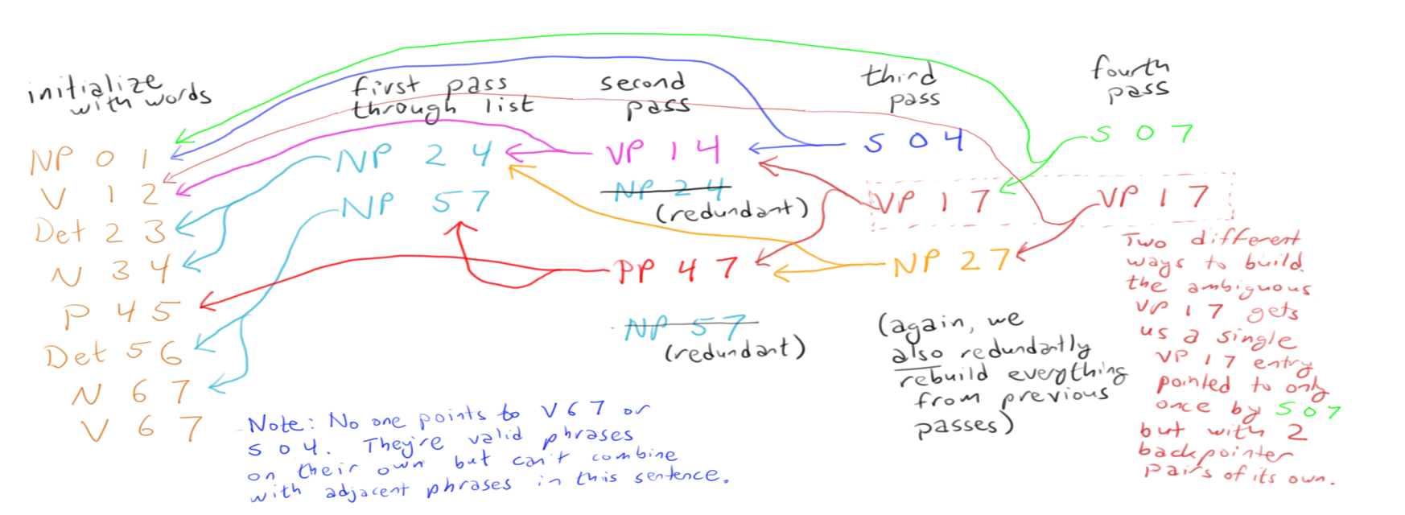
Turn sideways: See the trees?
“Papa ate the caviar with a spoon”

Slide 24
Correct but inefficient …
We kept checking the same pairs that we’d checked before (both bad and good pairs)
Can’t we manage the process in a way that avoids duplicate work?
Right phrase
 | old | new
old | old pair | new pair
new | new pair | new pair
Left phrase

Slide 25
Correct but inefficient …
We kept checking the same pairs that we’d checked before (both bad and good pairs)
Can’t we manage the process in a way that avoids duplicate work?
And even finding new pairs was expensive because we had to scan the whole list
Can’t we have some kind of index that will help us find adjacent pairs?

Slide 26

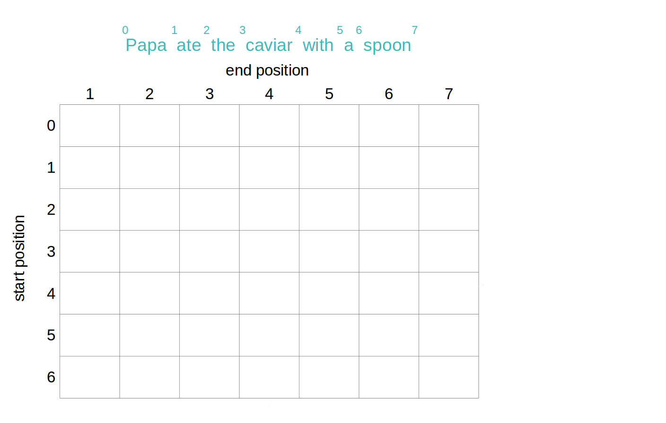
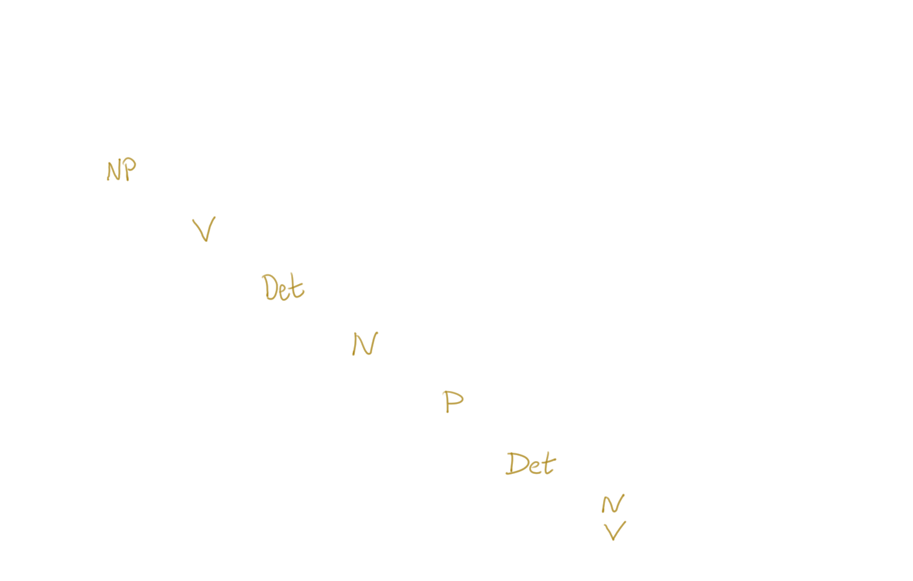
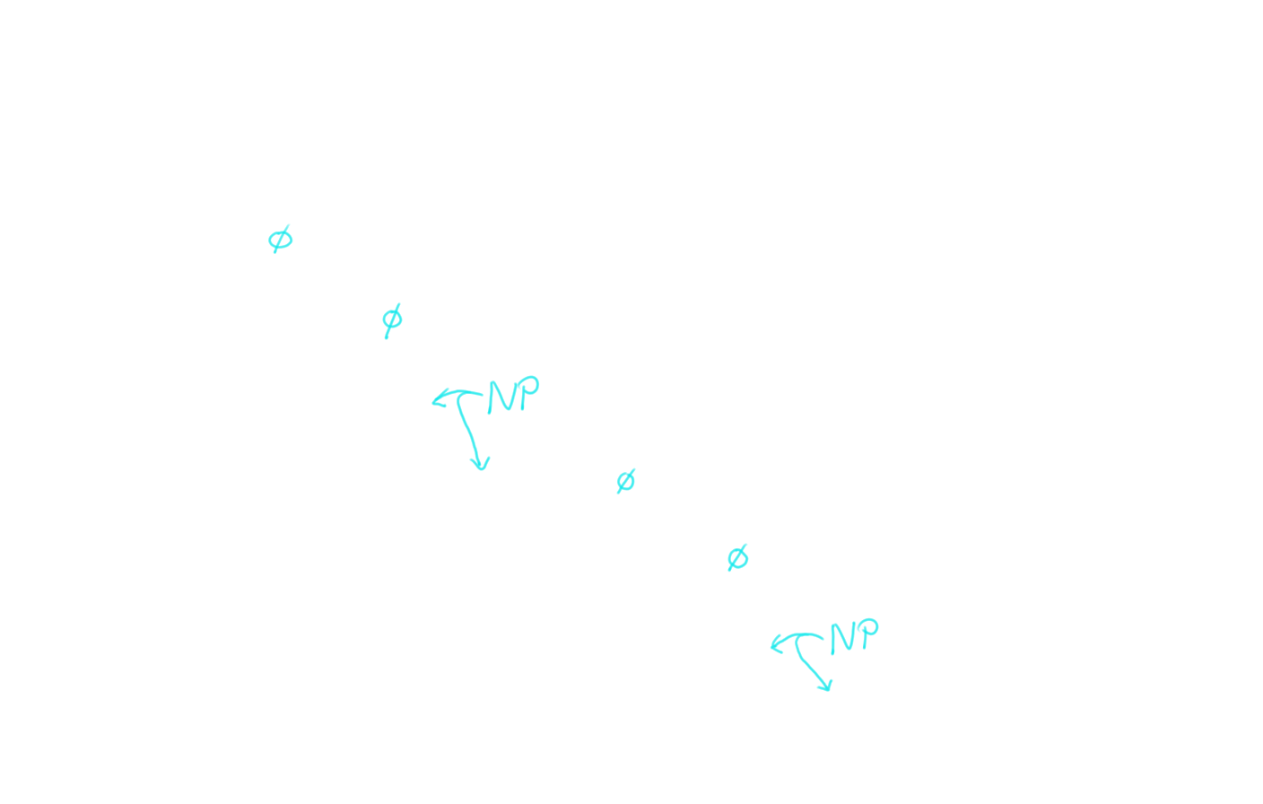
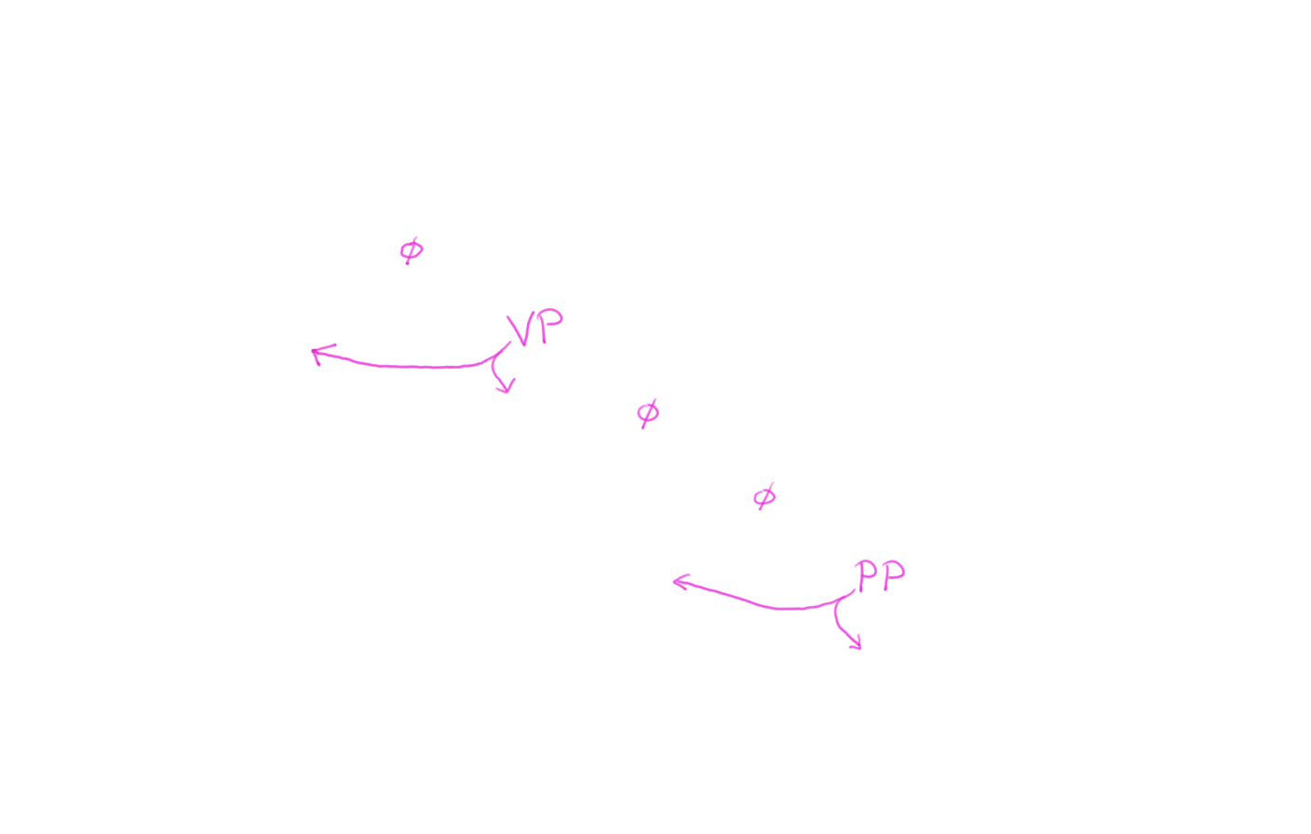
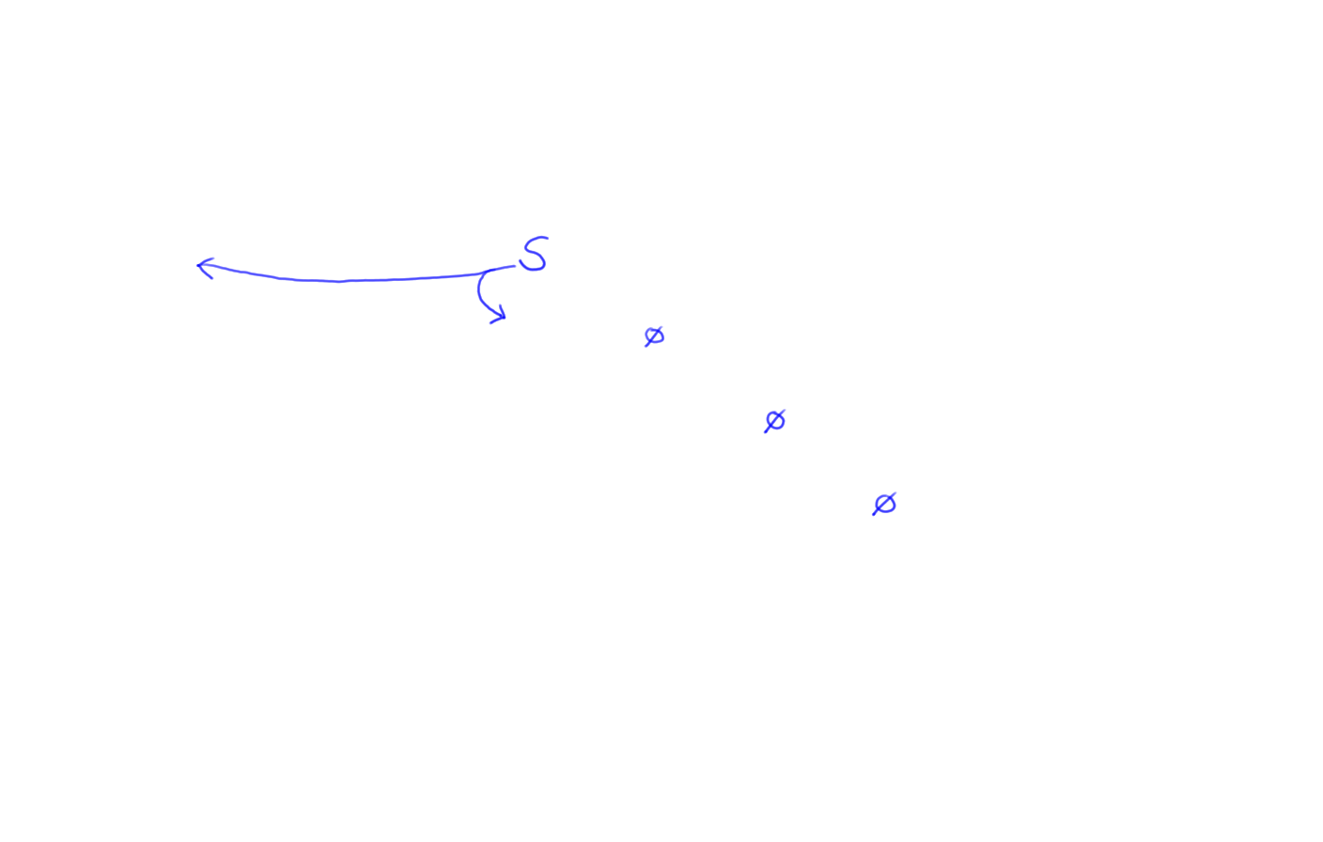
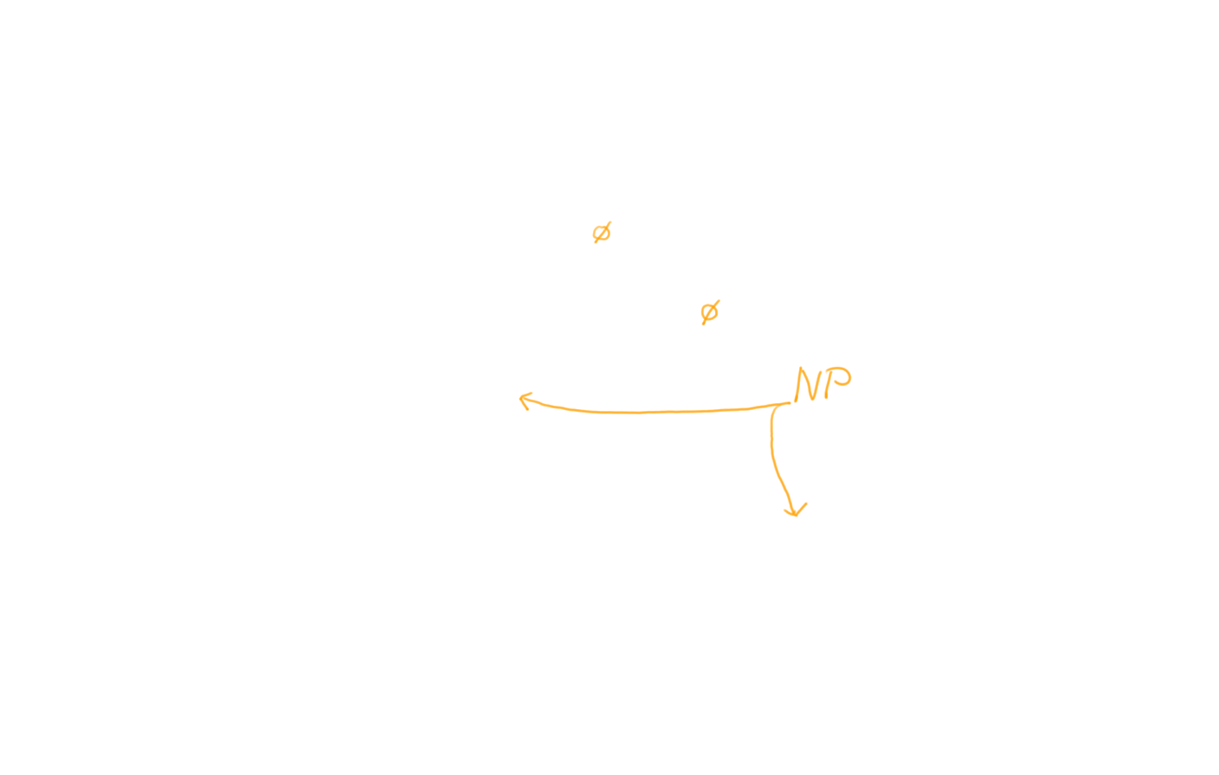
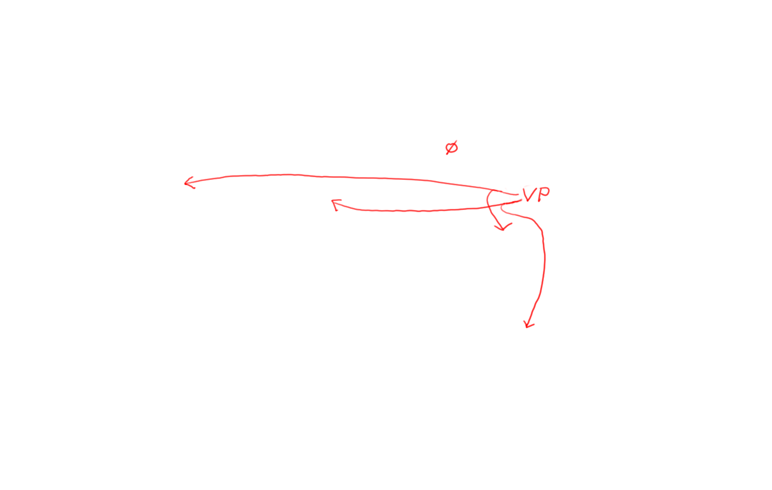
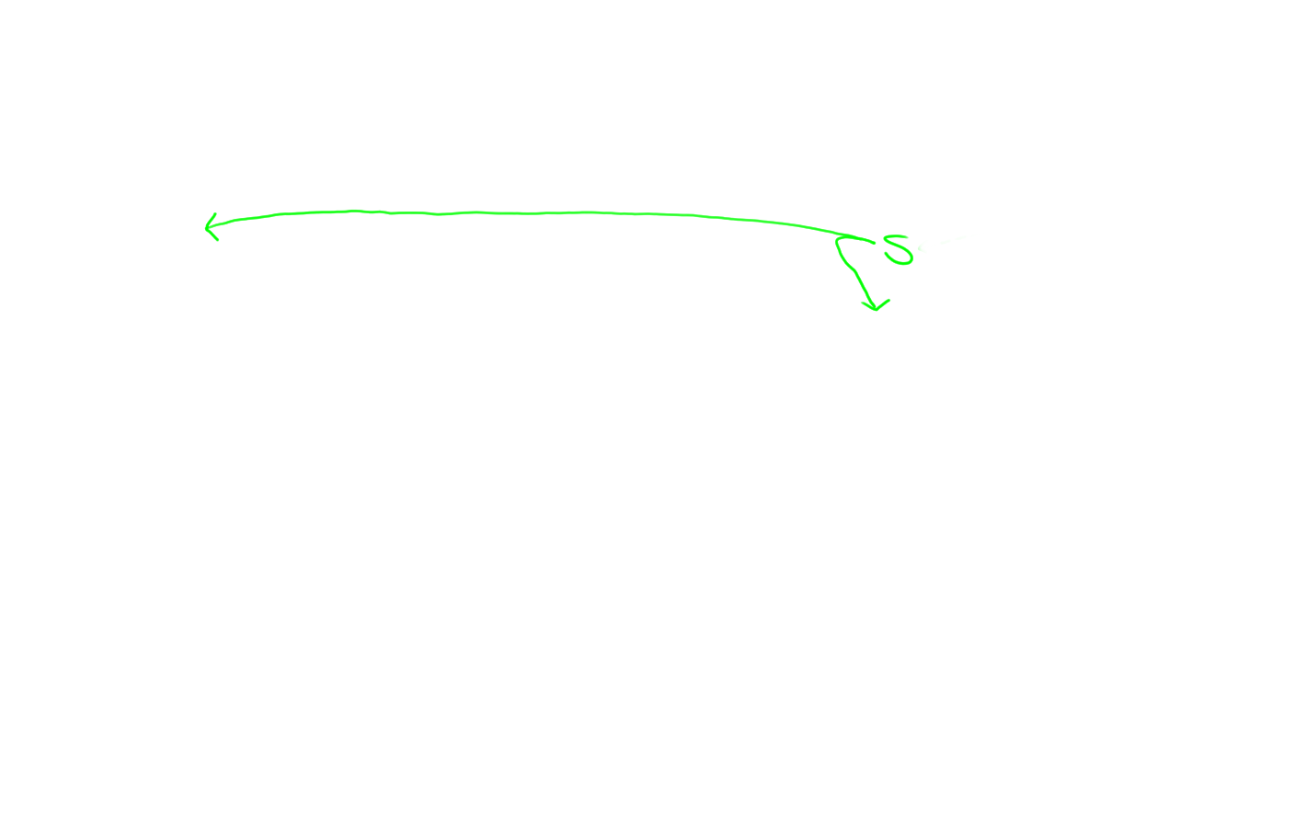
Indexing: Store S 0 4 in chart[0,4]

Slide 27
Avoid duplicate work: Build width-1, then width-2, etc.

Slide 28
How do we build a width-6 phrase? (after building and indexing all shorter phrases)
?
1 7 =
1 2 + 2 7 ☺
1 3 + 3 7
1 4 + 4 7 ☺
1 5 + 5 7
1 6 + 6 7

Slide 29
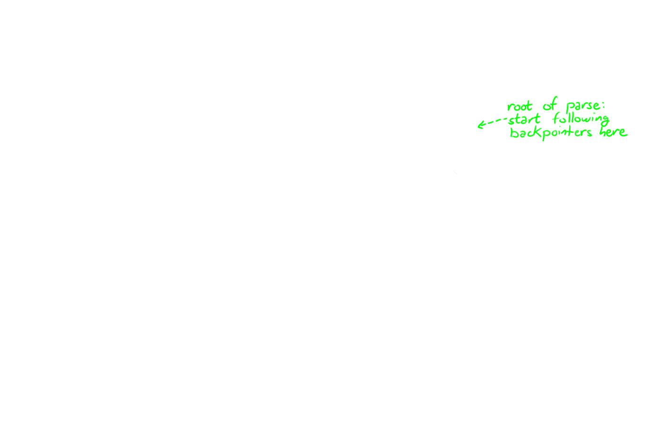
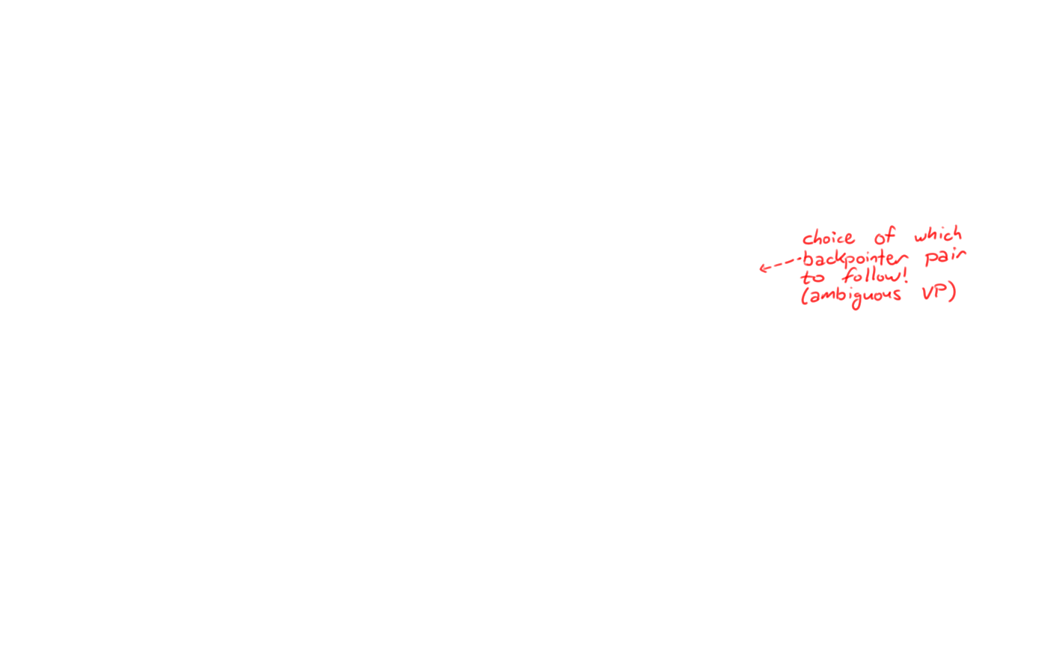
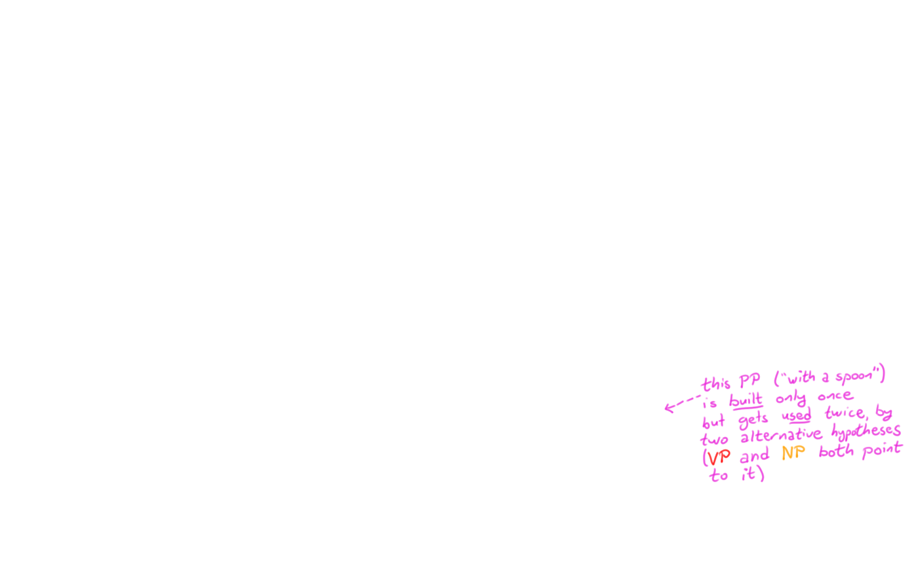
Avoid duplicate work: Build width-1, then width-2, etc.

Slide 30
CKY algorithm, recognizer version
Input: string of n words
Output: yes/no (since it’s only a recognizer)
Data structure: n × n table
rows labeled 0 to n-1
columns labeled 1 to n
cell [i,j] lists constituents found between i and j
Basic idea: fill in width-1 cells, then width-2, …

Slide 31

“Papa ate the caviar with a spoon”
1
2
3
4
5
6
7
0
[0,1]
[0,2]
[0,3]
[0,4]
[0,5]
[0,6]
[0,7]
1
[1,2]
[1,3]
[1,4]
[1,5]
[1,6]
[1,7]
S → NP VP
NP → Det N
NP → NP PP
VP → V NP
VP → VP PP
PP → P NP
NP → Papa
N → caviar
N → spoon
V → spoon
V → ate
P → with
Det → the
Det → a
2
[2,3]
[2,4]
[2,5]
[2,6]
[2,7]
Length 1
3
[3,4]
[3,5]
[3,6]
[3,7]
4
[4,5]
[4,6]
[4,7]
5
[5,6]
[5,7]
6
[6,7]

Slide 32
“Papa ate the caviar with a spoon”
1
2
3
4
5
6
7
0
[0,1]
[0,2]
[0,3]
[0,4]
[0,5]
[0,6]
[0,7]
1
[1,2]
[1,3]
[1,4]
[1,5]
[1,6]
[1,7]
S → NP VP
NP → Det N
NP → NP PP
VP → V NP
VP → VP PP
PP → P NP
NP → Papa
N → caviar
N → spoon
V → spoon
V → ate
P → with
Det → the
Det → a
2
Length 2
[2,3]
[2,4]
[2,5]
[2,6]
[2,7]
3
[3,4]
[3,5]
[3,6]
[3,7]
4
[4,5]
[4,6]
[4,7]
5
[5,6]
[5,7]
6
[6,7]

Slide 33
“Papa ate the caviar with a spoon”
1
2
3
4
5
6
7
0
[0,1]
[0,2]
[0,3]
[0,4]
[0,5]
[0,6]
[0,7]
1
[1,2]
[1,3]
[1,4]
[1,5]
[1,6]
[1,7]
S → NP VP
NP → Det N
NP → NP PP
VP → V NP
VP → VP PP
PP → P NP
NP → Papa
N → caviar
N → spoon
V → spoon
V → ate
P → with
Det → the
Det → a
Length 3
2
[2,3]
[2,4]
[2,5]
[2,6]
[2,7]
3
[3,4]
[3,5]
[3,6]
[3,7]
4
[4,5]
[4,6]
[4,7]
5
[5,6]
[5,7]
6
[6,7]

Slide 34
“Papa ate the caviar with a spoon”
1
2
3
4
5
6
7
0
[0,1]
[0,2]
[0,3]
[0,4]
[0,5]
[0,6]
[0,7]
1
[1,2]
[1,3]
Length 4
S → NP VP
NP → Det N
NP → NP PP
VP → V NP
VP → VP PP
PP → P NP
NP → Papa
N → caviar
N → spoon
V → spoon
V → ate
P → with
Det → the
Det → a
[1,4]
[1,5]
[1,6]
[1,7]
2
[2,3]
[2,4]
[2,5]
[2,6]
[2,7]
3
[3,4]
[3,5]
[3,6]
[3,7]
4
[4,5]
[4,6]
[4,7]
5
[5,6]
[5,7]
6
[6,7]

Slide 35
“Papa ate the caviar with a spoon”
1
2
3
4
5
6
7
0
[0,1]
[0,2]
[0,3]
[0,4]
[0,5]
[0,6]
[0,7]
Length 5
1
[1,2]
[1,3]
[1,4]
[1,5]
[1,6]
[1,7]
S → NP VP
NP → Det N
NP → NP PP
VP → V NP
VP → VP PP
PP → P NP
NP → Papa
N → caviar
N → spoon
V → spoon
V → ate
P → with
Det → the
Det → a
2
[2,3]
[2,4]
[2,5]
[2,6]
[2,7]
3
[3,4]
[3,5]
[3,6]
[3,7]
4
[4,5]
[4,6]
[4,7]
5
[5,6]
[5,7]
6
[6,7]

Slide 36
“Papa ate the caviar with a spoon”
1
2
3
4
5
6
7
0
[0,1]
[0,2]
[0,3]
[0,4]
[0,5]
[0,6]
[0,7]
Length 6
1
[1,2]
[1,3]
[1,4]
[1,5]
[1,6]
[1,7]
S → NP VP
NP → Det N
NP → NP PP
VP → V NP
VP → VP PP
PP → P NP
NP → Papa
N → caviar
N → spoon
V → spoon
V → ate
P → with
Det → the
Det → a
2
[2,3]
[2,4]
[2,5]
[2,6]
[2,7]
3
[3,4]
[3,5]
[3,6]
[3,7]
4
[4,5]
[4,6]
[4,7]
5
[5,6]
[5,7]
6
[6,7]

Slide 37
“Papa ate the caviar with a spoon”
1
2
3
4
5
6
7
Len 7
0
[0,1]
[0,2]
[0,3]
[0,4]
[0,5]
[0,6]
[0,7]
1
[1,2]
[1,3]
[1,4]
[1,5]
[1,6]
[1,7]
S → NP VP
NP → Det N
NP → NP PP
VP → V NP
VP → VP PP
PP → P NP
NP → Papa
N → caviar
N → spoon
V → spoon
V → ate
P → with
Det → the
Det → a
2
[2,3]
[2,4]
[2,5]
[2,6]
[2,7]
3
[3,4]
[3,5]
[3,6]
[3,7]
4
[4,5]
[4,6]
[4,7]
5
[5,6]
[5,7]
6
[6,7]

Slide 38
Avoid duplicate work: Build width-1, then width-2, etc.
S → NP VP
NP → Det N
NP → NP PP
VP → V NP
VP → VP PP
PP → P NP
NP → Papa
N → caviar
N → spoon
V → spoon
V → ate
P → with
Det → the
Det → a
Notes:
Pause and have people write the psuedo code

Slide 39
CKY algorithm, recognizer version
for J := 1 to n
Add to [J-1,J] all categories for the J^{th} word
for width := 2 to n
for start := 0 to n-width // this is I
Define end := start + width // this is J
for mid := start+1 to end-1 // find all I-to-J phrases
for every nonterminal Y in [start,mid]
for every nonterminal Z in [mid,end]
for all nonterminals X
if X → Y Z is in the grammar
then add X to [start,end]

Slide 40
Loose ends to tie up (no slides)
What’s the space?
Duplicate entries?
How many parses could there be?
Can we fix this?
What’s the runtime?

Slide 41
CKY algorithm, recognizer version
for J := 1 to n
Add to [J-1,J] all categories for the J^{th} word
for width := 2 to n
for start := 0 to n-width // this is I
Define end := start + width // this is J
for mid := start+1 to end-1 // find all I-to-J phrases
for every nonterminal Y in [start,mid]
for every nonterminal Z in [mid,end]
for all nonterminals X
if X → Y Z is in the grammar
then add X to [start,end]

Slide 42
CKY algorithm, recognizer version
for J := 1 to n
Add to [J-1,J] all categories for the J^{th} word
for width := 2 to n
for start := 0 to n-width // this is I
Define end := start + width // this is J
for mid := start+1 to end-1 // find all I-to-J phrases
for every nonterminal Y in [start,mid]
for every nonterminal Z in [mid,end]
for every X → Y Z in the grammar
add X to [start,end]

Slide 43
CKY algorithm, recognizer version
for J := 1 to n
Add to [J-1,J] all categories for the J^{th} word
for width := 2 to n
for start := 0 to n-width // this is I
Define end := start + width // this is J
for mid := start+1 to end-1 // find all I-to-J phrases
for every nonterminal Y in [start,mid]
for every X → Y Z in the grammar
if Z in [mid,end]
then add X to [start,end]

Slide 44
Alternative version of inner loops
for J := 1 to n
Add to [J-1,J] all categories for the J^{th} word
for width := 2 to n
for start := 0 to n-width // this is I
Define end := start + width // this is J
for mid := start+1 to end-1 // find all I-to-J phrases
for every rule X → Y Z in the grammar
if Y in [start,mid] and Z in [mid,end]
then add X to [start,end]

Slide 45
CKY
for J := 1 to n
Add to [J-1,J] all categories for the J^{th} word
for width := 2 to n
for start := 0 to n-width // this is I
Define end := start + width // this is J
for mid := start+1 to end-1 // find all I-to-J phrases
for every nonterminal Y in [start,mid]
for every nonterminal Z in [mid,end]
for every X → Y Z in the grammar
add X to [start,end]

Slide 46
Incremental CKY: Visit columns left to right and fill each bottom-up
for J := 1 to n
Add to [J-1,J] all categories for the J^{th} word
for end := 2 to n // this is J
for width := 2 to end
Define start := end - width // this is I
for mid := start+1 to end-1 // find all I-to-J phrases
for every nonterminal Y in [start,mid]
for every nonterminal Z in [mid,end]
for every X → Y Z in the grammar
add X to [start,end]

Slide 47
CKY Parsing
Reasonably efficient
Easy to code
Easily extendable to weighted case
Requires Chomsky Normal Form
X
Y Z
X
x
nonterminal rule
terminal rule
Notes:
What is the Chomsky Normal Form?

Slide 48
Other things to do with CKY
Grammar check: whether we can parse a grammar tree for the input sentence?
Generate entire forest of trees: Keep all backpointers instead of just one
Count trees: ambiguity analysis

Slide 49
Penn Treebank (Marcus et al., 93)
Goal: investigate the syntactic phenomena that naturally occur
1 million words of English Wall Street Journal text in 40,000 sentences, annotated with syntactic structure
$1/word
Since then, treebanks have been created for many other languages

Slide 50
Why make the Treebank?
Before this it was common for linguists to declare what constituted a legitimate sentence structure in a language (this is a gross simplification).
The Treebank provides a documentation of how (a very specific subset of) people actually structure English.
Constructed with this goal: given a new sentence, can we automatically put the tree on top? (i.e. syntactic parsing)

Slide 51
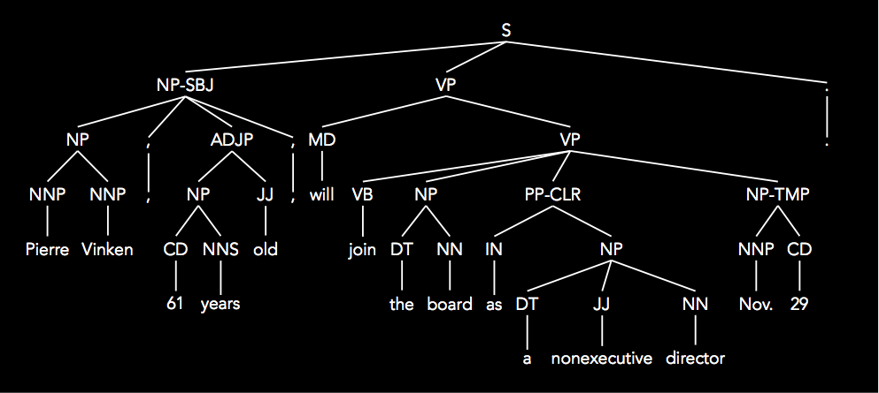
(S
(NP-SBJ
(NP (NNP Pierre) (NNP Vinken) )
(, ,)
(ADJP
(NP (CD 61) (NNS years) )
(JJ old) )
(, ,) )
(VP (MD will)
(VP (VB join)
(NP (DT the) (NN board) )
(PP-CLR (IN as)
(NP (DT a) (JJ nonexecutive) (NN director) ))
(NP-TMP (NNP Nov.) (CD 29) )))
(. .) )

Slide 52
(S
(NP-SBJ
(NP (NNP Pierre) (NNP Vinken) )
(, ,)
(ADJP
(NP (CD 61) (NNS years) )
(JJ old) )
(, ,) )
(VP (MD will)
(VP (VB join)
(NP (DT the) (NN board) )
(PP-CLR (IN as)
(NP (DT a) (JJ nonexecutive) (NN director) ))
(NP-TMP (NNP Nov.) (CD 29) )))
(. .) )
36 POS (part of speech) tags:
NN[P][S] = noun [proper] [plural]
JJ[R|S] = adjective [comparative|superlative]
VB[D|G|N|P|Z] = verbs [various kinds]
MD = modal IN = preposition
CD = cardinal number
DT = determiner
punctuation, pronouns, adverbs, the word “to”, foreign words, etc.

Slide 53
(S
(NP-SBJ
(NP (NNP Pierre) (NNP Vinken) )
(, ,)
(ADJP
(NP (CD 61) (NNS years) )
(JJ old) )
(, ,) )
(VP (MD will)
(VP (VB join)
(NP (DT the) (NN board) )
(PP-CLR (IN as)
(NP (DT a) (JJ nonexecutive) (NN director) ))
(NP-TMP (NNP Nov.) (CD 29) )))
(. .) )
26 constituent tags:
S = declarative sentence NP = noun phrase
VP = verb phrase ADJP = adjective phrase
PP = prepositional phrase SBAR = sentential clause
SQ = question SINV = inverted sentence FRAG = fragment
…

Slide 54
(S
(NP-SBJ
(NP (NNP Pierre) (NNP Vinken) )
(, ,)
(ADJP
(NP (CD 61) (NNS years) )
(JJ old) )
(, ,) )
(VP (MD will)
(VP (VB join)
(NP (DT the) (NN board) )
(PP-CLR (IN as)
(NP (DT a) (JJ nonexecutive) (NN director) ))
(NP-TMP (NNP Nov.) (CD 29) )))
(. .) )
20 function tags:
-SBJ = subject of sentence
-CLR = closely related (in this case, to the verb)
-TMP = temporal
…
These are usually not considered in parsing. I’ve never paid any attention to them.

Slide 55
How to Use The Treebank
Evaluation:
I’ll give you some of the sentences from the treebank (without trees).
You give me the trees your computer parser produced.
I’ll tell you how close you were to the human trees.
Training:
Use the treebank trees as input to some data-driven parsing algorithm (just don’t use the same trees to evaluate)
Standard split: sections 2-21 for training, section 23 for test

Slide 56
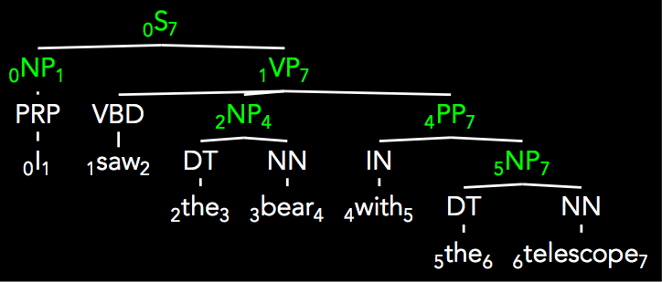
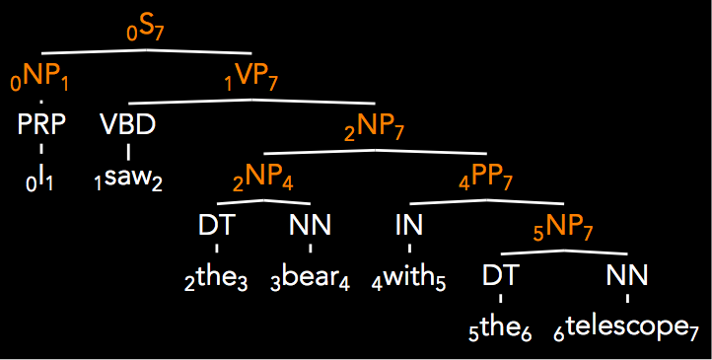
Parser Evaluation
Parseval (Black et al. ’91)
Decompose tree into labeled constituent spans (note: POS tags not considered!)
Calculate balanced precision and recall (f-measure)
(S 0 7)
(NP 0 1)
(VP 1 7)
(NP 2 4)
(PP 4 7)
(NP 5 7)
(S 0 7)
(NP 0 1)
(VP 1 7)
(NP 2 7)
(NP 2 4)
(PP 4 7)
(NP 5 7)

Slide 57
Parser Evaluation
(S 0 7)
(NP 0 1)
(VP 1 7)
(NP 2 7)
(NP 2 4)
(PP 4 7)
(NP 5 7)
(S 0 7)
(NP 0 1)
(VP 1 7)
(NP 2 4)
(PP 4 7)
(NP 5 7)
A = answers
C = correct
Precision: Of the answers I gave, what percent were correct?
|A ⋂ C| / |A|
Recall: What percent of the correct answers did I give?
|A ⋂ C| / |C|
F1: Harmonic mean of Precision and Recall (reciprocal of mean of reciprocals)
2*P*R / P+R
2*|A ⋂ C| / (|C| + |A|)

Slide 58
Parser Evaluation
A = answers
C = correct
(S 0 7)
(NP 0 1)
(VP 1 7)
(NP 2 7)
(NP 2 4)
(PP 4 7)
(NP 5 7)
(S 0 7)
(NP 0 1)
(VP 1 7)
(NP 2 4)
(PP 4 7)
(NP 5 7)
extra!
|A ∩ C| = 6
|A| = 7
|C| =6
R = 1.0
P= .857
F1 = .923

