Slide 1
Lecture 12: Neural Language Models
USC CSCI 544: Applied Natural Language Processing
Jonathan May -- 梅約納
Nanyun (Violet) Peng -- 彭楠赟
September 28, 2018
based on slides of Kai-Wei Chang

Slide 2
Smoothing as Optimization: Conditional Modeling
Given a context x
Which outcomes y are likely in that context?
We need a conditional distribution p(y | x)
A black-box function that we call on x, y
p(NextWord=y | PrecedingWords=x)
y is a unigram
x is an (n-1)-gram
Remember: p can be any function over (x,y)!
Provided that p(y | x) ≥ 0, and ∑_{y} p(y | x) = 1
2

Slide 3
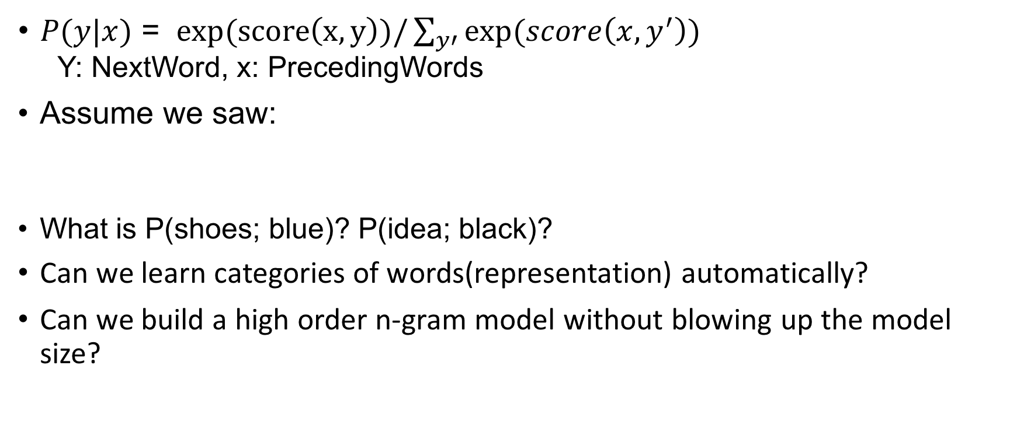
More complex assumption?
$P(y|x)$ = $exp(score\left(x,y\right))/\sum_{y′}{exp(score\left(x,y^{′}\right))}$ Y: NextWord, x: PrecedingWords
Assume we saw:
What is P(shoes; blue)? P(idea; black)?
Can we learn categories of words(representation) automatically?
Can we build a high order n-gram model without blowing up the model size?
red glasses; yellow glasses; green glasses; blue glasses
red shoes; yellow shoes; green shoes;

Slide 4
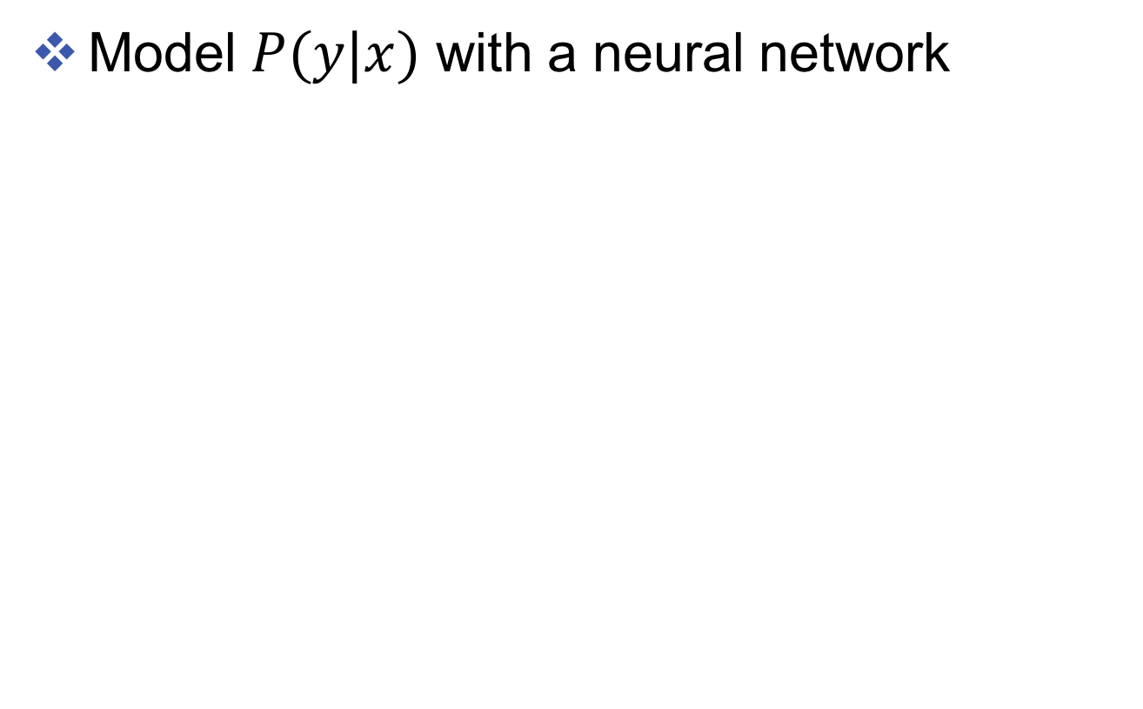
Neural language model
Model $P(y|x)$ with a neural network
Example 1:
One hot vector: each component of the vector represents one word
[0, 0, 1, 0, 0]
Example 2: word embeddings
Notes:
A brief introduction

Slide 5
Why?
Potentially generalize to unseen contexts
Example: P(“blue” | “the”, “shoes”, “are”)
This does not occurs in training corpus but [“the”, ”glasses”, ”are”, “red”] does.
If the word representations of “red” and “blue” are similar, then the model can generalize.
Why are “red” and “blue” similar?
Because NN saw “red skirt”, “blue skirt”, “red pen”, ”blue pen”, etc.
Notes:
Neural models are better than smoothing is because of many reasons. One of these reasons is that smoothing assign the same probability for unseen words. However, neural models assign different probabilities to different words.

Slide 6
Continuous Space Language Models
Word tokens map to vectors in a low-dimensional space
Conditional word probabilities replaced by normalized dynamical models on vectors of word embeddings
Vector-space representation enables semantic/syntactic similarity between words/sentences
Use cosine similarity can measure word similarity
Find nearest neighbours: synonyms, antonyms
Algebra on words: {king} – {man} + {woman} = {queen}

Slide 7
Vector-space representation of words
“One-hot” of “one-of-V” representation of a word token at position t in the text corpus, with vocabulary of size V
1
Vector-space representation of the prediction of target word w_{t} (we predict a vector of size D)
ẑ_{t}
v
V
z_{t-1}
Vector-space representation of any word v in the vocabulary using a vector of dimension D
Also called distributed representation
z_{v}
1
Vector-space representation of the t^{th} word’s history: e.g., concatenation of n-1 vectors of size D
z_{t-2}
D
z_{t-1}

Slide 8
Learning continuous space language models
Input:
word history (one-hot or distributed representation)
Output:
target word (one-hot or distributed representation)
Function that approximates word likelihood:
Linear transform
Feed-forward neural network
Recurrent neural network
Continuous bag-of-words
Skip-gram
…

Slide 9
Learning continuous space language models
How do we learn the word representations z for each word in the vocabulary?
How do we learn the model that predicts the next word or its representation ẑ_{t} given a word history?
Simultaneous learning of model and representation

Slide 10
Vector-space representation of words
Compare two words using vector representations:
Dot product
Cosine similarity
Euclidean distance
Normalized probability:
Using softmax function
Notes:
S(z,v) the score of a word and it’s representation

Slide 11
Loss function
Log-likelihood model:
Numerically more stable
Loss function to maximize:
Log-likelihood
In general, loss defined as: score of the right answer + normalization term

Slide 12
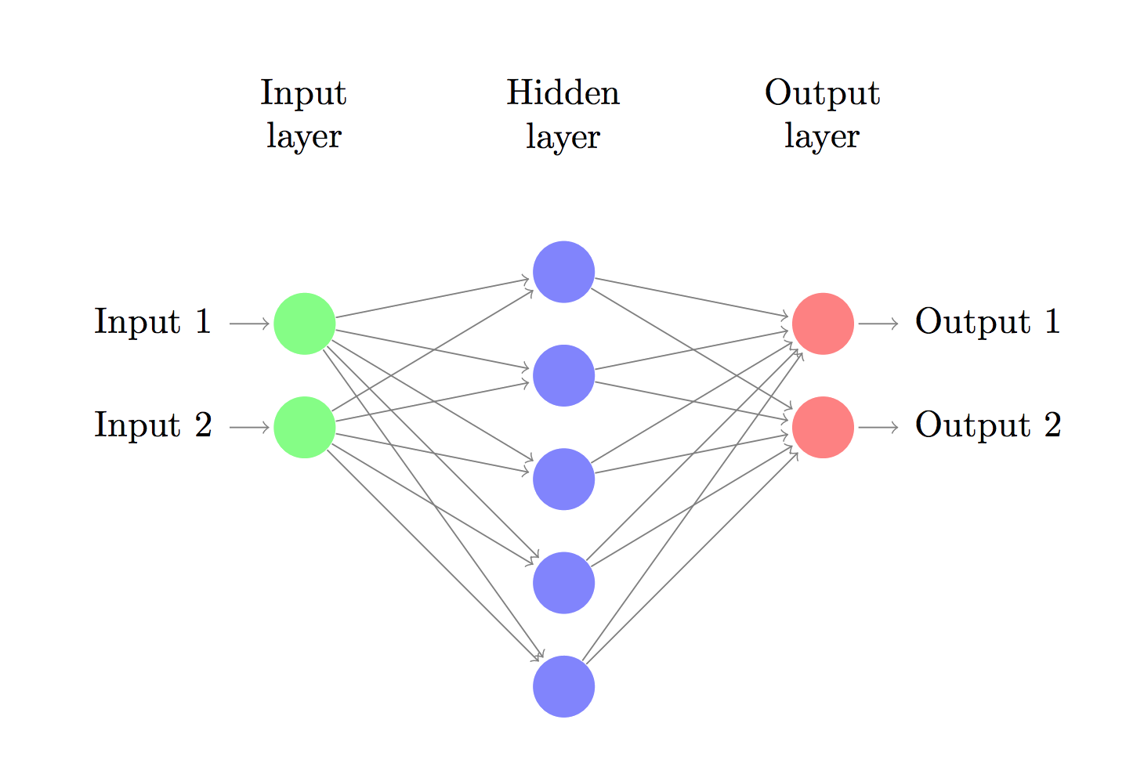
Neural Networks
Let’s consider a 3-layer neural network

Slide 13





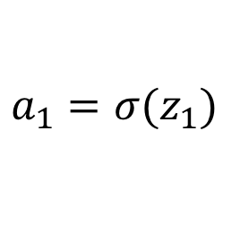




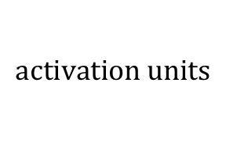
How NN Makes Predictions
Uses forward propagation
Just a bunch of linear transformation and applying the activation functions to introduce non-linearity
$$z_{1}=xW_{1}+b_{1}$$
$$W_{1}, b_{1}$$
$$W_{2}, b_{2}$$
$$a_{1}=σ⁡(z_{1})$$
$$z_{2}=a_{1}W_{2}+b_{2}$$
$$input, x$$
$$output, \hat{y}$$
$$a_{2}= \hat{y}=softmax(z_{2})$$
$$z_{1}$$
$$a_{1}$$
$$activation units$$

Slide 14
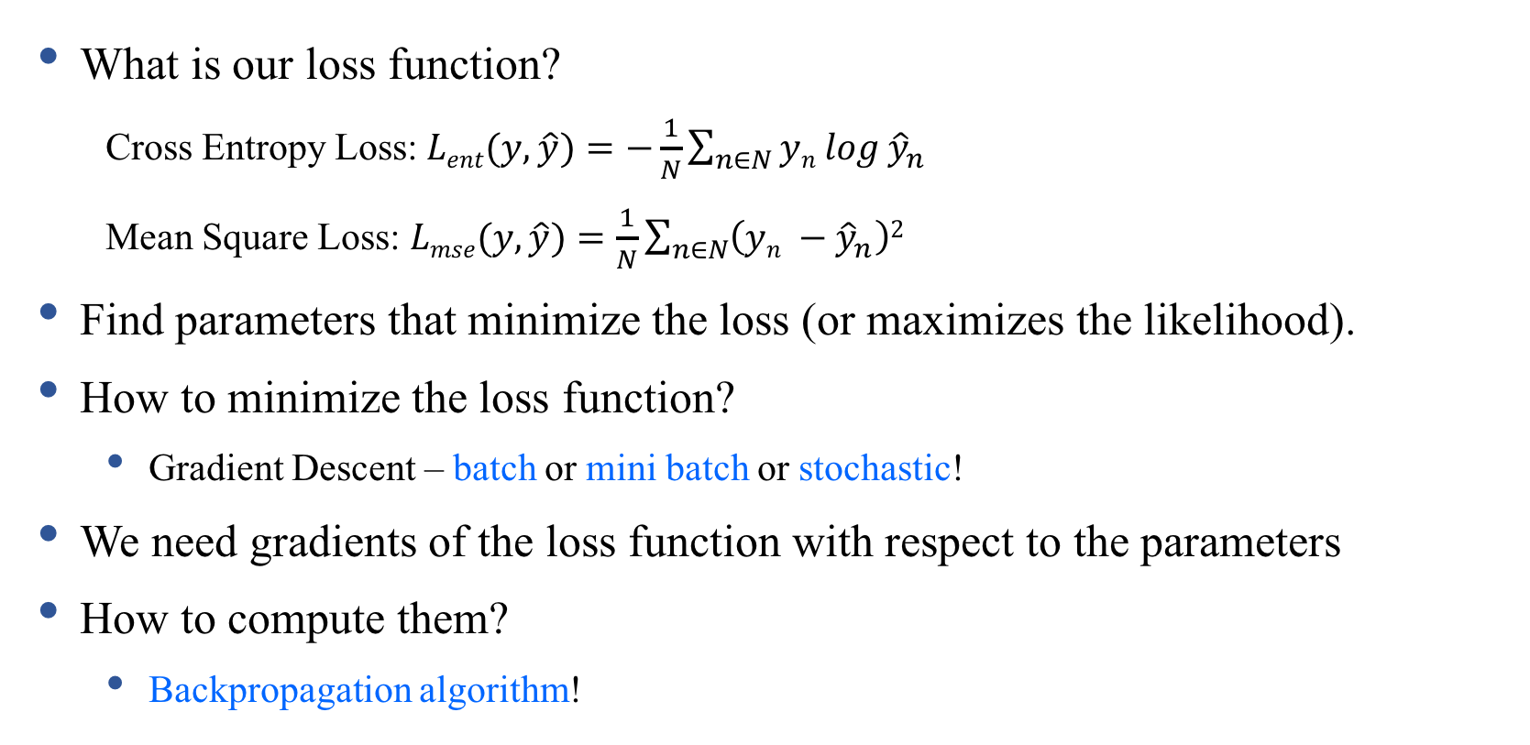
Learning the Parameters
What is our loss function?
Cross Entropy Loss: $Lent(y, \hat{y})=−\frac{1}{N}\sum_{n∈N}{yn log}{\hat{y}}_{n}$
Mean Square Loss: $Lmse(y, \hat{y})=\frac{1}{N}\sum_{n∈N}{\left(yn −{\hat{y}}_{n}\right)2}$
Find parameters that minimize the loss (or maximizes the likelihood).
How to minimize the loss function?
Gradient Descent – batch or mini batch or stochastic!
We need gradients of the loss function with respect to the parameters
How to compute them?
Backpropagation algorithm!

Slide 15
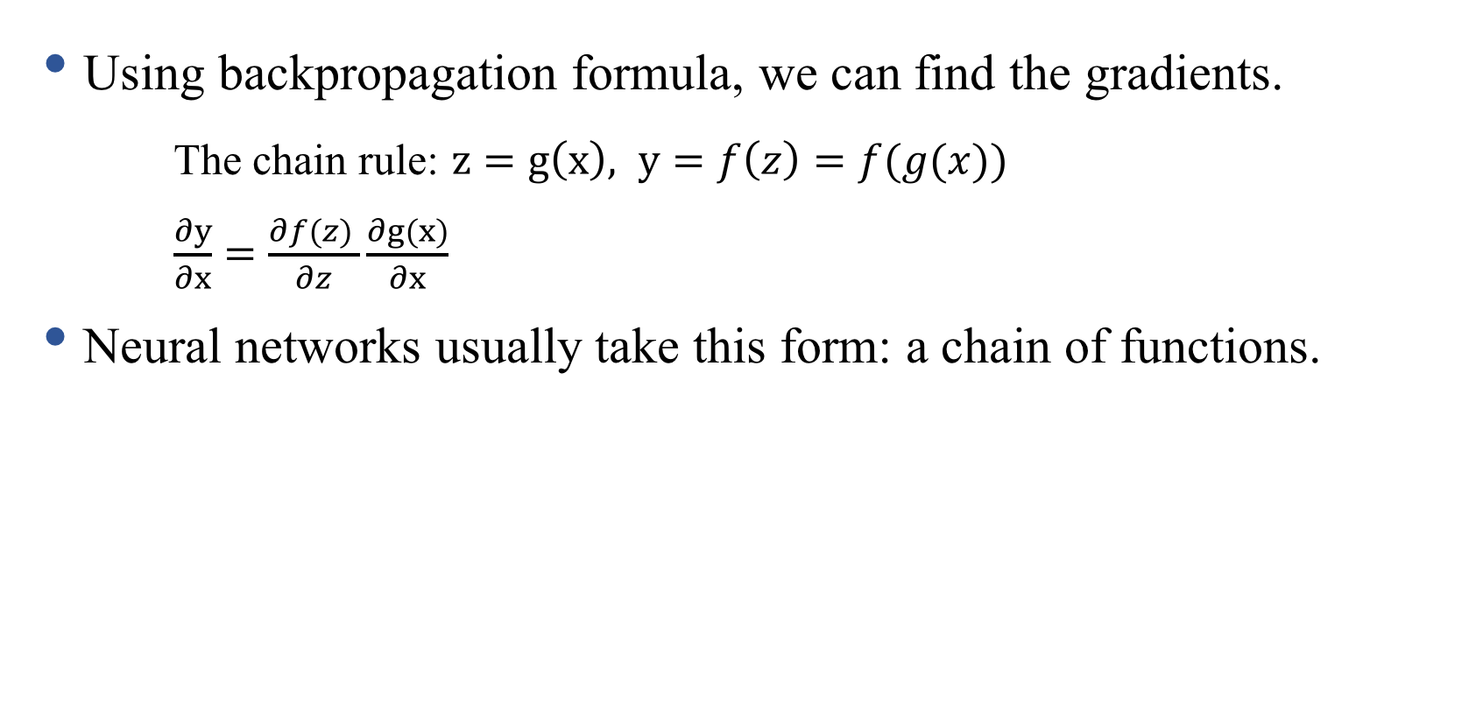
Backpropagation
Using backpropagation formula, we can find the gradients.
The chain rule: $z=g\left(x\right), y=f\left(z\right)=f(g(x))$
$\frac{∂y}{∂x}=\frac{∂f(z) }{∂z}\frac{∂g(x)}{∂x}$
Neural networks usually take this form: a chain of functions.

Slide 16

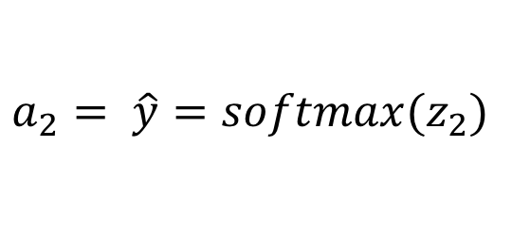


Recipe for Backpropagation
Identify intermediate functions (forward propagation)
Compute local gradients
Combine with upstream error signal to get full gradient
$$z_{1}=xW_{1}+b_{1}$$
$$W_{1}, b_{1}$$
$$W_{2}, b_{2}$$
$$a_{1}=σ⁡(z_{1})$$
$$z_{2}=a_{1}W_{2}+b_{2}$$
$$input, x$$
$$output, \hat{y}$$
$$a_{2}= \hat{y}=softmax(z_{2})$$
$$z_{1}$$
$$a_{1}$$
$$activation units$$

Slide 17
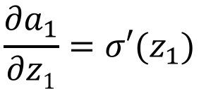

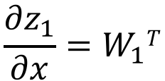
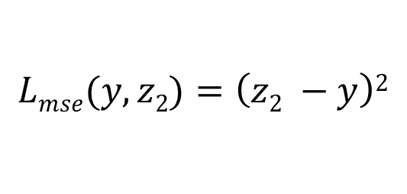
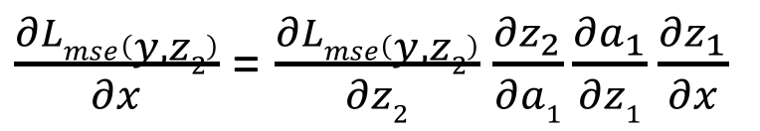

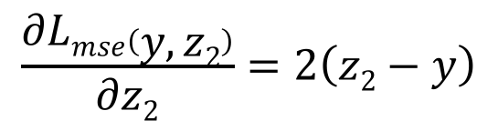
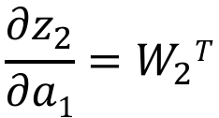
Intermediate Variables (forward propagation)
Intermediate Gradients (backward propagation)
$$z_{1}=xW_{1}+b_{1}$$
$$\frac{{∂z}_{1}}{∂x}=W_{1}T$$
$$\frac{{∂a}_{1}}{∂z1}=σ′⁡(z_{1})$$
$$a_{1}=σ⁡(z_{1})$$
$$\frac{{∂z}_{2}}{∂a1}=W_{2}T$$
$$z_{2}=a_{1}W_{2}+b_{2}$$
$$Lmse(y,z2)=\left(z2 −y\right)2$$
$$\frac{∂Lmse\left(y, z2\right)}{∂z2}=2\left(z2−y\right)$$
$\frac{∂Lmse\left(y, z2\right)}{∂x}$ = $\frac{∂Lmse\left(y, z2\right)}{∂z2}$ $\frac{{∂z}_{2}}{∂a1}\frac{{∂a}_{1}}{∂z1}\frac{{∂z}_{1}}{∂x}$
Notes:
Mse: minimum square error loss

Slide 18

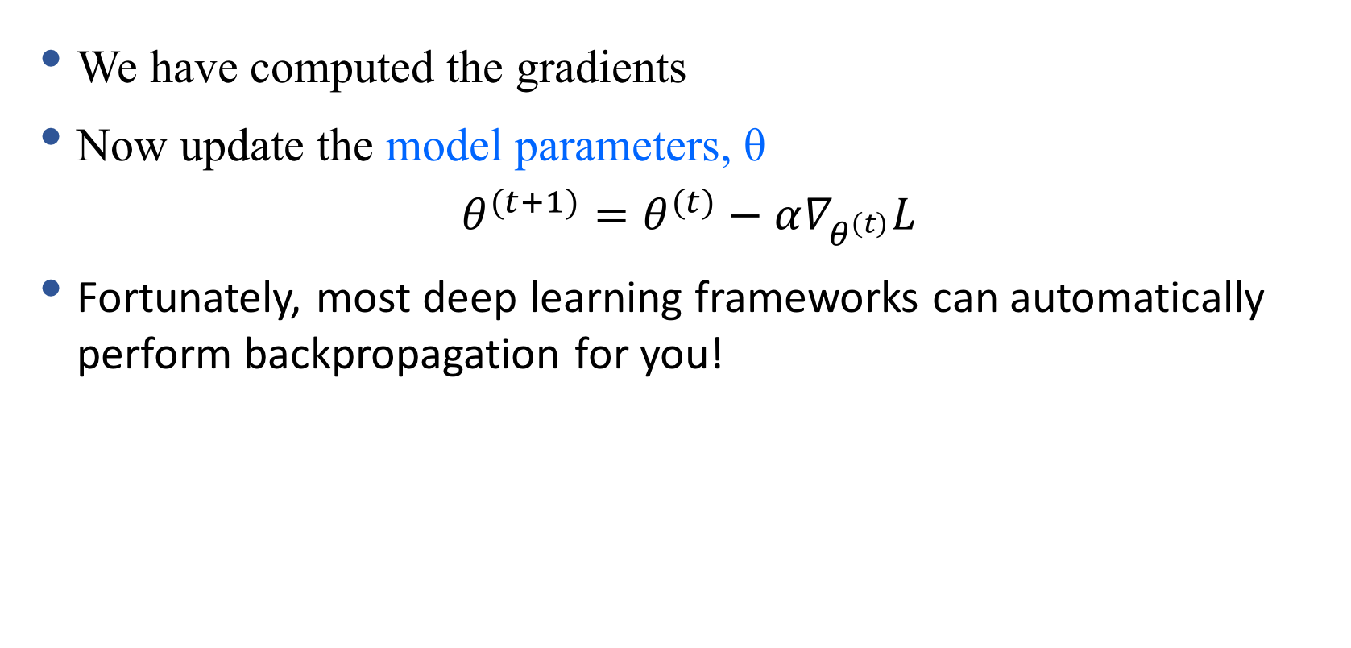
Update the Parameters
We have computed the gradients
Now update the model parameters, θ
$$θ^{(t+1)}=θ^{(t)}−α∇_{θ^{\left(t\right)}}L$$
Fortunately, most deep learning frameworks can automatically perform backpropagation for you!

Slide 19
Recurrent Neural Networks (RNNs)
Main idea is to make use of sequential information
How RNN is different from feedforward neural network?
Feedforward neural networks assume all inputs are independent of each other
In many cases (especially for language), it is not true.
What RNN does?
Perform the same task at every step of a sequence (that’s what recurrent stands for)
Output depends on the previous computations
Another way of interpretation – RNNs have a “memory”
To store previous computations

Slide 20
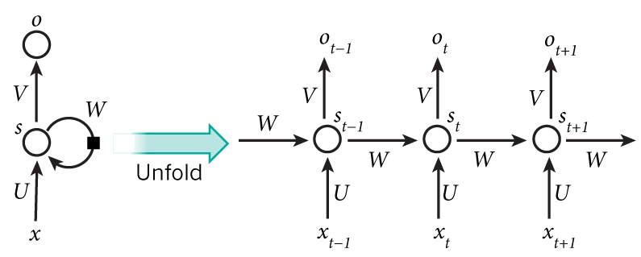
Recurrent Neural Networks (RNNs)
Hidden state at time step t
Output state at time step t
Activation function
h
h_{t-1}
h_{t}
h_{t+1}
Input at time step $t−1$

Slide 21
Recurrent Neural Networks (RNNs)
Mathematically, the computation at each time step:

Slide 22
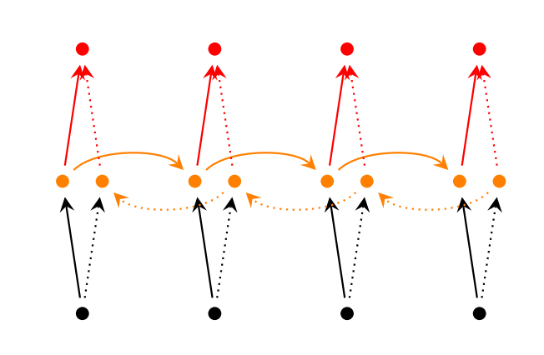
RNN Extensions
Bidirectional RNNs
Notes:
We do biderctional because we want to capture information from left to right and from right to left. Because RNNs depend on the previous values

Slide 23
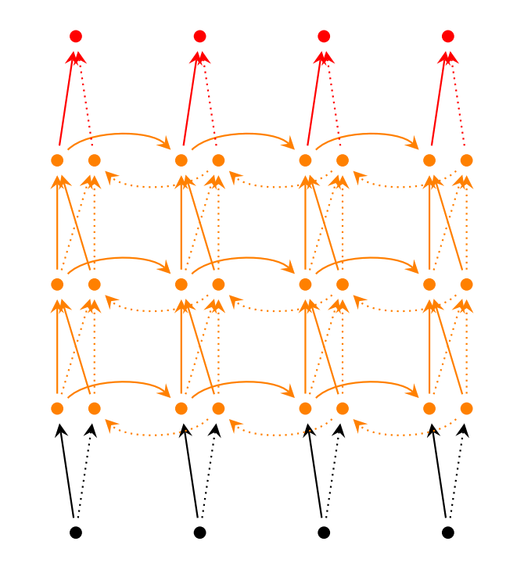
RNN Extensions
Deep (Bidirectional) RNNs

Slide 24
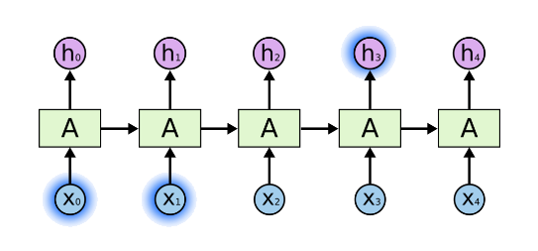
Long-Term Dependencies
Is RNN capable of capturing long-term dependencies?
Why long-term dependencies?
Sometimes we only need to look at recent information to perform present task
Consider an example
Predict next word based on the previous words
The clouds are in the sky

Slide 25
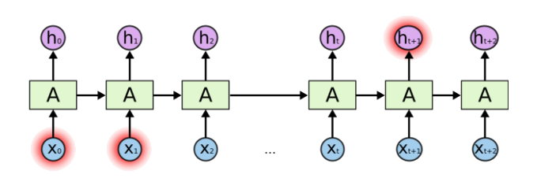
Problem of Long-Term Dependencies
What if we want to predict the next word in a long sentence?
Do we know which past information is helpful to predict the next word?
In theory, RNNs are capable of handling long-term dependencies.
But in practice, they are not!

Slide 26
Long Short Term Memory (LSTM)
A special type of recurrent neural networks.
Explicitly designed to capture the long-term dependency .
So, what is the structural difference between RNN and LSTM?

Slide 27
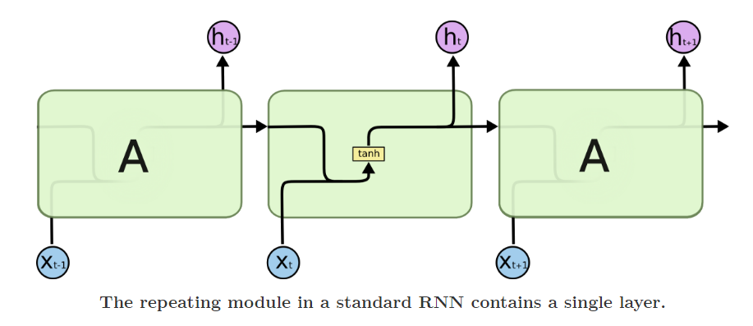
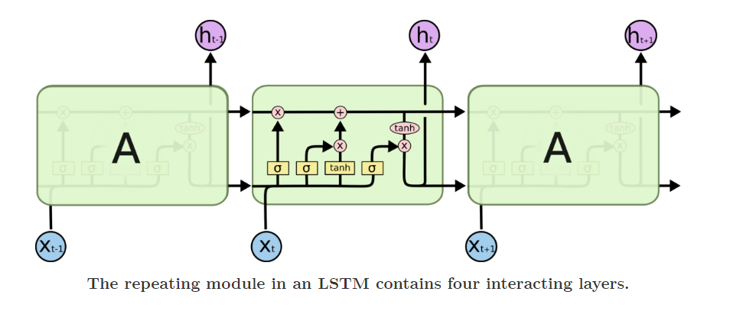
Difference between RNN and LSTM

Slide 28
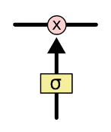
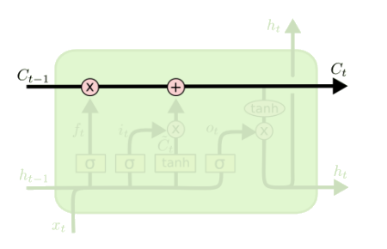
Core Idea Behind LSTM
Key to LSTMs is the cell state
The horizontal line running through the top of the diagram
LSTMs memory cells add and remove information as the sequence goes
How? Through a structure called gate.
LSTM has three gates to control the memory in the cells
Pointwise multiplication operation
Sigmoid neural net layer

Slide 29
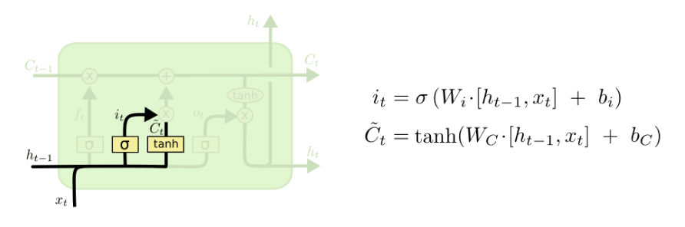

Step-by-Step LSTM Walk Through
The input gate decides what information will be stored in the cell state
Two parts –
A sigmoid layer (input gate layer): decides what values we’ll update
A $tanh⁡$layer: creates a vector of new candidate values, $\tilde{C_{t}}$
Example: add the gender of the new subject to the cell state
Replace the old one we’re forgetting
Input gate layer
tanh layer

Slide 30
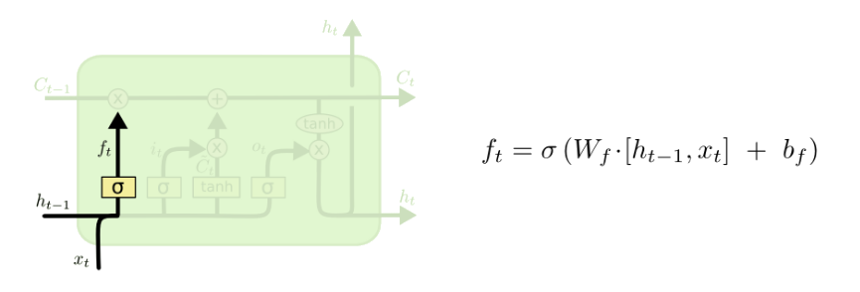

Step-by-Step LSTM Walk Through
The forget gate decides what information will be thrown away
Looks at $h_{t−1}$ and $x_{t}$ and outputs a number between 0 and 1
1 represents completely keep this, 0 represents completely get rid of this
Example: forget the gender of the old subject, when we see a new subject

Slide 31
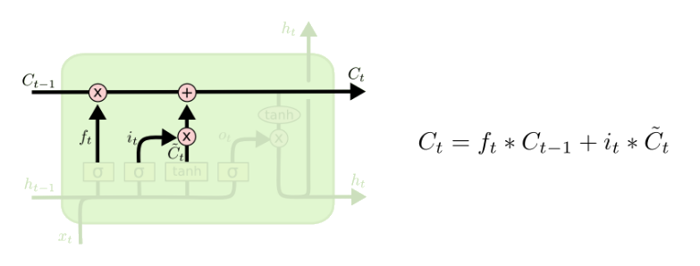
Step-by-Step LSTM Walk Through
Next step: update old state by $C_{t−1}$ into the new cell state $C_{t}$
Multiply old state by $f_{t}$
Forgetting the things we decided to forget earlier
Then we add $i_{t}∗\tilde{C_{t}}$

Slide 32
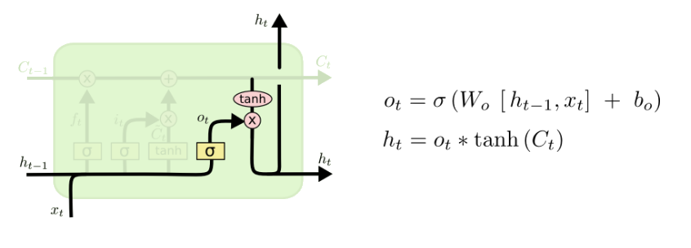
Step-by-Step LSTM Walk Through
Final step: decide what we’re going to output
First, we run a sigmoid layer
Which decides what parts of the cell state we’re going to output
Then, we put the cell state through tanh and multiply it by the output of the sigmoid gate

Slide 33
LSTMs Summary
LSTMs is an (advanced) variation of RNNs.
It captures long-term dependencies of the inputs.
Shown to be efficient in many NLP tasks.
A standard component to encode text inputs.

Slide 34
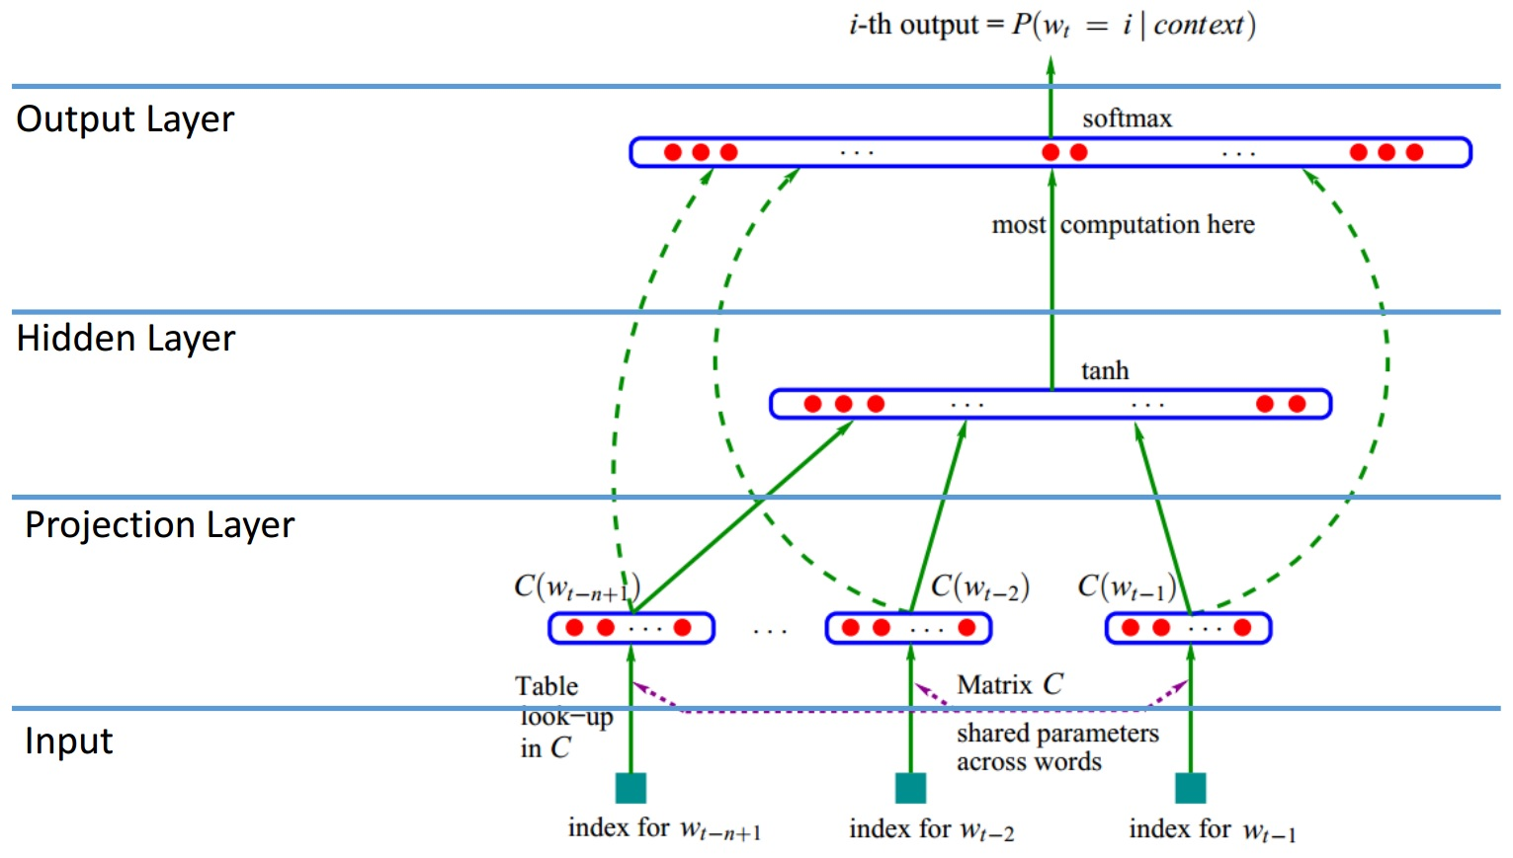

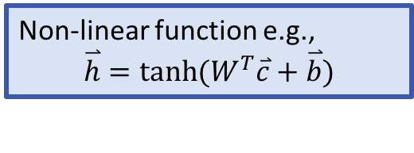
Neural language model
Model $P(y|x)$ with a neural network
Y. Bengio et al., JMLR’03
Obtain (y|x) by performing softmax
Non-linear function e.g.,
$$\overset{⃑}{h}=tanh⁡(W^{T}\overset{⃑}{c}+\overset{⃑}{b})$$
Concatenate projected vectors
Learned matrices to project the input vectors

Slide 35
Limitation of the Early Neural Language Model
Sparsity – Solved
World Similarity – Solved
Finite Context – Not solved yet

Slide 36
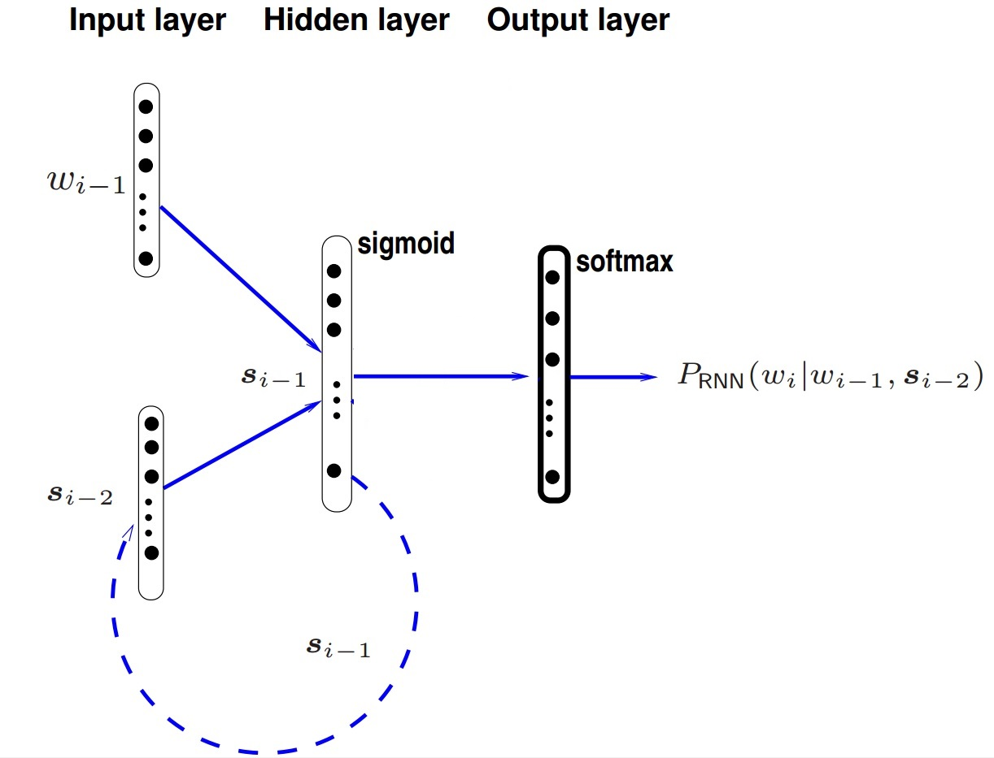
RNN Language Model
Handles infinite context in theory
LSTMs has shown to be efficient

Slide 37
Learning neural language models
Maximize the log-likelihood of observed data, w.r.t. parameters θ of the neural language model
Parameters θ (in a neural language model):
Word embedding matrix R and bias b_{v}
Neural weights: A, b_{A}, B, b_{B}
Gradient descent with learning rate η:

Slide 38
Maximizing the loss function
Maximum Likelihood learning:
Gradient of log-likelihood w.r.t. parameters θ:
Use the chain rule of gradients

Slide 39
Learning neural language models
Randomly choose a mini-batch (e.g., 1000 consecutive words)
Forward-propagate through word embeddings and through model
Estimate word likelihood (loss)
Back-propagate loss
Gradient step to update model

