Slide 1
Lecture 11: Smoothing for Language Models
USC CSCI 544: Applied Natural Language Processing
Jonathan May -- 梅約納
Nanyun (Violet) Peng -- 彭楠赟
September 26, 2018
based on slides of Jason Eisner

Slide 2
Midterm Logistics
Length: 1 hour, 40 minutes (you will need time to set up and hand in exam)
Date: Friday, October 5, 8:00 AM (Please arrive promptly!)
Please Bring:
Pencils/pens/erasers as needed
one 8.5x11 inch (or A4) sheet of paper with notes on both sides (optional)
NO OTHER NOTES
NO ELECTRONIC RESOURCES
NO BOOKS
We will provide extra paper for scratch work
Sit only at seats with exams on them. Fill up all available space.

Slide 3
What's On The Exam?
Fair game
Anything on the slides
Anything in the required reading
Anything in the homeworks
But
We're not trying to trick you
We're not trying to make this impossible
If you understand the lectures well, you should be ok

Slide 4
What's On The Exam
Major Topics
Levels of Linguistic Knowledge (L1)
Corpora, Regex, Basic text processing (L2)
Morphology, Finite State Automata and Transducers (L3)
Probability Theory (L4)
Naive Bayes, Features, Perceptron, Logistic Regression (L5)
POS Tagging and HMM tagger, Viterbi Decoding (L6)
Constituency Syntax Trees, Context-Free Grammars, CKY, CNF, Beam Decoding (L7-8)
Dependency Syntax Trees, Arc-Standard and Arc-Eager Dependency Parsing (L9)
Ngram Language Models, Smoothing, Backoff, Interpolation, alternate language models (L10-12) (Probably no neural; depends on how far we get)
It won't all be on there because there isn't enough time
But there is plenty of room on the final

Slide 5
Who is Where?
Rooms: SAL 101 and HAR 101. HAR 101 is Harris Hall.
Will post latest information on the course website, which has a very prominent link to a roster with firstname, last name, partially masked email address, and assignment
If you are still unsure of where to go, contact us on piazza

Slide 6
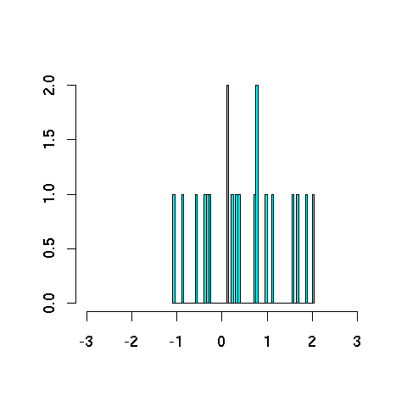
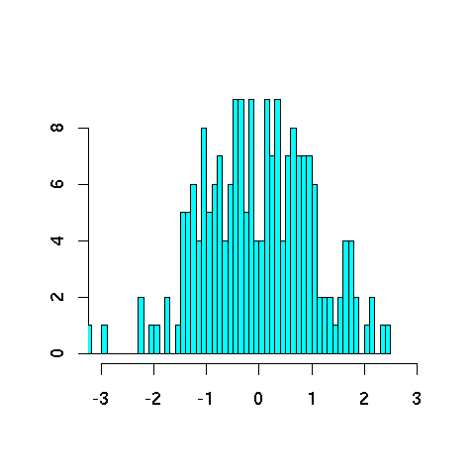
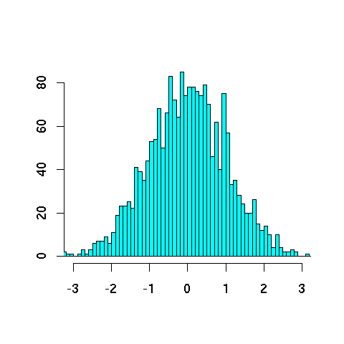
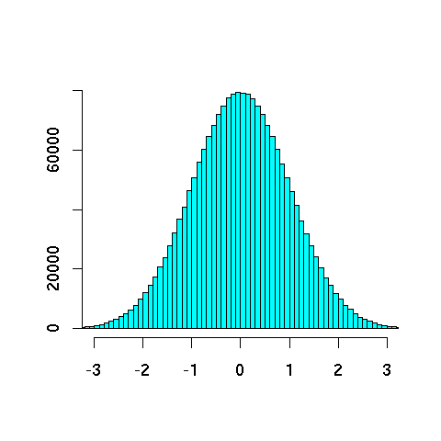
Never trust a sample under 30
20
200
2000
2000000

Slide 7
Never trust a sample under 30
Smooth out the bumpy histograms to look more like the truth
(we hope!)

Slide 8
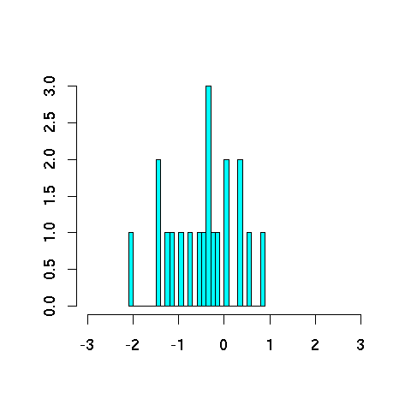
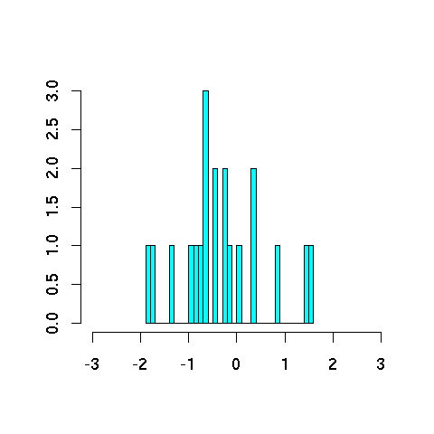
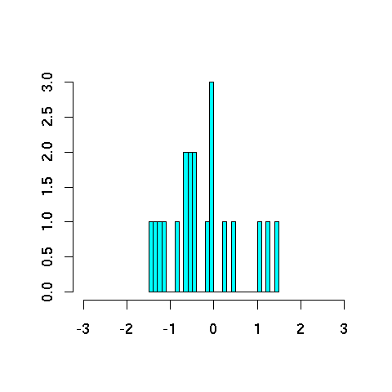
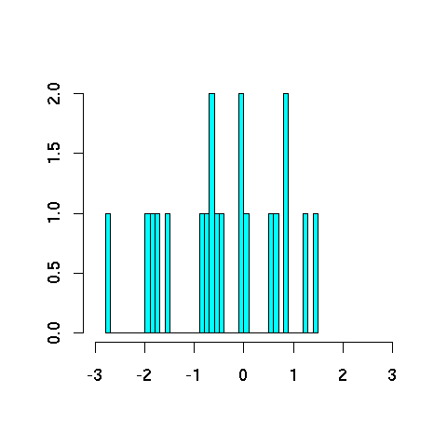
Smoothing reduces variance
20
20
Different samples of size 20 vary considerably
(though on average, they give the correct bell curve!)
20
20

Slide 9
Smoothing reduces variance
truth
truth
bias
average
unsmoothed estimates from different samples
estimates are correct on average: such an estimation method is called unbiased
estimates are typically far from truth (high variance (mean squared error))
smoothed estimates from different samples
estimates are incorrect on average: such an estimation method is called biased
but estimates are typically close to average (low variance (mean squared distance))
and so may tend to be closer to truth, too

Slide 10
Parameter Estimation
p(x₁=h, x₂=o, x₃=r, x₄=s, x₅=e, x₆=s, …)
≈ p(h | BOS, BOS)
* p(o | BOS, h)
* p(r | h, o)
* p(s | o, r)
* p(e | r, s)
* p(s | s, e)
* …
trigram model’s
parameters
4470/ 52108
395/ 4470
1417/ 14765
1573/ 26412
1610/ 12253
2044/ 21250
values of
those parameters, as naively estimated from Brown corpus.
Notes:
This is a trigram markov independence assumption from previous lecture

Slide 11
How to Estimate?
p(z | xy) = ?
Suppose our training data includes … xya .. … xyd … … xyd … but never xyz
Should we conclude p(a | xy) = 1/3? p(d | xy) = 2/3? p(z | xy) = 0/3?
NO! Absence of xyz might just be bad luck.

Slide 12
Smoothing the Estimates
Should we conclude p(a | xy) = 1/3? reduce this p(d | xy) = 2/3? reduce this p(z | xy) = 0/3? increase this
Discount the positive counts somewhat
Reallocate that probability to the zeroes
Especially if the denominator is small …
1/3 probably too high, 100/300 probably about right
Especially if numerator is small …
1/3 probably too high, 100/300 probably about right

Slide 13
Add-One Smoothing
xya | 1 | 1/3 | 2 | 2/29
xyb | 0 | 0/3 | 1 | 1/29
xyc | 0 | 0/3 | 1 | 1/29
xyd | 2 | 2/3 | 3 | 3/29
xye | 0 | 0/3 | 1 | 1/29
…
xyz | 0 | 0/3 | 1 | 1/29
Total xy | 3 | 3/3 | 29 | 29/29
Notes:
We have 26 letters in English. Here we have a sample size of 3, so we have 29 in total.

Slide 14
Add-One Smoothing
300 observations instead of 3 – better data, less smoothing
xya | 100 | 100/300 | 101 | 101/326
xyb | 0 | 0/300 | 1 | 1/326
xyc | 0 | 0/300 | 1 | 1/326
xyd | 200 | 200/300 | 201 | 201/326
xye | 0 | 0/300 | 1 | 1/326
…
xyz | 0 | 0/300 | 1 | 1/326
Total xy | 300 | 300/300 | 326 | 326/326

Slide 15
Problem with Add-One Smoothing
We’ve been considering just 26 letter types …
xya | 1 | 1/3 | 2 | 2/29
xyb | 0 | 0/3 | 1 | 1/29
xyc | 0 | 0/3 | 1 | 1/29
xyd | 2 | 2/3 | 3 | 3/29
xye | 0 | 0/3 | 1 | 1/29
…
xyz | 0 | 0/3 | 1 | 1/29
Total xy | 3 | 3/3 | 29 | 29/29

Slide 16
Problem with Add-One Smoothing
Suppose we’re considering 20000 word types, not 26 letters
see the abacus | 1 | 1/3 | 2 | 2/20003
see the abbot | 0 | 0/3 | 1 | 1/20003
see the abduct | 0 | 0/3 | 1 | 1/20003
see the above | 2 | 2/3 | 3 | 3/20003
see the Abram | 0 | 0/3 | 1 | 1/20003
…
see the zygote | 0 | 0/3 | 1 | 1/20003
Total | 3 | 3/3 | 20003 | 20003/20003

Slide 17
Problem with Add-One Smoothing
Suppose we’re considering 20000 word types, not 26 letters
see the abacus | 1 | 1/3 | 2 | 2/20003
see the abbot | 0 | 0/3 | 1 | 1/20003
see the abduct | 0 | 0/3 | 1 | 1/20003
see the above | 2 | 2/3 | 3 | 3/20003
see the Abram | 0 | 0/3 | 1 | 1/20003
…
see the zygote | 0 | 0/3 | 1 | 1/20003
Total | 3 | 3/3 | 20003 | 20003/20003
“Novel event” = 0-count event (never happened in training data).
Here: 19998 novel events, with total estimated probability 19998/20003.
So add-one smoothing thinks we are extremely likely to see novel events, rather than words we’ve seen in training data.
It thinks this only because we have a big dictionary: 20000 possible events.
Is this a good reason?
17
Notes:
Here’s the problem with Add-one smoothing

Slide 18
Infinite Dictionary?
In fact, aren’t there infinitely many possible word types?
see the aaaaa | 1 | 1/3 | 2 | 2/(∞+3)
see the aaaab | 0 | 0/3 | 1 | 1/(∞+3)
see the aaaac | 0 | 0/3 | 1 | 1/(∞+3)
see the aaaad | 2 | 2/3 | 3 | 3/(∞+3)
see the aaaae | 0 | 0/3 | 1 | 1/(∞+3)
…
see the zzzzz | 0 | 0/3 | 1 | 1/(∞+3)
Total | 3 | 3/3 | (∞+3) | (∞+3)/(∞+3)

Slide 19
Add-Lambda Smoothing
A large dictionary makes novel events too probable.
To fix: Instead of adding 1 to all counts, add λ = 0.01?
This gives much less probability to novel events.
But how to pick best value for λ?
That is, how much should we smooth?
Notes:
So the problem with Add-one smoothing is that when we have a very large dictionary with novel events, then the add-one smoothing will make these events very probable.
To fix this we will add 0.01 instead of 1.

Slide 20
Add-0.001 Smoothing
Doesn’t smooth much (estimated distribution has high variance)
xya | 1 | 1/3 | 1.001 | 0.331
xyb | 0 | 0/3 | 0.001 | 0.0003
xyc | 0 | 0/3 | 0.001 | 0.0003
xyd | 2 | 2/3 | 2.001 | 0.661
xye | 0 | 0/3 | 0.001 | 0.0003
…
xyz | 0 | 0/3 | 0.001 | 0.0003
Total xy | 3 | 3/3 | 3.026 | 1

Slide 21
Add-1000 Smoothing
Smooths too much (estimated distribution has high bias)
xya | 1 | 1/3 | 1001 | 1/26
xyb | 0 | 0/3 | 1000 | 1/26
xyc | 0 | 0/3 | 1000 | 1/26
xyd | 2 | 2/3 | 1002 | 1/26
xye | 0 | 0/3 | 1000 | 1/26
…
xyz | 0 | 0/3 | 1000 | 1/26
Total xy | 3 | 3/3 | 26003 | 1
Notes:
The last column is simplified and is estimate number.

Slide 22
Add-Lambda Smoothing
A large dictionary makes novel events too probable.
To fix: Instead of adding 1 to all counts, add λ = 0.01?
This gives much less probability to novel events.
But how to pick best value for λ?
That is, how much should we smooth?
E.g., how much probability to “set aside” for novel events?
Depends on how likely novel events really are!
Which may depend on the type of text, size of training corpus, …
Can we figure it out from the data?
We’ll look at a few methods for deciding how much to smooth.

Slide 23
Setting Smoothing Parameters
How to pick best value for λ? (in add- λ smoothing)
Try many λ values & report the one that gets best results?
How to measure whether a particular λ gets good results?
Is it fair to measure that on test data (for setting λ)?
Moral: Selective reporting on test data can make a method look artificially good. So it is unethical.
Rule: Test data cannot influence system development. No peeking! Use it only to evaluate the final system(s). Report all results on it.
Training
Test
General Rule of Experimental Ethics: Never skew anything in your favor.
Applies to experimental design, reporting, analysis, discussion.
Feynman’s Advice: “The first principle is that you must not fool yourself, and you are the easiest person to fool.”
Notes:
The verification method here is intrinsic.
This approach says that we should pick lambda based on its performance on the test data. But this is not a very good approach.
Test data should be only for testing and not to skew the results in our favors.

Slide 24
Setting Smoothing Parameters
How to pick best value for λ?
Try many λ values & report the one that gets best results?
How to fairly measure whether a λ gets good results?
Hold out some (say, 20% of training) as “development data” for purpose
Training
Test
Dev.
Training
Now use that λ to get smoothed counts from all 100% training data …
… and report results of that final model on test data.
Pick λ that gets best results on this 20% …
… when we collect counts from this 80% and smooth them using add-λ smoothing.
24

Slide 25
Setting Smoothing Parameters
Here we held out 20% of our training set (yellow) for development.
Would like to use > 20% yellow:
Would like to use > 80% blue:
Could we let the yellow and blue sets overlap?
☹ 20% not enough to reliably assess λ
☹ Best λ for smoothing 80%
≠ best λ for smoothing 100%
☹ Ethical, but foolish
Training
Test
Dev.
Training
Now use that λ to get smoothed counts from all 100% training data …
… and report results of that final model on test data.
Pick λ that gets best results on this 20% …
… when we collect counts from this 80% and smooth them using add-λ smoothing.
25
Notes:
The method of dividing the training data to a development set and training set, isn’t very general because we are only picking the best lambda based on the 20% dev data. We want the lambda that works best for more data.

Slide 26
5-fold Cross-Validation (“Jackknifing”)
☹ 20% not enough to reliably assess λ
☹ Best λ for smoothing 80%
≠ best λ for smoothing 100%
Would like to use > 20% yellow:
Would like to use > 80% blue:
Old version: Train on 80%, test on 20%
If 20% yellow too little: try 5 training/dev splits as below
Pick λ that gets best average performance
☺ Tests on all 100% as yellow, so we can more reliably assess λ
☹ Still picks a λ that’s good at smoothing the 80% size, not 100%.
But now we can grow that 80% without trouble …
Dev.
Training
Dev.
Dev.
Dev.
Dev.
Test
Dev.
26

Slide 27
N-fold Cross-Validation (“Leave One Out”)
(more extreme version of strategy from last slide)
…
Test
To evaluate a particular λ during dev, test on all the training data: test each sentence with smoothed model from other N-1 sentences
☺ Still tests on all 100% as yellow, so we can reliably assess λ
☺ Trains on nearly 100% blue data ((N-1)/N) to measure whether λ is good for smoothing that much data: nearly matches true test conditions
☺ Surprisingly fast: why?
Usually easy to retrain on blue by adding/subtracting 1 sentence’s counts
27
Notes:
Why this is fast?
Because we are dealing with n-gram models and since finding the probability of a model is based on counts, if we a take a sentence out of the training data, the count will be decreased by just subtracting or adding.
So this will be fast.

Slide 28
Smoothing reduces variance
Remember: So does backoff (by increasing size of sample). Use both?
20
20
200
20
20

Slide 29
Use the backoff
Why are we treating all novel events as the same?
p(zygote | see the) vs. p(baby | see the)
Unsmoothed probs: count(see the zygote) / count(see the)
Smoothed probs: (count(see the zygote) + 1) / (count(see the) + V)
What if count(see the zygote) = count(see the baby) = 0?
baby beats zygote as a unigram
the baby beats the zygote as a bigram
∴ see the baby beats see the zygote ? (even if both have the same count, such as 0)
Backoff introduces bias, as usual:
Lower-order probabilities (unigram, bigram) aren’t quite what we want
But we do have enough data to estimate them & they’re better than nothing.
29
Notes:
Novel event meaning that we haven’t seen that event in the training data.
We know that the baby is more probable than the zygote as a bigram. That’s why we have a bias towards P(see the baby)

Slide 30
Early idea: Model averaging
Jelinek-Mercer smoothing (“deleted interpolation”):
Use a weighted average of backed-off naïve models: p_{average}(z | xy) = μ₃ p(z | xy) + μ₂ p(z | y) + μ₁ p(z) where μ₃ + μ₂ + μ₁ = 1 and all are ≥ 0
The weights μ can depend on the context xy
If we have “enough data” in context xy, can make μ₃ large. E.g.:
If count(xy) is high
Learn the weights on held-out data w/ jackknifing
Different μ₃ when xy is observed 1 time, 2 times, 3-5 times, …
We’ll see some better approaches shortly
30

Slide 31
More Ideas for Smoothing
Cross-validation is a general-purpose tool for tweaking any hyper-parameters in any system.
Here, the system will train the counts from blue data, but we use yellow data to tweak how much the system smooths them (λ) and how much it backs off for different kinds of contexts (μ₃ etc.)
Is there anything more specific to try in this case?
Remember, we’re trying to decide how much to smooth.
E.g., how much probability to “set aside” for novel events?
Depends on how likely novel events really are …
Which may depend on the type of text, size of training corpus, …
Can we figure this out from the data?

Slide 32
How likely are novel events?
Is there any theoretically nice way to pick λ?
20000 types
300 tokens
300 tokens
a | 150 |  | 0
both | 18 |  | 0
candy | 0 |  | 1
donuts | 0 |  | 2
every | 50 | versus | 0
farina | 0 |  | 0
grapes | 0 |  | 1
his | 38 |  | 0
ice cream | 0 |  | 7
…
0/300
0/300
which zero would you expect is really rare?

Slide 33
How likely are novel events?
20000 types
300 tokens
300 tokens
a | 150 |  | 0
both | 18 |  | 0
candy | 0 |  | 1
donuts | 0 |  | 2
every | 50 | versus | 0
farina | 0 |  | 0
grapes | 0 |  | 1
his | 38 |  | 0
ice cream | 0 |  | 7
…
determiners:
a closed class

Slide 34
How likely are novel events?
20000 types
300 tokens
300 tokens
a | 150 |  | 0
both | 18 |  | 0
candy | 0 |  | 1
donuts | 0 |  | 2
every | 50 | versus | 0
farina | 0 |  | 0
grapes | 0 |  | 1
his | 38 |  | 0
ice cream | 0 |  | 7
…
(food) nouns:
an open class

Slide 35
How common are novel events?
Counts from Brown Corpus (N ≈ 1 million tokens)
N₆ *
N₅ *
N₄ *
N₃ *
N₂ *
doubletons (occur twice)
N₁ *
singletons (occur once)
N₀ *
novel words (in dictionary but never occur)
N2 = # doubleton types
N2 * 2 = # doubleton tokens
∑_{r} N_{r} = total # types = T (purple bars)
∑_{r} (N_{r} * r) = total # tokens = N (all bars)
Notes:
N1 * 1 → Number of of types that appear once
N2 * 2 → Number of types that appears twice (Number of tokens for the N2 type)

Slide 36
How common are novel events?
1 *
the
1 *
EOS
N₆ *
abdomen, bachelor, Caesar …
N₅ *
aberrant, backlog, cabinets …
N₄ *
abdominal, Bach, cabana …
N₃ *
Abbas, babel, Cabot …
N₂ *
aback, Babbitt, cabanas …
N₁ *
abaringe, Babatinde, cabaret …
N₀ *

Slide 37
Witten-Bell Smoothing Idea
If T/N is large, we’ve seen lots of novel types in the past, so we expect lots more.
Imagine scanning the corpus in order.
Each type’s first token was novel.
So we saw T novel types (purple).
N₆ *
N₅ *
N₄ *
N₃ *
unsmoothed → smoothed
N₂ *
doubletons
2/N → 2/(N+T)
N₁ *
singletons
1/N → 1/(N+T)
N₀ *
novel words
0/N → (T/(N+T)) / N₀
Intuition: p(novel) is estimated as T/(N+T), divided among N₀ specific novel types
Notes:
T/N → Number of types / total number of tokens
P(novel) ~ T(N+T)
The witten-bell smoothing assign the same probability to all novel events

Slide 38
Good-Turing Smoothing Idea
Partition the type vocabulary into classes (novel, singletons, doubletons, …) by how often they occurred in training data
Use observed total probability of class r+1 to estimate total probability of class r
N₆*
N₅*
N₄*
N₃*
obs. p(tripleton)
unsmoothed → smoothed
1.2%
est. p(doubleton)
2/N → (N₃*3/N)/N₂
N₂*
obs. p(doubleton)
(N₃*3/N)/N₂
1.5%
N₁*
obs. p(singleton)
est. p(singleton)
1/N → (N₂*2/N)/N₁
(N₂*2/N)/N₁
2%
N₀*
est. p(novel)
0/N → (N₁*1/N)/N₀
(N₁*1/N)/N₀
r/N = (N_{r}*r/N)/N_{r} → (N_{r+1}*(r+1)/N)/N_{r}

Slide 39
Witten-Bell vs. Good-Turing
Estimate p(z | xy) using just the tokens we’ve seen in context xy. Might be a small set …
Witten-Bell intuition: If those tokens were distributed over many different types, then novel types are likely in future.
Good-Turing intuition: If many of those tokens came from singleton types , then novel types are likely in future.
Very nice idea (but a bit tricky in practice)
See the paper “Good-Turing smoothing without tears”

Slide 40
Good-Turing (old slides)
Intuition: Can judge rate of novel events (in a context) by rate of singletons (in that context)
Let N_{r} = # of word types with r training tokens
e.g., N₀ = number of unobserved words
e.g., N₁ = number of singletons
Let N = Σ r N_{r} = total # of training tokens

Slide 41
Good-Turing (old slides)
Let N_{r} = # of word types with r training tokens
Let N = Σ r N_{r} = total # of training tokens
Naïve estimate: if x has r tokens, p(x) = ?
Answer: r/N
Total naïve probability of all word types with r tokens?
Answer: N_{r} r / N.
Good-Turing estimate of this total probability:
Defined as: N_{r+1} (r+1) / N
So proportion of novel words in test data is estimated by proportion of singletons in training data.
Proportion in test data of the N₁ singletons is estimated by proportion of the N₂ doubletons in training data. Etc.
So what is Good-Turing estimate of p(x)?

Slide 42
Smoothing + backoff
Basic smoothing (e.g., add-λ, Good-Turing, Witten-Bell):
Holds out some probability mass for novel events
E.g., Good-Turing gives them total mass of N₁/N
Divided up evenly among the novel events
Backoff smoothing
Holds out same amount of probability mass for novel events
But divide up unevenly in proportion to backoff prob.
When defining p(z | xy), the backoff prob for novel z is p(z | y)
Novel events are types z that were never observed after xy.
When defining p(z | y), the backoff prob for novel z is p(z)
Here novel events are types z that were never observed after y.
Even if z was never observed after xy, it may have been observed after the shorter, more frequent context y. Then p(z | y) can be estimated without further backoff. If not, we back off further to p(z).
When defining p(z), do we need a backoff prob for novel z?
What are novel z in this case? What could the backoff prob be? What if the vocabulary is known and finite? What if it’s potentially infinite?
42

Slide 43
Smoothing + backoff
Note: The best known backoff smoothing methods:
modified Kneser-Ney (smart engineering)
Witten-Bell + one small improvement (Carpenter 2005)
hierarchical Pitman-Yor (clean Bayesian statistics)
All are about equally good.
Note:
A given context like xy may be quite rare – perhaps we’ve only observed it a few times.
Then it may be hard for Good-Turing, Witten-Bell, etc. to accurately guess that context’s novel-event rate as required
We could try to make a better guess by aggregating xy with other contexts (all contexts? similar contexts?).
This is another form of backoff. By contrast, basic Good-Turing, Witten-Bell, etc. were limited to a single implicit context.
Log-linear models accomplish this very naturally.
600.465 - Intro to NLP - J. Eisner
43

Slide 44
Smoothing as Optimization: Conditional Modeling
Given a context x
Which outcomes y are likely in that context?
We need a conditional distribution p(y | x)
A black-box function that we call on x, y
p(NextWord=y | PrecedingWords=x)
y is a unigram
x is an (n-1)-gram
p(Category=y | Text=x)
y ∈ {personal email, work email, spam email}
x ∈ ∑* (it’s a string: the text of the email)
Remember: p can be any function over (x,y)!
Provided that p(y | x) ≥ 0, and ∑_{y} p(y | x) = 1
44

Slide 45
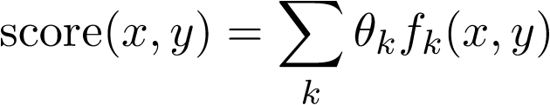
Linear Scoring
We need a conditional distribution p(y | x)
Convert our linear scoring function to this distribution p
Require that p(y | x) ≥ 0, and ∑_{y} p(y | x) = 1; not true of score(x,y)
How well does y go with x?
Simplest option: a linear function of (x,y). But (x,y) isn’t a number.
So describe it by one or more numbers:“numeric features” that you pick.
Then just use a linear function of those numbers.
Weight of feature k
To be learned …
Ranges over all features, e.g., f_{k}=5 (numbered features) or f_{k}=“see Det Noun” (named features)
Whether (x,y) has feature k(0 or 1)
Or how many times it fires (≥ 0)
Or how strongly it fires (real #)

Slide 46
What features should we use?
Weight of feature k
To be learned …
p(NextWord=y | PrecedingWords=x)
y is a unigram
x is an (n-1)-gram
p(Category=y | Text=x)
y ∈ {personal email, work email, spam email}
x ∈ ∑* (it’s a string: the text of the email)
Ranges over all features, e.g., k=5 (numbered features) or k=“see Det Noun” (named features)
Whether (x,y) has feature k (0 or 1)
Or how many times it fires (≥ 0)
Or how strongly it fires (real #)
Notes:
Brain storming

Slide 47
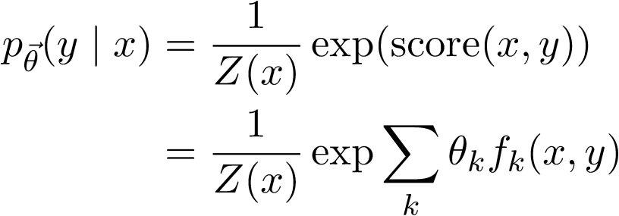

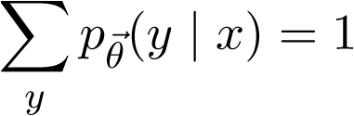
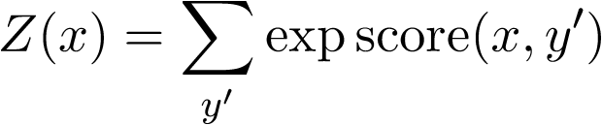
Log-Linear Conditional Probability (interpret score as a log-prob, up to a constant)
unnormalized
prob (at least
it’s positive!)
where we choose Z(x) to ensure that
thus,
sum of unnormalized
probabilities of all the
output candidates y’
Sometimes just written as Z
600.465 - Intro to NLP - J. Eisner
47

Slide 48


Training θ
n training examples
feature functions f₁, f₂, …
Want to maximize p(training data|θ)
Easier to maximize the log of that:

Slide 49
Training θ
n training examples
feature functions f₁, f₂, …
Want to maximize p(training data|θ) ⋅ p_{prior}(θ)
Easier to maximize the log of that:
Encourages weights close to 0: “L2 regularization” (other choices possible)
Corresponds to a Gaussian prior.

Slide 50
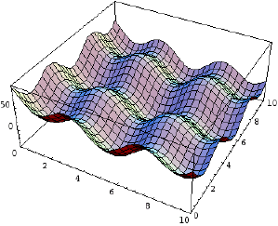
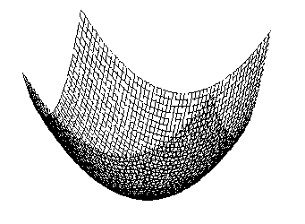
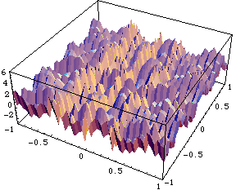
Gradient-based training
Gradually adjust θ in a direction that increases this
For this, use your favorite function maximization algorithm.
gradient descent, conjugate gradient, variable metric,etc.
nasty non-differentiable cost function with local minima
nice smooth and convex cost function: pick one of these

Slide 51
Gradient-based training
Gradually adjust θ in a direction that improves this
Gradient ascent to gradually increase f(θ):
while (∇f(θ) ≠ 0) // not at a local max or min
θ = θ + ∈⋅∇f(θ) // for some small ∈ > 0
Remember: ∇f(θ) = (∂f(θ)/∂θ₁, ∂f(θ)/∂θ₂, …)
So update just means: θ_{k} += ∂f(θ)/∂θ_{k}
This takes a little step “uphill” (direction of steepest increase).

Slide 52
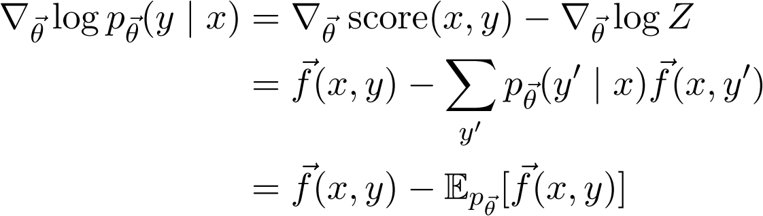
Gradient-based training
Gradually adjust θ in a direction that improves this
The key part of the gradient works out as …

