Slide 1
Lecture 10: Language Models
USC CSCI 544: Applied Natural Language Processing
Jonathan May -- 梅約納
Nanyun (Violet) Peng -- 彭楠赟
September 21, 2018
based on slides of Nathan Schneider / Sharon Goldwater

Slide 2
Please turn __ your homework ...
What word comes in the blank?
in
over
into
the
refrigerator
What are the probabilities of each of these?
And why should we care?

Slide 3
Probability of a sentence; P(s)
How likely is it to occur?
Colloquially, how likely is any speaker of language L to utter s?
P(the cat slept peacefully) > P(slept the peacefully cat)
P(she studies morphosyntax) > P(she studies more faux syntax)

Slide 4
Language Models in NLP
It's very difficult to know the true P(s) for an arbitrary sequence of words
But we can define a language model that will give us good approximations
Language models (LMs) are very useful whenever we are generating output
Machine Translation
Spelling Correction
Summarization
Speech Recognition
There are some very good, easy-to-use toolkits for building and using LMs
SRILM: around since the 90s. not advised with >300m tokens
KenLM: preferred choice; great scalability in memory and time with even billions of tokens
NLTK has some LM training/using support (ok for prototyping)

Slide 5
Use of Language Models: Spelling Correction
no much effect
so much effort
no much effort
not much effort
...
input
Error Model
LanguageModel
no much effort
not much effort

Slide 6
Use of Language Models: Speech Recognition
input
She studies morphosyntax
She studies more faux syntax
She's studies morph or syntax
...
Acoustic Model
LanguageModel
she studies morphosyntax

Slide 7
Use of Language Models: Machine Translation
input
ella se va a casa
She is going home
She is going house
She goes to home
To home she is going
...
TranslationModel
Language Model
she is going home

Slide 8
But How To Estimate These Probabilities?
We want to to know the probability of word sequence w = w₁, w₂, ..., w_{n} occurring in English
Assume we have some training data: large corpus of general English text
We use this data to estimate the probability of w (even if we never see it in the corpus)

Slide 9
Probability of a word sequence
P(w) = P(w₁, w₂, w₃, w₄, ..., w_{n})
e.g. P(w = the cat slept quietly) = P(w₁=the, w₂=cat, w₃⁼ slept, w₄=quietly)
We'll often abuse notation when talking about specific events and context is clear, e.g. P(the cat slept quietly)

Slide 10
Terminology: Types vs. Tokens
Word type = distinct vocabulary item
A dictionary is a list of types (once each)
Word token = occurrence of that type
A corpus is a list of tokens (each type has many tokens)
We’ll estimate probabilities of the dictionary types by counting the corpus tokens
26 types
300 tokens
a | 100
b | 0
c | 0
d | 200
e | 0
…
z | 0
Total | 300
100 tokens of this type
0 tokens of this type
200 tokens of this type
(in context)
10

Slide 11
Maximum Likelihood Estimation
Recall Maximum Likelihood Estimations (MLE) for our HMM POS tagger
AKA "Count and divide"
So get a corpus of N sentences
P_{MLE}(w = the cat slept quietly) = C(the cat slept quietly)/N
But consider these sentences:
the long-winded peripatetic beast munched contentedly on mushrooms
parsimonius caught the of about for syntax
Neither is in a corpus (I just made them up), so P_{MLE}=0 for both
But one is meaningful and grammatical and the other isn't!

Slide 12
Sparse Data and MLE
If something doesn't occur, vanilla MLE thinks it can't occur
No matter how much data you get, you won't have enough observations to model all events well with vanilla MLE
We need to make some assumptions so that we can provide a reasonable probability for grammatical sentences, even if we haven't seen them

Slide 13
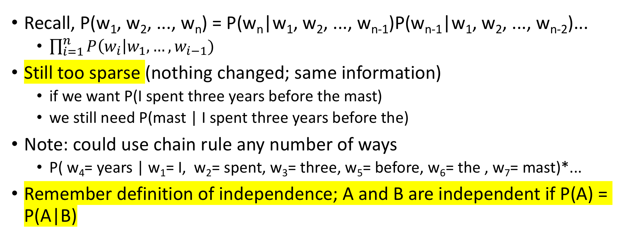
Independence (Markov) Assumption
Recall, P(w₁, w₂, ..., w_{n}) = P(w_{n}|w₁, w₂, ..., w_{n-1})P(w_{n-1}|w₁, w₂, ..., w_{n-2})...
$\prod_{i=1}^{n}{P\left(w_{i}\right|w_{1},…, w_{i−1})}$
Still too sparse (nothing changed; same information)
if we want P(I spent three years before the mast)
we still need P(mast | I spent three years before the)
Note: could use chain rule any number of ways
P( w₄= years | w₁= I, w₂= spent, w₃= three, w₅= before, w₆= the , w₇= mast)*...
Remember definition of independence; A and B are independent if P(A) = P(A|B)

Slide 14
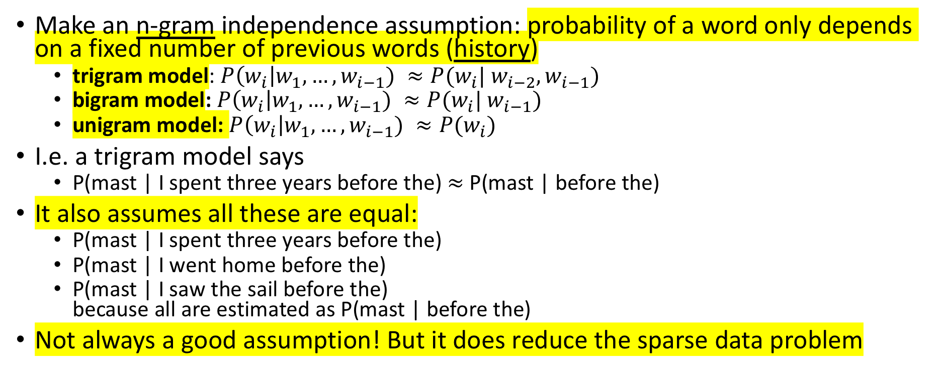
Independence (Markov) Assumption
Make an n-gram independence assumption: probability of a word only depends on a fixed number of previous words (history)
trigram model: $P\left(w_{i}\right|w_{1},…, w_{i−1}) ≈P(w_{i}| w_{i−2}, w_{i−1})$
bigram model: $P\left(w_{i}\right|w_{1},…, w_{i−1}) ≈P(w_{i}| w_{i−1})$
unigram model: $P\left(w_{i}\right|w_{1},…, w_{i−1}) ≈P(w_{i})$
I.e. a trigram model says
P(mast | I spent three years before the) $≈$ P(mast | before the)
It also assumes all these are equal:
P(mast | I spent three years before the)
P(mast | I went home before the)
P(mast | I saw the sail before the) because all are estimated as P(mast | before the)
Not always a good assumption! But it does reduce the sparse data problem

Slide 15

Estimating Trigram Conditional Probabilities
P_{MLE}(mast | before the) = Count(before the mast)/Count(before the)
In general, for any trigram, we have
$P_{MLE}\left(w_{i}\right|w_{i−2}, w_{i−1})= \frac{\text{Count}(w_{i−2}{,w}_{i−1},w_{i})}{\text{Count}(w_{i−2},w_{i−1})}$

Slide 16
Example from Moby Dick corpus
C(before, the) = 25; C(before, the, mast) = 4
C(before, the, mast) / C(before, the) = 0.16
mast is the most common word to come after "before the" (wind is second most common)
P_{MLE}(mast) = 56/110927 = .0005 and P_{MLE}(mast|the) = .003
Seeing "before the" vastly increases the probability of seeing "mast" next

Slide 17
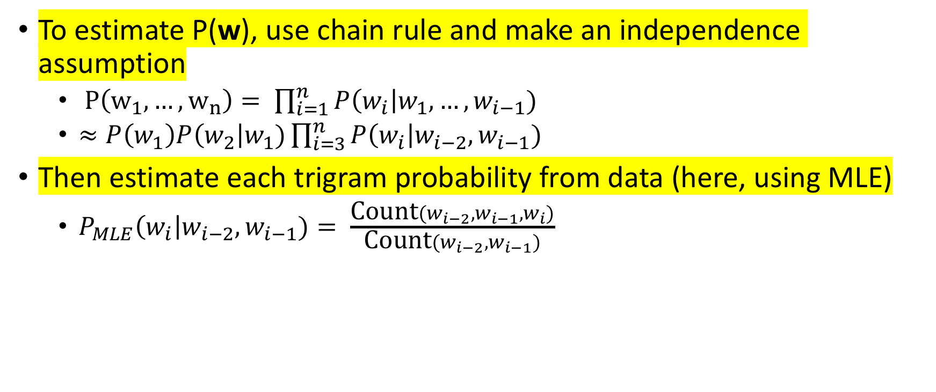
N-gram model summary
To estimate P(w), use chain rule and make an independence assumption
$P\left(w_{1}, …, w_{n}\right)= \prod_{i=1}^{n}{P\left(w_{i}\right|w_{1},…, w_{i−1})}$
$≈P\left(w_{1}\right)P\left(w_{2}\right|w_{1})\prod_{i=3}^{n}{P\left(w_{i}\right|w_{i−2},w_{i−1})}$
Then estimate each trigram probability from data (here, using MLE)
$P_{MLE}\left(w_{i}\right|w_{i−2}, w_{i−1})= \frac{\text{Count}(w_{i−2}{,w}_{i−1},w_{i})}{\text{Count}(w_{i−2},w_{i−1})}$

Slide 18
Practical details (I)
Trigram model assumes two-word history
But consider these sentences:
What's wrong?
a sentence shouldn't end with 'yellow'
a sentence shouldn't begin with 'feeds'
Does the model capture these problems?
w₁ | w₂ | w₃ | w₄
he | saw | the | yellow
feeds | the | cats | daily

Slide 19
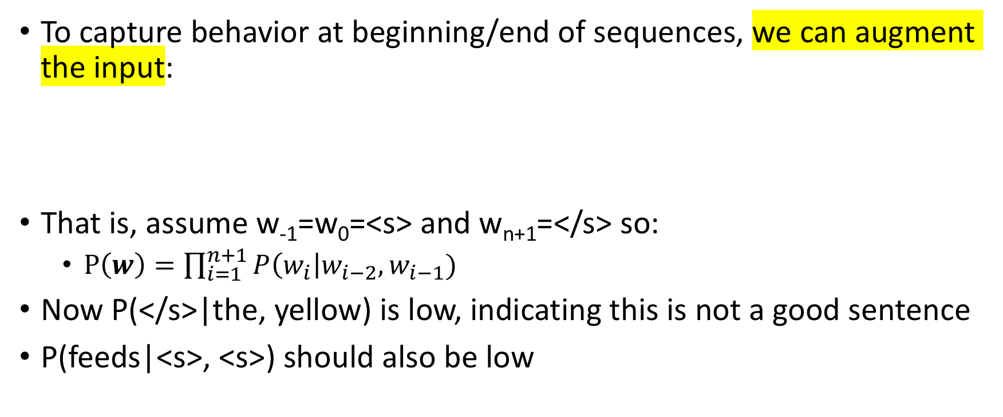
Beginning / end of sequence
To capture behavior at beginning/end of sequences, we can augment the input:
That is, assume w₋₁=w₀=<s> and w_{n+1}=</s> so:
$P\left(w\right)=\prod_{i=1}^{n+1}{P\left(w_{i}\right|w_{i−2},w_{i−1})}$
Now P(</s>|the, yellow) is low, indicating this is not a good sentence
P(feeds|<s>, <s>) should also be low
w₋₁ | w₀ | w₁ | w₂ | w₃ | w₄ | w₅
<s> | <s> | he | saw | the | yellow | </s>
<s> | <s> | feeds | the | cats | daily | </s>

Slide 20
Beginning / end of sequence
Alternatively, we could model all sentences as one (very long) sequence, including punctuation
two cats live in sam 's barn . sam feeds the cats daily . yesterday , he saw the yellow cat catch a mouse . [...]
Now, trigram probabilities like P(. | cats daily) and P(, | . yesterday) tell us about behavior at sentence edges
Here, all tokens are lowercased. What are the pros/cons of not doing that?

Slide 21
Practical details (II)
Word probabilities are typically very small.
Multiplying lots of small probabilities quickly gets so tiny we can't represent the numbers accurately, even with double precision floating point.
So in practice, we typically use log probabilities (usually base-e)
Since probabilities range from 0 to 1, log probs range from -∞ to 0
Instead of multiplying probabilities, we add log probs
Often, negative log probs are used instead; these are often called "costs"; lower cost = higher prob
Recall: we saw this with bigram HMM for POS tagging
Notes:
We had this problem is the Naive Bayes model when we looked at overflow

Slide 22
Interim Summary: N-gram probabilities
"Probability of a sentence": how likely is it to occur in natural language?
We can never know the true probability, but we may be able to estimate it from corpus data.
N-gram models are one way to do this:
To alleviate sparse data, assume word probs depend only on short history
Tradeoff: longer histories may capture more, but are also sparser
So far, we estimated N-gram probabilities using MLE

Slide 23
Interim Summary: Language Models
Language Models tell us P(w) = P(w₁, ..., w_{n}): How likely is this sequence of words to occur?
Roughly: Is this sequence of words a "good" one in my language?
LMs are used as a component in applications such as speech recognition, machine translation, and predictive text completion
To reduce sparse data, N-gram LMs assume words depend only on a fixed-length history, even though we know this isn't true
Next:
How to evaluate a language model
Weaknesses of n-gram LM and how to address them (more sparsity)

Slide 24
Two Types of Evaluation in NLP
Extrinsic: measure performance on a downstream application
For LM, plug it into a machine translation/ASR/etc system
The most reliable and useful evaluation: We don't use LMs absent other technology
But can be time-consuming
And of course we still need an evaluation measure for the downstream system
Intrinsic: design a measure that is inherent to the current task
much quicker/easier during development cycle
not always easy to figure out what the right measure is. Ideally, it's one that correlates with extrinsic measures

Slide 25
Intrinsically Evaluating a Language Model
For parsing, tagging, sentiment, etc. it was fairly clear how to evaluate: Hold a set of labeled data out and see how often your model gets it right
For LM, it's not quite so clear
Given a corpus of sentences and non-sentences, see how often the LM thinks you have a sentence?
Not a very realistic evaluation of how an LM is used
Often we are deciding between not-that-grammatical outputs
Ideally we want a regression evaluation
Given a sentence, how close is the model probability to the true probability
But we don't know the true probability of a sentence!

Slide 26
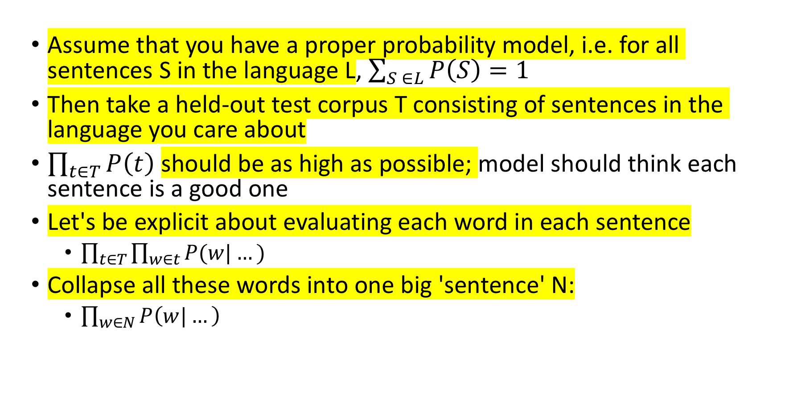
Idea: Model should give high probability to an unseen corpus
Assume that you have a proper probability model, i.e. for all sentences S in the language L, $\sum_{S ∈L}{P\left(S\right)=1}$
Then take a held-out test corpus T consisting of sentences in the language you care about
$\prod_{t∈T}{P\left(t\right)}$ should be as high as possible; model should think each sentence is a good one
Let's be explicit about evaluating each word in each sentence
$\prod_{t∈T}{\prod_{w∈t}{P(w|…)}}$
Collapse all these words into one big 'sentence' N:
$\prod_{w∈N}{P\left(w|…\right)}$

Slide 27
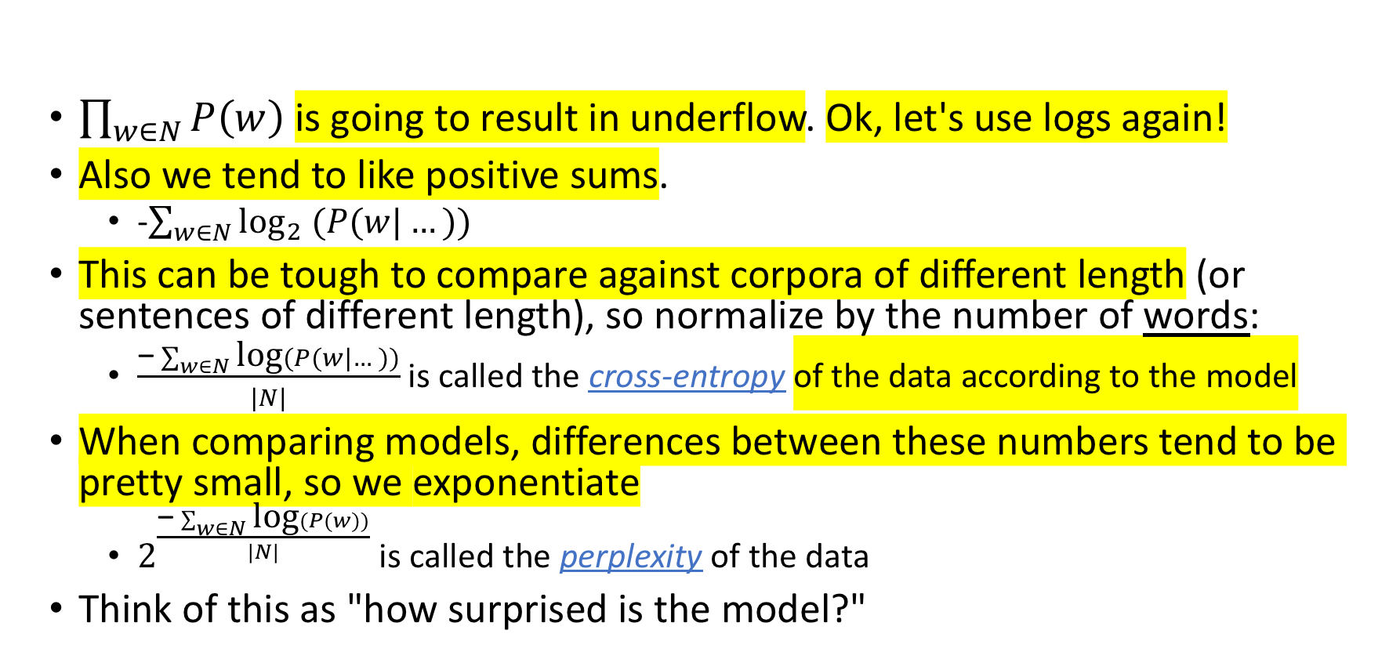
Resolving Some Problems
$\prod_{w∈N}{P\left(w\right)}$ is going to result in underflow. Ok, let's use logs again!
Also we tend to like positive sums.
-$\sum_{w∈N}{{\text{log}}_{2} (P(w|…))}$
This can be tough to compare against corpora of different length (or sentences of different length), so normalize by the number of words:
$\frac{\text{−}\sum_{w∈N}{\text{log}(P(w|…))}}{|N|}$ is called the cross-entropy of the data according to the model
When comparing models, differences between these numbers tend to be pretty small, so we exponentiate
$2^{\frac{\text{−}\sum_{w∈N}{\text{log}(P(w))}}{|N|}}$ is called the perplexity of the data
Think of this as "how surprised is the model?"

Slide 28
Example
Three word sentence with probabilities ¼ , ½, ¼
¼ * ½ * ¼ = .03125
cross-entropy: -(log(1/4) + log(1/2) + log(1/4))/3 = 5/3; 2^{5/3} ≈3.17
Six word sentence with probabilities ¼, ½, ¼, ¼, ½, ¼
¼ * ½ * ¼ * ¼ * ½ * ¼ = .00097
cross-entropy: -(log(1/4) + log(1/2) + log(1/4) + log(1/4) + log(1/2) + log(1/4))/6 = 10/6; 2^{10/6} ≈3.17
If you overfit your training corpus so that P(train) = 1, then Perplexity on train is 1
But Perplexity on test (which doesn't overlap with train) will be infinite

Slide 29
Intrinsic Evaluation Big Picture
Lower Perplexity is better
Roughly = number of bits needed to communicate information about a word
The terms 'cross-entropy' and 'perplexity' come out of information theory; it's in the reading if you're interested but we won't dwell on it
In principle you could compare on different test sets
In practice, domains shift. To know which of two LMs is better, train on common training sets, test on common test sets

Slide 30
Sparse data, again
Suppose we build a trigram model from Moby Dick and evaluate the sentence "I spent three years before the mast"
"I spent three" never occurs in training, so P_{MLE}(three|I spent) = 0
so cross-entropy is infinite
This is basically right; our model says "I spent three" should never occur so when it does our model is infinitely surprised!
Even with a unigram model we run into words we never saw, so we need better ways to estimate probabilities from sparse data

Slide 31
Add-1 (Laplace) and Add-α (Lidstone) Smoothing Again
Pretend we saw everything 1 (α) more times than we did before
P₊₁(w_{i}|w_{i-2}, w_{i-1}) = (C(w_{i-2}, w_{i-1}, w_{i})+1)/(C(w_{i-2}, w_{i-1})+|V|) where |V| is the size of the vocabulary
P_{+α} (w_{i}|w_{i-2}, w_{i-1}) = (C(w_{i-2}, w_{i-1}, w_{i})+α)/(C(w_{i-2}, w_{i-1})+α|V|)

Slide 32
Dealing with unknown vocabulary
Can we also add a new 'OOV' token as was done in HMM emission table?
It gets kind of complicated...
P_{+α} (w_{i}|w_{i-2}, w_{i-1}) = (C(w_{i-2}, w_{i-1}, w_{i})+α)/(C(w_{i-2}, w_{i-1})+α|V|+1)
P_{+α} (w_{i} =OOV|w_{i-2}, w_{i-1}) = α/(C(w_{i-2}, w_{i-1})+α|V|+1)
But then we also have to deal with, e.g., P_{+α} (w_{i}|w_{i-2}, w_{i-1}=OOV)
Better solution: replace low-count words in corpus with "OOV"
Intuition: appears once is basically the same as never appears

Slide 33
Remaining Problem
In a training corpus, suppose we see Scottish beer but neither of
Scottish beer drinkers
Scottish beer eaters
If we build a smoothed trigram model (with any kind of smoothing), which example has higher probability?
Both the same! Unknown events are treated equally by smoothing!

Slide 34
Remaining Problem
Previous smoothing methods assign equal probability to unseen events
Better: use information from lower-order N-grams (shorter histories)
Scottish beer drinkers
Scottish beer eaters
Two ways: backoff and interpolation

