Slide 1
General Workflow of DTA Application: 4 Stages
A: Calibration
of FD, DTA queue model
B: DTA-based Congestion State Estimation
C: ODME for
OD-to-Count Consistence
D: Future Year
Scenario Analysis
Speed data
v(l,t)
Volume from STA
Subarea OD from base year, Traffic Count C(l)
FY OD and FY link volume from STA
Congestion Bottleneck
Identification
P: Congestion duration
Volume data
q(l,t)
Dynamic Traffic Assignment (DTA) and ODME
Scenario Data
Fundamental diagram
D: Congested Demand
QHF: queued hour factor
Polynomial arrival rate parameters γ
Updated OD demand matrix and link volume x(l)
Updated FY OD demand matrix and link volume x^{fy}(l)
vf: free-flow speed
vc: critical speed
kc: critical density
m: Flow maximizing inertia factor
Estimated time dependent DTA volume and speed v'(l,t)
Time dependent speed : v‘‘(l,t) consistent with OD
DTA queue evolution function calibration
MAE, MAPE v'(l,t)-v(l,t)
MAE, MAPE:
v‘’(l,t)-v(l,t)
x(l)-C(l)
MOE: v^{fy}(l,t)-v(l,t)
x^{fy}(l)-C(l)
Notes:
We need to list both free-speed from the original model and reference speed from Inrix, and definition of LOS introduces potential inconsistency. Cleary define the critical speed, critical density for the congestion duration.
List from node id and to node id directly..
Show corridor/road id first and then show road order

Slide 2


Fundamental diagram calibration
Cheng, Qixiu, Zhiyuan Liu, Yuqian Lin, and Xuesong Zhou. 2021. "An s-shaped three-parameter (S3) traffic stream model with consistent car following relationship." Transportation Research Part B: Methodological 153:246-71.
Calibration method: a recent 3-parameter model (S3 model) by Cheng et al., (2021)
Input: observed speed and density
speed-density relationship
Output: free-flow speed, critical density, shape parameter
v: speed
k: density
vf: free-flow speed
kc: critical density
m: shape parameter
Output: ultimate capacity
Example of calibrated speed-volume curve using S3 model

Slide 3

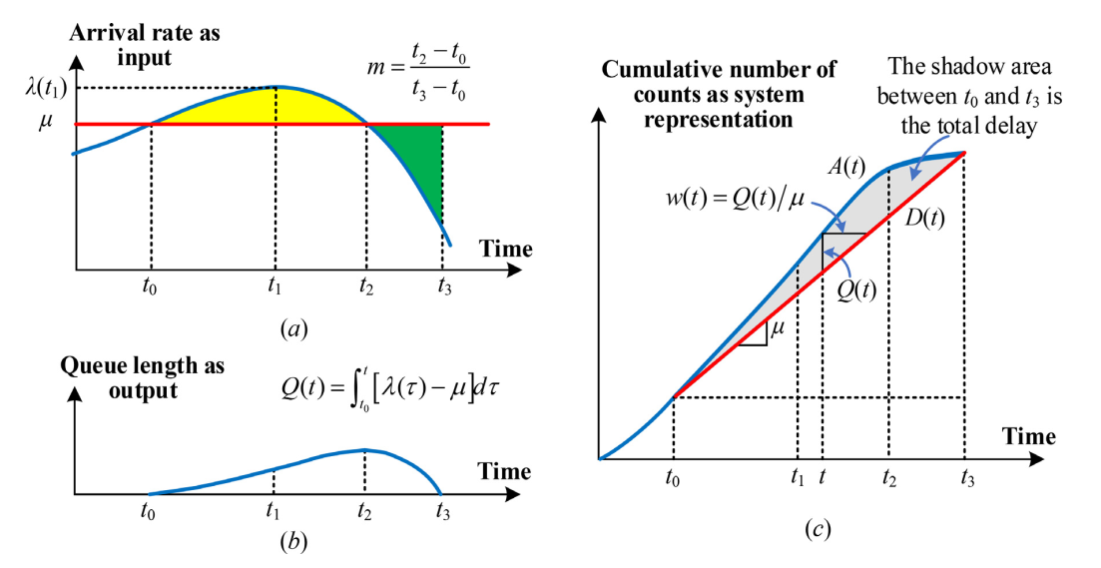



Queue analysis
Cheng, Qixiu, Zhiyuan Liu, Jifu Guo, Xin Wu, Ram Pendyala, Baloka Belezamo, and Xuesong Zhou. 2022. "Estimating key traffic state parameters through parsimonious spatial queue models." Transportation Research Part C: Emerging Technologies 137:103596
Analysis method: a parsimonious spatial queue model by Cheng et al., (2022)
Assumption: the discharge rate is constant and arrival rate is cubic
Time dependent queue
Time dependent delay
Average delay

Slide 4
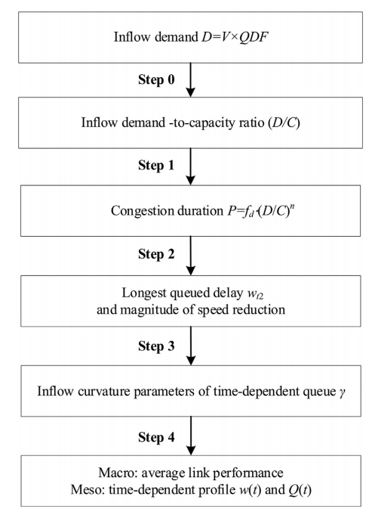
QVDF calibration
Zhou Simon, Xuesong, Qixiu Cheng, Xin Wu, Peiheng Li, Baloka Belezamo, Jiawei Lu, and Mohammad Abbasi. 2022. "A meso-to-macro cross-resolution performance approach for connecting polynomial arrival queue model to volume-delay function with inflow demand-to-capacity ratio." Multimodal Transportation 1 (2):100017
Major steps towards queue-oriented link performance function QVDF

Slide 5



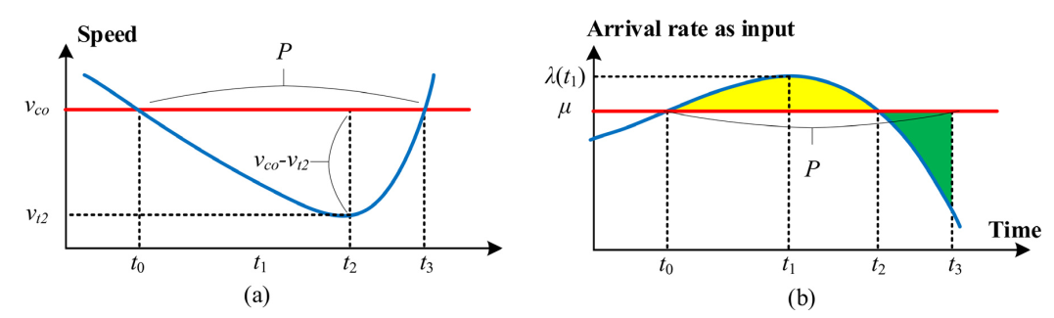
QVDF calibration
Zhou Simon, Xuesong, Qixiu Cheng, Xin Wu, Peiheng Li, Baloka Belezamo, Jiawei Lu, and Mohammad Abbasi. 2022. "A meso-to-macro cross-resolution performance approach for connecting polynomial arrival queue model to volume-delay function with inflow demand-to-capacity ratio." Multimodal Transportation 1 (2):100017
Calibration method: a recent queue-based volume delay function by Zhou et al., (2022)
Basic assumptions
Assumption 1: Link congestion duration and D∕C ratio
Assumption 2: Link magnitude of speed reduction and congestion duration
P: congestion duration
fd: congestion duration constant
D: total inflow demand
C: ultimate capacity
n: oversaturation-to-duration elasticity factor
v_co: cut-off speed
v_t2: lowest speed in congestion duration
fp: MSR reduction constant
P: congestion duration
s: duration-to-speed reduction elasticity factor

Slide 6
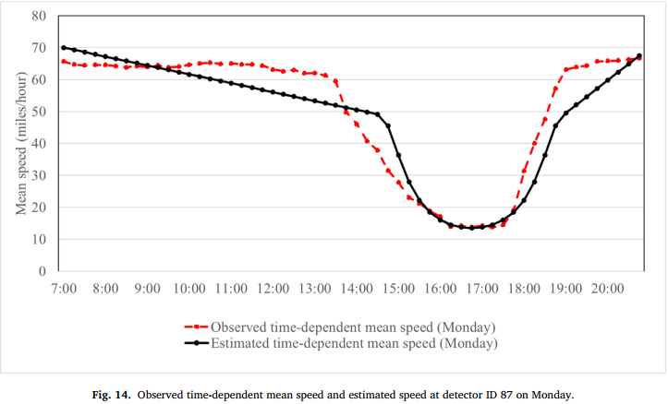



QVDF calibration
Zhou Simon, Xuesong, Qixiu Cheng, Xin Wu, Peiheng Li, Baloka Belezamo, Jiawei Lu, and Mohammad Abbasi. 2022. "A meso-to-macro cross-resolution performance approach for connecting polynomial arrival queue model to volume-delay function with inflow demand-to-capacity ratio." Multimodal Transportation 1 (2):100017
Calibration method: a recent queue-based volume delay function by Zhou et al., (2022)
Generate time-dependent delay
Generate time-dependent speed
time-dependent queue
time-dependent speed
time-dependent delay

Slide 7

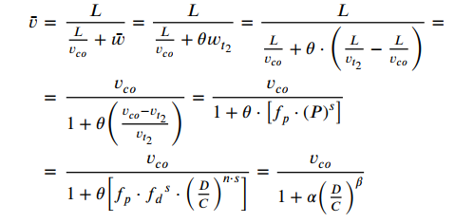


QVDF calibration
Zhou Simon, Xuesong, Qixiu Cheng, Xin Wu, Peiheng Li, Baloka Belezamo, Jiawei Lu, and Mohammad Abbasi. 2022. "A meso-to-macro cross-resolution performance approach for connecting polynomial arrival queue model to volume-delay function with inflow demand-to-capacity ratio." Multimodal Transportation 1 (2):100017
Calibration method: a recent queue-based volume delay function by Zhou et al., (2022)
Generate average delay
Generate average speed
Generate largest delay
Transition ratio

