Slide 1




DTS202TC Foundation of Parallel Computing
Tutorial 1: Environment setup and getting started

Slide 2
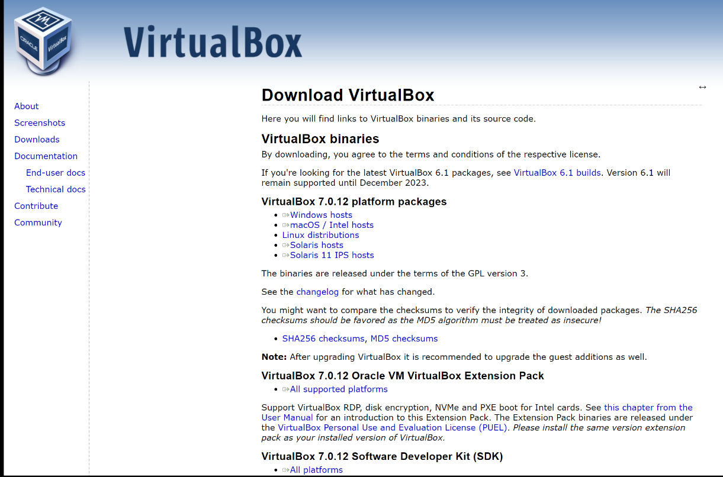

1.Installation of VirtualBox and setting of Linux
For Mac M1/M2:
You can choose to download Parallels Desktop
https://www.parallels.cn/directdownload/pd/?mode=trial
For Intel Windows and Mac:
You can download VirtualBox
https://www.virtualbox.org/wiki/Downloads

Slide 3
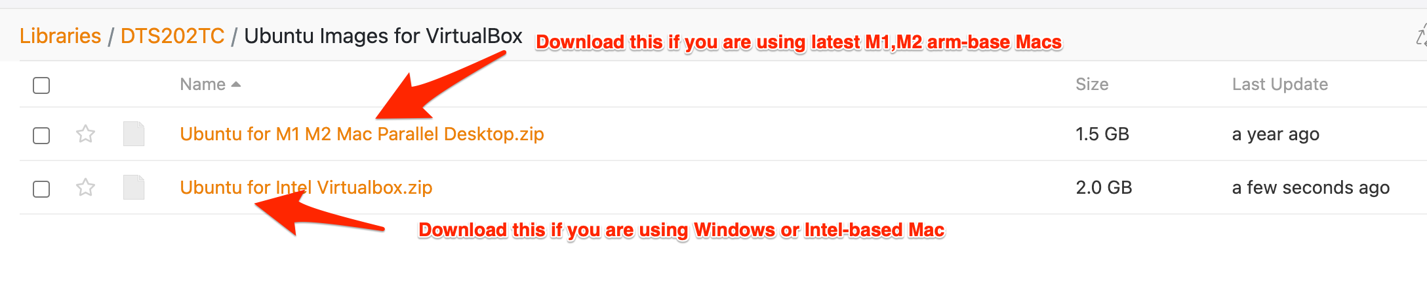
1.Installation of VirtualBox and setting of Linux
Download the Linux Image

Slide 4
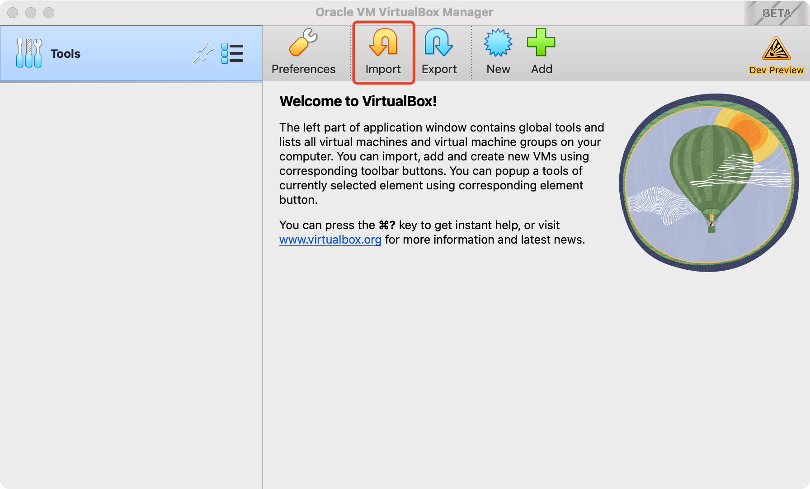
1.Installation of VirtualBox and setting of Linux
1) Click Import button to import an VM image

Slide 5
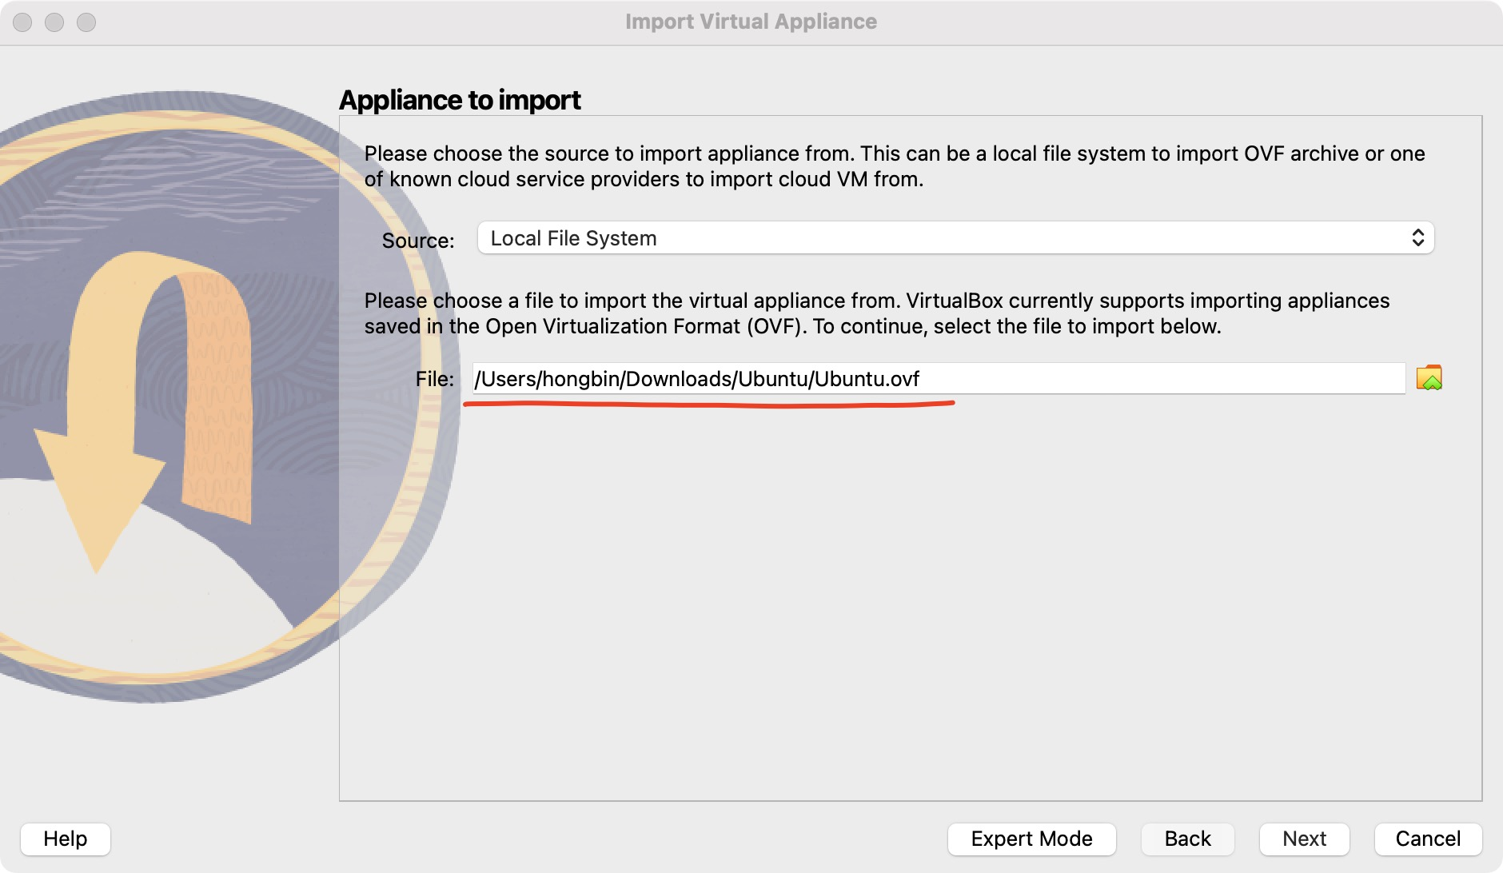
1.Installation of VirtualBox and setting of Linux
2) Select the previously downloaded and unzip VM image and click “Next”.

Slide 6
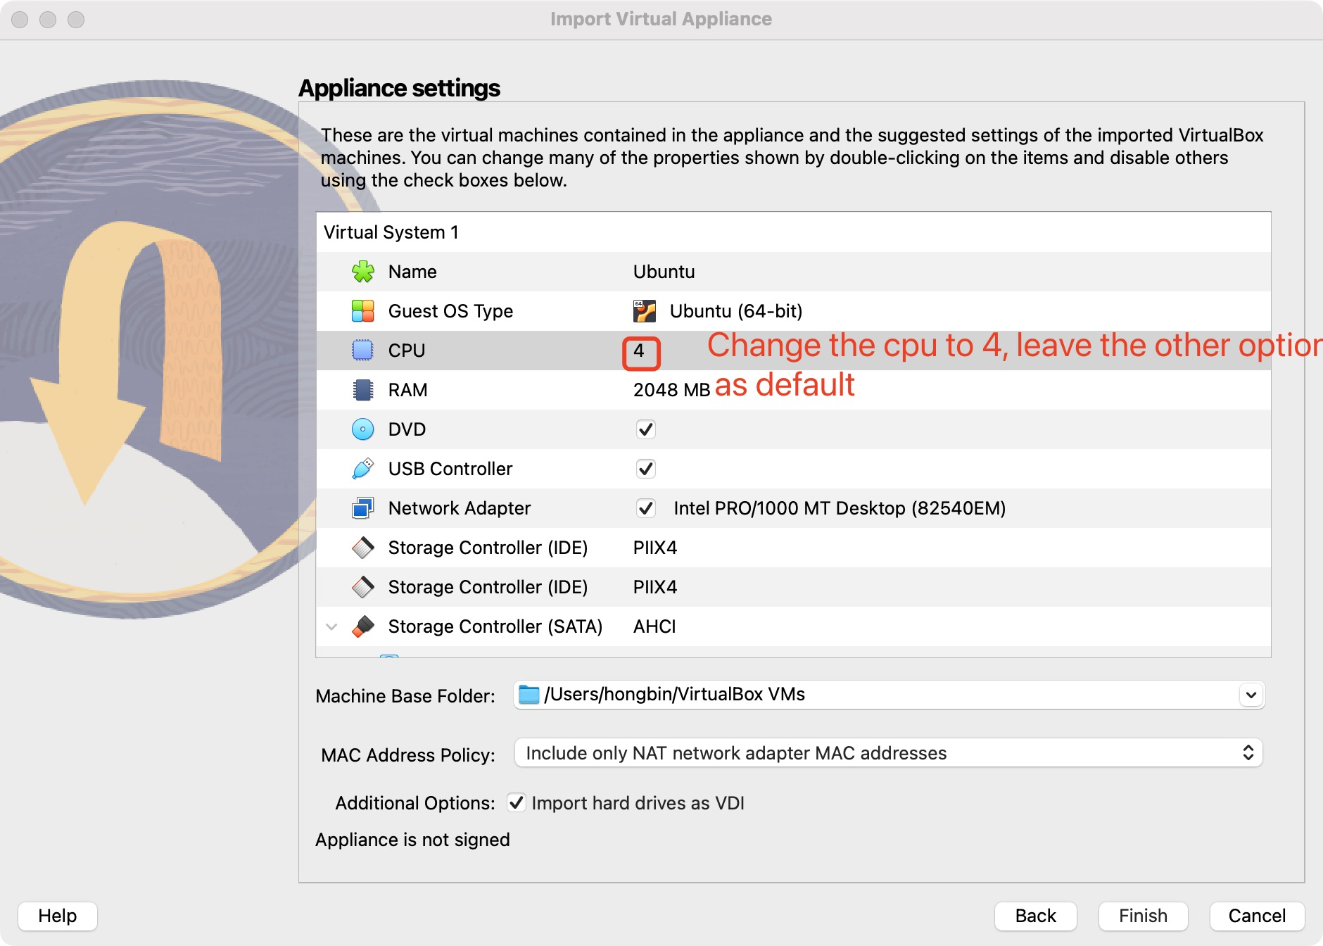
1.Installation of VirtualBox and setting of Linux

Slide 7
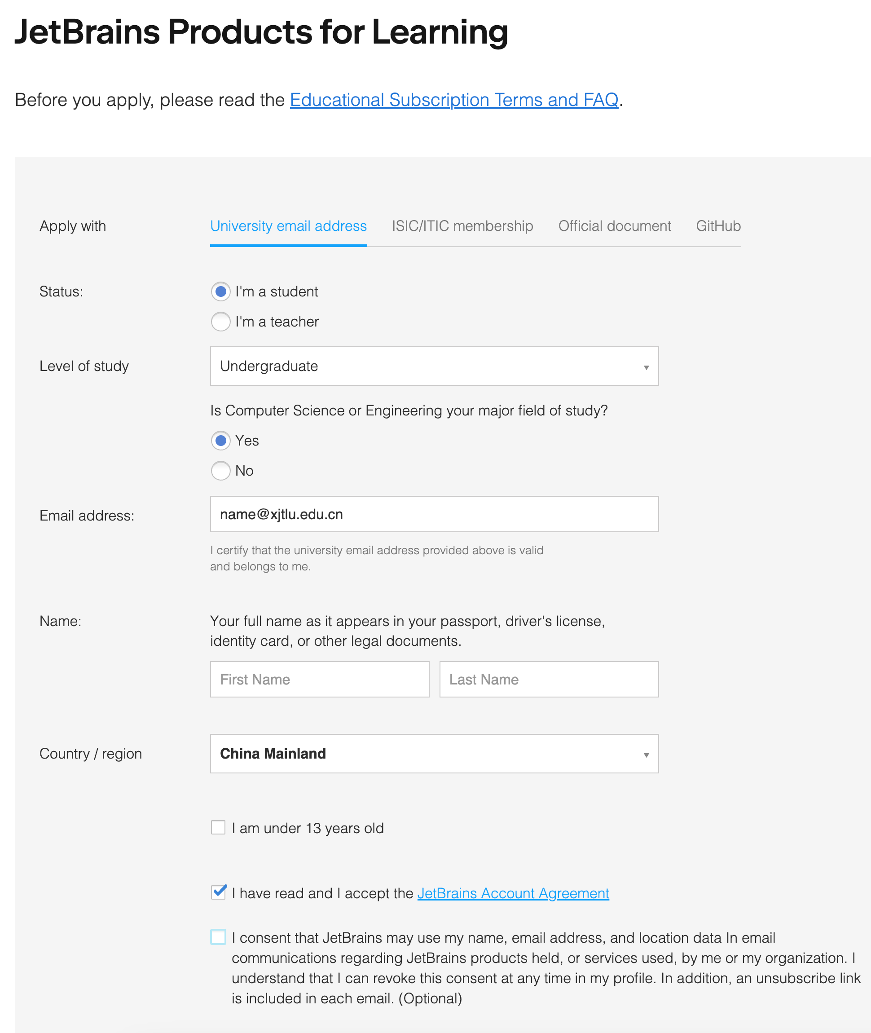
2. Installation of CLion
1. Download and install Clion from https://www.jetbrains.com/clion/download/
2. Open https://www.jetbrains.com/shop/eform/students to apply a free Education license

Slide 8
2. Demonstrates the basics of running the helloworld program on CLion
To create C project with CLion
First you should create a new folder and write a makefile like this
The content of a makefile looks like:

Slide 9
3. Files transfer between local PC and Linux
You can choose use FileZilla to do upload and download operations
1) Download FileZilla(https://www.filezilla.cn/download)

Slide 10
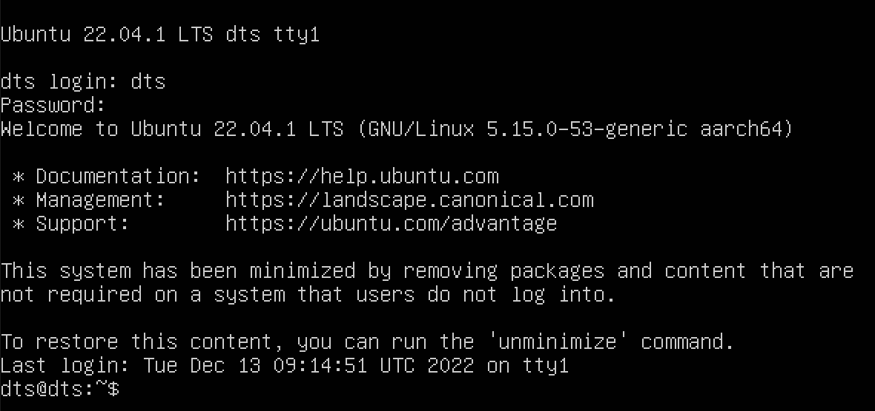
3. Files transfer between local PC and Linux
Turn on your Virtual Machine
The username is “dts” and password is “dts202”

Slide 11
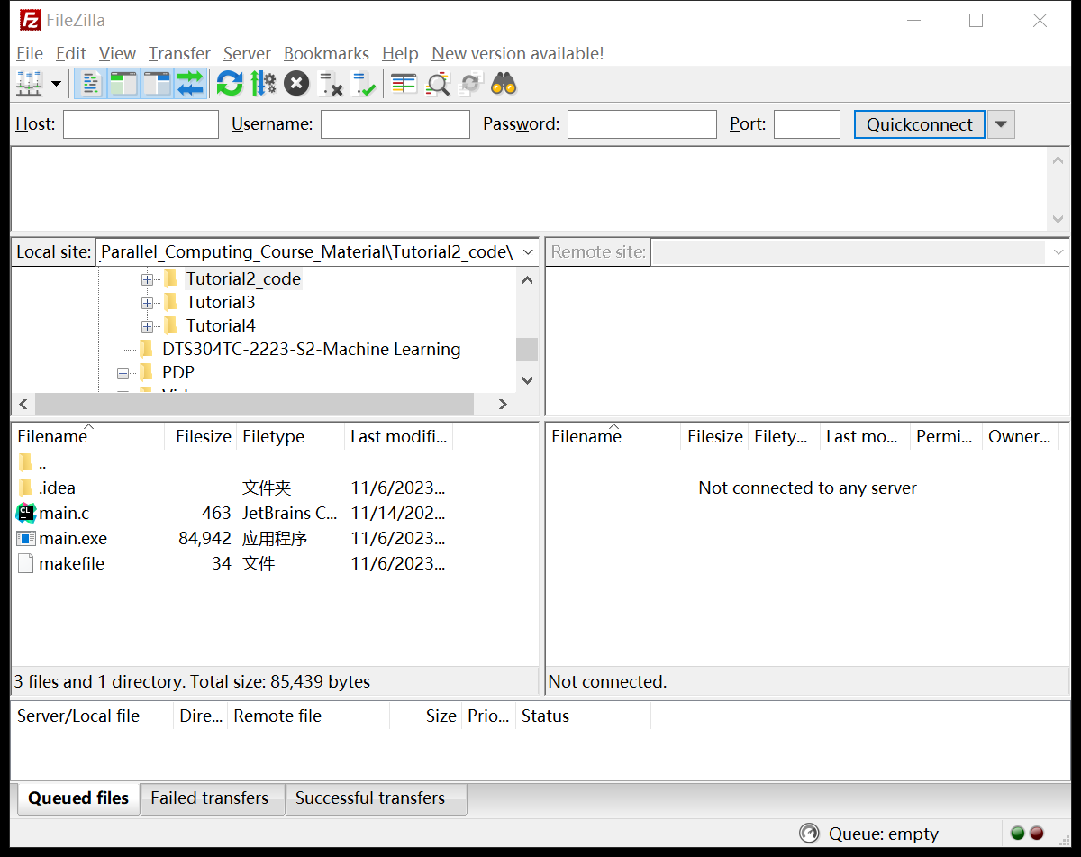
3. Files transfer between local PC and Linux
Click the icon to go into
Site Manager

Slide 12
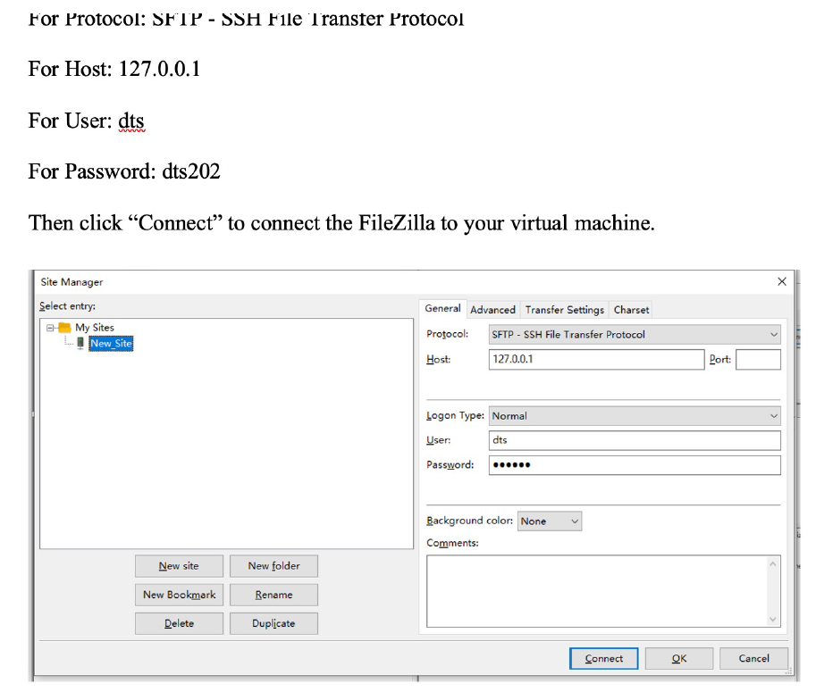
3. Files transfer between local PC and Linux

Slide 13
3. Files transfer between local PC and Linux

