Slide 1
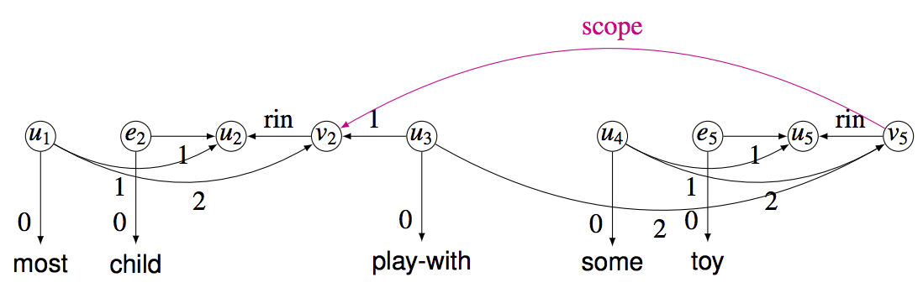
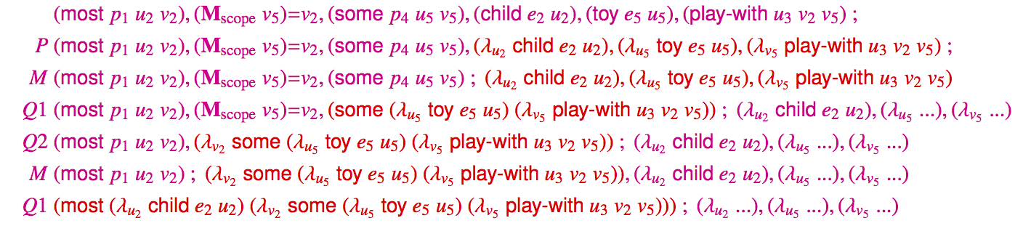
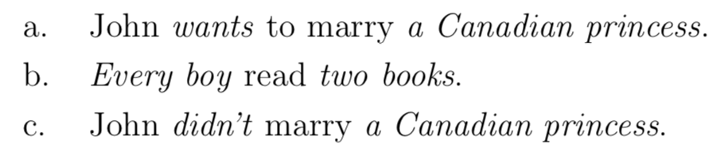
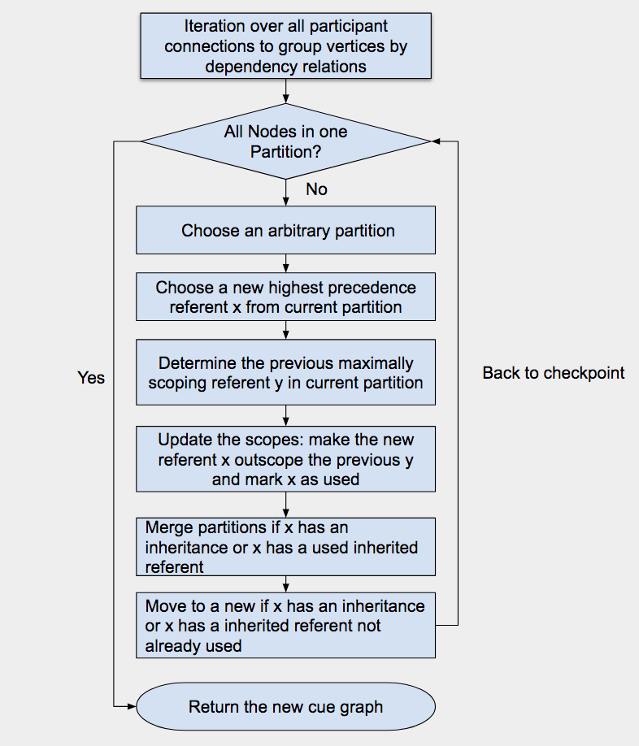
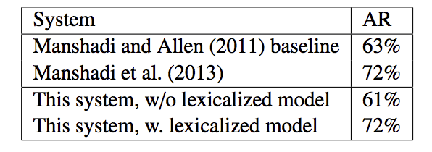
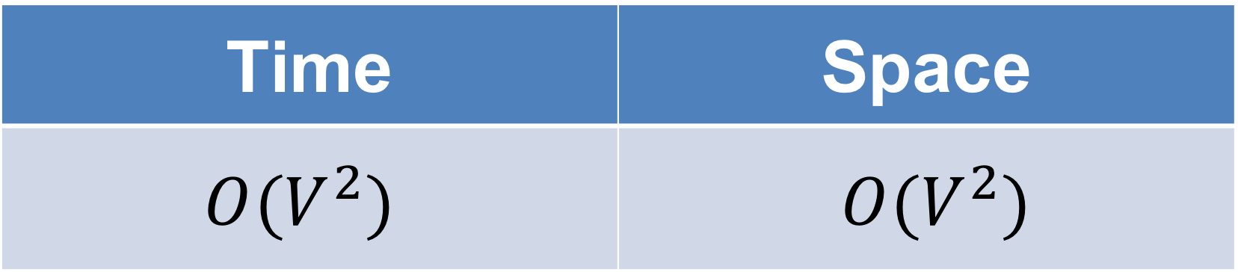
Semantics Processing – Quantifier Scoping Peiyuan Tang, Professor William Schuler
The Ohio State University/College of Arts & Sciences/Department of linguistics
INTRODUCTION
The objective of this research is to develop a more effective implementations on the Schuler and Wheeler quantifier scoping algorithm (2014). This algorithm introduces a new representation of mental states in resolving scope of quantifiers, given the priorities of different categories of noun phrases. It applies the cued association graph in modelling the continuation dependencies when humans are interpreting complex ideas with working memories. The previous implementation of Schuler and Wheeler quantifier scoping algorithm (2014) has its limitations in broad-coverage evaluation. The new implementation applies a preference vector, which stores the scope priorities of words. In such cases, the new implementation is amenable to tests on broader data sources.
Implementation
The code of the algorithm is written in python3 with NumPy library. The directional cue graph is stored as a python dictionary (a collections of key value pair); the key is a tuple of two elements – (the vertex of the cued state and the label of the transition edge); the value is the vertex of the target state.
Algorithm Complexity
The table below shows the time and space complexity of the new implementation. The quantifier scoping is resolved in polynomial amount of time and space. V stands for the number of vertices (the number of mental states)
Time | Space
$$O(V^{2})$$ | $O(V^{2})$
Figure 2: Cued Association Graph [2]
Lambda Calculus Translation
Methodology
Through running over associations between words and numbers in large test datasets, a vector mapping words to information of priority is learned.
Schuler and Wheeler Algorithm (2014)
Schuler and Wheeler algorithm [3] (2014) is an effective algorithm, which resolves continuation dependency (quantifier scoping) problems of cognitive compositional semantics. It traverses through vertices and resolves the scopes between quantified referents.
CONCLUSION
In the new implementation of the algorithm, the accurate rate is as same as the previous implementation, based on previous test cases. The new implementation is more stable and amenable.
In the further research, the new implementation will be tested using Wikipedia corpuses for accuracy evaluation on quantifier scoping. Therefore, whether this quantifier scoping algorithm is learnable using general text data is able to be tested.
Figure3: Lambda Calculus Representation [2]
Ambiguity in Scopes
When two quantified arguments are connected with one predicate, the scope ambiguity occur in semantics interpretation
This figure is showing the generated Lambda calculus of graph representation in Figure 2
RESULTS
The new algorithm is as accurate as the previous version when tested on the Quan-Text corpus. The first test does not incorporate with the lexicalized model, while the second test incorporates with the lexicalized model. The results are displayed below, as compared to the previous Manshadi and Allen’s research on previous NP chunks in the Quan-Text tests.
BIBLIOGRAPHY
Figure 1: Ambiguous Quantified Noun Phrases [1]
[1] Bernardi, Raffaella. 2002. Reasoning with Polarity in Categorical Type Logic. PhD Diss. University of Utrecht.
[2] Schuler, William, 2017. Linguistics 8700H Class Slides
[3] Schuler, W. and Wheeler, A. (2014). Cognitive compositional semantics using continuation dependencies. In Third Joint Conference on Lexical and Computational Semantics (*SEM’14).
Cue Graph
Cue graph represents the interpretation process of complex ideas in associative memory. It displays semantics processing procedures computationally, mimicking the brain. Each vertex represents a single mental state of neurons. Each edge represents a transition between two mental states. Cue graph gives a topological representation. It integrates algorithmic-level model of brain, which can be applied for predictions of memory effects on human subjects data. The figure below displays child out-scopes toy (a set of toys maps to a single child).
ACKNOWLEDGEMENTS
Thanks for the opportunity and help from Professor William Schuler. Thanks for the wonderful collaboration with Nathan (Rasmussen). Thanks for Cory’s (Shain) advice on poster creation.
Table 1: AR Comparison [3]
Figure 2: Flow chart Algorithm

