Slide 1
A Macro to Add Variables to SDTM Standard Domains
Xianhua(Allen) Zeng, PAREXEL
PharmaSUG China 2015 Paper #PT13

Slide 2
Contents
Introduction
Method
Examples
Add variables to SDTM standard domains
Aligning Column in TXT/LST/PDF output
References
@pharmasug

Slide 3
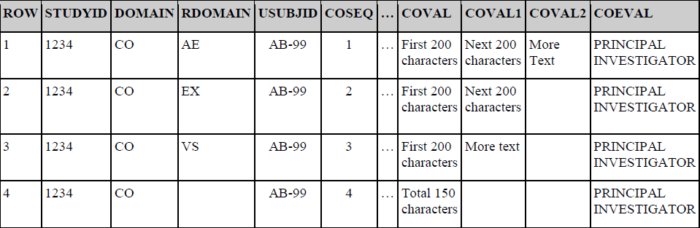
Introduction
Adding variables to SDTM standard domains
@pharmasug

Slide 4
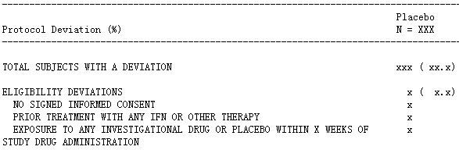
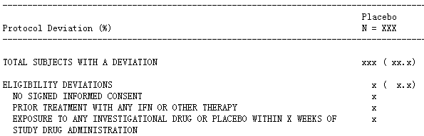
Introduction
Aligning Column in TXT/LST/PDF output
@pharmasug

Slide 5
Method
PRXCHANGE Function:
i.e.: _COVAL_=prxchange('s/(.{1,200})([\s]|$)/\1~/',-1,cats (COVAL));
@pharmasug

Slide 6
Examples: Add variables to SDTM standard domains
PRXCHANGE Function:
_COVAL_=prxchange('s/(.{1,200})([\s]|$)/\1~/',-1,cats (COVAL));
@pharmasug

Slide 7
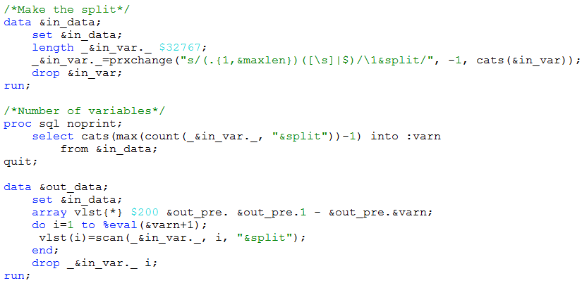
Examples: Add variables to SDTM standard domains
PRXCHANGE Function:
@pharmasug

Slide 8
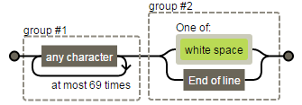

Examples: Aligning Column in TXT/LST/PDF output
PRXCHANGE Function:
ITEM=prxchange('s/(.{1,70})([\s]|$)/ \1~ /', -1, cats(ITEM));
ITEM=prxchange('s/(.+)~/\1/', -1, ITEM);
PROC REPORT SPLIT=character of ~
@pharmasug

Slide 9
Summary
PRXCHANGE Function:
Add variables to SDTM standard domains
Aligning Column in TXT/LST/PDF output
@pharmasug

Slide 10
References
SDTM Implementation Guide for Human Clinical Trials, http://www.cdisc.org/sdtm
SAS(R) 9.2 Language Reference: Dictionary, Fourth Edition, http://support.sas.com/documentation/cdl/en/lrdict/64316/PDF/default/lrdict.pdf
Regular Expression Visualization Site, http://www.regexper.com/
@pharmasug

Slide 11
Thanks
@pharmasug

Slide 12

Name: Xianhua Zeng
Organization: PAREXEL International
Address: 20F, Taiping Finance Tower, No. 488, Middle YinCheng Road, Pudong
City, State ZIP: Shanghai, 200120
Work Phone: +86 21-51118305
Fax: +86 21 61609196
E-mail: huazizeng@gmail.com
Web: http://www.parexel.com/
Twitter: @HuaziZeng
@pharmasug

